Slide 1
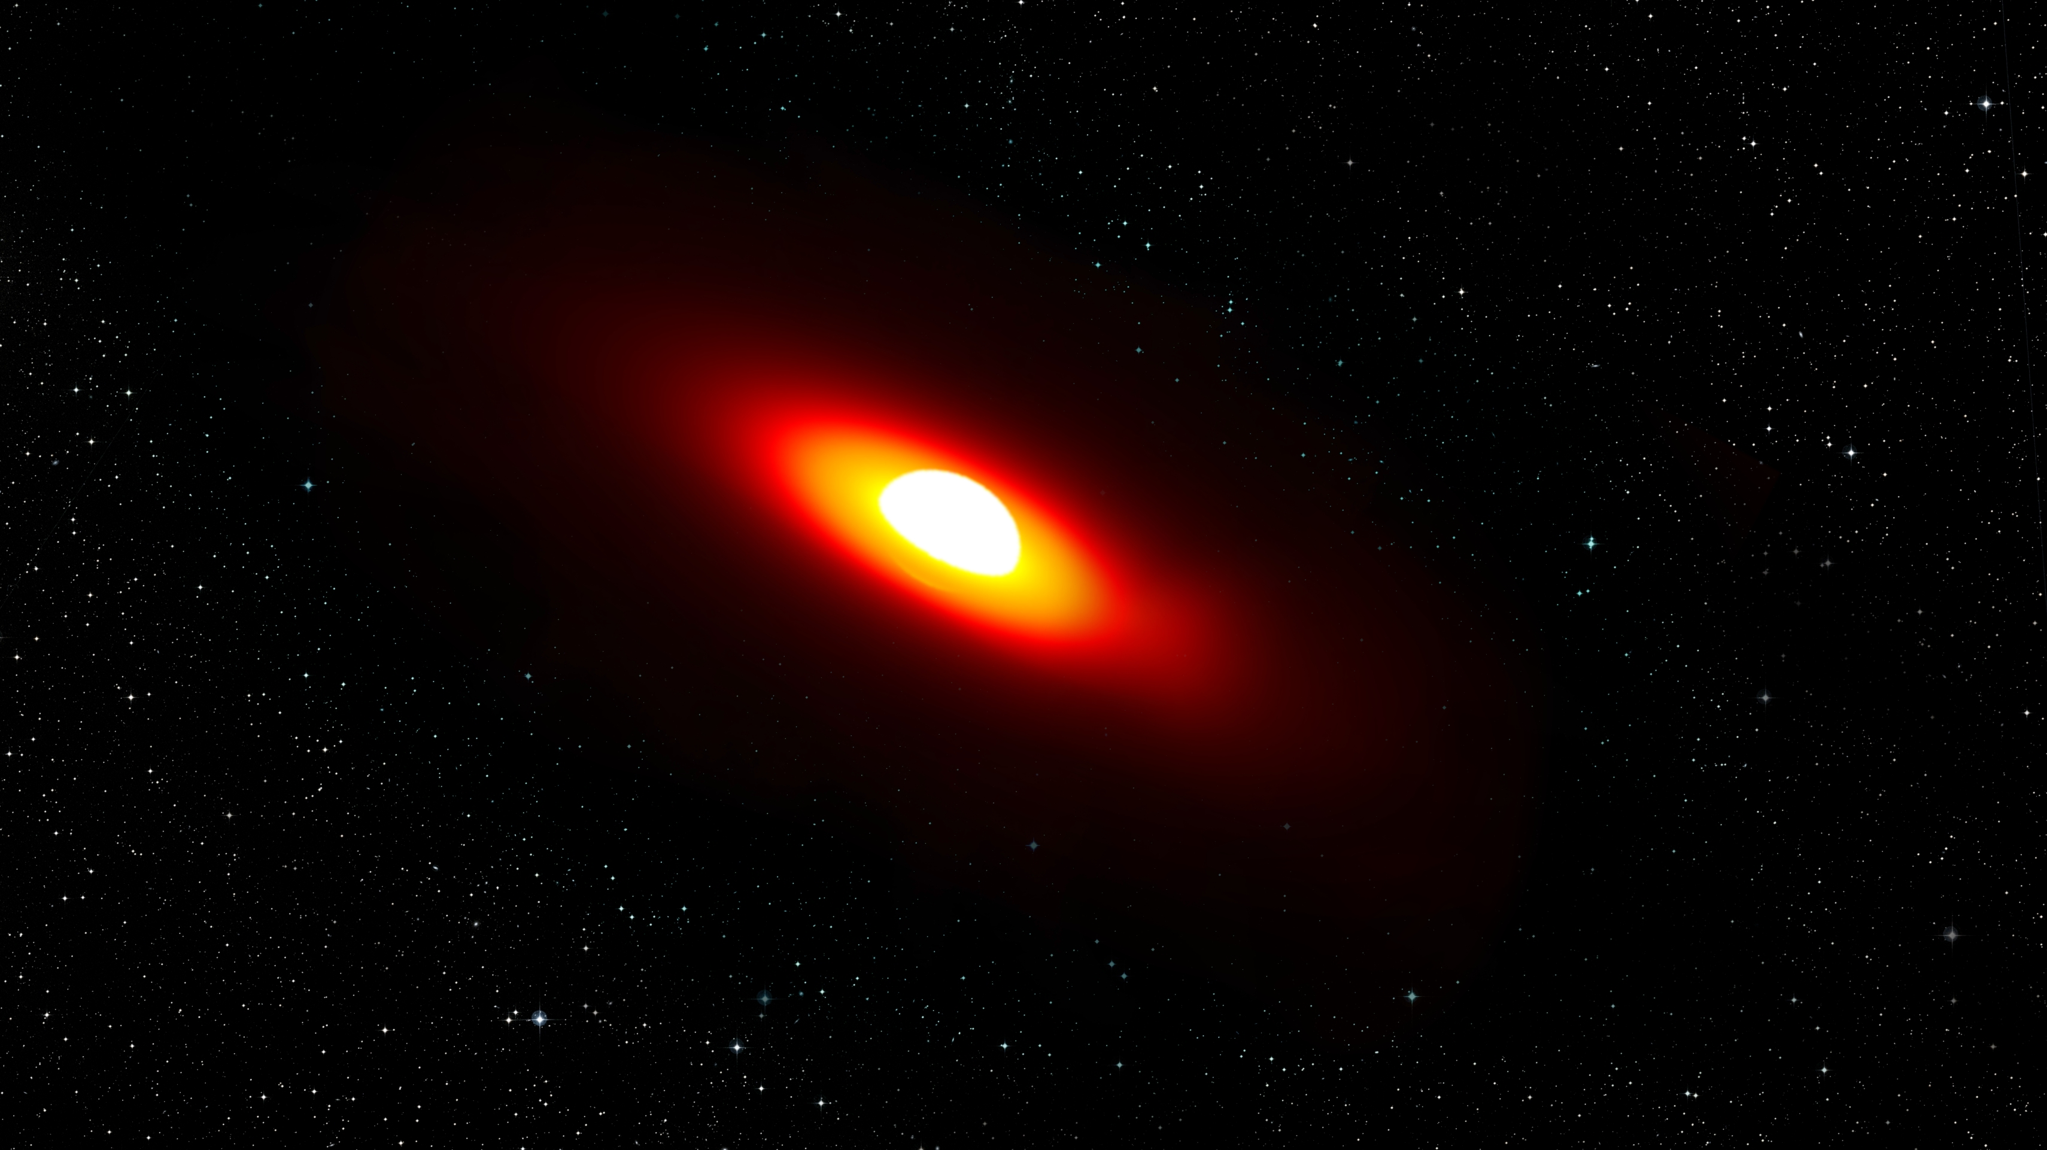
MATISSE observations of β CMi
and other classical Be Stars
A. Meilland, R. Klement, E. Saldhana de Almeida, F. Millour, Ph Stee, A Domiciano de Souza…

Slide 2
What are classical Be stars?
Fast-Rotators (almost critically)
with a viscous excretion disk
Spectral features from the disk:
Emission lines (mainly Hydrogen)
Moderate IR-excess (hot gas free-free)
Phenomenon found in 20% of main sequence B stars
Important to understand evolution of B stars of 3-18 Mo
And also of the first generation of Stars (more likely to be fast rotators)

Slide 3
Be stars with MATISSE?
DISCO pseudo-photosphere Models (Vieira+ 2015)
computed with the AMHRA service (JMMC)
https://amhra.oca.eu/AMHRA/index.htm

Slide 4
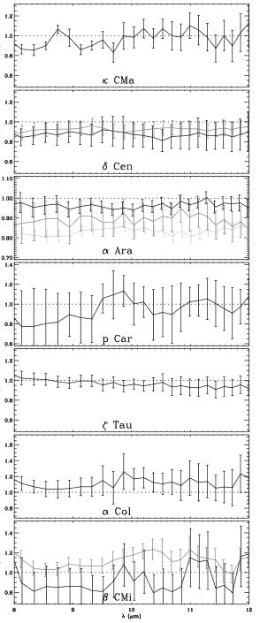
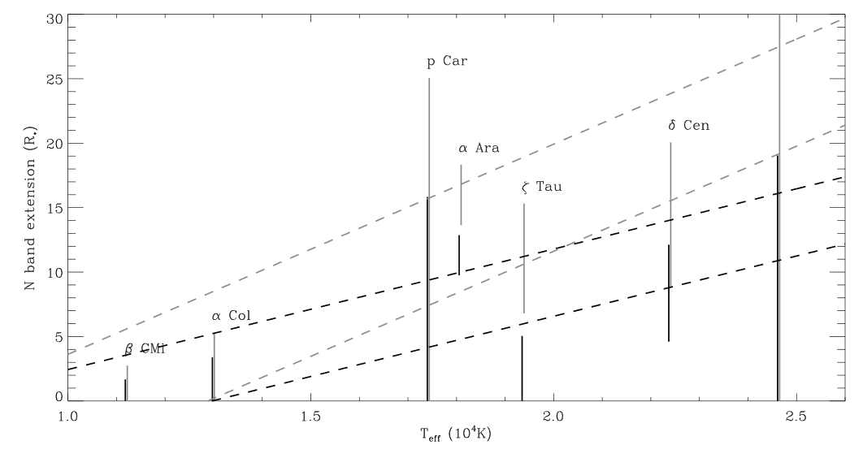
Be stars with MATISSE?
It might not be that easy in N band!
Quite Faint : Flux < 15 Jy (UTs are needed)
Quite Small : Extension < 7 mas (only marginally resolved)
Visibility
VLTI/MIDI UTs mini-survey of classical Be stars (Meilland+ 2009)
λ (µm)

Slide 5
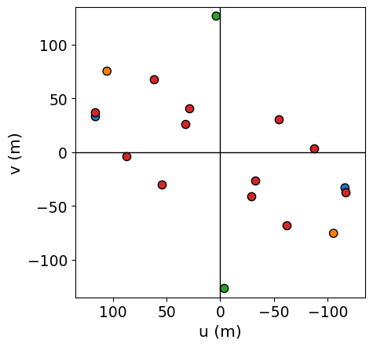
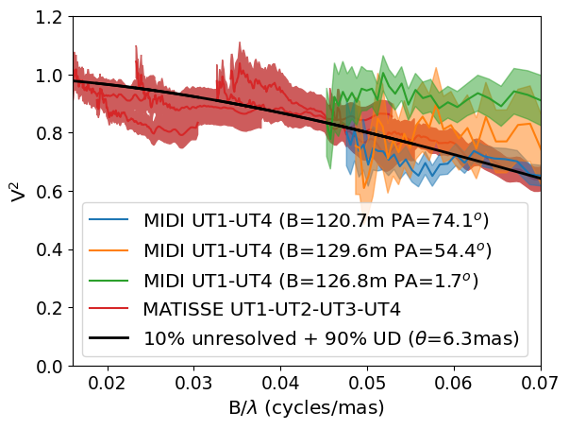
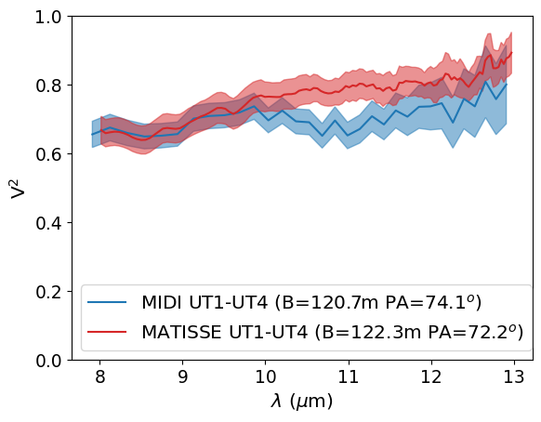
Be stars with MATISSE?
It might not be that easy in N band…
…but not impossible
MATISSE commissioning data
α Ara with UTs (2018-05-23)

Slide 6
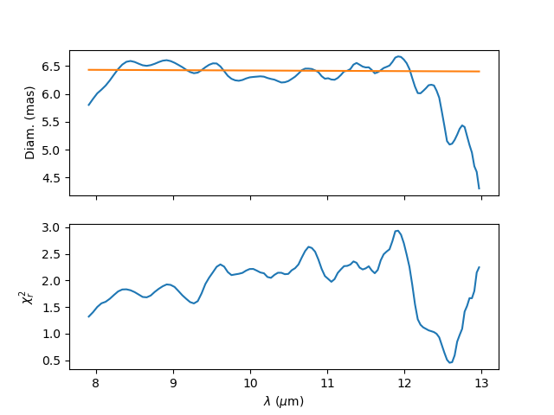
α Ara N band size
Disk size is constant with λ…
6.5mas ≈ 10 D*
…but disk size show increase with λ
according to radiative transfer models
Unless the disk is:
Truncated
Isothermal
TODO : model with DISCO and then radiative transfer model HDUST

Slide 7
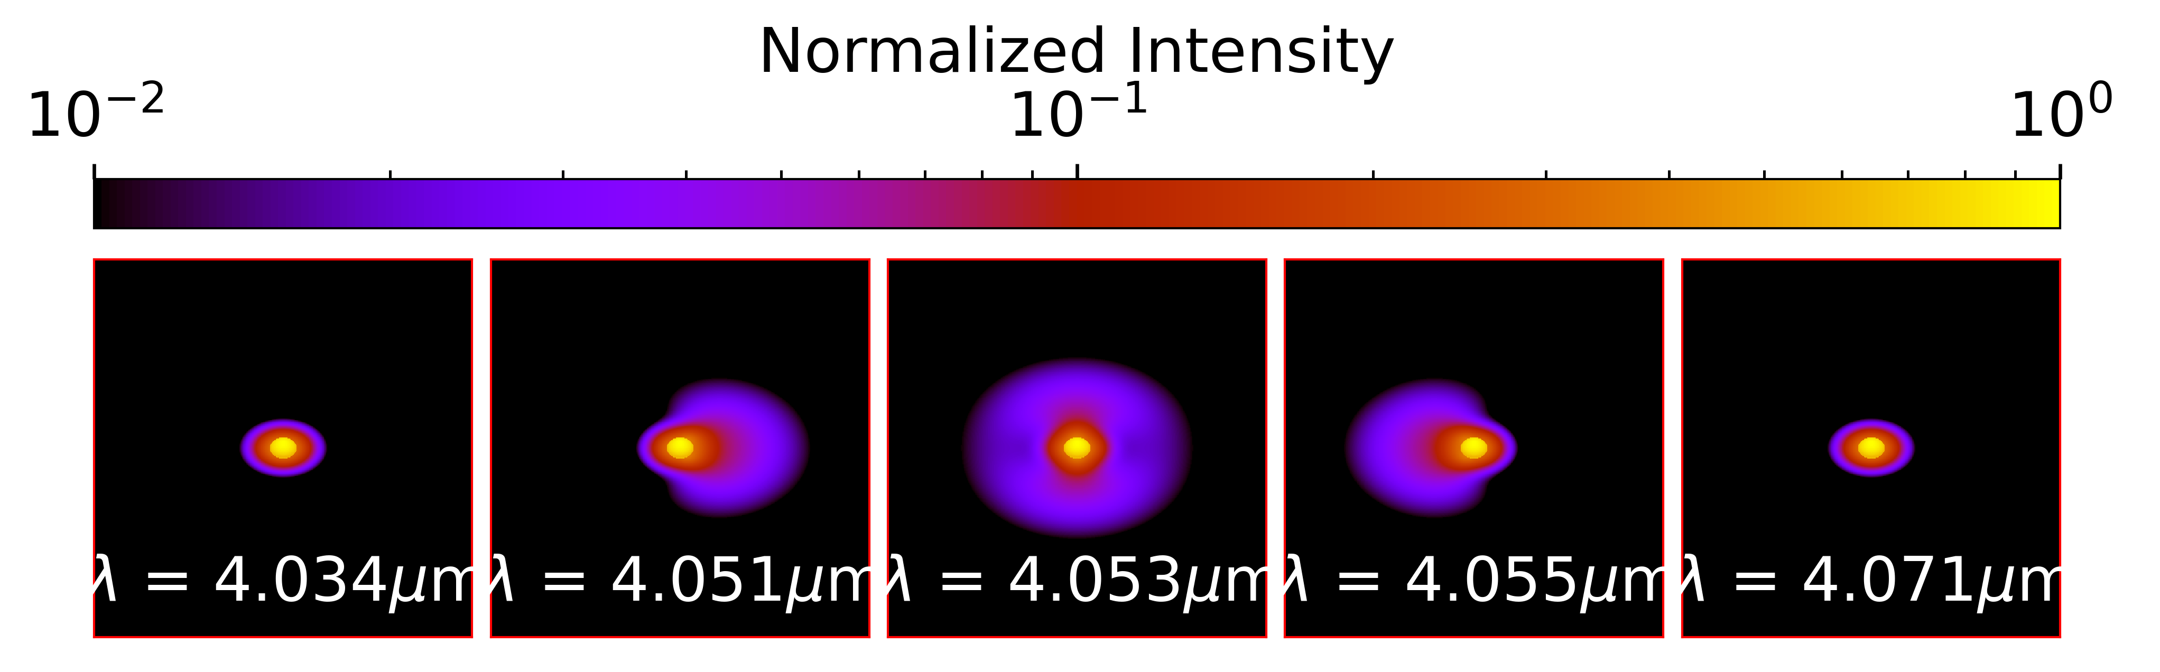
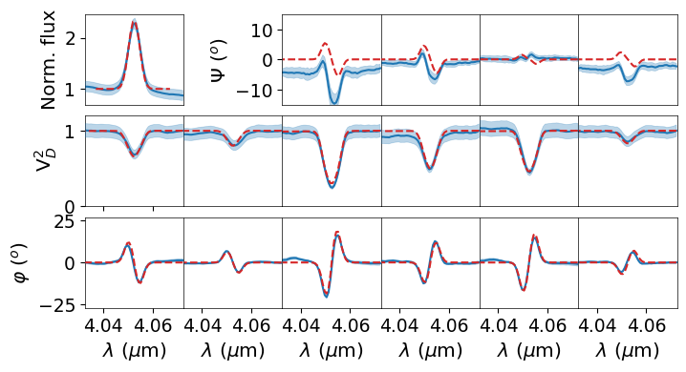
Geometry and kinematics in Br α
Analyzed with a kinematics toy model
Velocity Map
Emission Map
In the Line
Image cube
through the line
6.5mas ≈ 10 D*
Incl = 47.6°
P.A. = -86°
Vrot = 480km/s (97% of critical rotation)
β = -0.5 (Keplerian rotation in disk)
α = 0 (no expansion)
EW = 75 Å
FWHM = 5.1mas (D=6.5mas using UD)
MATISSE commissioning data
α Ara with UTs (2018-05-23)
Compatible with AMBER

Slide 8
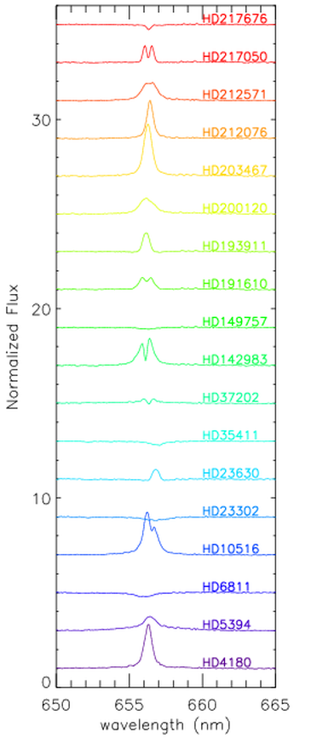
What about β CMi?
The project started with my CHARA/VEGA survey of Be stars
36 objects observed between 2015 and 2019…
Some β CMi CHARA/VEGA observations:
Spectrum
Differential Visibility
Differential phase
Some CHARA/VEGA
Hα spectrum Be stars

Slide 9
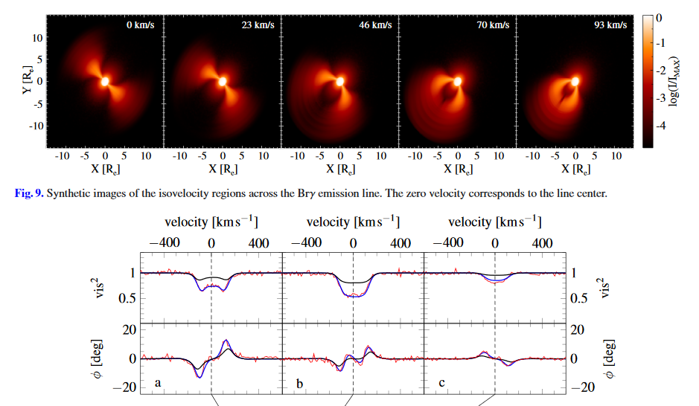
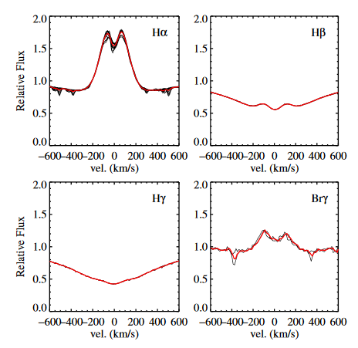
What about β CMi?
Interferometric :AMBER
…project evolved when Robert Klement
arrived at CHARA as a post-doctoral Fellow
UV to mid-IR SED
Sub-mm, mm, cm : HDUST images
Spectroscopy
in the visible and near-IR
APEX mm Flux

Slide 10
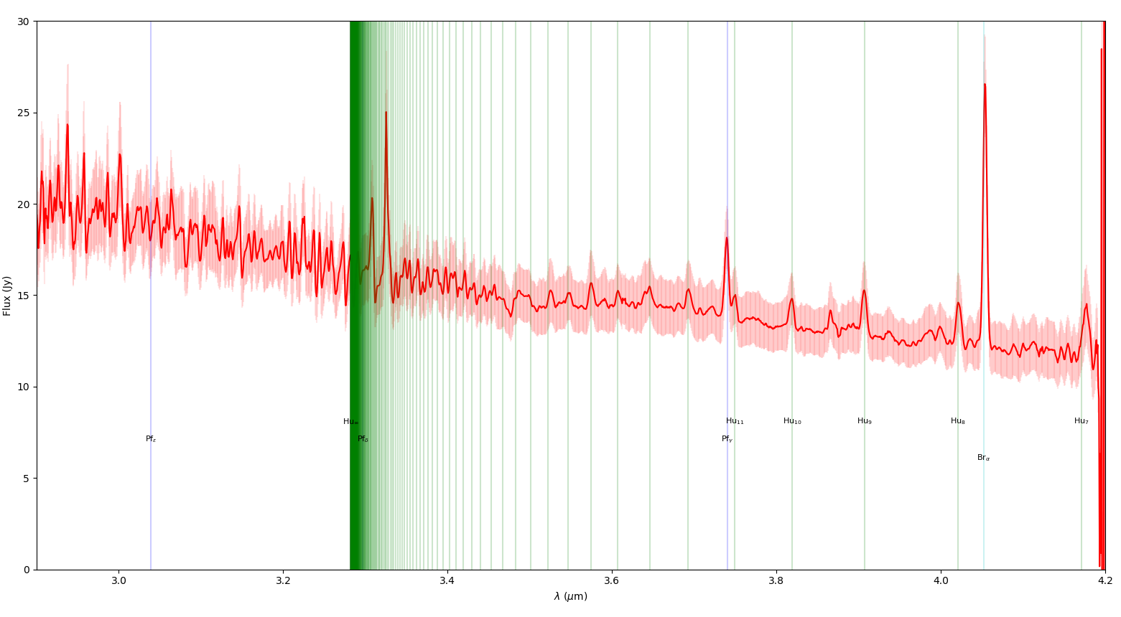
GRA4MAT Observation of β CMi
..and finally, some MATISSE observation this year
Brα
L-band HIGH (R≈1000) GRA4MAT commisioning with ATs(2020-03-03)

Slide 11
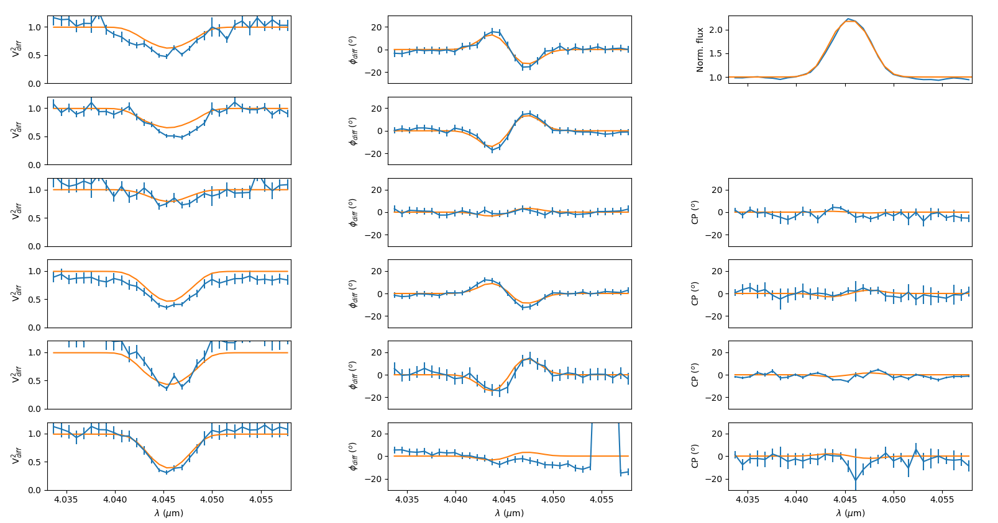
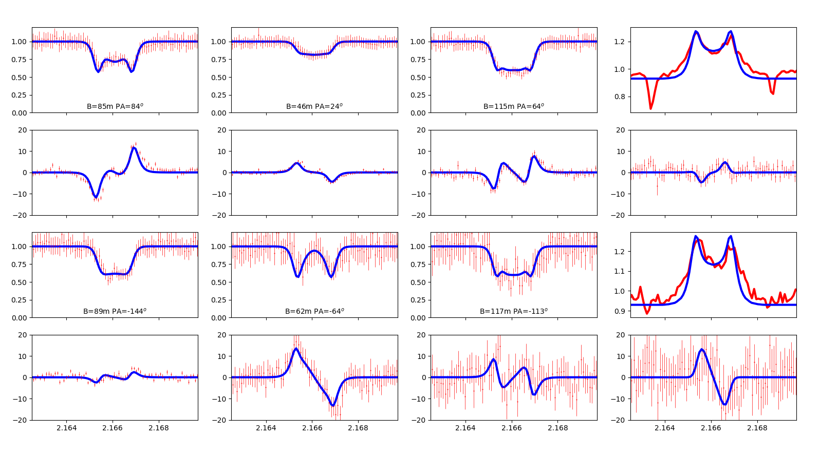
GRA4MAT Observation of β CMi
Data analysis has started…
kinematic model fitting in Brα
Compatible with AMBER in Brγ

Slide 12
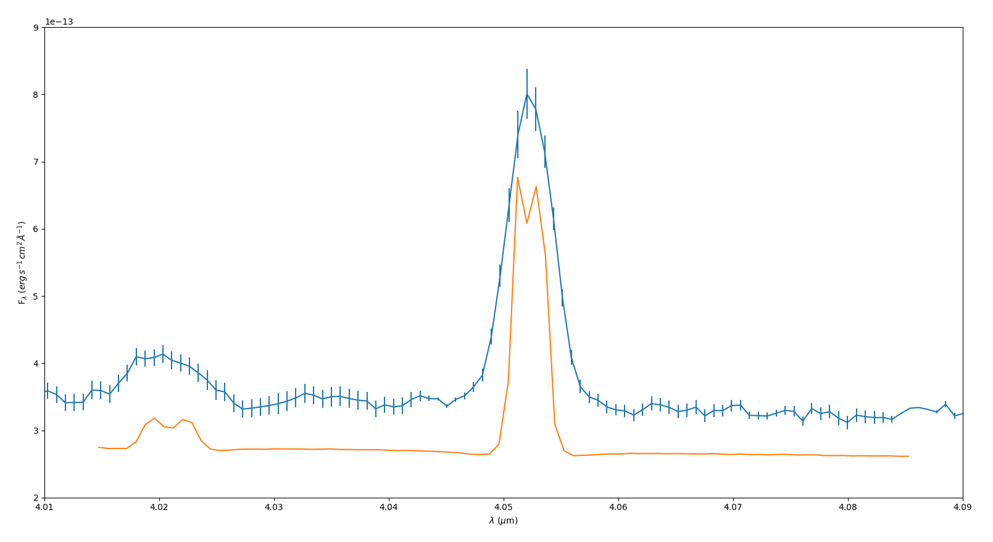
GRA4MAT Observation of β CMi
Calibrated fluxes compared to HDUST radiative transfer model
from Klement+ 2015
MATISSE data
HDUST model
35% difference
Calibration error
Or bad model?
We need to model the interferometric data (VEGA + MATISSE ) with HDUST

Slide 13
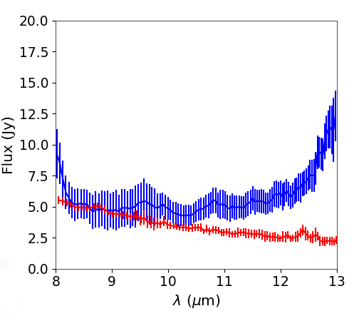
GRA4MAT Observation of β CMi
What about N Band?
ATs observation without chopping
Correlated flux only
But the disk seems barely resolved
MATISSE Corr Flux on ATs
MIDI Total Flux on UTs
Data should be reprocessed with Ph. Berio algo
measuring piston in K to coherently integrate longer in N

Slide 14
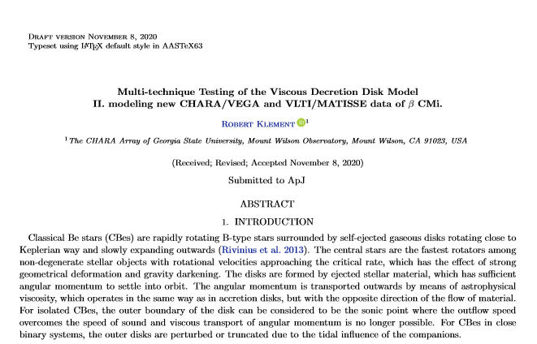
GRA4MAT Observation of β CMi
There’s a draft of paper
Brγ
Hα
Similar modelling done by my student on O Aqr
using AMBER & VEGA data (de Alemeida+ 2020)
But a lot of things to do:
Modelling MATISSE data with HDUST
VEGA mcmc-fitting with the kinematic model
MATISSE mcmc-fitting with the kinematic model
Submission in first half of 2021 (hopefully)

Slide 15
Other Be Stars observed with MATISSE
10 Objects observed
during commisioning:
α Ara
48 Lib
η Cen
δ Cen
δ Sco
Achernar
κ CMa
δ Cen
δ Sco
Very inhomogeneous set of data
All modes used in LM (LOW, MED, HIGH, VHIGH)
With and without GRA4MAT
Often observed without calibrator
Mainly with ATs (hard for N-band)
One big ‘’Survey’’ Paper on all observations
or one paper for each object?

Slide 16
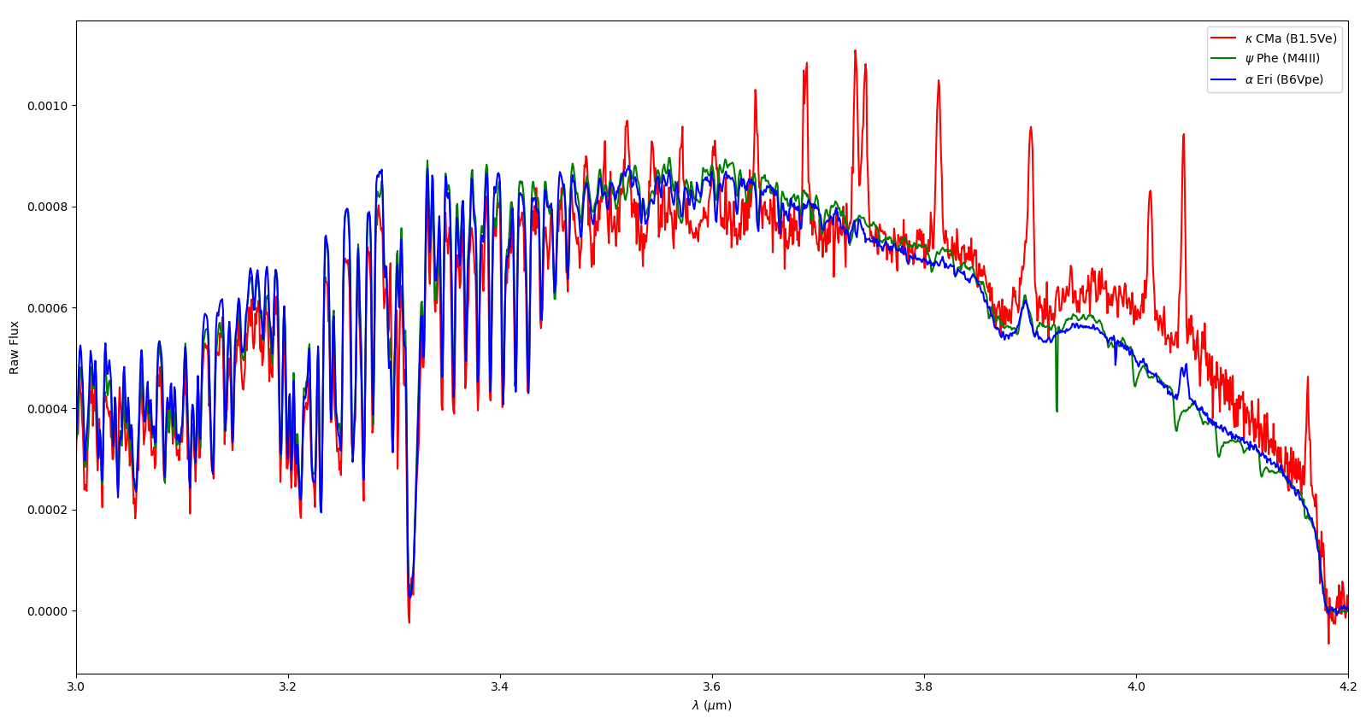
Other Be Stars observed with MATISSE
10 Objects observed
during commisioning:
α Ara
48 Lib
η Cen
δ Cen
δ Sco
Achernar
κ CMa
δ Cen
δ Sco
κ CMa
Achernar
…and a Bad
spectral calibrator
GRA4MAT 1st commissioning with ATs (2019-09-20)

Slide 17
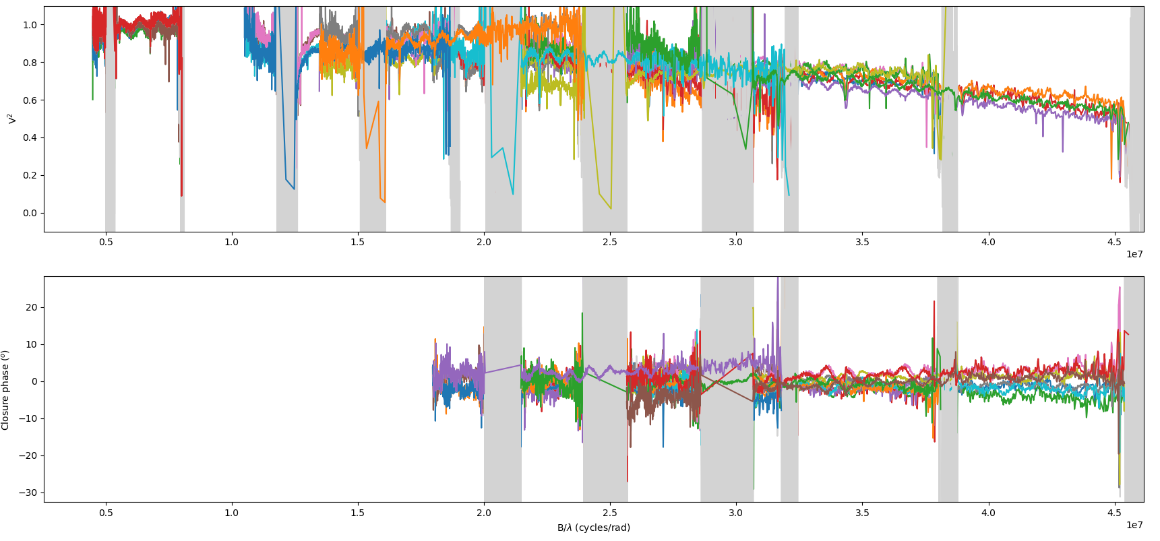
Other Be Stars observed with MATISSE
Achernar faint companion (≈1% of the flux)
10 Objects observed
during commisioning:
α Ara
48 Lib
η Cen
δ Cen
δ Sco
Achernar
κ CMa
δ Cen
δ Sco
Binaries
GRA4MAT 1st commissioning with ATs (2019-09-25)
To be included in a multi-technique study
of Achernar companion by Domiciano de Souza

