Slide 1
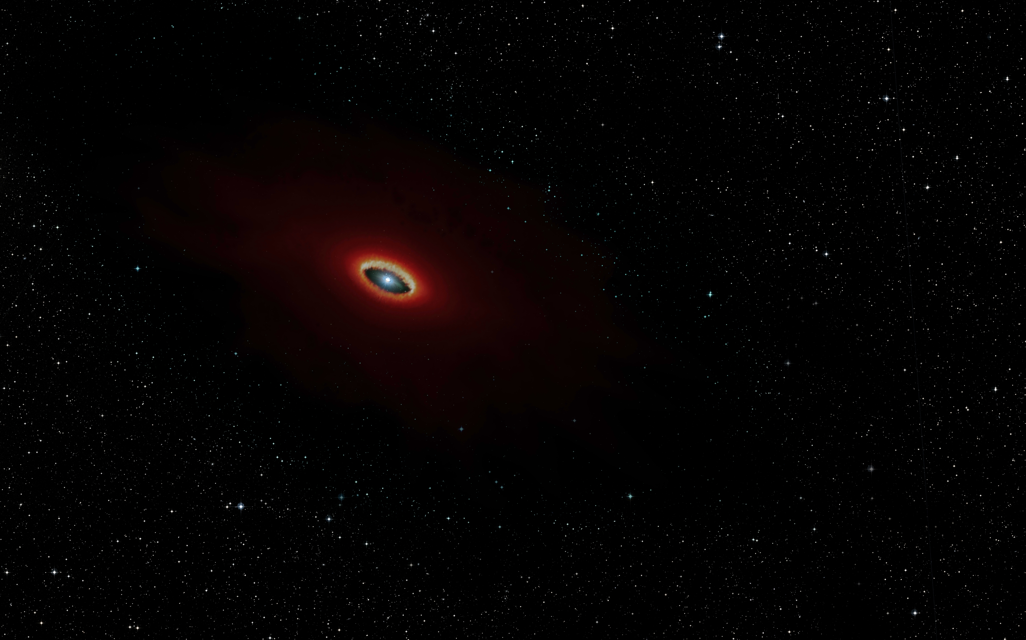
First B[e] stars survey with MATISSE
A. Meilland, A. Domiciano de Souza, F. Millour, G. Niccolini, Ph Stee…
and whoever’s motivated to join us!

Slide 2
What are B[e] stars?
Hot stars with 3 spectral features :
Emission lines (H, He, FeII…)
Forbidden lines : [FeII], [OI]
Strong IR excess

Slide 3
What are B[e] stars?
Hot stars with 3 spectral features :
Emission lines (H, He, FeII…)
Forbidden lines : [FeII], [OI]
Strong IR excess
Found for stars at various evolutionary status :
Herbig stars : HAeB[e]
Supergiants : sgB[e]
Compact planetary nebula : cPNB[e]
Symbiotic stars : symB[e]
Unclassified : unclB[e]
Better talking about
the B[e] phenomenon

Slide 4
What are B[e] stars?
Hot stars with 3 spectral features :
Emission lines (H, He, FeII…)
Forbidden lines : [FeII], [OI]
Strong IR excess
Strongly anisotropic circumstellar environment
Dense and hot zone for Hydrogen emission lines
Highly diluted and strongly illuminated zone for forbidden lines
Dense and cool zone to produce dust (not that easy around hot stars)
Mechanism(s) of mass-loss?
Break of its spherical symmetry?
Dust formation?
Radiative wind
Rotation
Binarity

Slide 5
Go beyond AMBER & MIDI results…
Name | Type of B[e] | Reference | Array/Instrument
HD62623 | Supergiant/binary? | Meilland+ 2010 | VLTI/MIDI
 |  | Millour+ 2011 | VLTI/AMBER
HD50138 | Herbig or Unclassified | Borges Fernandes+ 2011 | VLTI/MIDI & VLTI/AMBER
 |  | Ellerbroek+ 2015 | VLTI/AMBER & CHARA/VEGA
 |  | Kluska+ 2016 | VLTI/PIONIER
HD87643 | Herbig or Unclassified? | Millour+ 2009 | VLTI/MIDI & VLTI/AMBER
CPD -57° 2874 | Supergiant | Domiciano de Souza+ 2007 | VLTI/MIDI & VLTI/AMBER
 |  | Domiciano de Souza+ 2011 | VLTI/MIDI
HD85567 | Herbig or Unclassified? | Wheelwright+ 2013 | VLTI/AMBER
 |  | Vural+ 2014 | VLTI/AMBER
MWC300 | Herbig or Unclassified? | Wang+ 2012 | VLTI/AMBER
Hen 3-1191 |  | Lachaume+ 2007 | VLTI/MIDI
V921 Sco | Unclassified | Kreplin+ 2012 | VLTI/AMBER
HD45677 | Herbig or Unclassified | Monnier+ 2006 | IOTA/IONIC
GG Car | Supergiant | Domiciano de Souza+ 2015 | VLTI/MIDI
MWC361 | Herbig | Benisty+ 2013 | CHARA/VEGA
MWC 84 | Supergiant/binary | Thureau+ 2009 | IOTA/IONIC & PTI
HD327083 | Supergiant/binary | Wheelwright+ 2012 | VLTI/AMBER
CPD -52° 9243 | Supergiant | Cidale+ 2012 | VLTI/MIDI
Back in the last B[e] conference in Prague in 2017
8 Stars with VLTI/MIDI
10 Stars VLTI/AMBER
Constraints on :
the dusty disk geometry and physical properties
The gas geometry and kinematics
But
AMBER only sensitive to :
Dust inner rim
Hot gas
MIDI limitations mainly due to the 2 Tels mode:
Time-expensive to get good uv coverage
No closure phase
Review on B[e] interferometric observation (Meilland 2017)

Slide 6
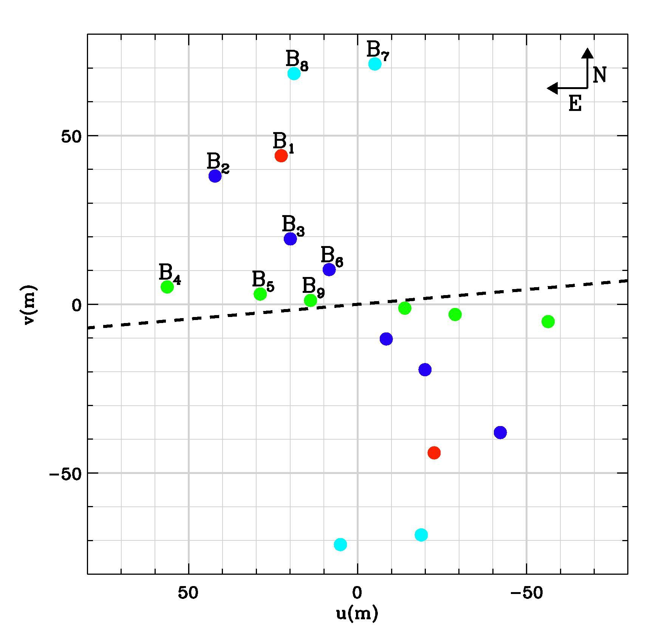
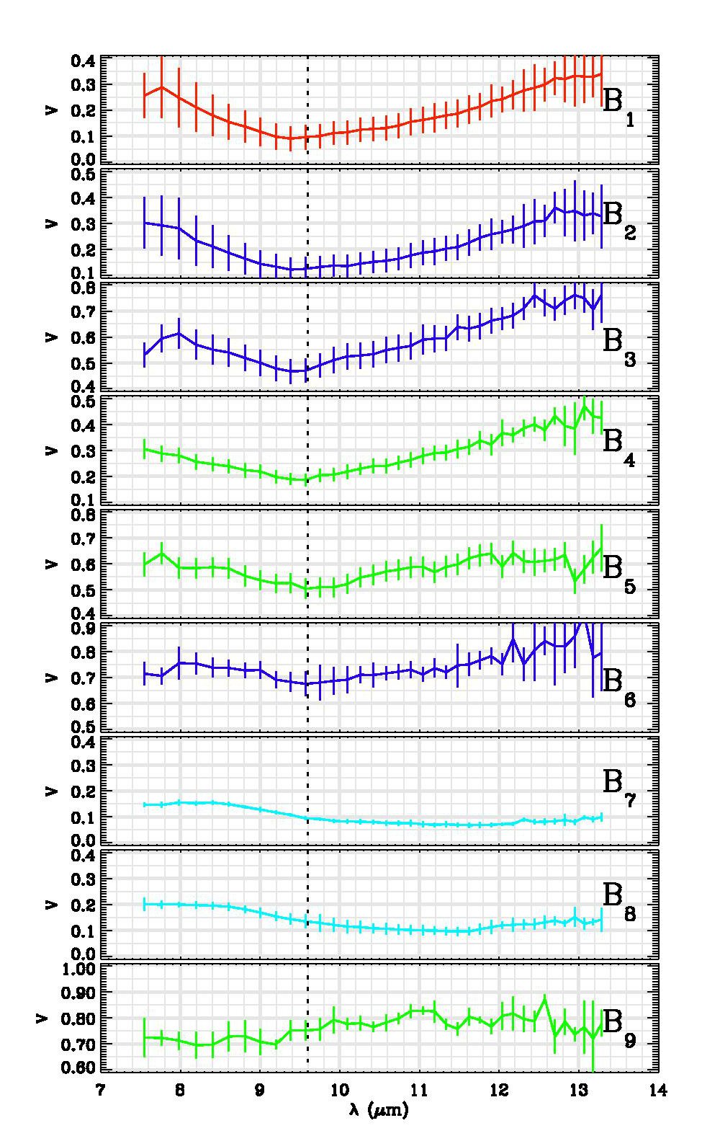
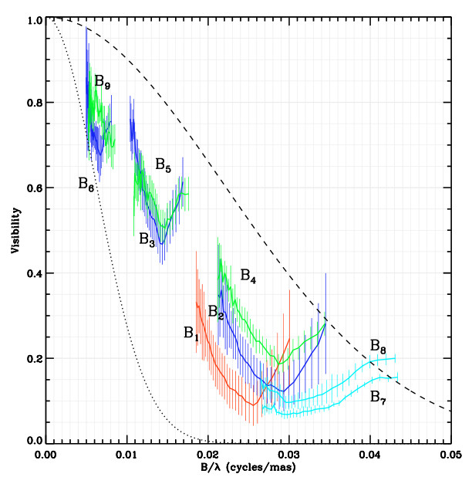
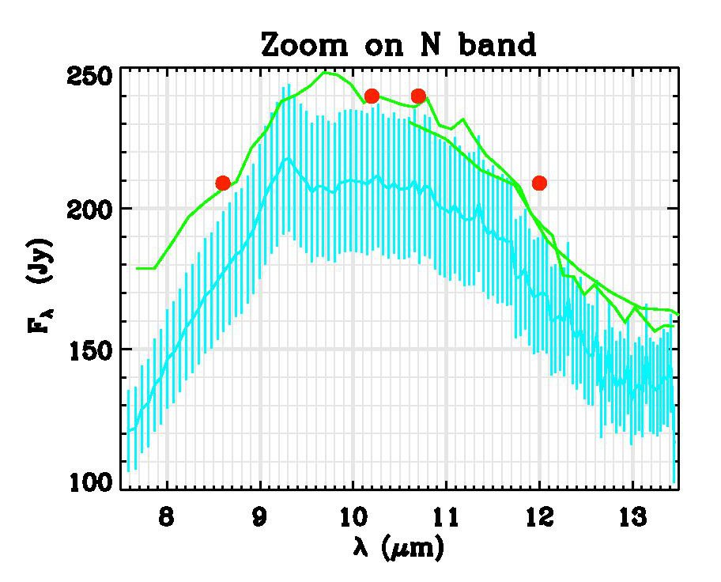
Go beyond MIDI results…
The A[e] supergiant l Pup seen by MIDI

Slide 7
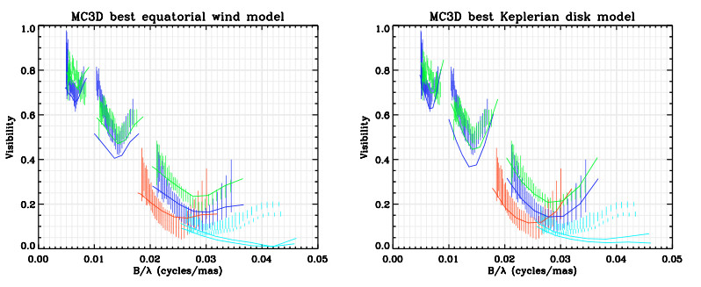
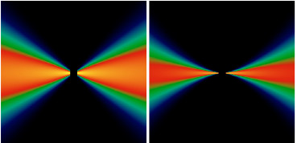
Go beyond MIDI results…
l Pup : Radiative transfert modeling of MIDI data with MC3D (Wolf 2003)
Keplerian disk
Equatorial wind
From Meilland+ 2010

Slide 8
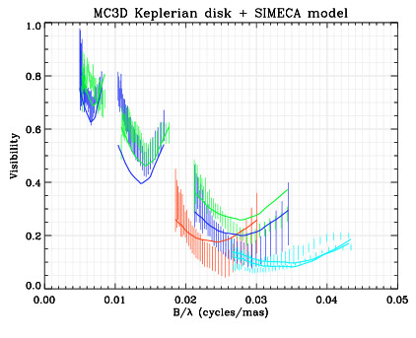
Go beyond MIDI results…
l Pup : Radiative transfert modeling of MIDI data with MC3D (dust) + SIMECA (gas)
Keplerian disk
We Added
4 10⁻⁷ Mo
Of gas
Equatorial wind
From Meilland+ 2010

Slide 9
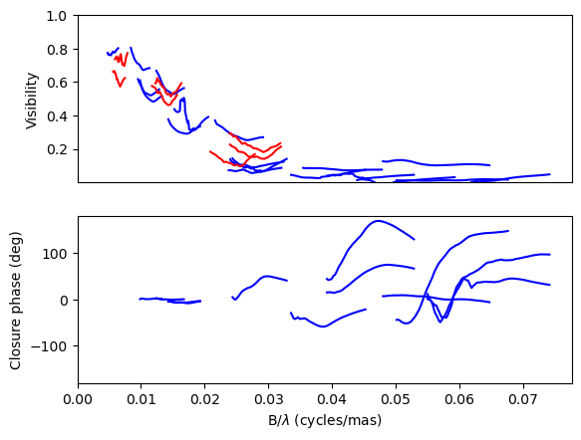
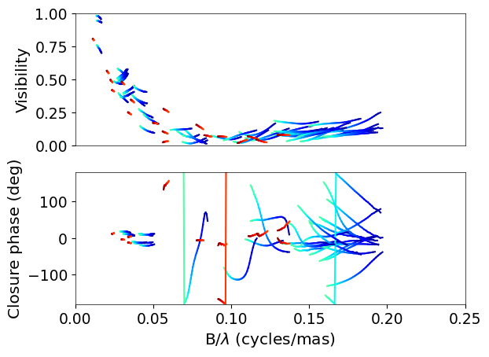
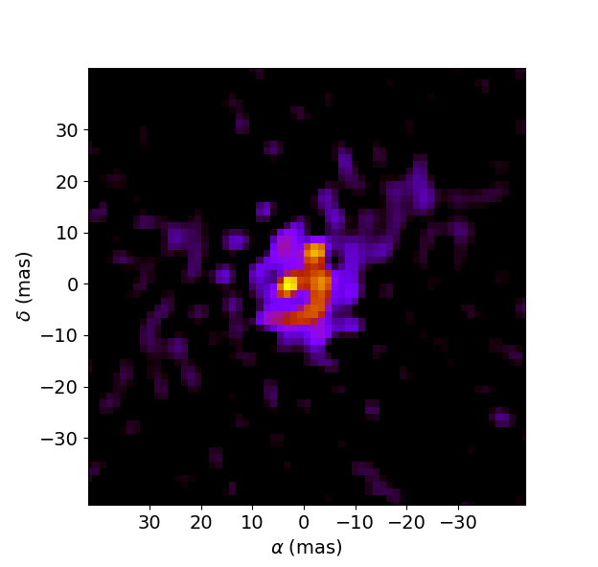
Go beyond MIDI results…
l Pup Observations : B[e] survey + commissioning pts
MATISSE L-band (9pts)
MATISSE N-band (3pts)
MATISSE M-band (9pts)
MIDI N-band (7pts)

Slide 10
Go beyond MIDI results…
l Pup Observations : Trying to reconstruct an image in L band
MATISSE L-band (9pts)
MATISSE M-band (9pts)
≈15 mas
IRBIS image 3.5µm
My first try
Still work to do
(I’m not Karl-Heinz or Florentin)

Slide 11
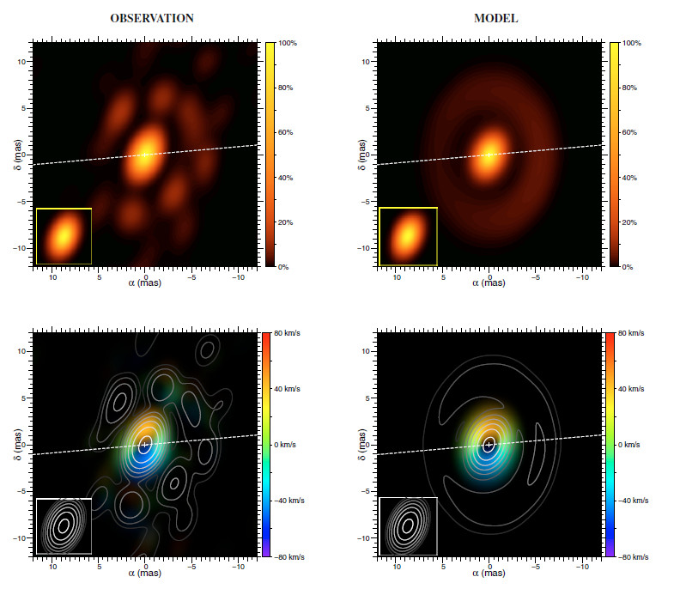
Go beyond MIDI results…
l Pup Observations : B[e] survey + commissioning pts
13 mas
IRBIS image 3.5µm
My first try
Still work to do
(I’m not Karl-Heinz or Florentin)
Compatible with AMBER image
From Millour+ (2011)

Slide 12
B[e] Stars observed with MATISSE
Name | Vmag | Kmag | L (Jy) | N (Jy) | N° of pts
L Pup | 3.9 | 2.5 | 138 | 249 | 9
HD 87643 | 9.0 | 3.5 | 46 | 157 | 10
FS CMa | 9.2 | 3.7 | 20 | 143 | 42
MWC 300 | 11.6 | 6.2 | 17 | 100 | 2
Hen 3-1300 | 11.4 | 4.5 | 35 | 90 | 3
HD 50138 | 6.6 | 4.1 | 24 | 69 | 3
Hen 3-847 | 10.6 | 7.8 | 2.4 | 36 | 2
CPD -57 2874 | 10.2 | 4.3 | 26 | 25 | 4
Hen 3-1191 | 13.7 | 6.3 | 2.3 | 23 | 2
HD 327083 | 9.8 | 3.2 | 20 | 21 | 2
CPD -52 9243 | 10.3 | 4.4 | 15 | 21 | 4
GG Car | 8.8 | 5.0 | 9.5 | 10 | 3
MWC 137 | 12.0 | 6.6 | 2.6 | 10 | 2
HD 316285 | 9.2 | 3.7 | 20 | 9 | 0
MWC 623 | 10.9 | 5.4 | 8 | 9 | 0
HD 85567 | 8.6 | 5.8 | 4.2 | 6.5 | 1
16 B[e] can be observed
with MATISSE and the ATs
(L > 2Jy)
14 Observed up to now
10 in Frebruary 2020
The last 2 should have
been in August

Slide 13
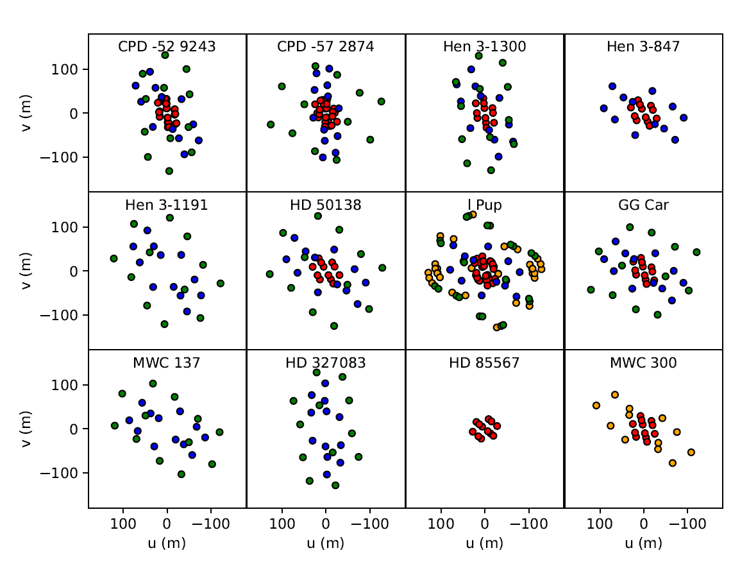
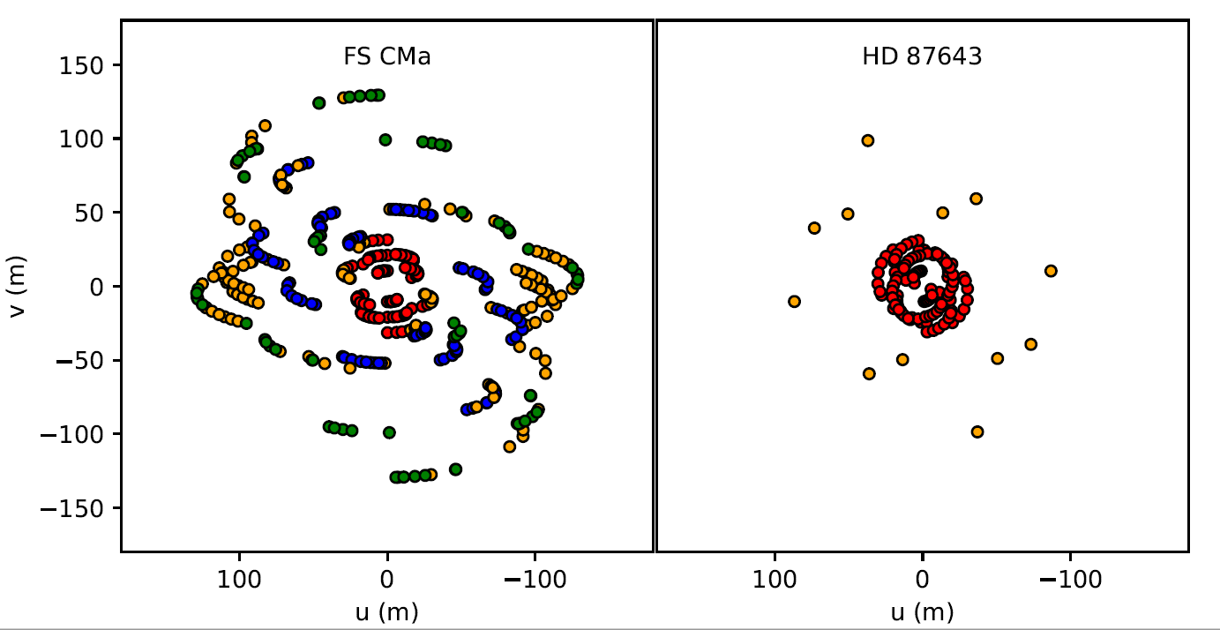
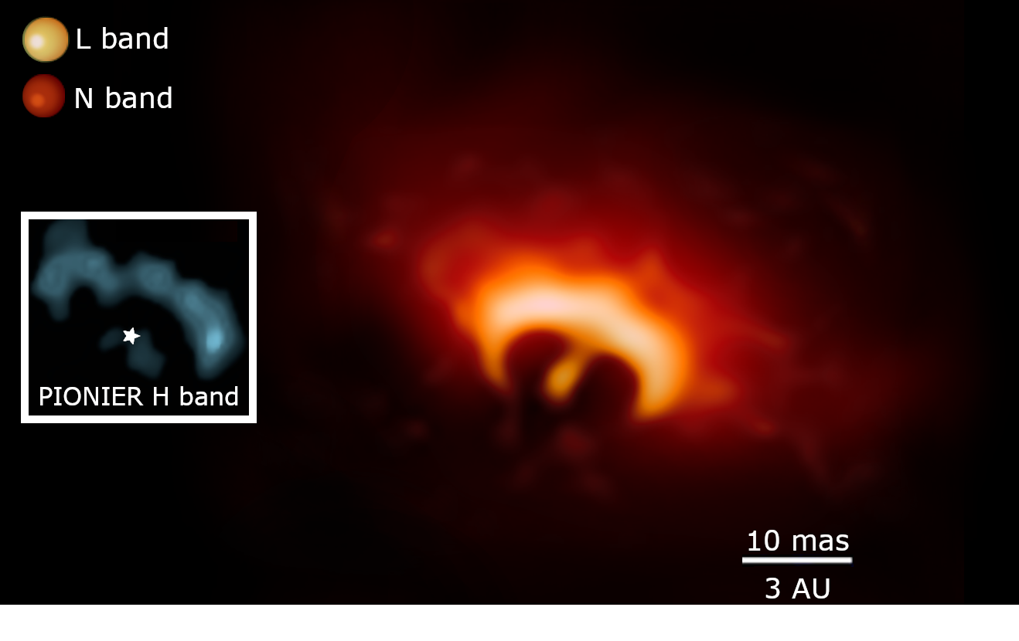
B[e] Stars observed with MATISSE
Observed during the B[e] survey 2020-02 (5 half-nights)
Open time
+ comm
SV
Karl-Heinz Image
Florentin’s binary

Slide 14
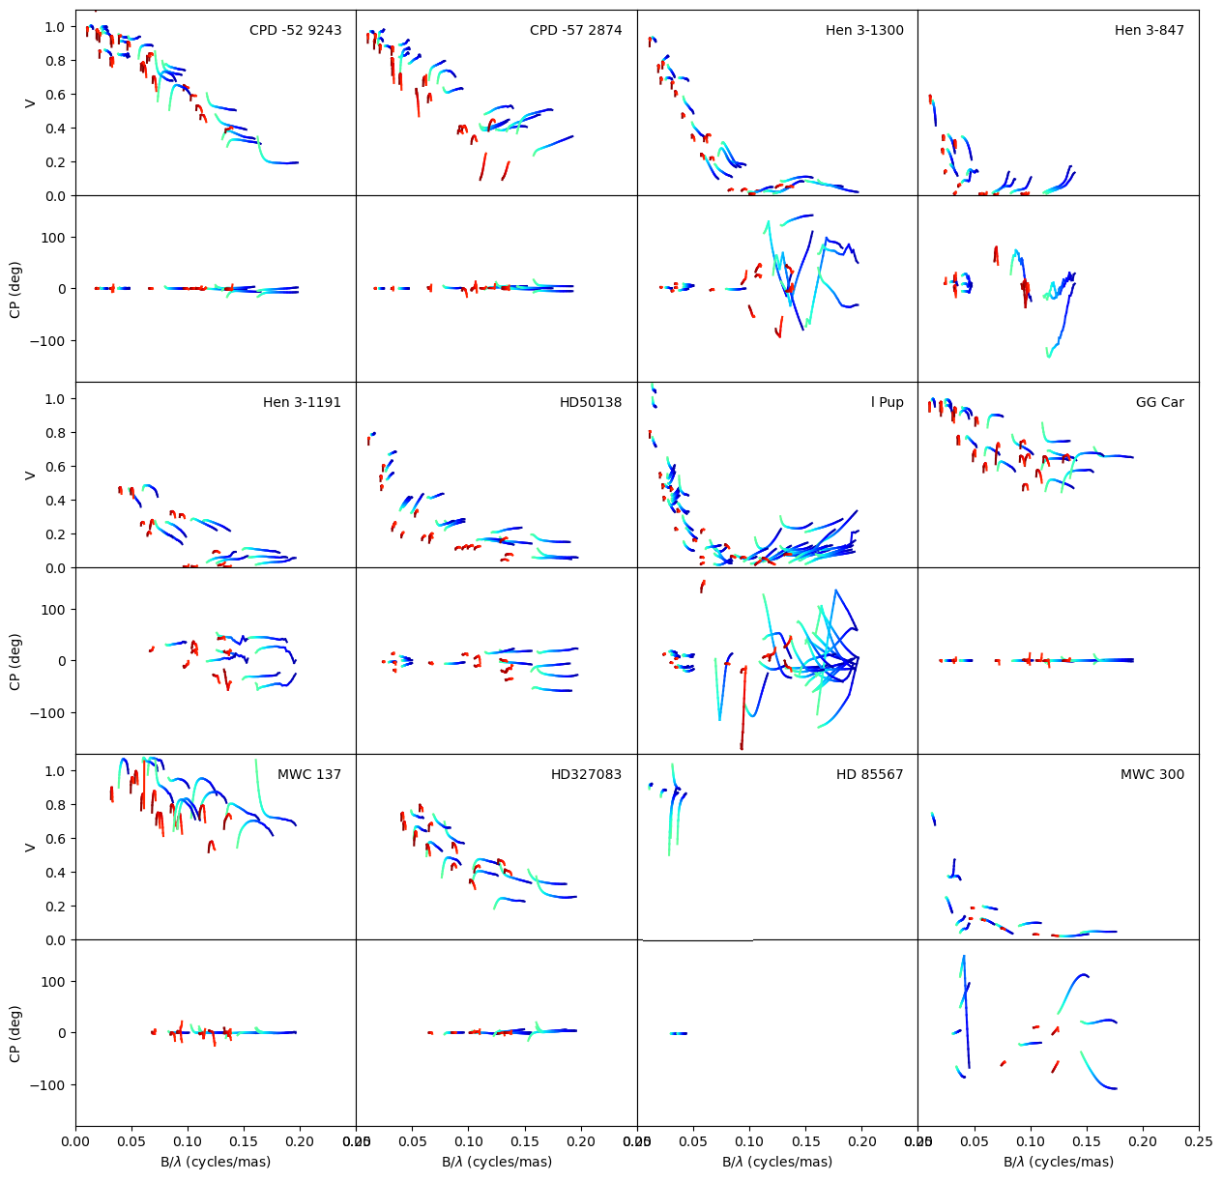
B[e] Stars observed with MATISSE
Zoom on some Visibility in LM
Variation as a function of λ quite different
Physics in the disks?
LM bands (binning = 5pixels)

Slide 15
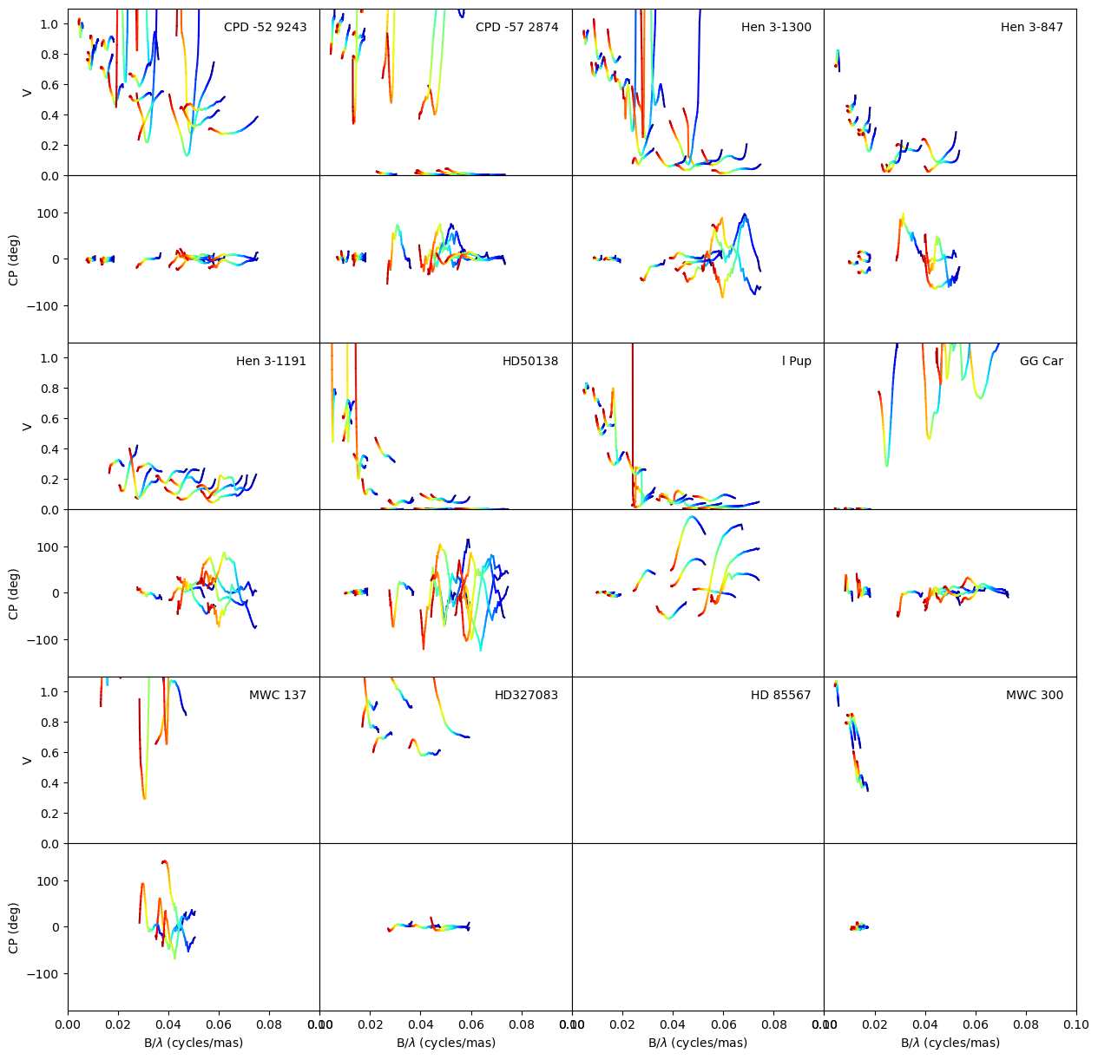
B[e] Stars observed with MATISSE
LM bands (binning = 5pixels)
N band (binning = 21pixels)

Slide 16
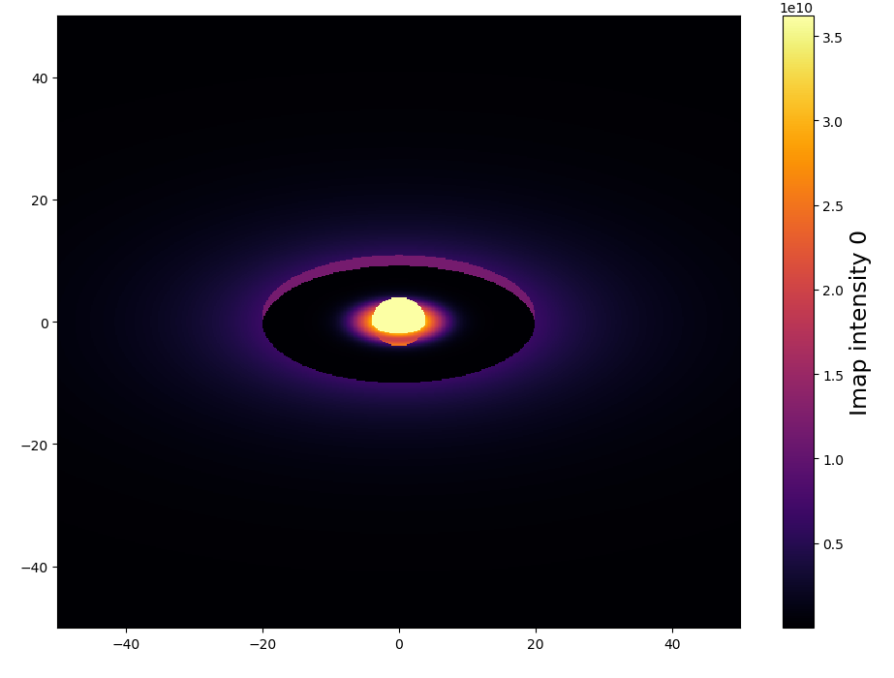
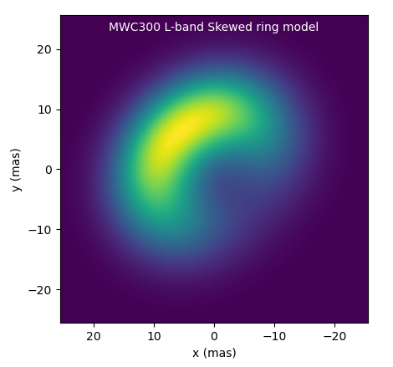
B[e] Stars observed with MATISSE
DISCO+ : semi-physical Gas + Dust (Blackbody)
Radiative transfer
Grid of HDUST models
(Gas + Dust)
Modelling the whole dataset
with tools of increasing complexity
Chromatic Geometric models
Image reconstruction (IRBIS+MIRA)
+
RADMC3D?
Hopefully submitting
a paper by the end of next year

Slide 17
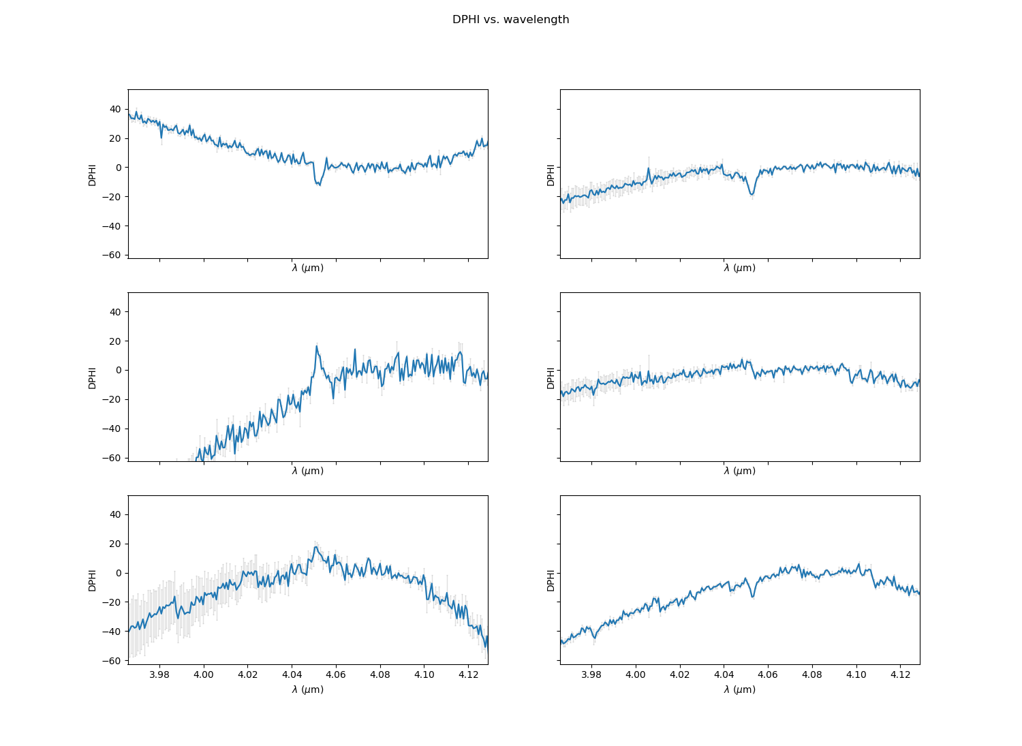
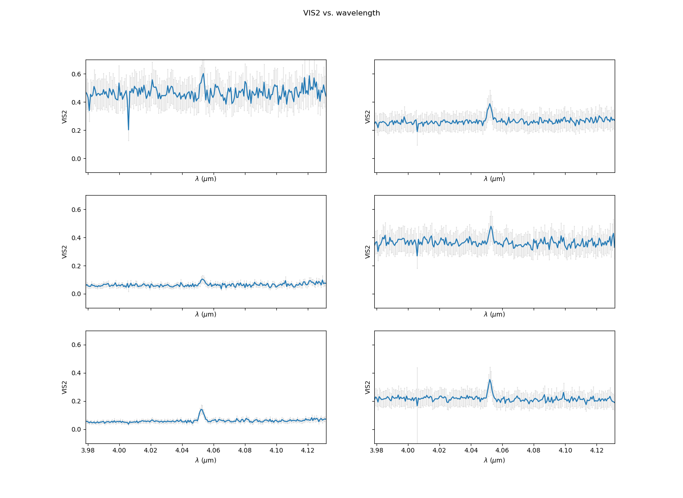
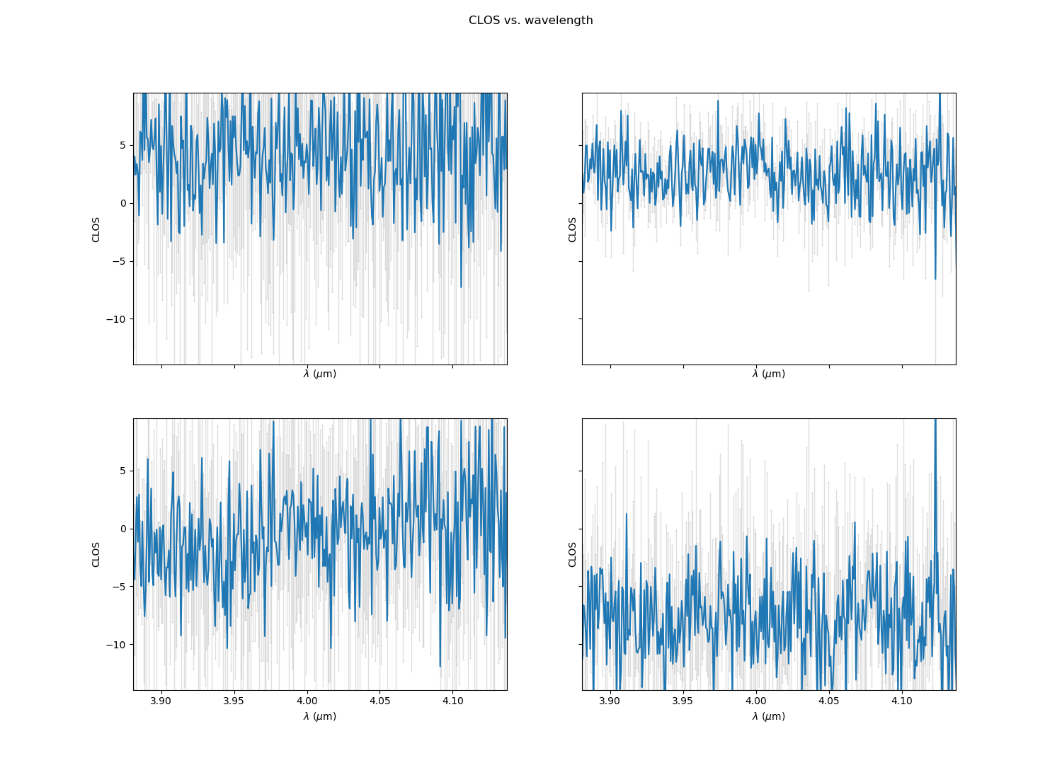
B[e] observed in Brα
Disantangling gas and dust around B[e] stars
Differential phase
Visibility
Another Paper?
Need of more GRA4MAT obs?
Or GRA+MAT (in Brα+Brγ)?
Closure phase

