Slide 1
VEGA news Be stars & co
A. Meilland & Co

Slide 2
Pogrammes Be & co
V66 (Meilland) Be Survey
V65 (Mourard/Wysocki) Be Assymetry
V72 (Klement) Beta CMi
V65b (Meilland/Millour) Kappa Dra imaging
V58 (Mourard/Meilland) Gamma Cas
V45 (Domiciano/Meilland) Pleiades
V68 (Meilland) B[e] HD62623 photosphere & gas
V64 (Meilland) Flattening of An star Zet Aql

Slide 3
V72 Beta CMi
Draft of Paper : Klement+
V to N dataset consisting of
VEGA
MATISSE
old data from AMBER & NPOI

Slide 4
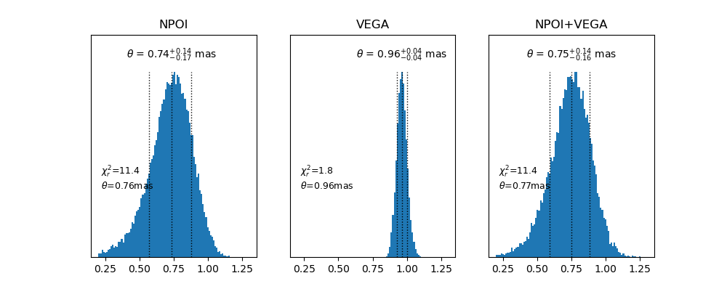
V72 Beta CMi : geometric models

Slide 5
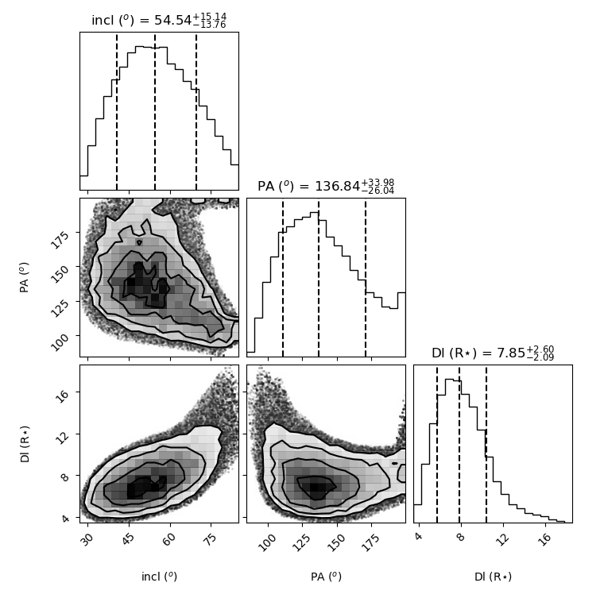
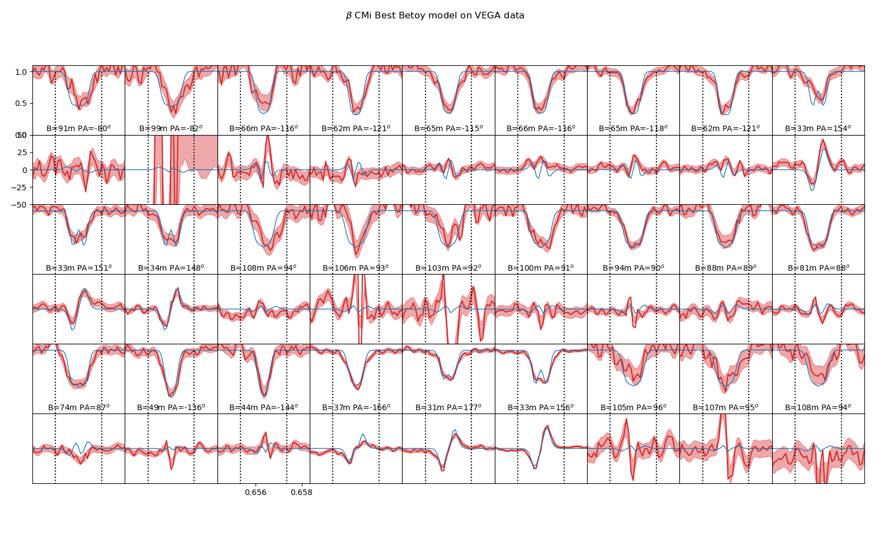
V72 Beta CMi : kinematics models

Slide 6
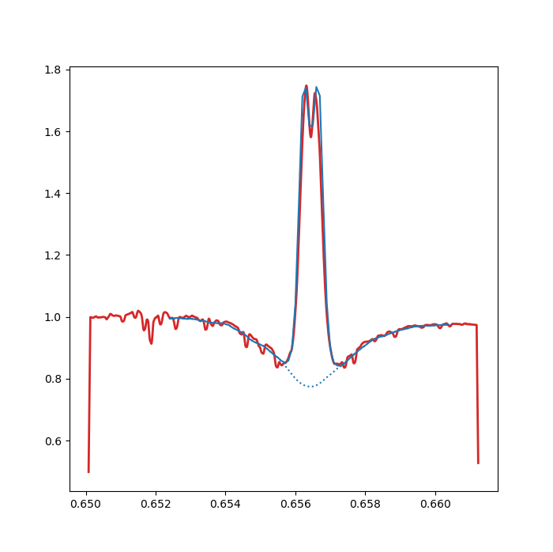
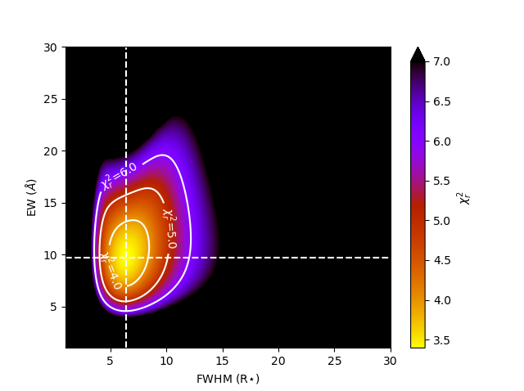
V72 Beta CMi : kinematics models

Slide 7
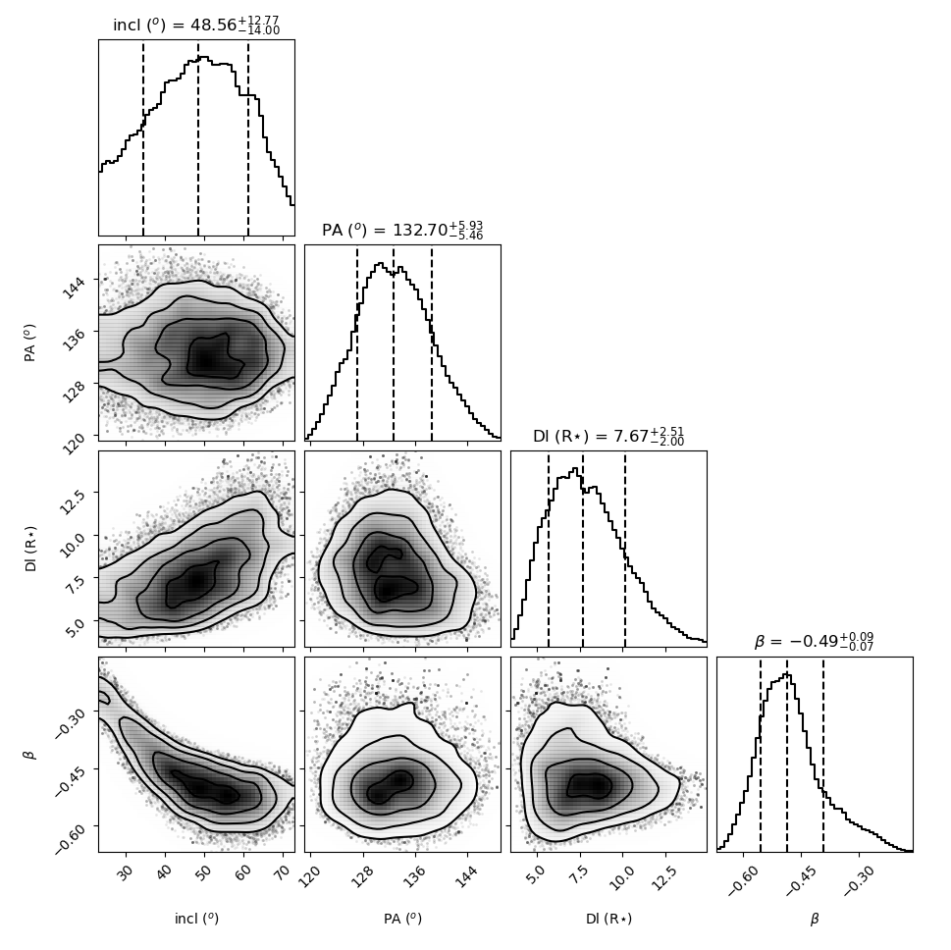
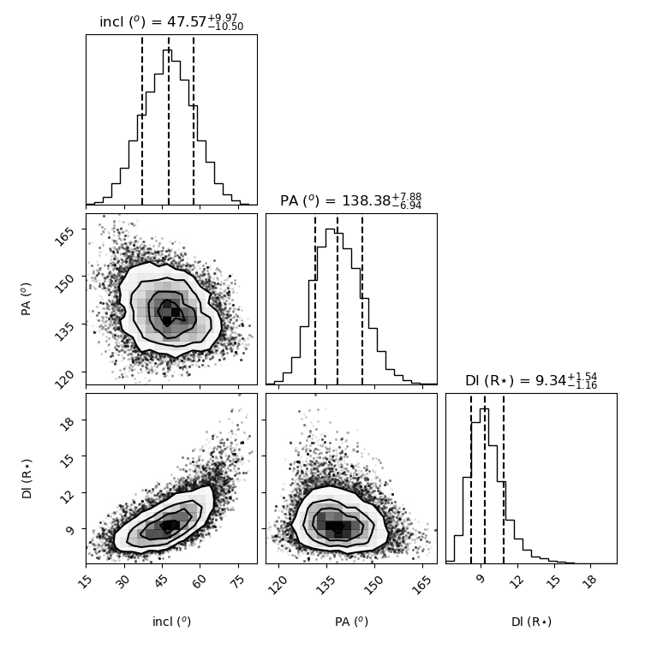
V72 Beta CMi : kinematics models multi-lines
AMBER : Brγ R=12000
MATISSE : Brα R=960

Slide 8
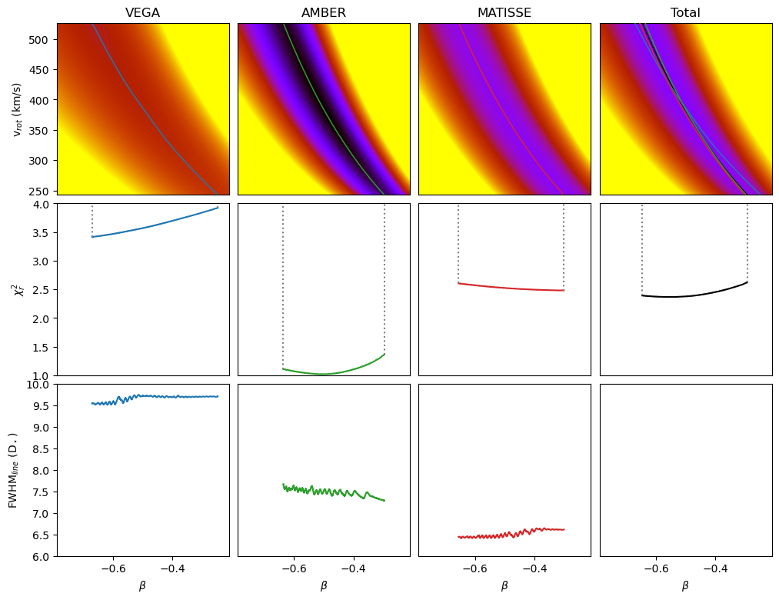
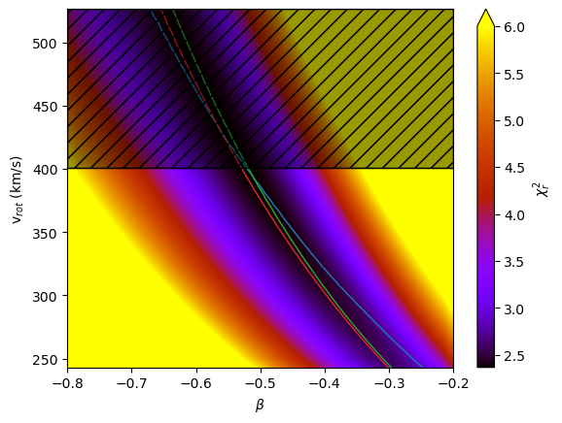
V72 Beta CMi : kinematics models multi-lines

Slide 9
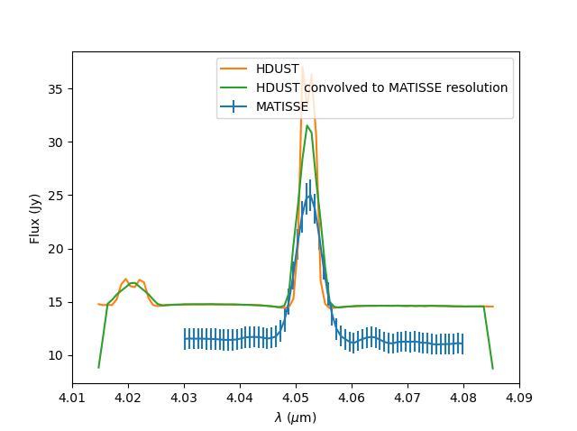
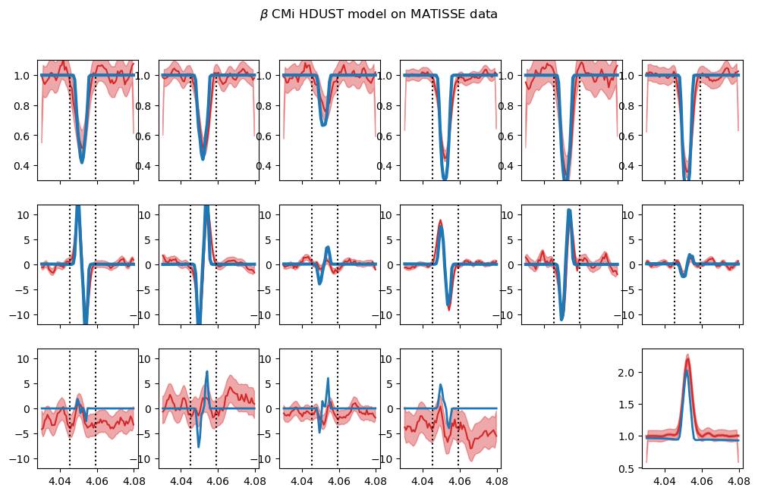
V72 Beta CMi : HDUST
Comparison of MATISSE data and a model based on best fit of NPOI + AMBER + SED from Klement 2015+ paper
New improved grid of models being computed

Slide 10
V66 Be Survey
Differential only data with S1S2, E1E2, W1W2
Goals:
Make statistical study on :
disk geometry : size in Halpha, orientation, flattening
disk kinematics : Vrot0, velocity law
Disk physical properties with SED : radial and vertical density law
Test dependance on stellar parameters
Observation from 2015 to 2020
264 observations
80 nights
32 stars

Slide 11
V66 Be Survey : New python-based reduction tool
#Creating database from csv file
db=vegaReducDB().create("/data/ame/test/beSurvey.txt")
#setting outpout directory
db.outDir= "/data/ame/test/“
#creating script with various reduction steps
script=vegaReductionScript(dirname)
script.addStep(vegaReducStepAC("algolr",650,665,"AC15")) #Autocorrelation on 15A
script.addStep(vegaReducStepBlockSelection("AC15",report=True)),pdf=True)) #Selection of blocks on the 15A AC
script.addStep(vegaReducStepIC("algolr",650,665,0,0,650,650.2,0.1,15,"IC2")) #Intercorrelation on Halpha
script.addStep(vegaReducStepIC("algolr",650,665,0,0,650,650.2,0.1,15,"IC2sel",blockSelection="AC15")) #Intercorrelation on Halpha with block selection
script.addStep(vegaReducStepIC2Fits("IC2",pdf=True, addSpectrum=True)) #Create fits files from the IC2 reduction
script.addStep(vegaReducStepIC2Fits("IC2sel",pdf=True, addSpectrum=True)) #Create fits files from the IC2sel reduction
script.addStep(vegaReducStepNightReport(["AC15","IC2","IC2sel"],["sel","icfits","icfits"])) #create night reports with AC block selection and fits from IC & ICsel
#applying reduction script to database
db.setReductionScript(script)
#launching pooled reduction on 5 processors
db.launchReductionScriptPooled(5)

Slide 12
V66 Be Survey : New python-based reduction tool
IC2 without selection
AC15 block selection from fit on peak
Example on HD142983 observed on 2015-04-13
IC2 with selection

Slide 13
V66 Be Survey : First full reduction statistics
Good
Unsuable
Bad

Slide 14
Beyond V72 & V66 on Be stars
V45 (Domiciano/Meilland) Pleiades
V65b (Meilland/Millour) Kappa Dra imaging
V58 (Mourard/Meilland) Gamma Cas

Slide 15
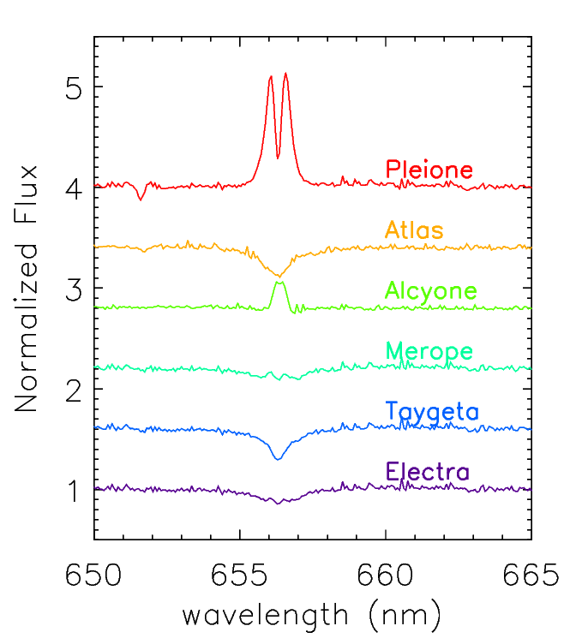
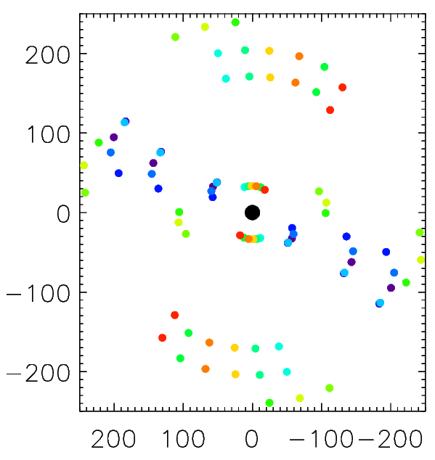
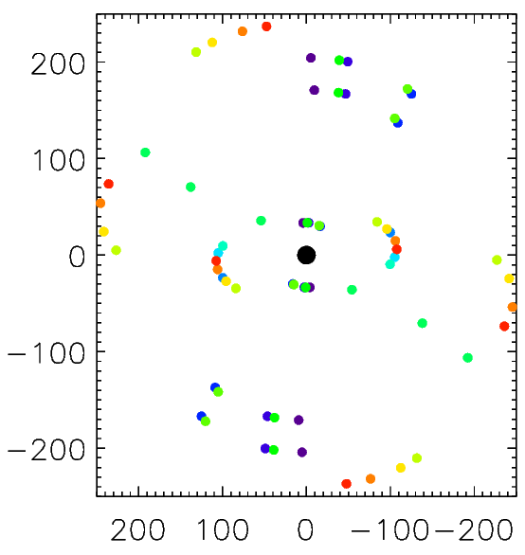
Beyond V72 & V66 on Be stars : V45 Pleiades
Pleione
Alcyone
Differential data on 4 Be stars to be included in Survey
Imaging Papers on Pleione & Alcyone ?

Slide 16
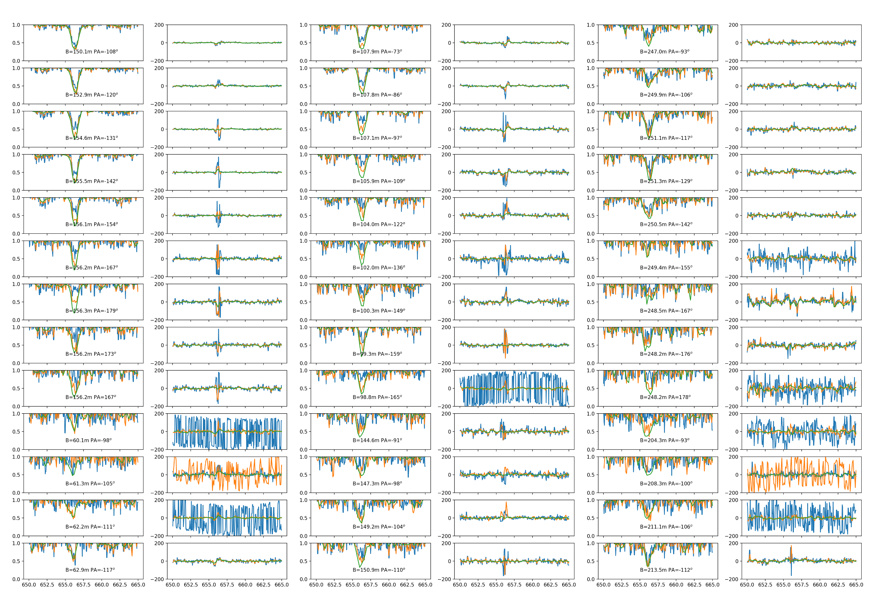
Beyond V72 & V66 on Be stars : Kappa Dra

Slide 17
Beyond V72 & V66 on Be stars : Kappa Dra
New reduction with python-based tools?
Need to go from 2T to 3T (then 4T for Gamma Cas)
Calibration step with removal of bad calibrators
AC2Fits step
Final dataset merge AC & IC or not?
Data analysis:
Image reconstruction : F. Millour
Geometric & kinematics modelling : A. Meilland
Radiative transfer xwith HDUST : R. Klement

Slide 18
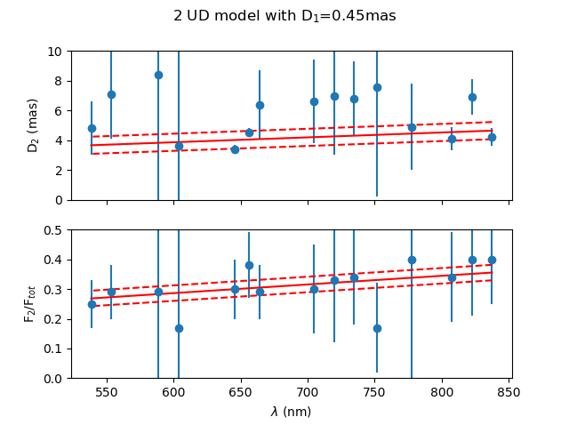
Beyond V72 & V66 on Be stars : Gamma Cas
New reduction with python-based tools?
Test at other wavelengths than Halpha

Slide 19
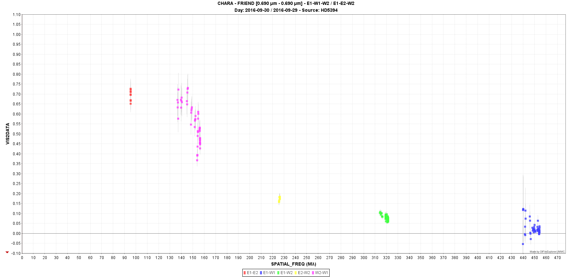
Beyond V72 & V66 on Be stars : Gamma Cas
Données FRIEND

Slide 20
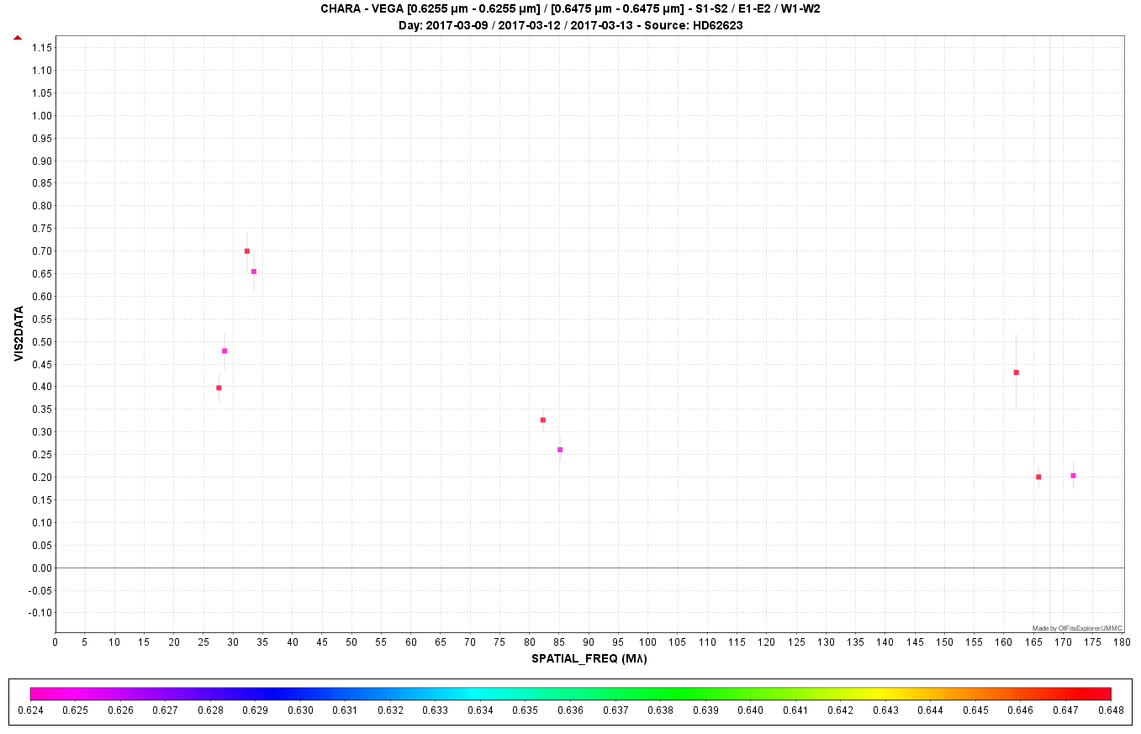
V68 : the B[e] star HD62623
Short letter or big paper including new MATISSE (+ old AMBER)
Differential data ⬄ size and kinematics in Halpha
Calibrated visibility ⬄ constraint on the stellar diameter

Slide 21
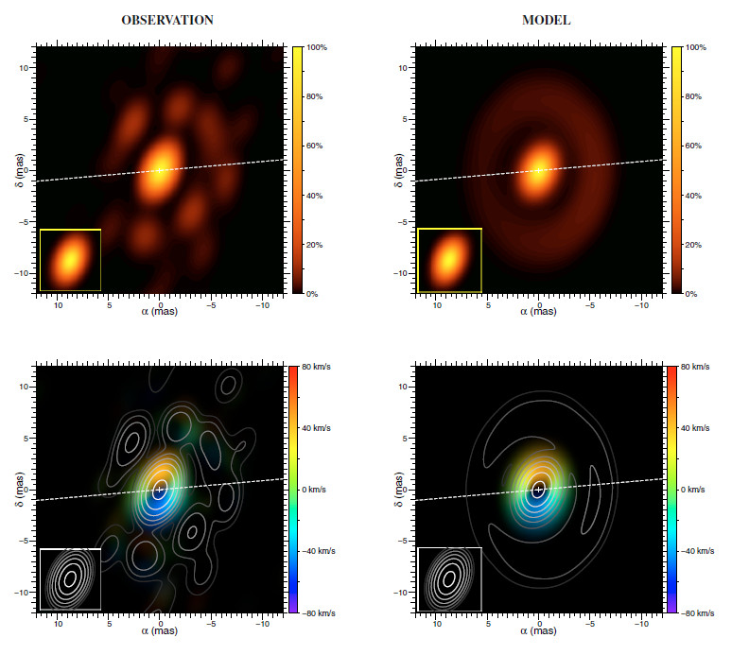
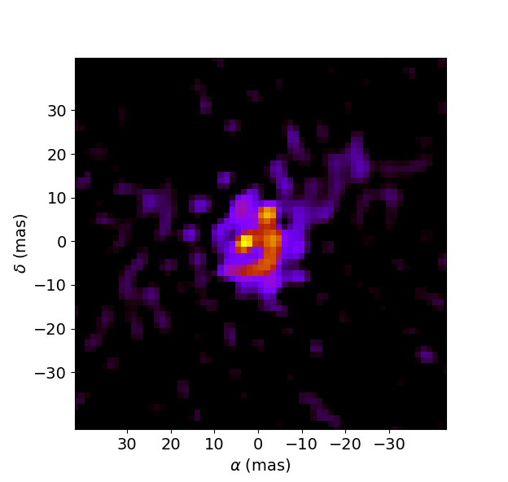
V68 : the B[e] star HD62623
Paper including new MATISSE data (+ image reconstruction)
13 mas
≈15 mas
IRBIS image 3.5µm
My first try Still work to do
(I’m not Karl-Heinz or Florentin)
Compatible with AMBER image (Millour 2011+)

Slide 22
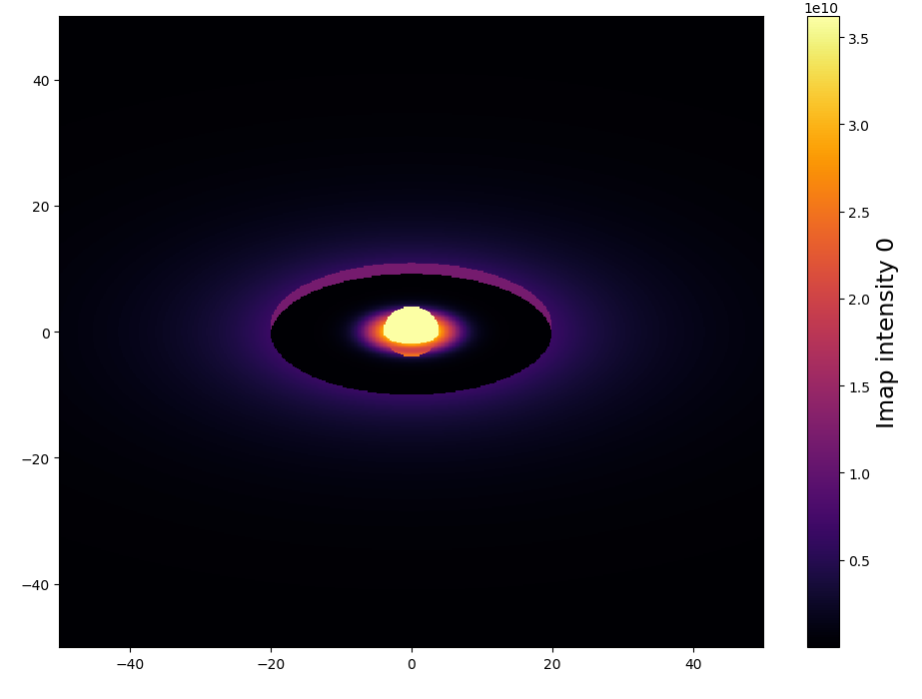
V68 : the B[e] star HD62623
Paper including new MATISSE data (+ image reconstruction)
Radiative transfer
Grid of HDUST models
(Gas + Dust)
DISCO+ : semi-physical Gas + Dust (Blackbody)

