Slide 1
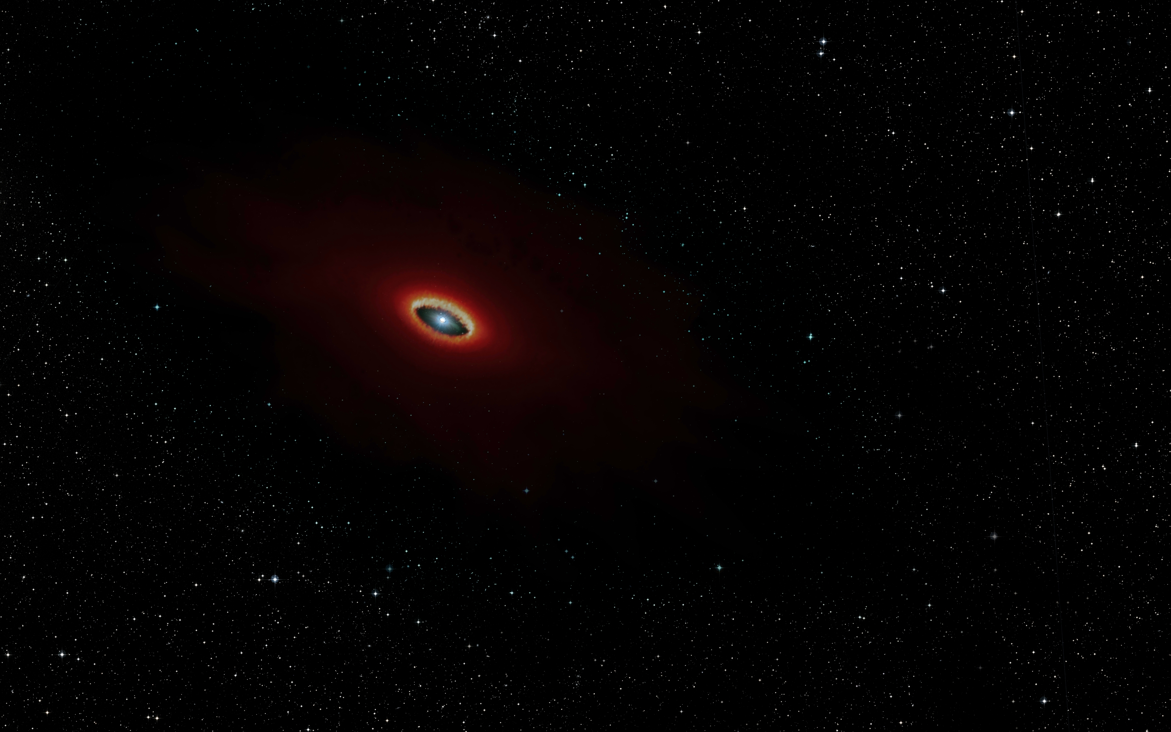
First B[e] stars survey with MATISSE
A small update on the programmes…
… an overview of the dataset …
… some questions on data reduction and data analysis for surveys…
…but no results
A. Meilland, A. Domiciano de Souza, F. Millour, G. Niccolini, Ph Stee, D. Demars…
and whoever’s motivated to join us!

Slide 2
What are B[e] stars?
Hot stars with 3 spectral features :
Emission lines (H, He, FeII…)
Forbidden lines : [FeII], [OI]
Strong IR excess

Slide 3
What are B[e] stars?
Hot stars with 3 spectral features :
Emission lines (H, He, FeII…)
Forbidden lines : [FeII], [OI]
Strong IR excess
Strongly anisotropic circumstellar environment
Dense and hot zone for Hydrogen emission lines
Highly diluted and strongly illuminated zone for forbidden lines
Dense and cool zone to produce dust (not that easy around hot stars)
Mechanism(s) of mass-loss?
Break of its spherical symmetry?
Dust formation?
Radiative wind
Rotation
Binarity

Slide 4
What are B[e] stars?
Hot stars with 3 spectral features :
Emission lines (H, He, FeII…)
Forbidden lines : [FeII], [OI]
Strong IR excess
Found for stars at various evolutionary status :
Herbig stars : HAeB[e]
Supergiants : sgB[e]
Compact planetary nebula : cPNB[e]
Symbiotic stars : symB[e]
Unclassified : unclB[e]
Better talking about
the B[e] phenomenon

Slide 5
Go beyond AMBER & MIDI results…
Name | Type of B[e] | Reference | Array/Instrument
HD62623 | Supergiant/binary? | Meilland+ 2010 | VLTI/MIDI
 |  | Millour+ 2011 | VLTI/AMBER
HD50138 | Herbig or Unclassified | Borges Fernandes+ 2011 | VLTI/MIDI & VLTI/AMBER
 |  | Ellerbroek+ 2015 | VLTI/AMBER & CHARA/VEGA
 |  | Kluska+ 2016 | VLTI/PIONIER
HD87643 | Herbig or Unclassified? | Millour+ 2009 | VLTI/MIDI & VLTI/AMBER
CPD -57° 2874 | Supergiant | Domiciano de Souza+ 2007 | VLTI/MIDI & VLTI/AMBER
 |  | Domiciano de Souza+ 2011 | VLTI/MIDI
HD85567 | Herbig or Unclassified? | Wheelwright+ 2013 | VLTI/AMBER
 |  | Vural+ 2014 | VLTI/AMBER
MWC300 | Herbig or Unclassified? | Wang+ 2012 | VLTI/AMBER
Hen 3-1191 |  | Lachaume+ 2007 | VLTI/MIDI
V921 Sco | Unclassified | Kreplin+ 2012 | VLTI/AMBER
HD45677 | Herbig or Unclassified | Monnier+ 2006 | IOTA/IONIC
GG Car | Supergiant | Domiciano de Souza+ 2015 | VLTI/MIDI
MWC361 | Herbig | Benisty+ 2013 | CHARA/VEGA
MWC 84 | Supergiant/binary | Thureau+ 2009 | IOTA/IONIC & PTI
HD327083 | Supergiant/binary | Wheelwright+ 2012 | VLTI/AMBER
CPD -52° 9243 | Supergiant | Cidale+ 2012 | VLTI/MIDI
Back in the last B[e] conference in Prague in 2017
14 Stars observed in total
8 Stars with VLTI/MIDI
10 Stars VLTI/AMBER
Constraints on :
the dusty disk geometry and physical properties
The gas geometry and kinematics
But
AMBER only sensitive to :
Dust inner rim
Hot gas
MIDI limitations mainly due to the 2 Tels mode:
Time-expensive to get good uv coverage
No closure phase
Review on B[e] interferometric observation (Meilland 2017)

Slide 6
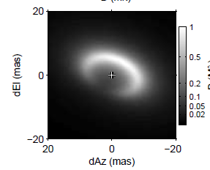
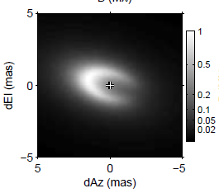
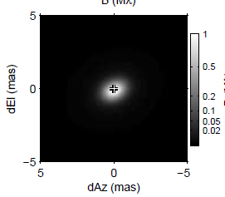
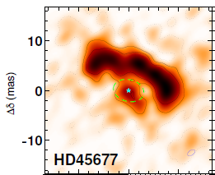
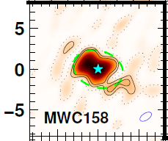
Go beyond AMBER & MIDI results…
Name | Type of B[e] | Reference | Array/Instrument
HD62623 | Supergiant/binary? | Meilland+ 2010 | VLTI/MIDI
 |  | Millour+ 2011 | VLTI/AMBER
HD50138 | Herbig or Unclassified | Borges Fernandes+ 2011 | VLTI/MIDI & VLTI/AMBER
 |  | Ellerbroek+ 2015 | VLTI/AMBER & CHARA/VEGA
 |  | Kluska+ 2016 | VLTI/PIONIER
HD87643 | Herbig or Unclassified? | Millour+ 2009 | VLTI/MIDI & VLTI/AMBER
CPD -57° 2874 | Supergiant | Domiciano de Souza+ 2007 | VLTI/MIDI & VLTI/AMBER
 |  | Domiciano de Souza+ 2011 | VLTI/MIDI
HD85567 | Herbig or Unclassified? | Wheelwright+ 2013 | VLTI/AMBER
 |  | Vural+ 2014 | VLTI/AMBER
MWC300 | Herbig or Unclassified? | Wang+ 2012 | VLTI/AMBER
Hen 3-1191 |  | Lachaume+ 2007 | VLTI/MIDI
V921 Sco | Unclassified | Kreplin+ 2012 | VLTI/AMBER
HD45677 | Herbig or Unclassified | Monnier+ 2006 | IOTA/IONIC
GG Car | Supergiant | Domiciano de Souza+ 2015 | VLTI/MIDI
MWC361 | Herbig | Benisty+ 2013 | CHARA/VEGA
MWC 84 | Supergiant/binary | Thureau+ 2009 | IOTA/IONIC & PTI
HD327083 | Supergiant/binary | Wheelwright+ 2012 | VLTI/AMBER
CPD -52° 9243 | Supergiant | Cidale+ 2012 | VLTI/MIDI
More recently a few papers with PIONIER
mainly on unclassified B[e] as part Herbig surveys
PIONIER survey on Herbig disk:
Lazareff+ 2017 : Geometric-models
FS CMa
HD50138
HD85567
Kluska+ 2020 : Image reconstruction
FS CMa
HD50138
Review on B[e] interferometric observation (Meilland 2017)
Only sensitive to hot dust (inner rim) and gas

Slide 7
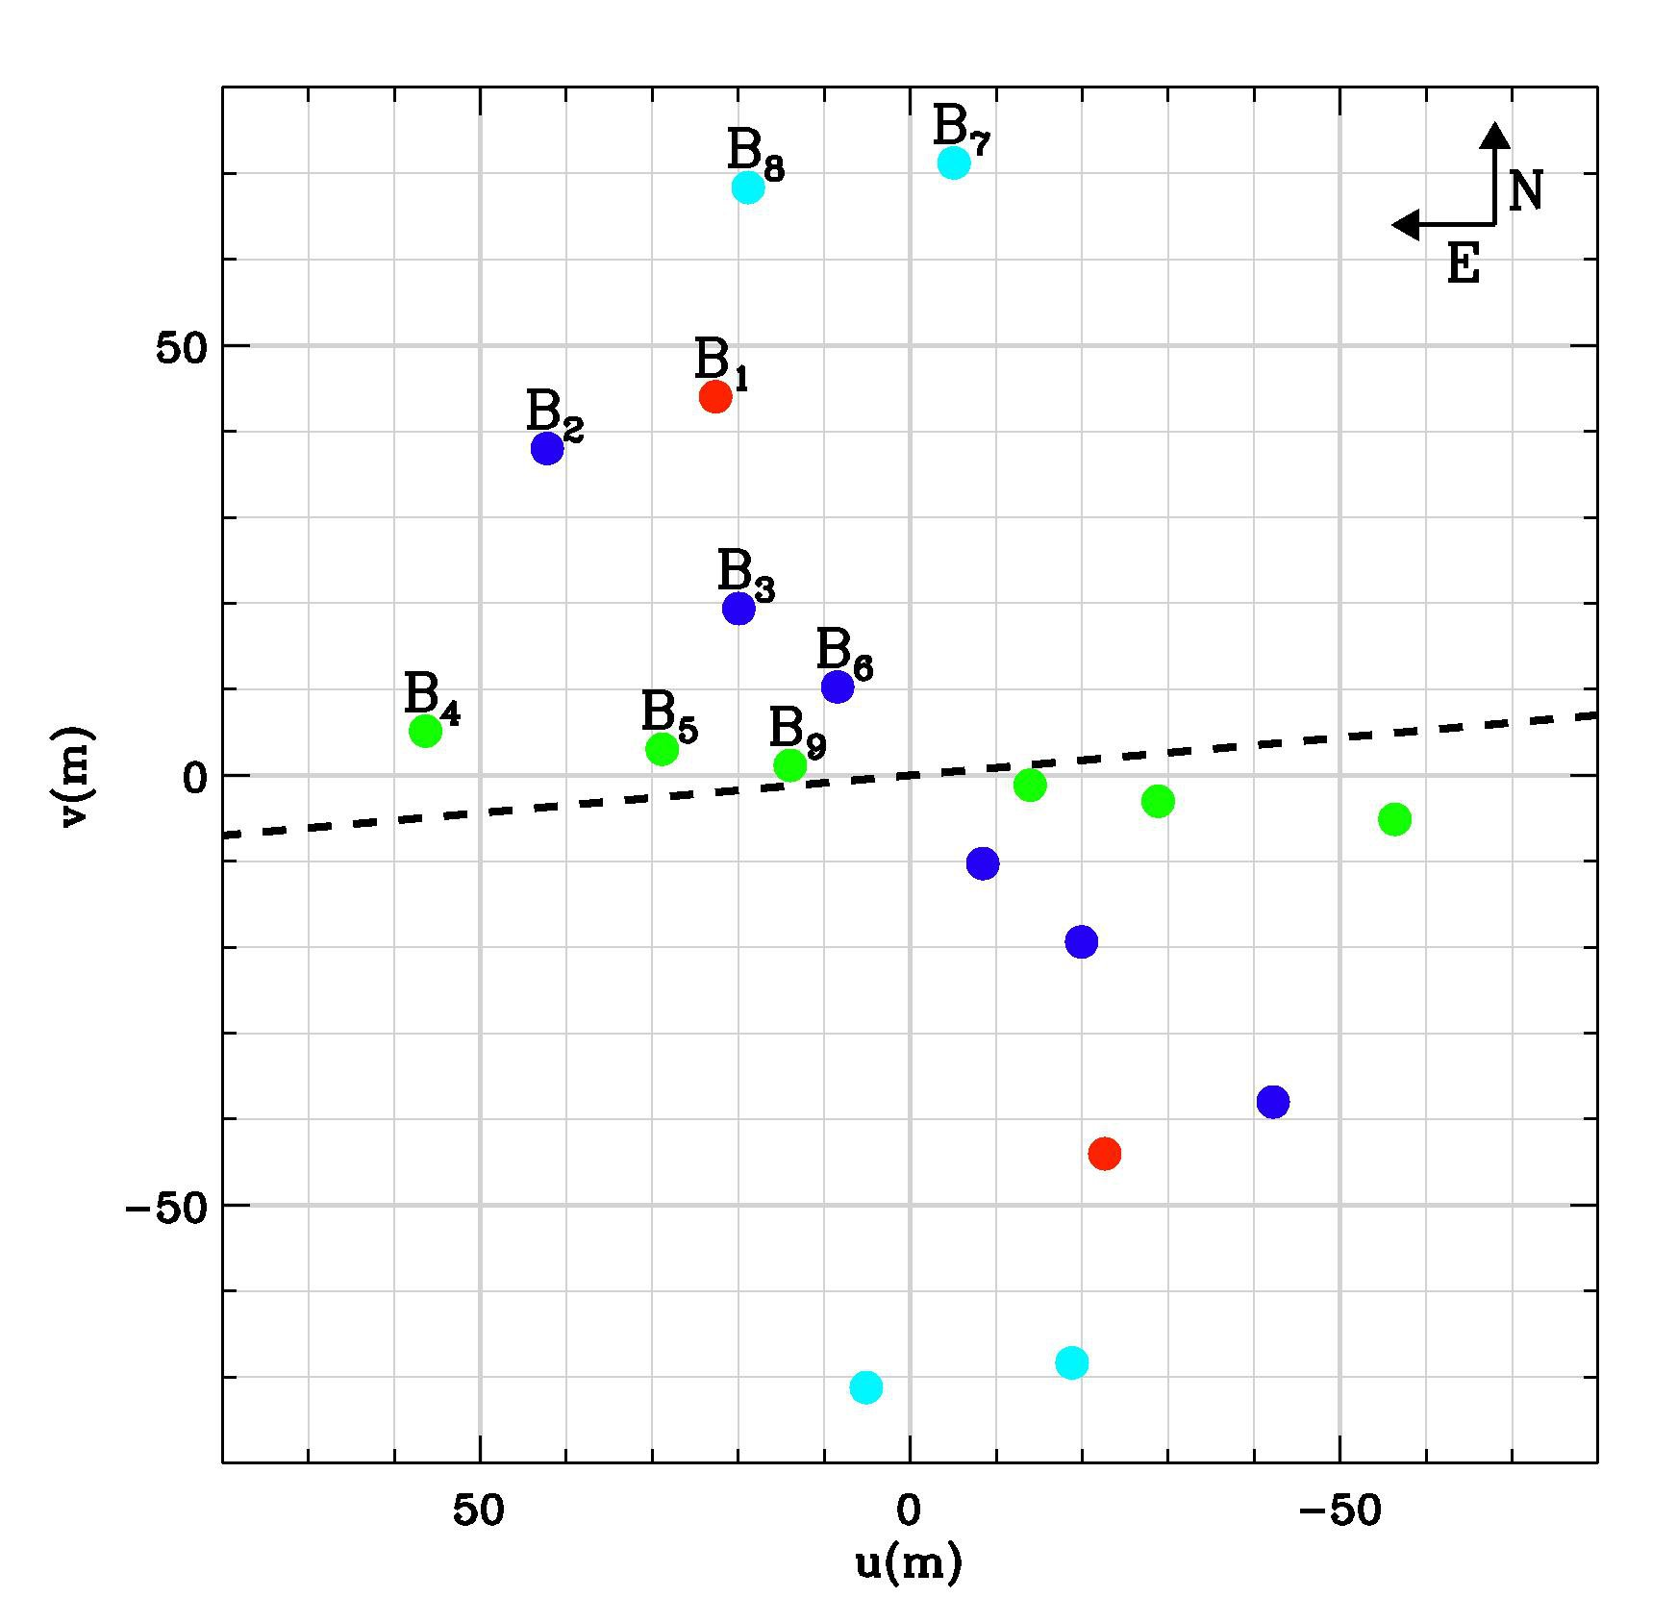
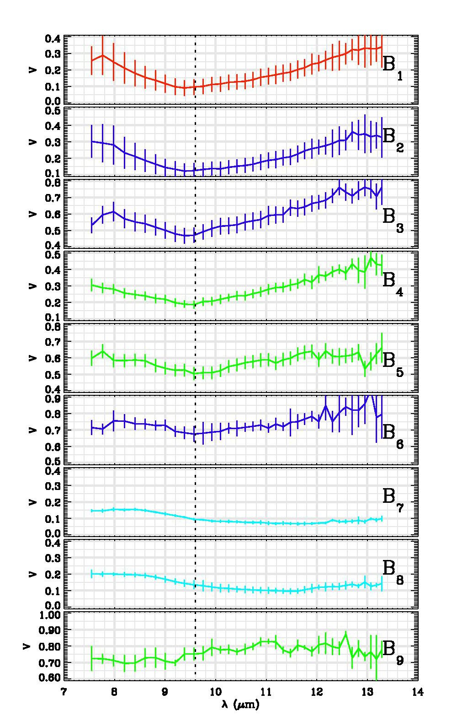
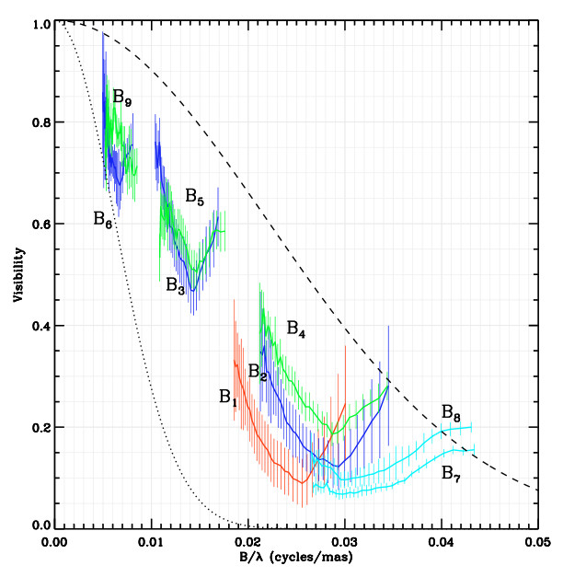
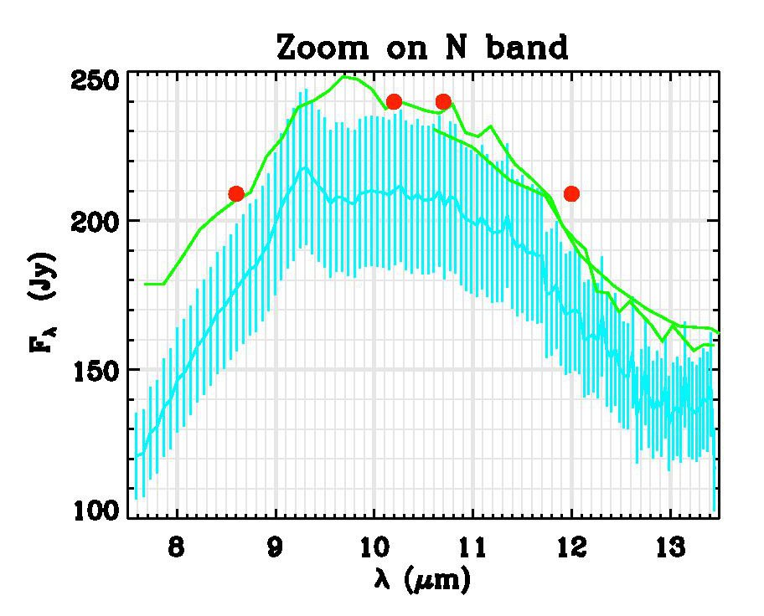
Go beyond MIDI results…
The A[e] supergiant l Pup seen by MIDI

Slide 8
Go beyond MIDI results…
The A[e] supergiant l Pup seen by MIDI
``Simple’’ wavelength-dependent geometric models
What can be determined:
Extension => 15 to 25 mas
Orientation => Ʇ to the Polarization
Flatenning => lower limit on i=> 40°
Λ-dependent
Elliptical Gaussian
But no Physics !

Slide 9
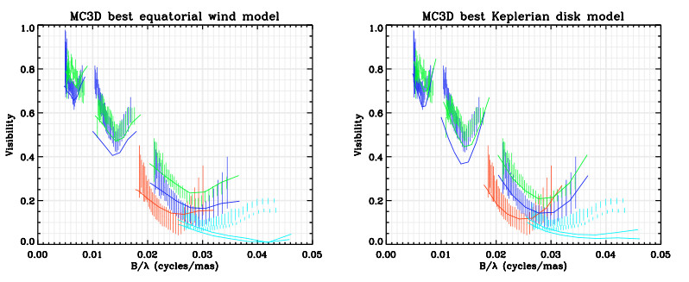
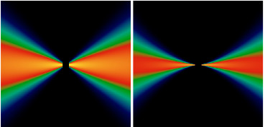
Go beyond MIDI results…
l Pup : Radiative transfer modeling of MIDI data with MC3D (Wolf 2003)
Keplerian disk
Equatorial wind
From Meilland+ 2010

Slide 10
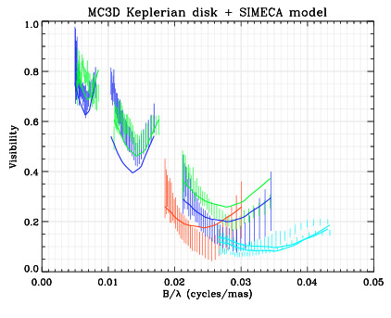
Go beyond MIDI results…
l Pup : Radiative transfer modeling of MIDI data with MC3D (dust) + SIMECA (gas)
Keplerian disk
We Added
4 10⁻⁷ Mo
Of gas
Equatorial wind
From Meilland+ 2010

Slide 11
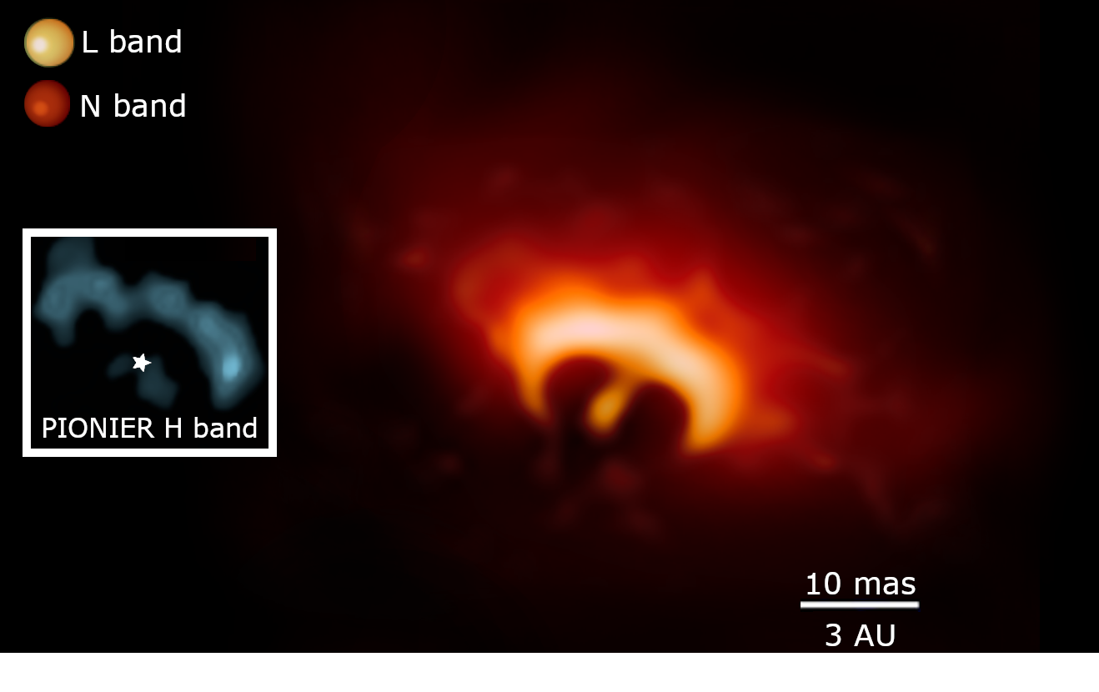
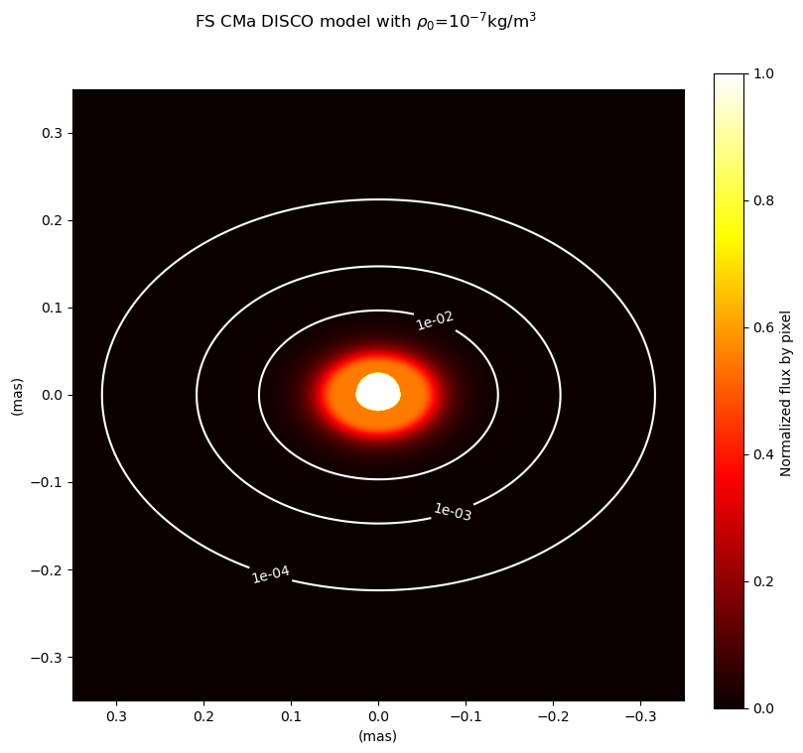
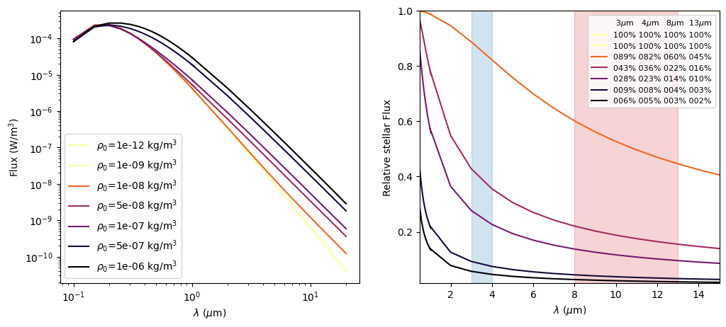
Of Gas and Dust around B[e]
N Band emission is not fully dominated by dust emission
FS CMa
This is not the star but
mainly hot gas emission
Images and SEDs of gaseous disk Computed with the DISCO code
Available on the AMHRA service
https://amhra.oca.eu/AMHRA/index.htm
Hofmann+ 2021

Slide 12
Of Gas and Dust around B[e]
N Band emission is not fully dominated by dust emission
FS CMa
This is not the star but
mainly hot gas emission
The flux ratio between the star and the disk grows with λ
Available on the AMHRA service
https://amhra.oca.eu/AMHRA/index.htm
Hofmann+ 2021

Slide 13
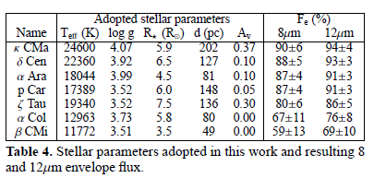
Of Gas and Dust around B[e]
N Band emission is not fully dominated by dust emission
FS CMa
Meilland+ 2009
This is not the star but
mainly hot gas emission
MATISSE can help constrain the Gas emission too
On Classical Be stars (no dust, only gas)
1.5 Fstar < Fgas < 5 Fstar

Slide 14
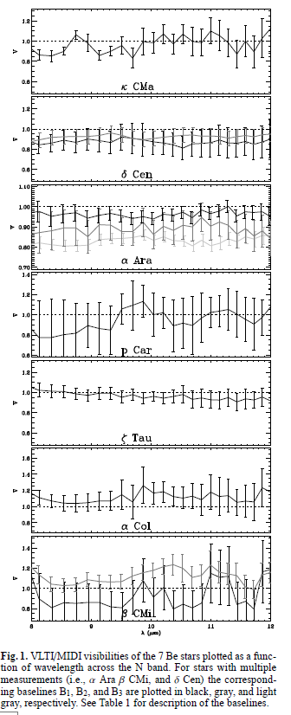
Of Gas and Dust around B[e]
N Band emission is not fully dominated by dust emission
FS CMa
This is not the star but
mainly hot gas emission
MATISSE can help constrain the Gas emission too
Even if they cannot be resolved in the mid-infrared
(FWHM is usually 2-5 Rstar)
Meilland+ 2009

Slide 15
Go beyond MIDI results…
l Pup : Radiative transfer modeling of MIDI data with MC3D (dust) + SIMECA (gas)
Keplerian disk
We Added
4 10⁻⁷ Mo
Of gas
Equatorial wind
From Meilland+ 2010

Slide 16
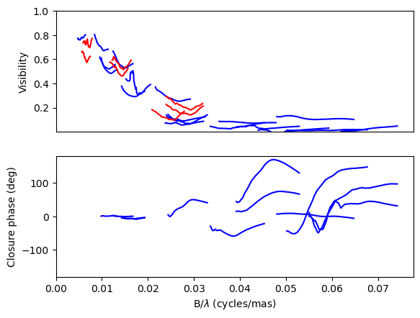
Go beyond MIDI results…
l Pup Observations : B[e] survey + commissioning pts
MATISSE N-band (3pts)
MIDI N-band (7pts)

Slide 17
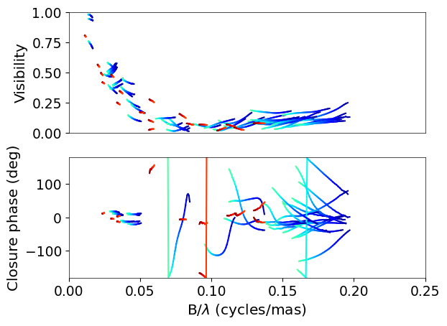
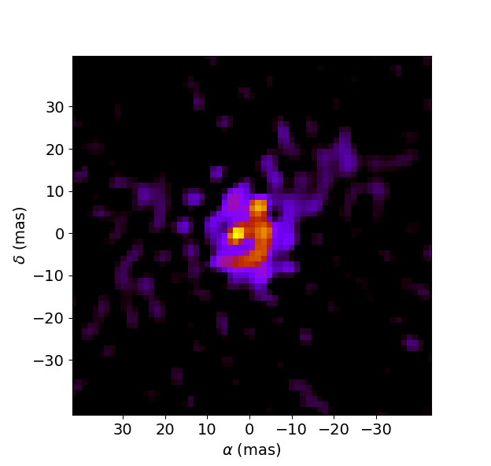
Go beyond MIDI results…
l Pup Observations : B[e] survey + commissioning pts
MATISSE L-band (9pts)
MATISSE N-band (3pts)
MATISSE M-band (9pts)
MIDI N-band (7pts)

Slide 18
Go beyond MIDI results…
l Pup Observations : Trying to reconstruct an image in L band
MATISSE L-band (9pts)
MATISSE M-band (9pts)
≈15 mas
IRBIS image 3.5µm
My first try
Still work to do
(I’m not Karl-Heinz or Florentin)

Slide 19
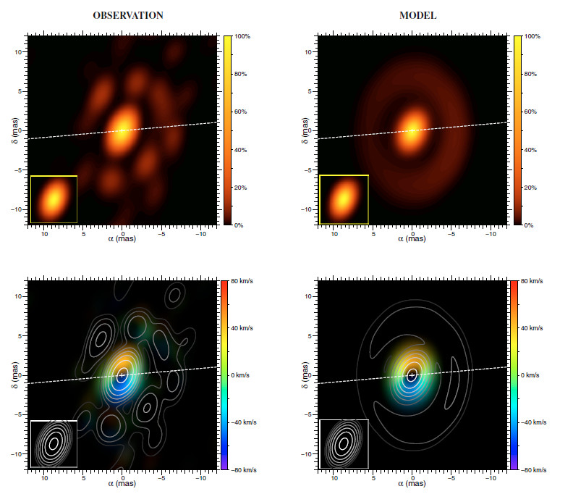
Go beyond MIDI results…
l Pup Observations : B[e] survey + commissioning pts
13 mas
≈15 mas
IRBIS image 3.5µm
My first try
Still work to do
(I’m not Karl-Heinz or Florentin)
Compatible with AMBER image
From Millour+ (2011)

Slide 20
B[e] Stars observed with MATISSE
Name | Vmag | Kmag | L (Jy) | N (Jy) | N° of pts
L Pup | 3.9 | 2.5 | 138 | 249 | 9
HD 87643 | 9.0 | 3.5 | 46 | 157 | 10
FS CMa | 9.2 | 3.7 | 20 | 143 | 42
MWC 300 | 11.6 | 6.2 | 17 | 100 | 2
Hen 3-1300 | 11.4 | 4.5 | 35 | 90 | 3
HD 50138 | 6.6 | 4.1 | 24 | 69 | 3
Hen 3-847 | 10.6 | 7.8 | 2.4 | 36 | 2
CPD -57 2874 | 10.2 | 4.3 | 26 | 25 | 4
Hen 3-1191 | 13.7 | 6.3 | 2.3 | 23 | 2
HD 327083 | 9.8 | 3.2 | 20 | 21 | 2
CPD -52 9243 | 10.3 | 4.4 | 15 | 21 | 4
GG Car | 8.8 | 5.0 | 9.5 | 10 | 3
MWC 137 | 12.0 | 6.6 | 2.6 | 10 | 2
HD 316285 | 9.2 | 3.7 | 20 | 9 | 0
MWC 623 | 10.9 | 5.4 | 8 | 9 | 0
HD 85567 | 8.6 | 5.8 | 4.2 | 6.5 | 1
Hen3-938 | 13.5 | 6.1 | 2.9 | 7.2 | 1
Hen3-298 | 11.4 | 5.7 | 6.2 | 13.1 | 1
18 B[e] can be observed
with MATISSE and the ATs
(L > 2Jy)
16 Observed up to now
10 in February 2020
2 more in March 2021!
The last 2 should have
been in August 2020 and are
Rescheduled for 2021

Slide 21
B[e] Stars observed with MATISSE
Name | Vmag | Kmag | L (Jy) | N (Jy) | N° of pts
L Pup | 3.9 | 2.5 | 138 | 249 | 9
HD 87643 | 9.0 | 3.5 | 46 | 157 | 10
FS CMa | 9.2 | 3.7 | 20 | 143 | 42
MWC 300 | 11.6 | 6.2 | 17 | 100 | 2
Hen 3-1300 | 11.4 | 4.5 | 35 | 90 | 3
HD 50138 | 6.6 | 4.1 | 24 | 69 | 3
Hen 3-847 | 10.6 | 7.8 | 2.4 | 36 | 2
CPD -57 2874 | 10.2 | 4.3 | 26 | 25 | 4
Hen 3-1191 | 13.7 | 6.3 | 2.3 | 23 | 2
HD 327083 | 9.8 | 3.2 | 20 | 21 | 2
CPD -52 9243 | 10.3 | 4.4 | 15 | 21 | 4
GG Car | 8.8 | 5.0 | 9.5 | 10 | 3
MWC 137 | 12.0 | 6.6 | 2.6 | 10 | 2
HD 316285 | 9.2 | 3.7 | 20 | 9 | 0
MWC 623 | 10.9 | 5.4 | 8 | 9 | 0
HD 85567 | 8.6 | 5.8 | 4.2 | 6.5 | 1
Hen3-938 | 13.5 | 6.1 | 2.9 | 7.2 | 1
Hen3-298 | 11.4 | 5.7 | 6.2 | 13.1 | 1
Observation during different programmes:
9 during the GTO B[e] survey
1 during the Imaging commissioning
1 during survey + img. Comm.
Florentin GTO imaging of HD87643
3 in Open time proposals
1 for SV
2 to come

Slide 22
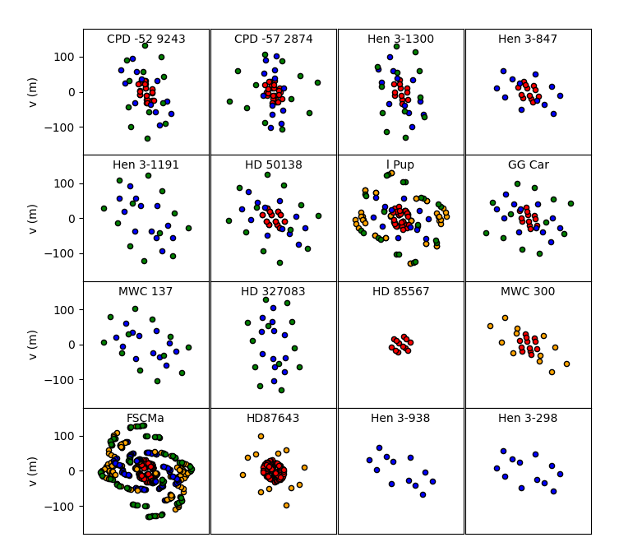
B[e] Stars observed with MATISSE
UV plan coverage
For the 16 observed targets
Karl-Heinz Image
Anthony’s
Florentin’s binary

Slide 23
Data Reduction in survey mode
25 nights of observations
240 Observing blocks to reduce!
480 Esorex mat_raw_estimate to launch!!
But only 25 mat_autoPipeline.py calls
Last reduction in May with the last version of the pipeline
Running time goes from 2-3 days in 2020 to less than 1 day now.
Optimization done by Philippe & ESO
Ideas for database of data reductions that could
be repeated each time the pipeline is updated
But mat_autoPipeline.py is not is end of data reduction
What about :
Interferometric calibration (mat_autoCalib.py)
Flux calibration ( Joszef scripts or my attempt of a mat_autoCalibFlux.py)

Slide 24
Data Reduction in survey mode
Interferometric calibration : mat_autoCalib is not (yet) fully automatic
Mat_autoCalib <directory> --timespan 0.04
Compute the TF from the mean of all calibrators within 0.04 day (= 1 hour) of the science
Don’t do anything if there is a calibrator a bit further
Don’t interpolate between calibrators
Don’t detect and remove bad calibrators
Mat_autoCalib <directory> <directory> --interpType xxxxxx
interpType can be :
MEAN (default and same as before)
NEAREST (take only the near calibrator before or after)
LINEAR ( linear interpolation)
=> small bug so for now it only make a mean of the two nearest calibrators

Slide 25
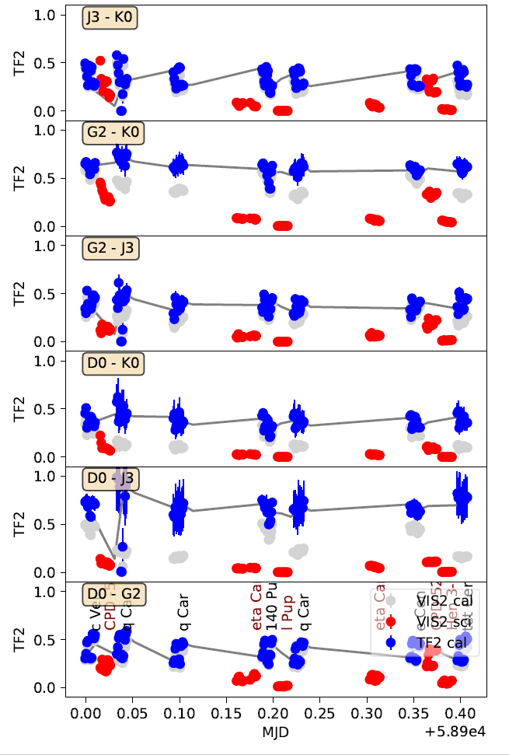
Data Reduction in survey mode
Interferometric calibration : mat_autoCalib is not (yet) fully automatic
Removing bad calibrators:
V² very different between exposures
Very noisy
Big TF variation compared to other cals
For now completely manual:
Plot TF
Decide who is good and who’s not
Create “bad” directory
Move bad obs. There
Plot TF again to check
Launch mat_autoCalib.py
Should be implemented
in mat_autoCalib

Slide 26
Data Reduction in survey mode
Flux calibration : mat_autoCalibFlux prototype
Script available in my contrib directory (contrib/ame)
Main functions are in the libFluxCalib.py file in the main directory mat_tools
mat_autoCalibFlux.py <dirUncalibrated> <dirCalibrated> --verbose –sepTels TRUE
Compute a Transfer Function in Flux (TFF) on all calibrators in the dirUncalibrated directory (Jy/ADU)
Use diameter for JSDC and GAIA temperature (both from Cruzalebes MDFC catalog)
Fit a black body on VIZIER and SIMBAD fluxes (other models can easily be added )
Compute Fcal_th at MATISSE wavelength from the fitted black body
Finally TFF = Fcal / Fcal_th
Add a TFF table to the .fits file (and other tables from the fitting process)
For all science objects in dirCalibrated, find the closest calibrators before and/or after
Interpolate the TFF between them
Divide the science flux by the TFF and create new files in a _FLUXCALIBRATED directory

Slide 27
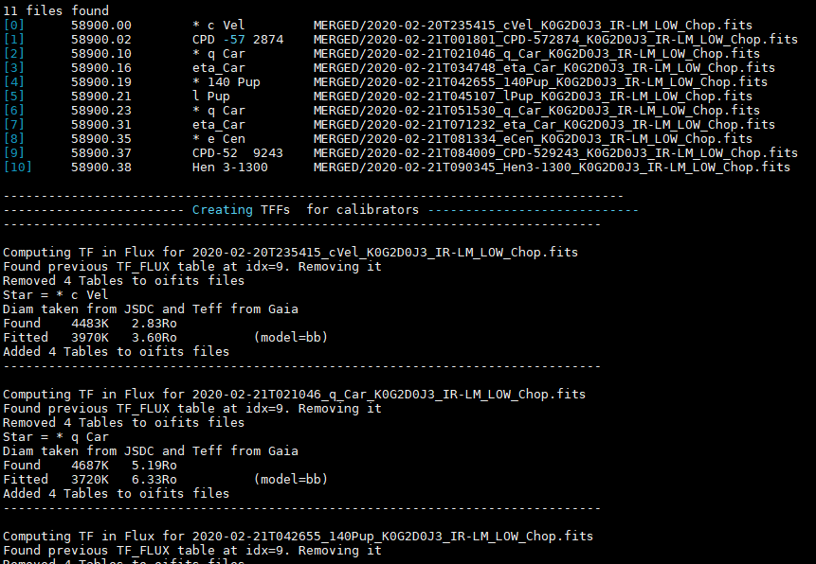
Data Reduction in survey mode
Flux calibration : mat_autoCalibFlux prototype
Listing files
Creating TFF for calibrators

Slide 28
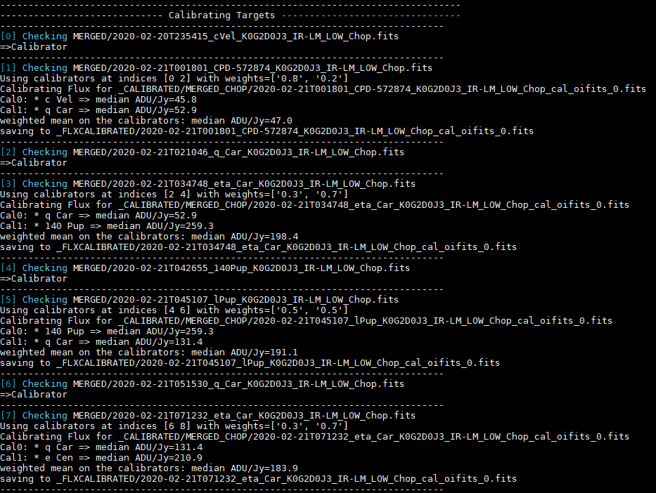
Data Reduction in survey mode
Flux calibration : mat_autoCalibFlux prototype
Interpolating TFFs and applying them
To calibrate science objects

Slide 29
Data Reduction in survey mode
Flux calibration : mat_autoCalibFlux prototype
Current limitations :
Separating data on BCD and chopping but not:
Bands (LM & N)
Spectral modes (LOW, MED, HIGH, VHIGH)
Central wavelength for L band
Never tested on MED & HIGH data
Don’t remove bad flux-calibrators
but how to detect them?
Fitting flux of cal. : is it the good method?
Black-body model : a bit too simple

Slide 30
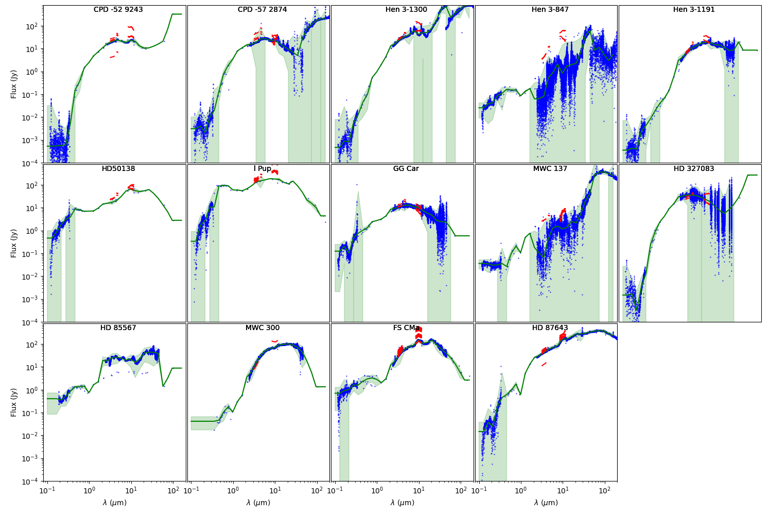
Reduced data on B[e] stars
Flux calibration : mat_autoCalibFlux prototype

Slide 31
Reduced data on B[e] stars
Flux calibration : mat_autoCalibFlux prototype

Slide 32
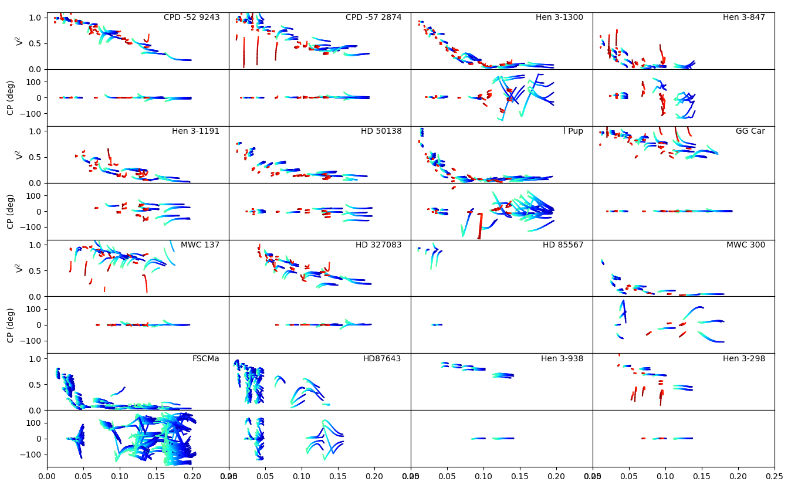
Reduced data on B[e] stars
Many interesting features:
V² Plateaux (gaz/dust ratio)
Some are fully resolved
2nd lobes(ring or sharp edge)
Different λ-dependence
Asymetries (non-zero CP)
Flattening
LM bands (binning = 15pixels)

Slide 33
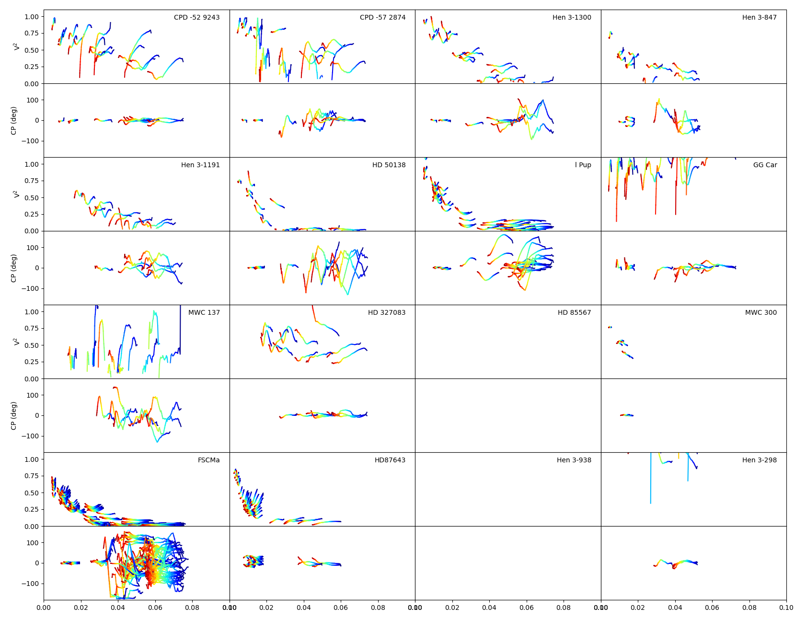
Reduced data on B[e] stars
N band (binning = 21pixels)

Slide 34
Reduced data on B[e] stars
In red N-band Flux below 25Jy
Need to reduce with corrFlux option
=>But Flux calibration problem
N band (binning = 21pixels)

Slide 35
B[e] Stars modeling
Modelling the whole dataset : How?
Using tools of increasing complexity:

Slide 36
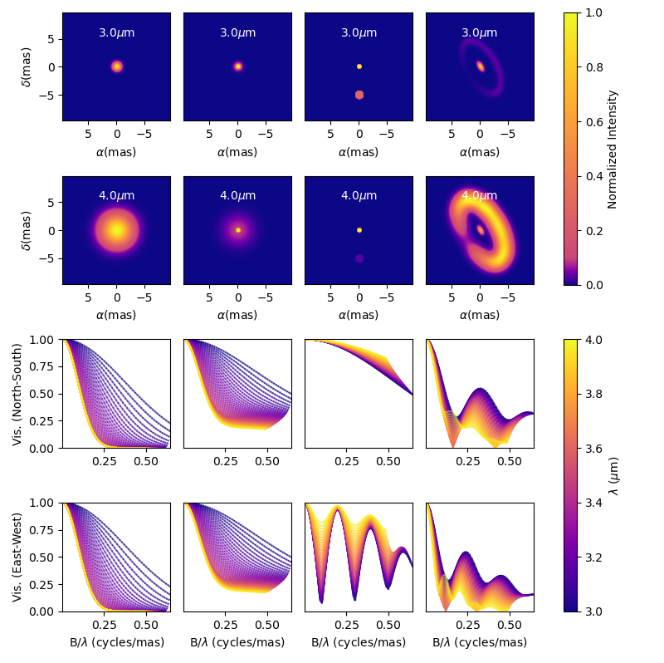
B[e] Stars modeling
Modelling the whole dataset : How?
Using tools of increasing complexity:
Geometrical models : oimodel.py
Prototype for a general, modular, panchromatic, and hopefully fast model-fitting tool in python
Models defined in Fourier plan:
Compute a model in 1ms
Data model comparison in 5-10ms
Perform a fit in few minutes
For B[e] star : Test 5-10 model-types for all objects:
from Achromatic Gaussian Disk
to convolve skewed ring

Slide 37
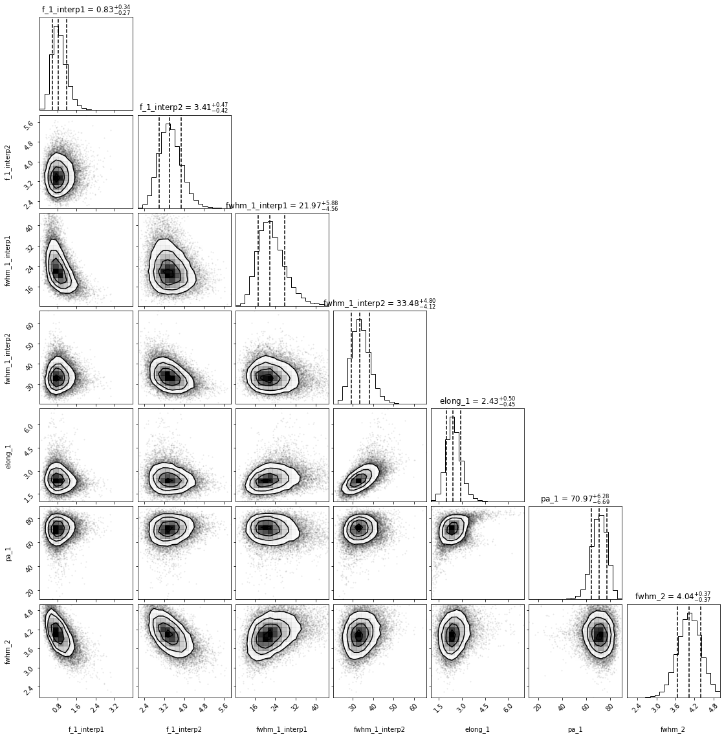
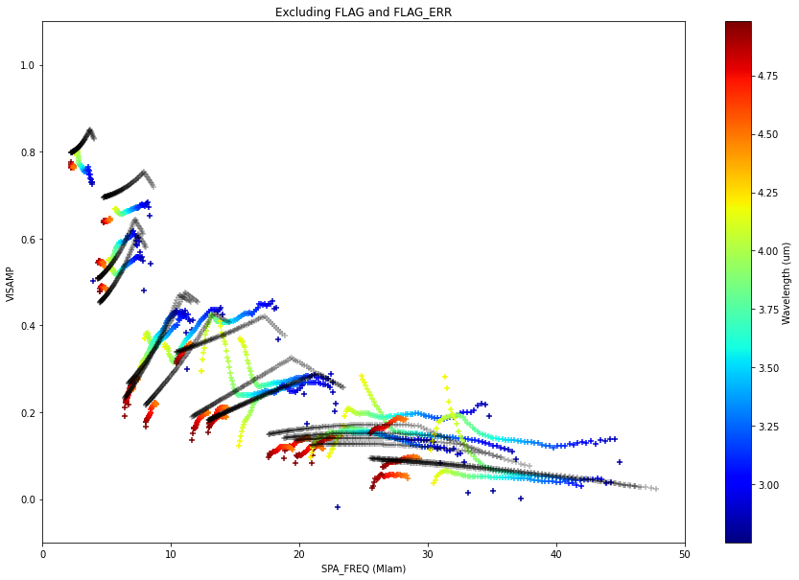
B[e] Stars modeling
Modelling the whole dataset : How?
Using tools of increasing complexity:
Geometrical models : oimodel
MASTER Student working on that : Dorian Demars

Slide 38
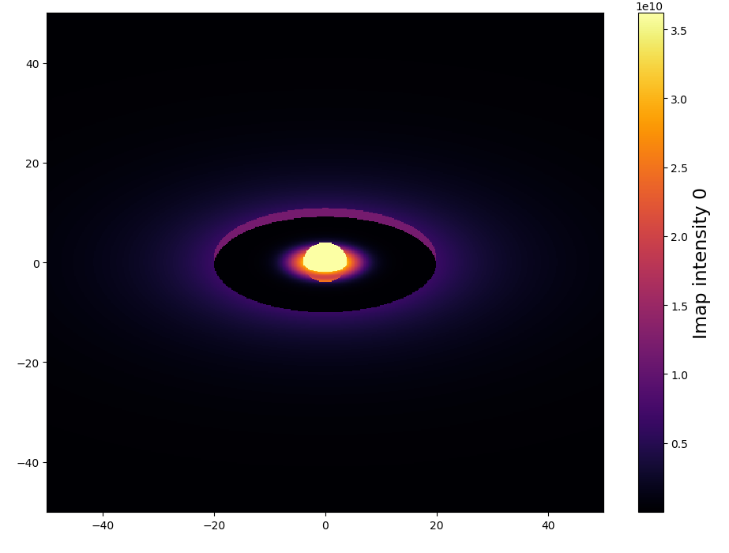
B[e] Stars modeling
Modelling the whole dataset : How?
Using tools of increasing complexity:
Geometrical models : oimodel.py
Semi-physical models : DISCO+
Black Body star
Viera+ 2015 gas disk
BB skewed inner rim
Temperature BB gradient disk
Or simplified RT
(dust opacity + surface density)
A few seconds for a models (depends on the number of λ
Work of Armando Domiciano de Souza & Gilles Niccolini

Slide 39
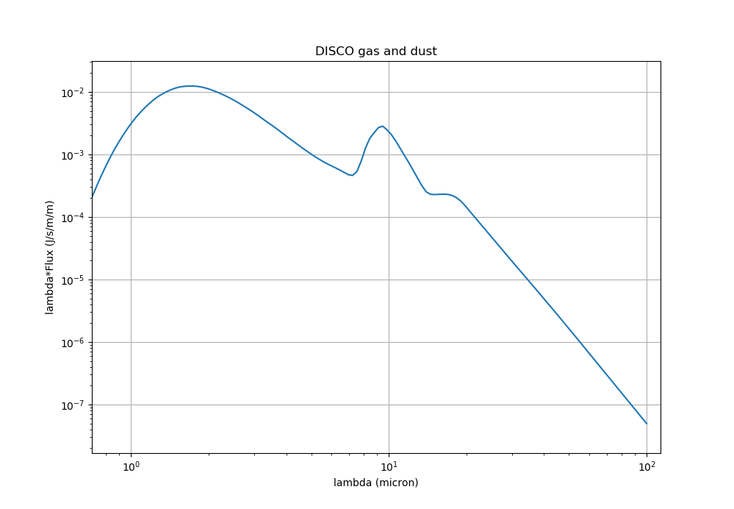
B[e] Stars modeling
Modelling the whole dataset : How?
Using tools of increasing complexity:
Geometrical models : oimodel.py
Semi-physical models : DISCO+
Black Body star
Viera+ 2015 gas disk
BB skewed inner rim
Temperature gradient disk
Or simplified RT
(dust opacity + surface density)
A few seconds for a models (depends on the number of λ
Work of Armando Domiciano de Souza & Gilles Niccolini

Slide 40
B[e] Stars modeling
Modelling the whole dataset : How?
Using tools of increasing complexity:
Geometrical models : oimodel.py
Semi-physical models : DISCO+
Radiative transfer : HDUST, RADMC3D
HDUST grid of models from the AMHRA website
https://amhra.oca.eu/AMHRA/sgbe-hdust/input.htm

Slide 41
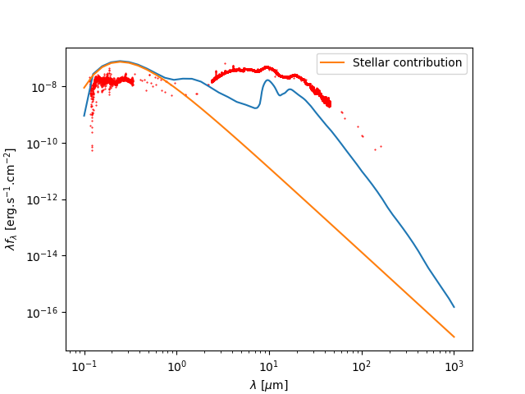
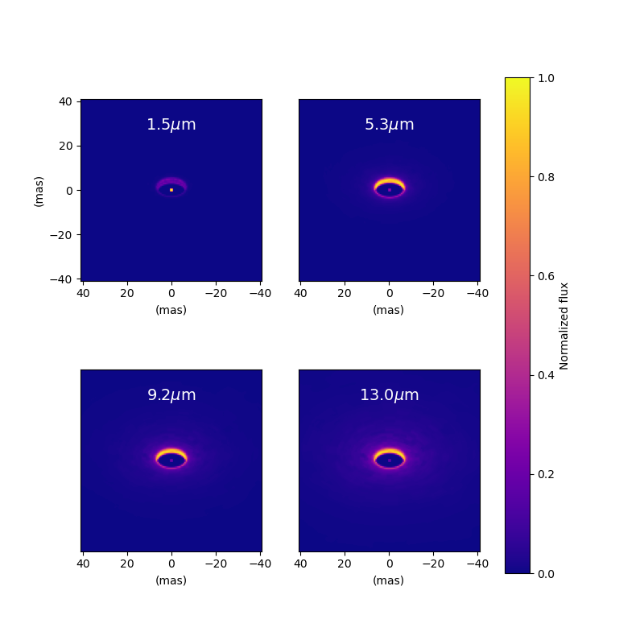
B[e] Stars modeling
Modelling the whole dataset : How?
Using tools of increasing complexity:
Geometrical models : oimodel.py
Semi-physical models : DISCO+
Radiative transfer : HDUST, RADMC3D
HDUST grid of models from the AMHRA website
https://amhra.oca.eu/AMHRA/sgbe-hdust/input.htm
Starting to learn how to use RADMC3D (with Alexis help)
But not gas in RADMC3D
Replacing RADMC3D star by DISCO (gas+star)

Slide 42
B[e] Stars modeling
Modelling the whole dataset : How?
Using tools of increasing complexity:
Geometrical models : oimodel.py
Semi-physical models : DISCO+
Radiative transfer : HDUST, RADMC3D
Image reconstruction : IRBIS + MIRA
(+ SPARCCO)
IRBIS image 3.5µm
My first try
(I’m not Karl-Heinz or Florentin)
Florentin’s jobs in the team

Slide 43
B[e] Stars observed with MATISSE
That’s a lot of work…
Hopefully, paper at the end of the year
Results presented at next year Massive-stars meeting in Dublin
…but that’s not the end of it!
Complementary obs. with GRAVITY & PIONIER
Observation in visible with SPICA (hopefully starting next year)
New GRA4MAT observations in HIGH mode in Brα

Slide 44
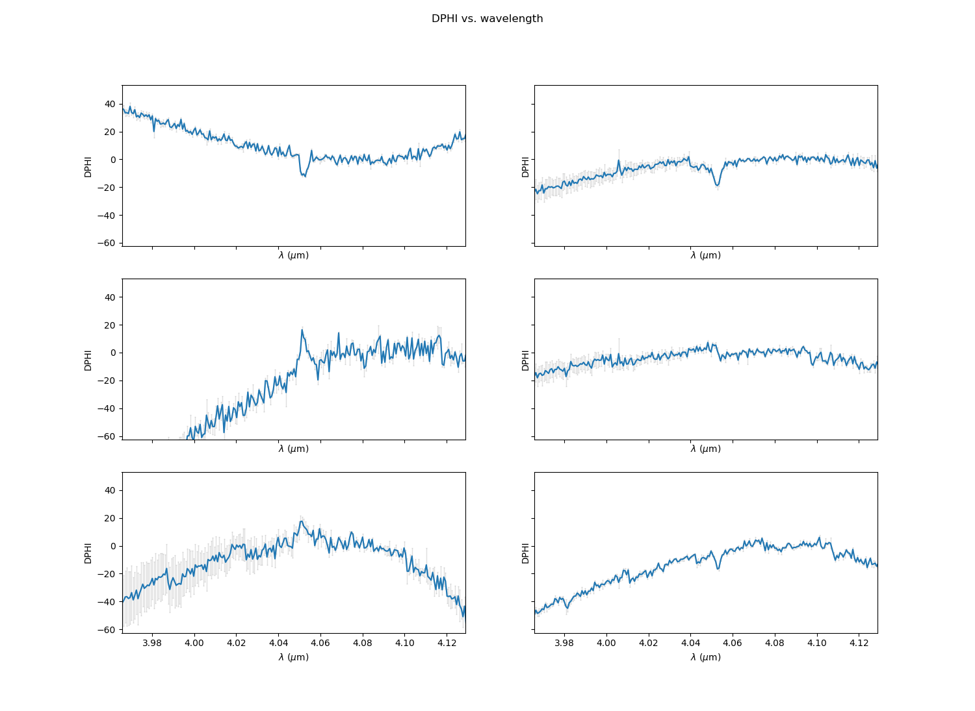
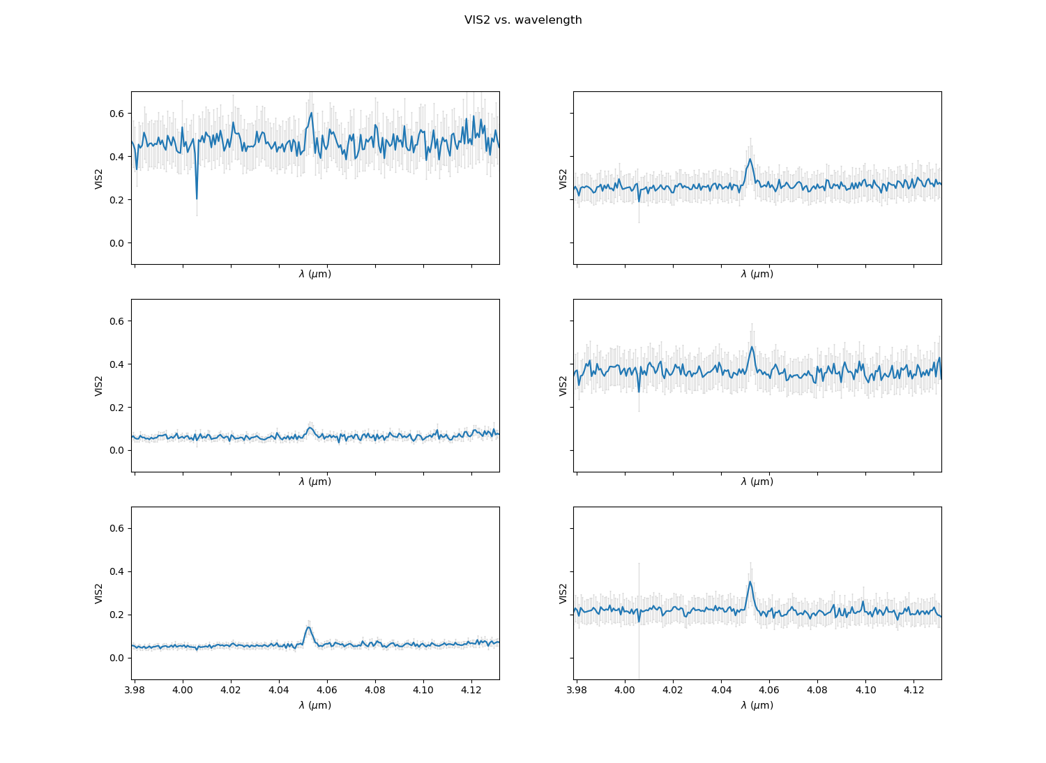
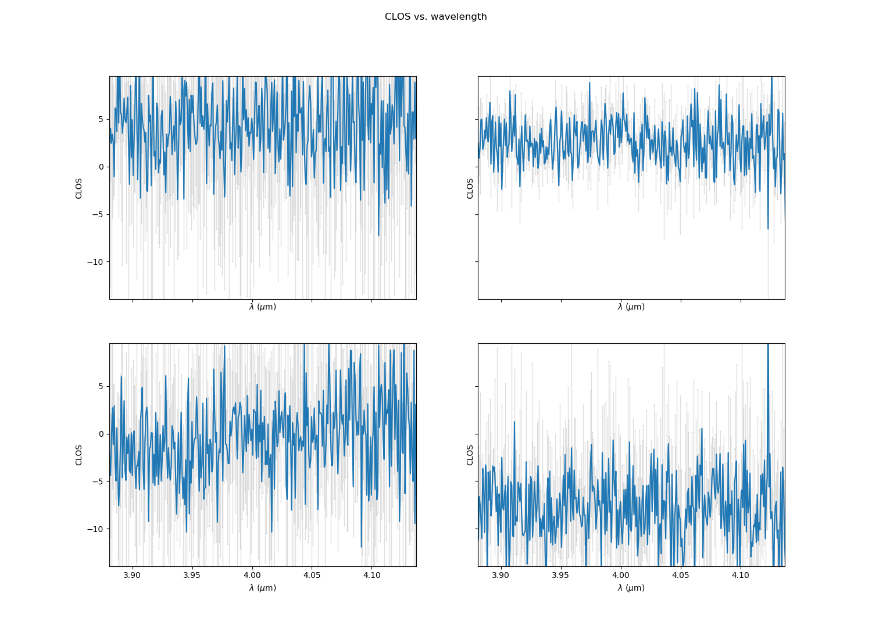
B[e] observed in Brα
Disantangling gas and dust around B[e] stars
Differential phase
Visibility
Closure phase

