Slide 1
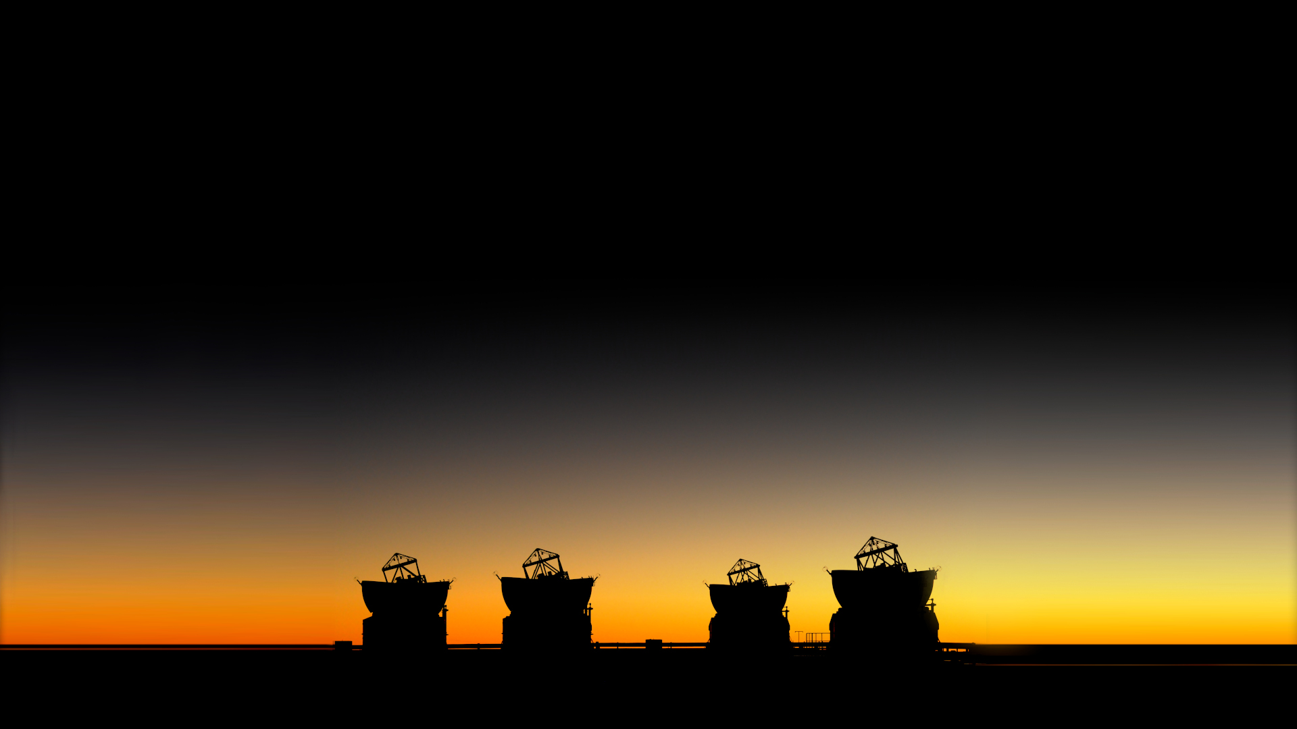




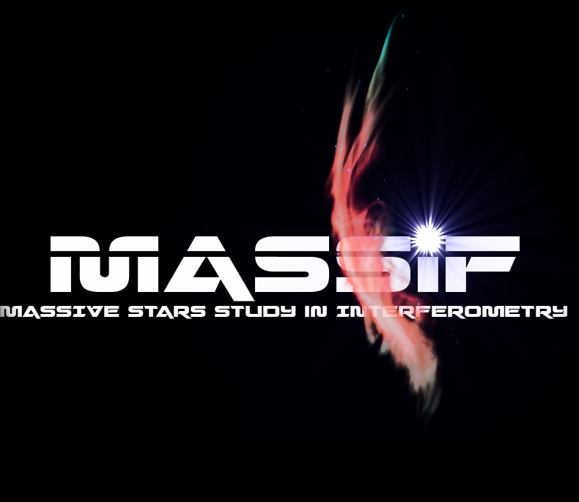
Project Presentation
Kick-off Meeting
December, 29-30, 2022, Toulouse

Slide 2
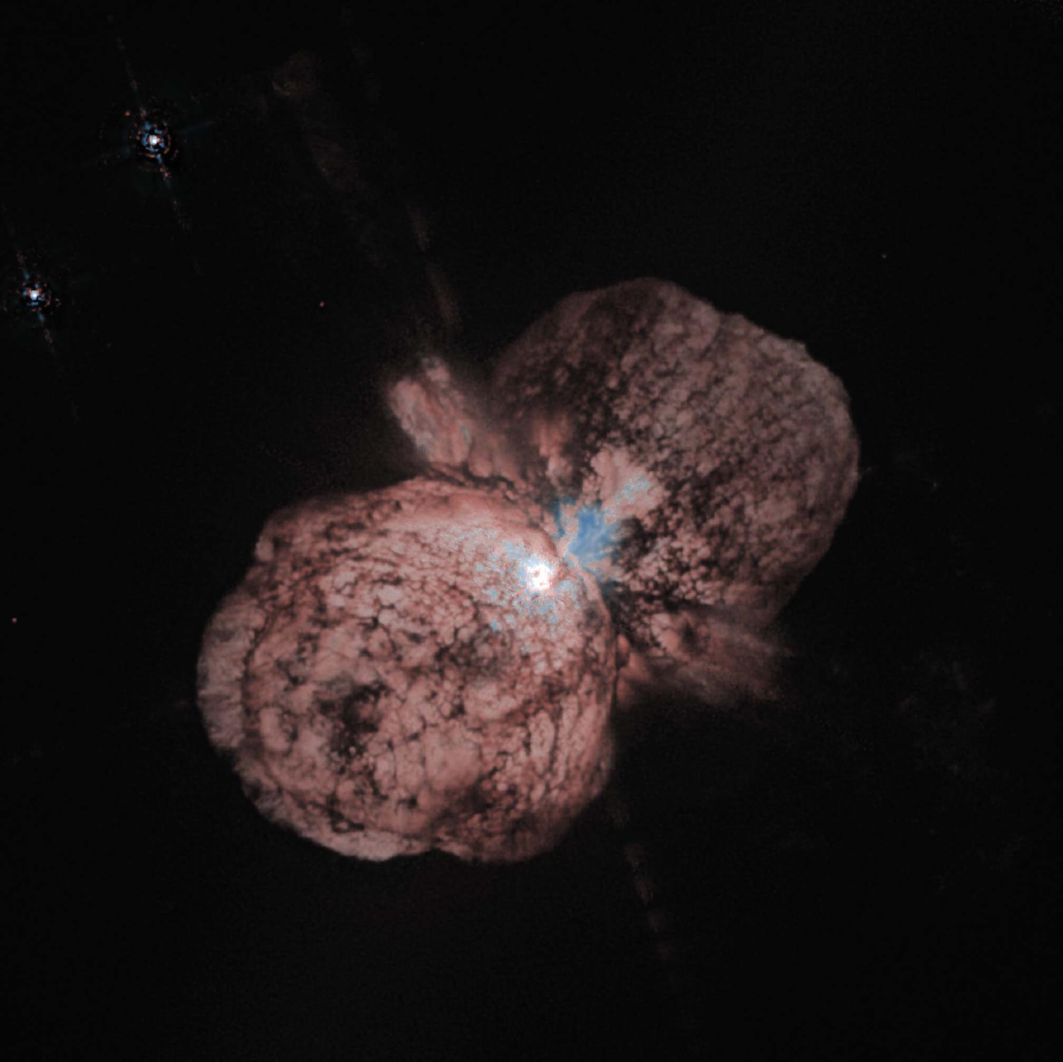
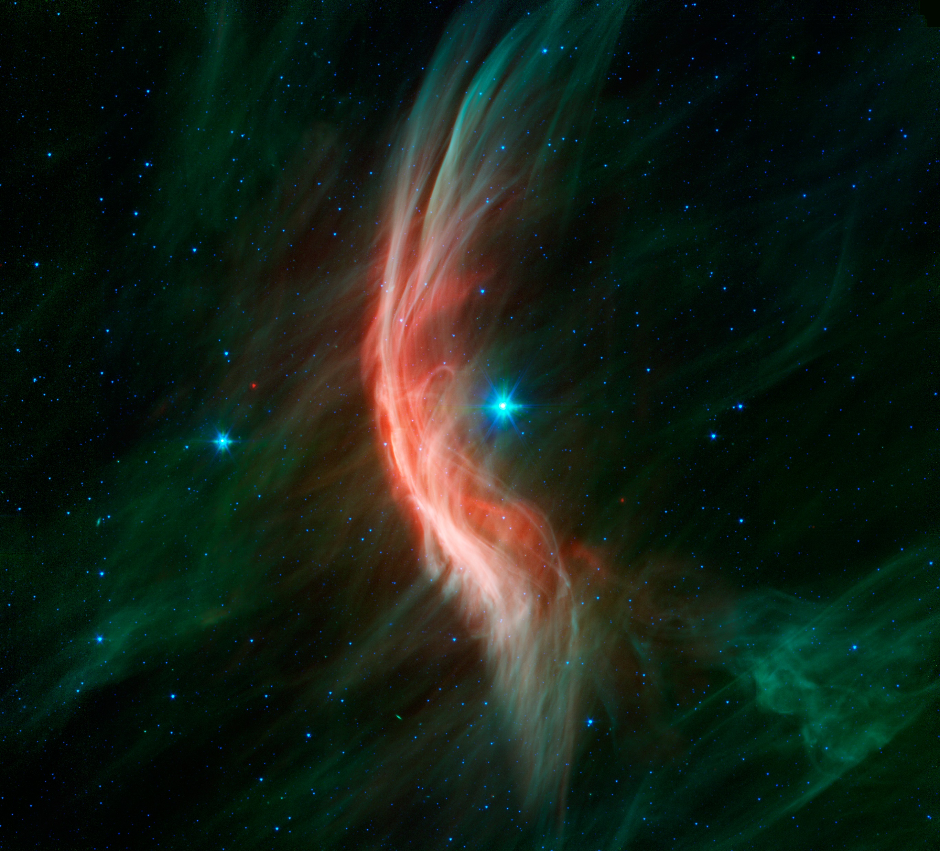
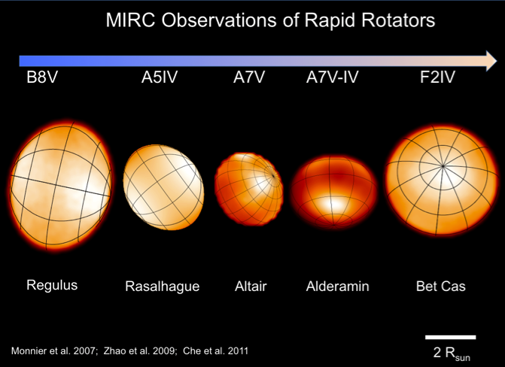
Kick-off Meeting : December, 29-30, 2022, Toulouse
Context
Massive stars are complex objects affected by
Strong mass-loss through radiative winds
Fast-rotation
High binary rate
often surrounded by dense environments
Ionized gas
Dust
They affect the galaxy:
Kinetic and radiative energy
Chemical evolution (dust and metals)
Understanding them is important for
Stellar physic
Galactic evolution
Cosmology (early universe)

Slide 3
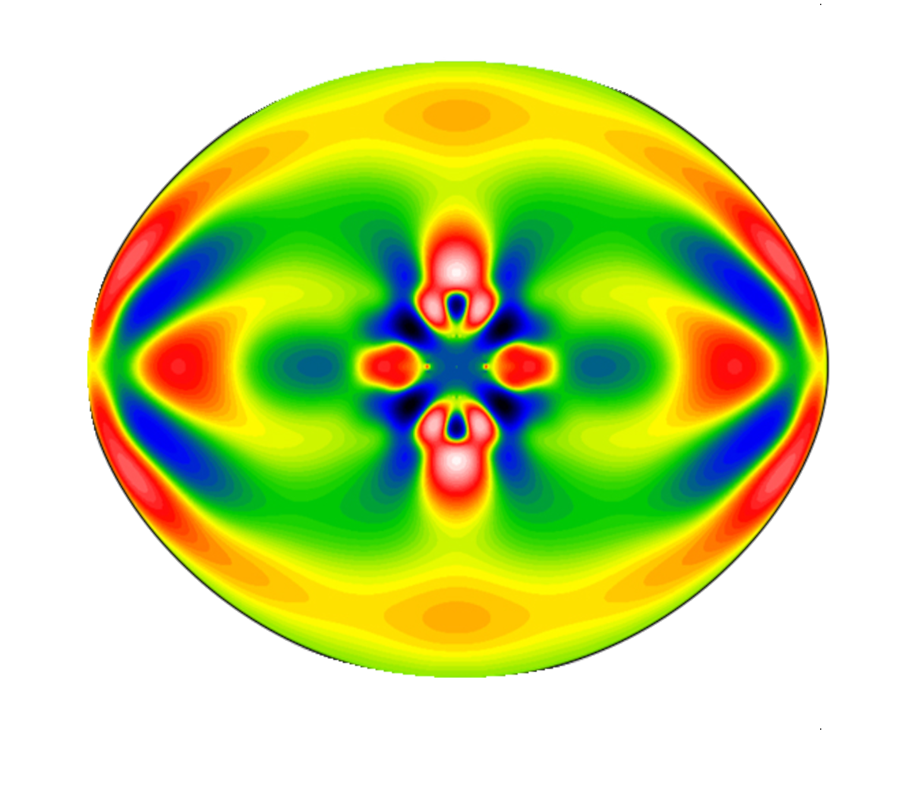
Kick-off Meeting : December, 29-30, 2022, Toulouse
Aim of the MASSIF Project
Improve our knowledge of massive stars coupling
Stellar interiors models
Rotation
Pulsation
Mass
Radiative transfer models
in atmosphere
in circumstellar environment
wind (Hot supergiants & MS OB stars)
Disks (Be, B[e])
And comparing their prediction with observations from
the latest generation of interferometric instruments at VLTI & CHARA (+ other)

Slide 4
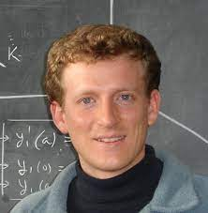
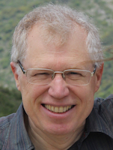
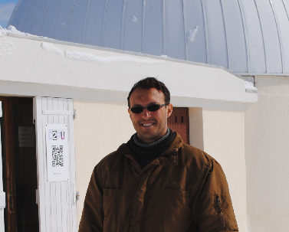
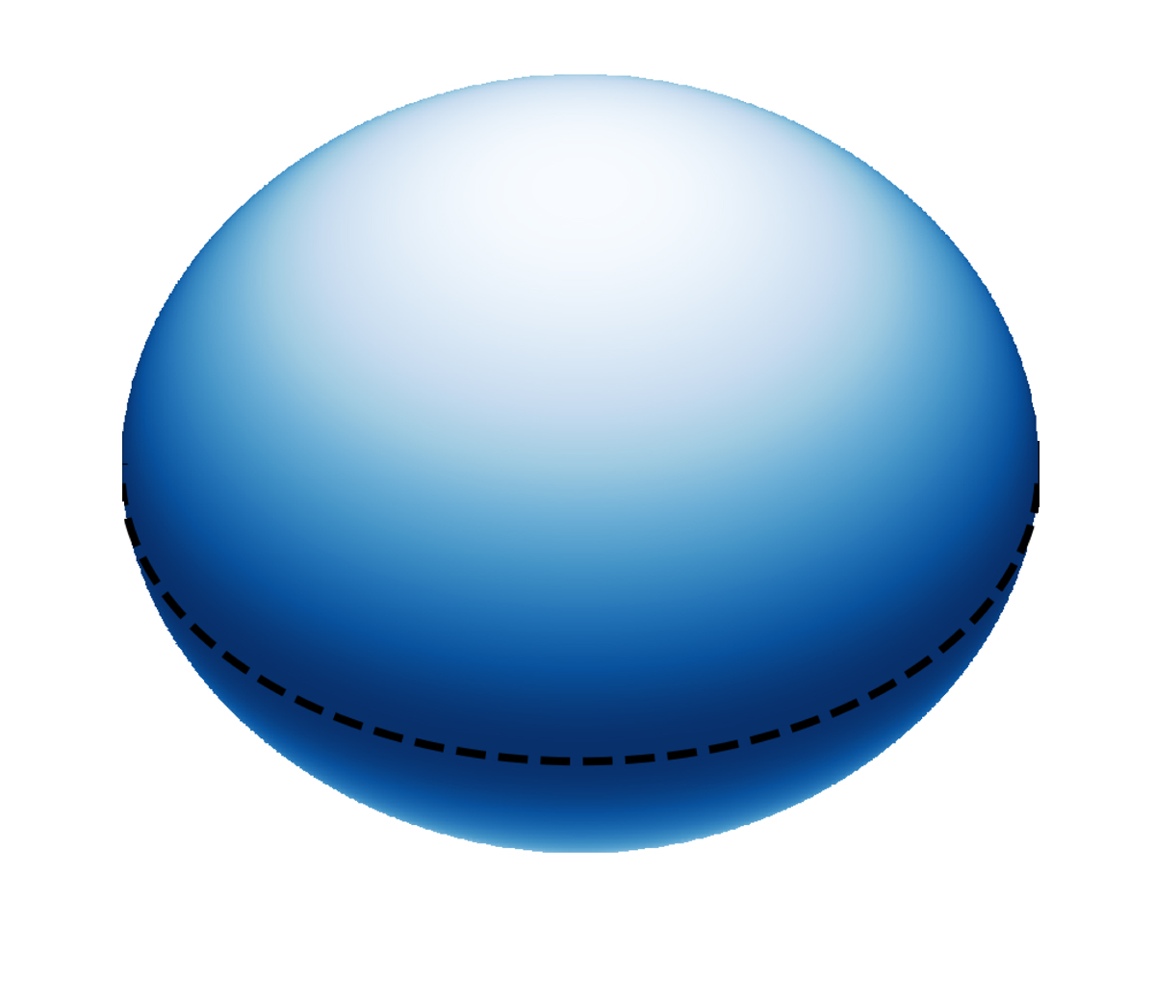
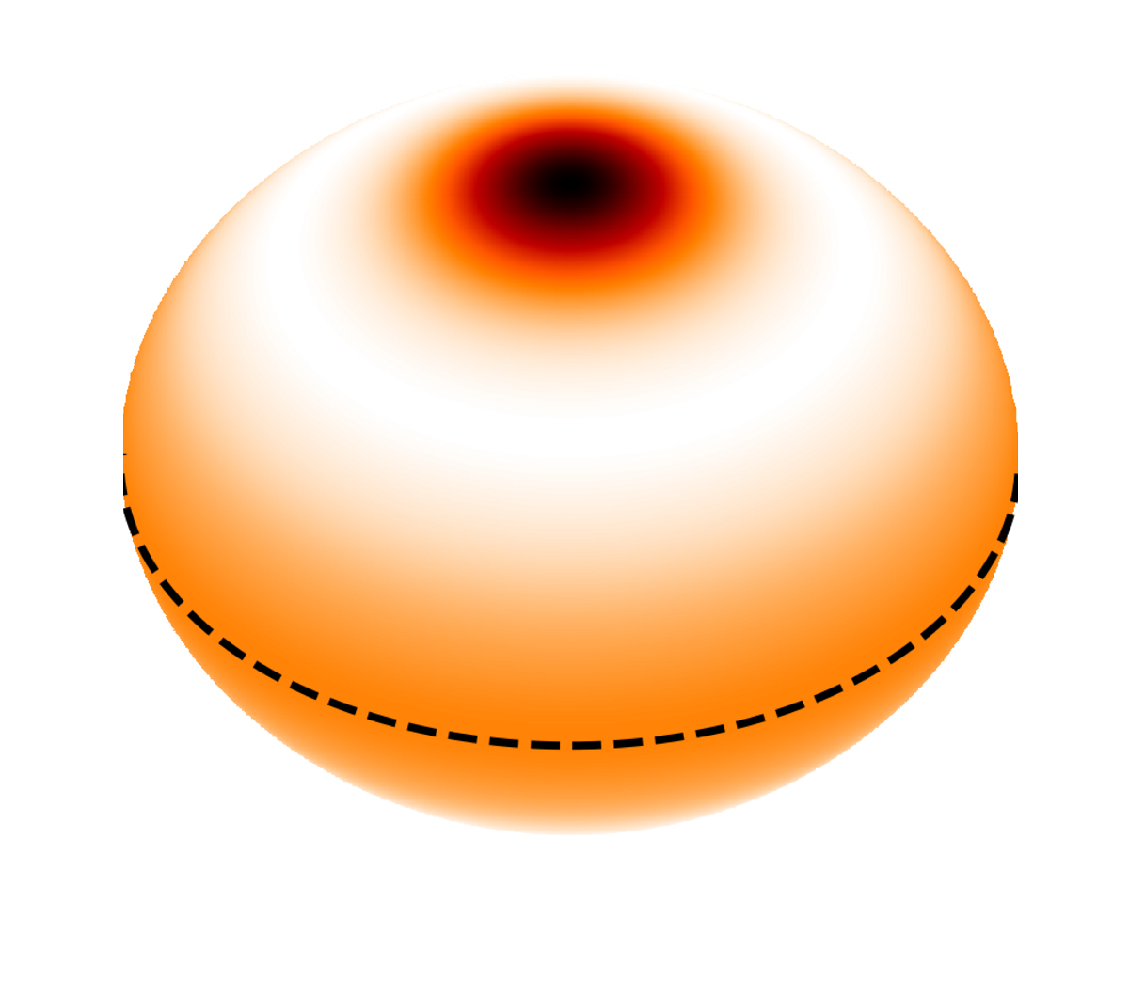
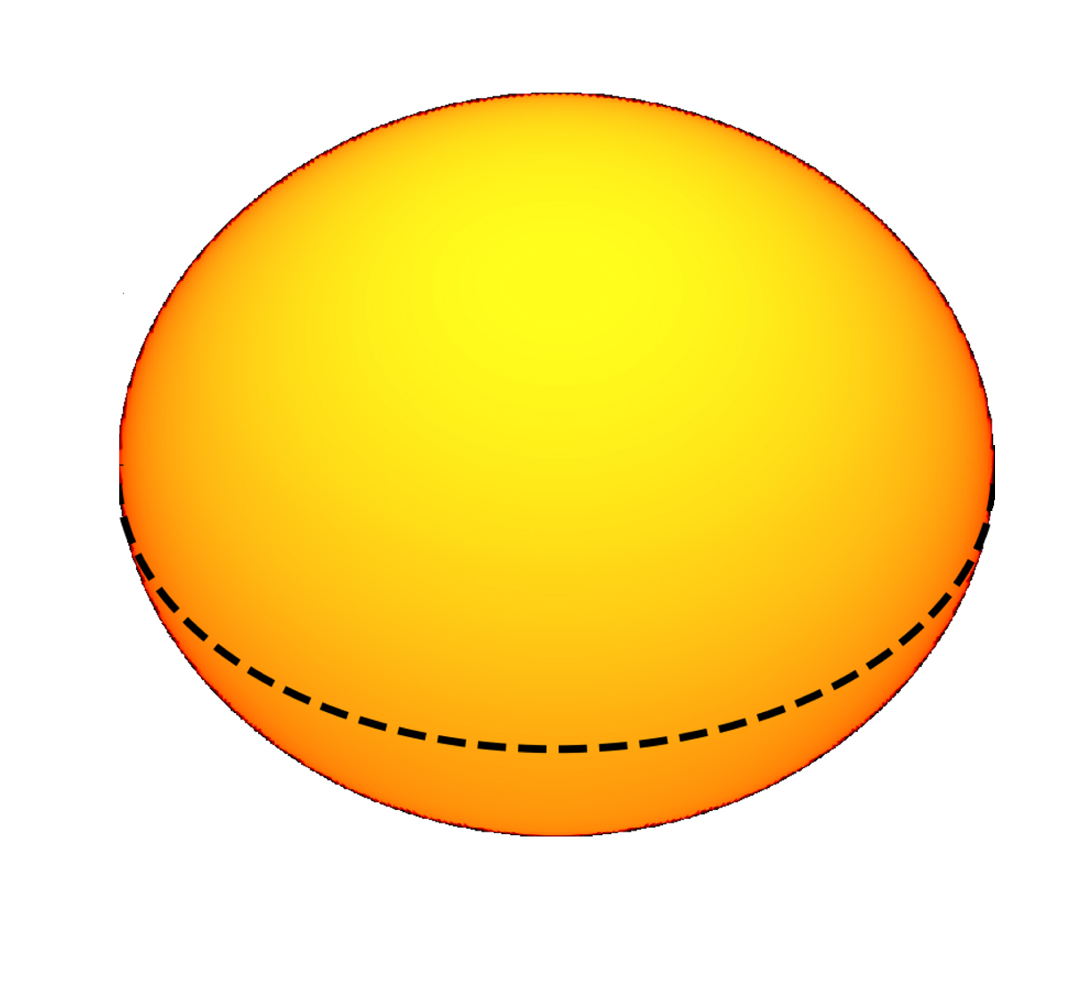
Kick-off Meeting : December, 29-30, 2022, Toulouse
MASSIF builds on the success of
The ESRR ANR project (2016-2020)
summarized on the paper by Bouchaud+ 2020
A realistic 2D-model of Altair
from interferometric & asteroseismologic observations and 2D stellar interior modelling
Surface temperature
Rotational Rate
Pulsations
Effective gravity
Aim of the MASSIF project do the same
on massive stars: including mass-loss and complex environments
Many objects: statistical approach + automatic model-fitting

Slide 5
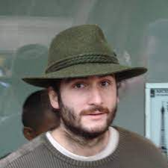
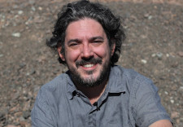
Kick-off Meeting : December, 29-30, 2022, Toulouse
MASSIF builds on the expertise of Nice
In interferometry of massive stars
1st generation of instruments
at VLTI (AMBER & MIDI)
at CHARA (VEGA)

Slide 6
Kick-off Meeting : December, 29-30, 2022, Toulouse
MASSIF builds on the expertise of Nice
In interferometry of massive stars
2nd generation of instruments
MATISSE
SPICA

Slide 7
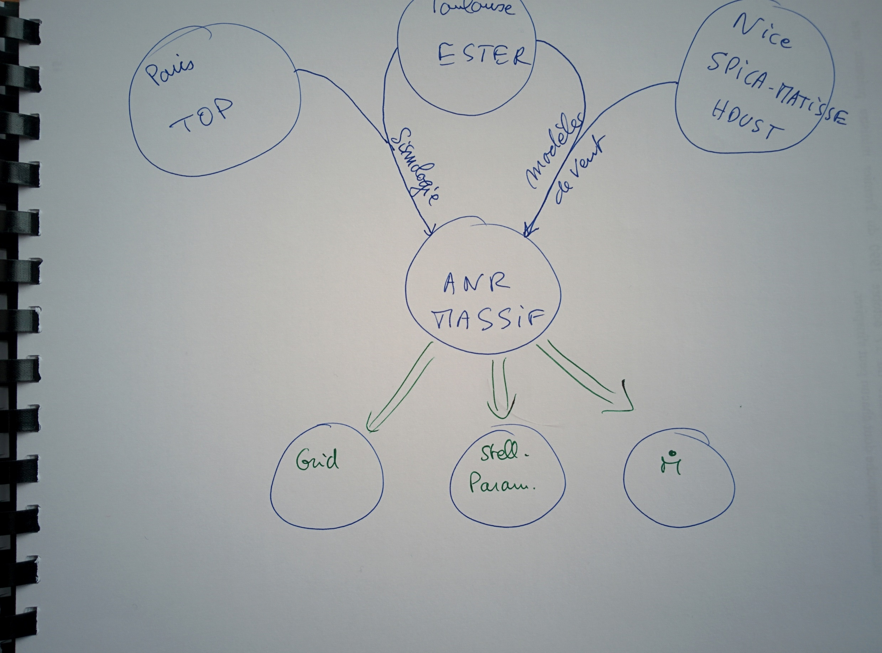
Kick-off Meeting : December, 29-30, 2022, Toulouse
Project organization : original diagram

Slide 8
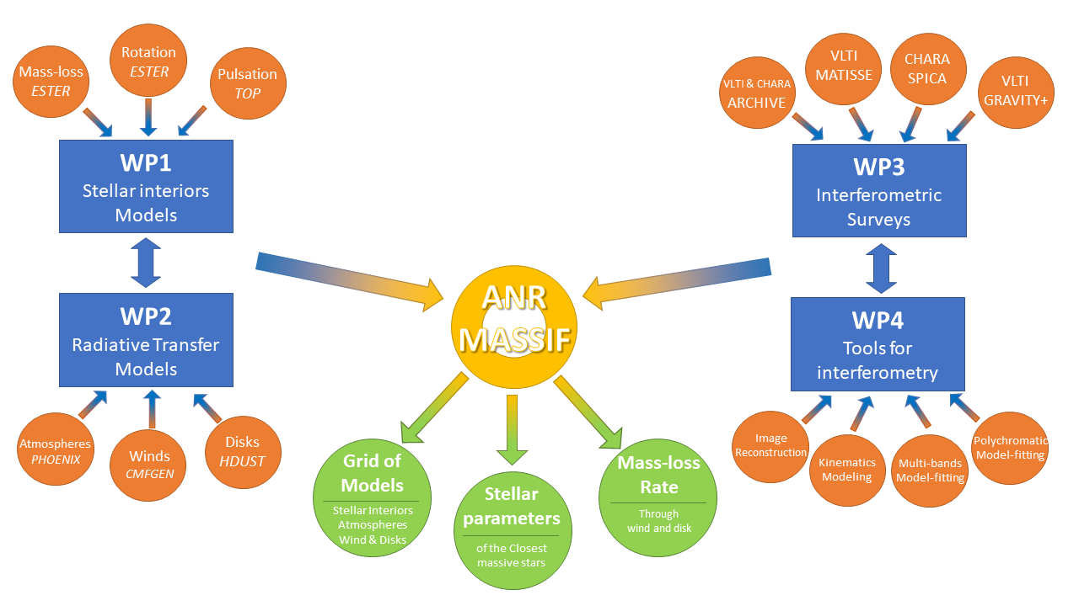
Kick-off Meeting : December, 29-30, 2022, Toulouse
Project organization : First try

Slide 9
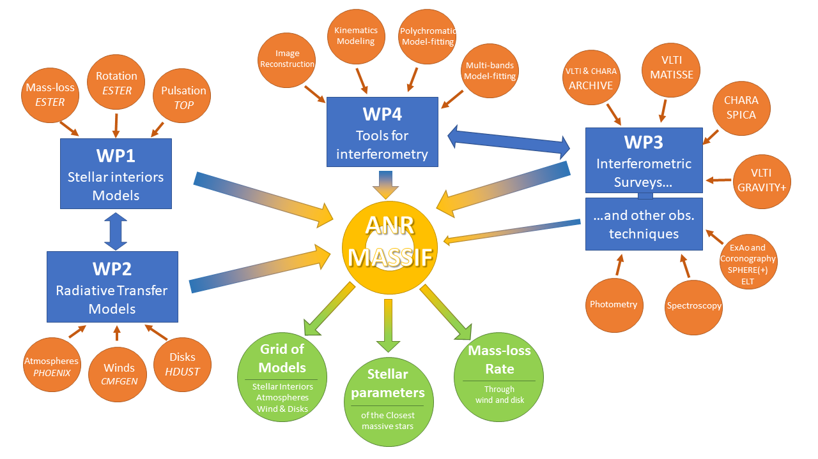
Kick-off Meeting : December, 29-30, 2022, Toulouse
Project organization : Second guess

Slide 10
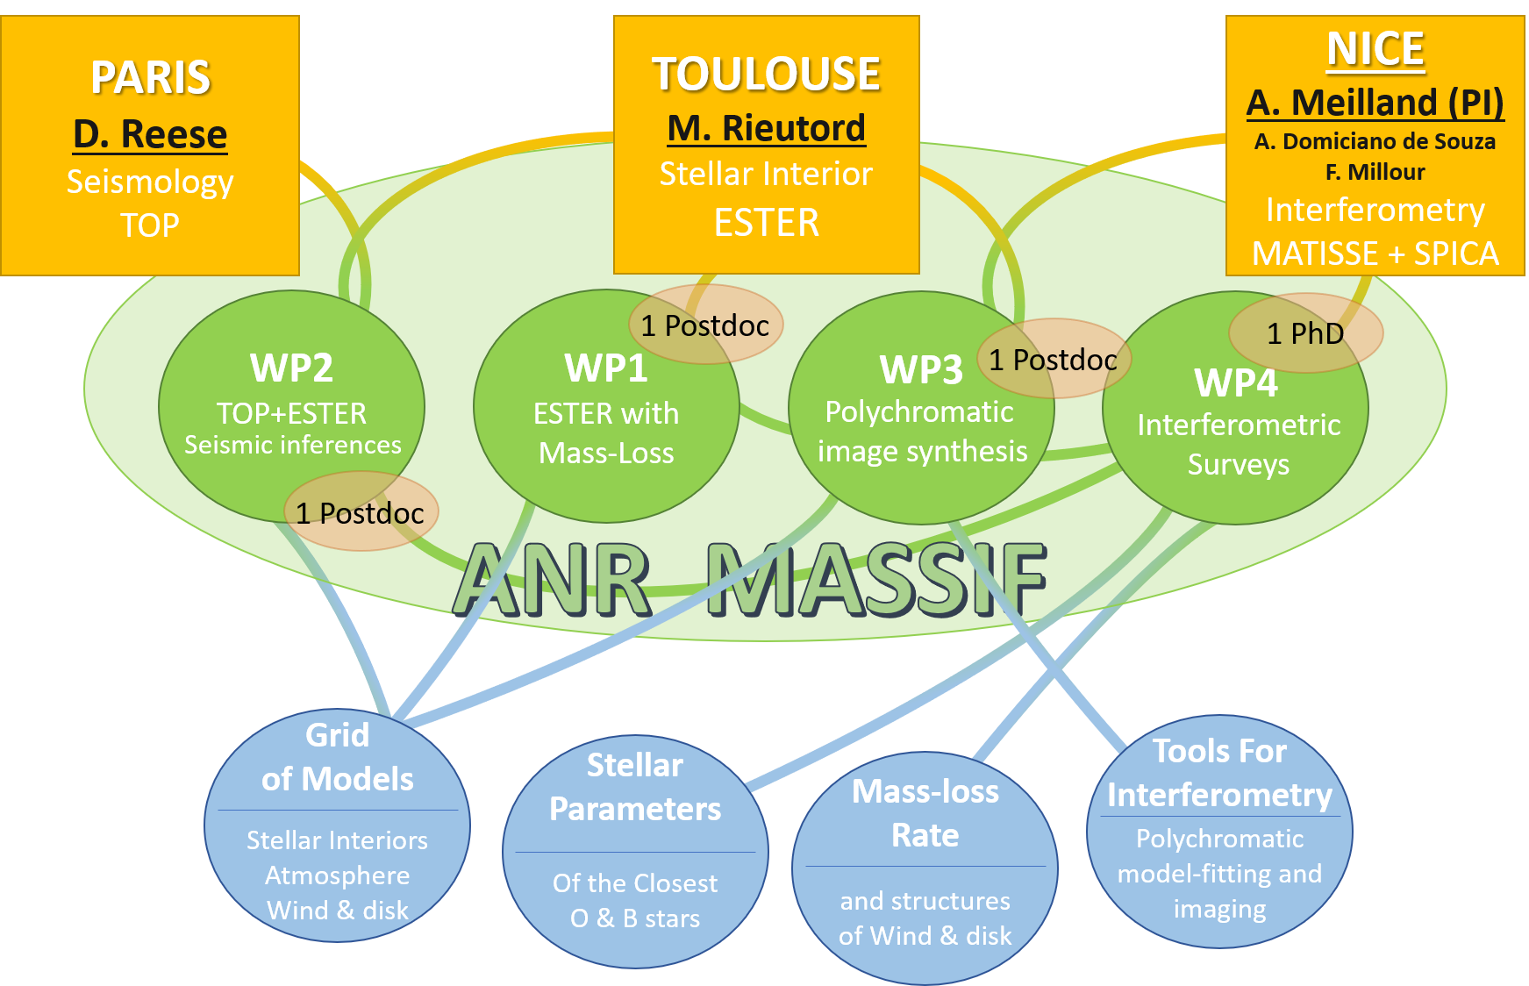
Kick-off Meeting : December, 29-30, 2022, Toulouse
Project organization
F. Millour
D. Reese
M. Rieutord
A. Meilland
A. Domiciano
de Souza

Slide 11
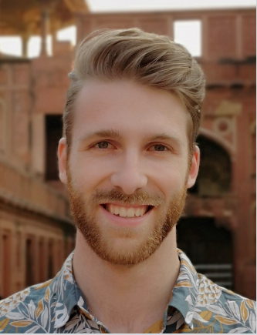
Kick-off Meeting : December, 29-30, 2022, Toulouse
WP1: Modelling the Star with ESTER
WP11: mass & angular momentum loss
⬄ WP31 (input for HUDST RT)
WP21: Coupling with atmosphere models
PHOENIX / TLUSTY
WP13 : Grids of models for typical massive stars
⬄ WP4 (Surveys)
+ Post-Doc
Joey Mombarg

Slide 12
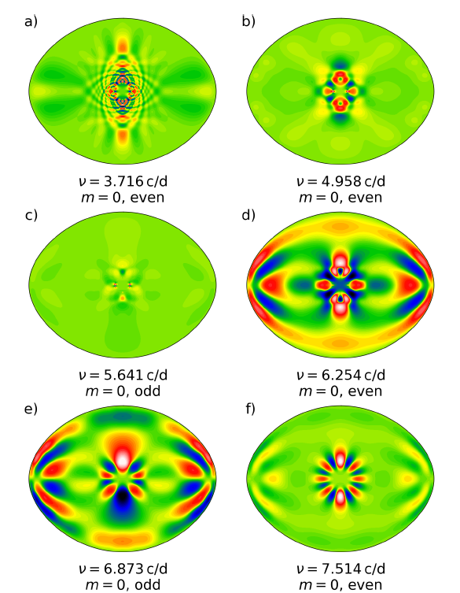
Kick-off Meeting : December, 29-30, 2022, Toulouse
WP2: Asteroseismology of Massive stars
With TOP
WP21: Further improvements of TOP
(non-adiabatic pulsations only partly implemented)
WP22: Production of asteroseismic synthetic observables
⬄ link with WP12 (ESTER + PHOENIX/TLUSTY)
WP13: Calibrate the models on specific targets
⬄ stars observed by TESS
⬄ stars from WP4 (Surveys)
+ Post-Doc (Paris) 2023?

Slide 13
Kick-off Meeting : December, 29-30, 2022, Toulouse
WP3: Polychromatic image synthesis
WP31: RT transfer models of wind and disks
HDUST radiative transfer for disk with gas and dust (Be & B[e])
Coupling ESTER & HDUST for more consistent model ⬄ WP11, WP12
RT for radiative wind (CMFGEN vs HDUST 3D)
WP32: Tools for spectro-interferometry
Polychromatic image reconstruction & model-fitting
Advanved techniques: IA enhanced, semi-physical, temperature mapping
+ Post-Doc (Nice) 2023

Slide 14
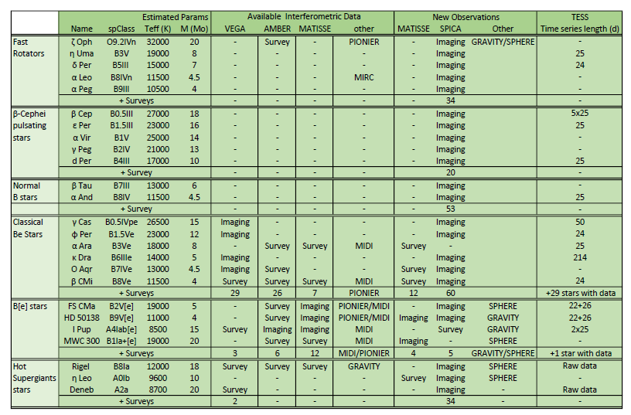
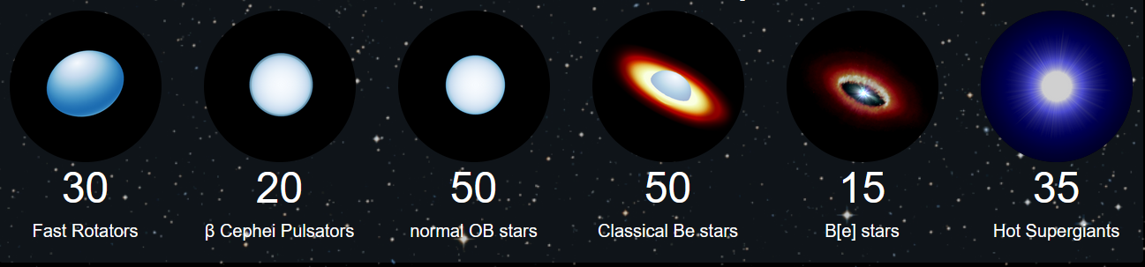
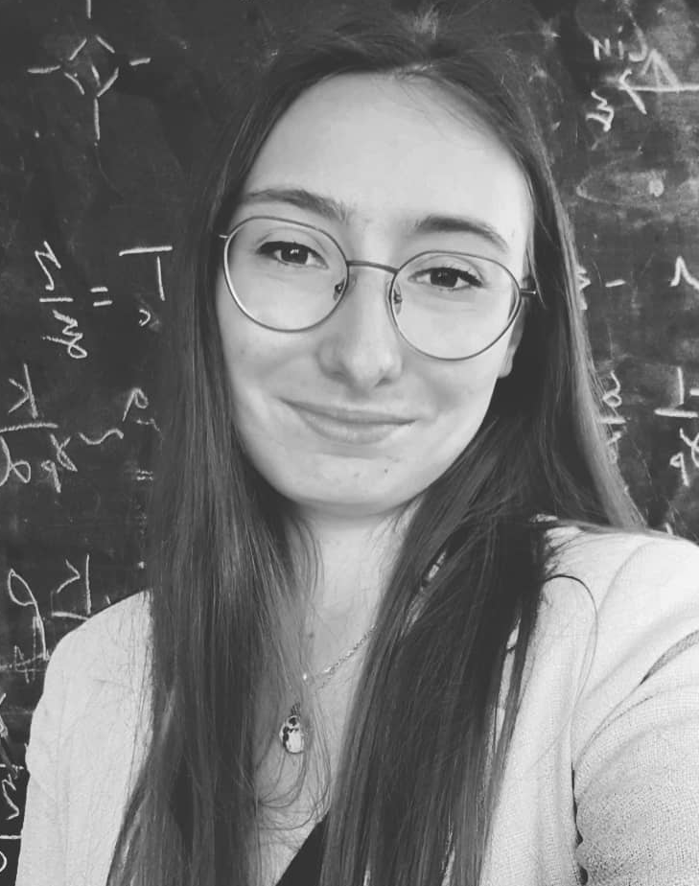
Kick-off Meeting : December, 29-30, 2022, Toulouse
WP4: Interferometric Surveys
WP41 MATISSE Surveys
WP42 SPICA Surveys
WP43 Physical analysis of the datasets
+ PhD
Margaux Abello

Slide 15
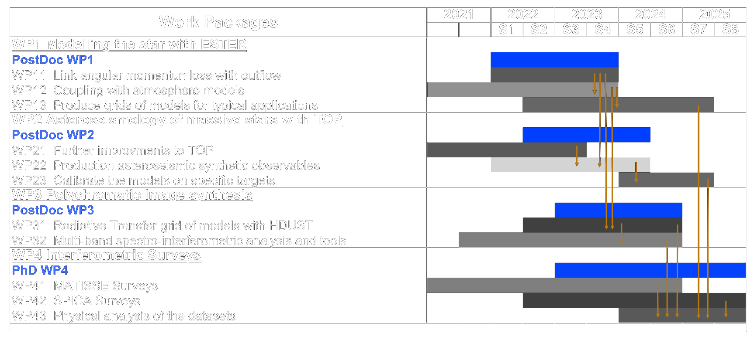
Kick-off Meeting : December, 29-30, 2022, Toulouse
Timeline

Slide 16
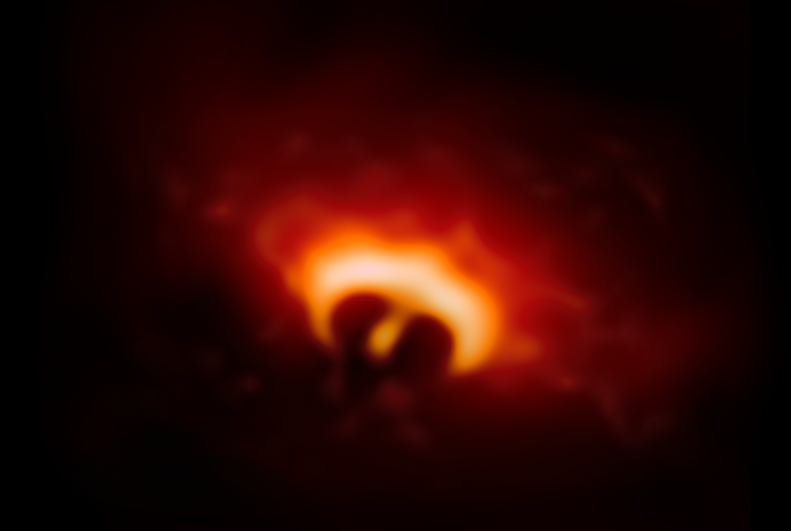
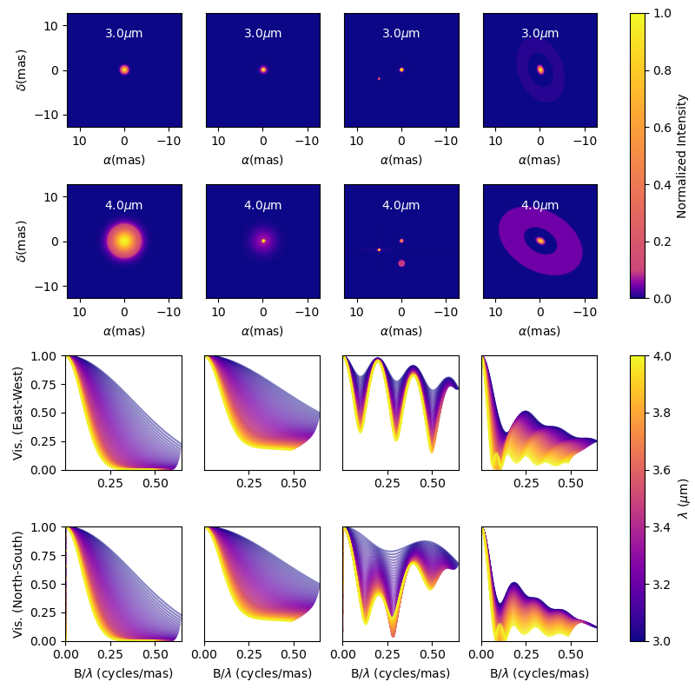
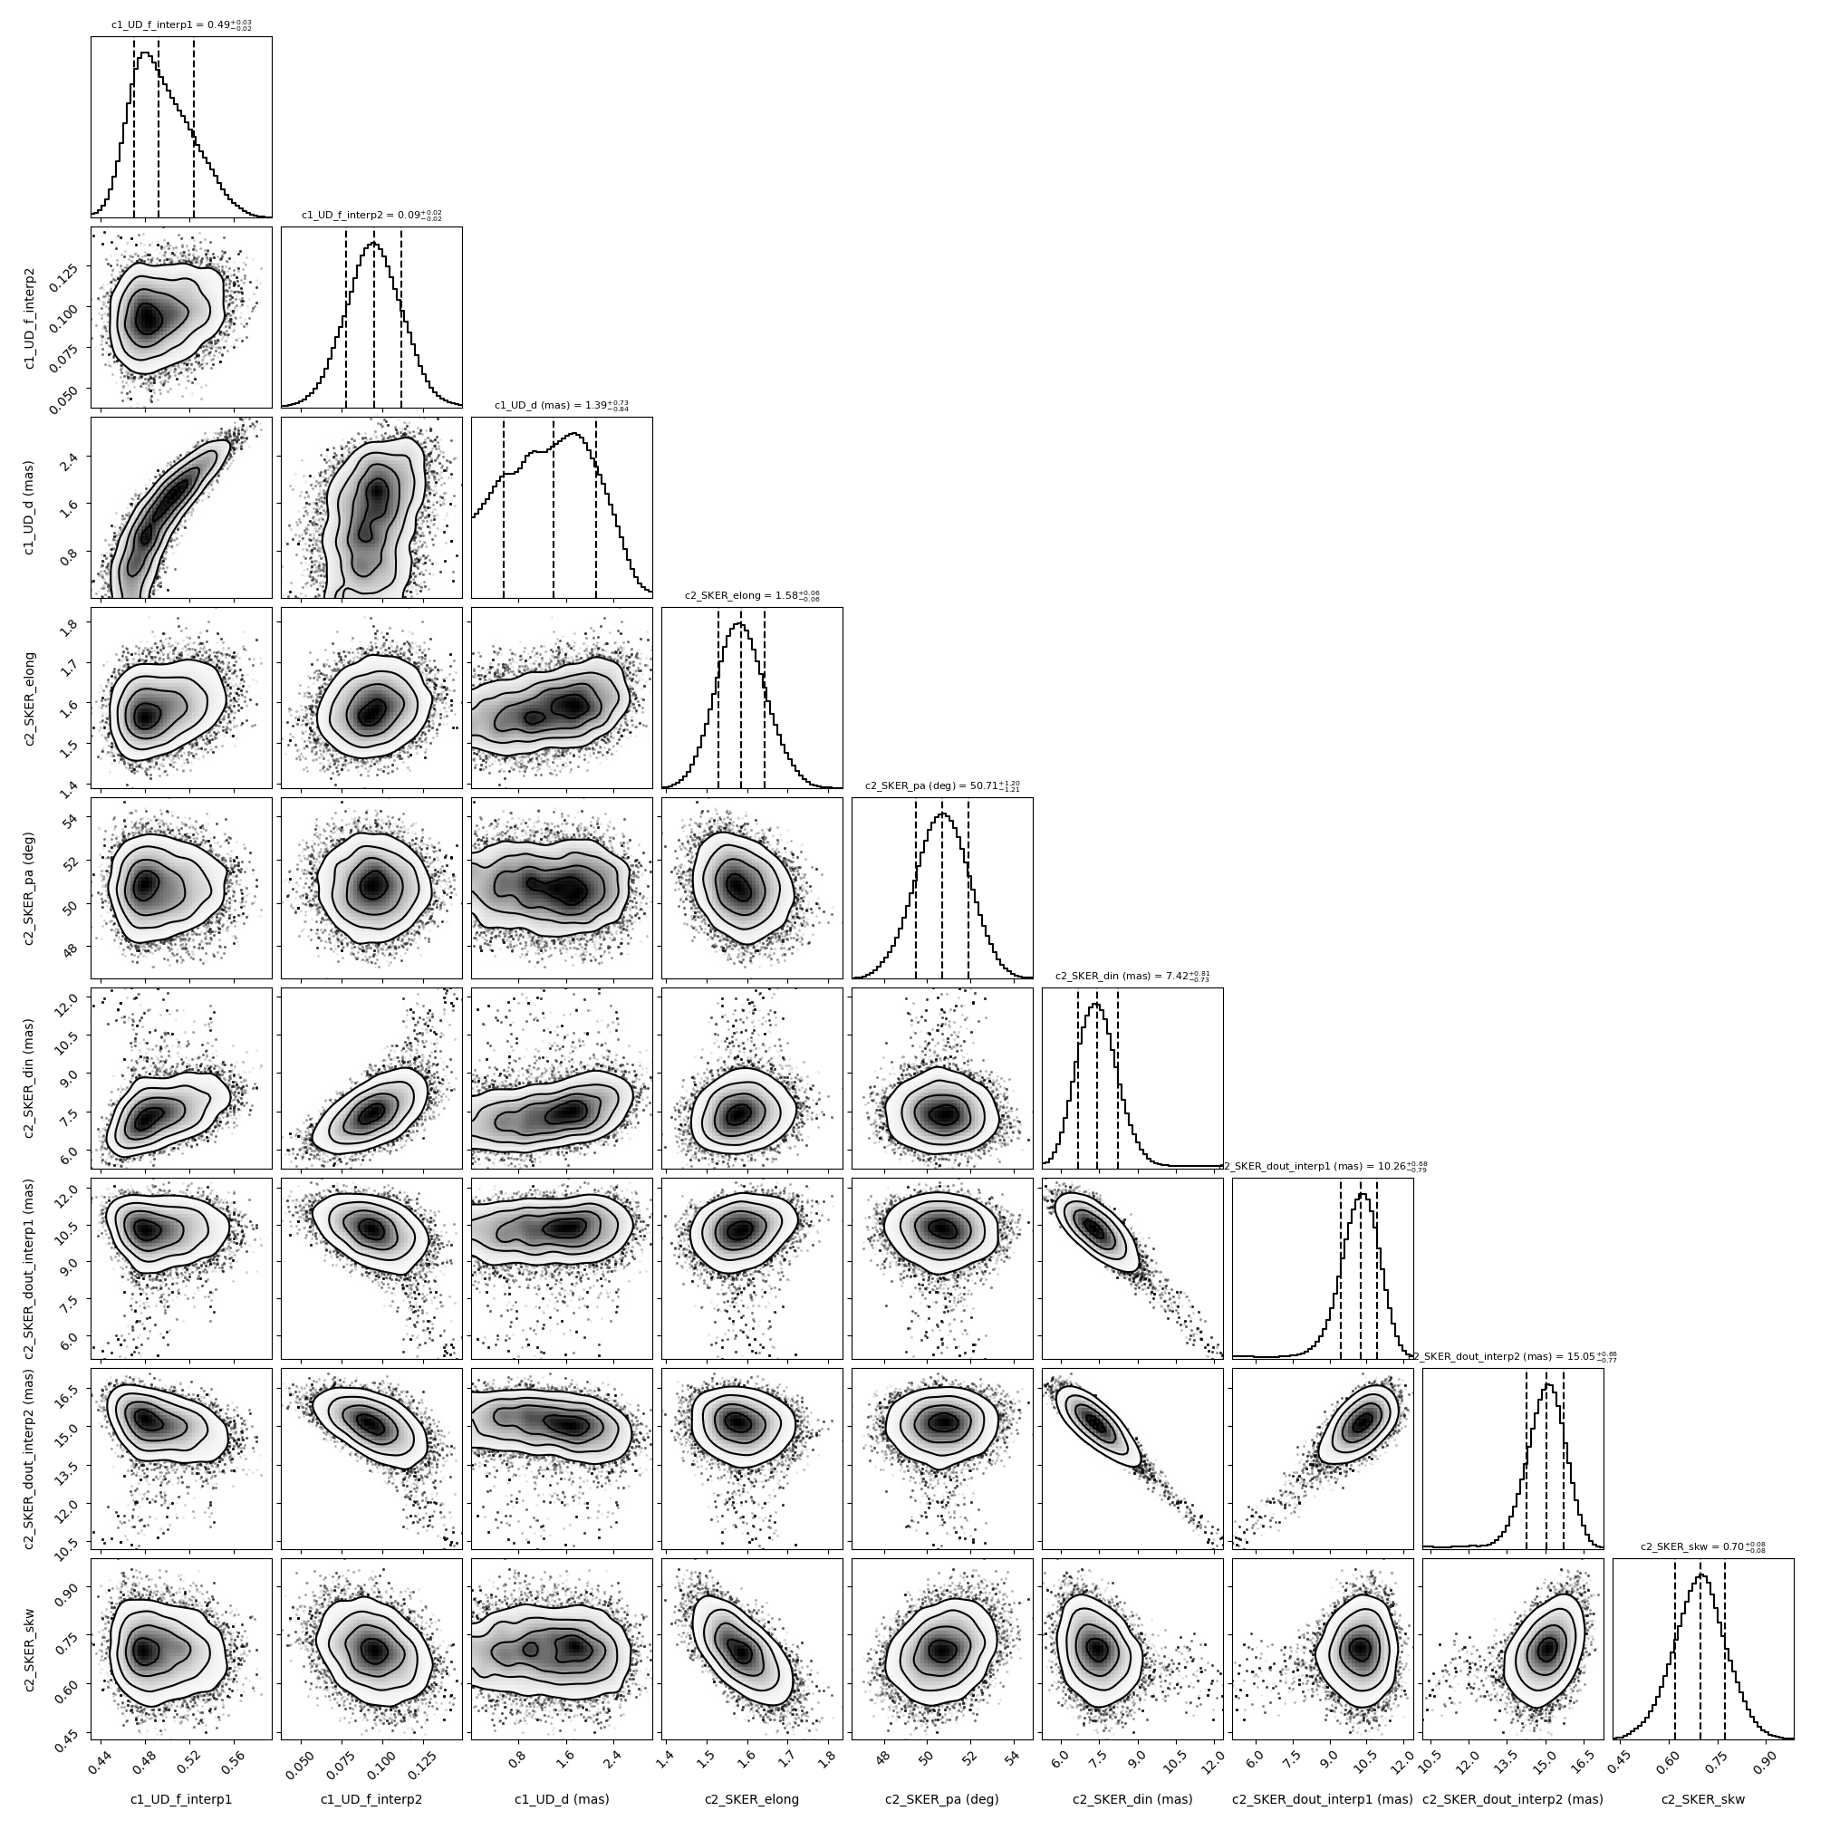
Kick-off Meeting : December, 29-30, 2022, Toulouse
Delivrables
1) Grid of models
Stellar interiors
Stellar atmospheres
Environnement stellaires (vent et disques)
2) Physical parameters of close-by massive stars
200 stellar parameters
100 mass-loss and environment parameters
25 Images of photospheres and/or environments
3) Tools for spectro-interferometry
Chromatic modelling-fitting
Polychromatic image-reconstruction
… as Bonus
VR-environment for stellar and circumstellar models
Stage Aldan Saldou (2021)
1 stage par an

Slide 17
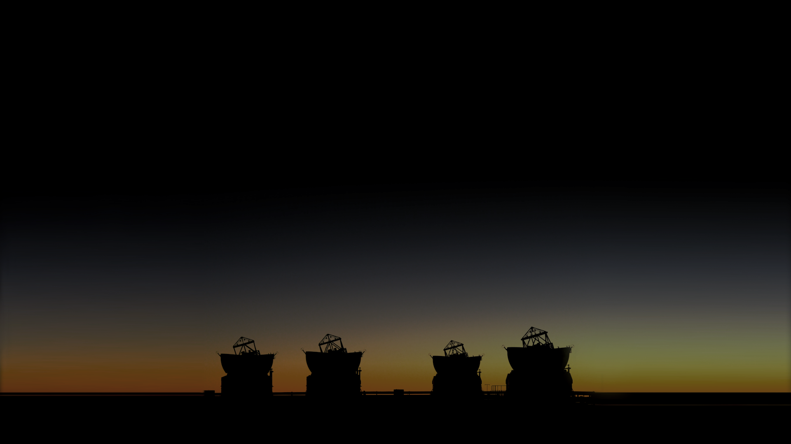
Organisation
ANR de type PRC
Nice, Toulouse et Paris
515k€ (2022-2025)
1 Postdoc de 2 ans
par institut
+
1 thèse à Nice
A. Domiciano
de Souza
M. Rieutord
A. Meilland
Méthodologie
Coupler
des modèles d’intérieurs
d’étoiles massives
incluant rotation, pulsations
et perte de masse
avec
des modèles de transfert radiatif
des photosphères et environnements
Et comparer avec
des observations
spectro-interférométriques
(VLTI/MATISSE & CHARA/SPICA)
et astérosismologiques
F. Millour
Délivrables
Grilles de modèles
Intérieurs stellaires, atmosphères et environnements
Paramètres physiques
200 paramètres stellaires, 100 environnements, 25 Images
Outils pour l’interférométrie
Ajustement de modèles et reconstruction d’image panchromatique
…et en Bonus
Développement d’un environnement immersif de réalité
virtuelle pour la visualisation de modèles astrophysiques
M. Abello
J. Mombarg
D. Reese
Pour 2022
Kick-off meeting
1 Stages de Master (Nice) : MATISSE & Réalité Virtuelle
Démarrage de la thèse à Nice (Octobre)
Démarrage des postdocs à Toulouse et Paris?
Plus d’infos sur www.anr-massif.fr

