Slide 1
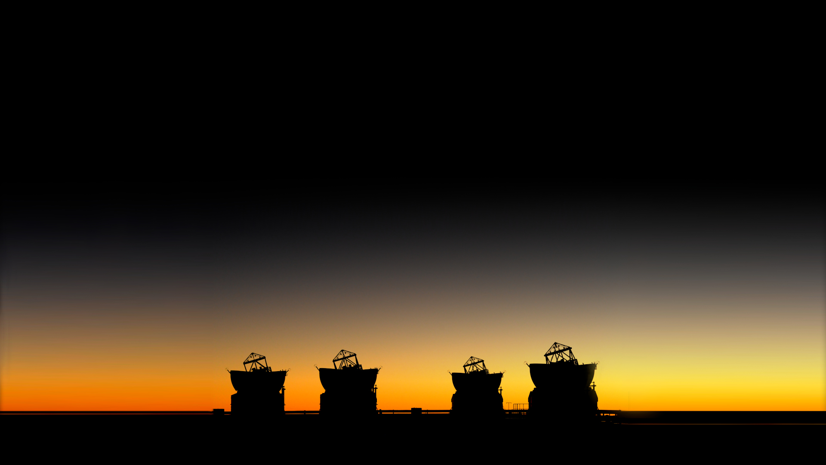




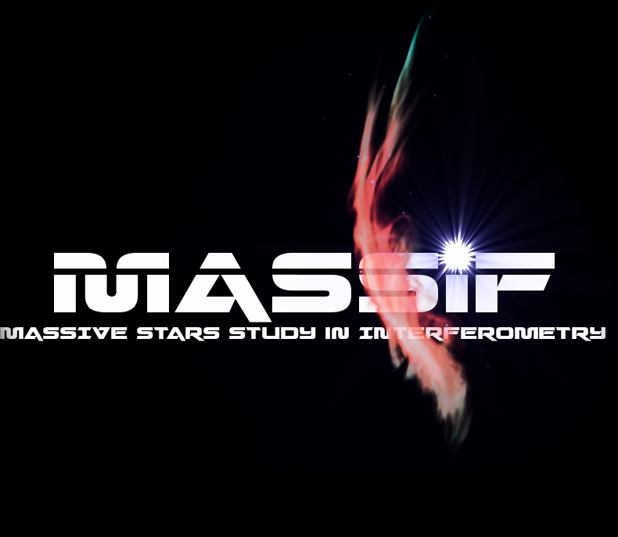
Contribution from A. Meilland
Kick-off Meeting
December, 29-30, 2022, Toulouse

Slide 2
Kick-off Meeting : December, 29-30, 2022, Toulouse
1 - Massive stars with the first generation
of instrument at VLTI and CHARA
Few stellar surfaces
  mainly supergiants (not part of our ANR programme)
  a few fast rotators (not very massive)
Binarity
  orbits & mass
  binary fraction
Gas and dust environments in continuum
  Classical Be stars, B[e] stars, Wolf-Rayet, Hot Supergiants, YSO, interacting binaries
Dynamics of gas around massive stars in disks and wind

Slide 3
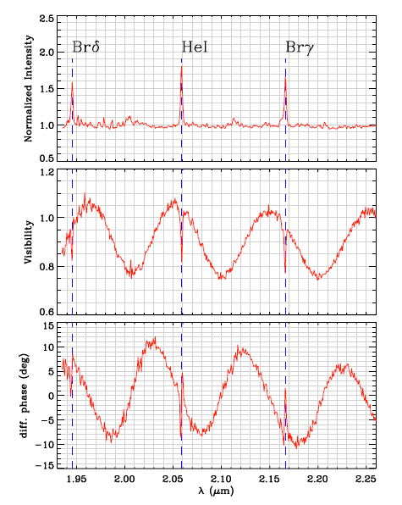
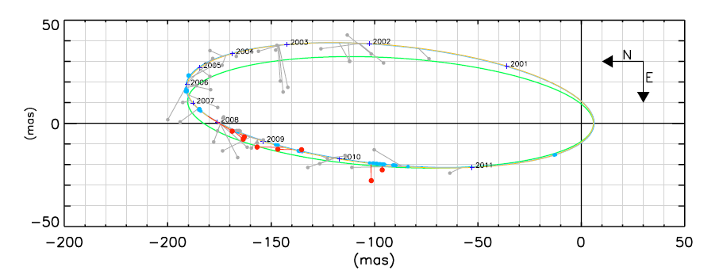
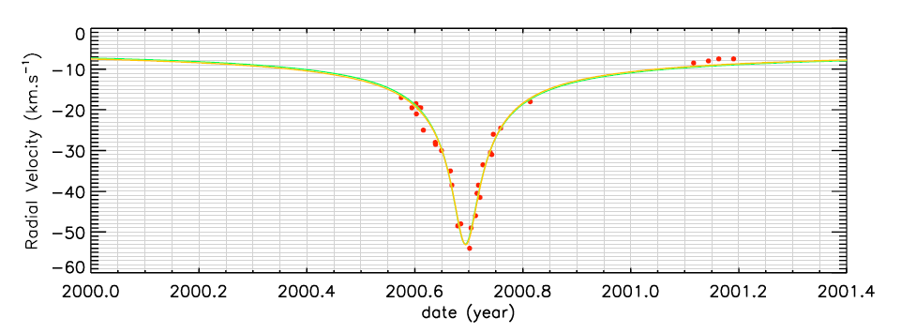
Kick-off Meeting : December, 29-30, 2022, Toulouse
Binaries with 1st gen VLTI: example δ Sco VLTI/ AMBER
2D Orbit
Projected
separation
Flux ratio
+Radial Velocities => 3D Orbit => Mass or Masses
Meilland+ 2010

Slide 4
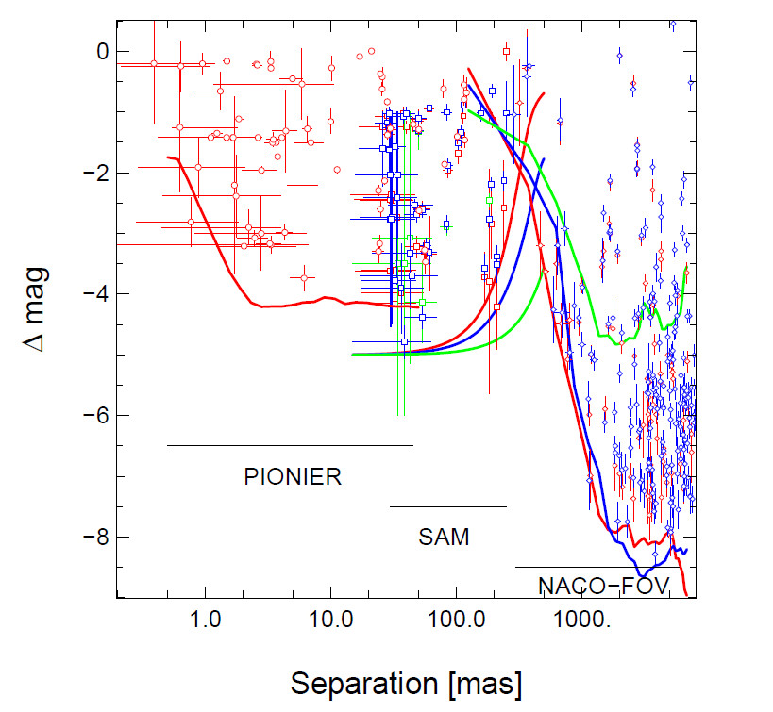
Kick-off Meeting : December, 29-30, 2022, Toulouse
The binary fraction among massive stars (VLTI/PIONIER)
The SMaSH+ program
(Southern Massive Stars at High Angular resolution)
173 O stars observed
105 VLTI/PIONIER
(small separation 1 - 45 mas)
+
162 VLT/NACO
(larger separation 30 mas - 8’’)
High binary fraction : 0.86
Average companion : 1.83±0.32
η Car
Massive stars were formed nearly exclusively in multiple systems
Le Bouquin+ 2014

Slide 5
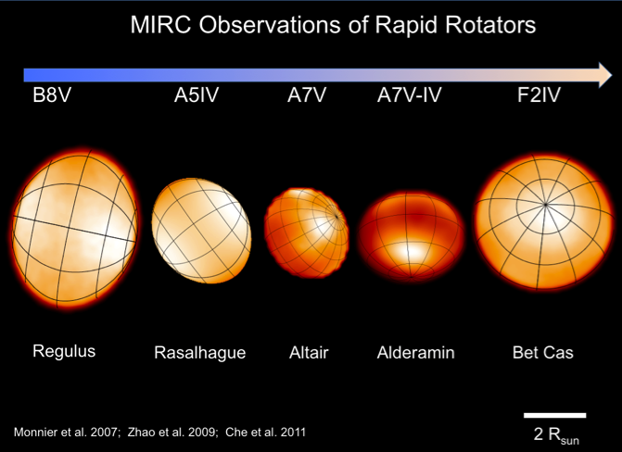
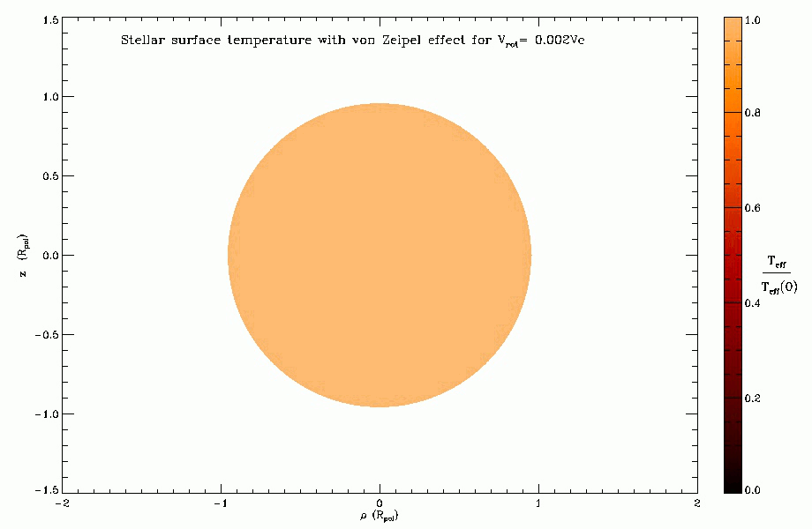
Kick-off Meeting : December, 29-30, 2022, Toulouse
Stellar surfaces of fast-rotators (CHARA/MIRC H-band)
Constraints on the Gravity darkening
Teff α geff ^{β}
(von Zeipel ⬄ β = 0.25 )
β ~ 0.22 ( and depends on Teff)
Compatible with stellar interior model
for fast-rotators ESTER
(Espinoza Lara+ 2011)

Slide 6
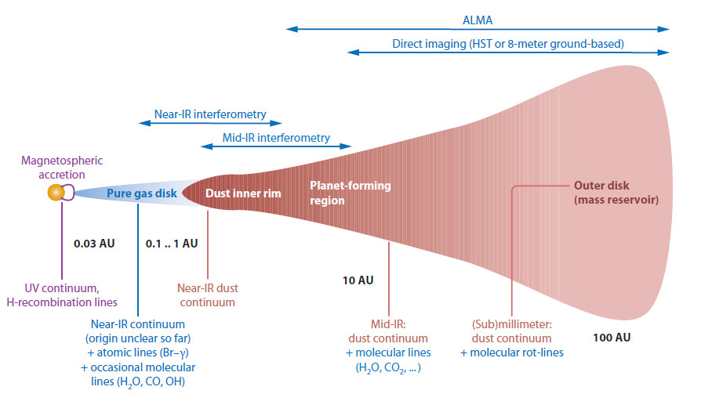
Kick-off Meeting : December, 29-30, 2022, Toulouse
Circumstellar environments with VLTI & CHARA
Visible interferometry
Dullemond & Monnier (2010)

Slide 7
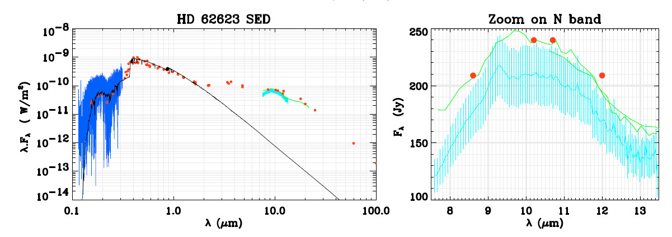
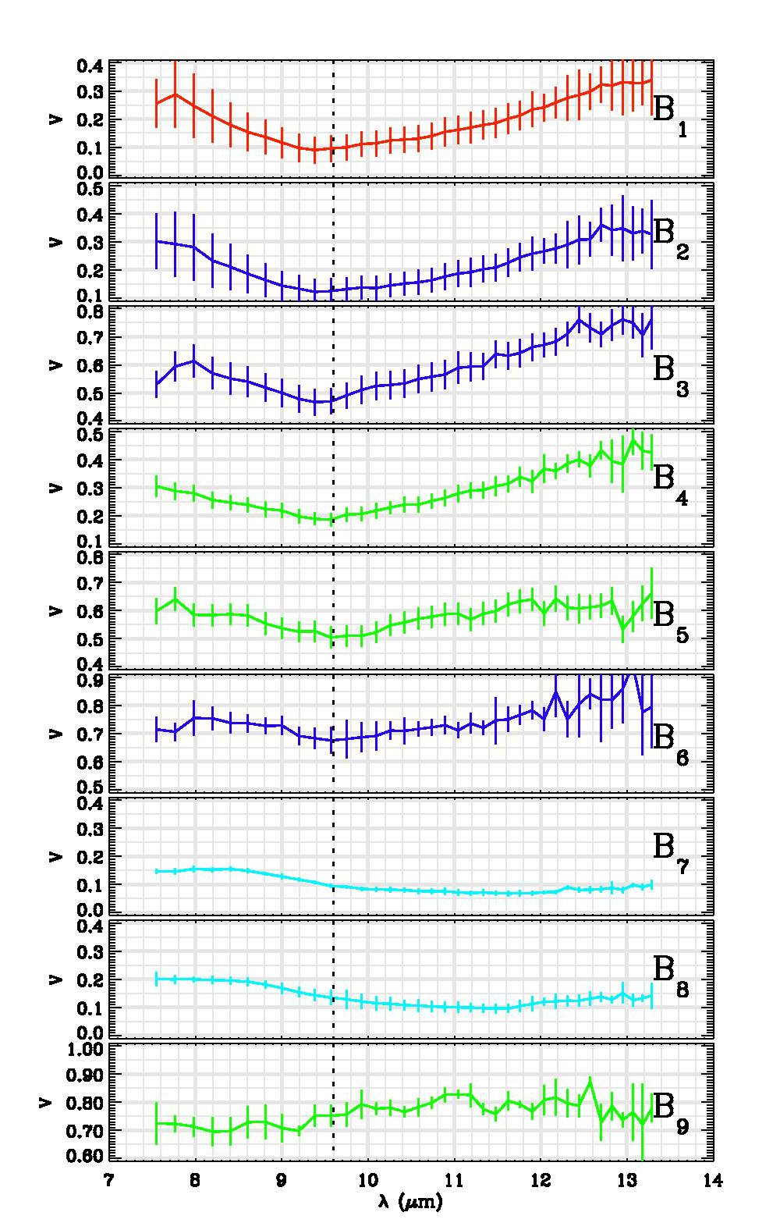
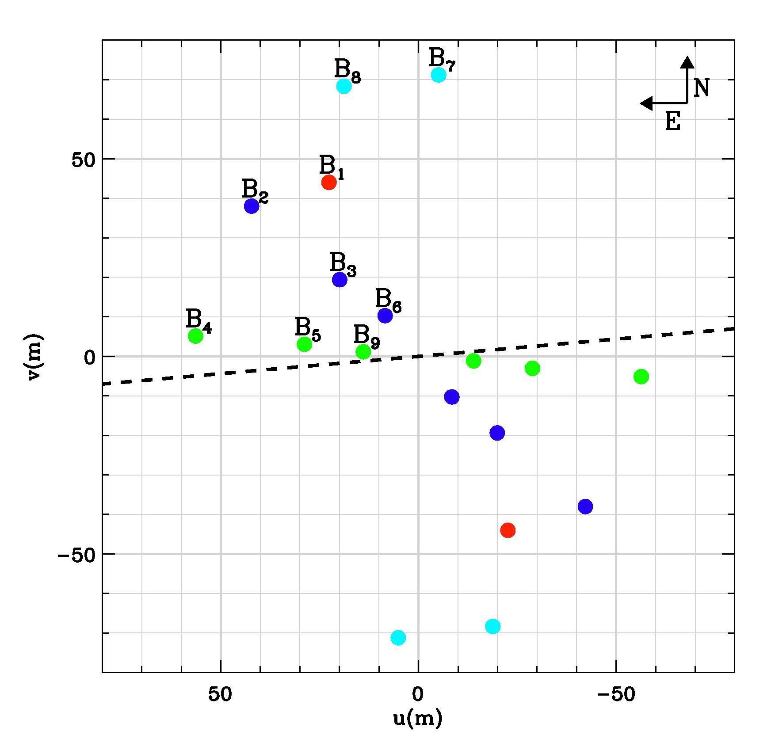
Kick-off Meeting : December, 29-30, 2022, Toulouse
Dust in the mid-IR : the A[e] supergiant HD62623
From Meilland+ 2010
From the VLTI/MIDI point of view
UV plan
Visibility
Infrared Excess
SED

Slide 8
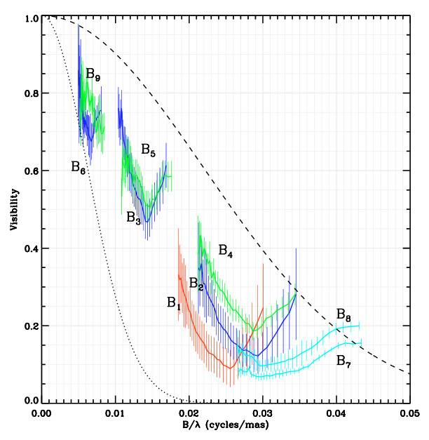
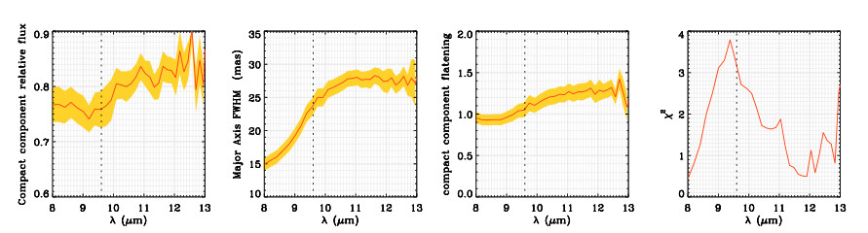
Kick-off Meeting : December, 29-30, 2022, Toulouse
Dust in the mid-IR : the A[e] supergiant HD62623
From Meilland+ 2010
Simple wavelength-depend geometric model
What can be determined:
Extension => 15 to 25 mas
Flatenning => lower limit on i=> 40°
Orientation => Ʇ to the Polarization

Slide 9
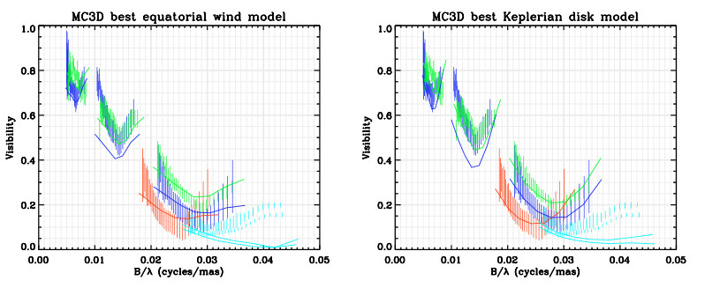
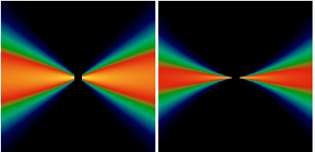
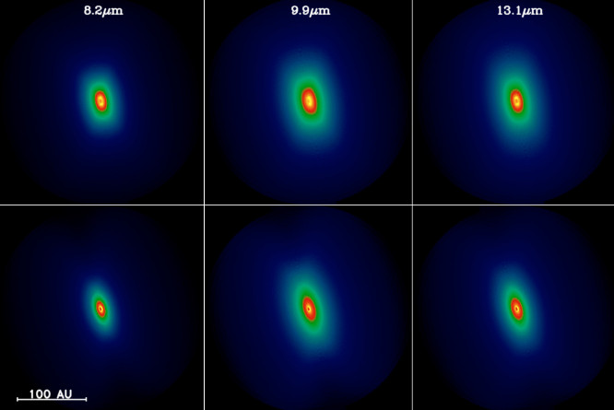
Kick-off Meeting : December, 29-30, 2022, Toulouse
Dust in the mid-IR : the A[e] supergiant HD62623
From Meilland+ 2010
Radiative transfert modelling with MC3D (dust only)
Keplerian disk
Only marginally better fit
Equatorial wind

Slide 10
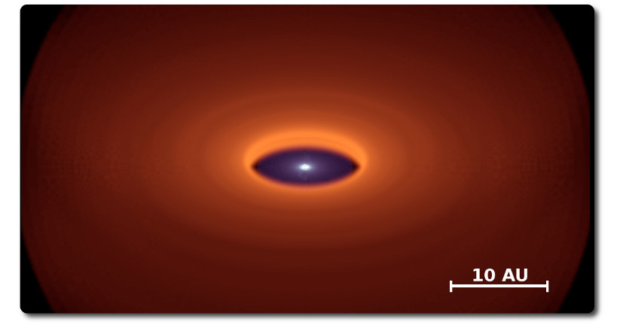
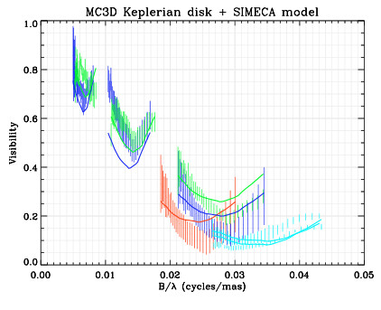
Kick-off Meeting : December, 29-30, 2022, Toulouse
Dust in the mid-IR : the A[e] supergiant HD62623
From Meilland+ 2010
Radiative transfert modelling with MC3D (dust) + SIMECA (gas)
We Add
4 10⁻⁷Mo
Of gas

Slide 11
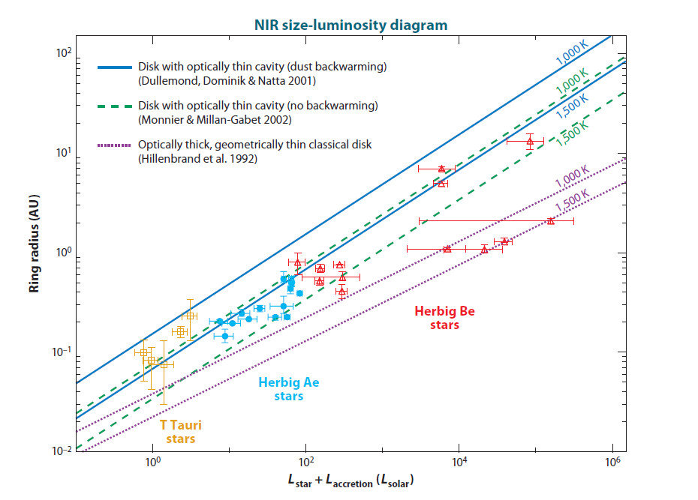
Kick-off Meeting : December, 29-30, 2022, Toulouse
Dust in the near-IR ⬄ Inner rim of the disk
Survey on Herbig Ae/Be stars
near-IR extension
Correlation between
NIR extension and Luminosity
Radius/Luminosity
Dust sublimation
temperature
Heating processes
below the inner rim
Chemistry of dust
Physical properties
of the gaz
Monnier+ 2005, Millan-Gabet+ 2006, Dullemond & Monnier 2010

Slide 12
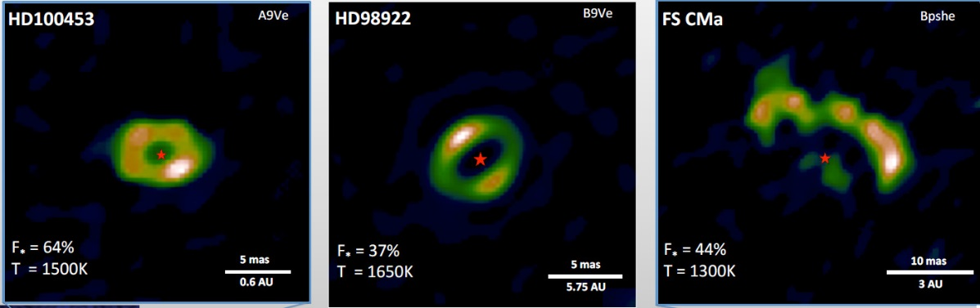

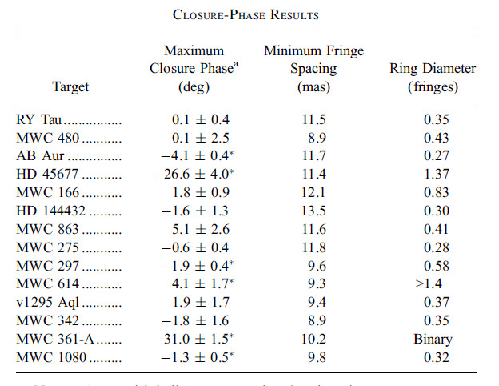

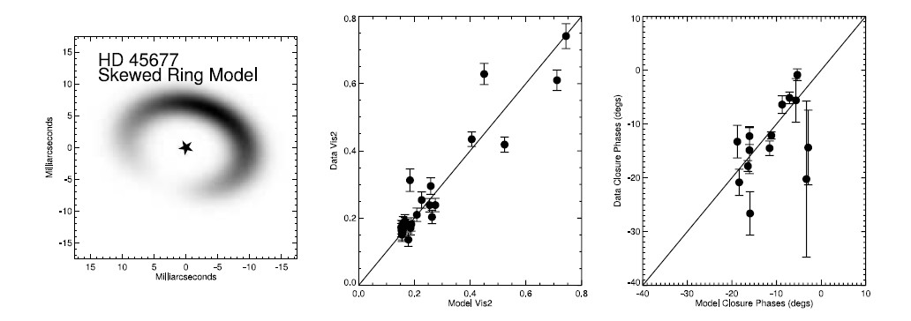
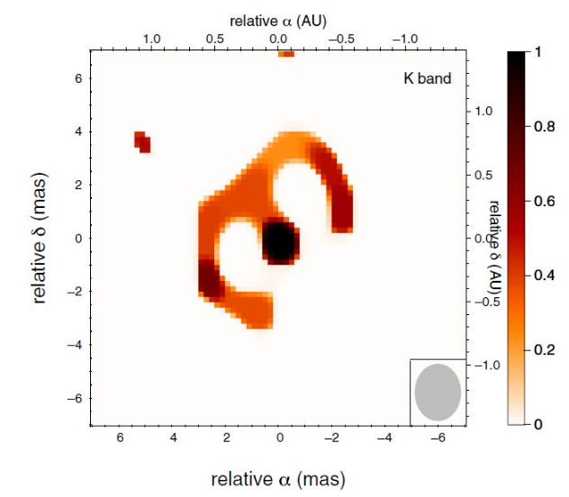
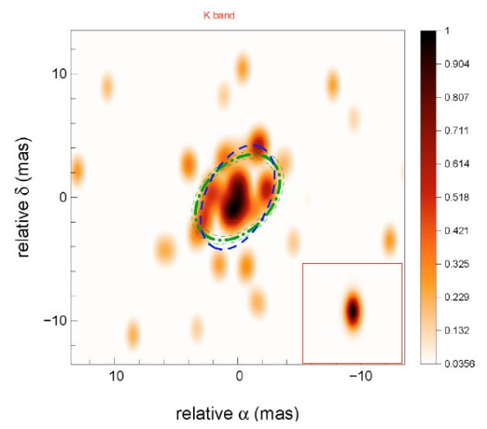
Kick-off Meeting : December, 29-30, 2022, Toulouse
Dust in the near-IR
Kluska+ 2014
VLTI/PIONIER
From model fitting…
Monnier+ 2006
IOTA/IONIC3
Renard+ 2010
VLTI/AMBER
Benisty+ 2011
VLTI/AMBER
…to Imaging

Slide 13
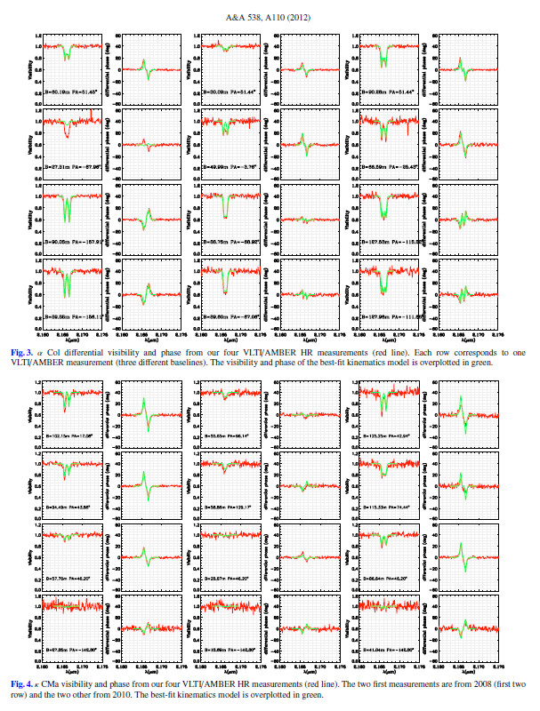
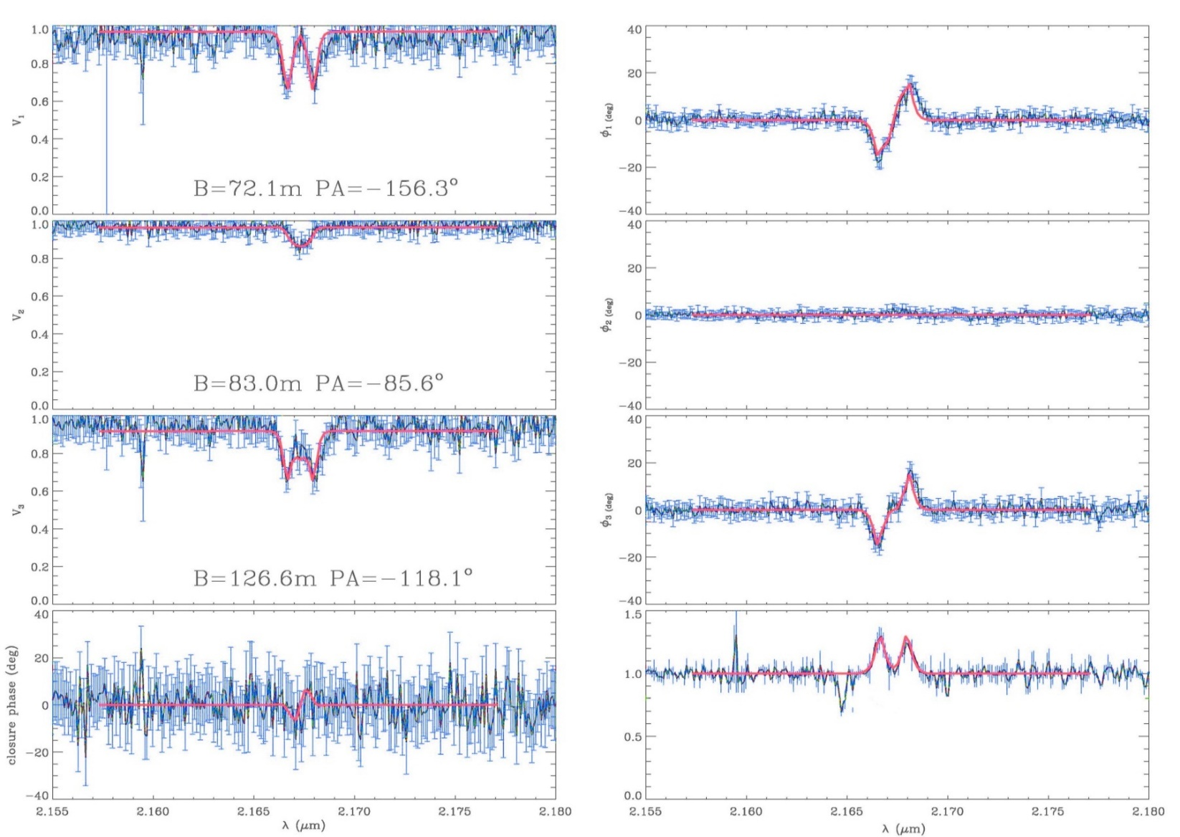
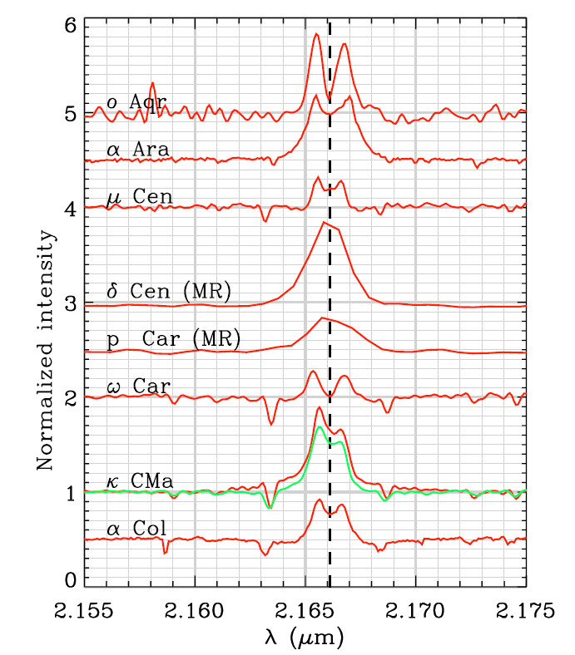
Kick-off Meeting : December, 29-30, 2022, Toulouse
What about the kinematics : classical Be stars
V₁₂
dφ₁₂
V₂₃
dφ₂₃
V₁₃
dφ₁₃
Closure phase
Spectrum

Slide 14
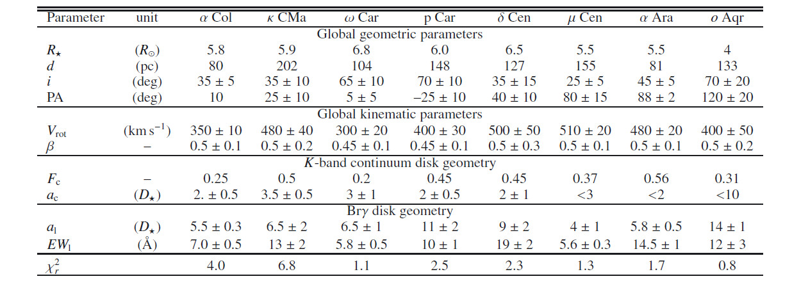
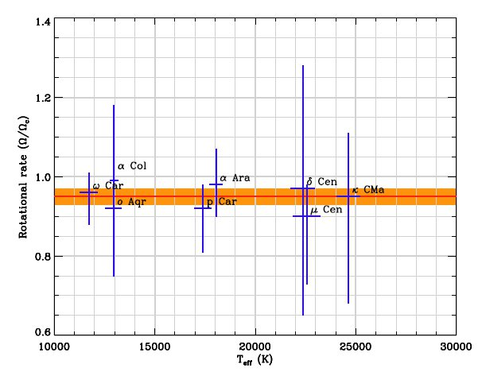
Kick-off Meeting : December, 29-30, 2022, Toulouse
What about the kinematics : classical Be stars
Keplerian disks with no expansion (v_{exp}<10km/s )
Nearly critical rotators
V/V_{c} = 0.82 ± 0.08
Ω/Ω_{c} = 0.95 ± 0.02
8 Be stars observed with the
VLTI/AMBER

Slide 15
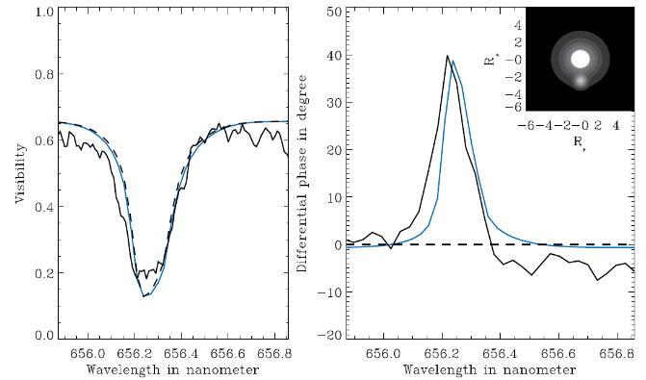
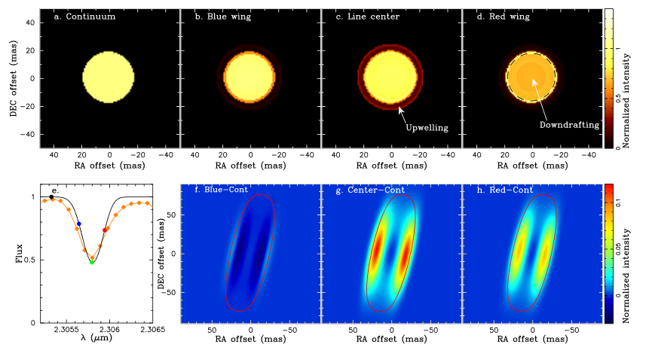
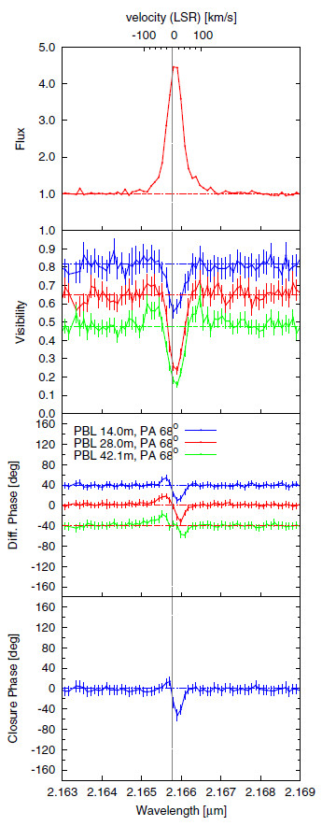
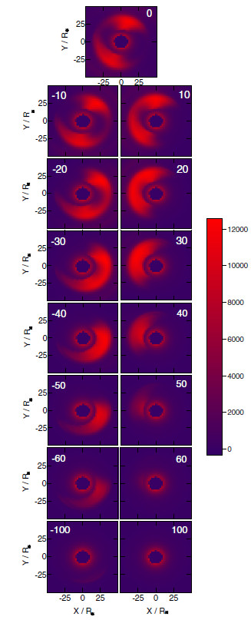
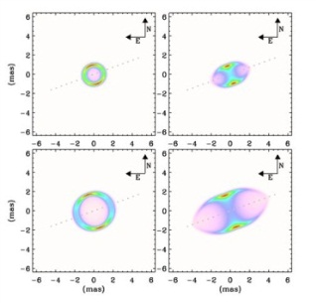
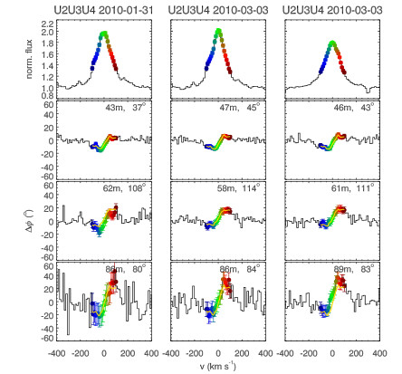
Kick-off Meeting : December, 29-30, 2022, Toulouse
What about the kinematics : other objects
Hot supergiant’s wind
Cool supergiant’s extended atmosphere
Herbig Ae/Be stars
Chesneau+ 2010
Ohnaka+ 2013
Novas
Supergiant B[e] stars
Malbet+ 2007, Tatulli+2007, Weigelt+ 2011, Perrault 2010+, Benisty 2013+
Chesneau+ 2011
Ellerbroek+ 2015, wheelwright+ 2012, Millour+ 2012

Slide 16
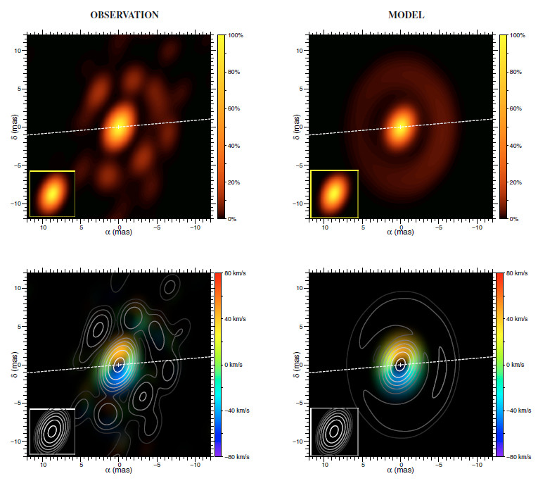
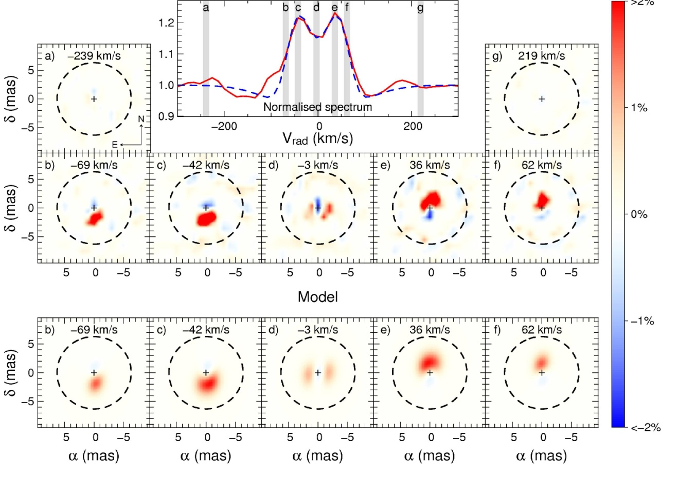
Kick-off Meeting : December, 29-30, 2022, Toulouse
Spectro-imaging © Millour
The A[e] supergiant HD62623 from VLTI/AMBER HR observations (Millour+ 2011)
η Car
Image in the 2.1µm continuum
Narrow-band images through the Brγ emission line
(with continuum substracted)

Slide 17
Kick-off Meeting : December, 29-30, 2022, Toulouse
Spectro-imaging © Millour
The A[e] supergiant HD62623 from VLTI/AMBER HR observations (Millour+ 2011)
η Car
Reconstructed projected velocity field
Narrow-band images through the Brγ emission line
(with continuum substracted)

Slide 18
Kick-off Meeting : December, 29-30, 2022, Toulouse
Spectro-imaging © Millour
The A[e] supergiant HD62623 from VLTI/AMBER HR observations (Millour+ 2011)
η Car
Reconstructed projected velocity field
Narrow-band images through the Brγ emission line
(with continuum substracted)

Slide 19
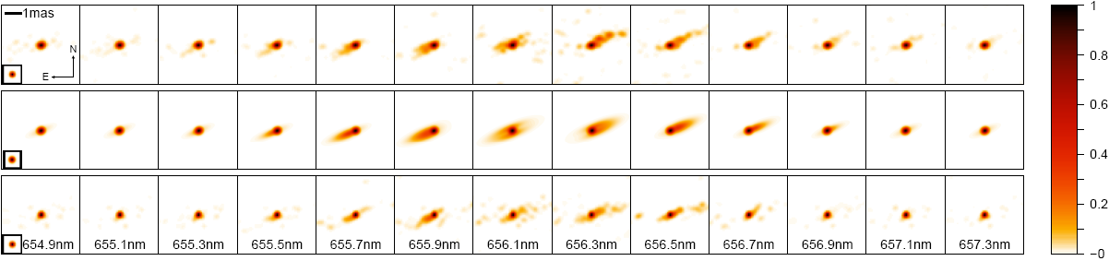
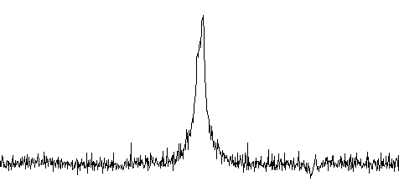
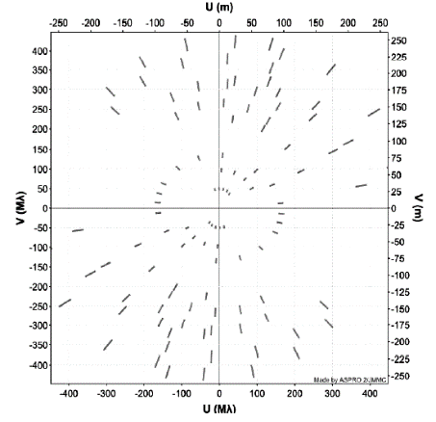
Kick-off Meeting : December, 29-30, 2022, Toulouse
Spectro-imaging © Millour
The binary Be star ϕ Persei seen by CHARA/VEGA (Mourard+ 2015)
Reconstructed images from the VEGA data
CHARA/VEGA Hα Image
Keplerian disk model
Observation with CHARA/VEGA in the Hα emission line wit h a nice (u,v) plan coverage

Slide 20
Kick-off Meeting : December, 29-30, 2022, Toulouse
Some limitations of the 1st generation instruments
No or Low imaging capability
  MIDI 2T
  VEGA 4T (no Closure Phase) ⬄ only differential imaging
  AMBER 3T
Low efficiency (time consuming)
In 3 nights with MATISSE we observed more B[e] than in 7 years with MIDI
Low Sensibility (bad Detector & instrumental concept)

Slide 21
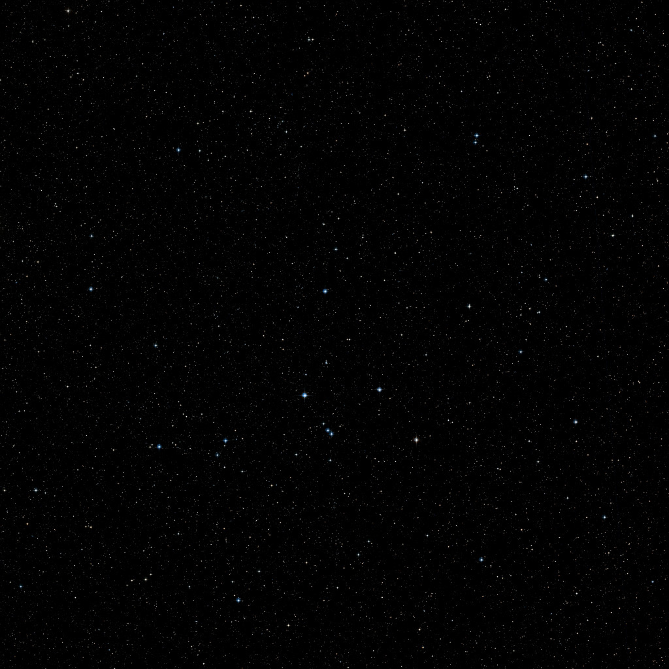
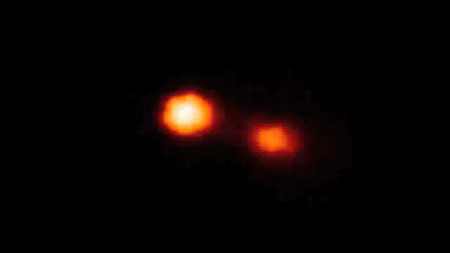
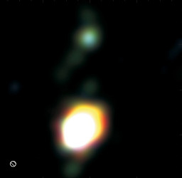
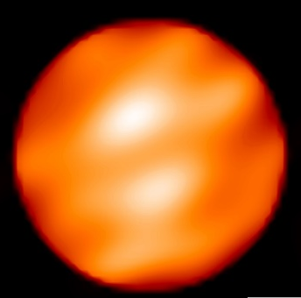
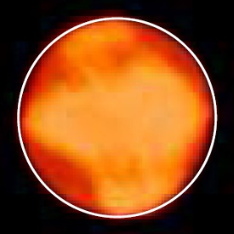

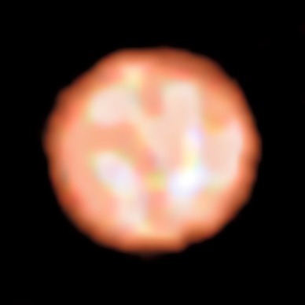

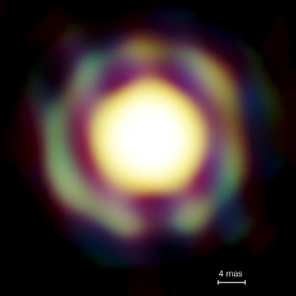
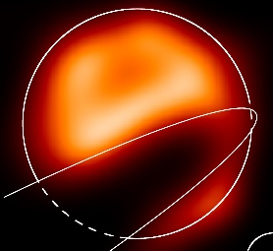


Kick-off Meeting : December, 29-30, 2022, Toulouse
A few images from optical interferometers
Binaries (Interacting, symbiotics, B[e]…)
Dust disks Inner rims of YSO
Giants and Supergiants
Kluska+ 2014
Zhao+ 2008
Kraus+ 2012
Benisty+ 2011
Blind+ 2014
Baron+ 2014
Haubois+ 2009
Millour+ 2009
Paladini+ 2018
Mira stars
The Eclipse of ε Aur
very massive YSO disks
Fast rotators
Kraus+ 2010
Le Bouquin+ 2009
Monnier+ 2007, Zhao+ 2009, Che+ 2011
Kloppenborg+ 2009

Slide 22
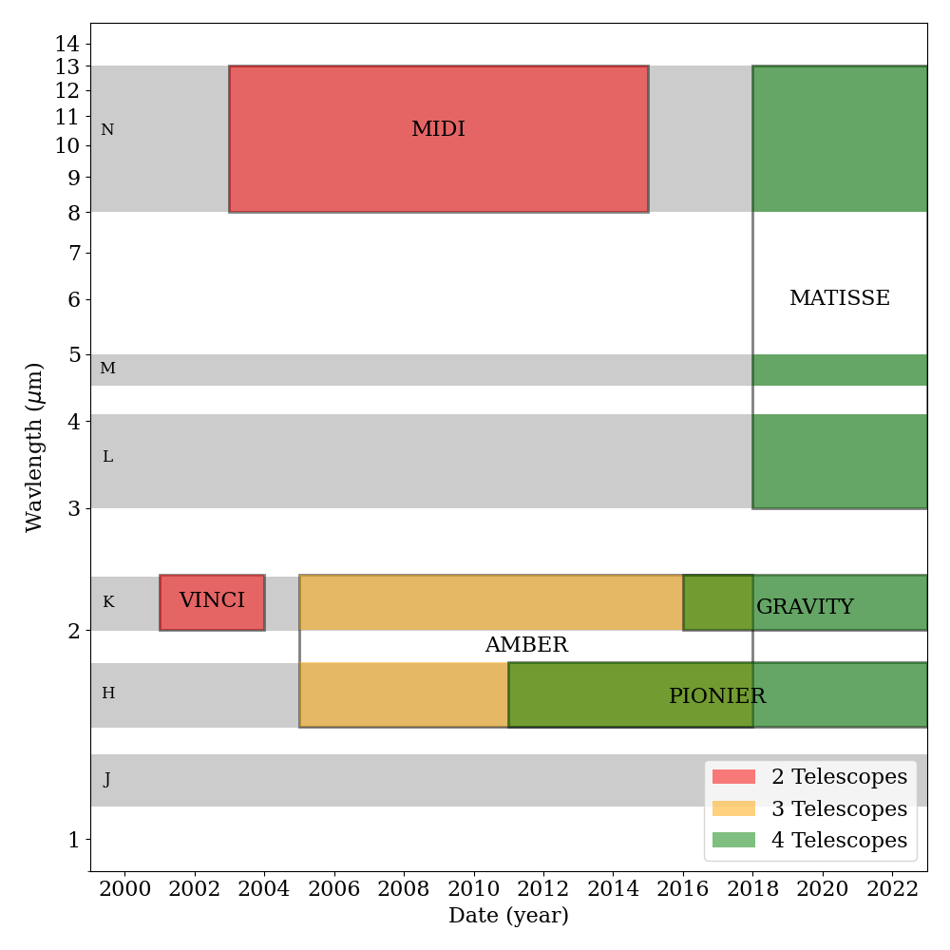
Kick-off Meeting : December, 29-30, 2022, Toulouse
MATISSE : the new mid-infrared instrument at VLTI
VLTI
4 Fixed 8m-Tels (UT)
4 Movable 1.8m-Tels (AT)
Baselines from 8m to 130m

Slide 23
Kick-off Meeting : December, 29-30, 2022, Toulouse
2 - Instruments that will be used in the MASSIF Project
VLTI/MATISSE 2018
CHARA/SPICA 2022
Also : VLTI/GRAVITY, VLT/SPHERE
VLTI/PIONIER, CHARA/MIRC
Instrumental prospective in the MASSIF frame

Slide 24

Kick-off Meeting : December, 29-30, 2022, Toulouse
MATISSE : the new mid-infrared instrument at VLTI
Cryostat-N
AQUARIUS
Cryostat-LM
HAWAII-2GR
Warm Optics table

Slide 25






Kick-off Meeting : December, 29-30, 2022, Toulouse
MATISSE : the new mid-infrared instrument at VLTI
YSO + planet formation
AGNs
Evolved Stars

Slide 26

Kick-off Meeting : December, 29-30, 2022, Toulouse
MATISSE : the new mid-infrared instrument at VLTI
Circumstellar environments
  LMN continuum emission:
    hot and warm dust
  LMN emission lines and bands
    hot gas
    Carbonaceous molecules
    crystalline dust
L&M bands | N band
3-4.1 + 4.5-5µm | 8-13µm
R = 34, 506, 950, 4000 | R = 30, 220

Slide 27









Kick-off Meeting : December, 29-30, 2022, Toulouse
MATISSE : First results
WIND Collision
unclB[e] star FS CMa
LBV+O star system Eta Car
Weigelt+ (2021)
AGB star R Scl
Gamez Rosas+ (2022)
Hofmann+ 2021
Circumstellar disks
Devron+ (in press)
B[e] survey
Surfaces and shells around evolved stars
NGC 1068
Chiavassa+ (2022)
Isbell et al. (in press)
Dust around
AGNS
AGB or RSG? VX Sgr
Circinus
Meilland+ in prep.

Slide 28



Kick-off Meeting : December, 29-30, 2022, Toulouse
MATISSE : B[e] stars imaging test
Hofmann+ 2021
L-band image (3.4-3.8 um)
uv coverage
unclB[e] star FS CMa
Inner rim
Gaseous emission
N-band image (8.6-9.0 um)
Hofmann+ 2021
Extended disk
Inner-Rim of the dust 6x12 mas ⬄ compatible with PIONIER image
Modelling with 3D-Monte-Carlo Radiative transfer code Polaris
Constraints on the disk density profile
Separation of gaz and dust emission and constraints on the gaseous disk density

Slide 29

Kick-off Meeting : December, 29-30, 2022, Toulouse
MATISSE : B[e] stars Survey

Slide 30

Kick-off Meeting : December, 29-30, 2022, Toulouse
MATISSE : B[e] stars Survey

Slide 31
Kick-off Meeting : December, 29-30, 2022, Toulouse
MATISSE : B[e] stars Survey (and imaging)
HD 87643
HD 62623
MWC 300

Slide 32

Kick-off Meeting : December, 29-30, 2022, Toulouse
MATISSE : in emission lines
First GRA4MAT test on the Be star δ Cen 2019-05-30 DIT = 10s

Slide 33





Kick-off Meeting : December, 29-30, 2022, Toulouse
MATISSE : in emission lines
Weigelt+ 2021
LBV+O star system Eta Car
redshifted
Direct view of the shock cone
at the periastron passage !
blue-shifted
Madura's clumpy cavity model
MATISSE iso-velocity images across the Br-alpha feature at 4.05 um

Slide 34

Kick-off Meeting : December, 29-30, 2022, Toulouse
MATISSE : in emission lines (Classical Be star β CMi)

Slide 35

Kick-off Meeting : December, 29-30, 2022, Toulouse
MATISSE : in emission lines (Classical Be star β CMi)
MATISSE Data in Brα
Fitted with a
kinematic toy model

Slide 36

Kick-off Meeting : December, 29-30, 2022, Toulouse
MATISSE : in emission lines (Classical Be star β CMi)
AMBER Data in Br γ
Fitted with a
kinematic toy model

Slide 37

Kick-off Meeting : December, 29-30, 2022, Toulouse
MATISSE : in emission lines (Classical Be star β CMi)
VEGA Data in Hα
Fitted with a
kinematic toy model

Slide 38

Kick-off Meeting : December, 29-30, 2022, Toulouse
MATISSE : in emission lines (Classical Be star β CMi)
Degenerecence of the
rotational law parameters
Vrot and β

Slide 39

Kick-off Meeting : December, 29-30, 2022, Toulouse
MATISSE : in emission lines (Classical Be star β CMi)

Slide 40
Kick-off Meeting : December, 29-30, 2022, Toulouse
SPICA : Surveying and Imaging stars in the visible
SPICA-VIS : the visible instrument
SPICA-FT : The fringe tracker in H-band (using MIRC)

Slide 41

Kick-off Meeting : December, 29-30, 2022, Toulouse
SPICA : Surveying and Imaging stars in the visible
Integrated optic ABDC chip based on GRAVITY-FT (but 6T instead of 4T)
To be installed on MIRC (using injection module and detector)

Slide 42

Kick-off Meeting : December, 29-30, 2022, Toulouse
SPICA-FT
Integrated optic ABDC chip based on GRAVITY-FT (but 6T instead of 4T)
To be installed on MIRC (using injection module and detector)

Slide 43


Kick-off Meeting : December, 29-30, 2022, Toulouse
SPICA-VIS
15 fringes systems + 6 Photometric beams
Recombination similar as AMBER & MATISSE

Slide 44


Kick-off Meeting : December, 29-30, 2022, Toulouse
SPICA : Surveying and Imaging stars in the visible

Slide 45



Kick-off Meeting : December, 29-30, 2022, Toulouse
SPICA : Simulation of Fast-rotators observation
DIM=256
ASPRO
oimodeler
User model
(image-cube fits)
Complex model
(chromatic or Image)
Image-Cube (fits)
DIM = 32
Data Simulator
with errors
Fitter
OIFITS
2000 steps
20 walkers
40000 models
13min
(20ms/model)
One 6T obs with SPICA

Slide 46


Kick-off Meeting : December, 29-30, 2022, Toulouse
SPICA : Simulation of Fast-rotators observation

Slide 47


Kick-off Meeting : December, 29-30, 2022, Toulouse
Other high-angular resolution instruments
GRAVITY observations of Rigel stellar surface & wind

Slide 48

Kick-off Meeting : December, 29-30, 2022, Toulouse
Other high-angular resolution instruments
Detection of radiative wind with VLT/SPHERE coronographic mode

Slide 49

Kick-off Meeting : December, 29-30, 2022, Toulouse
Current and future datasets

Slide 50

Kick-off Meeting : December, 29-30, 2022, Toulouse
Instrumental prospective at CHARA and VLTI
GRAVITY+
  upgrade du VLTI
  AO on 8m Telescope
  Large dual fields
ASGARD : near infrared suite of instrument
  New-fringe tracker
  Nulling interferometry (exoplanets)
  Instrument in J band (1-1.3 microns)
Visible instrument at VLTI : F. Millour
  White book on visible interferometry
  Many programs on massive stars
  No support for ESO
SPINE: SPectro-INterferomety Echelle (prototype) :
  R>20000 on large spectral window (0.6-0.9microns)

Slide 51
Kick-off Meeting : December, 29-30, 2022, Toulouse
3 - Modelling

Slide 52


Kick-off Meeting : December, 29-30, 2022, Toulouse
Modelling : oimodeler

Slide 53



Kick-off Meeting : December, 29-30, 2022, Toulouse
Modelling : oimodeler

Slide 54
Kick-off Meeting : December, 29-30, 2022, Toulouse
Modelling : oimodeler 2022
Implement missing basic features:
  Create components from fits files and grid
  Saving (data, models, fitter)
  Flux normalization (from 1 or ad-hoc to Jy)
  Photometric and spectroscopic data
Documentation and code cleaning
Add a few advanced features
  models (rot. disk, DISCO+, AMHRA, grids?)
  fitters (chromatic, lmfit, chain)
  filters (wl shift, smoothing, binning…)
Start building a test suite
  Tests for all models and features
  Simulated data (chromatic + time-dependent)
  Real data from all known instruments
Start working on optimization
  Parallelization
  FFT & Hankel algorithms
  Data optimization
January
  Model skeleton : oimParam, oimComponents, oimModel
March-May
  Implementation of Fourier-based components
  with chromatic parameters (using linear interpolation)
  Link between parameters
June-August:
  oimSimulator class (optimized data, data simulation, chi2)
  oimFitter class and first emcee Fitter
September:
  data filtering & plots
  documentation (on readthedoc)
October :
  image-plan components (FFT, sampling…)

Slide 55


Kick-off Meeting : December, 29-30, 2022, Toulouse
Modelling : oimodeler
Code available on github
https://github.com/oimodeler
Documentation available on readthedocs
https://oimodeler.readthedocs.io

