Slide 1
A modular modelling software
for optical interferometry

Slide 2
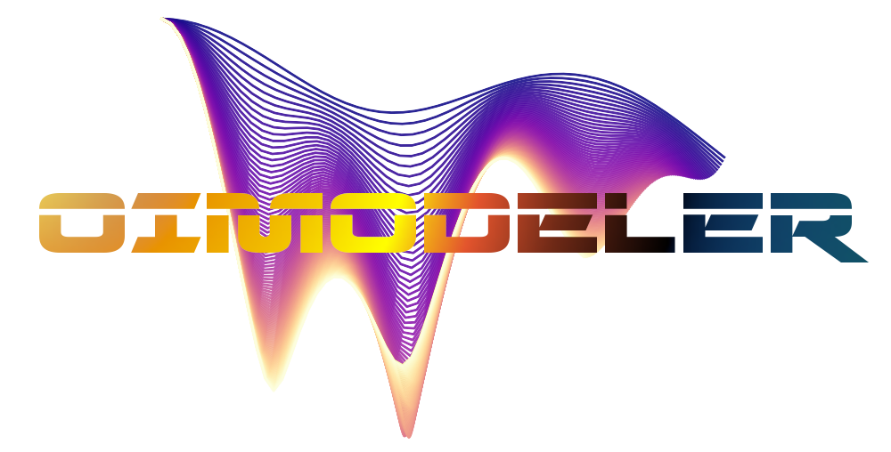
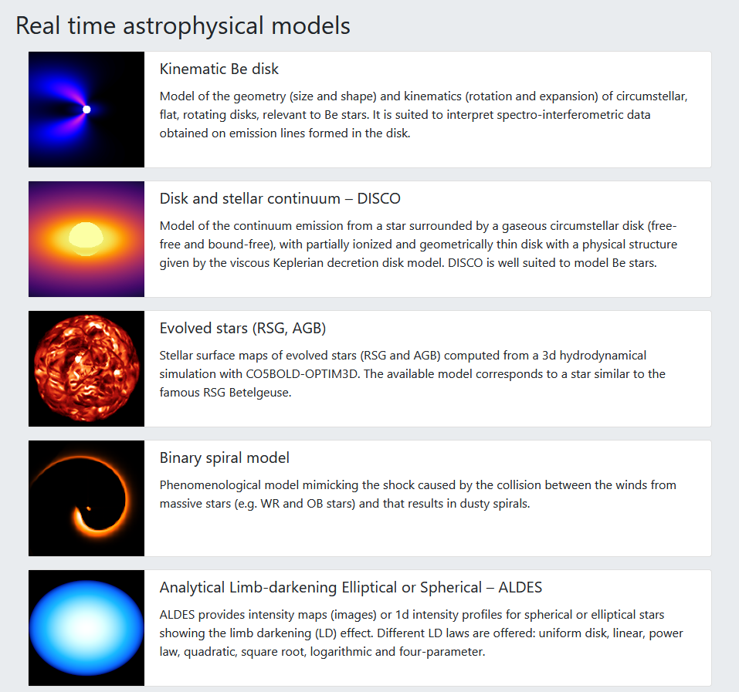
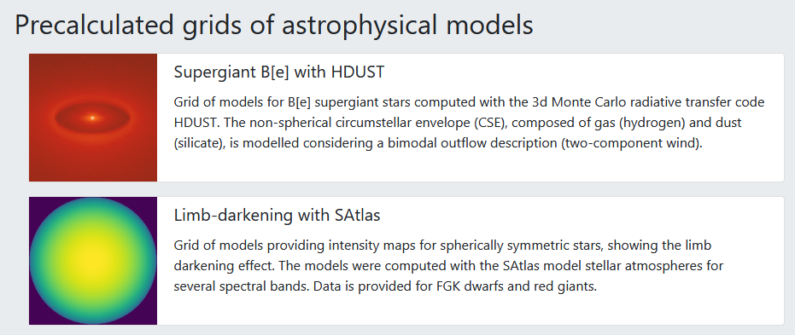
Context of the project
July 2021
MATISSE group
JMMC/AMHRA

Slide 3
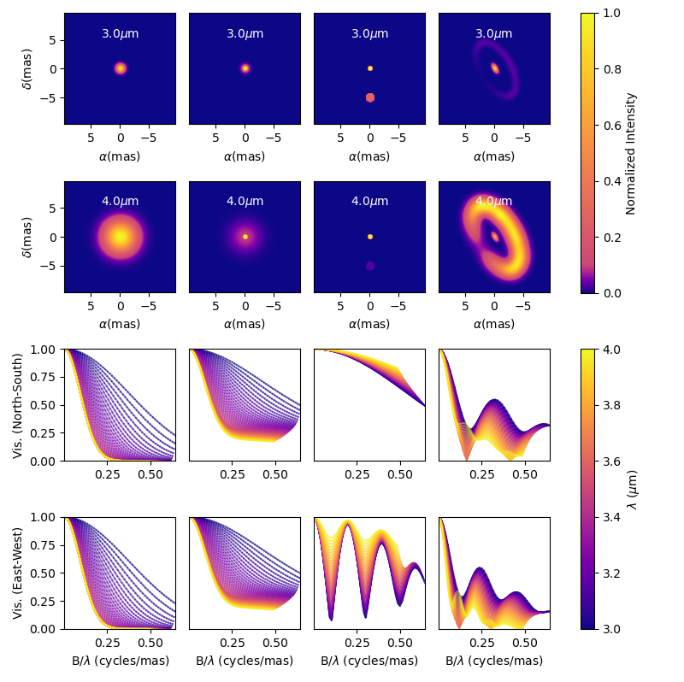
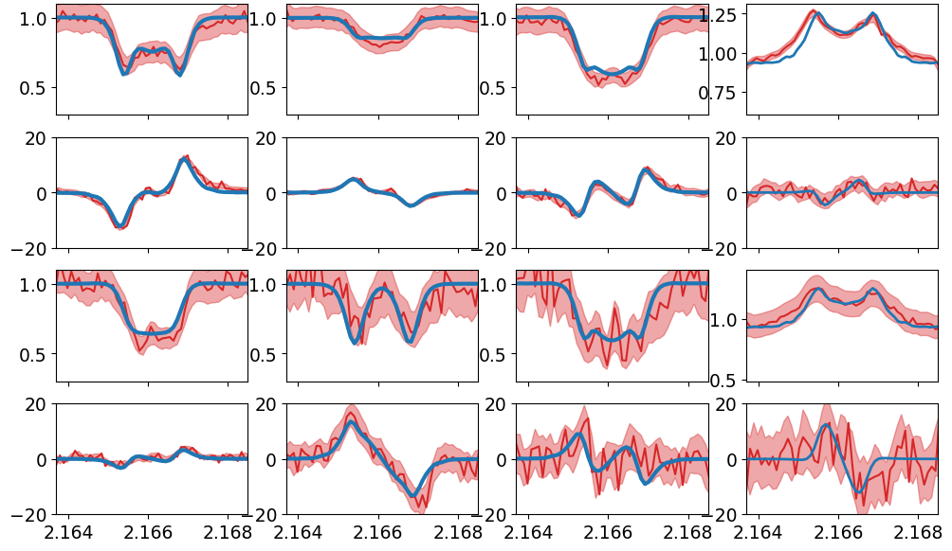
Context of the project
Oimodel.py (2021)
A modular & Fourier-based chromatic modelling tool
with a emcee (MCMC) fitter
Cubetools.py (2017)
Computing interferometric measurements
from chromatic image-cubes

Slide 4
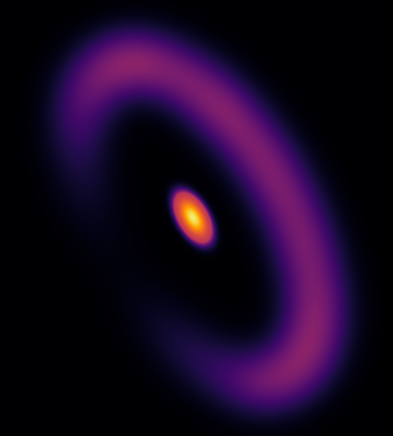
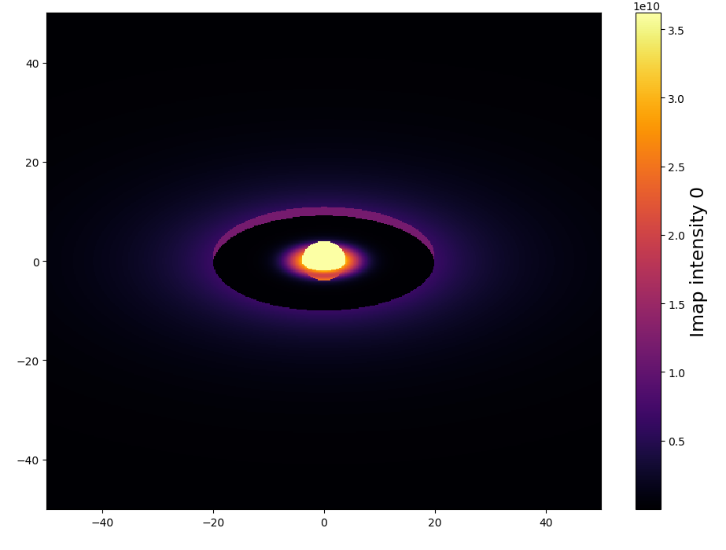
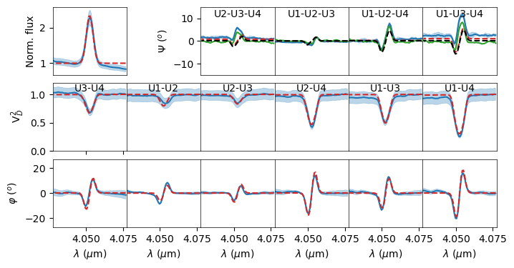
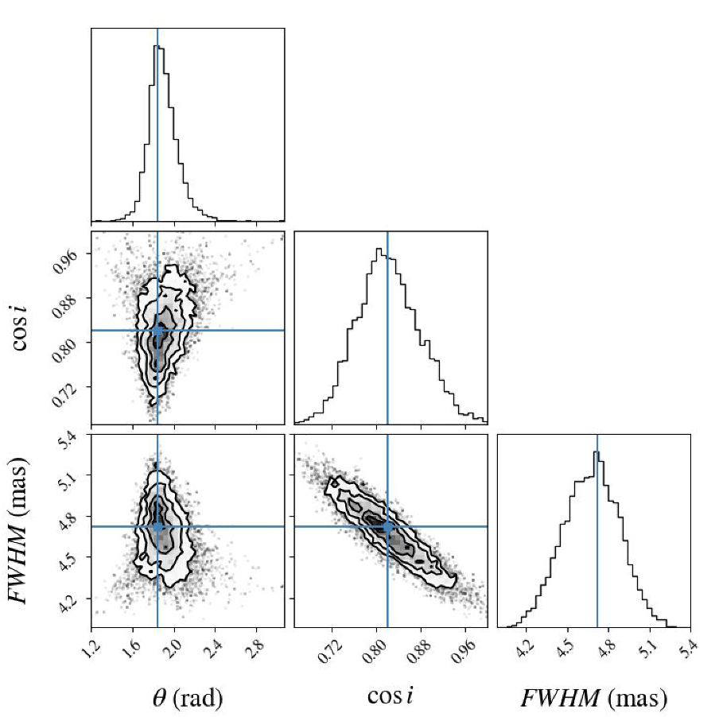
Discussion in MATISSE modelling group
By the end of 2021
Analytical model
Python3
Modularity and flexibility
Analytical models in Fourier-plan
Analytical & numerical models in Image-plan
Use outputs from radiative transfer and explore grids of models
Build more complex geometries by mixing components
Chromaticity and time dependence
Of the components parameters
Chromatic components (such as temperature gradient, binary)
Kinematics through line models
Ability to use interferometric data from all instruments (oifits)
Produce high-quality publishable outputs
Robust estimation of parameters with uncertainties and correlations
Nice customizable plots
Export simulated data and images to standard format (oifits and fits images)
Expandability
Easily create new components for models (inheritance, wrapping functions)
But also other features: type of data, filters, fitters, plots
Well documented (and with a test suite, examples, tutorials)
Open source & easily available (Github)
Semi-physical
RT-models
Or grid
DISCO+
Kinematic
HDUST
Betoy

Slide 5
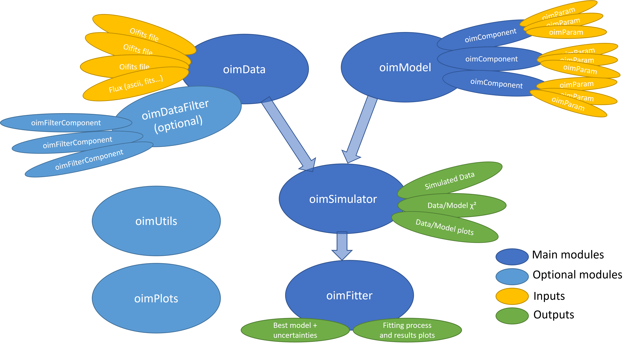
Coding started in 2022
January :
Model skeleton : oimParam, oimComponents, oimModel

Slide 6
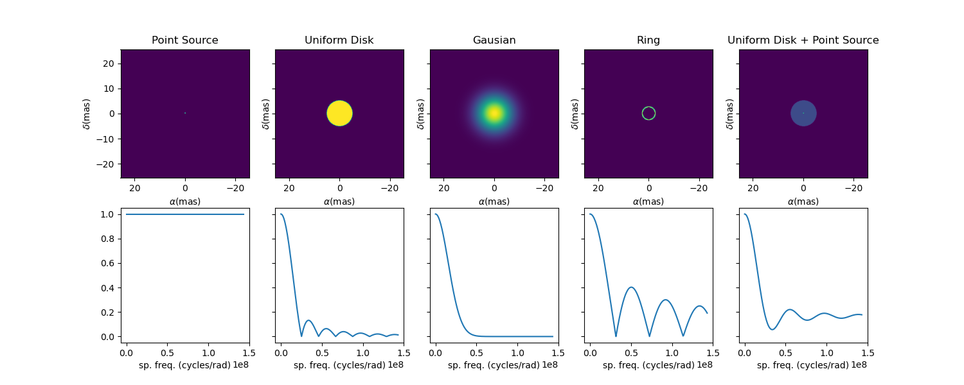
Coding started in 2022
January :
Model skeleton : oimParam, oimComponents, oimModel
March-May :
Implementation of Fourier-based components
with chromatic parameters (using linear interpolation)
Link between parameters

Slide 7
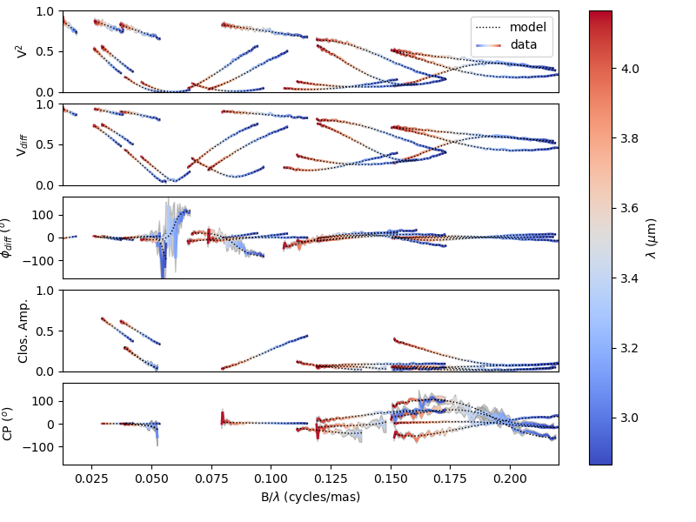
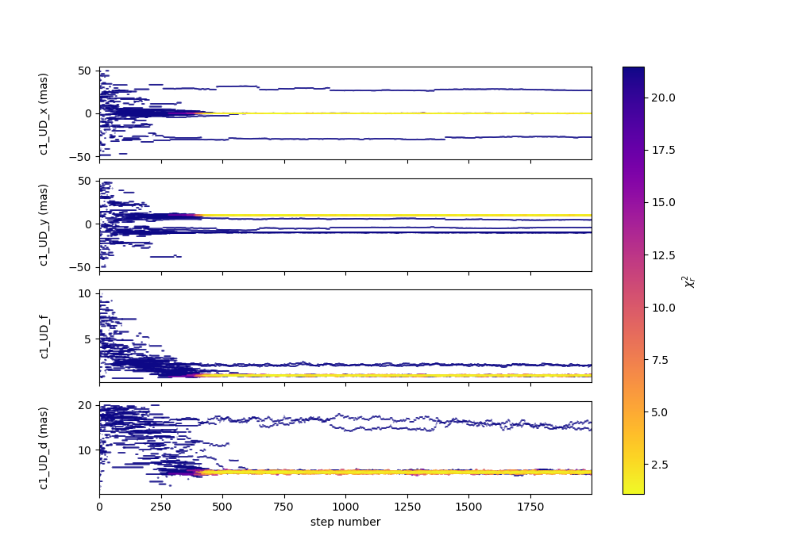
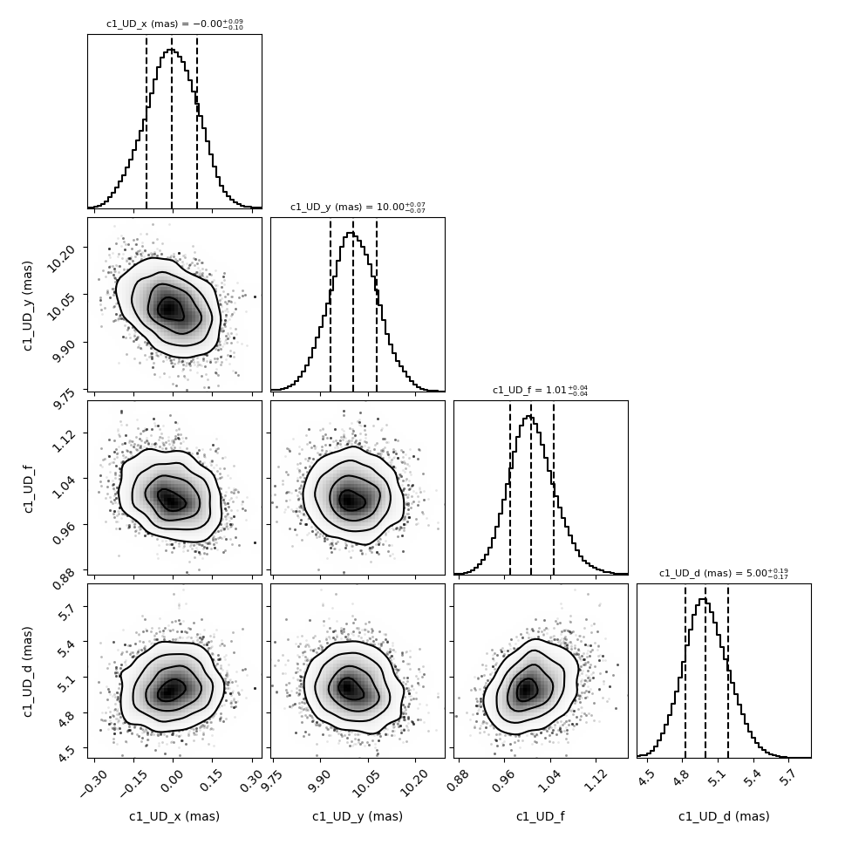
Coding started in 2022
January :
Model skeleton : oimParam, oimComponents, oimModel
March-May :
Implementation of Fourier-based components
with chromatic parameters (using linear interpolation)
Link between parameters
June-August:
oimSimulator class (optimized data, data simulation, chi2)
oimFitter class and first emcee Fitter

Slide 8
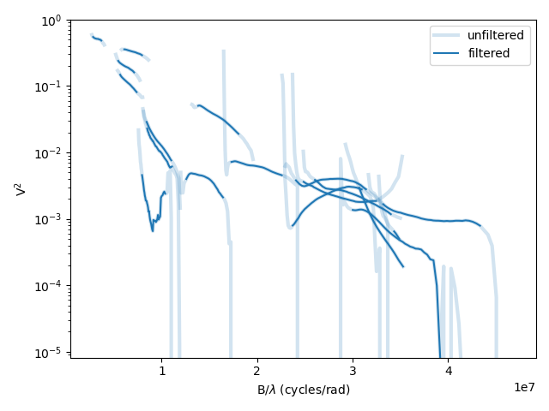
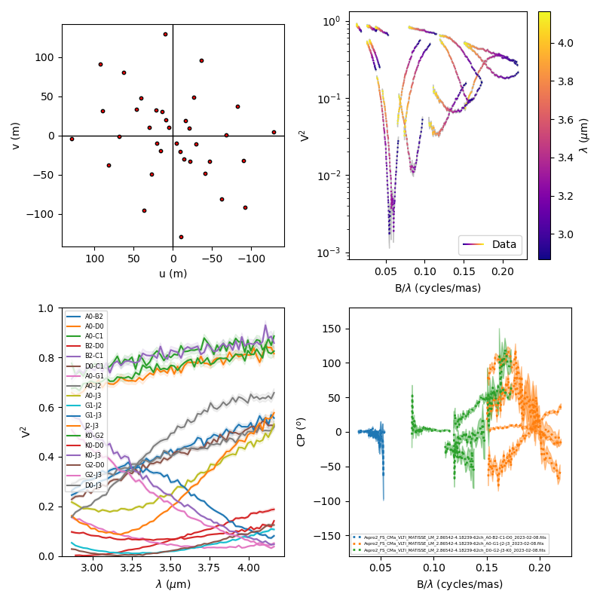
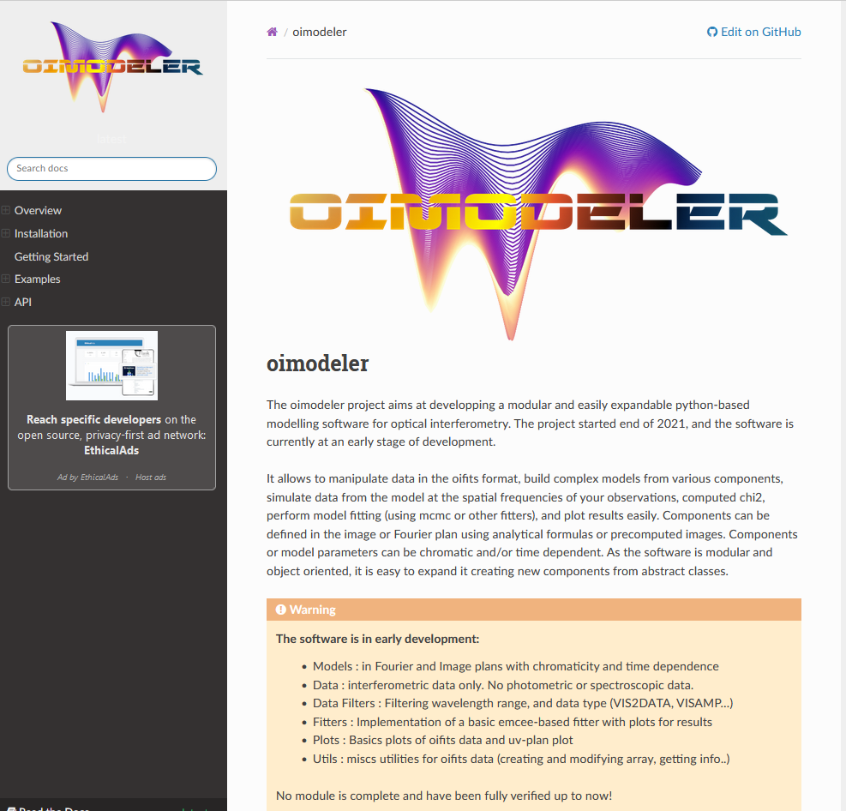
Coding started in 2022
January :
Model skeleton : oimParam, oimComponents, oimModel
March-May :
Implementation of Fourier-based components
with chromatic parameters (using linear interpolation)
Link between parameters
June-August:
oimSimulator class (optimized data, data simulation, chi2)
oimFitter class and first emcee Fitter
September:
data filtering & plots
documentation (on readthedoc)

Slide 9
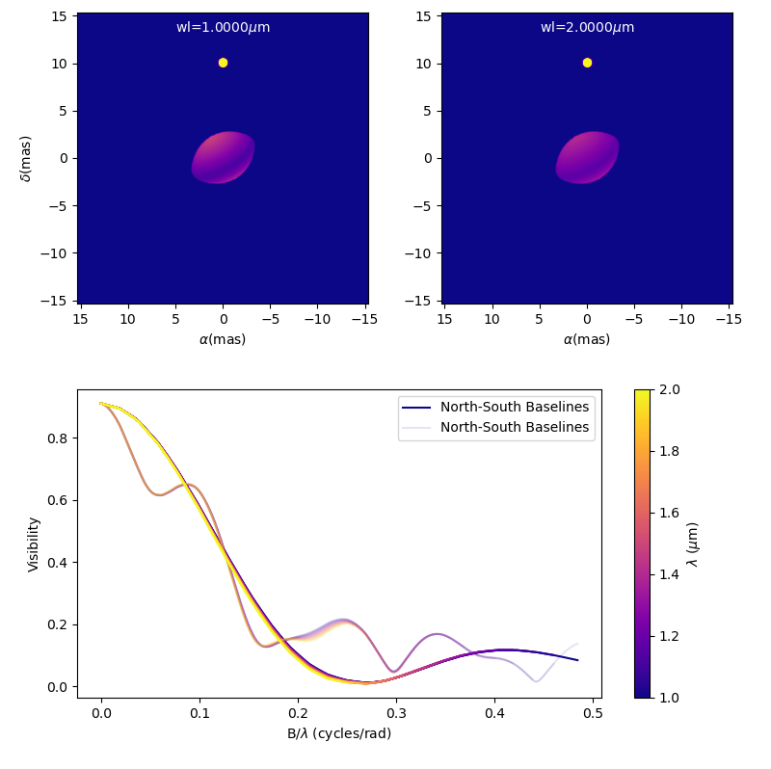
Coding started in 2022
January :
Model skeleton : oimParam, oimComponents, oimModel
March-May :
Implementation of Fourier-based components
with chromatic parameters (using linear interpolation)
Link between parameters
June-August:
oimSimulator class (optimized data, data simulation, chi2)
oimFitter class and first emcee Fitter
September:
data filtering & plots
documentation (on readthedoc)
October :
image-plan components (FFT, sampling…)

Slide 10
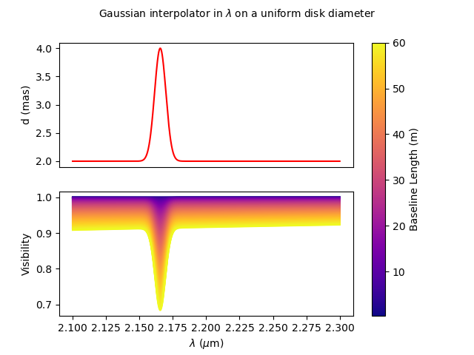
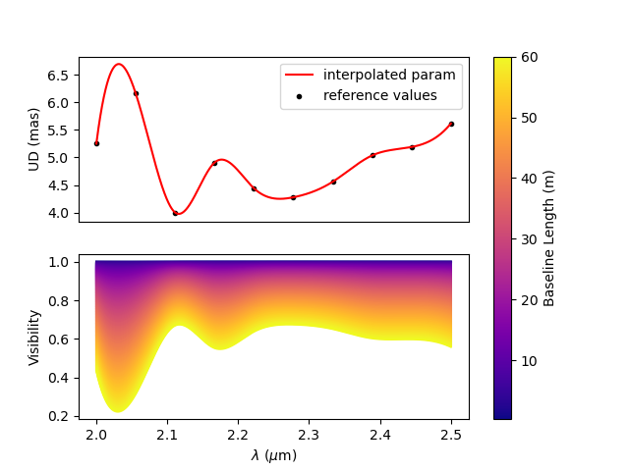
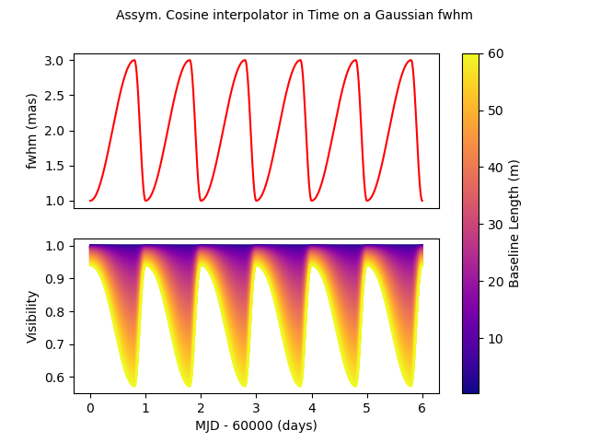
Coding started in 2022
January
Model skeleton : oimParam, oimComponents, oimModel
March-May
Implementation of Fourier-based components
with chromatic parameters (using linear interpolation)
Link between parameters
June-August:
oimSimulator class (optimized data, data simulation, chi2)
oimFitter class and first emcee Fitter
September:
data filtering & plots
documentation (on readthedoc)
October :
image-plan components (FFT, sampling…)
parameter interpolators (time and chromaticity)

Slide 11
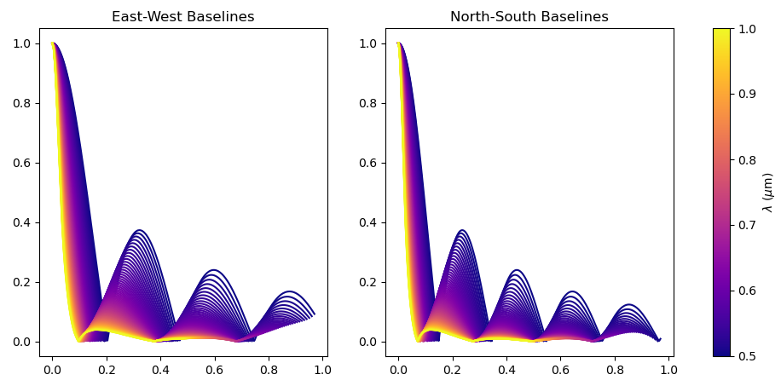
Coding started in 2022
January
Model skeleton : oimParam, oimComponents, oimModel
March-May
Implementation of Fourier-based components
with chromatic parameters (using linear interpolation)
Link between parameters
June-August:
oimSimulator class (optimized data, data simulation, chi2)
oimFitter class and first emcee Fitter
September:
data filtering & plots
documentation (on readthedoc)
October :
image-plan components (FFT, sampling…)
parameter interpolators (time and chromaticity)
November :
radial profile components (Hankel Transform)

Slide 12
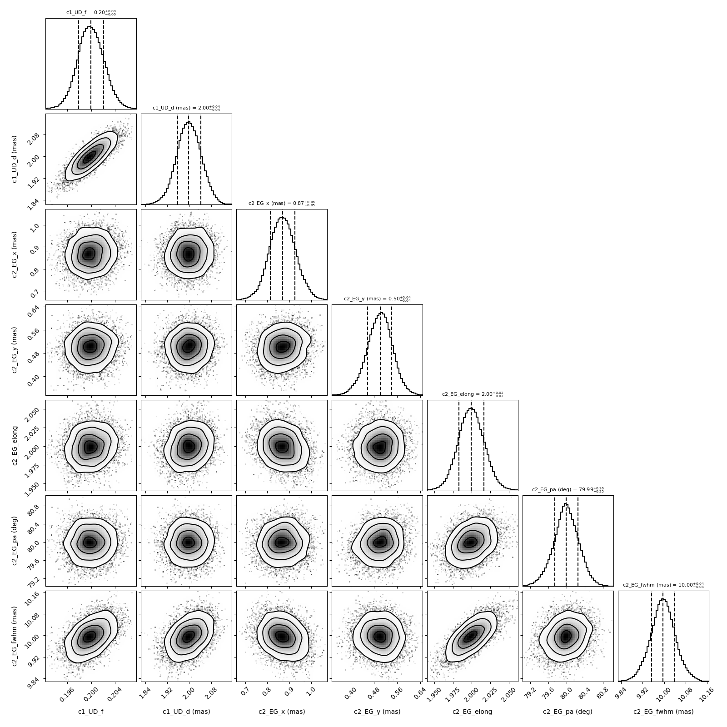
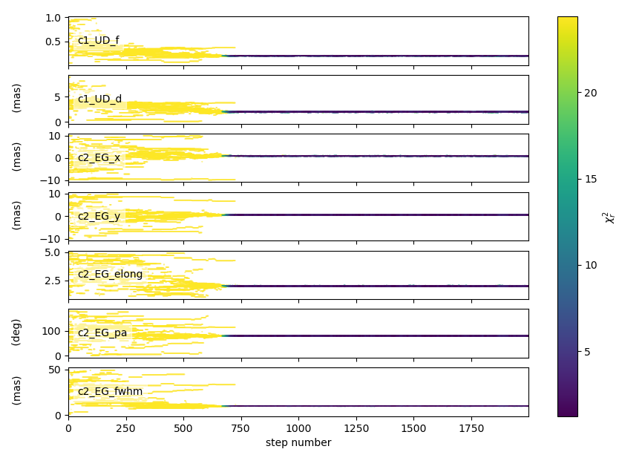
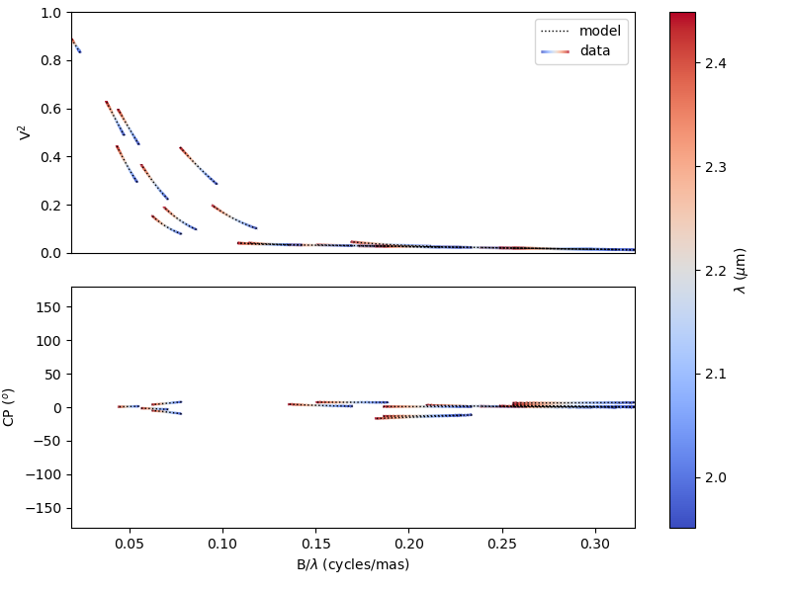
Coding started in 2022
January
Model skeleton : oimParam, oimComponents, oimModel
March-May
Implementation of Fourier-based components
with chromatic parameters (using linear interpolation)
Link between parameters
June-August:
oimSimulator class (optimized data, data simulation, chi2)
oimFitter class and first emcee Fitter
September:
data filtering & plots
documentation (on readthedoc)
October :
image-plan components (FFT, sampling…)
parameter interpolators (time and chromaticity)
November :
radial profile components (Hankel Transform)
December :
Code cleaning + examples
Test suite (ASPRO simulated data and real data from various instruments)

Slide 13
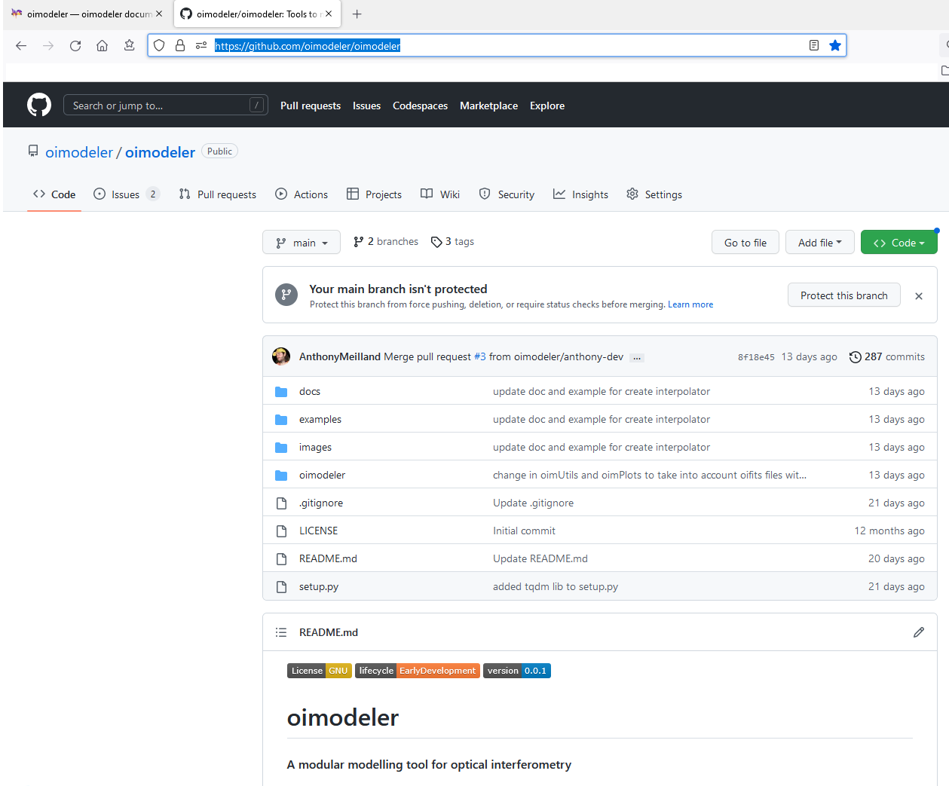
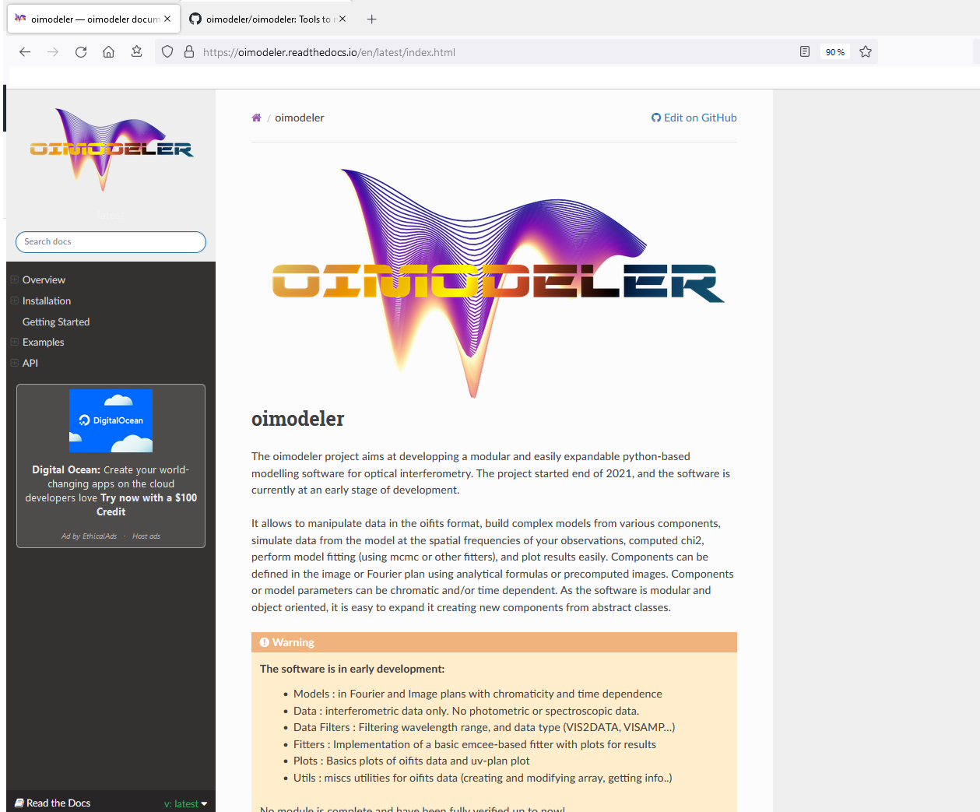
Oimodeler on the web
Code available on github
https://github.com/oimodeler
Documentation available on readthedocs
https://oimodeler.readthedocs.io

Slide 14
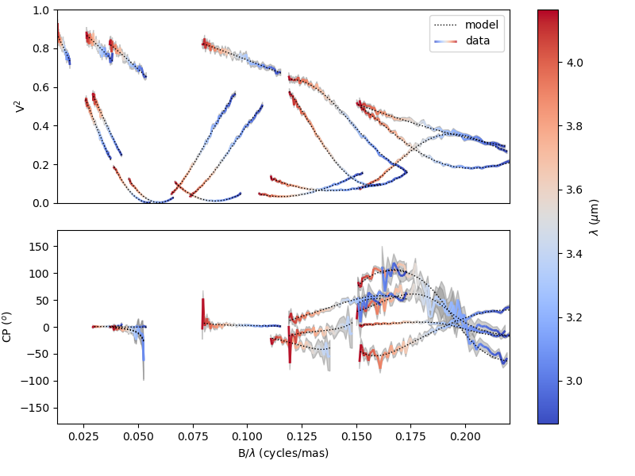
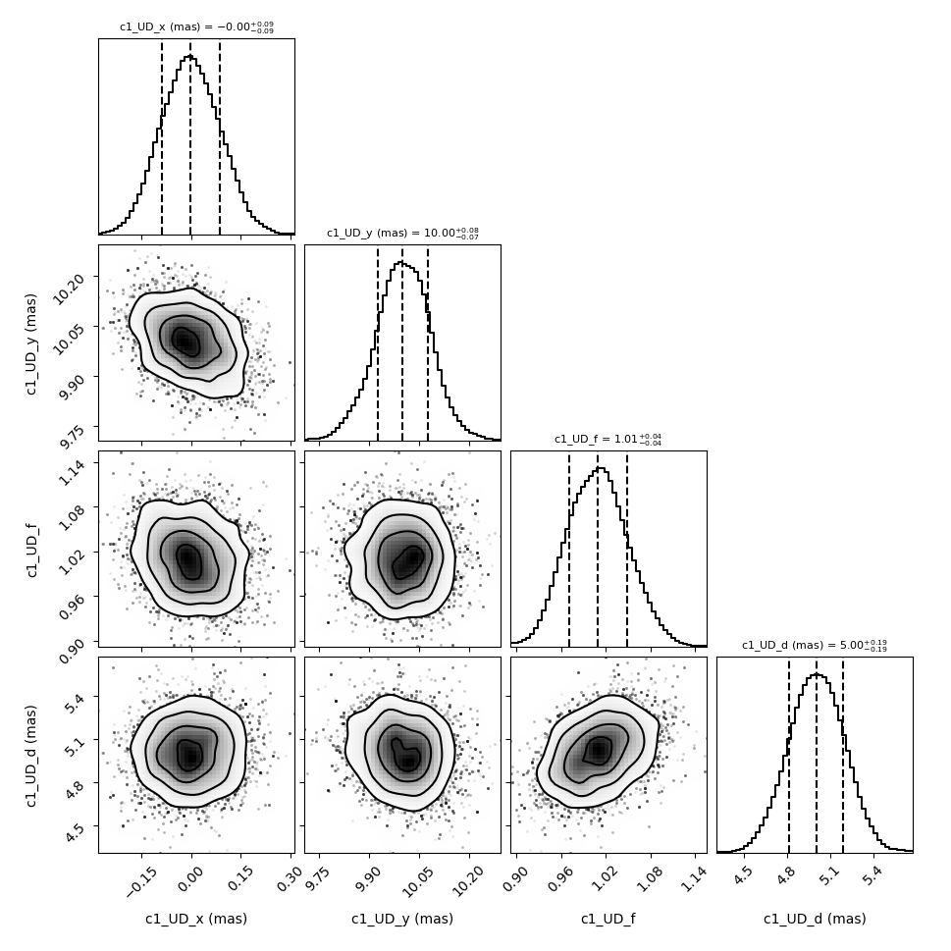
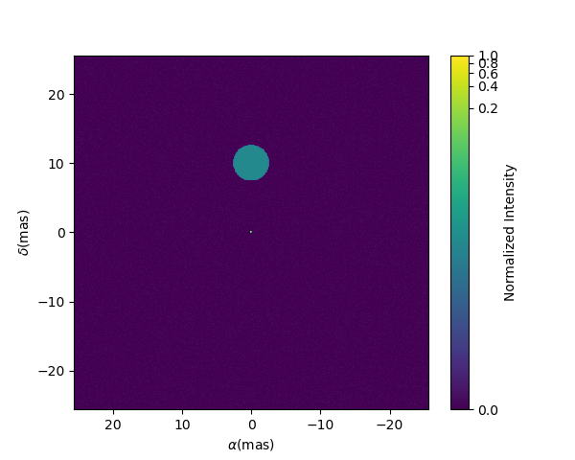
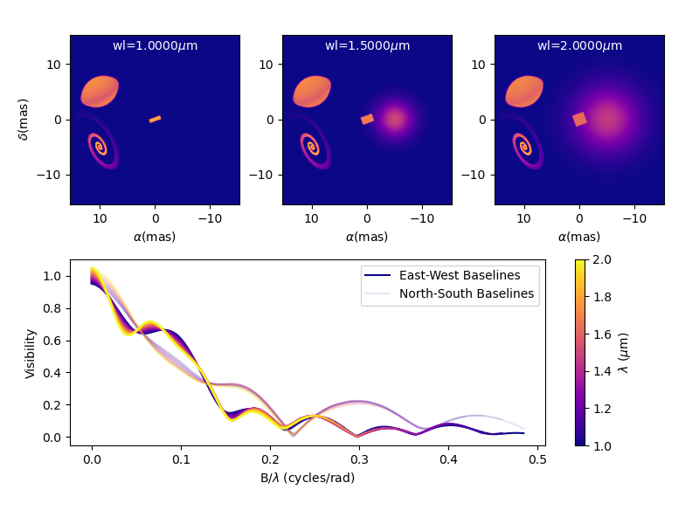
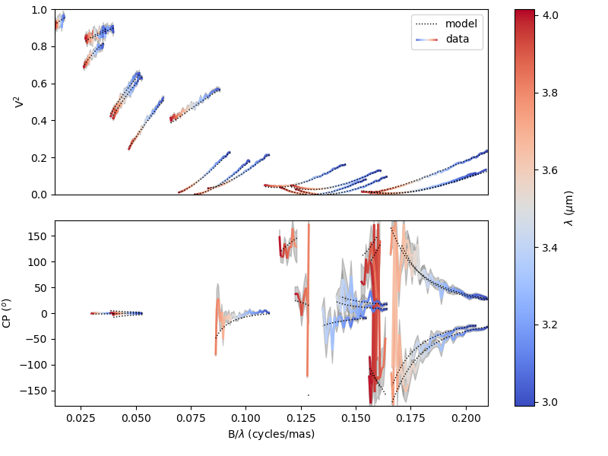
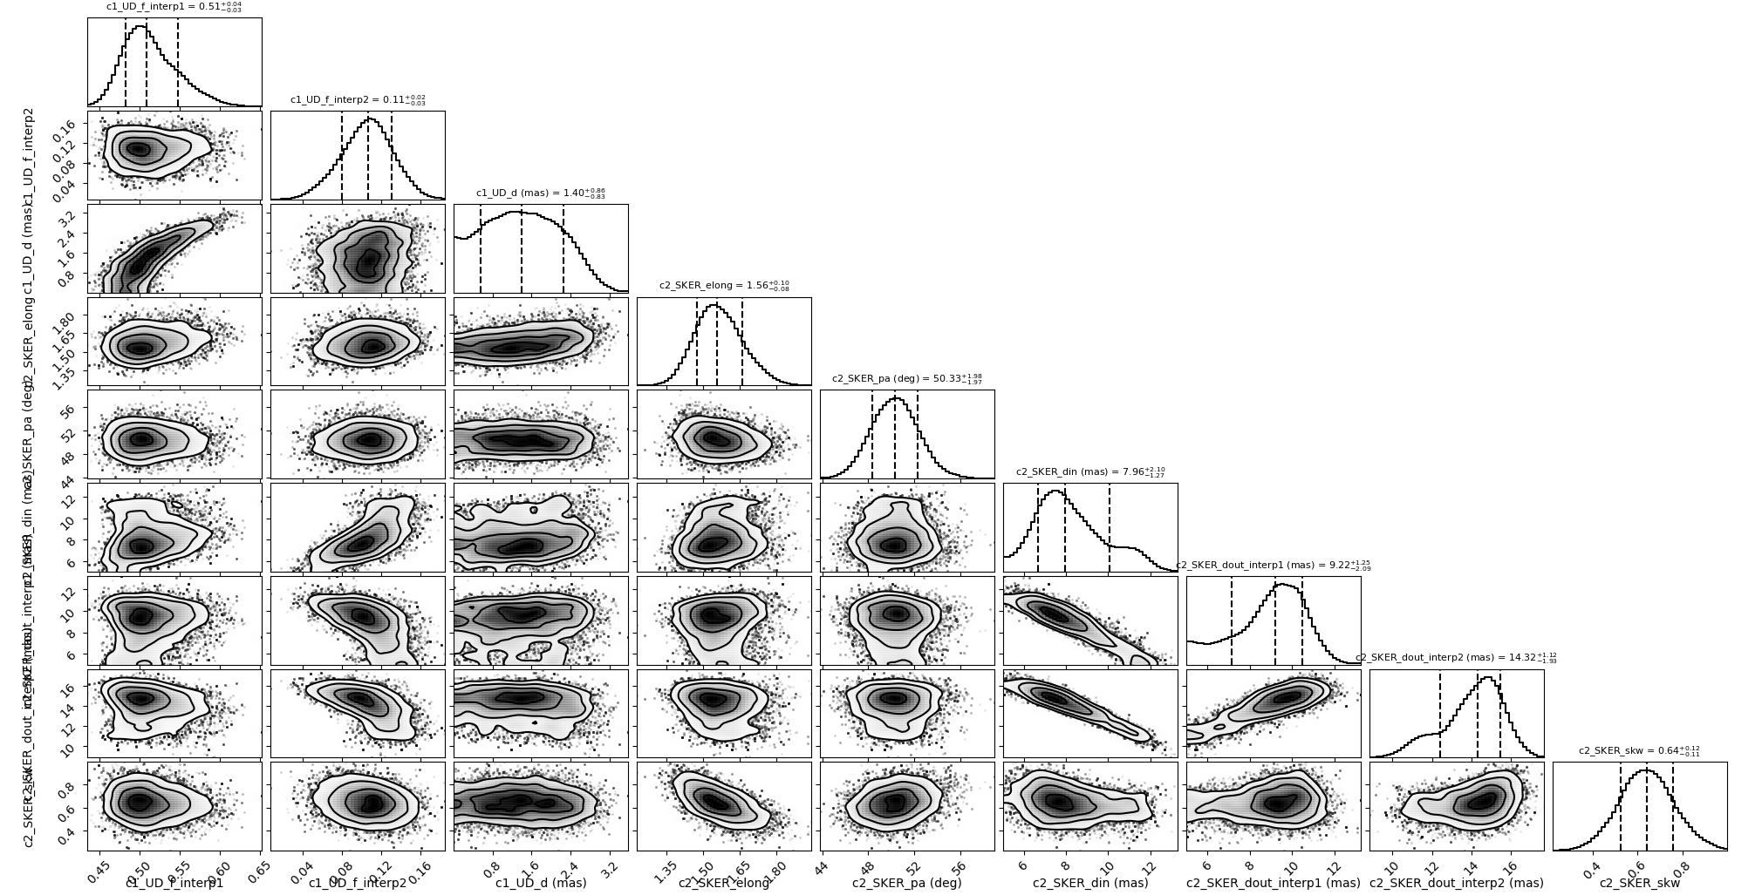
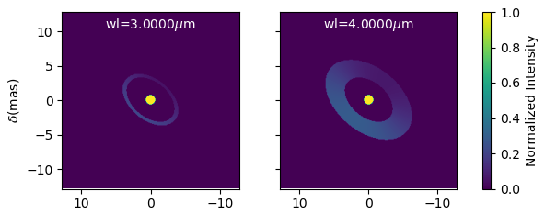
A Few examples
Model-fitting (on simulated data)
Adding new components
Achromatic
binary
Chromatic
Skewed disk
+ star

Slide 15
Example of simple model-fitting
Import oimodeler
import oimodeler as oim
ud = oim.oimUD(d=3,f=0.5,x=5,y=-5)
pt = oim.oimPt(f=1)
model = oim.oimModel(ud,pt)
ud.params['d'].set(min=0.01,max=20)
ud.params['x'].set(min=-50,max=50,free=True)
ud.params['y'].set(min=-50,max=50,free=True)
ud.params['f'].set(min=0.,max=10.)
pt.params['f']=oim.oimParamNorm(ud.params['f’])
fit = oim.oimFitterEmcee(files,model,nwalkers=20)
fit.prepare(init="random")
fit.run(nsteps=2000, progress=True)
median,err_l,err_u,err=fit.getResults(discard=1000)
fit.walkersPlot()
fit.cornerPlot()
fit.simulator.plot(["VIS2DATA","T3PHI"])
model.showModel(512,0.1)
Create a binary model
Set the parameters space
Normalizing flux to 1 (remove one free parameter)
Create, prepare and run the MCMC fitter
Get the results and plots
Make nice plots

Slide 16
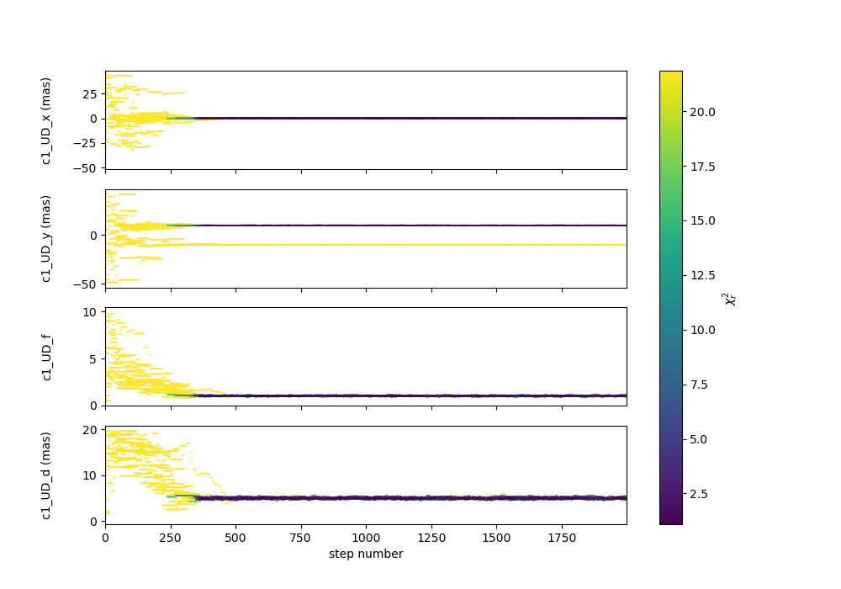
Example of simple model-fitting
import oimodeler as oim
ud = oim.oimUD(d=3,f=0.5,x=5,y=-5)
pt = oim.oimPt(f=1)
model = oim.oimModel(ud,pt)
ud.params['d'].set(min=0.01,max=20)
ud.params['x'].set(min=-50,max=50,free=True)
ud.params['y'].set(min=-50,max=50,free=True)
ud.params['f'].set(min=0.,max=10.)
pt.params['f']=oim.oimParamNorm(ud.params['f’])
fit = oim.oimFitterEmcee(files,model,nwalkers=20)
fit.prepare(init="random")
fit.run(nsteps=2000, progress=True)
median,err_l,err_u,err=fit.getResults(discard=1000)
fit.walkersPlot()
fit.cornerPlot()
fit.simulator.plot(["VIS2DATA","T3PHI"])
model.showModel(512,0.1)

Slide 17
Example of simple model-fitting
import oimodeler as oim
ud = oim.oimUD(d=3,f=0.5,x=5,y=-5)
pt = oim.oimPt(f=1)
model = oim.oimModel(ud,pt)
ud.params['d'].set(min=0.01,max=20)
ud.params['x'].set(min=-50,max=50,free=True)
ud.params['y'].set(min=-50,max=50,free=True)
ud.params['f'].set(min=0.,max=10.)
pt.params['f']=oim.oimParamNorm(ud.params['f’])
fit = oim.oimFitterEmcee(files,model,nwalkers=20)
fit.prepare(init="random")
fit.run(nsteps=2000, progress=True)
median,err_l,err_u,err=fit.getResults(discard=1000)
fit.walkersPlot()
fit.cornerPlot()
fit.simulator.plot(["VIS2DATA","T3PHI"])
model.showModel(512,0.1)

Slide 18
Example of simple model-fitting
import oimodeler as oim
ud = oim.oimUD(d=3,f=0.5,x=5,y=-5)
pt = oim.oimPt(f=1)
model = oim.oimModel(ud,pt)
ud.params['d'].set(min=0.01,max=20)
ud.params['x'].set(min=-50,max=50,free=True)
ud.params['y'].set(min=-50,max=50,free=True)
ud.params['f'].set(min=0.,max=10.)
pt.params['f']=oim.oimParamNorm(ud.params['f’])
fit = oim.oimFitterEmcee(files,model,nwalkers=20)
fit.prepare(init="random")
fit.run(nsteps=2000, progress=True)
median,err_l,err_u,err=fit.getResults(discard=1000)
fit.walkersPlot()
fit.cornerPlot()
fit.simulator.plot(["VIS2DATA","T3PHI"])
model.showModel(512,0.1)

Slide 19
Example of simple model-fitting
import oimodeler as oim
ud = oim.oimUD(d=3,f=0.5,x=5,y=-5)
pt = oim.oimPt(f=1)
model = oim.oimModel(ud,pt)
ud.params['d'].set(min=0.01,max=20)
ud.params['x'].set(min=-50,max=50,free=True)
ud.params['y'].set(min=-50,max=50,free=True)
ud.params['f'].set(min=0.,max=10.)
pt.params['f']=oim.oimParamNorm(ud.params['f’])
fit = oim.oimFitterEmcee(files,model,nwalkers=20)
fit.prepare(init="random")
fit.run(nsteps=2000, progress=True)
median,err_l,err_u,err=fit.getResults(discard=1000)
fit.walkersPlot()
fit.cornerPlot()
fit.simulator.plot(["VIS2DATA","T3PHI"])
model.showModel(512,0.1)

Slide 20
Chromatic model-fitting
import oimodeler as oim
star=oim.oimUD(d=1,f=oim.oimInterp("wl",wl=[3e-6,4e-6],values=[0.5,0.1]))
disk=oim.oimESKRing(din=8,dout=oim.oimInterp("wl",wl=[3e-6,4e-6],values=[9,14]),elong=1.5,skw=0.8,pa=50)
disk.params["skwPa"]=oim.oimParamLinker(disk.params["pa"],"add",90)
disk.params['f']=oim.oimParamNorm(star.params['f'])
model=oim.oimModel(star,disk)
params=model.getFreeParameters()
params['c1_UD_f_interp1'].set(min=0.0,max=1)
params['c1_UD_f_interp2'].set(min=0.0,max=1)
params['c1_UD_d'].set(min=0,max=5,free=True)
params['c2_SKER_pa'].set(min=0.,max=180)
params['c2_SKER_elong'].set(min=1,max=3)
params['c2_SKER_din'].set(min=5,max=20.)
params['c2_SKER_skw'].set(min=0,max=1.)
params['c2_SKER_dout_interp1'].set(min=5.,max=30.)
params['c2_SKER_dout_interp2'].set(min=5.,max=30.)
fit=oim.oimFitterEmcee(files,model,nwalkers=30)
fit.prepare(init="random")
fit.run(nsteps=2000,progress=True)
figWalkers,axeWalkers=fit.walkersPlot()
figCorner,axeCorner=fit.cornerPlot(discard=1000)
median,err_l,err_u,err=fit.getResults(mode='median',discard=1000)
figSim,axSim=fit.simulator.plot(["VIS2DATA","T3PHI"])
figImg,axImg,im=model.showModel(256,0.1,wl=[wl[0],wl[-1]])

Slide 21
Chromatic model-fitting
import oimodeler as oim
star=oim.oimUD(d=1,f=oim.oimInterp("wl",wl=[3e-6,4e-6],values=[0.5,0.1]))
disk=oim.oimESKRing(din=8,dout=oim.oimInterp("wl",wl=[3e-6,4e-6],values=[9,14]),elong=1.5,skw=0.8,pa=50)
disk.params["skwPa"]=oim.oimParamLinker(disk.params["pa"],"add",90)
disk.params['f']=oim.oimParamNorm(star.params['f'])
model=oim.oimModel(star,disk)
params=model.getFreeParameters()
params['c1_UD_f_interp1'].set(min=0.0,max=1)
params['c1_UD_f_interp2'].set(min=0.0,max=1)
params['c1_UD_d'].set(min=0,max=5,free=True)
params['c2_SKER_pa'].set(min=0.,max=180)
params['c2_SKER_elong'].set(min=1,max=3)
params['c2_SKER_din'].set(min=5,max=20.)
params['c2_SKER_skw'].set(min=0,max=1.)
params['c2_SKER_dout_interp1'].set(min=5.,max=30.)
params['c2_SKER_dout_interp2'].set(min=5.,max=30.)
fit=oim.oimFitterEmcee(files,model,nwalkers=30)
fit.prepare(init="random")
fit.run(nsteps=2000,progress=True)
figWalkers,axeWalkers=fit.walkersPlot()
figCorner,axeCorner=fit.cornerPlot(discard=1000)
median,err_l,err_u,err=fit.getResults(mode='median',discard=1000)
figSim,axSim=fit.simulator.plot(["VIS2DATA","T3PHI"])
figImg,axImg,im=model.showModel(256,0.1,wl=[wl[0],wl[-1]])

Slide 22
Creating new Fourier components
class oimBox(oim.oimComponentFourier):
name="2D Box"
shortname = "BOX“
def __init__(self,**kwargs):
super().__init__(**kwargs)
self.params["dx"]=oim.oimParam(name="dx", value=1,description="Size in x",unit=u.mas)
self.params["dy"]=oim.oimParam(name="dy", value=1,description="Size in y",unit=u.mas)
self._eval(**kwargs)
def _visFunction(self,ucoord,vcoord,rho,wl,t):
x=self.params["dx"](wl,t)*self.params["dx"].unit.to(u.rad)*ucoord
y=self.params["dy"](wl,t)*self.params["dy"].unit.to(u.rad)*vcoord
return np.sinc(x)*np.sinc(y)
def _imageFunction(self,xx,yy,wl,t):
return ((np.abs(xx)<=self.params["dx"](wl,t)/2) &
(np.abs(yy)<=self.params["dy"](wl,t)/2)).astype(float)
Initialization function
Call parent __init__
Define parameters (oimParam)
Call eval function
visibility function
formula as function of u and v or ρ (and optionally λ and t)
Image function
formula as function of x and y (and optionally λ and t)

Slide 23
Creating new Fourier components
class oimBox(oim.oimComponentFourier):
name="2D Box"
shortname = "BOX“
def __init__(self,**kwargs):
super().__init__(**kwargs)
self.params["dx"]=oim.oimParam(name="dx", value=1,description="Size in x",unit=u.mas)
self.params["dy"]=oim.oimParam(name="dy", value=1,description="Size in y",unit=u.mas)
self._eval(**kwargs)
def _visFunction(self,ucoord,vcoord,rho,wl,t):
x=self.params["dx"](wl,t)*self.params["dx"].unit.to(u.rad)*ucoord
y=self.params["dy"](wl,t)*self.params["dy"].unit.to(u.rad)*vcoord
return np.sinc(x)*np.sinc(y)
def _imageFunction(self,xx,yy,wl,t):
return ((np.abs(xx)<=self.params["dx"](wl,t)/2) &
(np.abs(yy)<=self.params["dy"](wl,t)/2)).astype(float)
b1=oimBox(dx=40,dy=10)
m1=oim.oimModel(b1)
m1.showModel(512,0.2,axe=ax[0],colorbar=False)
vis=np.abs(m.getComplexCoherentFlux(spfx,spfy)

Slide 24
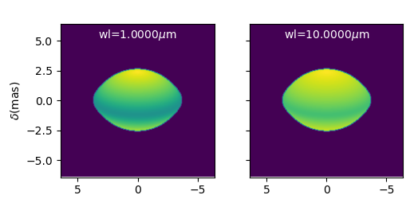
Creating new Image components (external code)
class oimFastRotator(oim.oimComponentImage):
name="Fast Rotator"
shortname="FRot"
def __init__(self,**kwargs):
super(). __init__(**kwargs)
self.params["incl"]=oim.oimParam(name="incl",value=0,description="Inclination angle",unit=units.deg)
self.params["rot"]=oim.oimParam(name="rot",value=0,description="Rotation Rate",unit=units.one)
self.params["Tpole"]=oim.oimParam(name="Tpole",value=20000,description="Polar Temperature",unit=units.K)
self.params["dpole"]=oim.oimParam(name="dplot",value=1,description="Polar diameter",unit=units.mas)
self.params["beta"]=oim.oimParam(name="beta", value=0.25,description="Gravity Darkening Exponent",unit=units.one)
self._t = np.array([0])
self._wl = np.linspace(0.5e-6,15e-6,num=10)
self._eval(**kwargs)
def _internalImage(self):
dim=self.params["dim"].value
incl=self.params["incl"].value
rot=self.params["rot"].value
Tpole=self.params["Tpole"].value
dpole=self.params["dpole"].value
beta=self.params["beta"].value
im=fastRotator(dim,1.5,incl,rot,Tpole,self._wl,beta=beta)
im=np.tile(np.moveaxis(im,-1,0)[None,:,:,:],(1,1,1,1))
self._pixSize=1.5*dpole/dim*units.mas.to(units.rad)
return im

Slide 25
Creating new Radial Profile components (analytical)
class oimExpRing(oim.oimComponentRadialProfile):
name="A ring with a descreasing exponential profil"
shortname = "ExpR"
elliptic=True
def __init__(self,**kwargs):
super().__init__(**kwargs)
self.params["d"]=oim.oimParam(**(oim._standardParameters["d"]))
self.params["fwhm"]=oim.oimParam(**(oim._standardParameters["fwhm"]))
self._dim=256
self._t = np.array([0])
self._wl = np.array([0.5e-6,1e-6])
self._r = np.arange(0, self._dim)*0.05 #in mas
self._eval(**kwargs)
def _radialProfileFunction(self,r,wl,t):
r0=self.params["d"](wl,t)/2
fwhm=self.params["fwhm"](wl,t)
return np.nan_to_num((r>r0)*np.exp(-0.692*np.divide(r-r0,fwhm)),nan=0)

Slide 26
Combining components

Slide 27
TODO in 2023 …
Implement missing basic features:
Create components from fits files and grid
Saving (model, fit)
Flux normalization (from 1 or ad-hoc to Jy)
Photometric and spectroscopic data
Add a few advanced features
models (rot. disk, DISCO+, AMHRA, grids?)
“intelligent” sampling for image based models
fitters (options, λ-by-λ, lmfit, chain, external constraints…)
filters (wl shift, smoothing, binning…)
Extensive test of the code
Unitary tests for all models and features
Tests Simulated data (chromatic + time-dependent)
Real data from all known instruments
Start working on optimization
Parallelization (model & fitter)
FFT & Hankel algorithms
Data optimization
Documentation & project management (GIT…)
Oimodeler Team is building up…
Anthony Meilland, Jozsef Varga, Alexis Matter, Marten Scheuck, Armando Domiciano de Souza …
master and phD students in Nice, Leiden and Heildelberg …
+ ANR MASSIF

Slide 28
How did I produce simulated data for comparison?
ASPRO
oimodeler
Analytical model
Analytical model
Same model
Data Simulator
with errors
Fitter
OIFITS

Slide 29
How did I produce simulated data for comparison?
ASPRO
oimodeler
User model
(image-cube fits)
Complex model
(chromatic or Image)
Image-Cube (fits)
Data Simulator
with errors
Fitter
OIFITS

Slide 30
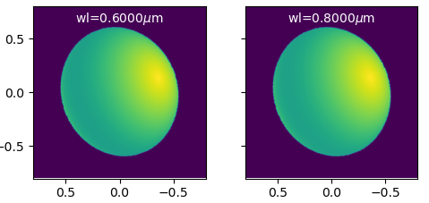
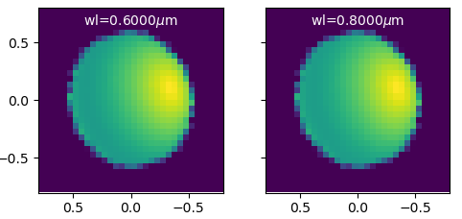
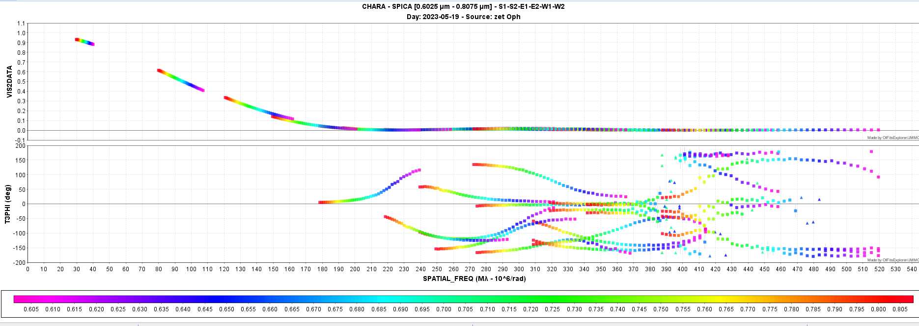
Model-fitting with a image-plan model
DIM=256
ASPRO
oimodeler
User model
(image-cube fits)
Complex model
(chromatic or Image)
Image-Cube (fits)
DIM = 32
Data Simulator
with errors
Fitter
OIFITS
2000 steps
20 walkers
40000 models
13min
(20ms/model)
One 6T obs with SPICA

