Slide 1
MATISSE Data Reduction
A. Meilland, P Berio, F. Millour and the MATISSE consortium

Slide 2
MATISSE Data Reduction Software
MATISSE Pipeline developed in C with ESO Standard
including CPL, GSL, FFTW, FITSIO, ERFA
MATISSE Recipes run through ESOREX :
directly in command line
with ESO interactive tools
REFLEX
GASGANO
with the consortium Python package (mat_tools)
In command line
Interactively

Slide 3
MATISSE Data Reduction Software
mat_raw_estimates : computes raw interferometric observables
(square visibility & coherent flux, closure phase, differential phase)
Produce OIFITS files for raw data
mat_cal_oifits : calibrates raw interferometric observables (SCI /CAL)
Produce OIFITS files for calibrated data
mat_cal_imarec : reconstructs an image from serie of OIFITS files
Use IRBIS algorythm

Slide 4
MATISSE Data Reduction Software
mat_raw_estimates :
mat_cal_image : raw image calibration
mat_ext_beams : photometric estimation
mat_est_corr : correlated flux estimation
mat_est_opd : OPD estimation
mat_proc_incoherent : incoherent processing
mat_proc_coherent : coherent processing
mat_est_tf : transfert function estimation
mat_merge_results : merge intermediate products into OIFITS files

Slide 5
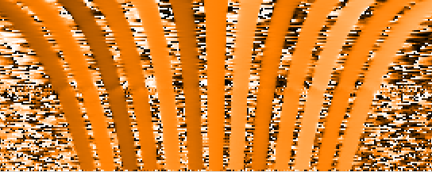
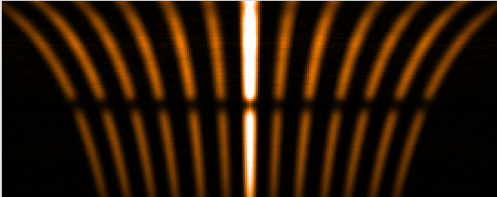
MATISSE Data Reduction Software
RAW Fringes
1D-FFT Phase
Differential Phase (OI_VIS)
Closure Phase (OI_T3)
1D-FFT Modulus
RAW Fringes
Corr. Flux
V² (OI_VIS2)
SHIFT
+
BIAS
STATIC CAL.
BPM + FFM
SKY
Photometric beams
Flux (OI_FLUX)

Slide 6
MATISSE Data Reduction Software
Frame integration in two different modes
Incoherent integration
Coherent integration
AMBER like
Per frame OPD
OPD correction
Coherent Integration
MIDI like
OPD and ϕ_{achromatic} phase per frame
Correaction OPD and ϕ_{achromatic}
Coherent integration
ϕ_{diff}
V_{diff}
ϕ_{diff}
Vis or Corr. Flux

Slide 7
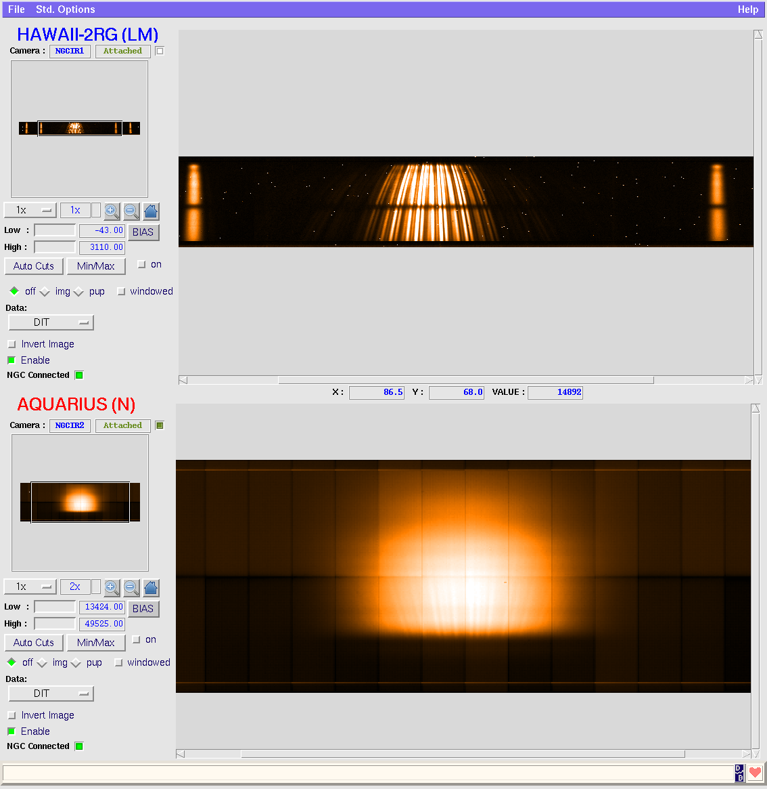
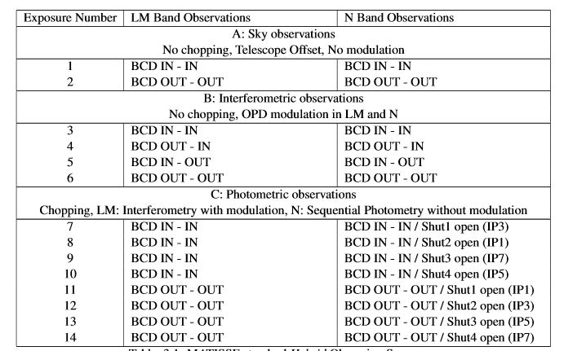
MATISSE Data Reduction Software
About the Photometry in Hybrid mode
L&M bands : SIPHOT
Hybrid sequence of observation
N band : HISENS

Slide 8
MATISSE Data Reduction Software
To Chop or not to Chop?
LM-bands
No Chopping
⬄
No Chopped Fringes
⬄
Bad photometry
for Fainter Targets
(limit depends on λ)
⬄
Bad visibility
(Corr. Flux not affected)
N-band
No Chopping
⬄
No Photometry
⬄
No visibility
(only Corr. Flux)

Slide 9
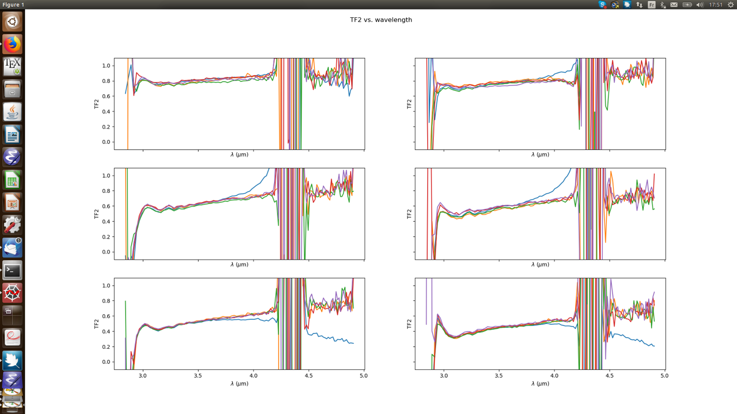
MATISSE Data Reduction Software
To Chop or not to Chop
Non-chopped (blue) diverges at 3.7um for this 14 Jy source
Consortium working on that issue (possibility to always chop)

Slide 10
MATISSE Data Reduction Software
The BCD sequence and its consequences
U1
U2
U3
U4
 | OUT-OUT | IN-OUT | OUT-IN | IN-IN
Peak1 | U3-U4 | U4-U3 | U3-U4 | U4-U3
Peak2 | U1-U2 | U1-U2 | U2-U1 | U2-U1
Peak3 | U2-U3 | U2-U4 | U1-U3 | U2-U3
Peak4 | U2-U4 | U2-U3 | U1-U2 | U1-U3
Peak5 | U1-U3 | U1-U4 | U2-U3 | U2-U4
Peak6 | U1-U4 | U1-U3 | U2-U4 | U2-U3
BCD2
BCD1
Effects in final OIFITS files :
Swap baselines between exposures
Inverse telescopes for some baselines
Effect on closure phase too (3 Tels)
Exposure merging is not trivial!
P1 P2 P3 P4 P5 P6
FFT

Slide 11
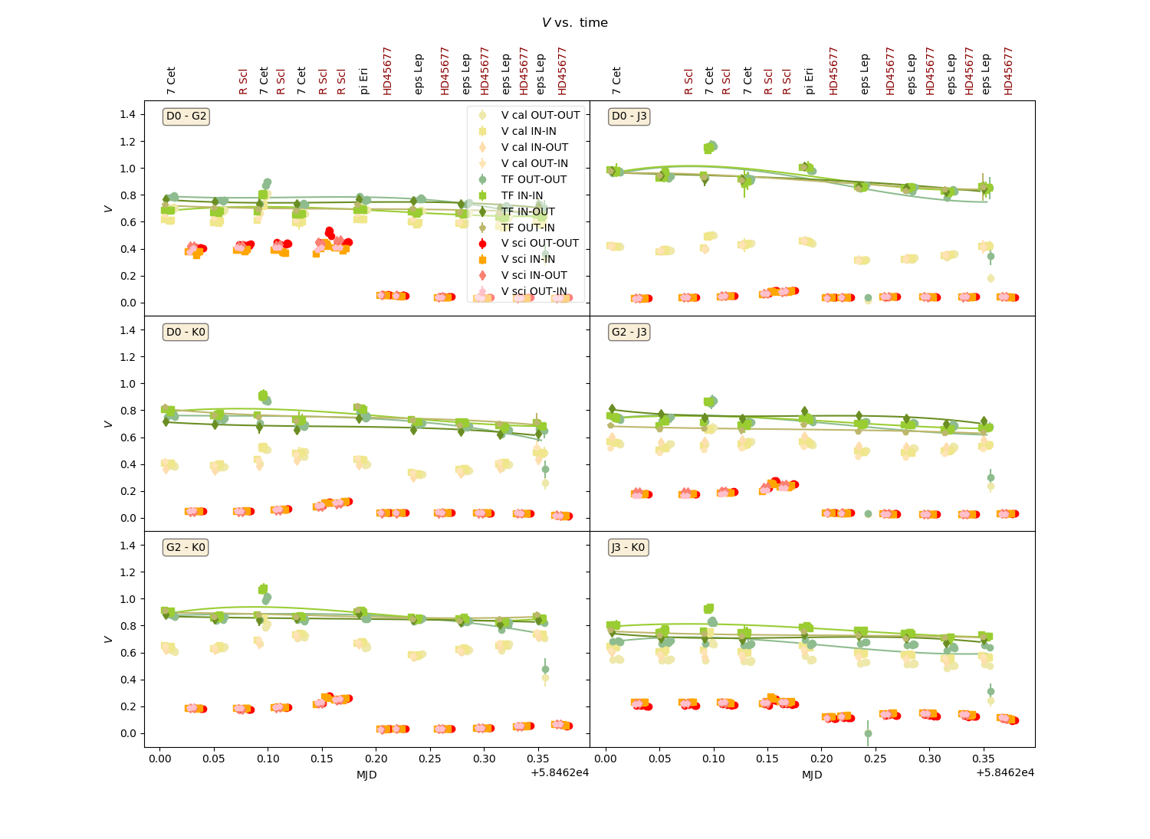
MATISSE Data Reduction Software
Data calibration : V²
Angular stellar diameter θ
from JSDC catalog
TF
V_{calibrator}
Transfer function
TF = $\frac{V_{calibrator}(λ)}{V_{theoretical}(θ,B,λ)}$
V_{science}
V = $\frac{V_{science}(λ)}{TF(λ)}$

Slide 12
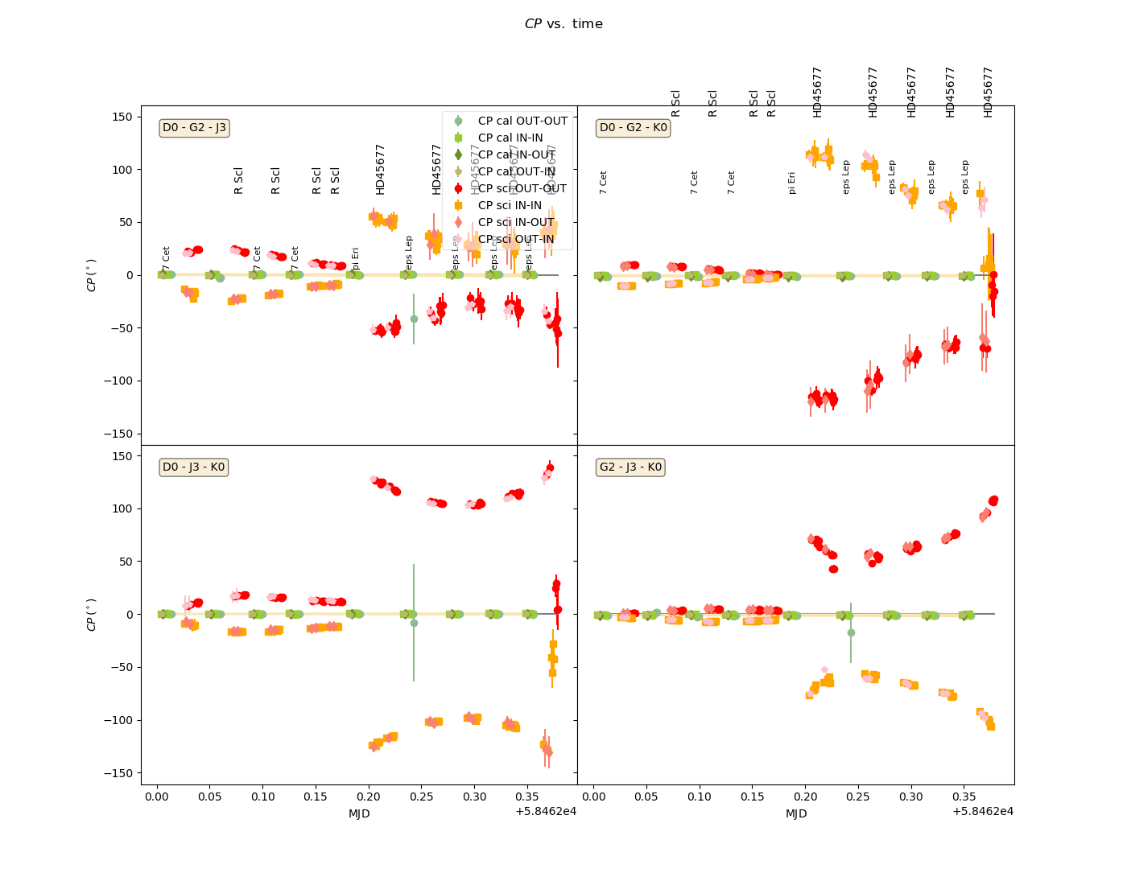
MATISSE Data Reduction Software
Data calibration : Closure phase ( and differential phase)
CP_{science}
CP_{calibrator}
-CP_{science} (BCD swap)
CP = CP_{science} - CP_{calibrator}
Computed in complex number
Same for differential phase

Slide 13
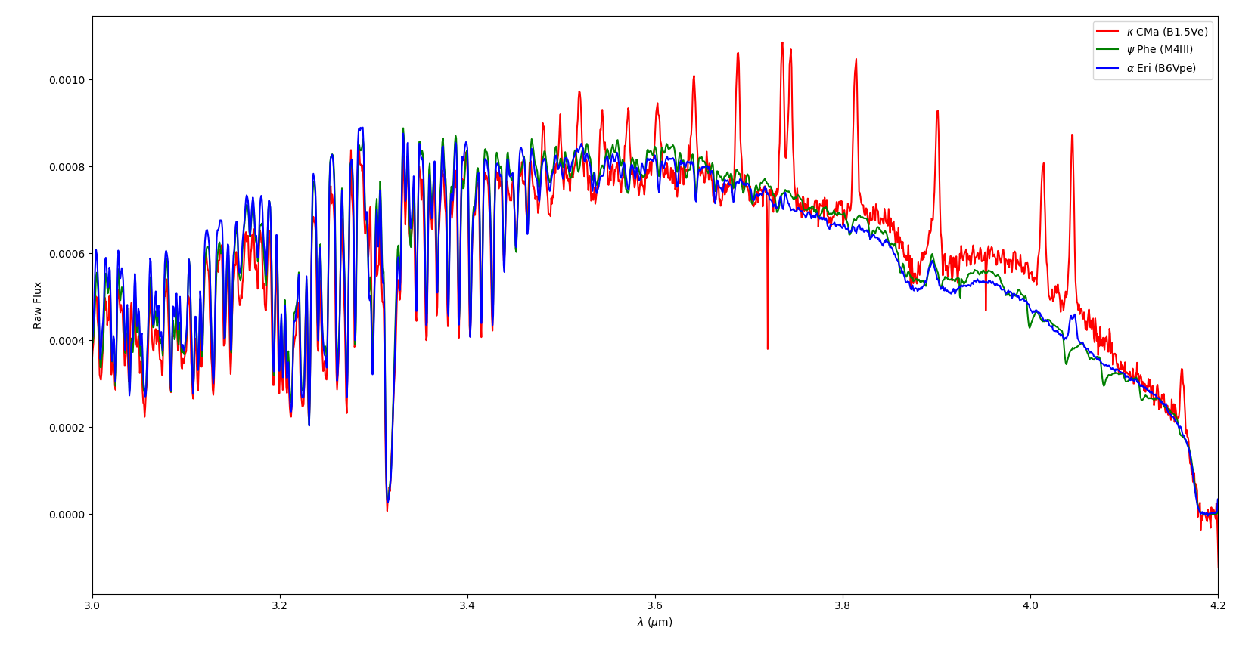
MATISSE Data Reduction Software
Data calibration : MATISSE data are spectro-interferometric
Rigel V² contaminated by spectral features from calibrator ψ Phe

Slide 14
MATISSE Data Reduction Software
Reducing data with ESOREX

Slide 15
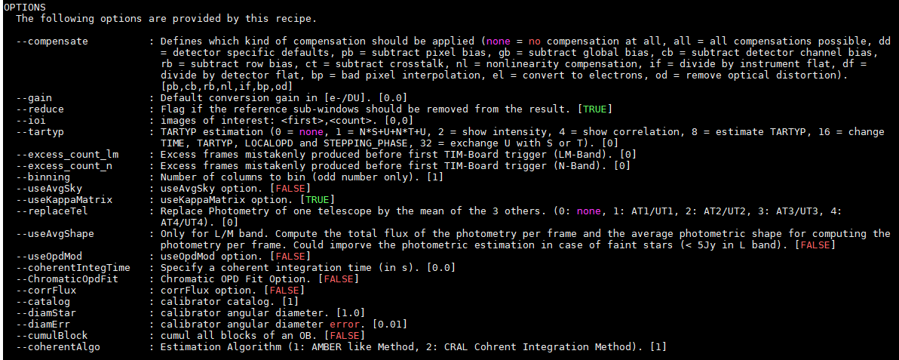
MATISSE Data Reduction Software
ESOREX mat_raw_estimates recipe options
esorex --man-page mat_raw_estimates

Slide 16
MATISSE Data Reduction Software
ESOREX mat_raw_estimates recipe sof file
Observations
Calibrations

Slide 17
MATISSE Data Reduction Software
Quick view on the REFLEX GUI

Slide 18
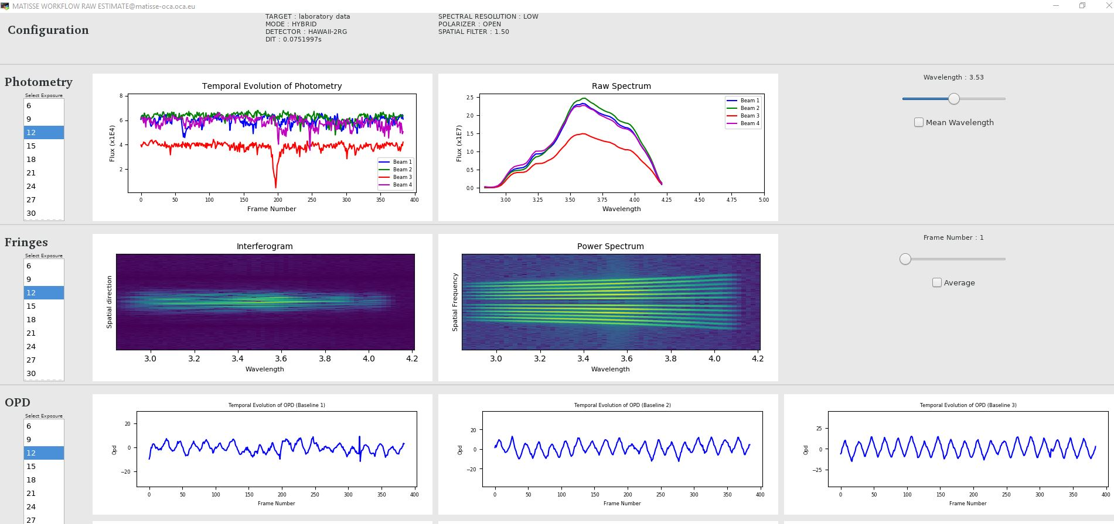
MATISSE Data Reduction Software
Quick view on the REFLEX GUI

Slide 19
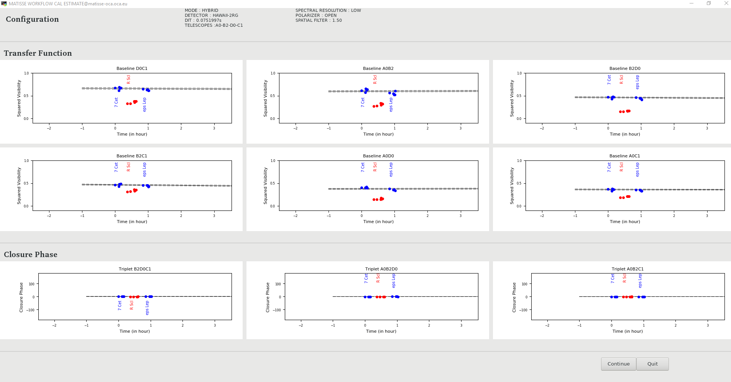
MATISSE Data Reduction Software
Quick view on the REFLEX GUI

Slide 20
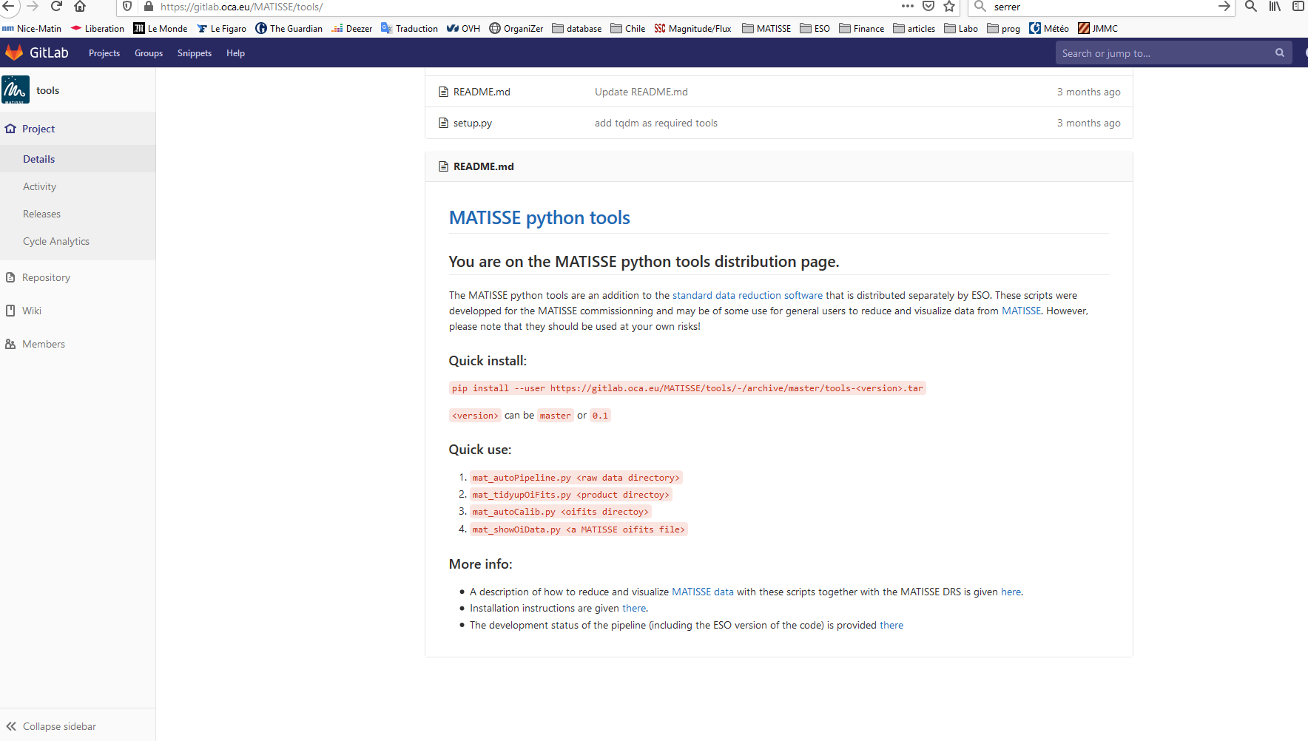
MATISSE Data Reduction Software
The consortium python tools
Download and installation instruction on the OCA gitlab repository
https://gitlab.oca.eu/MATISSE/tools/

Slide 21
MATISSE Data Reduction Software
The consortium python tools
Data reduction:
mat_autoPipeline.py : produces raw oifits file for a all raw data in a directory
mat_tidyupOiFits.py : renames data files after mat_automaticPipeline.py
mat_autoCalib.py : produces calibrated data from raw oifits files.
mat_logger.py : GUI allowing to perform reduction in an interactive way
Data visualization:
mat_show_oifits.py: Interactive plotting tools from MATISSE OiFits data (raw and calibrated)
mat_showOiData.py: AMBER like summary plot of one OiFits file (Flux, V², ϕ_{diff}, CP, Telescopes config)
mat_showOiFreq.py: V² and CP plotted as a function of the spatial frequency (B/λ )
mat_showTransFunc.py: Transfer function plot
Post-tools (upcoming) :
mat_mergeByTPLStart.py : merge all exposure of observation ( 4 in N and 4 or 12 in LM)
mat_spectralBinning.py : binning pixels into spectral channels (3 in LM and 5 in N)
Mar_spectralSmoothing.py : smooth on spectral channel instead of binning (produces more MIDI like data

Slide 22
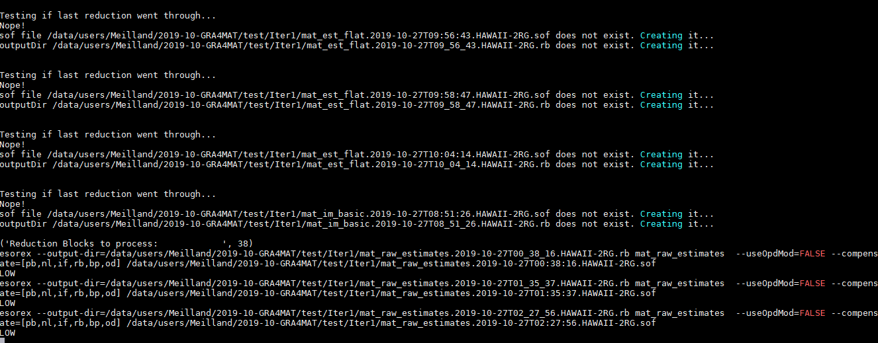
MATISSE Data Reduction Software
mat_autoPipeline.py

Slide 23
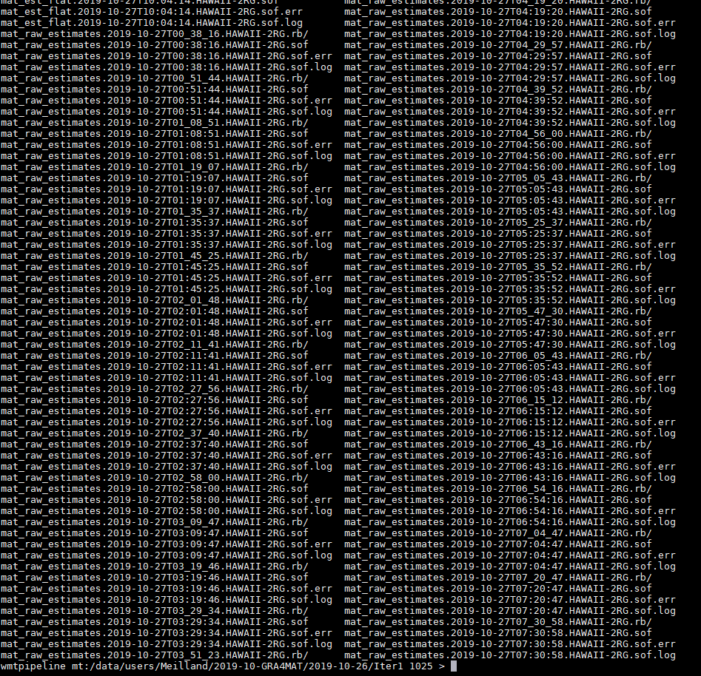
MATISSE Data Reduction Software
mat_autoPipeline.py
Example of MATISSE sof file for mat_raw_estimate recipe
Produce all SOF files for data reductions
Intermediate an final products from data reduction

Slide 24
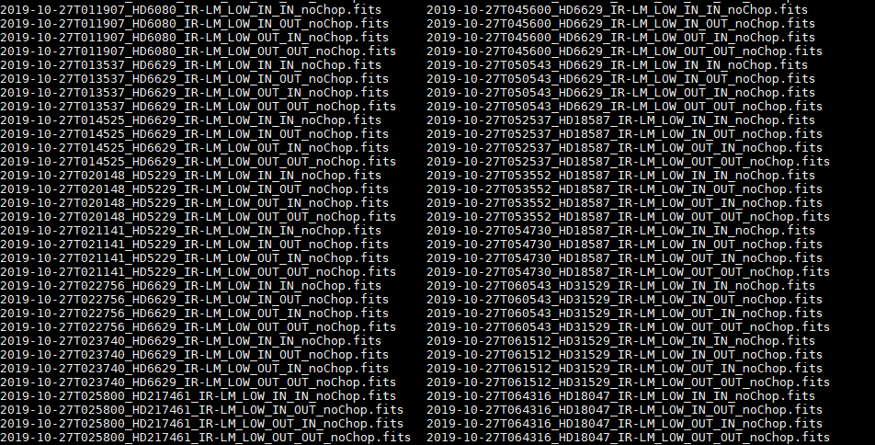
MATISSE Data Reduction Software
mat_tidyupOiFits.py : Copy and rename OiFits files

Slide 25
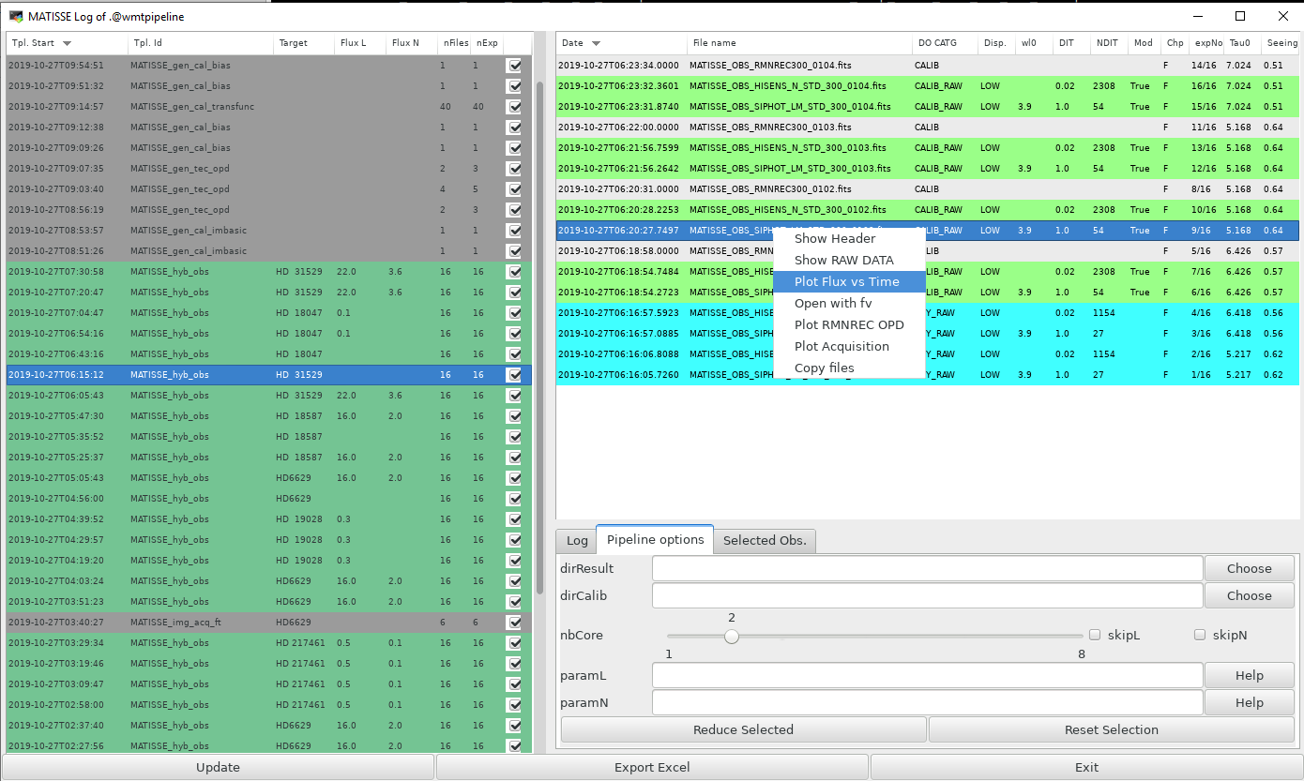
MATISSE Data Reduction Software
mat_logger.py GUI:
Logging tools but also
Interactive data reduction
visualization of raw files

Slide 26
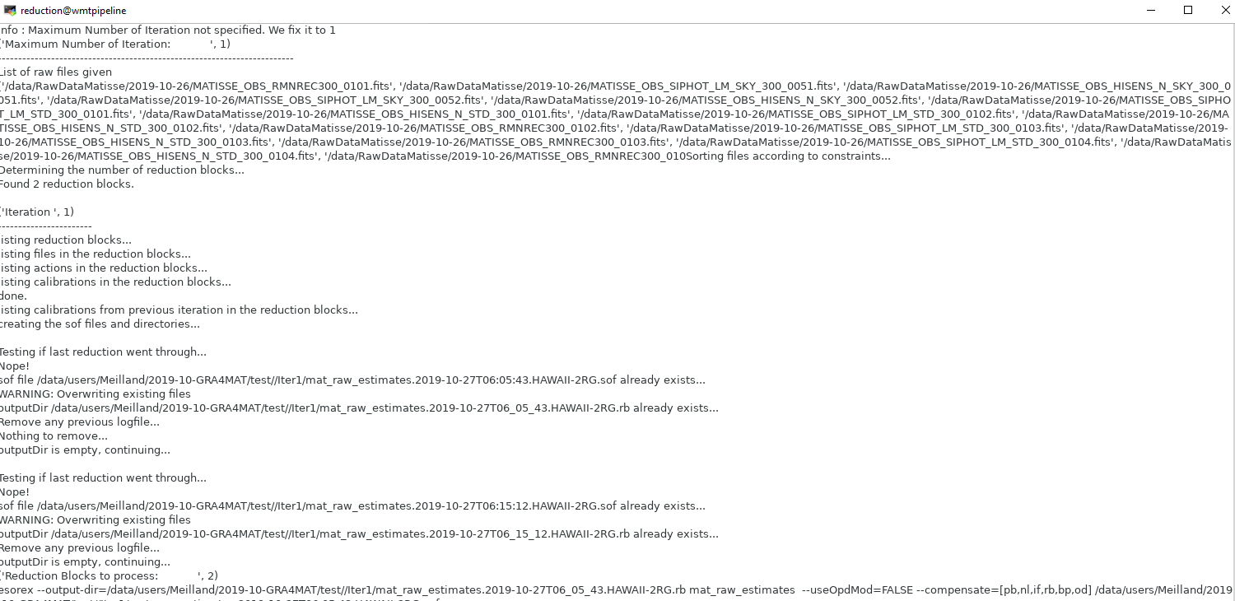
MATISSE Data Reduction Software
mat_logger.py GUI:
Launch mat_autoPipeline.py + mat_tidyupOifits.py
on selected Obs only (selected options)
Redirect data reduction logs into file.
Can be launch again using a sh script

Slide 27
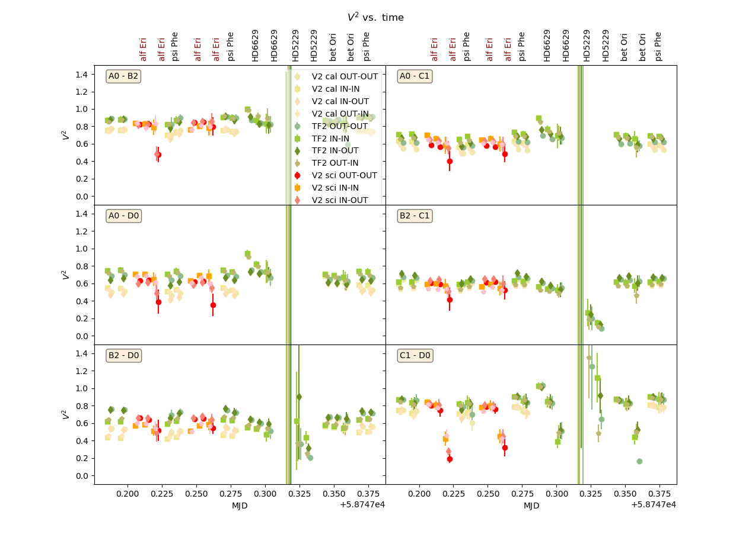
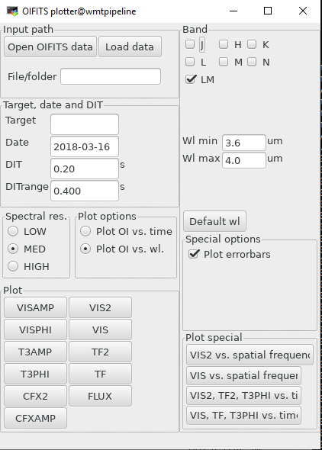
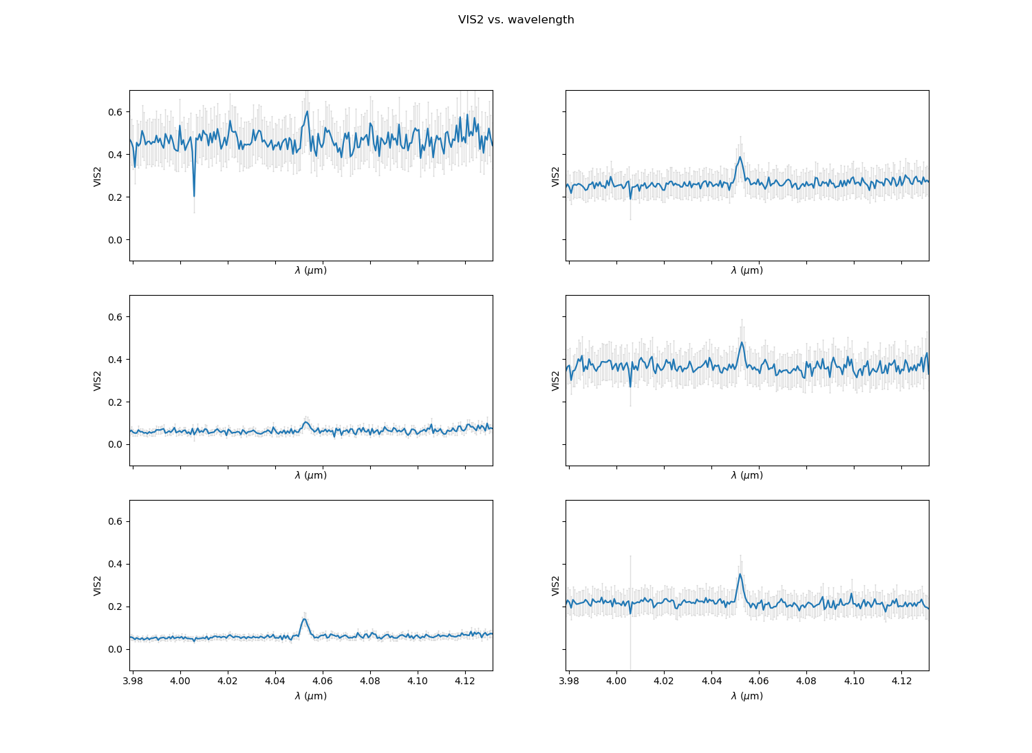
MATISSE Data Reduction Software
mat_show_oifits.py GUI:
Transfer Function
V² as function of λ

Slide 28
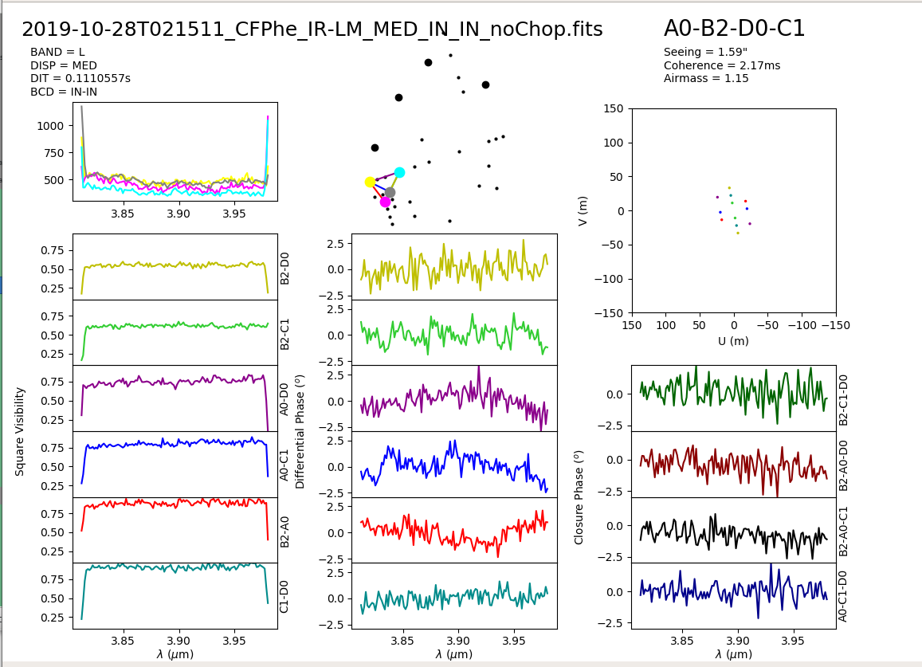
MATISSE Data Reduction Software
Examples of plots : mat_showOiData.py

Slide 29
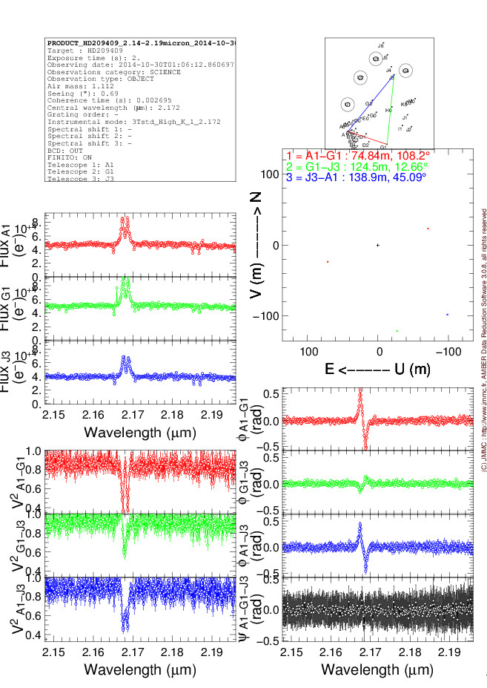
MATISSE Data Reduction Software
Examples of plots : mat_showOiData.py
Tribute to AmdlibShowOiData

Slide 30
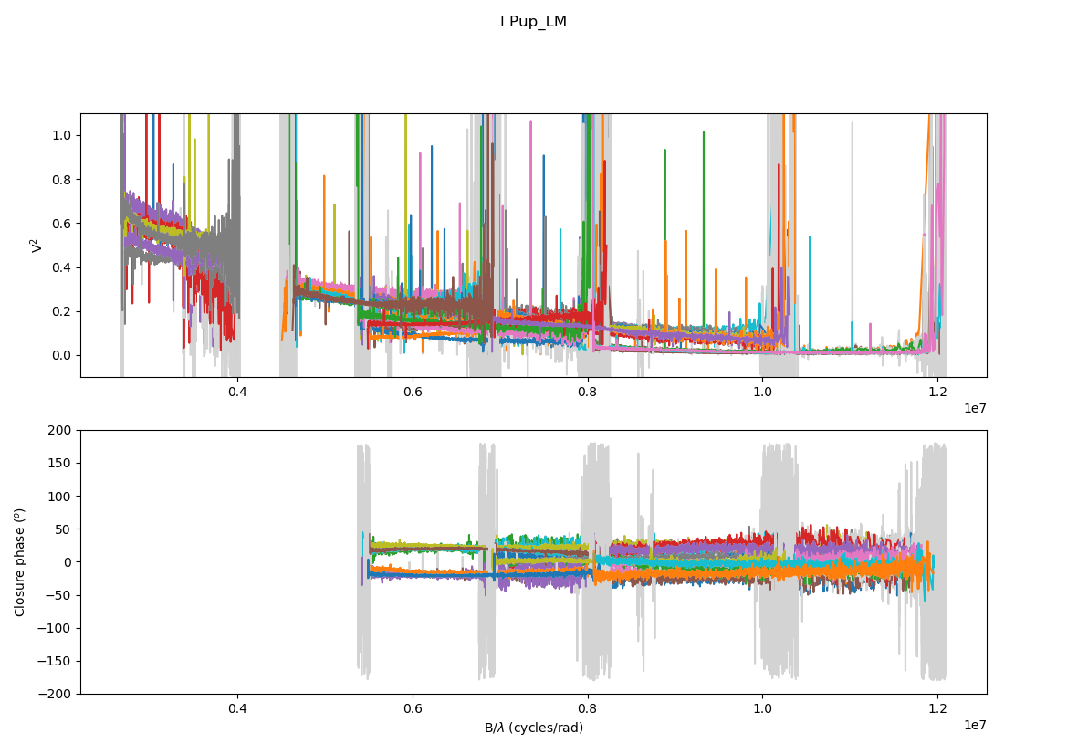
MATISSE Data Reduction Software
Examples of plots : mat_showOiFreq.py

Slide 31
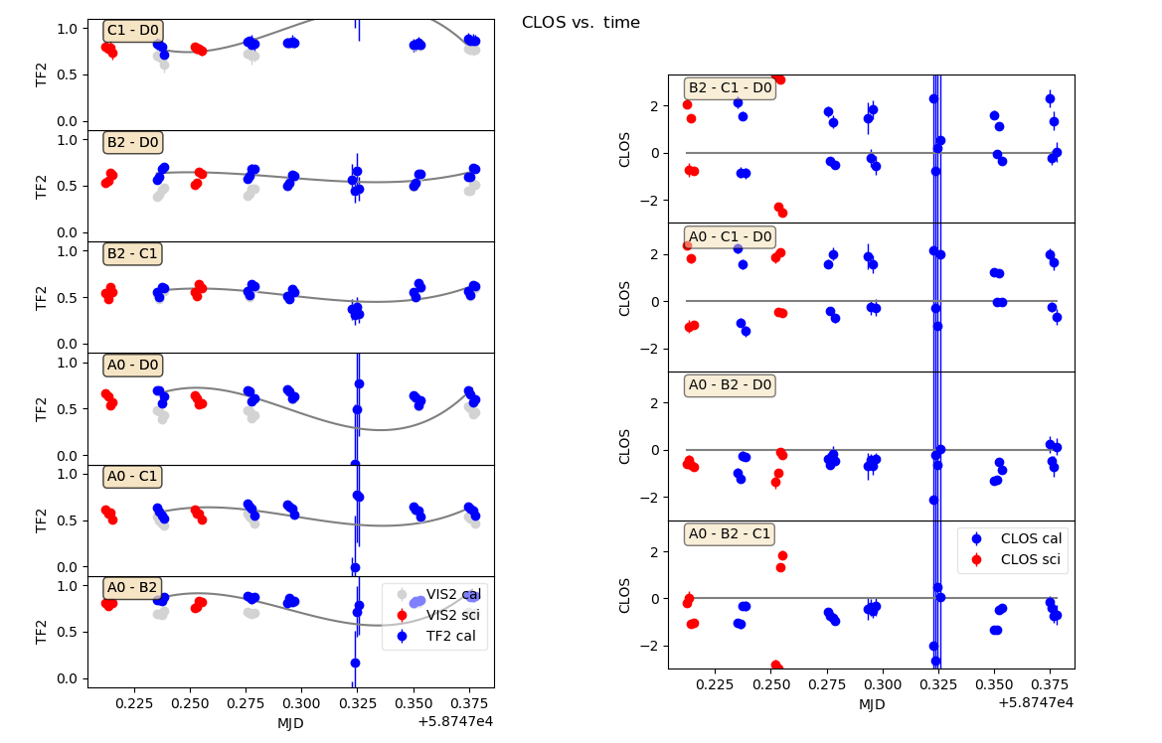
MATISSE Data Reduction Software
Examples of plots : mat_showTransFunc.py

Slide 32
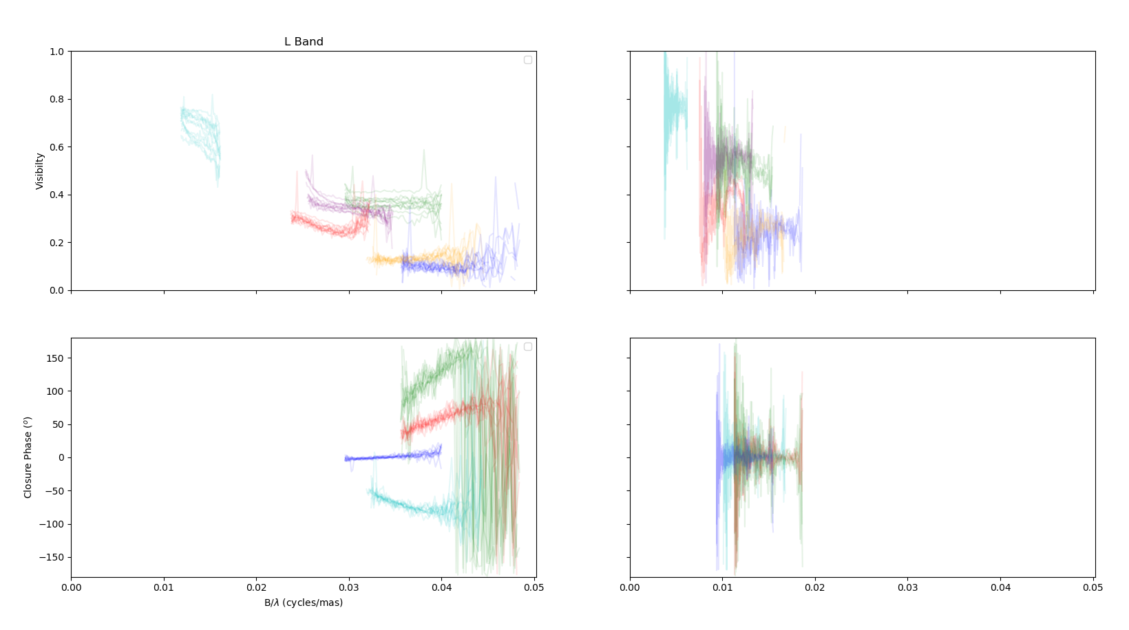
MATISSE Data Reduction Software
Upcoming post-tools : mat_mergeByTPLStart.py
4 exposures in N
12 exposures in L
One single calibrated measurement on the B[e] star MWC300

Slide 33
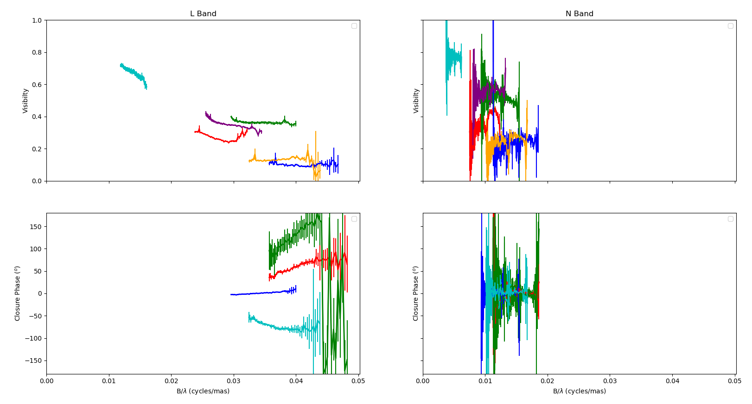
MATISSE Data Reduction Software
Upcoming post-tools : mat_mergeByTPLStart.py
Merging after correcting BCD sequence ⬄ SNR enhanced by 3.5 in L and 2 in N

Slide 34
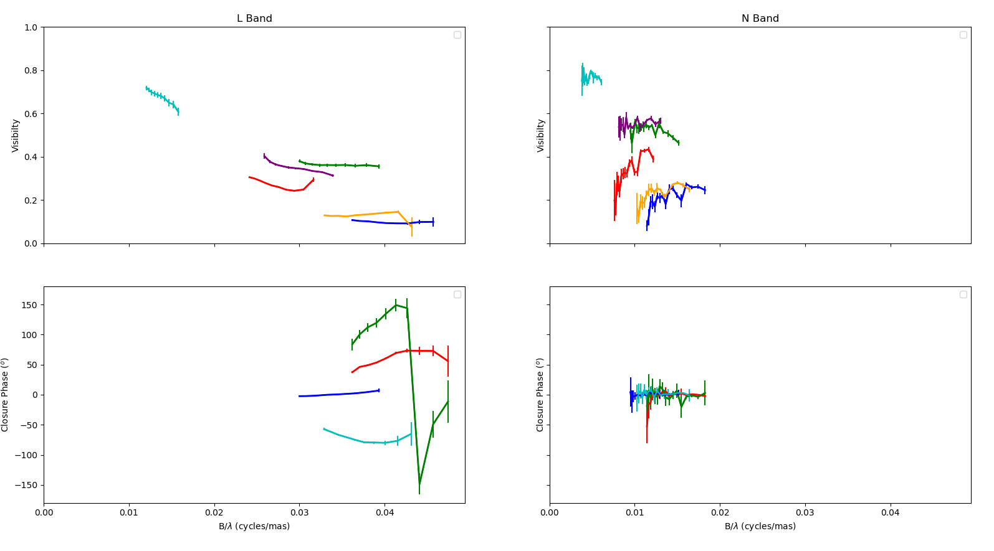
MATISSE Data Reduction Software
Upcoming post-tools : mat_spectralBinning.py
Spectral binning a-posteriori ⬄ SNR enhanced by 2.2 (5px) in L and 2.6 (7px) in N

Slide 35
MATISSE Data Reduction Software
DRS functional but still in development
Future Improvements in the pipeline:
“blind” Coherent integration using L band OPD for N
A-priori spectral binning/smoothing (MIDI-like)
GRA4MAT data (using K-band tracker information)
Frame selection to remove “bad frames”
Python tools improvements:
Post-tools (cutting, merging, binning, smoothing)
Improved data visualization
Spectrum and flux calibration
Interface to image reconstruction software IRBIS (currently in shell-scripts)
Don’t hesitate to contact us in Nice or at ESO

