Slide 1
GRA4MAT GRAVITY for MATISSE
A. Meilland, J. Woillez, F Gonte, G Zins
and GRAVITY, MATISSE Teams, and ESO

Slide 2
GRA4MAT : Kesaco?*
*« What is it? » in southern slang french (from Provençal locution « Qu’es aquò? » )

Slide 3
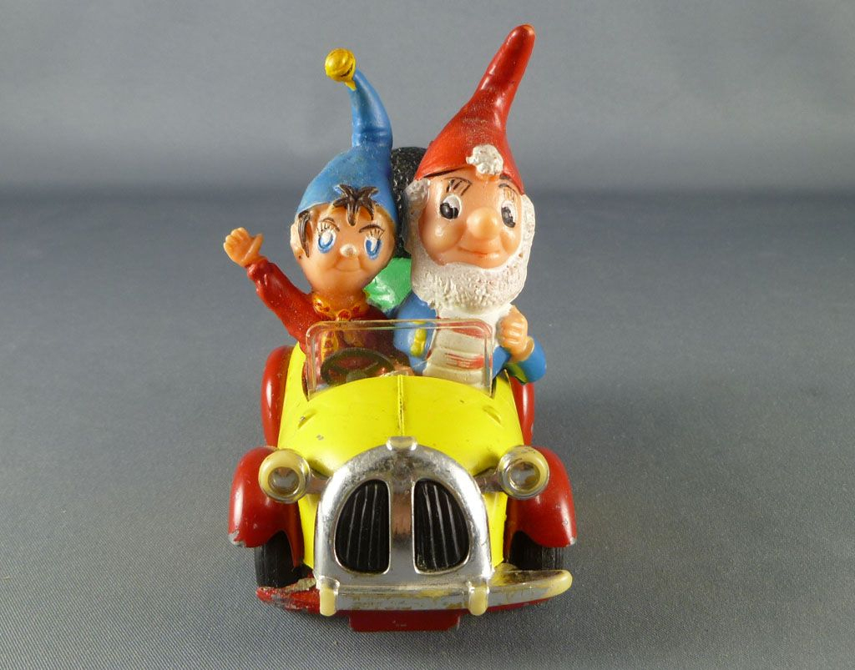
GRA4MAT : Kesaco?
MATISSE
GRAVITY
VLTI
GRAVITY «driving» the VLTI so MATISSE can do … more interesting things

Slide 4
GRA4MAT : Kesaco?
Field-tracking
MATISSE-LM
Cophased
VLTI
GRAVITY-FT
Pupil-tracking (off)
Coaligned
Tels
Fringe-tracking
Coaligned
Cophased
IRIS
Not used
MATISSE-N
GRAVITY-SC
Not used
DLs
FSM & VCM
Preliminary tests in May & June 2019
Technical runs AT in September & October
Unofficial commissioning during October run
First official AT commissioning in January 2020
First UT run in March 2020
SV run in April (to be confirmed)
Runs planned for P106 as well
All things I will present are very preliminary results !

Slide 5
GRA4MAT : How does it works?
Field-tracking
MATISSE-LM
Cophased
VLTI
GRAVITY-FT
Pupil-tracking (off)
Coaligned
Tels
Fringe-tracking
Coaligned
Cophased
IRIS
Not used
MATISSE-N
GRAVITY-SC
Not used
DLs
FSM & VCM
MATISSE & GRAVITY are roughly cophased during the day
Co-Alignment is done at the begining of the night on the first target :
Stars are centered in MATISSE using FSM
GRAVITY compensate internally and then takes control of the FSM to field-track
For each target
GRAVITY search and find the fringe
Fine MATISSE/GRAVITY cophasing at begining of observation (only useful for LOW resolution)

Slide 6
GRA4MAT : Compared to MATISSE alone
Field-tracking
MATISSE-LM
Cophased
VLTI
GRAVITY-FT
Pupil-tracking (off)
Coaligned
Tels
Fringe-tracking
Coaligned
Cophased
IRIS
Not used
MATISSE-N
GRAVITY-SC
Not used
DLs
FSM & VCM
MATISSE-LM
Coherencing
VLTI
Tels
Coaligned
Pupils check
Coaligned
Cophased
IRIS
MATISSE-N
DLs
Lab-Guiding
FSM & VCM

Slide 7
MATISSE standalone self-coherencing
OPD measured at each frame (or couple of frames)
Done simultaneously on both detectors (LM and N)
Fringes can be integrated coherently (complex number)
and/or incoherently (modulus) to enhance SNR
One detector (the MASTER) sends commands to the VLTI-DL
if the measured OPD is larger than a limit (2µm)
if SNR is higher than a limit
Commands proportional to measured OPD (x0.5).
MATISSE coherence-length is :
L : from 120µm in LOW to 4mm in HIGH
N : 300µm in LOW and 2mm in HIGH

Slide 8
MATISSE standalone self-coherencing
OPD measured at each frame (or couple of frames)
Done simultaneously on both detectors (LM and N)
Fringes can be integrated coherently (complex number)
and/or incoherently (modulus) to enhance SNR
One detector (the MASTER) sends commands to the VLTI-DL
if the measured OPD is larger than a limit (2µm)
if SNR is higher than a limit
Commands proportional to measured OPD (x0.5).
MATISSE coherence-length is :
L : from 120µm in LOW to 4mm in HIGH
N : 300µm in LOW and 2mm in HIGH

Slide 9
About the coherence time
We cannot increase DIT beyond ≈3-4 times coherent time ⬄ limit ≈ 100ms in normal conditions in L
Coherence Time in V, L and N bands
τ_{0V} (ms) | 1 | 2 | 4 | 8
τ_{0L} (ms) | 8 | 16 | 32 | 64
τ_{0N} (ms) | 30 | 60 | 120 | 240
Assuming
Kolmogorov
turbulence
DIT = 75ms

Slide 10
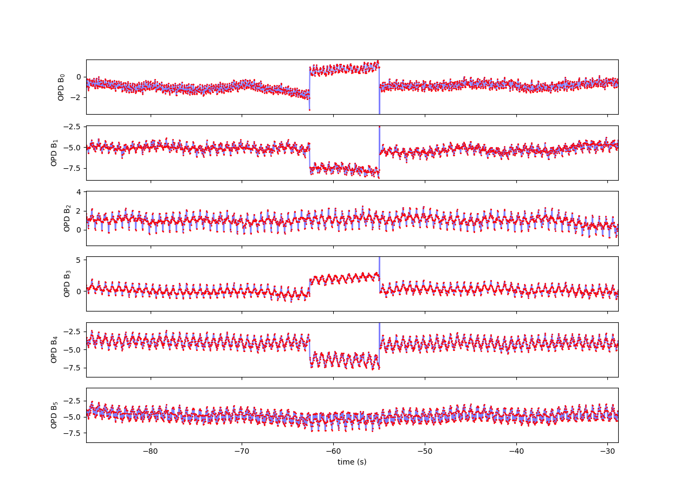
GRA4MAT : GRAVITY Tracking quality
Don’t look at the oscillations
-- it’s just MATISSE internal modulation --
GRAVITY tracking residual ≈150nm
⬄
λ/20 for MATISSE at 3µm
But « sometimes » 2µm fringe jumps
Depends on the seeing and τ0
And target magnitude
2 µm = λ/2 at 4 µm !!!
So this is killing the constrast
Need to be properly quantifed
during commisionning
Limits the longest DIT possible
Implement frame selection in MATISSE
MATISSE measured OPD as function of time

Slide 11
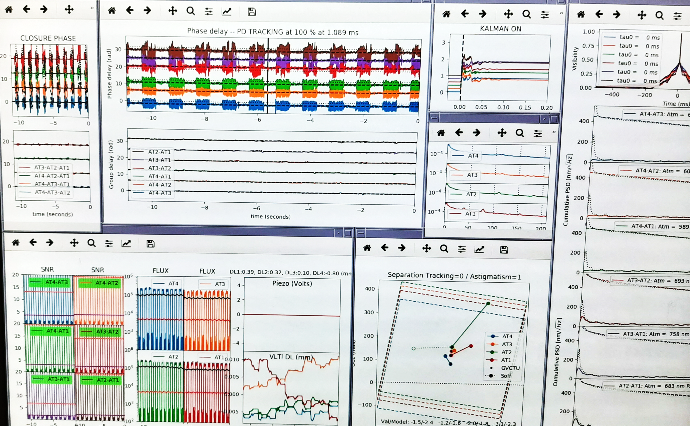
GRA4MAT : What about chopping?

Slide 12
GRA4MAT : What about chopping?
MATISSE measured OPD as a function of time for a full sequence (non-chopped + chopped)
SKY
SKY
SKY
SKY
TARGET
TARGET
TARGET
TARGET
TARGET
Only the first frame affected ⬄ GRAVITY « centers back » fringes in less than 40ms

Slide 13
GRA4MAT : What gains do we expect?
Allow longer DITs in L:
Improve spectral coverage in MED-LM and HIGH-L modes
Improve SNR in L band and push limiting magnitude
Enable the use of VHIGH mode which requires long DITs except for few objects
Improve the transfer function in L (and slightly in N) :
Higher instrumental visibility by stabilizing fringes even for the shorter DITs
Higher stability (less dependence on the seeing) and thus better calibrated data
Allow longer “blind” coherent integration in N
Improve N band sensitivity

Slide 14
GRA4MAT : What gains do we expect?
Allow longer DITs in L:
Improve spectral coverage in MED-LM and HIGH-L modes
Improve SNR in L band and push limiting magnitude
Enable the use of VHIGH mode which requires long DITs except for few objects
Improve the transfer function in L (and slightly in N) :
Higher instrumental visibility by stabilizing fringes even for the shorter DITs
Higher stability (less dependence on the seeing) and thus better calibrated data
Allow longer “blind” coherent integration in N
Improve N band sensitivity

Slide 15
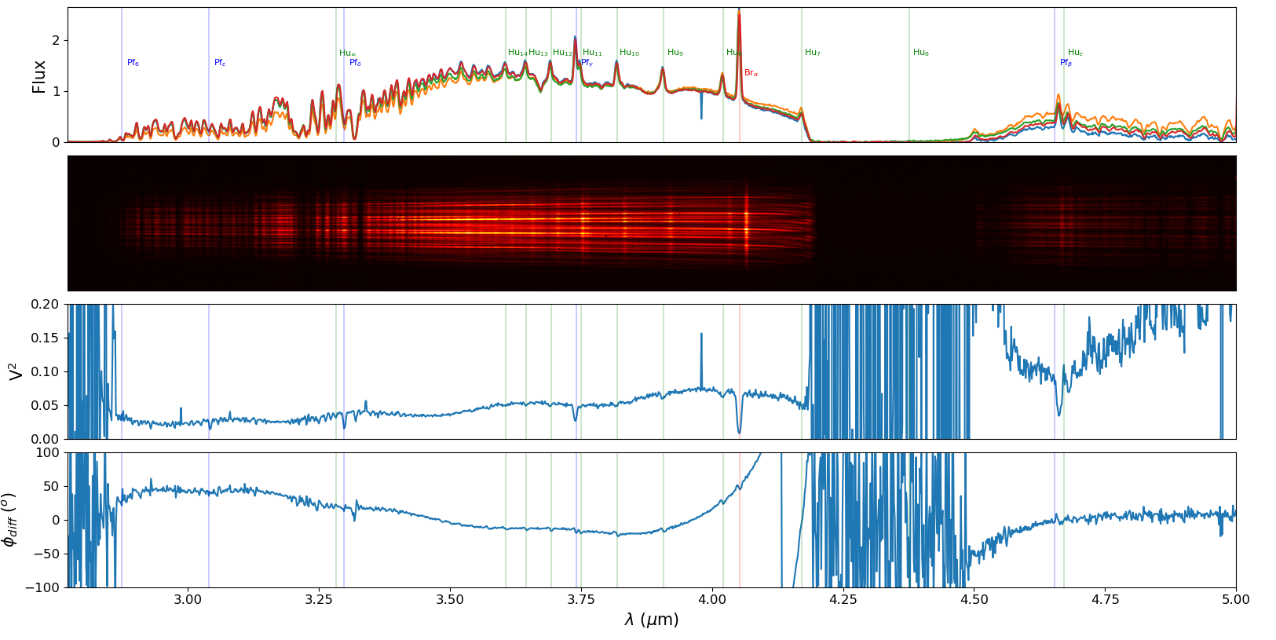
GRA4MAT : What gains do we expect?
Improve spectral coverage in MED-LM and HIGH-L modes
First GRA4MAT test on the Be star δ Cen 2019-05-30 DIT = 10s

Slide 16
GRA4MAT : What gains do we expect?
Improve spectral coverage in MED-LM and HIGH-L modes
Current spectral window of 0.16μm
with DIT=0.111s
First GRA4MAT test on the Be star δ Cen 2019-05-30 DIT = 10s

Slide 17
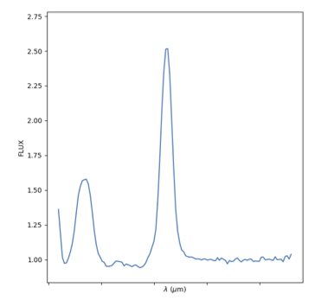
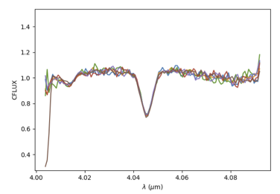
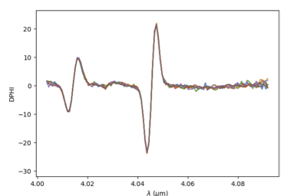
GRA4MAT : What gains do we expect?
Improve spectral coverage in MED-LM and HIGH-L modes
Brα Line Profile (+ Hu 9)
Visibility
Differential Phase
Current spectral window of 0.16μm
with DIT=0.111s
First GRA4MAT test on the Be star δ Cen 2019-05-30 DIT = 10s

Slide 18
GRA4MAT : What gains do we expect?
Improve spectral coverage in MED-LM and HIGH-L modes
1.3s needed to reading the full detector
First GRA4MAT test on the Be star δ Cen 2019-05-30 DIT = 10s

Slide 19
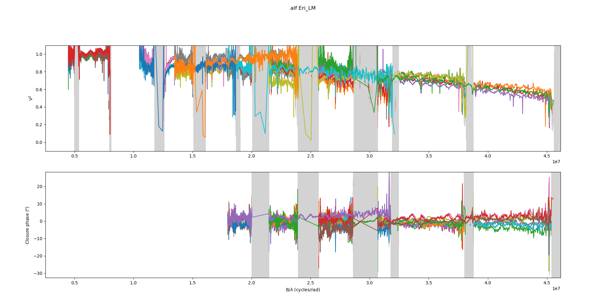
GRA4MAT : What gains do we expect?
Improve spectral coverage in MED-LM and HIGH-L modes
This improves also the spatial coverage
The Binary Be star Achernar

Slide 20
GRA4MAT : What gains do we expect?
Allow longer DITs in L:
Improve spectral coverage in MED-LM and HIGH-L modes
Improve SNR in L band and push limiting magnitude
Enable the use of VHIGH mode which requires long DITs except for few objects
Improve the transfer function in L (and slightly in N) :
Higher instrumental visibility by stabilizing fringes even for the shorter DITs
Higher stability (less dependence on the seeing) and thus better calibrated data
Allow longer “blind” coherent integration in N
Improve N band sensitivity

Slide 21
GRA4MAT : What gain we expect?
Improve SNR in L band and push limiting magnitude
For a constant total integration time : SNR on V² ∝ $\sqrt{DIT}$ if not dominated by background noise
Background noise >> Detector noise for a DIT :
2700 ms at 3.5 μm in LOW ⬄ potential gain up to 5 in flux
54000 ms at 3.5 μm in MED ⬄ potential gain up to 22 in flux !
130 ms at 4.5 μm in LOW ⬄ close to the current DIT in LOW-LM (i.e 111ms)
2600 ms at 4.5 μm in MED ⬄ potential gain up to 5 in flux
When dominated by background noise longer DIT is equivalent to coherent integration with shorter DITs.

Slide 22
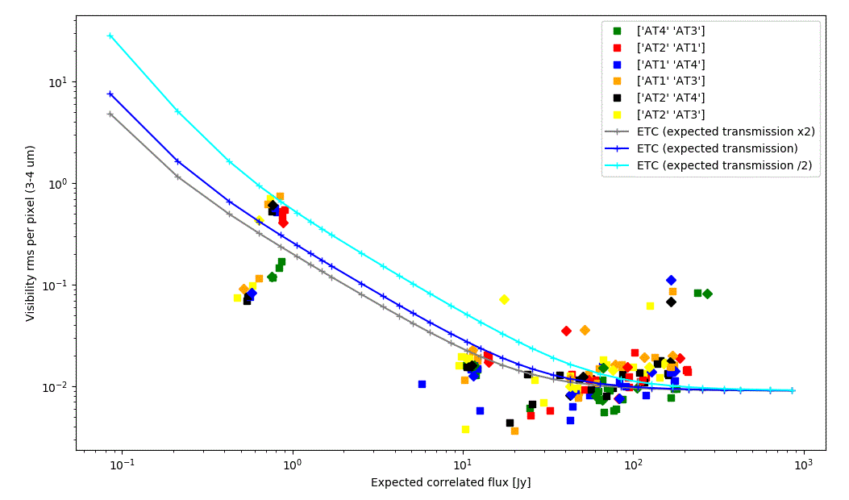
GRA4MAT : What gain we expect?
Improve SNR in L band and push limiting magnitude
2.5Jy per px for 1min
⬄0.6Jy per sp. Chan. for 1 OB
Limit (rms = 10%) around 0.6Jy in MED (currently offered 8Jy) ⬄ gain of factor ~ 13

Slide 23
GRA4MAT : What gains do we expect?
Improve SNR in L band and push limiting magnitude
L = 0.3Jy (Lmag = 7.5) calibrator with ATs
DIT=3s
DIT=0.111s
Limit around 0.1-0.2Jy for accurate differential phase, closure phase and coherent flux in LOW-L
Currently offered 1Jy ⬄ gain of factor 5 in Flux

Slide 24
GRA4MAT : What gains do we expect?
Improve SNR in L band and push limiting magnitude
Preliminary limiting flux (for 1min exposure)
MODE | MATISSE alone | GRA4MAT
LOW | 1Jy for 0.111s | 0.2Jy for 3s
MED | 8Jy for 0.111s | 0.6Jy for 10s
HIGH | 30Jy for 0.111s | (3Jy for 10s in theory)
But Photometry problem below ~10 Jy without Chopping
⬄
biasing visibility measurement
but
Differential phase, Closure Phase, and coherent flux not affected

Slide 25
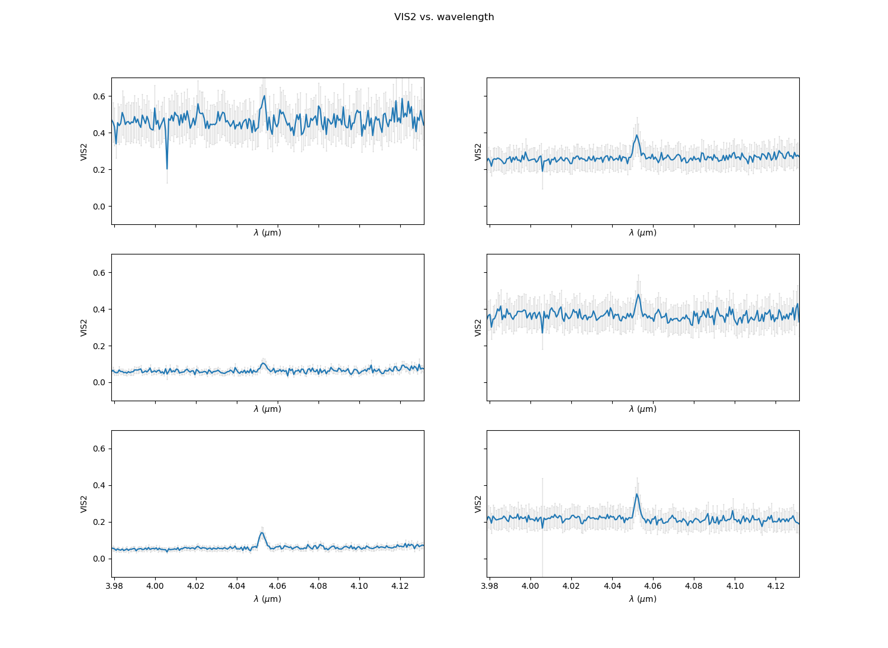
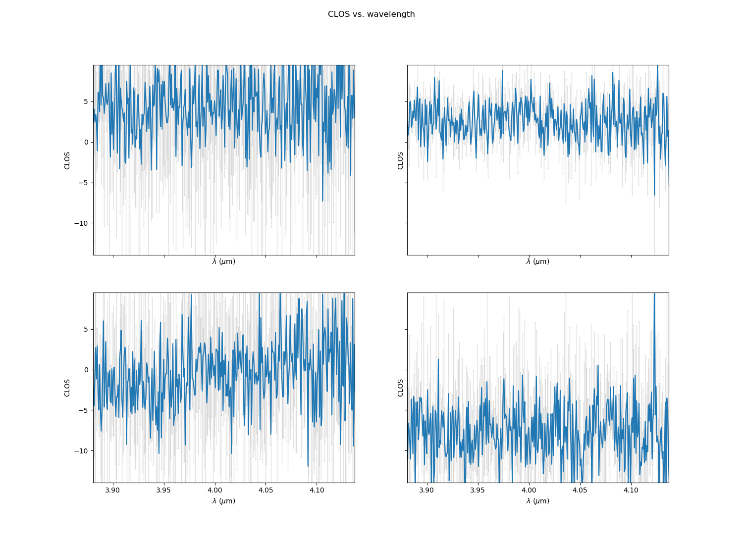
GRA4MAT : What gains do we expect?
Improve SNR in L band and push limiting magnitude
YSO/B[e] star FS Cma (HD45677) : L=20 Jy in HIGH
Limit (SNR=3) around 0.3-0.9Jy in MED (currently offered 4-8Jy) ⬄ gain of factor 10

Slide 26
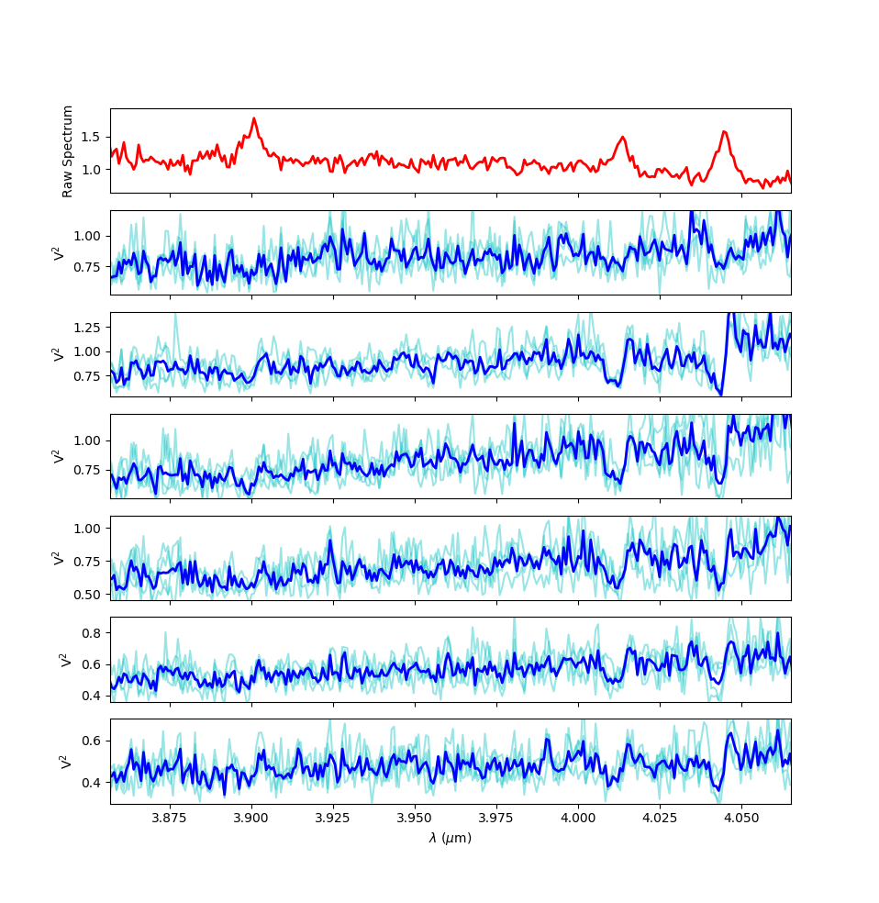
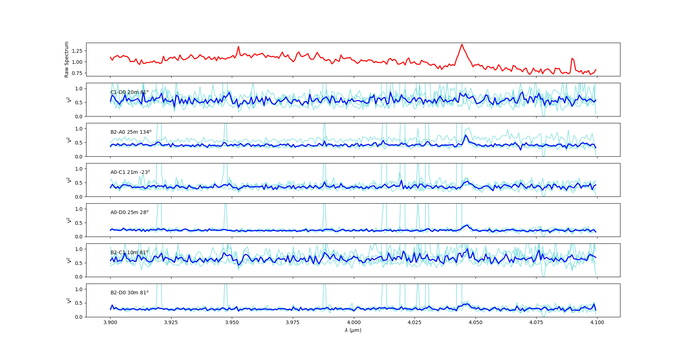
GRA4MAT : What gain we expect?
Improve SNR in L band and push limiting magnitude
Classical Be star K CMa (L ≈ 12Jy)
B[e] or YSO : HD50138 (L ≈ 15Jy)

Slide 27
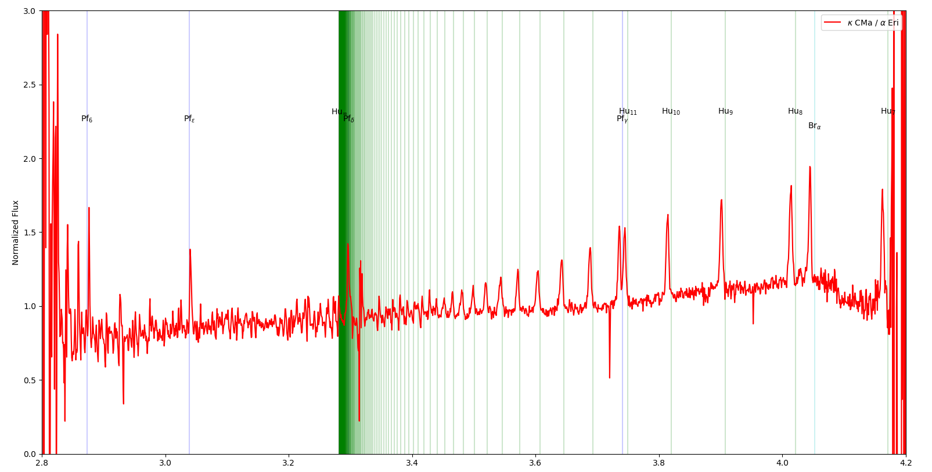
GRA4MAT : What gains do we expect?
Improve SNR in L band and push limiting magnitude

Slide 28
GRA4MAT : What gains do we expect?
Allow longer DITs in L:
Improve spectral coverage in MED-LM and HIGH-L modes
Improve SNR in L band and push limiting magnitude
Enable the use of VHIGH mode which requires long DITs except for few objects
Improve the transfer function in L (and slightly in N) :
Higher instrumental visibility by stabilizing fringes even for the shorter DITs
Higher stability (less dependence on the seeing) and thus better calibrated data
Allow longer “blind” coherent integration in N
Improve N band sensitivity

Slide 29
GRA4MAT : What gains do we expect?
Enable the use of VHIGH mode which requires long DITs except for few objects
VHIGH mode (R≈4000) will be commissioned next week
Sensitivity at least 5 times lower than HIGH
This mode needs an external fringe tracker to be fully operational
Potential limiting flux with VHIGH (in the best case)
DIT | 111ms | 10s
ATs | 150 Jy | 15Jy
UTs | 10Jy | 1Jy

Slide 30
GRA4MAT : What gains do we expect?
Allow longer DITs in L:
Improve spectral coverage in MED-LM and HIGH-L modes
Improve SNR in L band and push limiting magnitude
Enable the use of VHIGH mode which requires long DITs except for few objects
Improve the transfer function in L (and slightly in N) :
Higher instrumental visibility by stabilizing fringes even for the shorter DITs
Higher stability (less dependence on the seeing) and thus better calibrated data
Allow longer “blind” coherent integration in N
Improve N band sensitivity

Slide 31
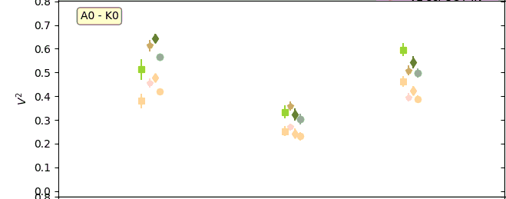
GRA4MAT : What gain we expect?
Higher instrumental visibility by stabilizing fringes even for the shorter DITs
Instrumental vis level
Calibrator observed under very bad seeing (1.5-2.5’’) in MED 111ms
VLTI is normally in
standby for such bad seeing
GRA4MAT
τ₀=2.5ms
GRA4MAT
τ₀=1.5ms
MATISSE alone
τ₀=2.5ms

Slide 32
GRA4MAT : What gains do we expect?
Higher stability (less dependence on the seeing) and thus better calibrated data
Instrumental vis level
High and stable seeing
Seeing deteriorating during the night

Slide 33
GRA4MAT : What gains do we expect?
Allow longer DITs in L:
Improve spectral coverage in MED-LM and HIGH-L modes
Improve SNR in L band and push limiting magnitude
Enable the use of VHIGH mode which requires long DITs except for few objects
Improve the transfer function in L (and slightly in N) :
Higher instrumental visibility by stabilizing fringes even for the shorter DITs
Higher stability (less dependence on the seeing) and thus better calibrated data
Allow longer “blind” coherent integration in N
Improve N band sensitivity

Slide 34
GRA4MAT : What gains do we expect?
Improve N band sensitivity with longer “blind” coherent integration in N
Laboratory fringes with 1000Jy source
N band is fully dominated by sky emission.
DIT is set to 20ms to avoid saturation
Longer DITs are “simulated” in DRS => coherent integration
Equivalent to longer DIT if not detector noise dominated
Maximum integration time ~ 2x τ₀ ~ 0.2-0.5s
If fringes are fully “locked” by an external fringe tracker
integrate “blindly” longer time up to full exposure
Theoretical gain of a factor $\sqrt{DIT∗NDIT/2τ_{0}}$~ 10 but
chromatic OPD between K and N should not vary during exposure more than 2µm
No “fringe jump” during exposure

Slide 35
GRA4MAT : Conclusion
Should be offered on ATs for next call for proposal (P106) without chopping
No V² for N-band and for LM band for faint targets (5-15Jy)
Improving MED and HIGH
spectral coverage ⬄ full windows
SNR and limiting Flux (by factor up to 10 for DIT=10s)
Improving Corr. Flux in LOW-L by factor of 5 for DIT=3s
UTs and Chopping should be offered in P107 or P108
Final performance (including V²)
Effect in N-band (“blind” coherent integration) still needs to be investigated
Next step will be GRA+MAT
GRAVITY-Science & MATISSE simultaneously
Data from 2 to 13µm

