Slide 1
GRA4MAT Expected Performance & Operation
A. Meilland and the MATISSE team

Slide 2
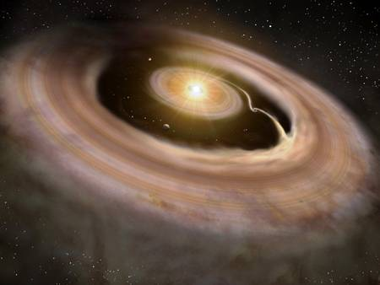
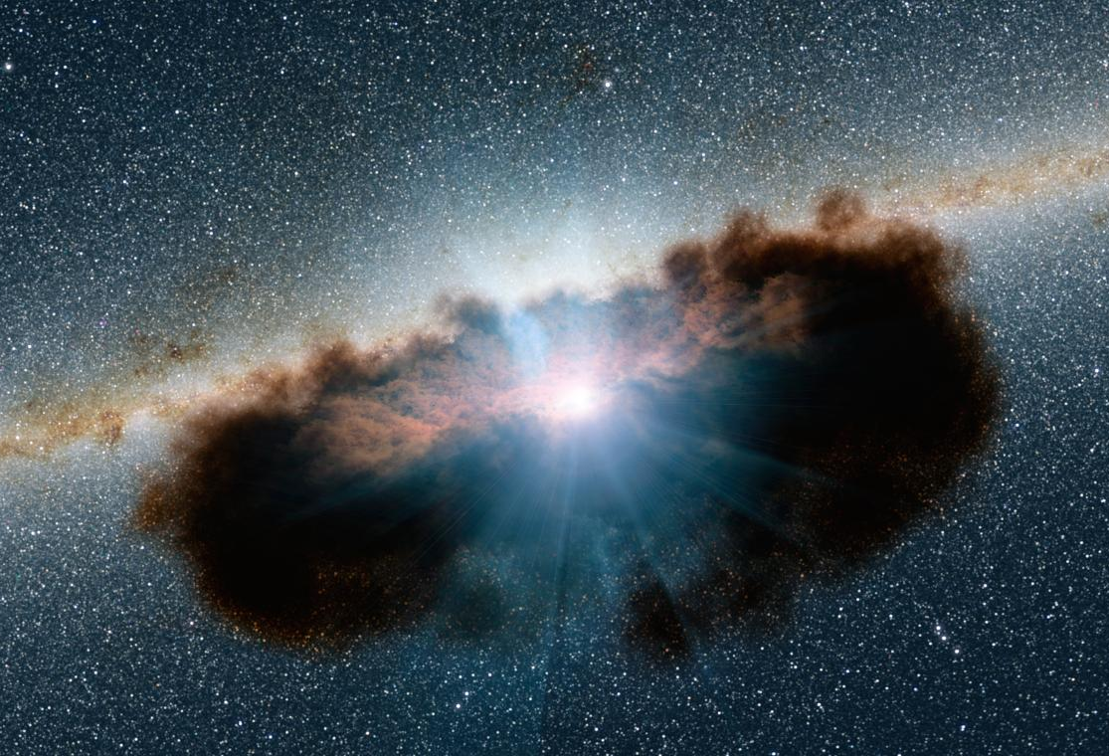
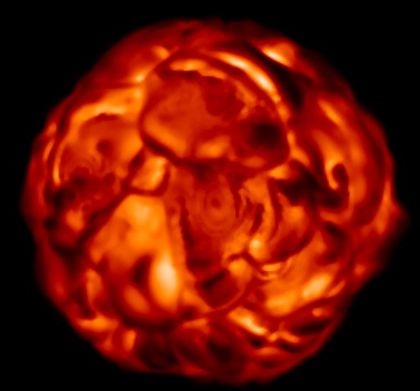
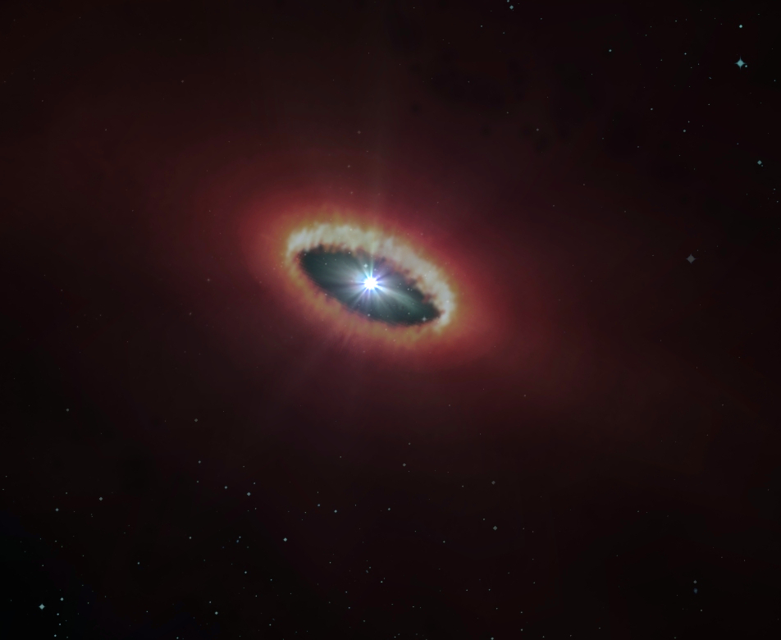
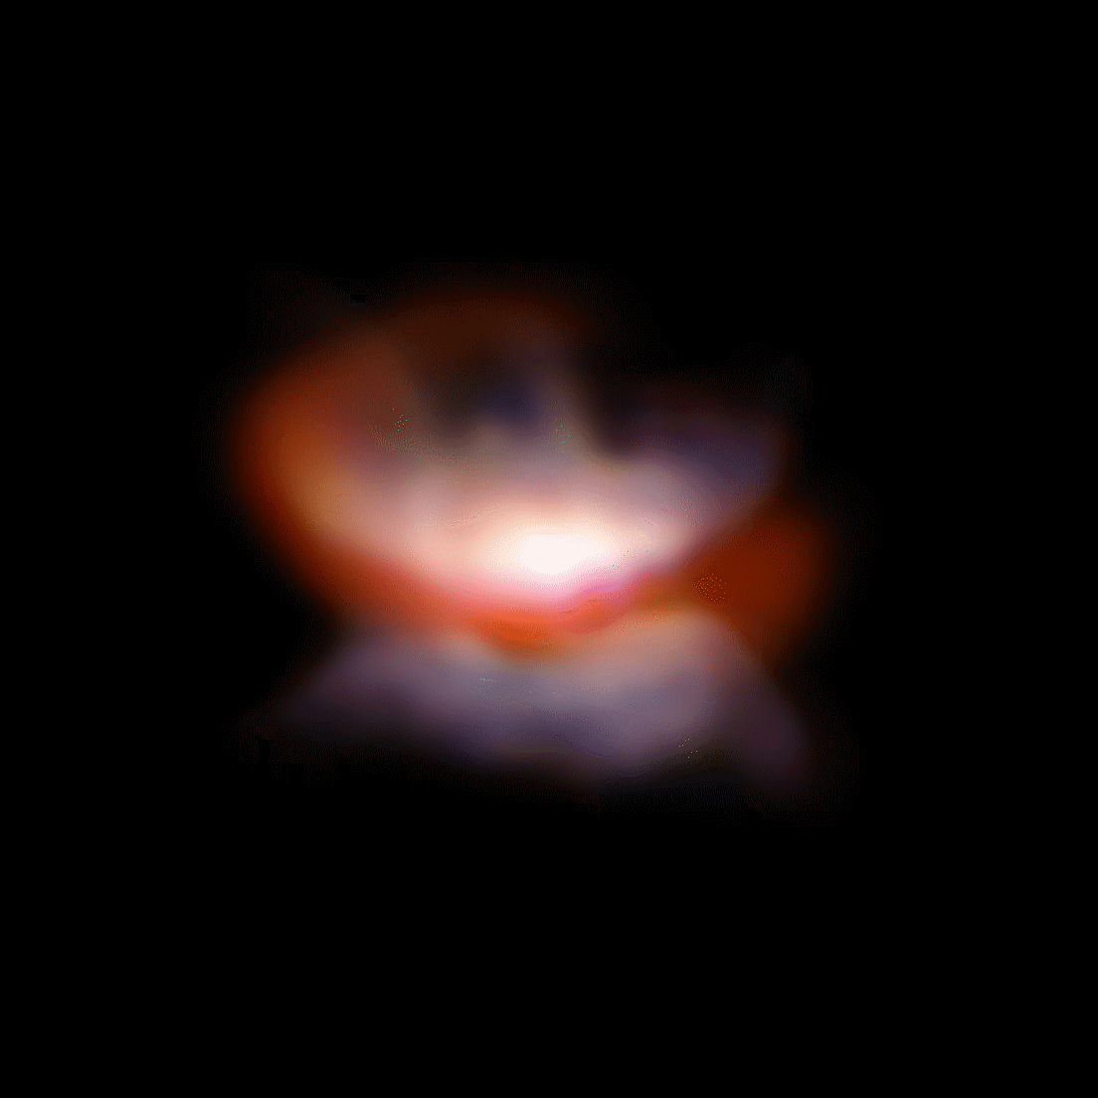
MATISSE in 1 slide
L&M bands arm (2.85 - 5 μm)
Detector : HAWAII-2RG 2048x2048
4 spectral modes :
LOW ⬄ R ≈ 35 (full LM)
MED ⬄ R ≈ 500 (full LM)
HIGH ⬄ R ≈ 950 (only L)
VHIGH ⬄ R ≈ 4000 (4.05 and 4.65)
N band arm (7.5 – 13 μm )
Detector : AQUARIUS 1024x1024
2 spectral modes :
LOW ⬄ R ≈ 30
HIGH ⬄ R ≈ 220
Hot dust, circumstellar gas, and stellar surface
Geometry + kinematics of
H lines, H2O, PAHs, CO,
CO-ice, Nano-diamonds
Mainly geometry of warm Dust
Fine structure of dust + PAHs
Protoplanetary disk
AGN
Evolved stars

Slide 3
What do we expect from an external fringe tracker?
Improve spectral coverage in MED-LM and HIGH-L modes by allowing longer DITs
Improve SNR in L band by allowing longer DITs
Enable the use of VHIGH mode which always requires long DITs
Improve instrumental visibility in L by stabilizing fringes even for the shorter DITs
Improve accuracy on transfer function and thus calibrated data
Improve N band sensitivity using coherent integration using pistons estimated in K band

Slide 4
Detector Read Time vs Coherent Time
Coherence Time in V, L and N bands
τ_{0V} (ms) | 1 | 2 | 4 | 8
τ_{0L} (ms) | 8 | 16 | 32 | 64
τ_{0N} (ms) | 30 | 60 | 120 | 240
Computed with
Kolmogorov
turbulence
Detector Read Time (or minimum DIT) with HAWAII-2RG (LM bands)
Mode | LOW-L | LOW-LM | MED-LM | HIGH-L | MED-LM | HIGH-L
DIT (ms) | 75 | 111 | 111 | 111 | 1380 | 1380
Spectral band (μm) | 2.85 - 4.2 | 2.85 - 5.0 | λ ± 0.08 | λ ± 0.04 | 2.85 - 5.0 | 2.85 - 4.2
The full detector can be read in 1380ms
Offered DIT with AQUARIUS (N)
Mode | LOW-N | HIGH-N
DIT (ms) | 30 | 75
Spectral band (μm) | 8 - 13 | 8 - 13
Chosen to avoid detector saturation
by the sky/background
The full detector can be read in 3.5ms

Slide 5
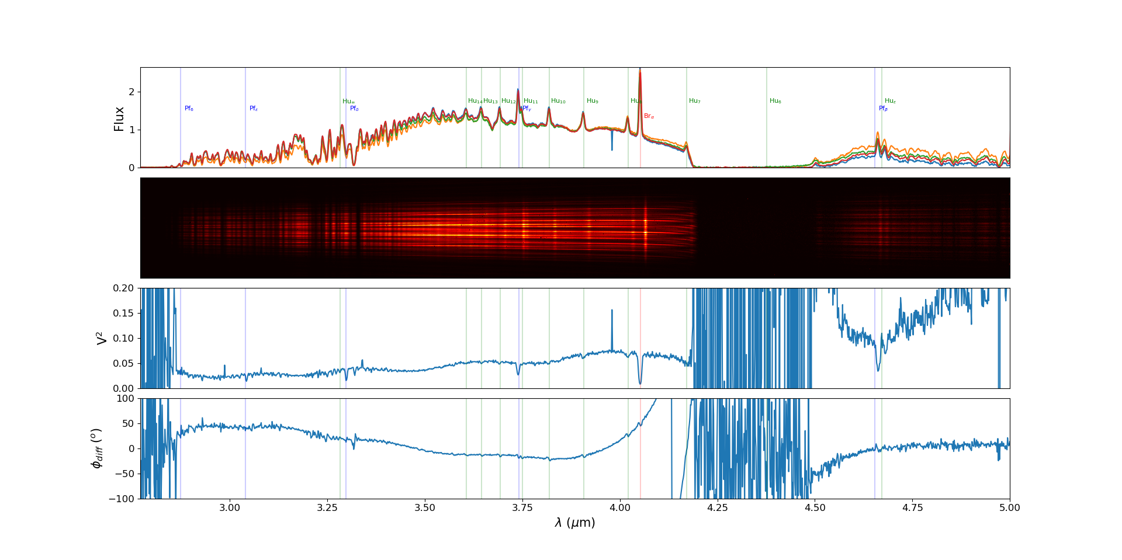
Improve spectral coverage in MED-LM and HIGH-L modes by allowing longer DITs
First GRA4MAT test on the Be star δ Cen 2019-05-30 DIT = 10s

Slide 6
Improve spectral coverage in MED-LM and HIGH-L modes by allowing longer DITs
First GRA4MAT test on the Be star δ Cen 2019-05-30 DIT = 10s
Current spectral window of 0.16μm

Slide 7
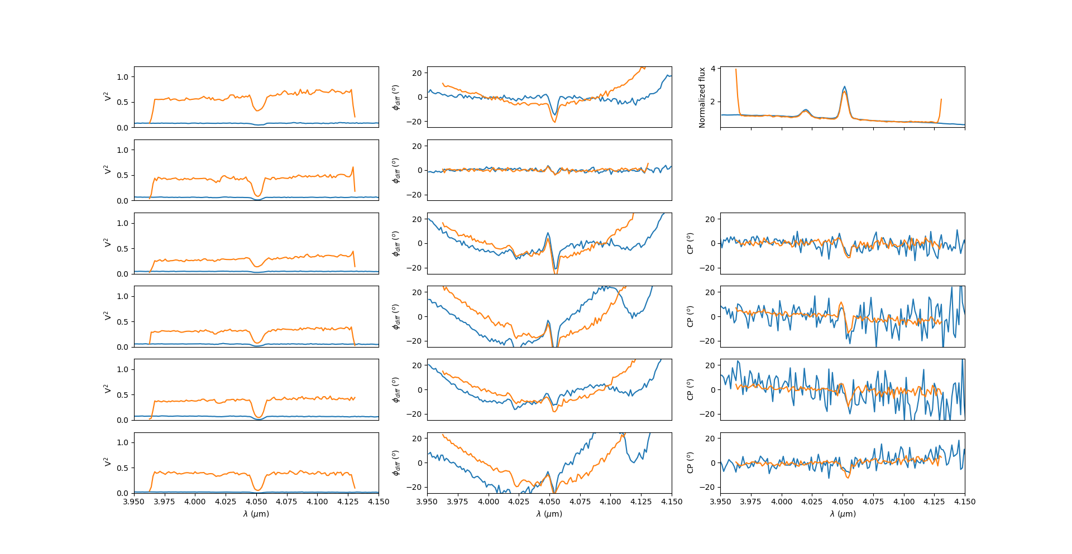
Improve SNR in L band by allowing longer DITs
111ms DIT
10s DIT
Loss of factor 10 in V²

Slide 8
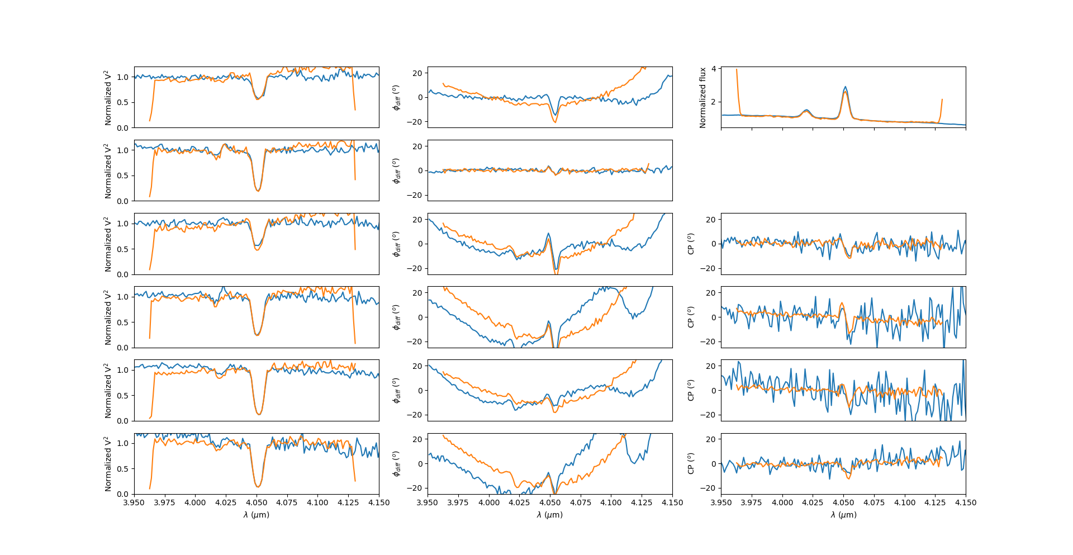
Improve SNR in L band by allowing longer DITs
111ms DIT
10s DIT
Same SNR on V²
Same SNR on φ_{diff}
Strongly degraded SNR on CP
SNR on CP ∝ V³
$\frac{V_{10s}^{2}}{V_{111ms}^{2}}$x $\sqrt{\frac{10000}{111}}$ ≈ 1

Slide 9
Improve SNR in L band by allowing longer DITs
For a constant total integration time : SNR on V² ∝ $\sqrt{DIT}$ if not dominated by background noise
Background noise >> Detector noise for a DIT :
2700 ms at 3.5 μm in LOW ⬄ potential gain of 6 in flux
54000 ms at 3.5 μm in MED ⬄ potential gain of 22 in flux !
130 ms at 4.5 μm in LOW ⬄ close to the current DIT in LOW-LM (i.e 111ms)
2600 ms at 4.5 μm in MED ⬄ potential gain of 5 in flux
When dominated by background noise longer DIT is equivalent to coherent integration

Slide 10
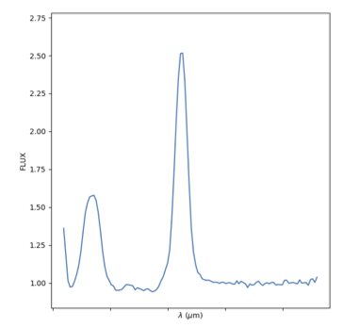
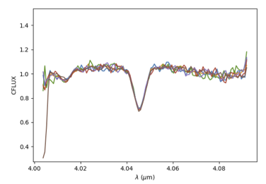
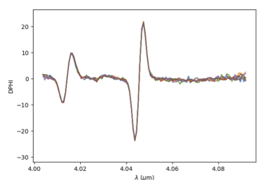
Enable the use of VHIGH mode which always requires long DITs
VHIGH mode (R≈4000) will be commissioned next November/December
Technical run to change prism + characterisation on sky
This mode needs an external fringe tracker to be fully operational
Sensitivity at least 5 times lower than HIGH:
DIT | 111ms | 10s
ATs | 50Jy | 5Jy
UTs | 3.5Jy | 0.35Jy
Spectral window is quite narrow with DIT=111ms ⬄ λ₀± 10nm ⬄ |v| < 700km/s

Slide 11
Improve instrumental visibility in L by stabilizing fringes even for the shorter DITs
τ_{0V} (ms) | 1 | 2 | 4 | 8
τ_{0L} (ms) | 8 | 16 | 32 | 64
DIT = 75ms
Loss of 50% of contrast for τ₀ = 1ms
Visibility constant for τ₀ > 6 ms

Slide 12
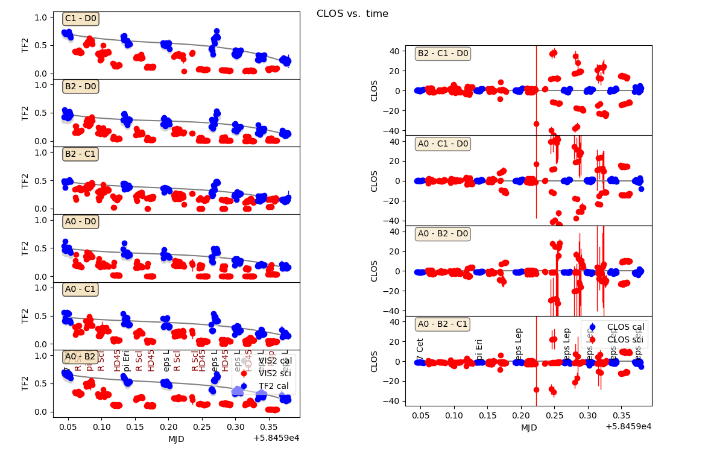
Improve accuracy on transfer function and thus calibrated data

Slide 13
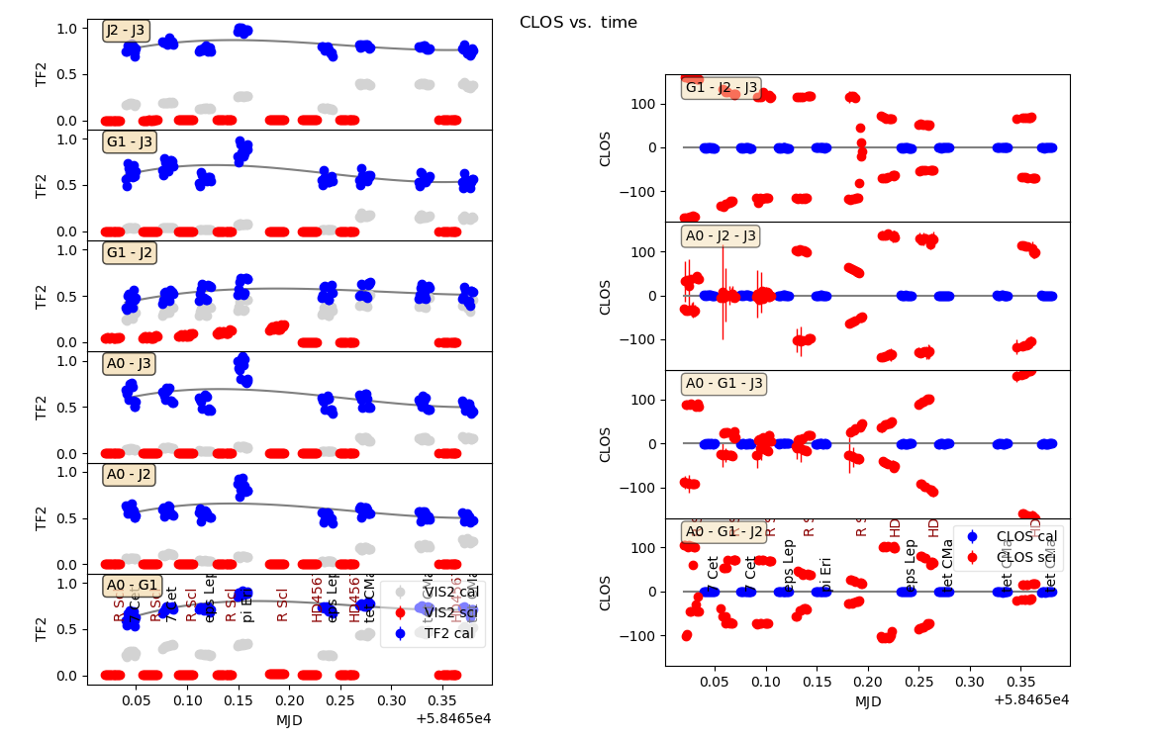
Improve accuracy on transfer function and thus calibrated data

Slide 14
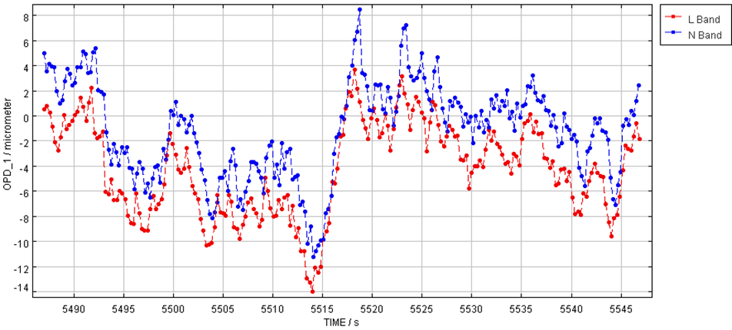
Improve N band sensitivity using coherent integration using pistons estimated in K band
Comparison of OPD estimated in L and N from MATISSE data

Slide 15
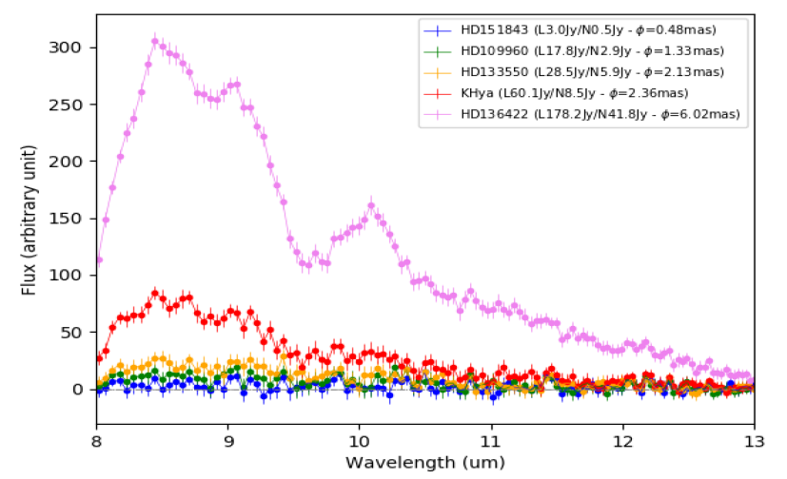
Improve N band sensitivity using coherent integration using pistons estimated in K band
Same band (N for N)
Cross band (L for N)
Working but not improving limiting flux in N (i.e., ≈ 4 Jy)
Why?

Slide 16
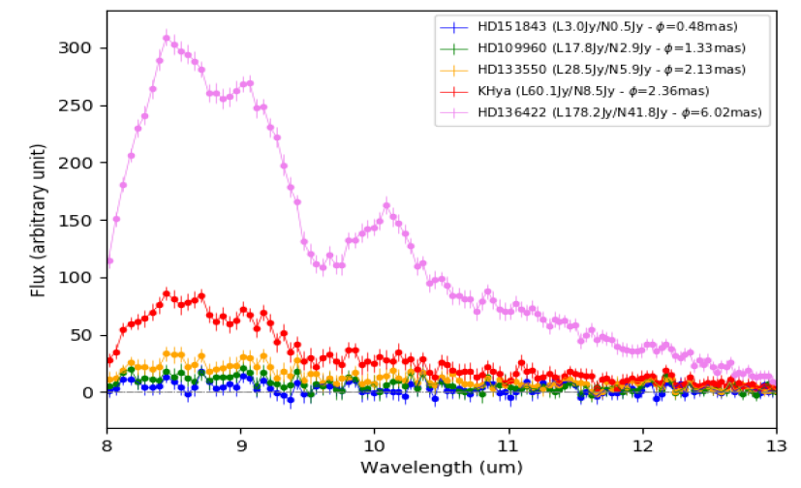
Improve N band sensitivity using coherent integration using pistons estimated in K band
Same band (N for N)
Cross band (L for N)
Working but not improving limiting flux in N (i.e., ≈ 4 Jy)
Why?
Can we estimate this term in the tracking band and extrapolate its value in the “science” band?
If fringes are really “locked” we could integrate coherently without OPD estimation!
Estimated in N
Estimated in L

Slide 17
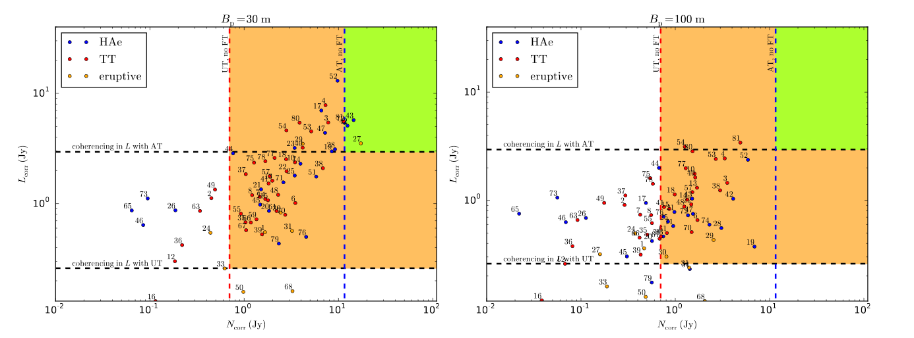
Application to YSOs
Sensitivity in N when coherencing in L

Slide 18
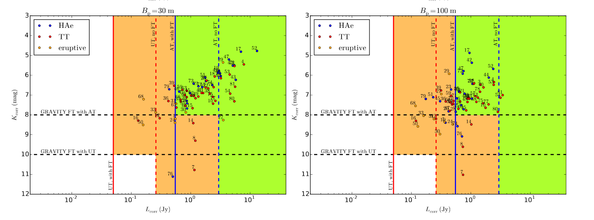
Application to YSOs
Sensitivity in L when tracking in K

Slide 19
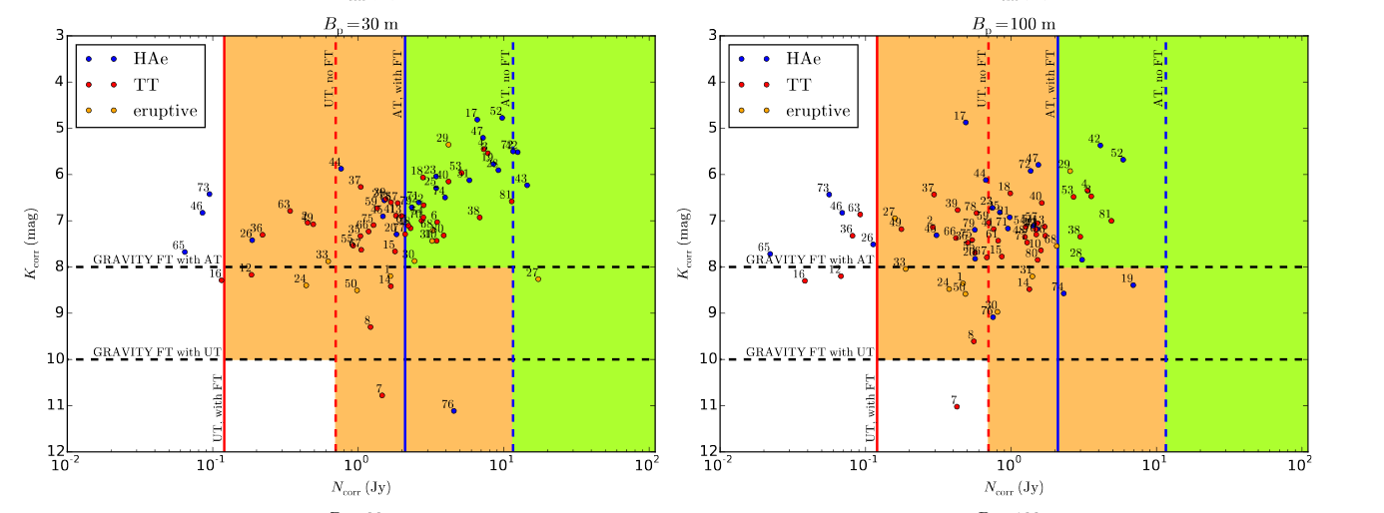
Application to YSOs
Sensitivity in N when tracking in K

Slide 20
Operating MATISSE
MATISSE Alone
GRA4MAT
Telescope pointing
Image acquisition => correction on IRIS pix
Fringe search => VLTI DL
Cophasing L/N (CPN)
Telescope pointing
VLTI-MATISSE-GRAVITY image acquisition (FSM + Gravity)
Pupil acquisition in GRAVITY => VCM
GRAVITY fringe search => VLTI-DL
GRAVITY tracking => VLTI-DL
Acquisition
done once per night
Instrument setup
Skies L + N
Fringe check/search
=> VLTI-DL
Fringes L + N
=> internal coherencing (L or N)
Chopped fringes L + photometry N
=> internal coherencing L
Instrument setup
Skies L + N
Fringe check/search
=> CPL/CPN
Fringes L + N
=> GRAVITY tracking
Chopped fringes L + photometry N
=> Who’s tracking?
Observation

Slide 21
MATISSE Observing modes

Slide 22
MATISSE Observing sequence in Hybrid mode
LM bands | N band
Sky IN-IN Sky OUT-OUT | Sky IN-IN Sky OUT-OUT
Fringes SI-PHOT IN-IN Fringes SI-PHOT IN-OUT Fringes SI-PHOT OUT-IN Fringes SI-PHOT OUT-OUT | Fringes HI-SENS IN-IN Fringes HI-SENS IN-OUT Fringes HI-SENS OUT-IN Fringes HI-SENS OUT-OUT
Chopped Fringes SI-PHOT IN-IN Chopped Fringes SI-PHOT IN-IN Chopped Fringes SI-PHOT IN-IN Chopped Fringes SI-PHOT IN-IN | Chopped Photom. Beam1 SI-PHOT IN-IN Chopped Photom. Beam2 SI-PHOT IN-IN Chopped Photom. Beam3 SI-PHOT IN-IN Chopped Photom. Beam4 SI-PHOT IN-IN
Chopped Fringes SI-PHOT OUT-OUT Chopped Fringes SI-PHOT OUT-OUT Chopped Fringes SI-PHOT OUT-OUT Chopped Fringes SI-PHOT OUT-OUT | Chopped Photom. Beam1 SI-PHOT OUT-OUT Chopped Photom. Beam2 SI-PHOT OUT-OUT Chopped Photom. Beam3 SI-PHOT OUT-OUT Chopped Photom. Beam4 SI-PHOT OUT-OUT
Optional steps :
Necessary to compute
V² in N band
if not performed
Only coherent flux

Slide 23
MATISSE Observing sequence with GRA4MAT ?
LM bands | N band
Sky IN-IN Sky OUT-OUT | Sky IN-IN Sky OUT-OUT
Fringes SI-PHOT IN-IN Fringes SI-PHOT IN-OUT Fringes SI-PHOT OUT-IN Fringes SI-PHOT OUT-OUT | Fringes HI-SENS IN-IN Fringes HI-SENS IN-OUT Fringes HI-SENS OUT-IN Fringes HI-SENS OUT-OUT
Chopped Fringes SI-PHOT IN-IN Chopped Fringes SI-PHOT IN-IN Chopped Fringes SI-PHOT IN-IN Chopped Fringes SI-PHOT IN-IN | Chopped Photom. Beam1 SI-PHOT IN-IN Chopped Photom. Beam2 SI-PHOT IN-IN Chopped Photom. Beam3 SI-PHOT IN-IN Chopped Photom. Beam4 SI-PHOT IN-IN
Chopped Fringes SI-PHOT OUT-OUT Chopped Fringes SI-PHOT OUT-OUT Chopped Fringes SI-PHOT OUT-OUT Chopped Fringes SI-PHOT OUT-OUT | Chopped Photom. Beam1 SI-PHOT OUT-OUT Chopped Photom. Beam2 SI-PHOT OUT-OUT Chopped Photom. Beam3 SI-PHOT OUT-OUT Chopped Photom. Beam4 SI-PHOT OUT-OUT
GRAVITY « standby »
(tracking+images+pupils)
Tracking with
GRAVITY-FT
What to do here?
No tracking
Or
Internal Coherencing
same mode or LOW
Or
GRAVITY-FT
with slow chopping (0.1-0.25Hz)
Or
Hi-Sens mode in L

Slide 24
GRA4MAT drawbacks and problems
Chopping and tracking simultaneously
Would be great if possible
Other solution would be HISENS mode in L band
Fringe jumps in GRAVITY :
Change “weight” between GD and PD to prevent them
Double jumps to limit the effect at 4µm.
In N band, the photometry is limiting the accuracy on V²
GRA4MAT will only improve the coherent flux
In L&M bands, for faint targets (below 5-10Jy), photometry problem on fringes without chopping
Chopped SI-PHOT fringes or full HISENS mode

Slide 25
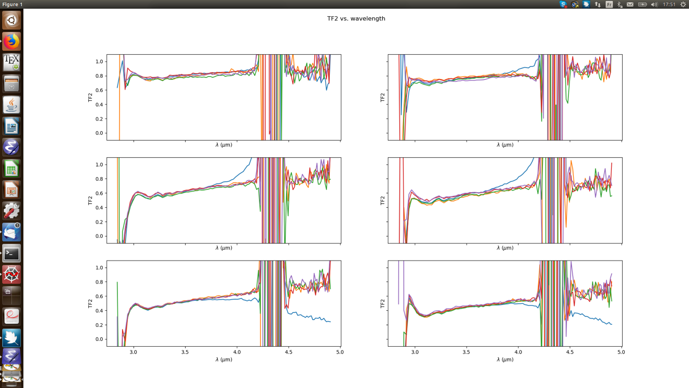
GRA4MAT drawbacks and problems
Non-chopped (blue) diverges at 3.7um for this 14 Jy source .

