Slide 1

MATISSE
Overview of stellar physics programs for 2019-2020

Slide 2
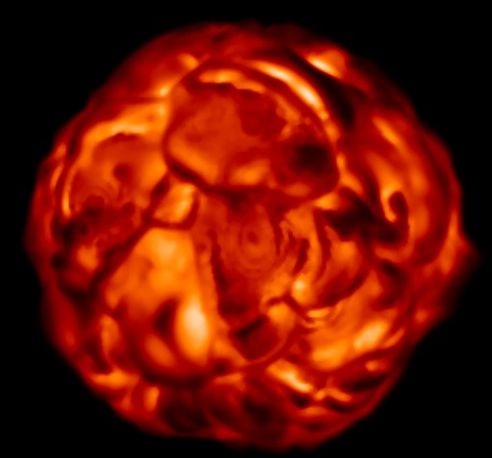
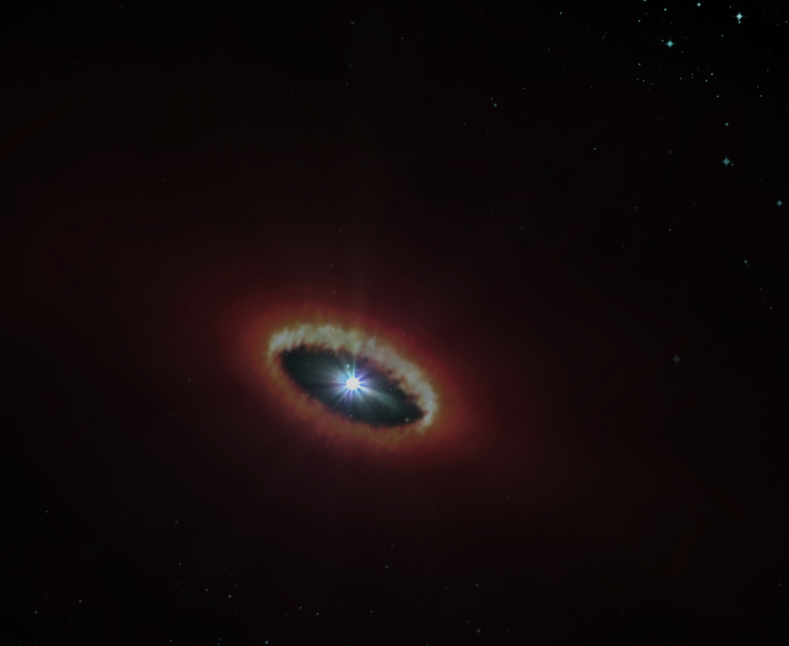
Overview of stellar physics programs for 2019-2020
  Overview on :
  MATISSE GTO Programs
  MATISSE commissioning data
  GRA4MAT commissioning data
  Open time programs
  About the following types :
  Red Supergiants
  AGBs
  Cepheids
  B[e] stars
  Be stars
  LBV (η Car)
Surface of evolved stars
Gaz and Dust in circumstellar environments

Slide 3
Overview of stellar physics programs for 2019-2020
  MATISSE GTO programs in P103 (March-September 2019):
  Supergiant Vx Sgr (Chiavassa)
  η Car (Weigelt)
  B[e] star HD87643 (Millour)
  3 Cepheids (Hocde)
  3 Carbon AGBs (Hron)

Slide 4
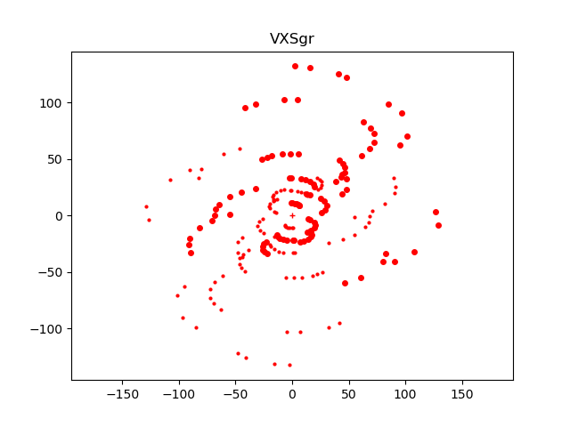
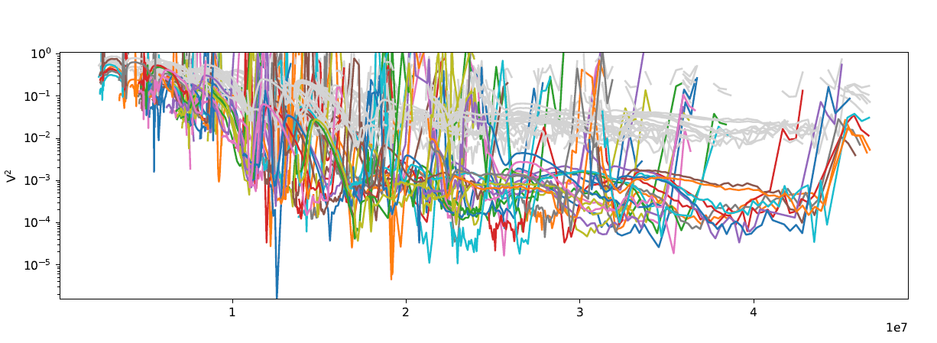
Overview of stellar physics programs for 2019-2020
  GTO P103: Supergiant Vx Sgr (Chiavassa)
  Observations during 5 nights
  with SMALL, MEDIUM, and LARGE configs
  17 Good measurements in LM-LOW and N-LOW
  Data Reduced
  Image reconstruction should be the next step

Slide 5

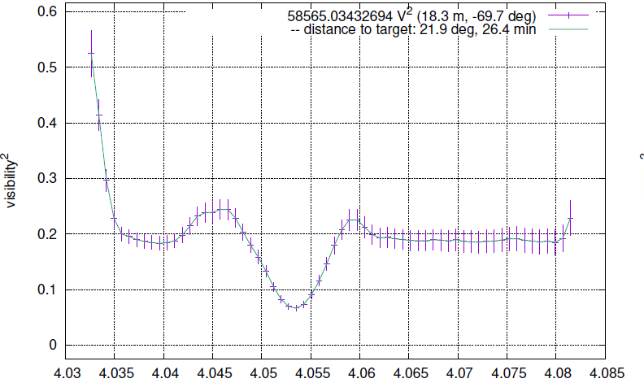
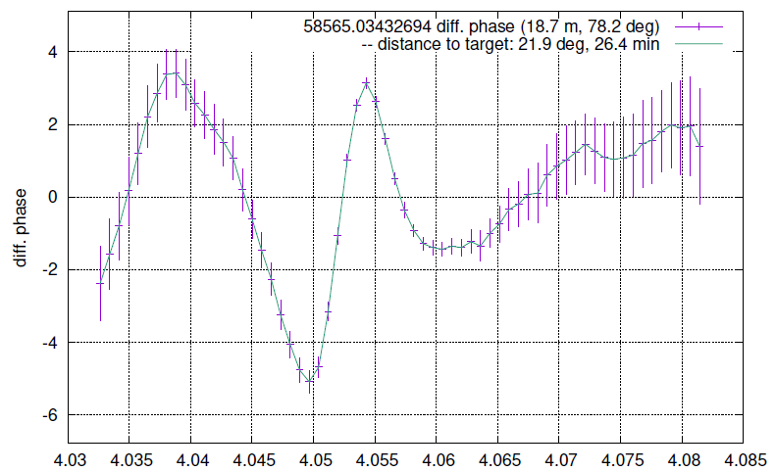
Overview of stellar physics programs for 2019-2020
  GTO P103: η Car (Weigelt)
  Observations during 4 nights (March and May)
  with SMALL, MEDIUM and UT
  LM-HIGH centered on Brα and LM-LOW and N-LOW

Slide 6
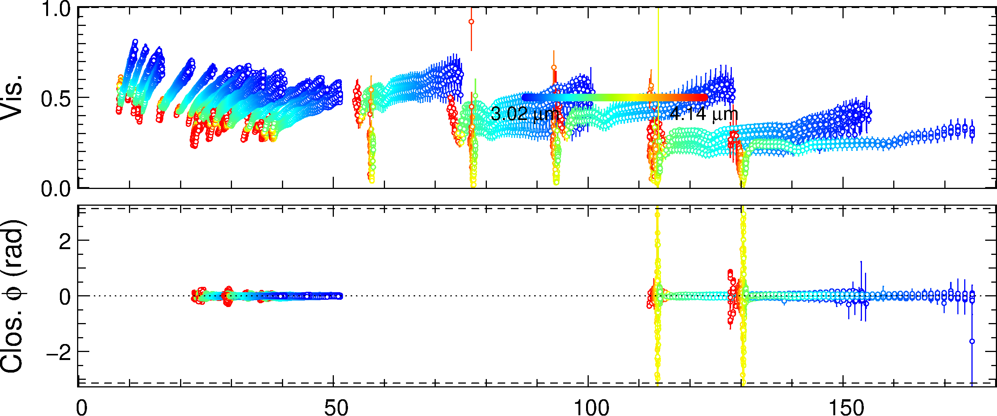
Overview of stellar physics programs for 2019-2020
  GTO P103: η Car (Weigelt)
  Observations during 4 nights (March and May)
  with SMALL, MEDIUM and UT
  LM-HIGH centered on Brα and LM-LOW and N-LOW

Slide 7
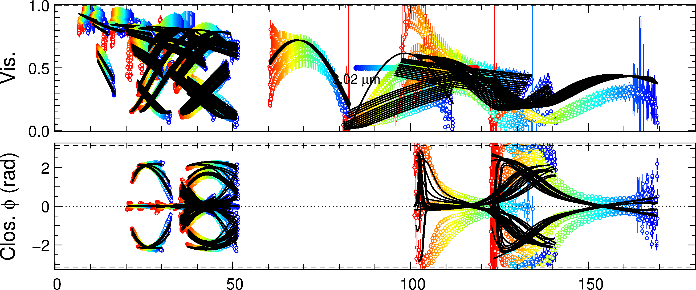
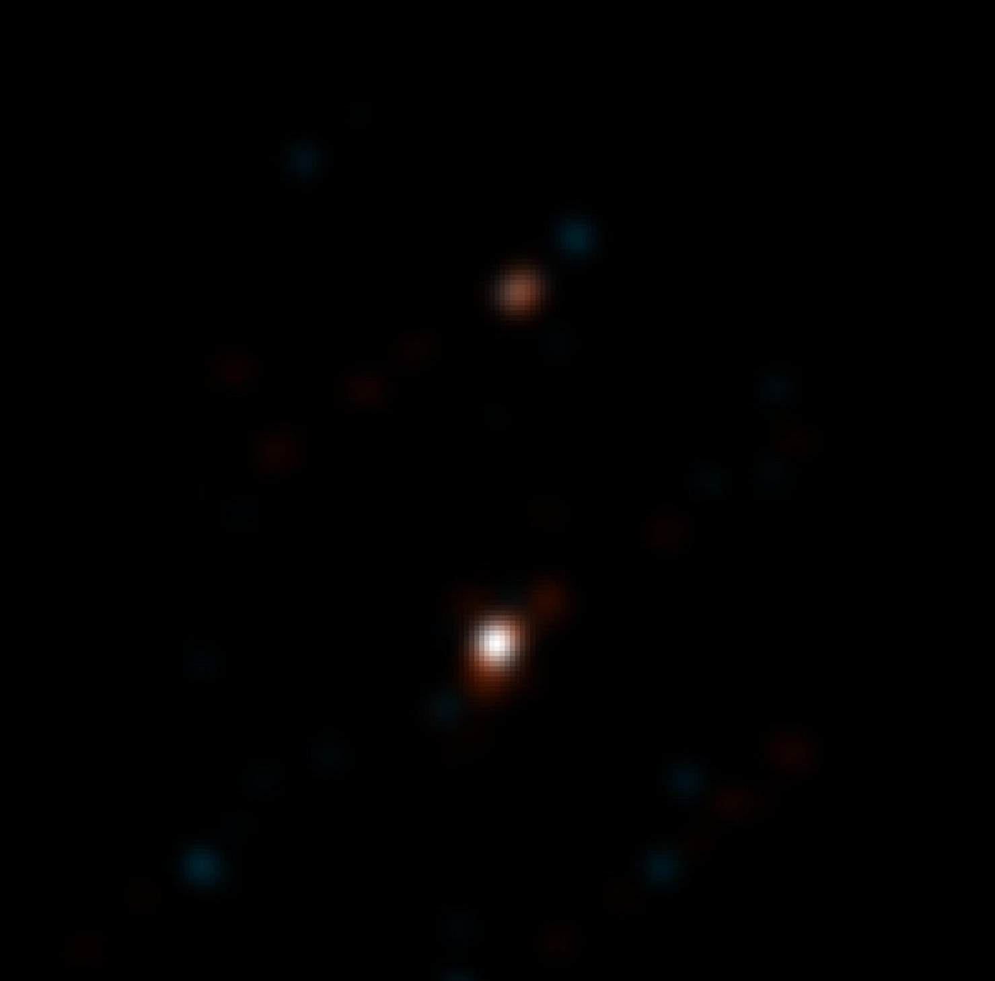
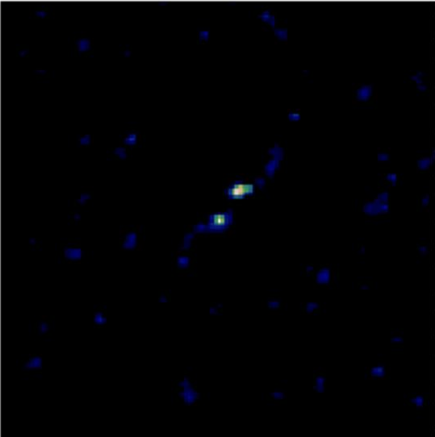
Overview of stellar physics programs for 2019-2020
  GTO P103: B[e] HD87643 (Millour)
VLTI/AMBER 2008
  Observations during 3 nights (March and May)
  with SMALL, MEDIUM configs
  LM-LOW and N-LOW
Millour+ 2009
VLTI/MATISSE 2019
50 mas

Slide 8
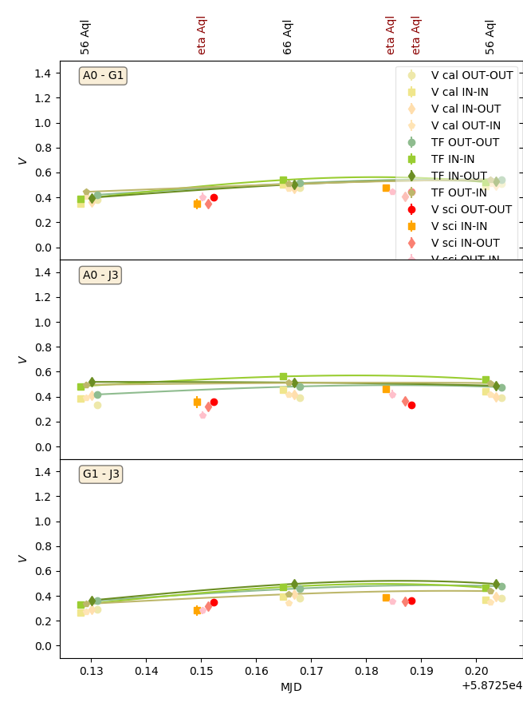
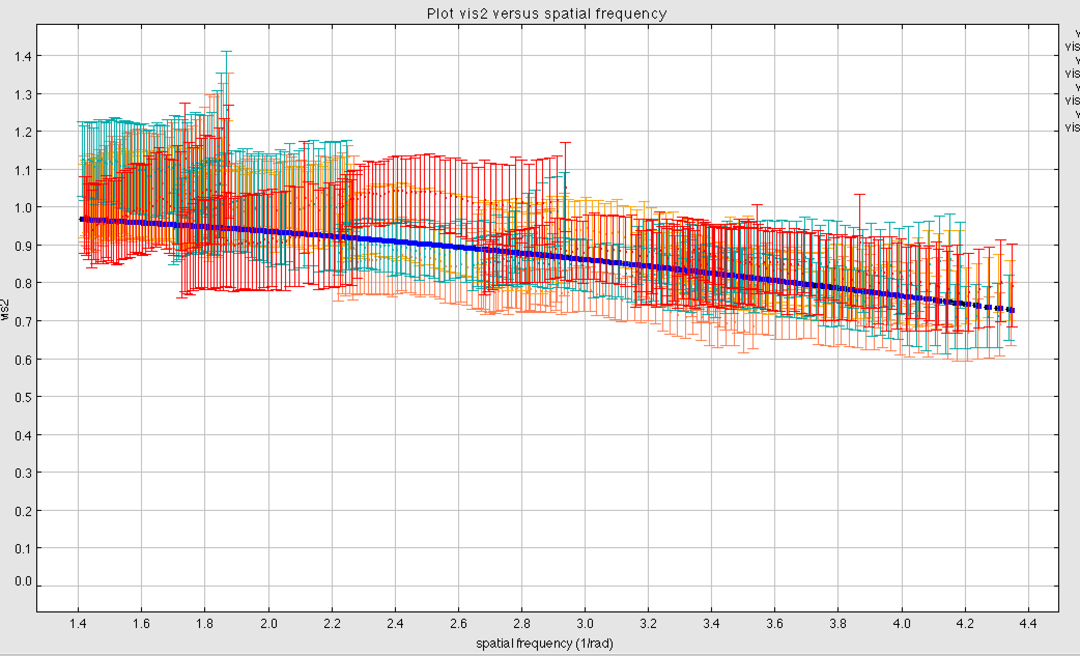
Overview of stellar physics programs for 2019-2020
  GTO P103: 3 Cepheids : (Hocde)
  Observations during 2 nights (August) with LARGE config
  LM-LOW and N-LOW
  3pts η Aql + 1pt S Sge + 1pt TT Aql + 1pt Y Sgr
  Relatively bad seeing (between 1 and 2”)
η Aql
Phase 0.751
Fit UD = 1.671 mas
SPIPS LD : 1.658

Slide 9
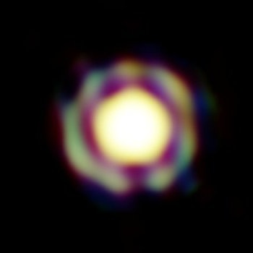
Overview of stellar physics programs for 2019-2020
  MATISSE GTO programs observed in P104 (Now):
  3 Carbon stars (Hron)
  7 B[e] stars (Meilland)
  η Car (Weigelt)
  2 Cepheids (Hocde)
  AGB T Lep (Millour)
Observations in February (9n on AT)
and March (4 half-nights on UT)
T Lep
Observed in December
VLTI/AMBER
Le Bouquin+ 2009

Slide 10
Overview of stellar physics programs for 2019-2020
  MATISSE GTO programs in P105 (April-September 2020)
  6 Carbon stars (Hron) => rejected
  2 B[e] stars (Meilland) in August (3x0.3n on AT)
  η Car (Weigelt) => Accepted (3runs ≈ 2n in Service)
  2 Cepheids (Hocde) => rejected or not submitted?
  VX Sgr (Chiavassa) => rejected or not submited?

Slide 11
Overview of stellar physics programs for 2019-2020
  Data from the MATISSE commissioning
  R Scl (AGB) : Millour
  FS CMa (B[e]/Herbig) : Weigelt
  7 Be stars : Meilland
  HD62623 (B[e]) : Meilland
  Mira (AGB) : Cruzalebes
  WR104 : Matter
  Betelgeuse : Petrov
  Antares : ???

Slide 12
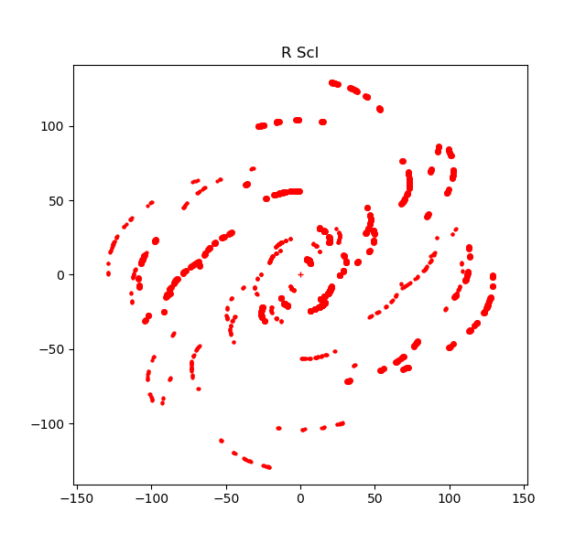
Overview of stellar physics programs for 2019-2020
  Data from the MATISSE commissioning : R Scl (Millour)
  Observations during the Imaging Commissioning
  10 nights In December 2018
  With All configs (including Intermediate ones)
  In LOW-L and LOW-N

Slide 13
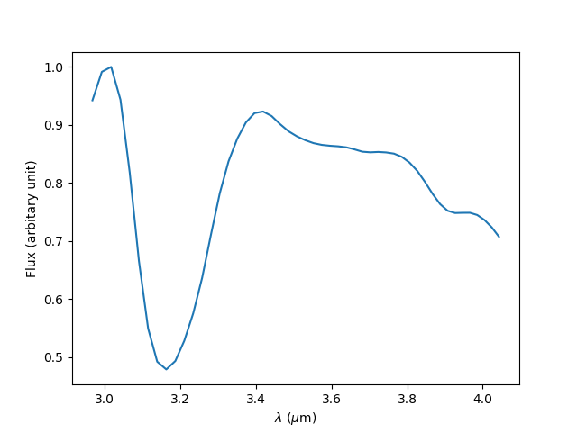
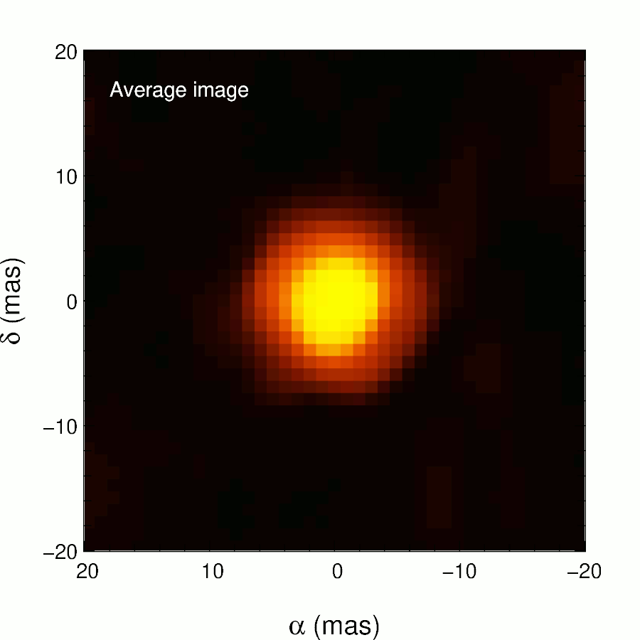
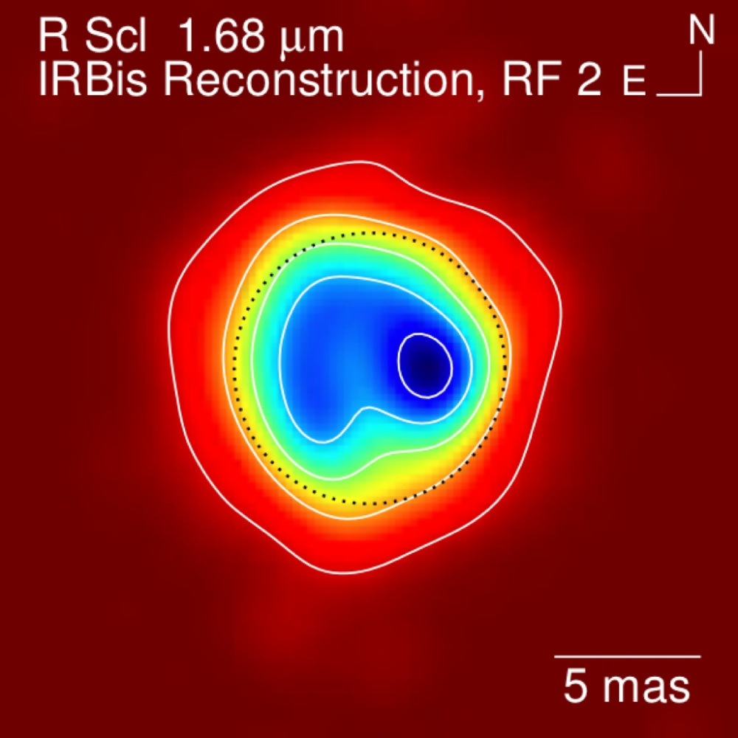
Overview of stellar physics programs for 2019-2020
  Data from the GRA4MAT commissioning
PIONIER H-band
MATISSE L-band spectrally-resolved images

Slide 14
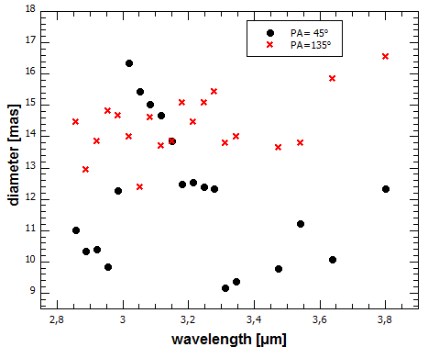
Overview of stellar physics programs for 2019-2020
  Data from the GRA4MAT commissioning

Slide 15
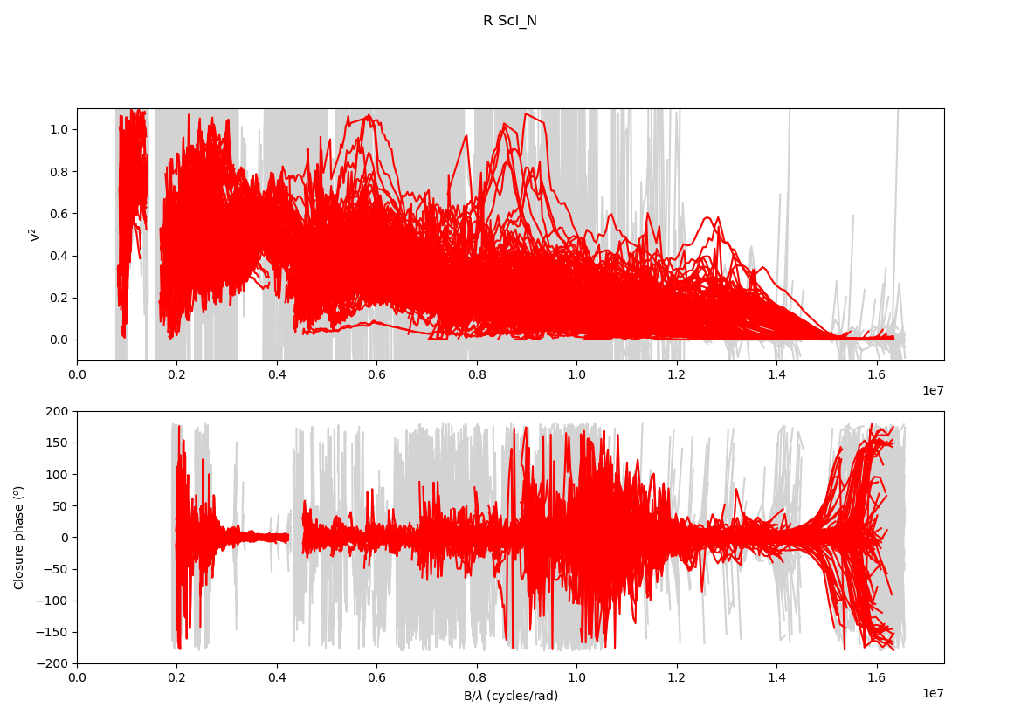
Overview of stellar physics programs for 2019-2020
  Data from the MATISSE commissioning : R Scl (Millour)
  Better N band data
  thanks to binning with
  new version of the pipeline
  Image reconstruction on N band
  on going

Slide 16
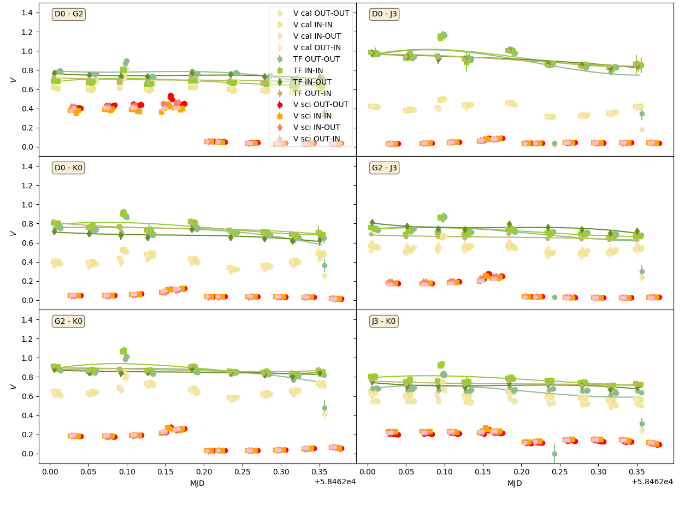
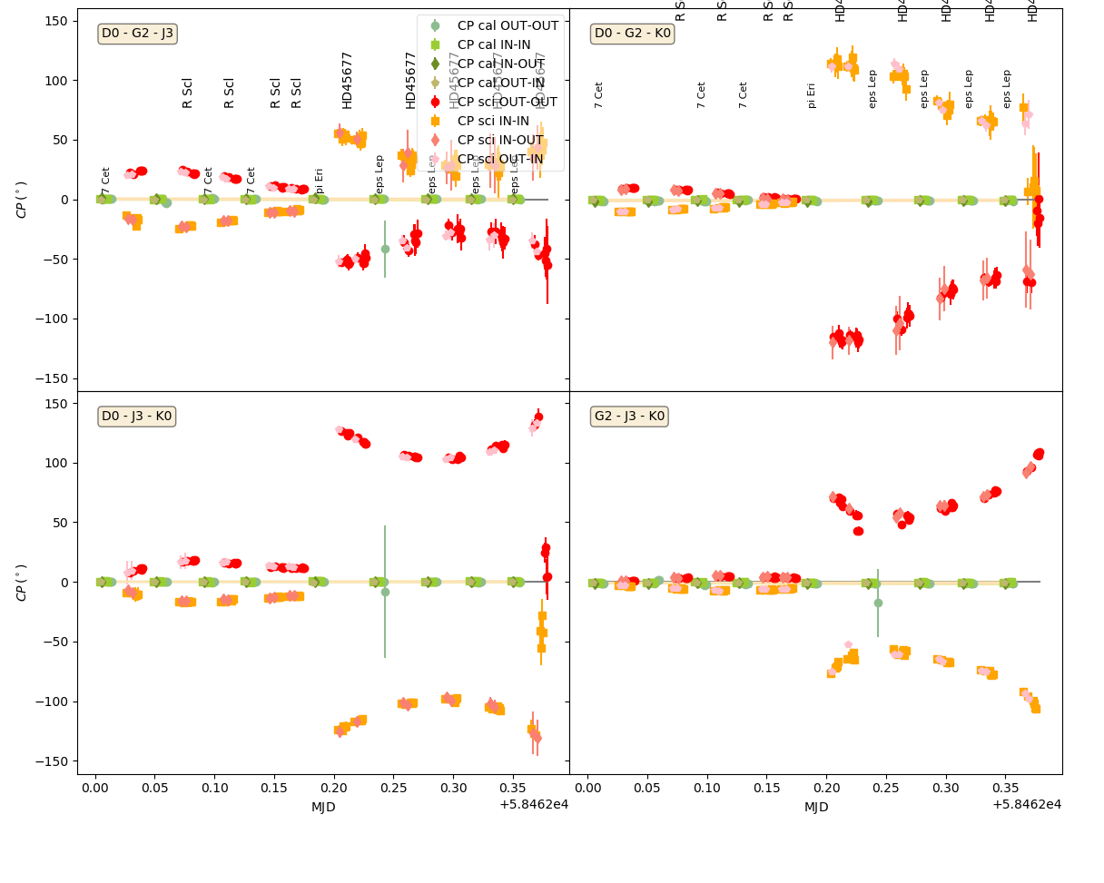
Overview of stellar physics programs for 2019-2020
  Data from the MATISSE commissioning : B[e] FS CMa (Weigelt)
  Observations during the Imaging Commissioning in December 2018
R Scl
FS CMa
R Scl
FS CMa
L-Band Transfer function in visibility
L-Band Transfer function in Closure Phase

Slide 17
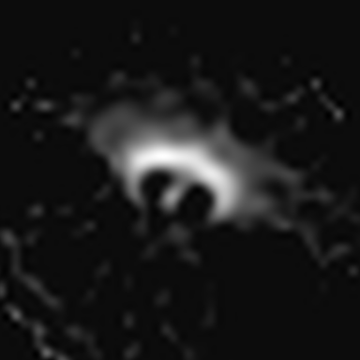
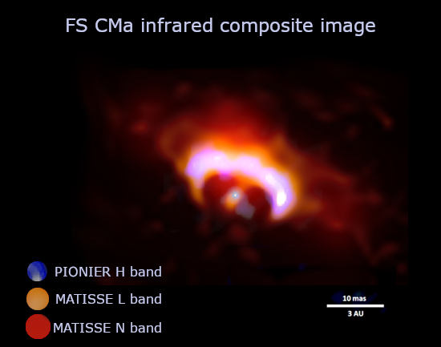
Overview of stellar physics programs for 2019-2020
  Data from the MATISSE commissioning : B[e] FS CMa (Weigelt)
  Observations during the Imaging Commissioning in December 2018
MATISSE L
MATISSE N
  N band image quality limited by SNR on CP
  Spectral binning should help!

Slide 18
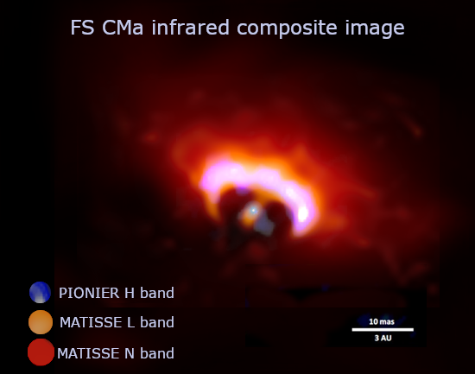

Overview of stellar physics programs for 2019-2020
  Data from the MATISSE commissioning : B[e] FS CMa (Weigelt)
  Observations during the Imaging Commissioning in December 2018
MATISSE L
MATISSE N
PIONIER H
  N band image quality limited by SNR on CP
  Spectral binning helps!

Slide 19
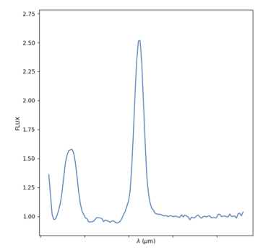
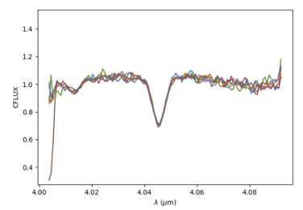
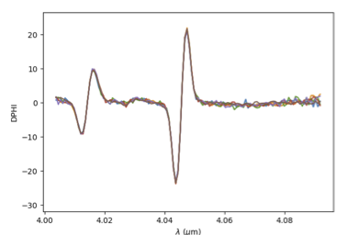
Overview of stellar physics programs for 2019-2020
  Data from the MATISSE commissioning : 7 Be stars (Meilland)
  α Ara, Achernar, η Cen, δ Cen, δ Sco, 48 Lib, HD112091
  mainly in MED or HIGH centered on Brα
Brα Line Profile (+ Hu 9)
Visibility
Differential Phase

Slide 20
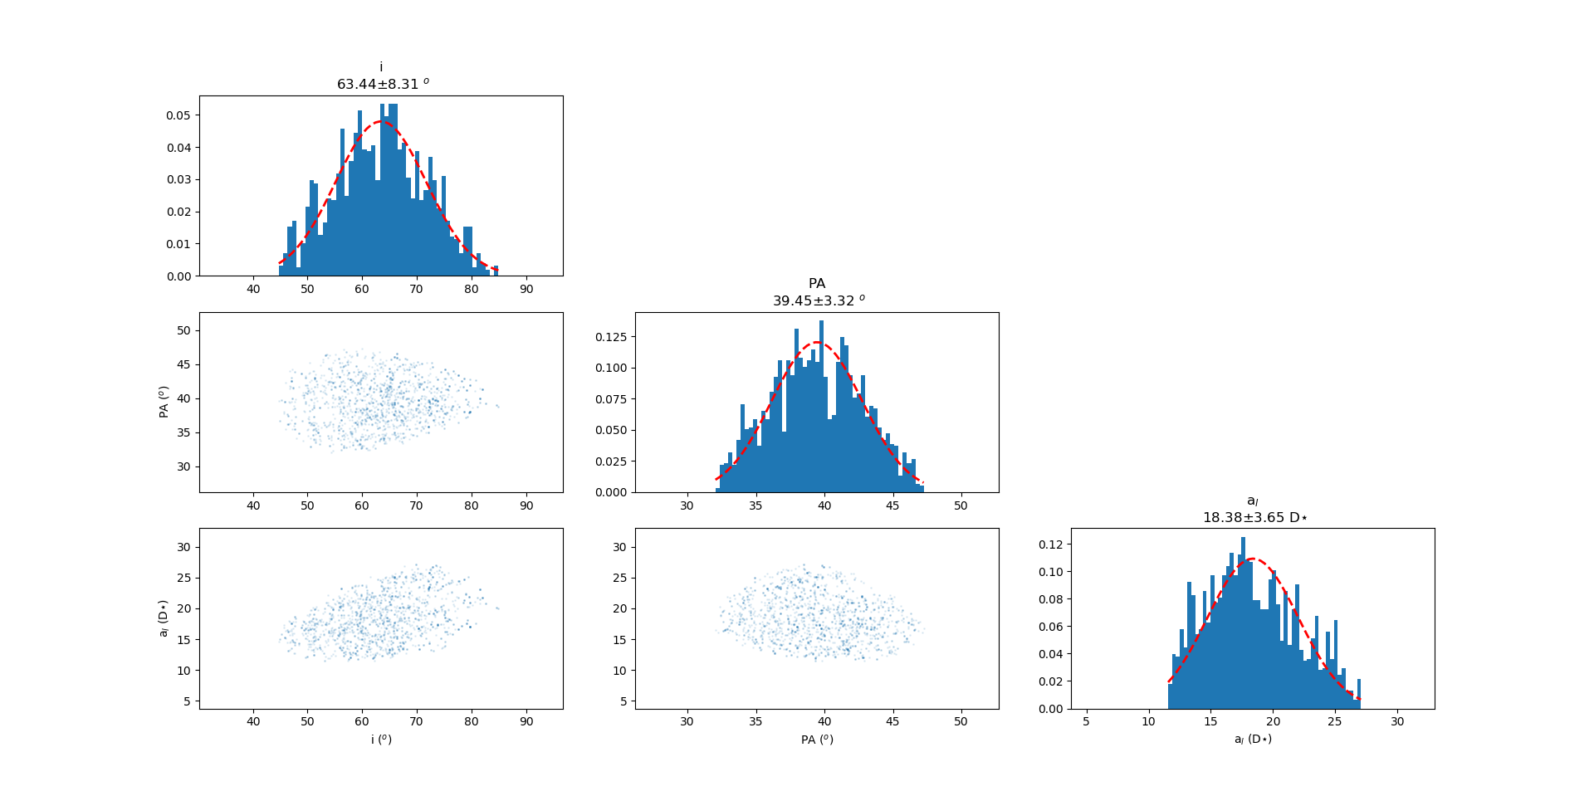
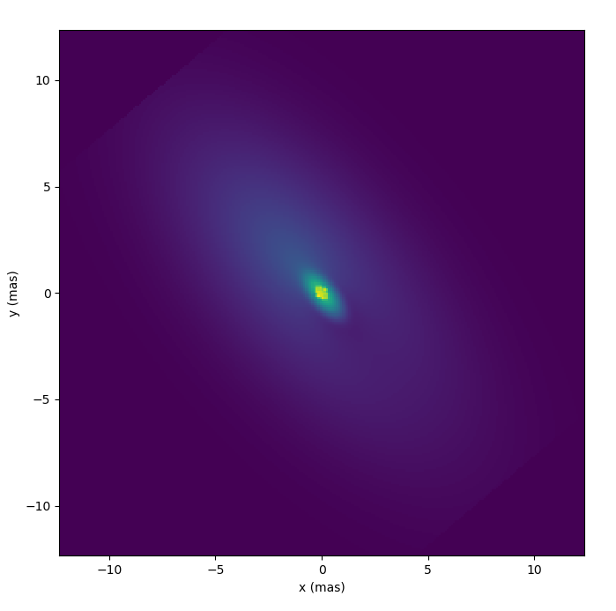
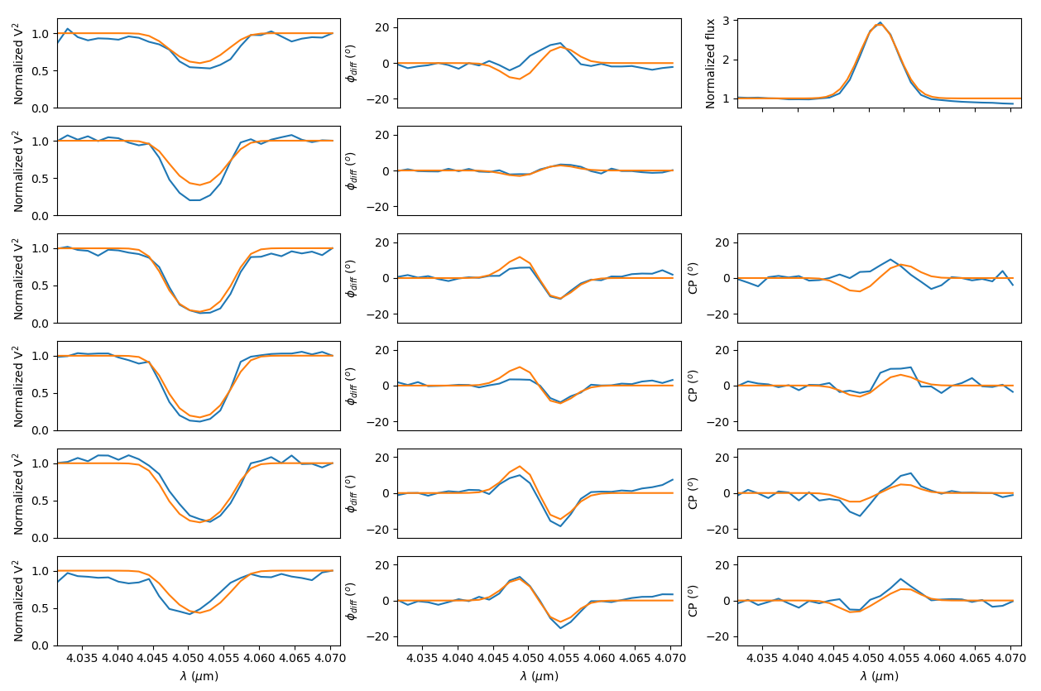
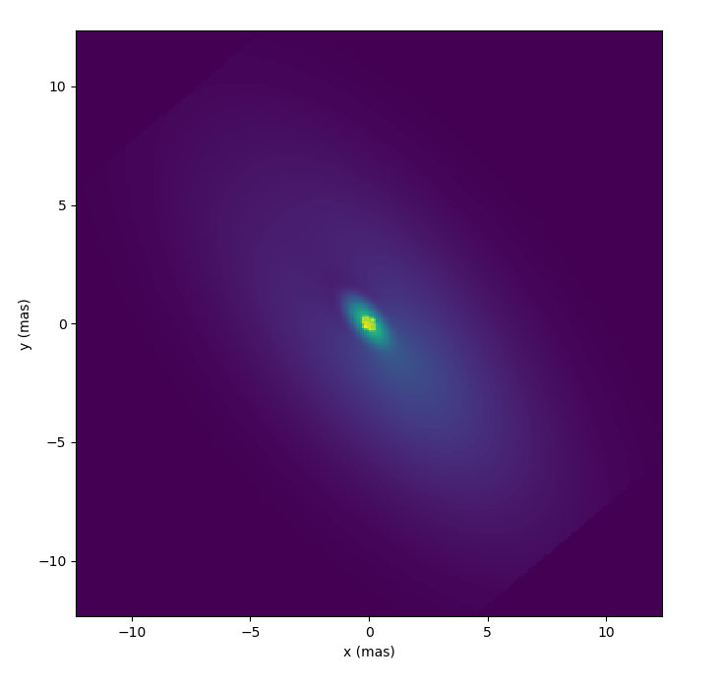
Overview of stellar physics programs for 2019-2020
  Data from the MATISSE commissioning : 7 Be stars (Meilland)
λ = 4.047µm
Size
v=-300km/s
Orientation
λ = 4.056µm
v=+300km/s
Inclination Angle
MCMC–fit on disk geometry and kinematics from Brα using a toy-model
Radiative transfer will add information on the density and temperature distribution

Slide 21
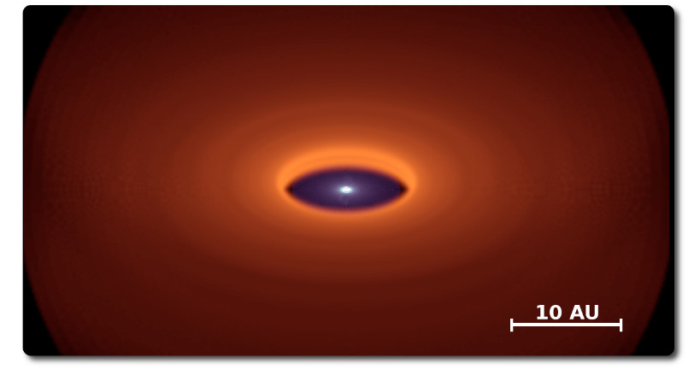
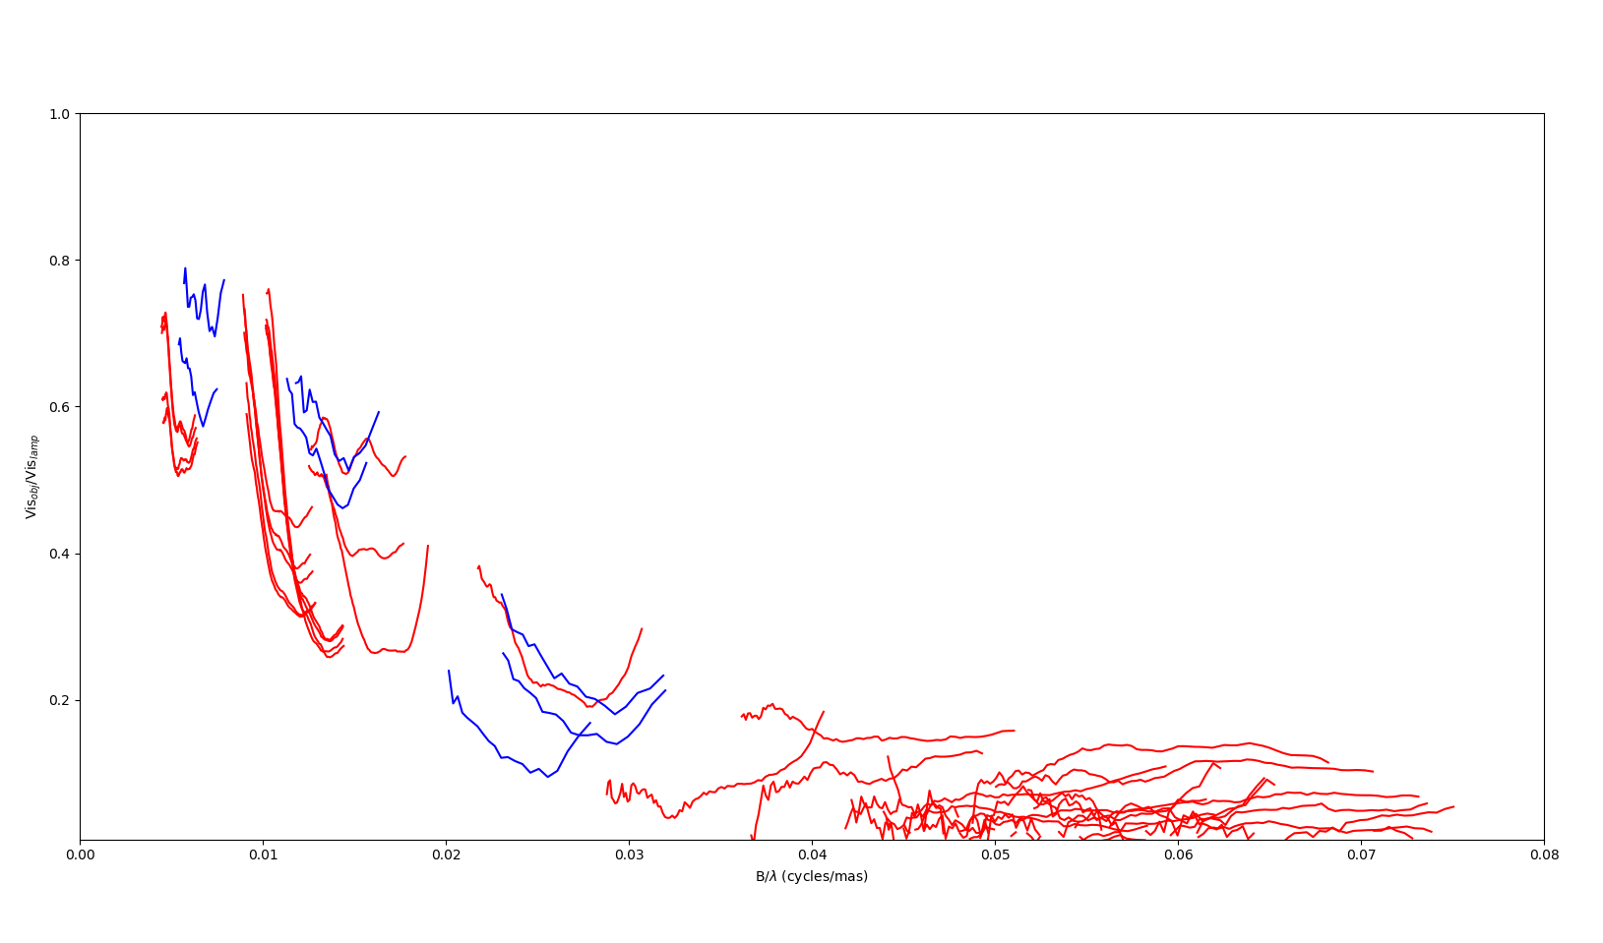
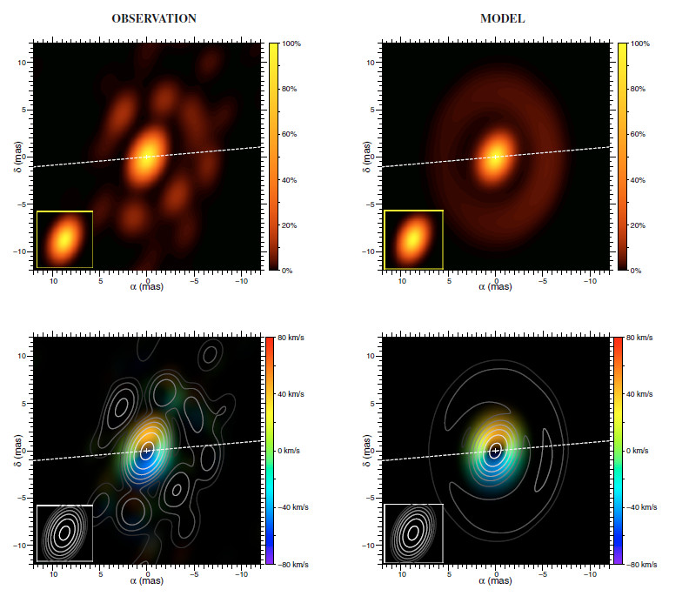
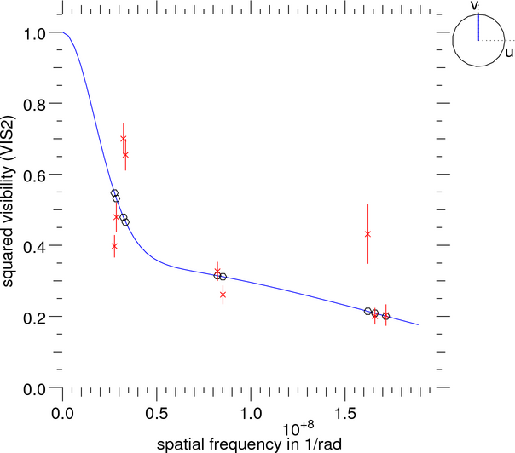
Overview of stellar physics programs for 2019-2020
  Data from the MATISSE commissioning : B[e] HD62623 (Meilland)
  Observed as backup during December 2018 imaging run
VLTI/MIDI (Meilland+ 2010)
E
N
HD62623 observation from MIDI and MATISSE
4h MATISSE
1n MIDI
VLTI/AMBER (Millour+ 2011)
CHARA/VEGA

Slide 22
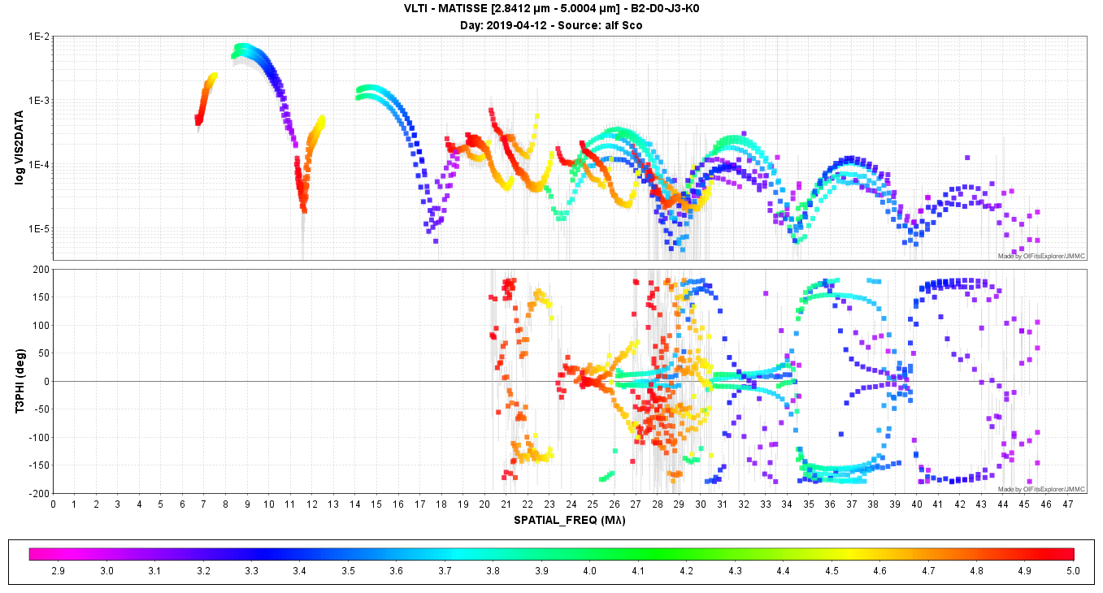
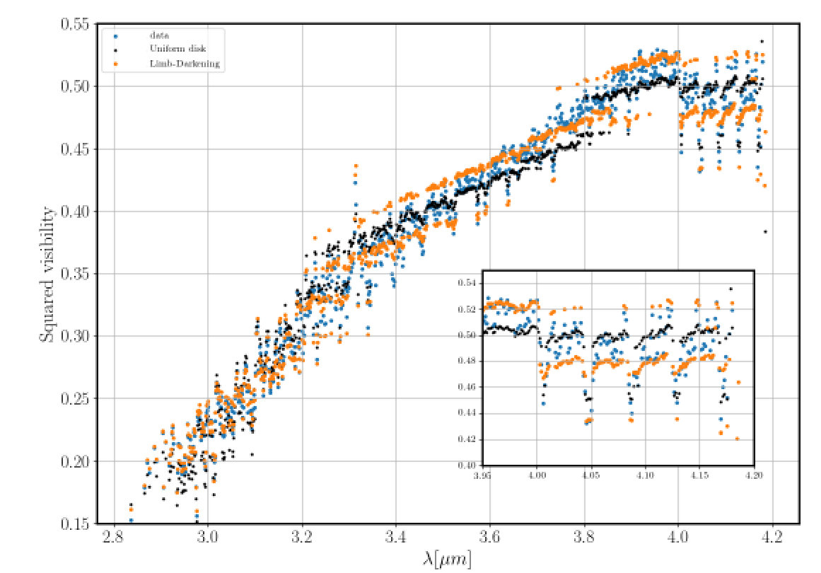
Overview of stellar physics programs for 2019-2020
  Data from the MATISSE commissioning : Antares and Betelgeuse
Antares
Betelgeuse
  On a few measurements in LOW-LM
  Observed a lot in MED-LM and HIGH-N
  During December 2018 imaging run

Slide 23

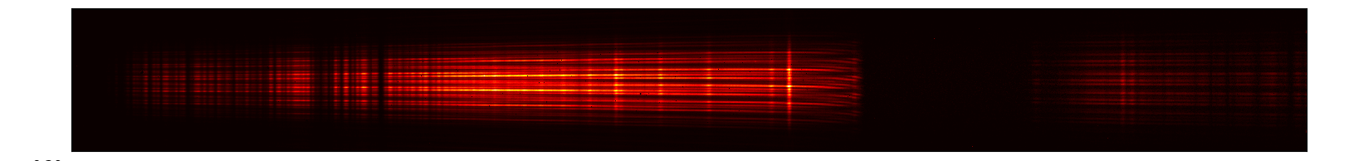
Overview of stellar physics programs for 2019-2020
  Data from the GRA4MAT commissioning
  A few Be stars
  And B[e] stars
  Rigel radiatively driven wind
  η Car in VHIGH
  Not that many cold stars up to now
Emission line stars
GRA4MAT
First GRA4MAT fringes obtained in May 2019 on the Be star δ Cen
Commisioning in September, October and December 2019

Slide 24
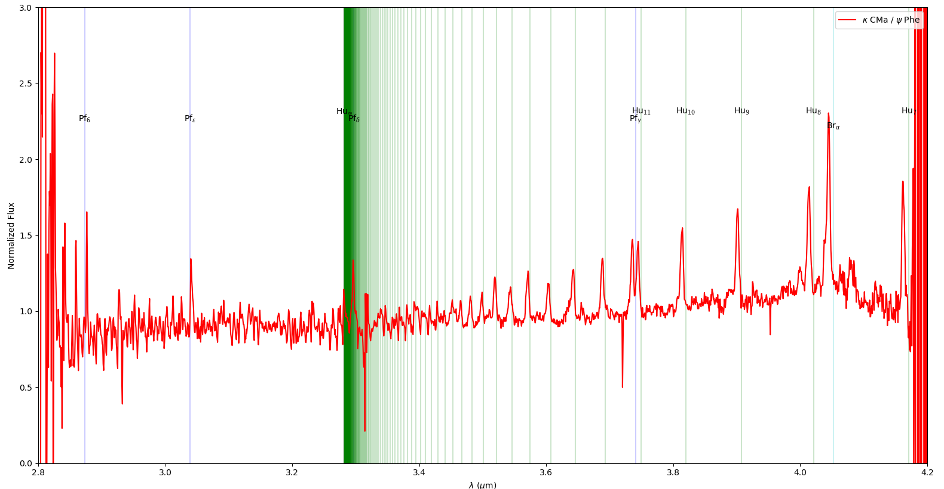
Overview of stellar physics programs for 2019-2020
  Data from the GRA4MAT commissioning : Be stars
Brα
Pfund lines (+ Humphreys)
GRA4MAT spectrum obtained on K CMa

Slide 25
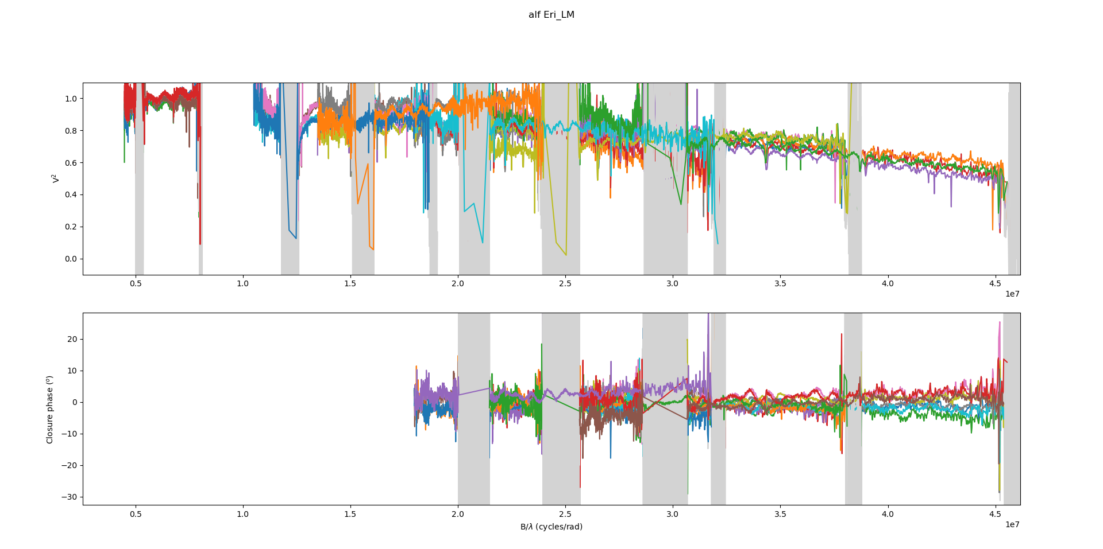
Overview of stellar physics programs for 2019-2020
  Data from the GRA4MAT commissioning : Be stars
The Binary Be star Achernar

Slide 26
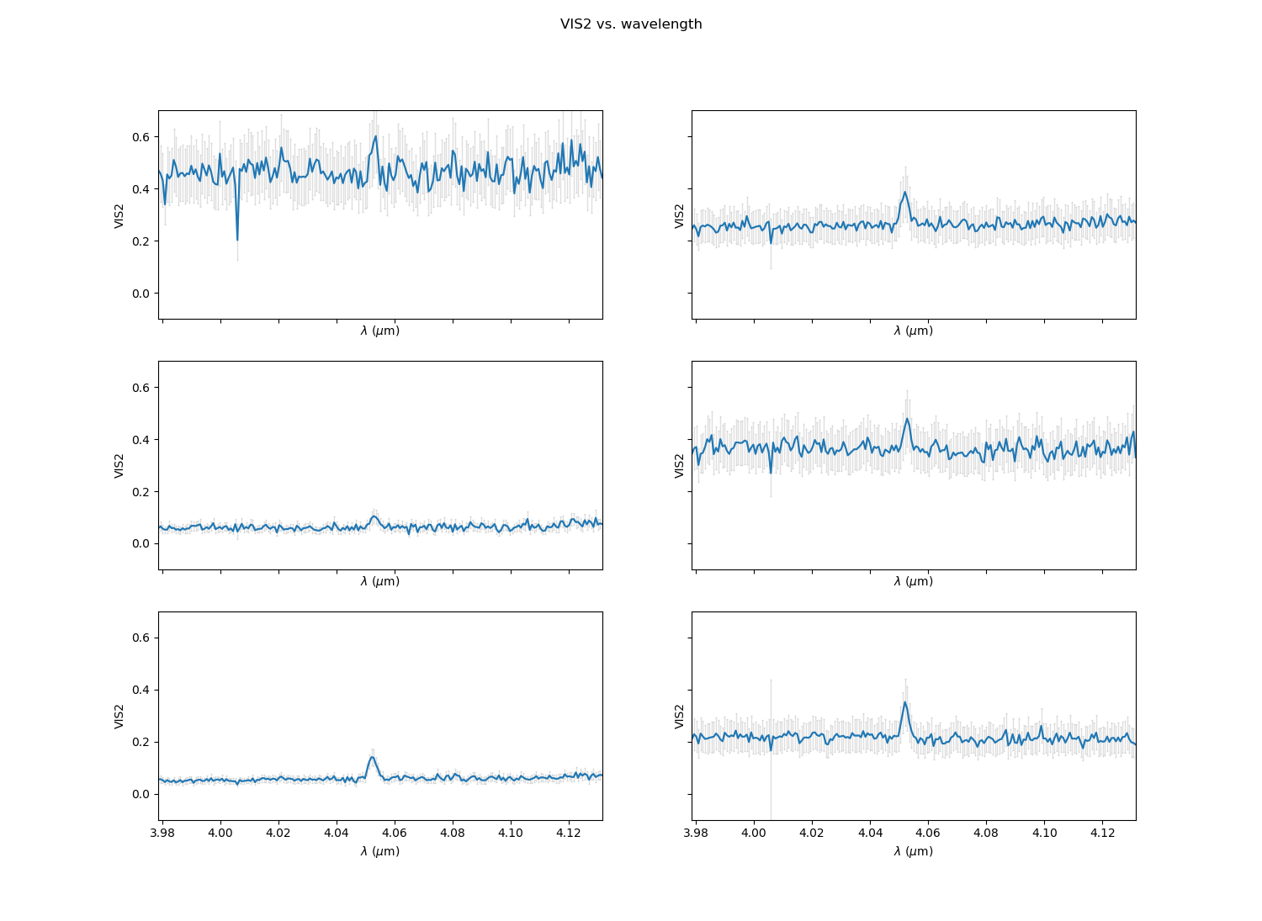
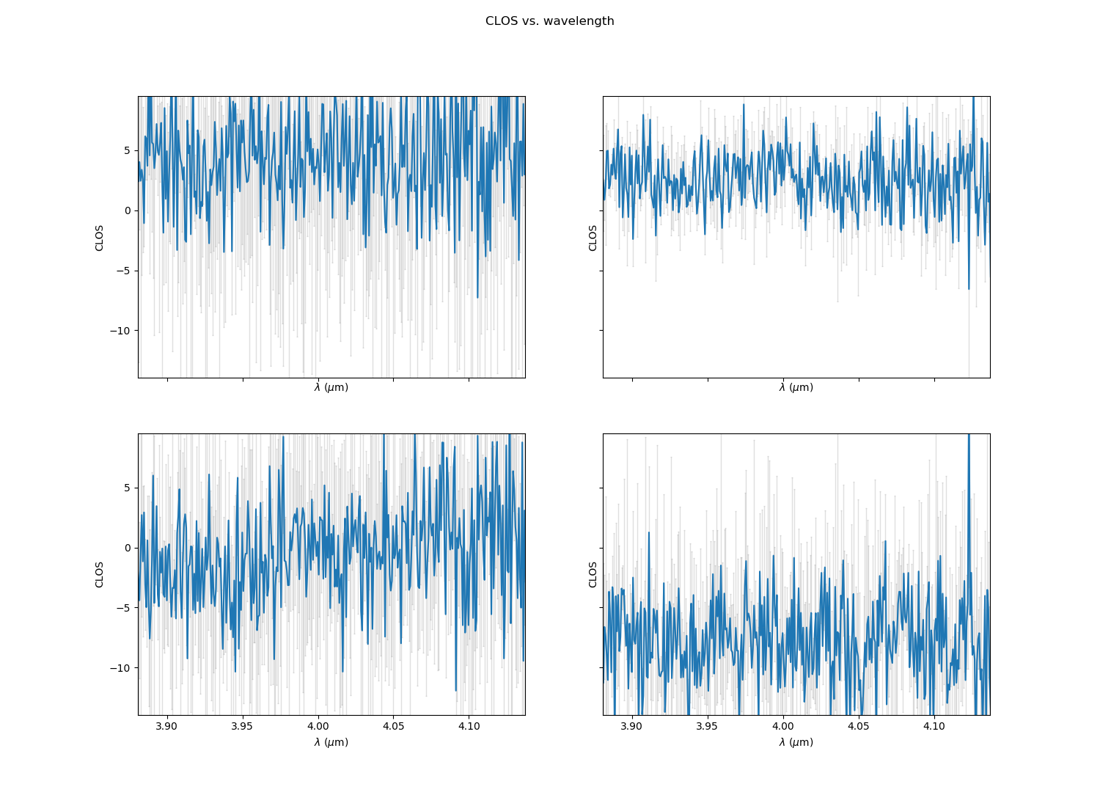
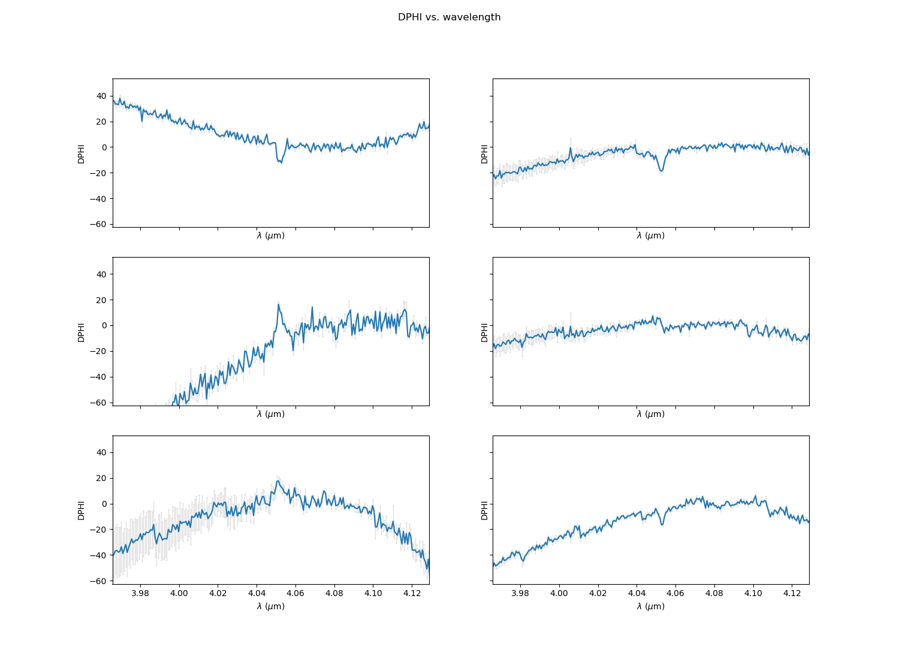
Overview of stellar physics programs for 2019-2020
  Data from the GRA4MAT commissioning : B[e] stars
FS CMa (15Jy) around Brα
Visibility
Closure phase
Differential phase
Similar data on HD 50138 and HD 62623

Slide 27
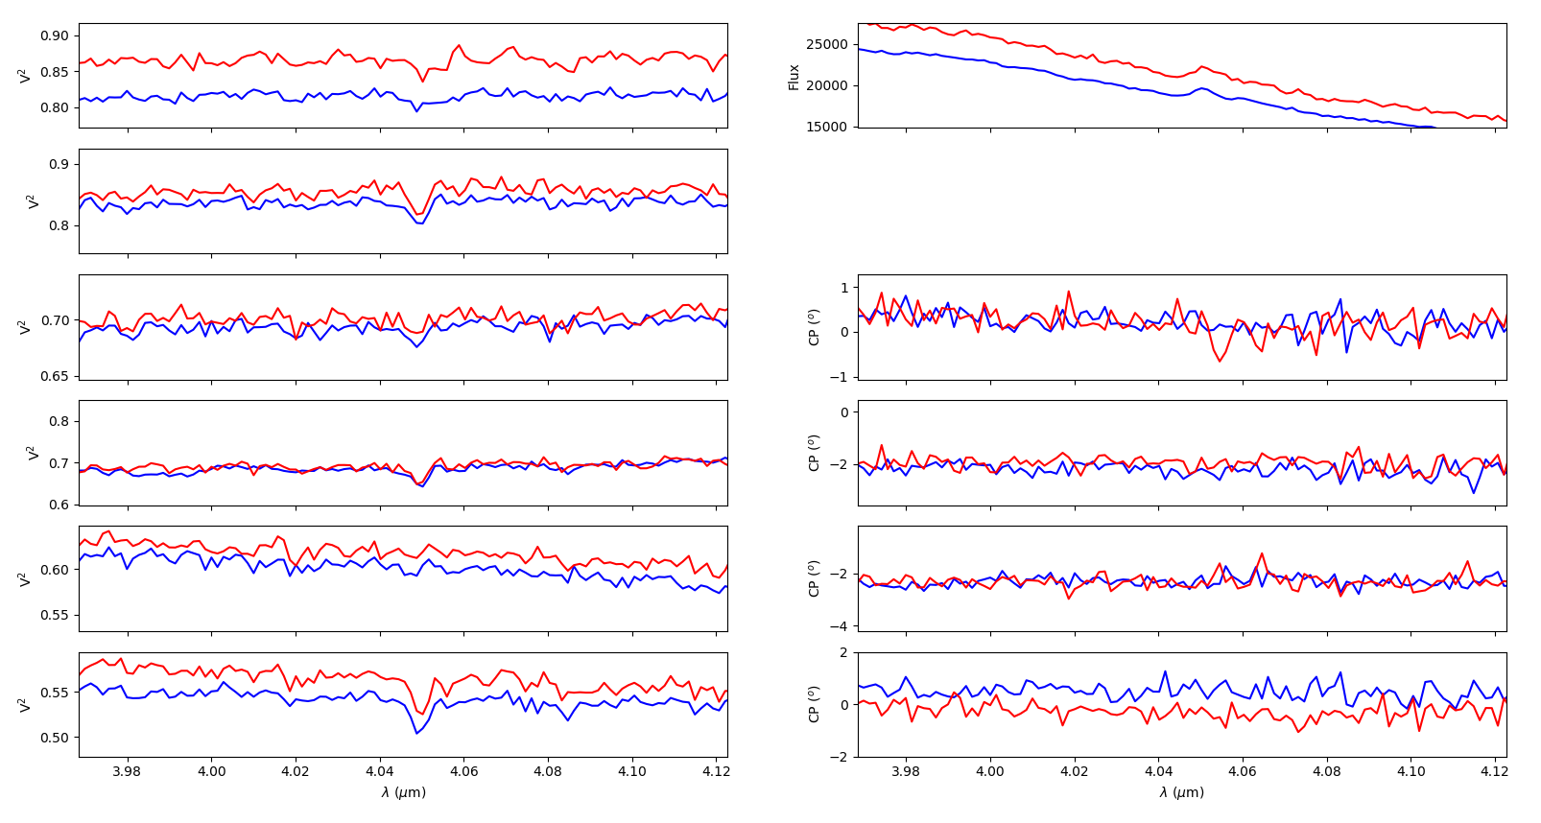
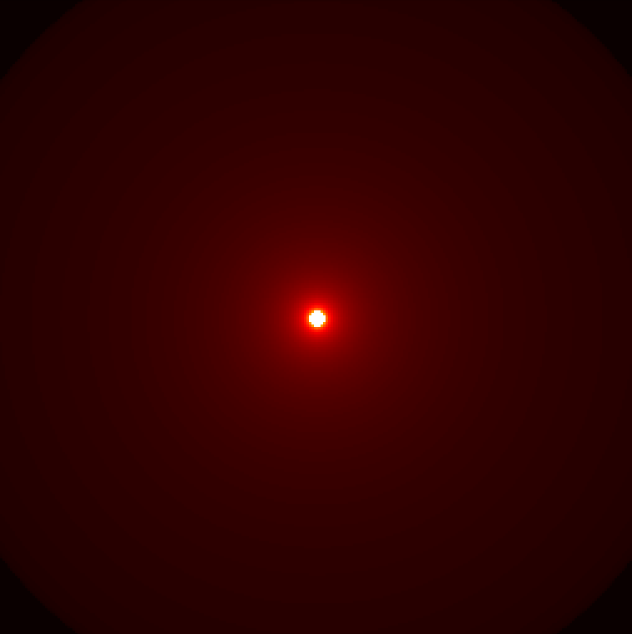
Overview of stellar physics programs for 2019-2020
  Data from the GRA4MAT commissioning : Rigel wind
CMFGEN model
DIT=1.3s
DIT=10s
Constraints on Mass-loss
+
Clumping or Asymmetry
Wind of Rigel in the Brα line

Slide 28
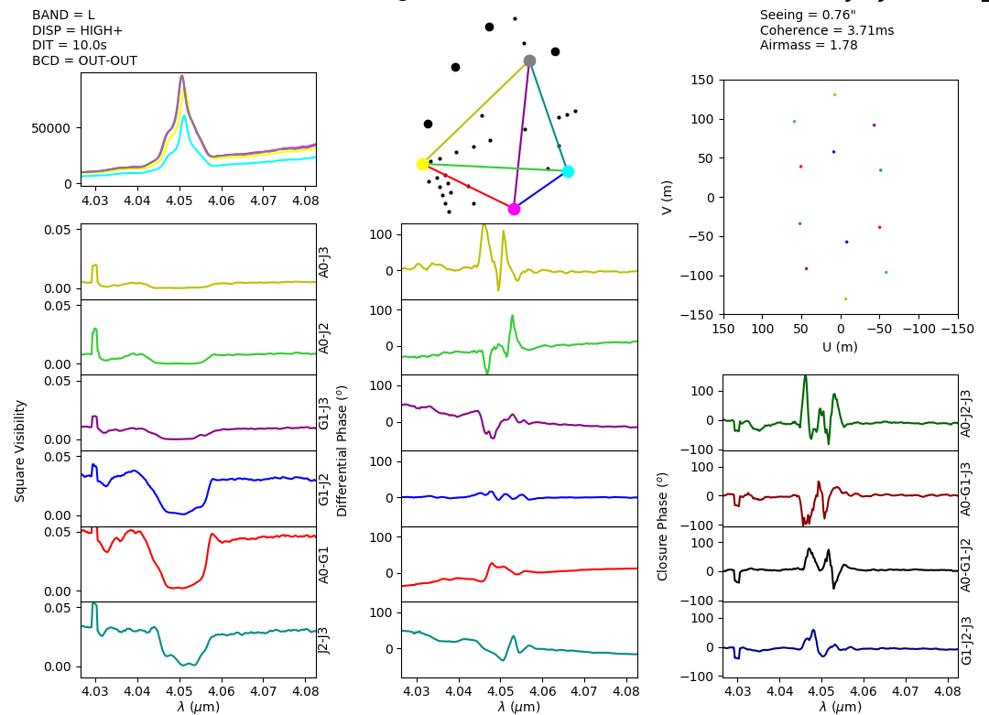
Overview of stellar physics programs for 2019-2020
  Data from the GRA4MAT commissioning : η Car in VHIGH

Slide 29
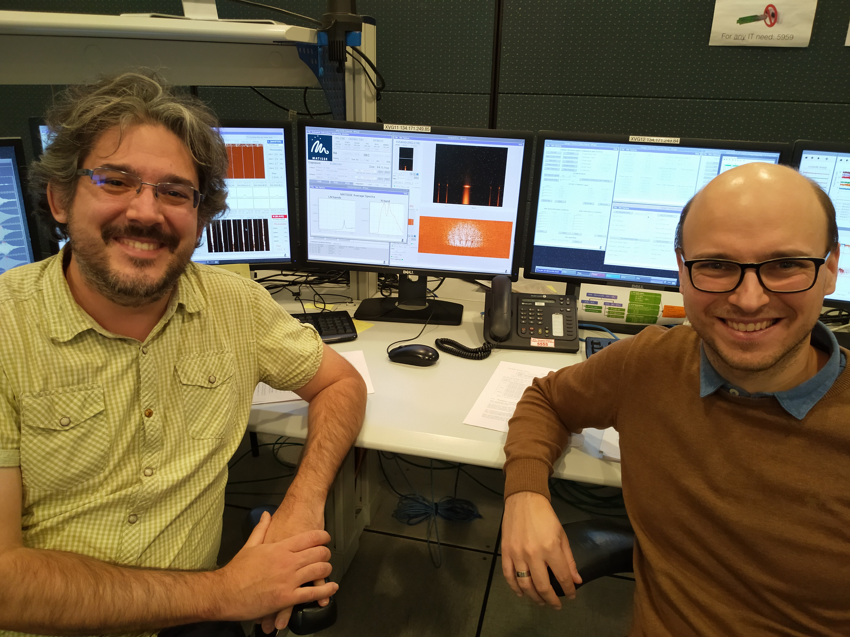
Overview of stellar physics programs for 2019-2020
  GRA4MAT commisioning is still going on
  GRA4MAT in VHIGH last night on η Car

