Slide 1

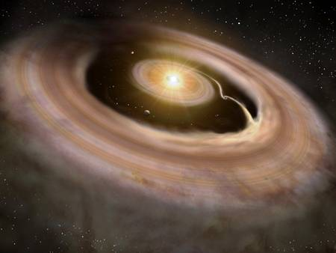

Slide 2
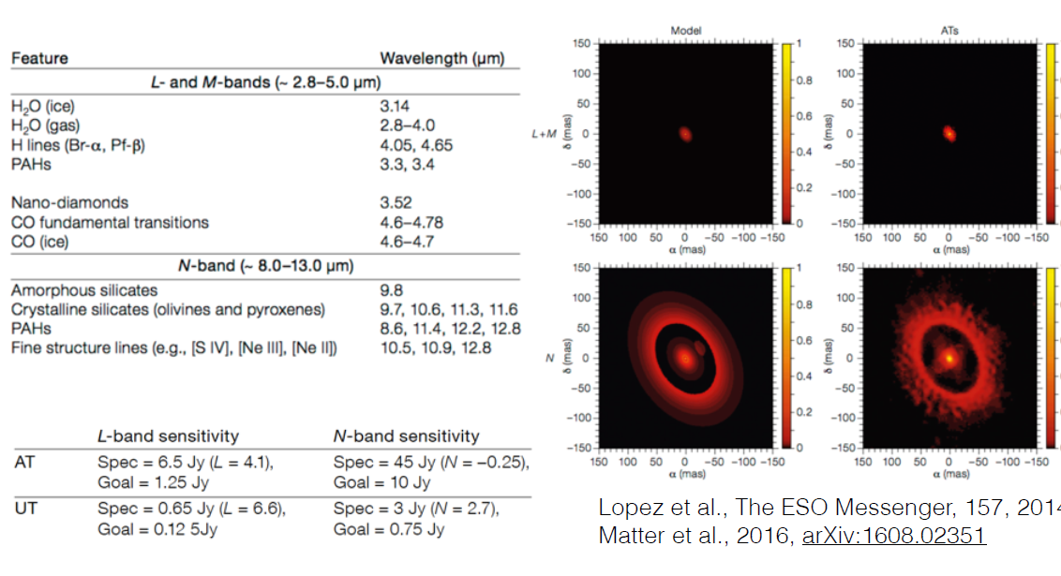
MATISSE : 4-beams combiner in the LMN bands (2.8-13.5μm)
High angular resolution + spectral resolution (from 20 to 4000)
Notes:
2

Slide 3
MATISSE : 4-beams combiner in the LMN bands (2.8-13.5μm)
High angular resolution + spectral resolution (from 20 to 4000)
Main science case
proplanetary disks
But also
Active Galactic Nuclei (AGNs)
Mass loss and dust formation
Reconstruct
spectrally resolved images
of circumstellar environment
and stellar surfaces
Notes:
3

Slide 4
Concept of the instrument
Beam commutation
Spectral
separation
OPD
modulation
Delay lines
Spatial filter
Beam configuration
3D 9D 6D
N band
Anamorphic optics
L band
Anamorphic optics
Filters
Polarizers
Dispersive elements
Camera optics
Notes:
4

Slide 5
Concept of the instrument
Beam commutation
Spectral
separation
OPD
modulation
Delay lines
Spatial filter
Beam configuration
3D 9D 6D
N band
Anamorphic optics
Photometry Units
L band
Interferometry/ photometry splitter
Anamorphic optics
Filters
Polarizers
Dispersive elements
Camera optics
+
Thermal background + photometry for each beam
Notes:
5

Slide 6
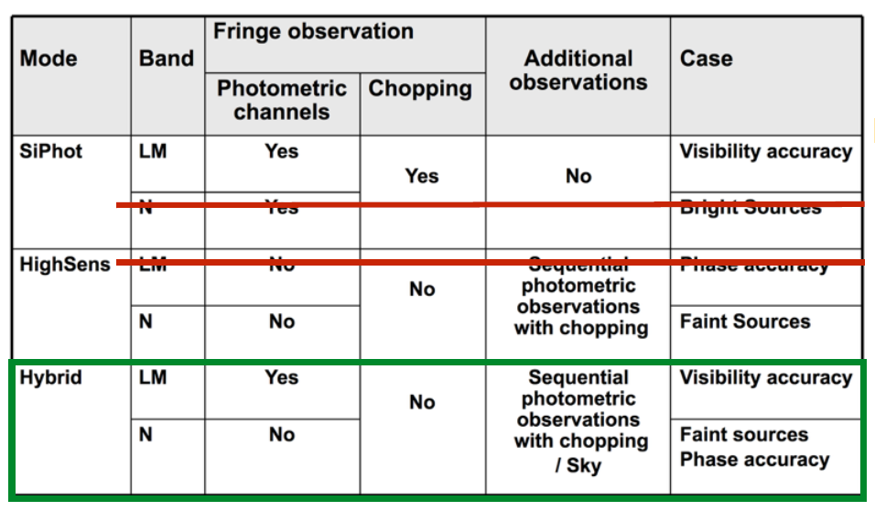
Observing Modes
Notes:
6

Slide 7
MATISSE FUNCTIONS
VLTI
MATISSE
ADAPTIVE OPTICS
BEAM COMMUTATION
ARTICIAL SOURCES
TIP/TILT CORRECTION
BEAM ANAMORPHISM (1)
PUPIL MONITORING
SPECTRAL SEPARATION
OPD MODULATION
FRINGE TRACKING
L band
CO-ALIGNMENT
N band
CO-PHASING
BEAM SELECTION
Interferometry
SPATIAL FILTERING
BEAM CONFIGURATION
PHOT/INTERF SPLITTING
BEAM ANAMORPHISM (2)
SPECTRAL FILTERING
Photometry
POLARIZATION SELECTION
SPECTRAL DISPERSION
BEAM COMBINATION
DETECTION
Notes:
7

Slide 8
MATISSE in the focal laboratory
Installed in the VLTI Focal Lab between the end of November and begining of December 2017

Slide 9
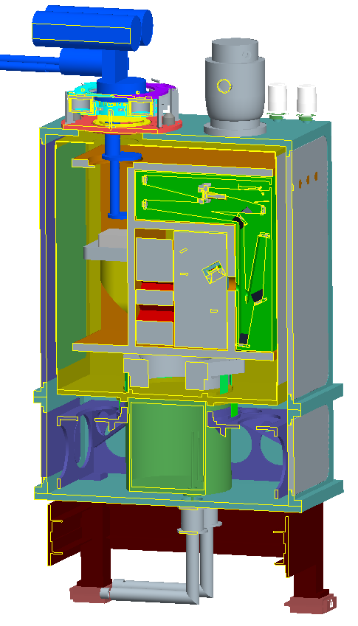
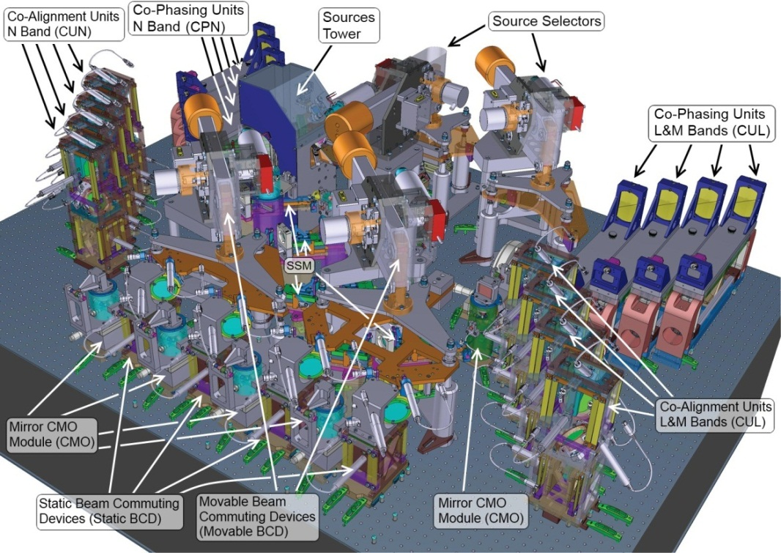
MATISSE in the focal laboratory
  Instrument FDR Garching 25 – 27 April 2012

Slide 10
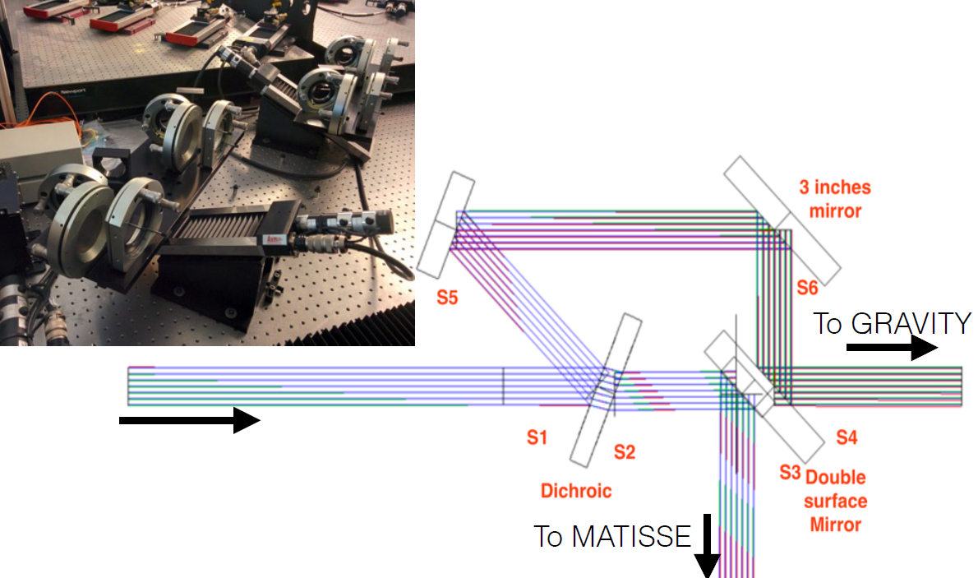
The feeding Optics

Slide 11
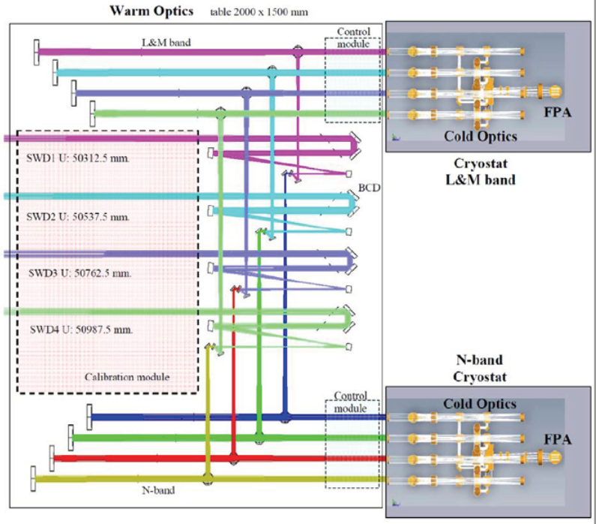
MATISSE Layout

Slide 12
The WOP (Warm Optic table)

Slide 13
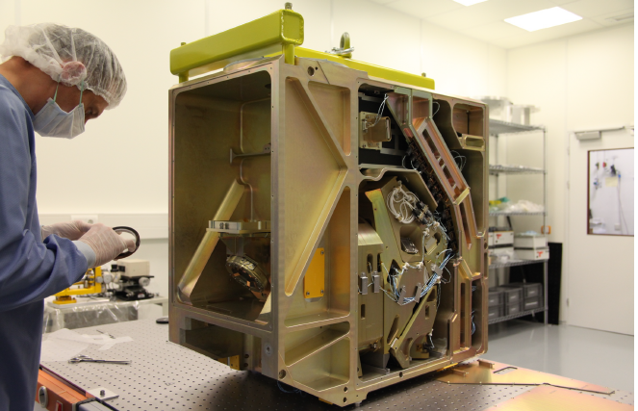
The Cold Optics Benchs (COBL & COBN)

Slide 14
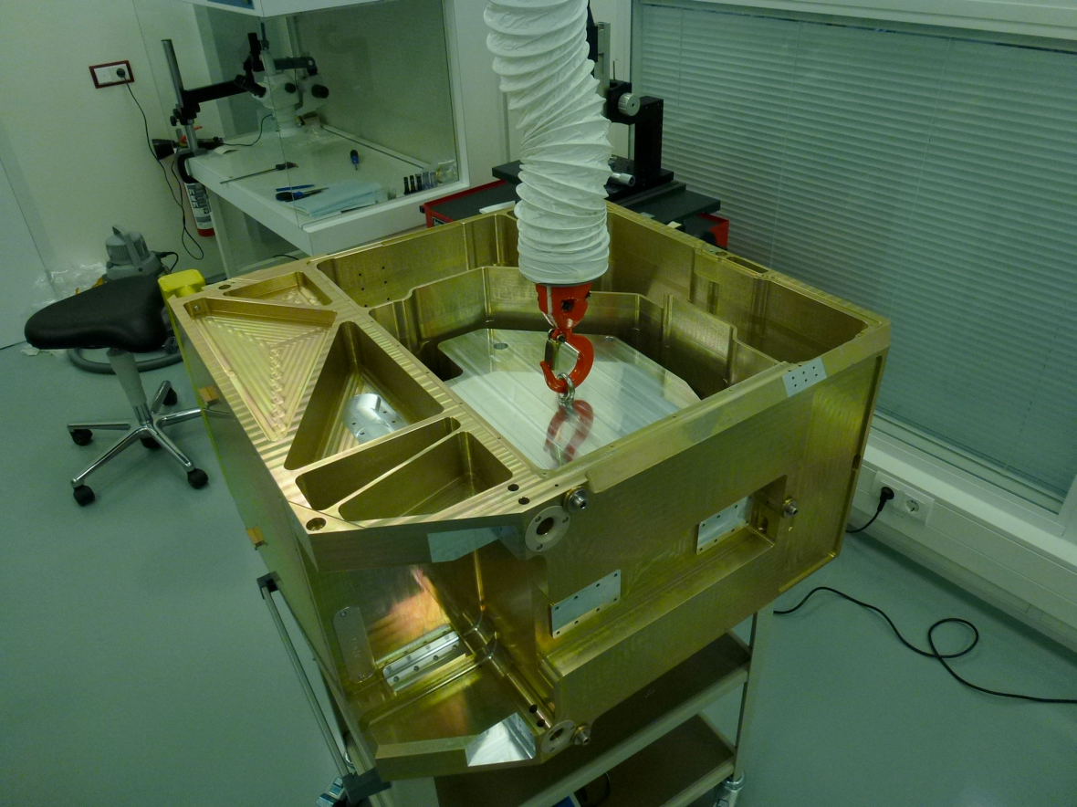
The Cold Optics Benchs (COBL & COBN)

Slide 15
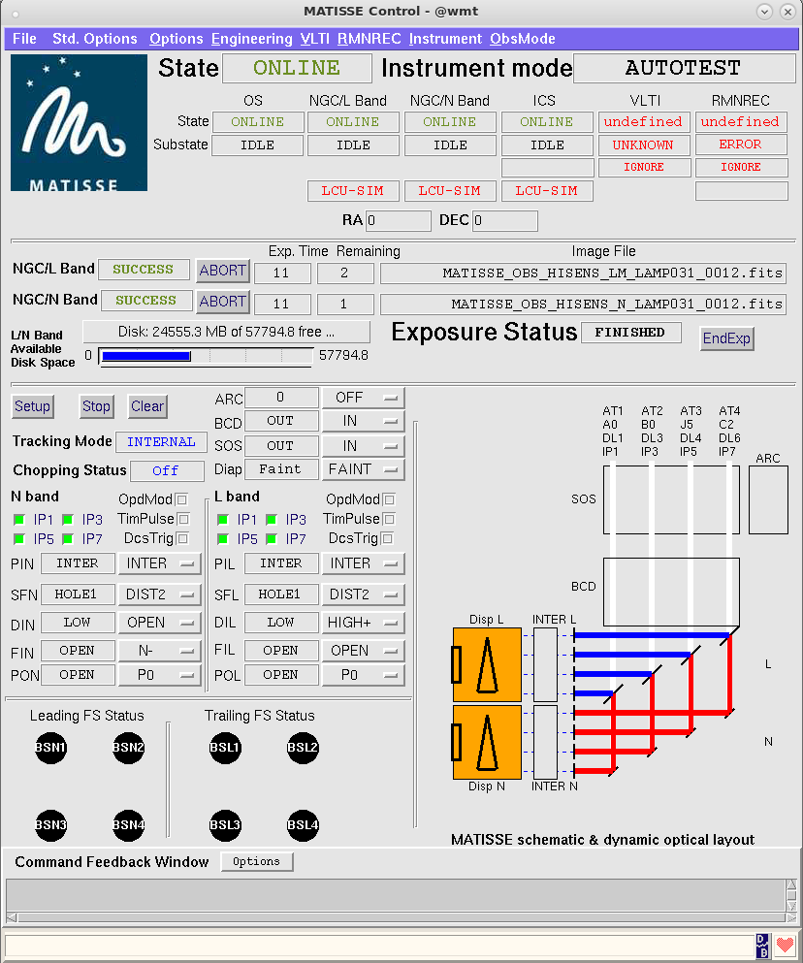
SOFTWARE : the OS Panel

Slide 16
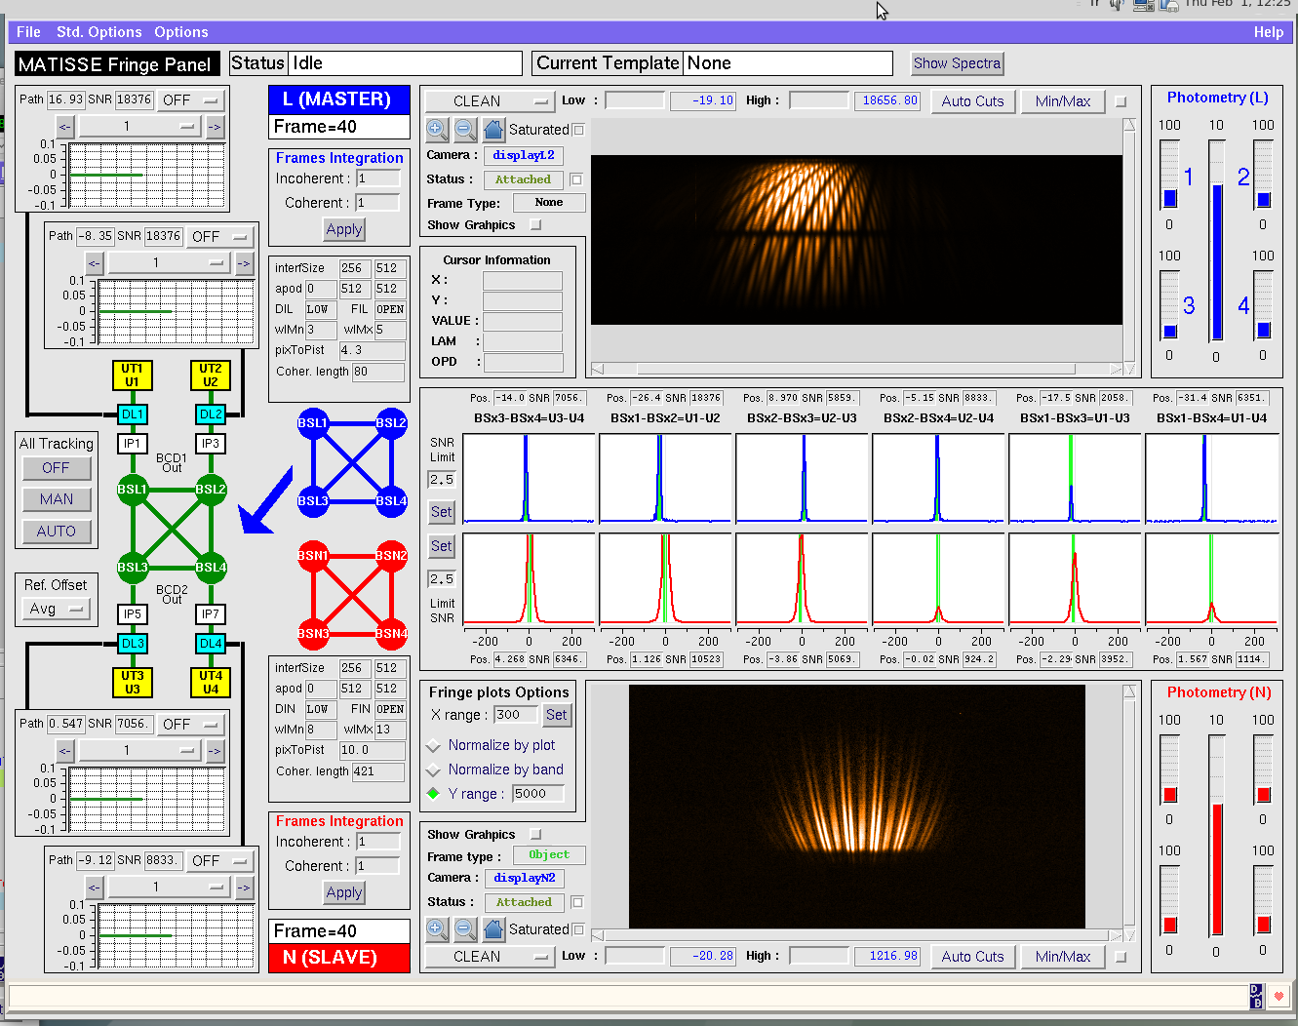
SOFTWARE : the Fringes Panel

Slide 17
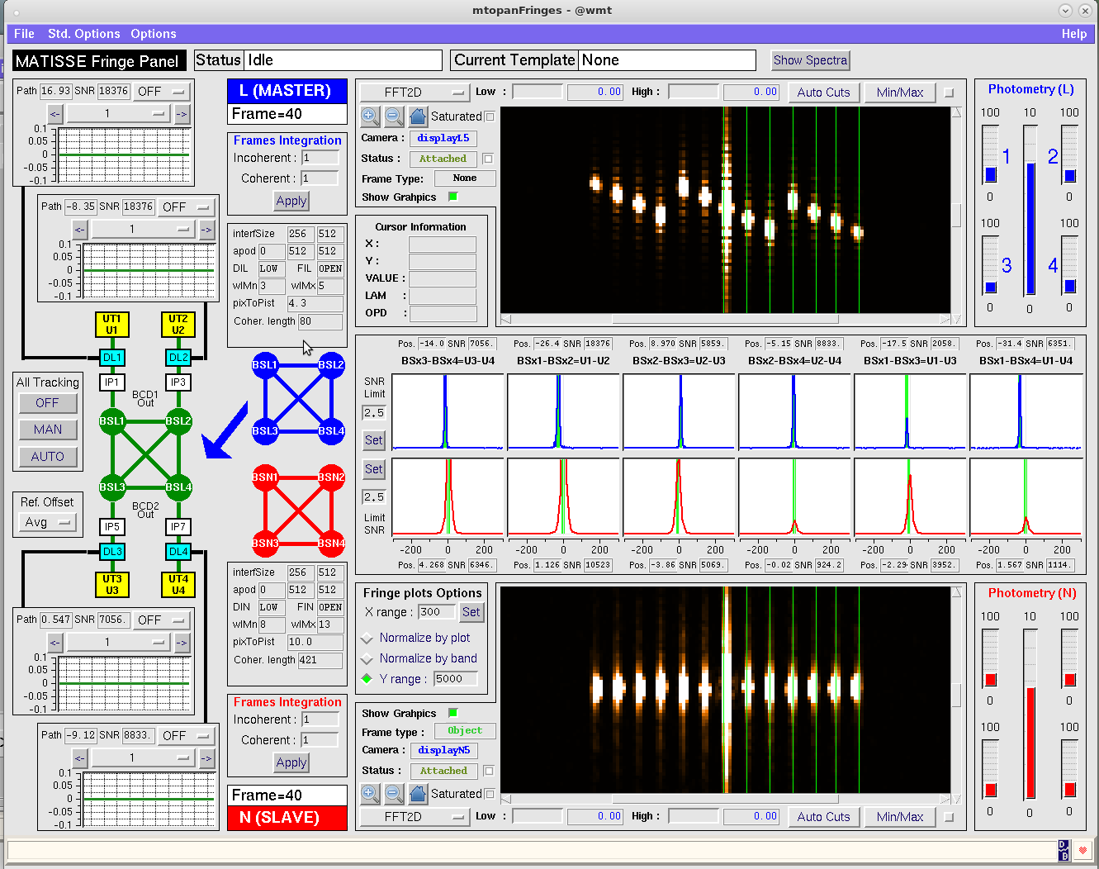
SOFTWARE : the Fringes Panel

Slide 18
Current Status
AIV started in October
First internal fringes on calibration source on Jan 18
First light on-sky planned around February 20
AIV Sky run (= Commisioning 0) from March 8 to 26.
Commisioning runs unit Q4 2018 (including with NAOMI)
Science Verification late 2018 or early 2019
Foreseen to be offered in 2019
GRAV4MAT mode (using GRAVITY fringe tracker for MATISSE) in 2019

