Slide 1
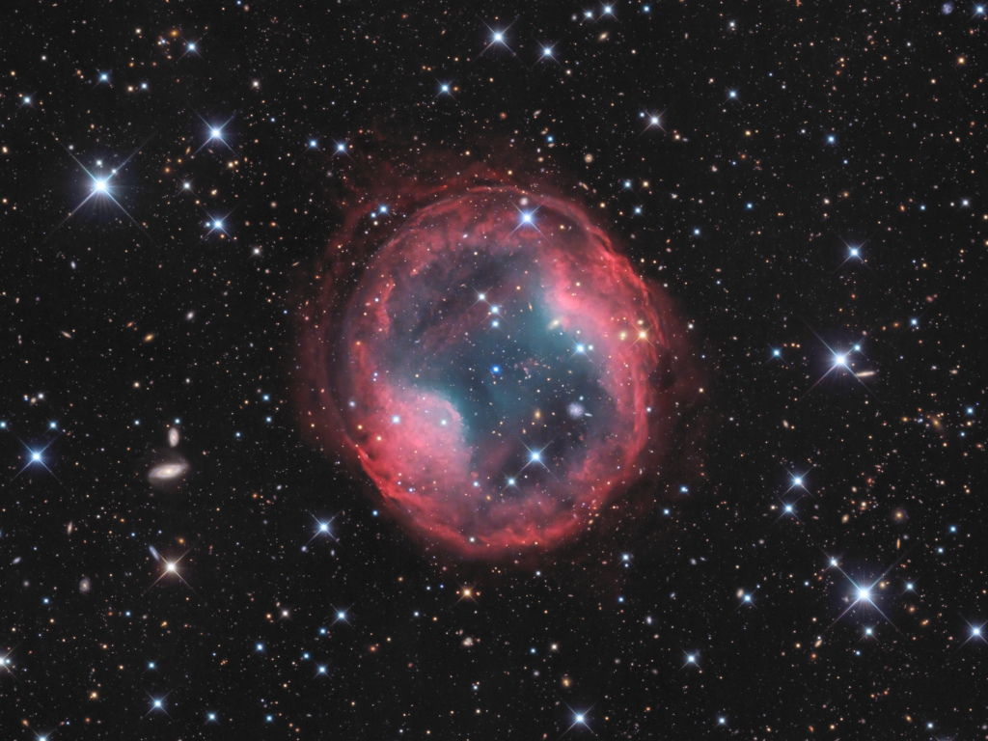
MAUCA METEOR C2PU
(UCA – Lagrange/OCA)
Stellar physics for Observations
A. Domiciano + A. Meilland
Jones-Emberson 1 planetary nebula as seen from the C2PU telescope in Calern

Slide 2
Objectives and Outlines
Objectives
To prepare for the 2 weeks of observations at Calern Observatory
To give some reminders on the stellar physics and spectroscopy
To show examples of projects that you can do with the C2PU telescopes
Outlines
A few useful reminders from stellar physics
  Why do we care about stars?
  Stellar structure and interiors
  Stellar evolution
  Stellar photosphere
Stellar Spectroscopy in practice
  Stellar classification
  Stellar rotation
  Binarity
  Circumstellar environments
Possibles applications at C2PU
  Observing the Pleiades
  Other possible programs on circumstellar environments

Slide 3
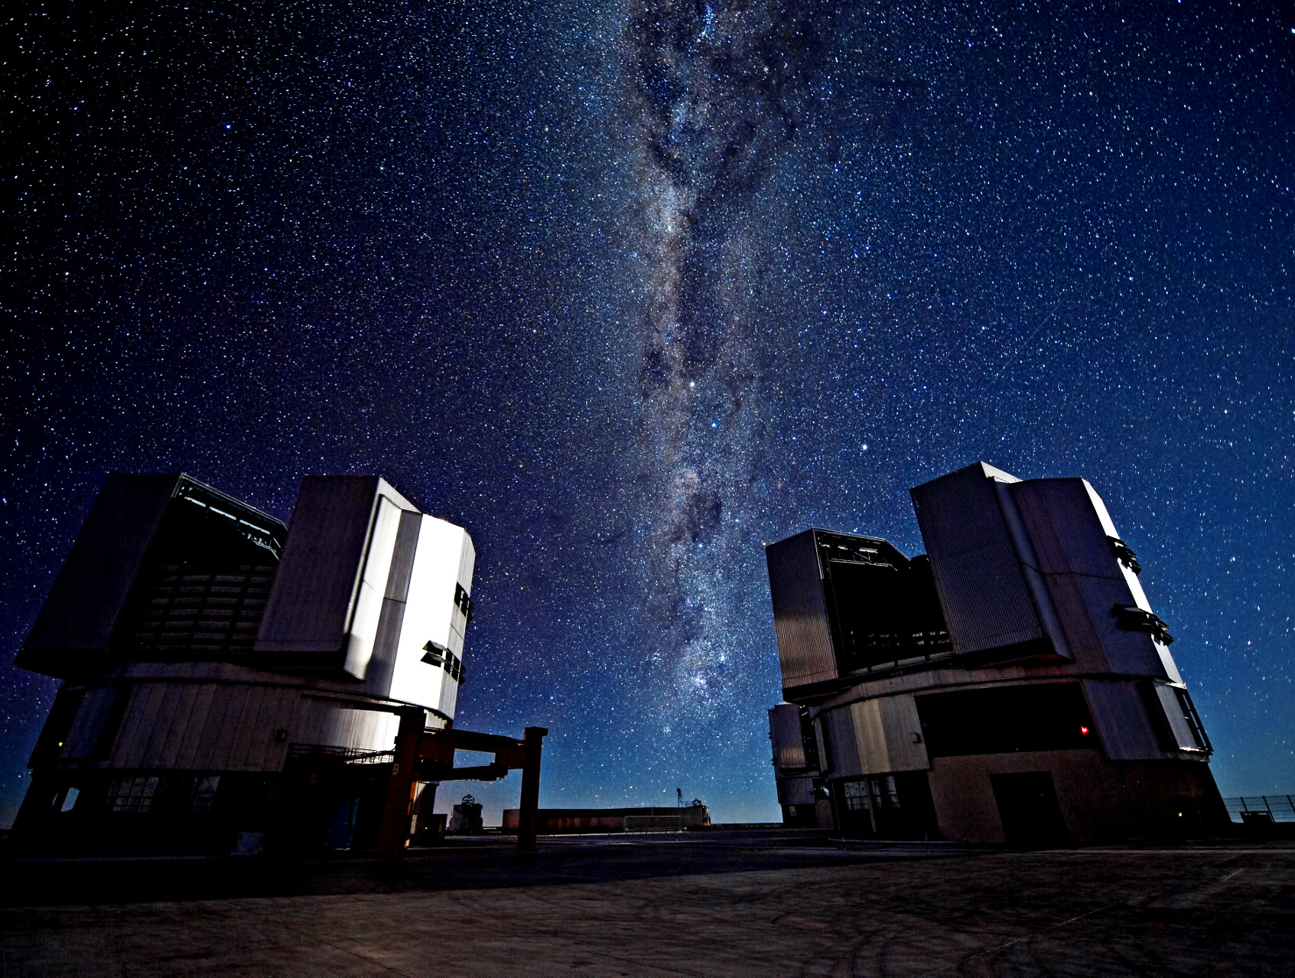
I. A Few useful reminders from stellar physics
The Milky way over VLT in Atacama desert Chili

Slide 4
1. Why do we care about stars?
The Milky way over VLT in Atacama desert Chili

Slide 5
Stars in the Universe
Ordinary Matter
Other (1%)
Stars (12%)
Interstellar gas (87%)

Slide 6
Stars in the Universe
Ordinary Matter
Observable Universe Energy
Other (1%)
Stars (12%)
Ordinary Matter (4%)
Dark Matter (23%)
Interstellar gas (87%)
Dark Energy (73%)

Slide 7
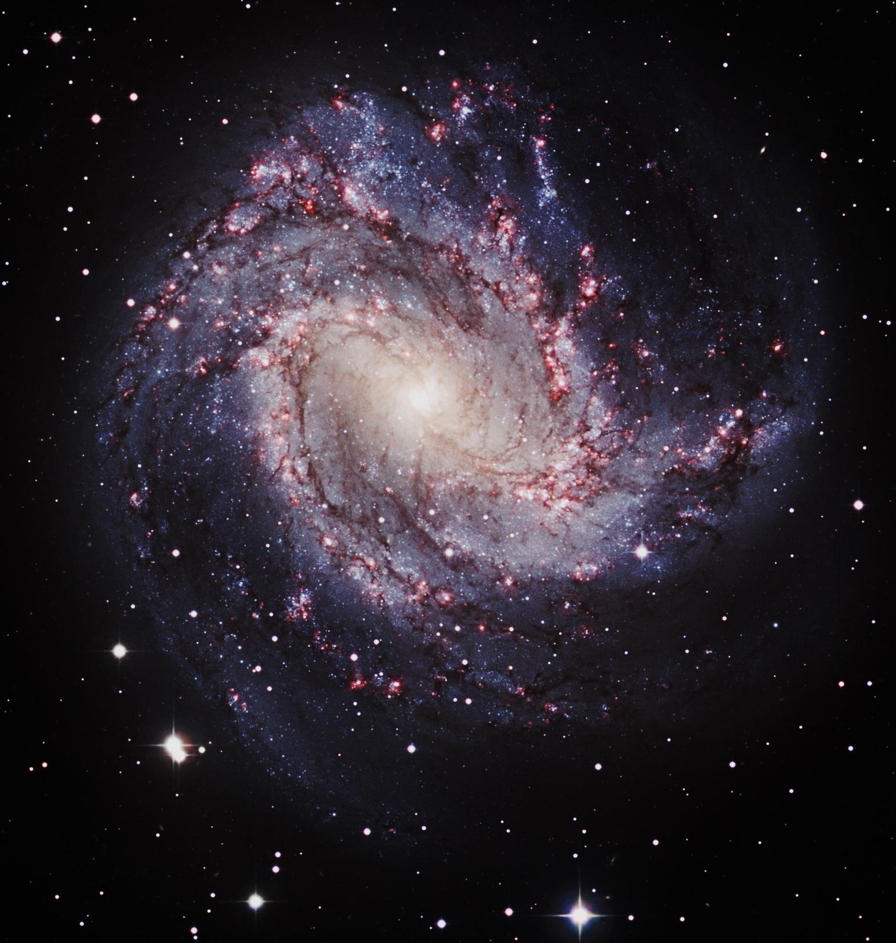
Stars in the Universe
Stars are Candles
in the Universe
They help us study
all other objects
Even the «invisible»
M83

Slide 8
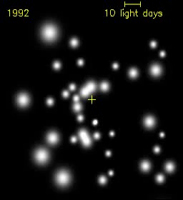
Stars in the Universe
Stars are Candles
in the Universe
They help us study
all other objects
Even the «invisible»
M83
Stars orbiting the massive black hole at the center of the milky-way

Slide 9
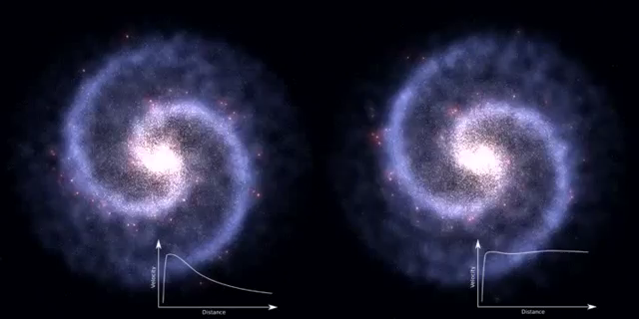
Stars in the Universe
Stars are Candles
in the Universe
They help us study
all other objects
Even the «invisible»
Galactic Rotation models
Without and with Dark Mater
M83

Slide 10
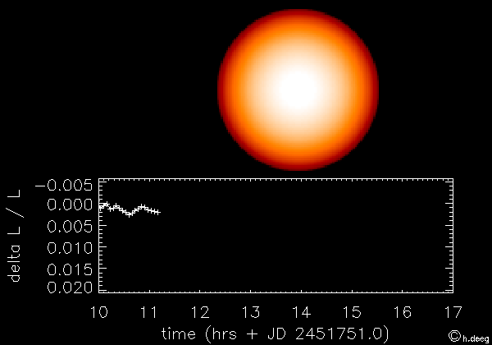
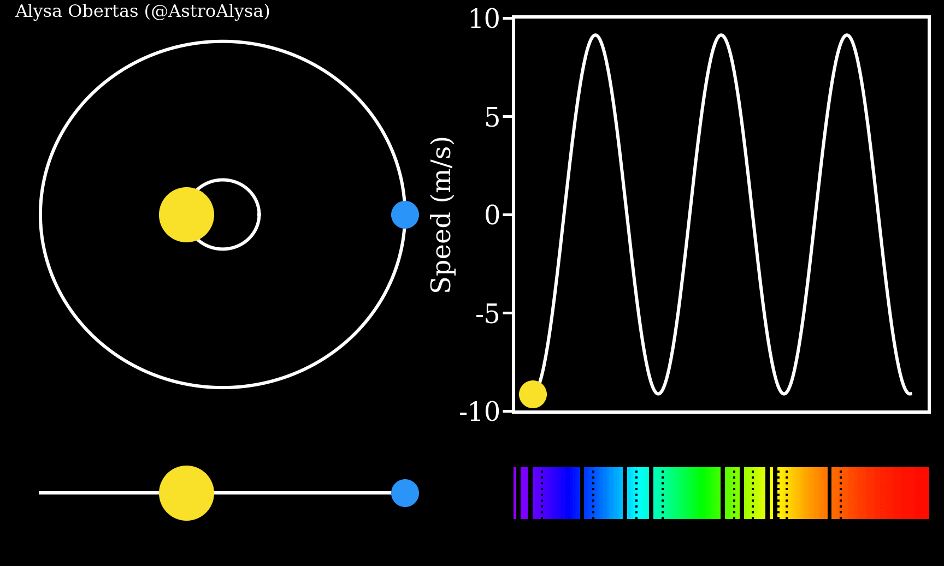
Stars in the Universe
Stars are Candles
in the Universe
They help us study
all other objects
Even the «invisible»
Exoplanets detection with
Transit and radial velocities
M83

Slide 11
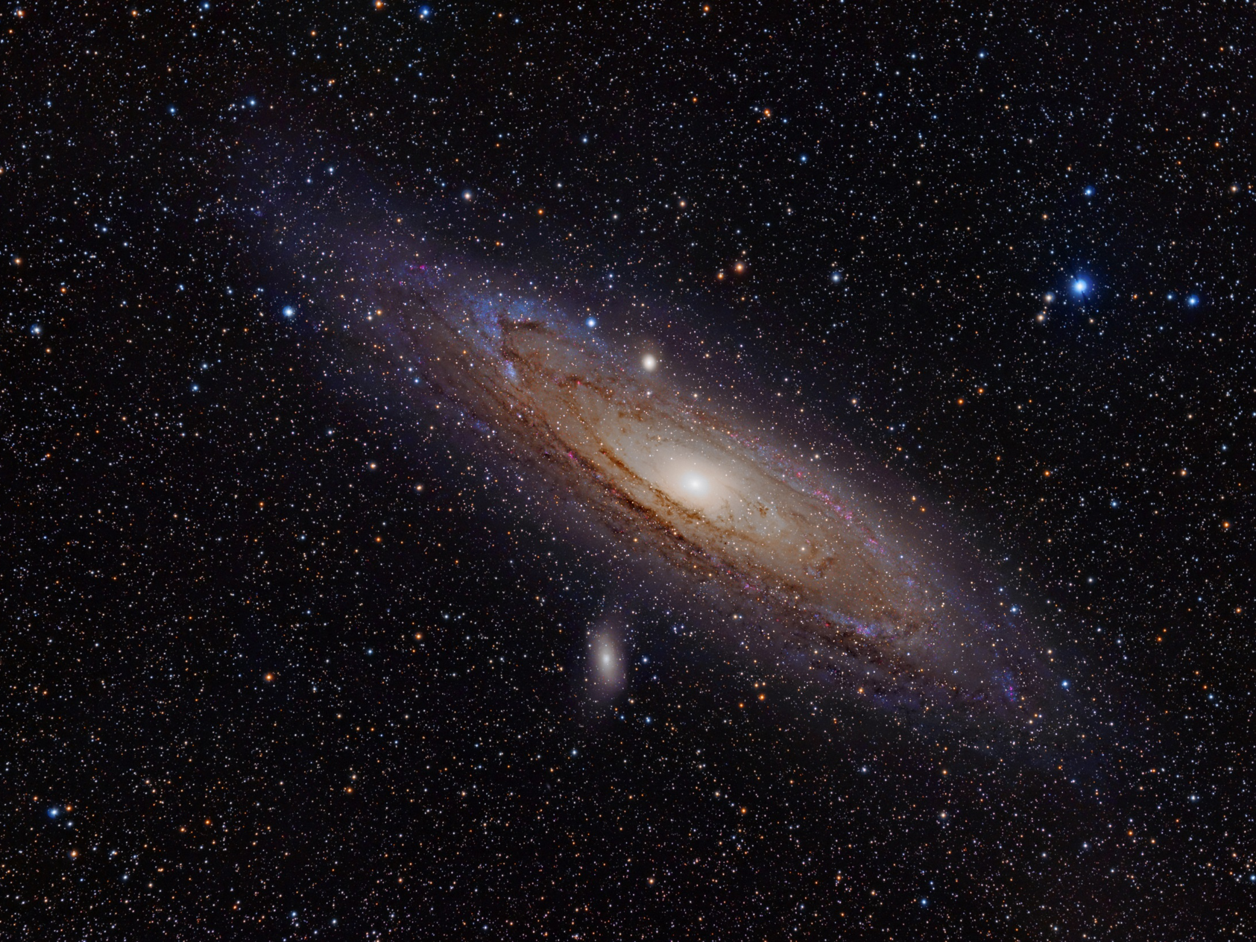
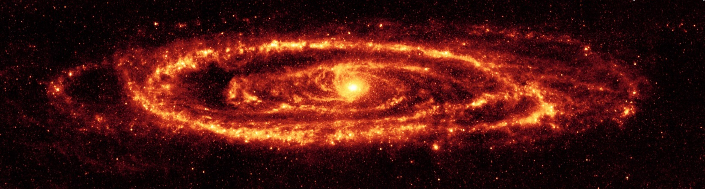
Stars are not our only Candles
Andromeda Galaxy (M31)

Slide 12
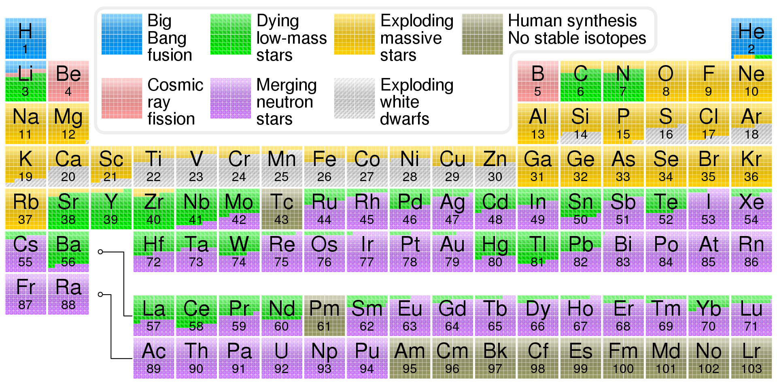
Stars ‘’transform’’ the universe
M83

Slide 13

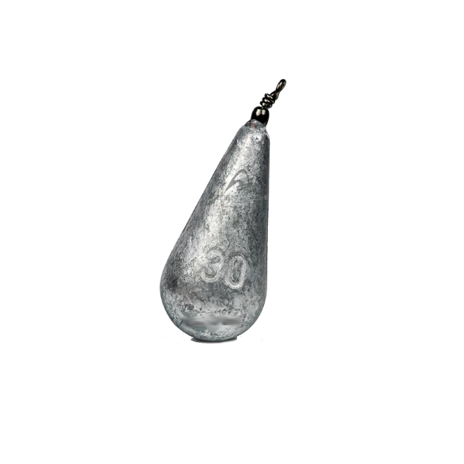
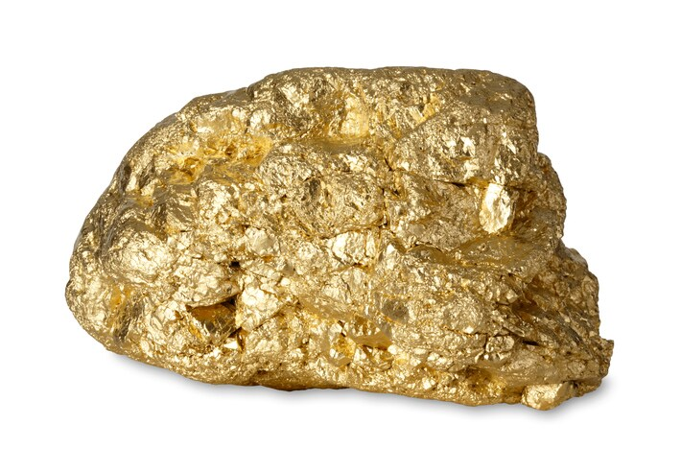
Stars ‘’transform’’ the universe
10% Hydrogen ⬄ big bang
65% Oxygen
18% Carbon
3% Nitrogen
1.5% Calcium
1% Phosphorus
1% Heavier elements ⬄ Supernova / neutron star merger
Stellar nucleo-synthesis
Human body
M83
Gold and Lead ⬄ Supernova / neutron star merger

Slide 14
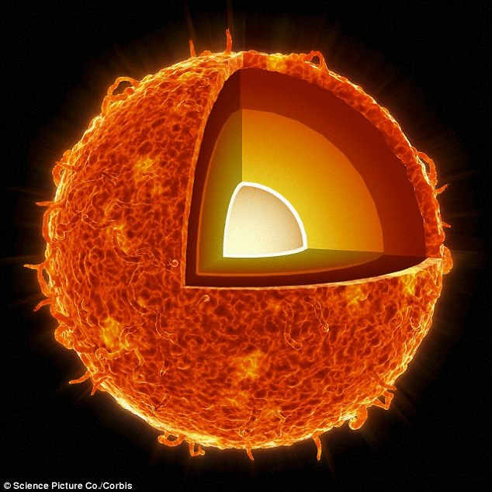
2. Stellar structure & interior

Slide 15
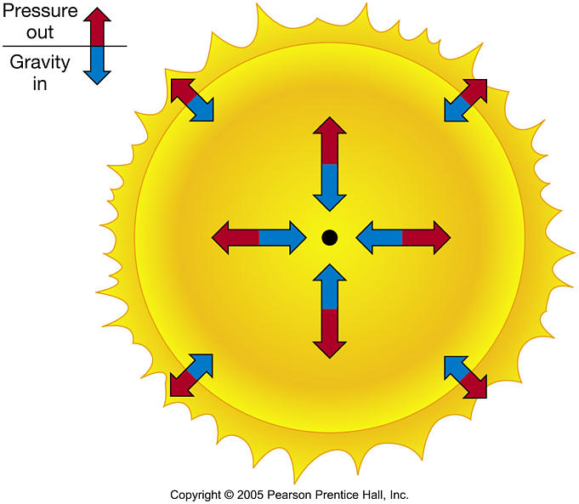
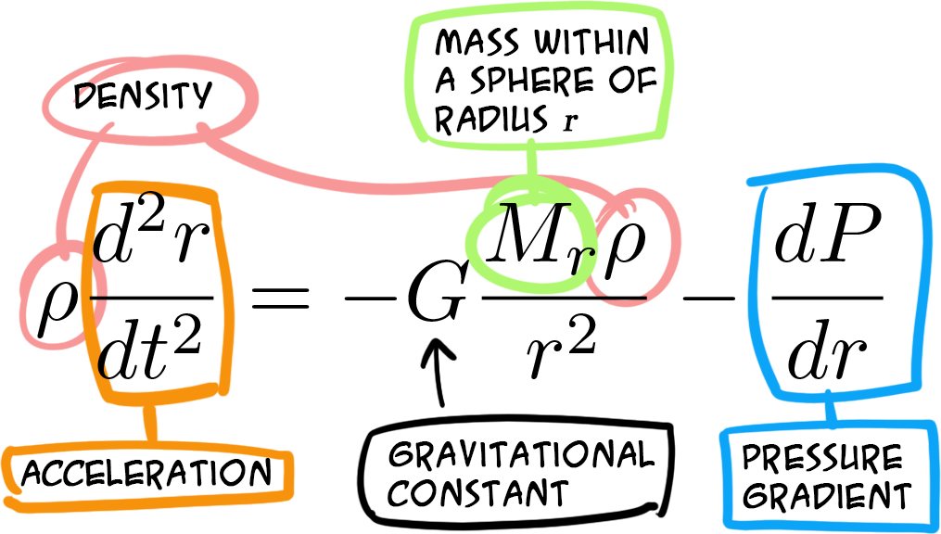
Hydrostatic equilibrium in stars
= 0
(static star)

Slide 16
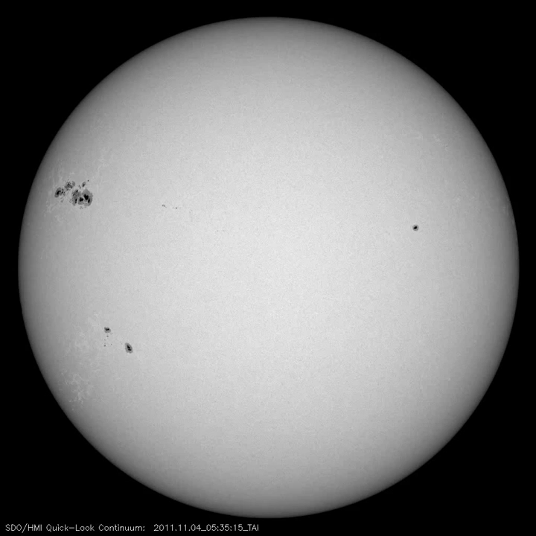
What about rotation?
Centrifugal force from
rotation is small
for slowly rotating stars
Like our Sun
P= 24.5 days ⬄ 2 km/s

Slide 17
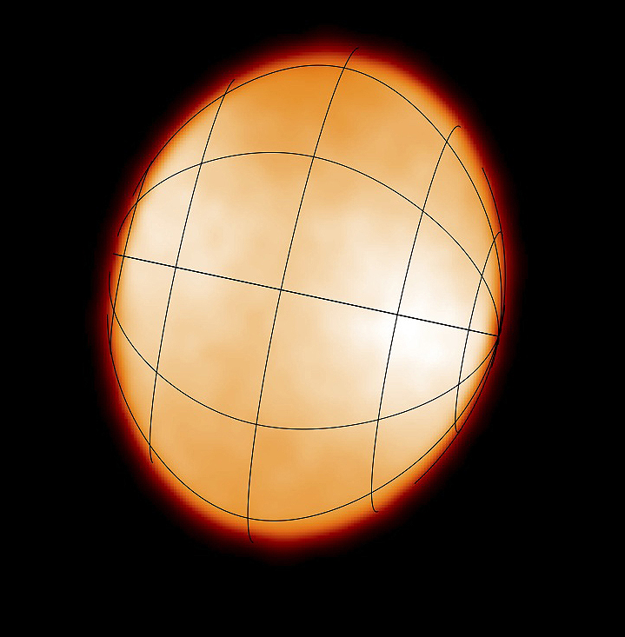
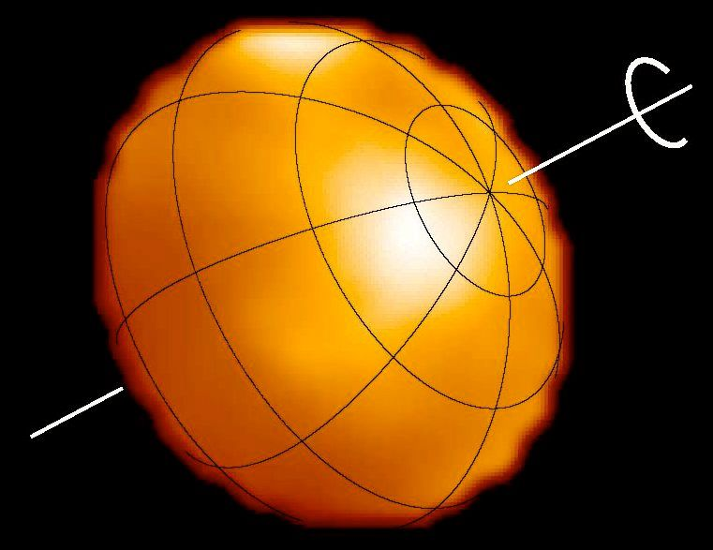
Hydrostatic equilibrium in stars with rotation
Altair vrot = 286 km/s
Regulus vrot= 347 km/s
Images from CHARA interferometer (Monnier+ 2007)

Slide 18
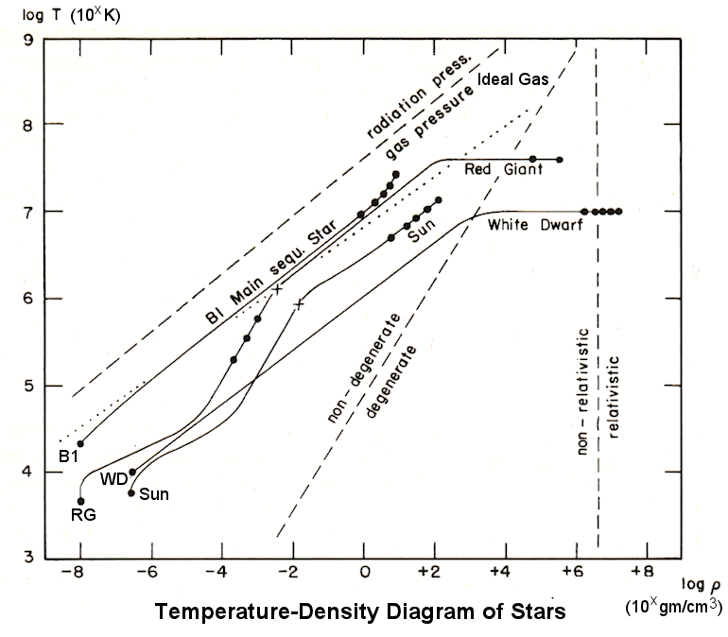










Internal structure
Equation of state
CORE
Credit: https://universe-review.ca/F08-star05a.htm
Photosphere

Slide 19
Internal structure
Equation of state
CORE
Credit: https://universe-review.ca/F08-star05a.htm
Photosphere

Slide 20
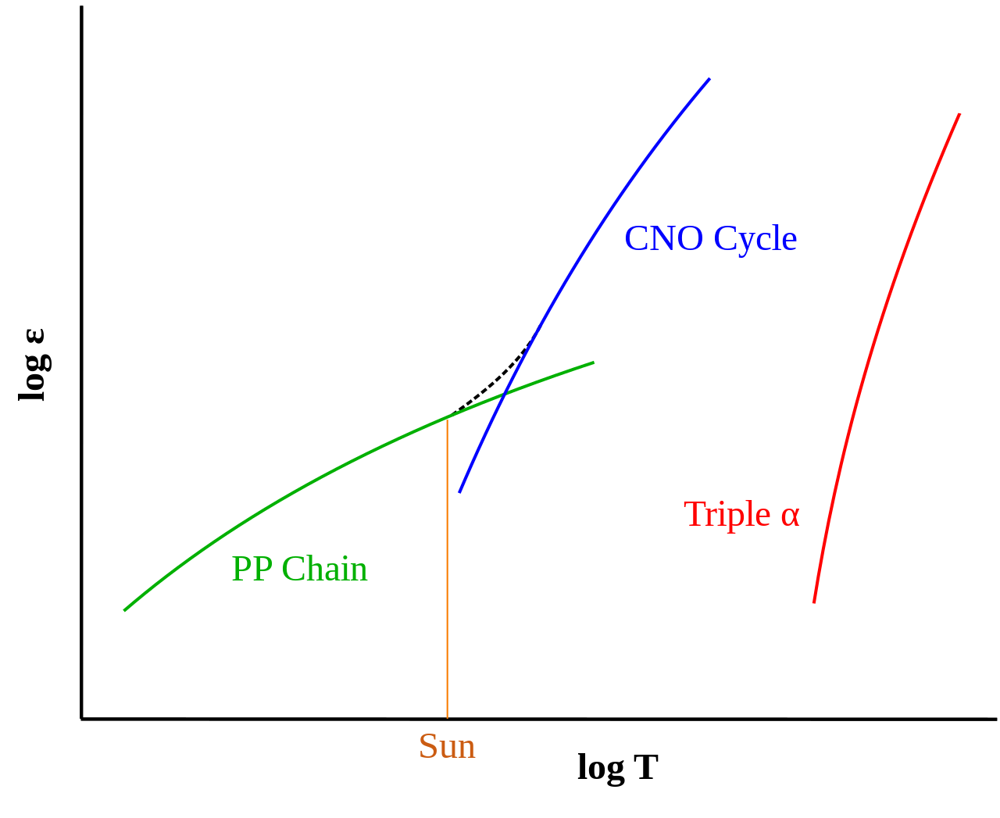
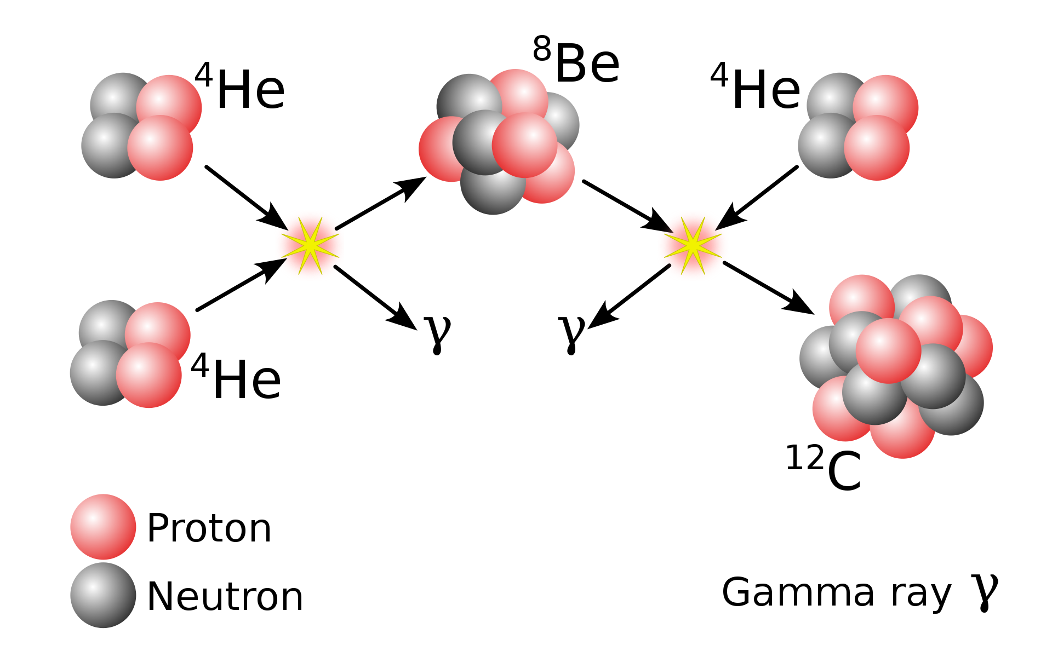
Nuclear fusion in the core
Mecanisms depend on the core temperature
Hydrogen
Fusion
relative energy output
Crossover 18MK
For Stars about 1.3 Mo
Helium fusion requires 100 MK
Only in evolved stars

Slide 21
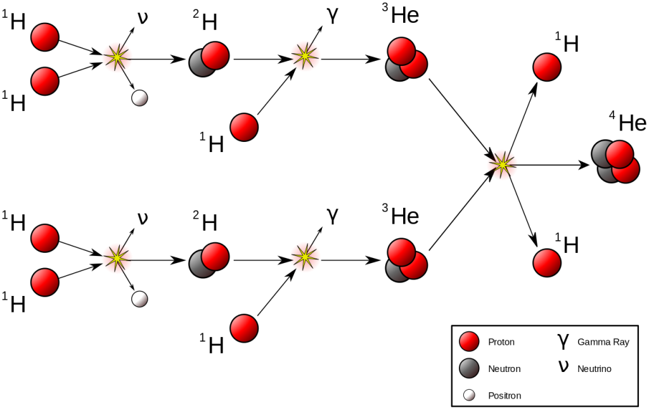
Nuclear fusion in the core: 4H 1He
Low mass stars proton-proton (or pp) cycle

Slide 22
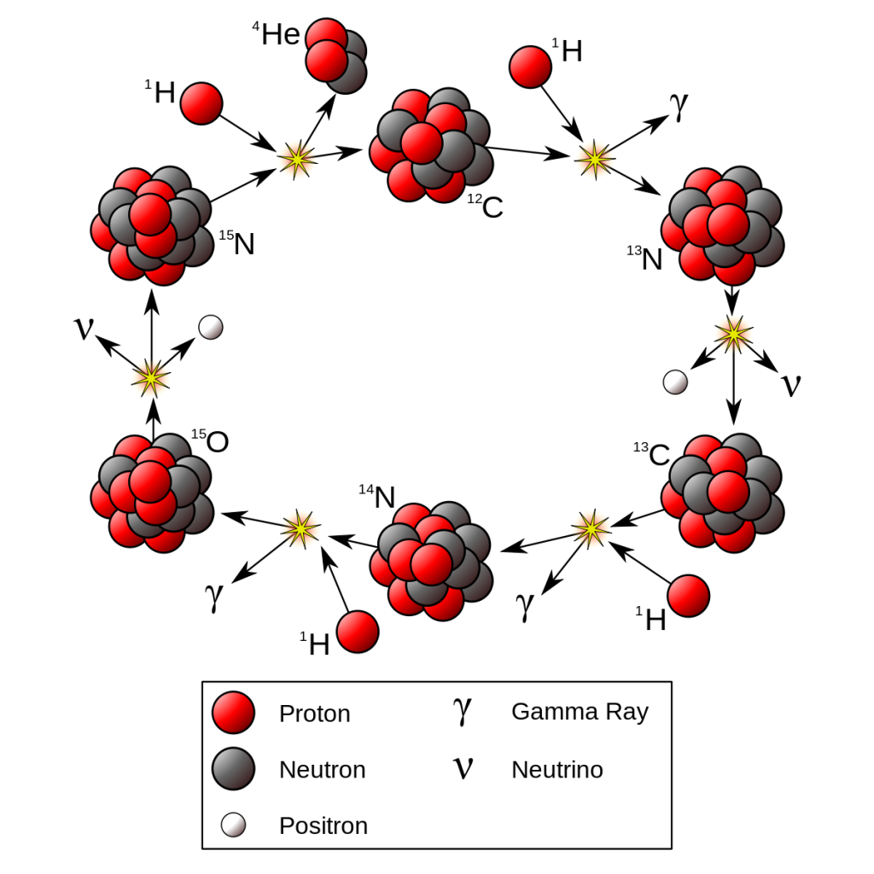
Nuclear fusion in the core: 4H 1He
Massive stars CNO cycle

Slide 23
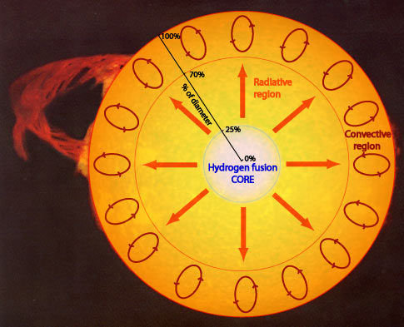
Radiative & Convective regions

Slide 24
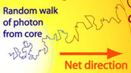
Radiative & Convective regions
Radiative zone
10⁵-10⁶ years to reach
the convective zone
Temperature drops from
15MK to 1.5MK

Slide 25
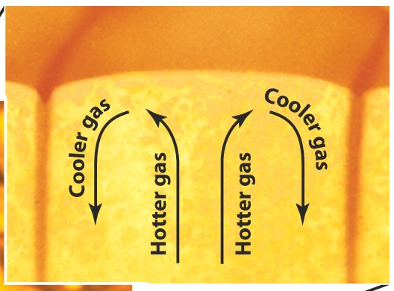
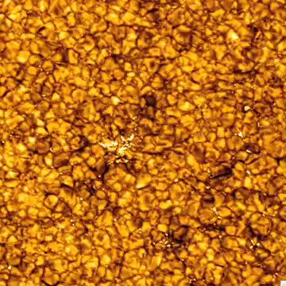
Radiative & Convective regions
Radiative zone
Convective zone

Slide 26
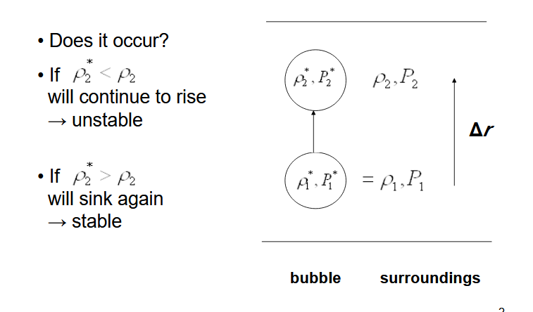
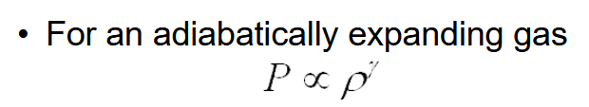

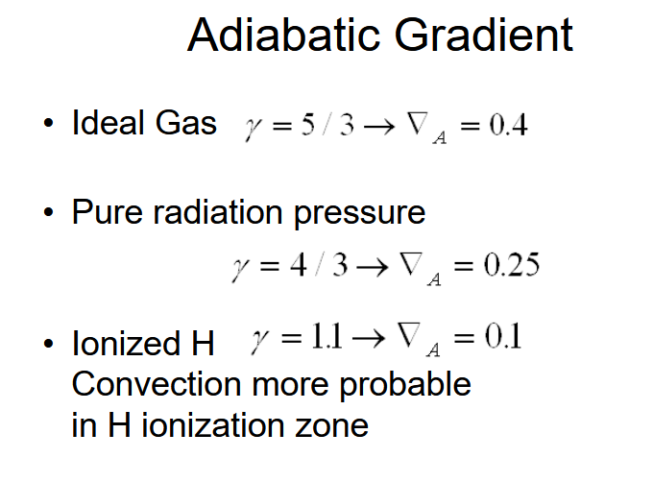
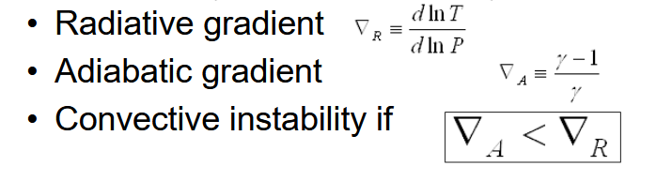
Radiative & Convective regions
Schwarzchild Stability Criterion

Slide 27
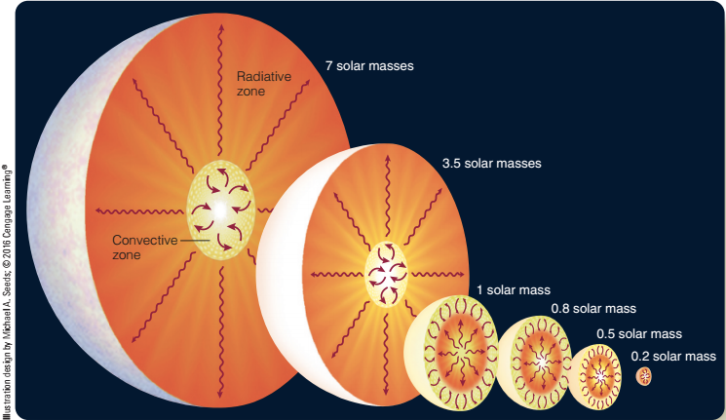
Radiative & Convective regions
For main-sequence stars of different masses

Slide 28
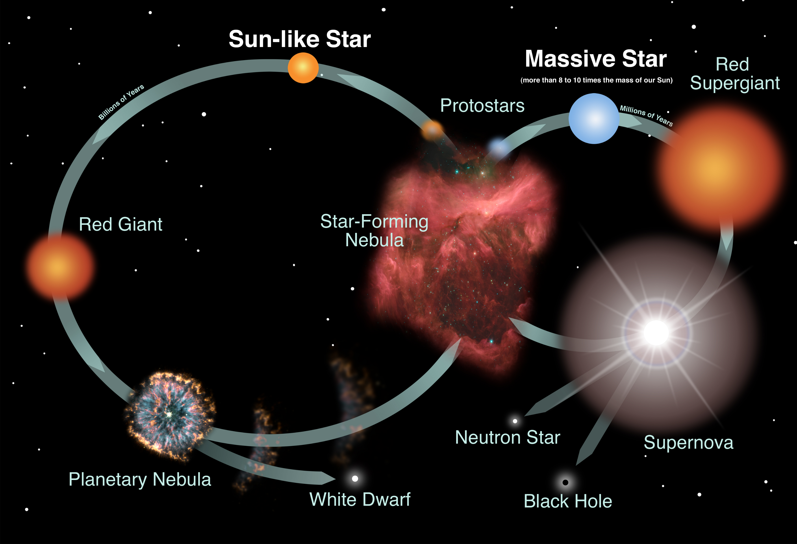
3. A few words on stellar evolution

Slide 29
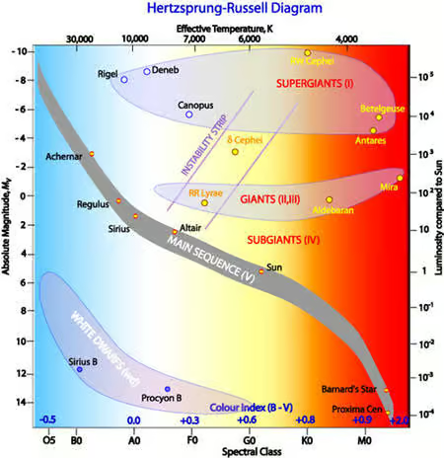
Hertzprung-Russel Diagram
(Crédit : CSIRO Australia 2004)

Slide 30
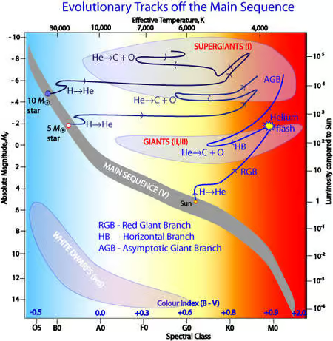
Evolutionnary tracks
(Crédit : CSIRO Australia 2004)

Slide 31
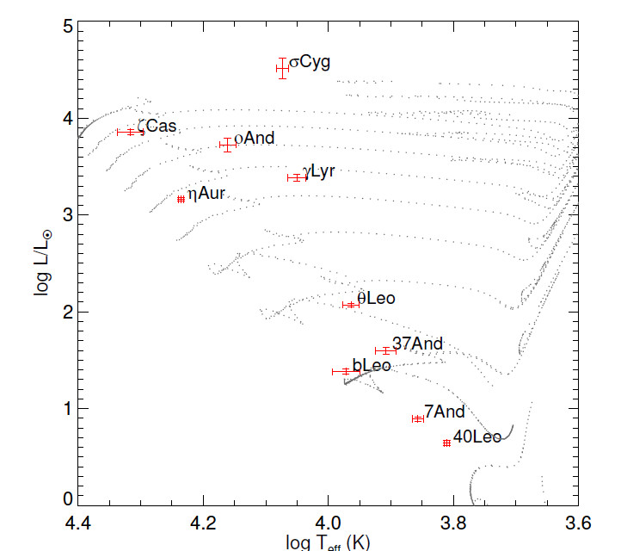
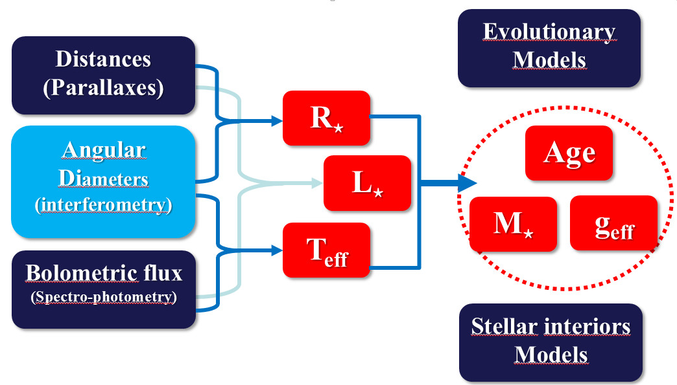
Determining fundamental
parameters of stars
CHARA/PAVO
10 early type stars
Maestro+ 2013
η Car
Need of accurate measurements of Radius, Luminosity and effective Temperature
Highly model dependent! (stellar interiors+ evolutionary models)

Slide 32
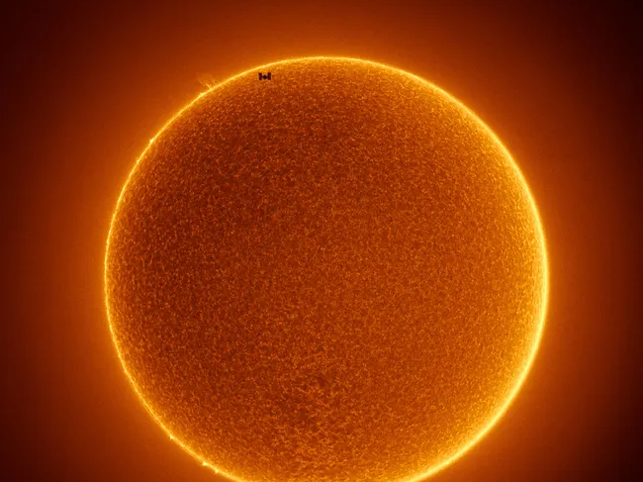
4. Stellar Photosphere
The International Space Station flies across the spotless sun (Image credit: Rainee Colacurcio)

Slide 33
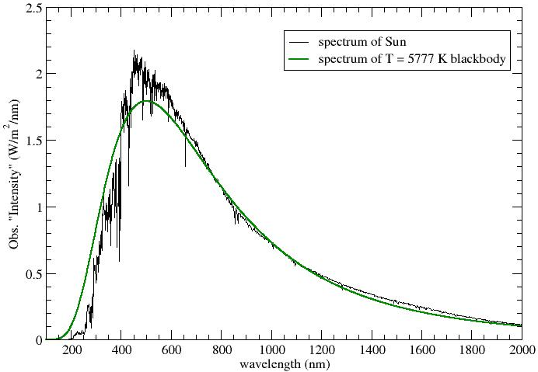
Blackbody emission is a first approximation of the stellar flux

Slide 34


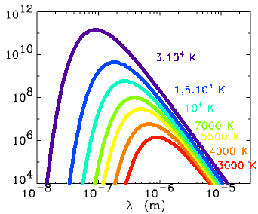
Blackbody emission
Planck’s constant ➔
Boltzmann’s constant ➔
Light speed ➔
Temperature
Maximum (Wien’s law) :
λ_{max} (µm) = 2900/Τ(K)

Slide 35
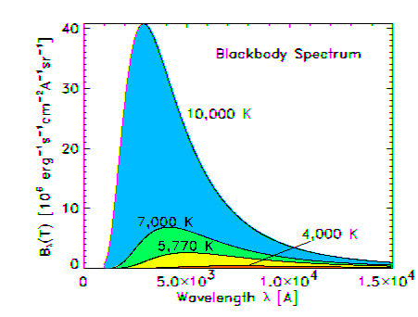
Effective temperature & luminosity
Stefan-Boltzmann
law for blackbody
Area
under curve
Area proportional to σT⁴
where σ = 5.67x10⁻⁸ W/(m²K⁴)
The Effective temperature T_{eff} is the temperature of a blackbody resulting in the same luminosity and flux of the corresponding star of radius R
Luminosity L = 4 π R² σT_{eff}⁴ [W]

Slide 36
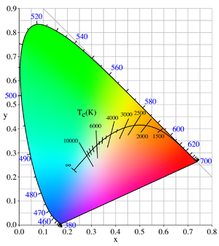
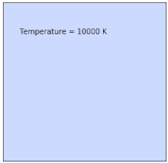
Color and temperature
Actually, Red Giants are Orange!
Planckian locus on the chromaticity space

Slide 37

Luminosity, flux, and magnitude
Spectral radiance [W/sr/m³] ⬄ power / solid angle / surface / wavelength
Luminosity L = 4 π R² σT_{eff}⁴ [W] ⬄ Total Energy per unit of time radiated by the star
Flux F = L/(4π d²) = σT_{eff}⁴ R²/ d² [W/m²] ⬄ Total Power received at distance d
Magnitudes:
First defined by Hipparchus (~ 150 BC)
Vega as seen from Earth
is used as the zero point (F_{x,0})
Depends on a photometric band : U, B, V, R, I ,J ,H, K, L, M, N ,Q ….
Depends on the stars spectral type, radius (hence luminosity) and Distance !!
Apparent ⬄ a seen from Earth
Absolute ⬄ apparent magnitude if the star would be at 10 pc
Bolometric ⬄ integrated on all wavelength
Notes:
37
37

Slide 38
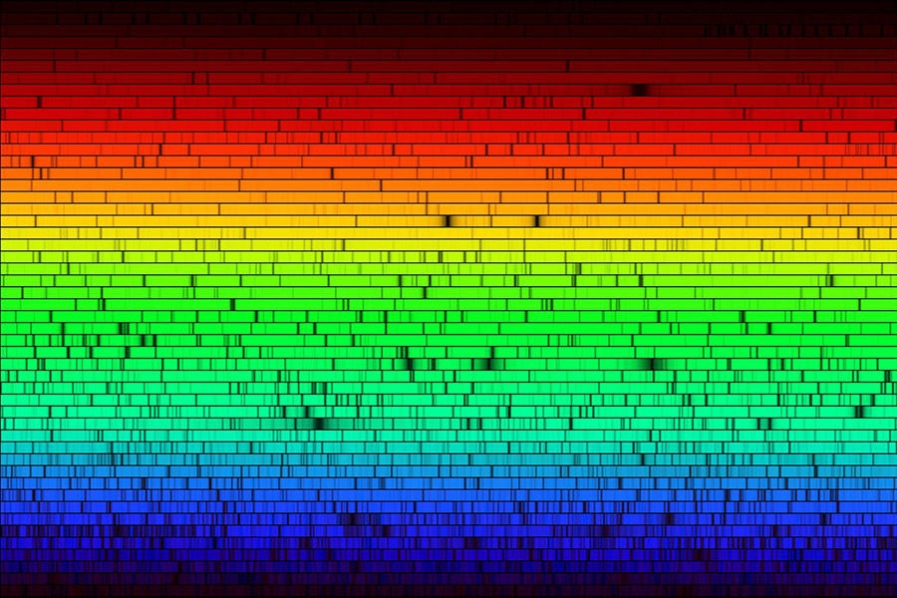
Stars beyond the black body …
N.A.Sharp, NOAO/NSO/Kitt Peak FTS/AURA/NSF

Slide 39
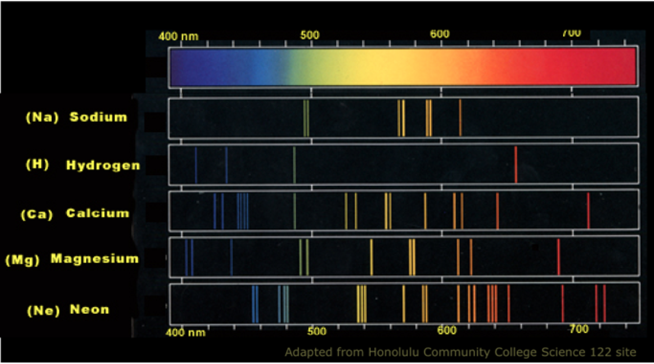
Formation of stellar spectral lines
Lines from several atoms present in the star

Slide 40
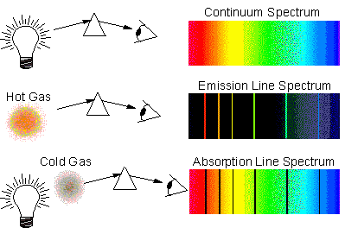


Formation of stellar spectral lines
Light bulb
Star
Atoms in the stellar photosphere are influenced by the local temperature. They are not always in the fundamental state (minimum energy)
Atomic transitions (electrons changing from energy level) generate spectral signatures that are superposed to the continuum blackbody radiation.

Slide 41
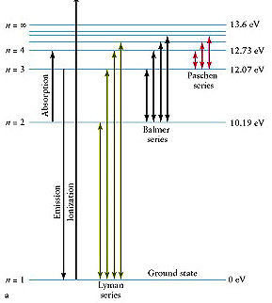
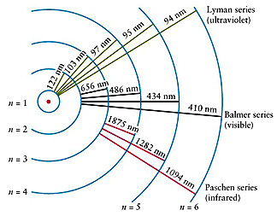
Formation of stellar spectral lines
Hydrogen atom
(simple Bohr model)
Energy difference between two levels:
ΔE = h ν = h c / λ
Level n
Energy of level = 13.6 eV - E_{n}
E_{n} = 13.6/n² eV (quantized energy in Bohr model)

Slide 42



Formation of stellar spectral lines
Spectral lines are not infinitely thin.
They are broadened by several physical processes, such as:
Natural broadening: Heisenberg's uncertainty principle
Lorentzian shape with width
Hα (656 nm): 2x10⁻⁵ nm
Doppler thermal broadening: random movement of atoms with a Maxwell distribution of velocities
Gaussian shape with width
Hα (656 nm): 0.04 nm
Pressure (collision) broadening: collisions between atoms
Lorentzian shape with width
Hα (656 nm): 1x10⁻⁵ nm
Convolution of Lorentzian and Gaussian : Voigt profile

Slide 43
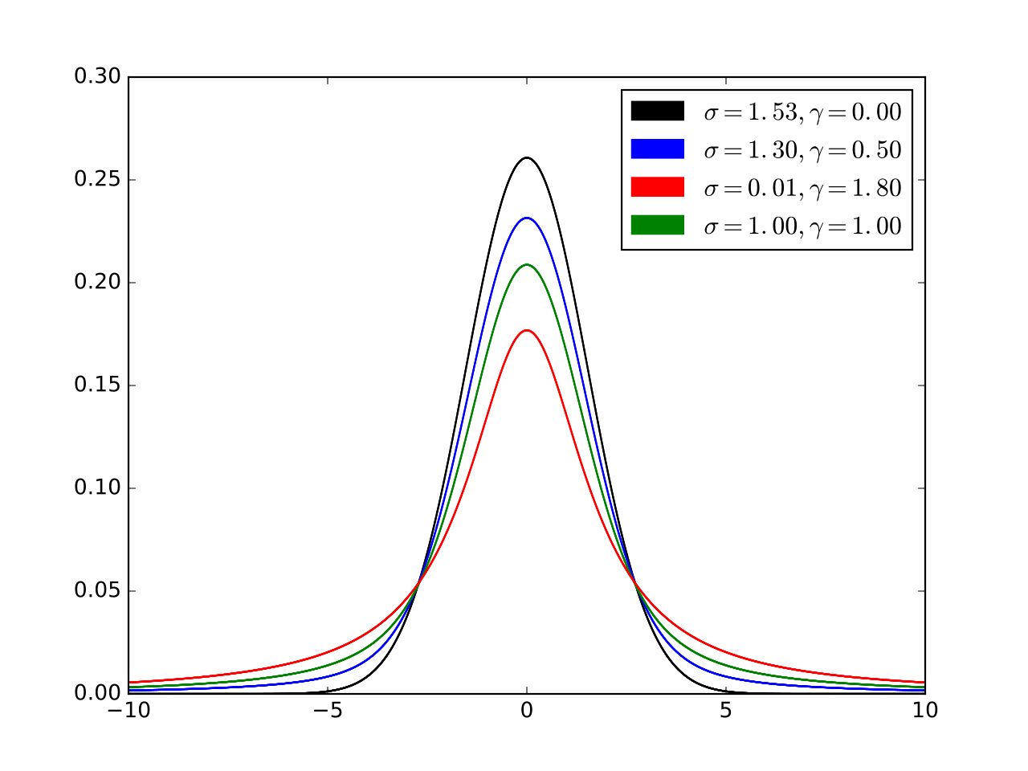
Formation of stellar spectral lines
Gaussian
Lorentzian
Convolution of Lorentzian and Gaussian : Voigt profile

Slide 44
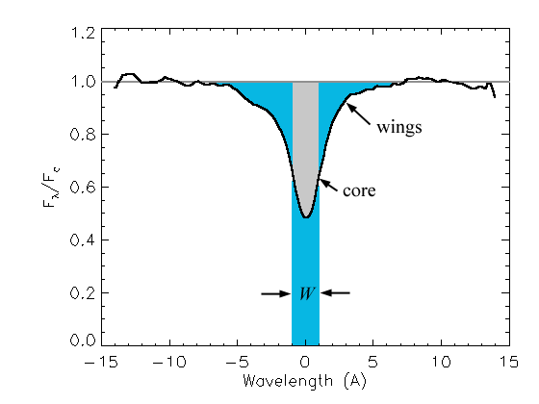


Formation of stellar spectral lines
The stellar spectra is the sum of the contribution from each visible point of the star
Full width at half-depth
Equivalent width

Slide 45


Reminder: Equivalent Width

Slide 46

Reminder: Radiative transfer (spectral lines)
ds
Radiative transfer equation
Absorption and emission
coefficients

Slide 47
Reminder: Radiative transfer (spectral lines)
Absorption coefficient
Emission coefficient
Related to the Einstein coefficients
(probability of absorption or emission of light by an
atom or molecule between levels up u and down l)
spontaneous emission
absorption
stimulated or induced emission ("negative" absorption)

Slide 48

Reminder: Radiative transfer (spectral lines)
Absorption coefficient
Emission coefficient
Radiative transfer equation

Slide 49
Absorption lines
(simplified case of absorption coefficient only)
ds
Exercise: compute I_{ν} (assume constant absorption)

Slide 50
Absorption lines
(simplified case of absorption coefficient only)
ds

Slide 51
Emission lines
(simplified case of emission coefficient only)
ds
Exercise: compute I_{ν} (assume constant emission)

Slide 52
Emission lines
(simplified case of emission coefficient only)
ds

Slide 53

Other opacity sources
Quiz: In addition to line transitions, cite some opacity sources in stellar astrophysics

Slide 54
Opacity sources
(ionization)
(Bremsstrahlung)
~6.65x10⁻²⁹ m² (Thomson cross-section)
There are many other opacity sources: Rayleigh, Compton, …

Slide 55

II. Stellar Spectroscopy in practice

Slide 56
II. Stellar Spectroscopy in practice
Some examples of spectroscopic studies that can be done at C2PU (OCA – Plateau de Calern)
Stellar spectral classification
Rotation velocity of stars
Binaries
Circumstellar environments

Slide 57

1. Stellar spectral classification

Slide 58



Stellar spectral classification
Spectral classes: O, B, A, F, G, K, M
Based on the strength of the Balmer absorption lines.
Annie Jump Cannon
(1863-1941)

Slide 59


Stellar spectral classification
Wavelength location of lines

Slide 60

Stellar spectral classification
Intensities (relative) of lines

Slide 61

Stellar spectral classification
and line profiles of main sequence stars
Useful relations:
L = 4 π R² σT_{eff}⁴
L/Lo = (M/Mo)^{α}, α ∼ 3−4

Slide 62

Spectral types and the Hertzsprung-Russell
(H-R) diagram

Slide 63


Stellar spectral classification
Morgan-Keenan (MK) classification
2D classification
Temperature and luminosity
Spectral lines sensitive to surface gravity
Surface Gravity lower on evolved object
(Giant & Super giant)
Adding a luminosity class to the spectral type

Slide 64

Spectroscopy in practice
Spectrum extraction from a CDD
H γ
(4341 A)
MgII
(4481 A)
Altair

Slide 65

Spectrum normalisation
H α
(6560 A)
(normalized)

Slide 66
Determining stellar spectral types from photospheric lines
Compare the observed spectrum of a star with synthetic or observed spectra of stars with known spectral types.
Brackett lines
Kervella, Domiciano de Souza, Bendjoya (2008)

Slide 67
Determining stellar spectral types from photospheric lines
Comparison by cross-correlation of the stellar spectra.
A1V-A3V
Kervella, Domiciano de Souza, Bendjoya (2008)

Slide 68
2. Stellar rotation

Slide 69

2. Stellar rotation
Doppler effect due to rotation

Slide 70


Stellar rotation velocity from spectral lines
In addition to the natural, thermal, and collisional broadening the stellar lines are also affected by the (projected) rotation velocity of the star.
Gray (1992)
Projected rotation velocity:
v_{proj} = x Ω sin i
max v_{proj} = v_{eq} sin i = R_{eq} Ω sin i
Total flux
Wavelength (A)

Slide 71

Spectral lines for several rotation velocities and spectra types
(4341 A)

Slide 72

Spectral lines for several rotation velocities and spectra types
(4341 A)

Slide 73

2. Stellar rotation velocity from spectral lines
Lines become wider and shallower for
increasing v_{eq} sin i, with equivalent width is constant.
We can thus measure v_{eq} sin i from spectral lines (idea from Abney 1877)
Two main techniques exist:
Full width at half-depth of absorption lines
Fourier transform of spectral lines
v_{eq} sin i

Slide 74

Stellar rotation velocity from full width at half-depth (FWHD) method
Several astronomers used this method in the past, for example Struve, Slettebak, Collins, etc
Full width at
half-depth
Collins 1974
There is a linear relation between the FWHD and the projected rotation velocity v sin i:
v_{eq} sin i = K *0.5 * FWHD/λ * c
with K ~1

Slide 75

Stellar rotation velocity from Fourier transform of spectral lines
Local flux F
(broadening: natural, Doppler, collisional, etc)
*
=
G
Rotation profile
Total flux
Wavelength (A)
convolution

Slide 76

Stellar rotation velocity from Fourier transform of spectral lines
TF (F*G) = TF (f) . TF(g)
F
*
G
=
∝ 1/(v_{eq} sin i)
This is a more recent and precise method used for example by Gray, Collins, Royer, Reiners, etc

Slide 77


Stellar rotation velocity from Fourier transform of spectral lines
Example: Rotation velocity of Altair from Fourier transform method
Smith & Gray 1976
Gray 1977
Fe II λ4352
(Elodie catalogue)
http://atlas.obs-hp.fr/elodie/

Slide 78

Stellar rotation velocity from Fourier transform of spectral lines
Application: statistic study of rotation velocities of stars
Fast rotation mainly concern
Hot main-sequence stars with
a peak around B9V-B4V
Quizz: Can you explain why?

Slide 79
Stellar rotation velocity from Fourier transform of spectral lines
Warning! blended lines

Slide 80

Other subtle effects of rotation
in spectral lines: gravity darkening
Gravity darnening (flux of the rotating star becomes dependent on the latitute)
Domiciano de Souza et al. 2002

Slide 81


Other subtle effects of rotation
in spectral lines: gravity darkening
High resolution (~10⁴) spectra with
high signal-to-noise ratio S/N (~400)
Domiciano de Souza, et al.
2018, A&A, 619, 167
5840 K
Sargas (F1II-III)
3.1 mas (30.3 R)
6750 K
Hα

Slide 82

Other subtle effects of rotation
in spectral lines: gravity darkening
Because of gravity darkening there is a non-linearity region in the relation between the spectral line width versus v_{eq} sin i
Townsend et al. 2004

Slide 83
Spectroscopic stellar physics in practice
Some examples of spectroscopic studies that can be done at C2PU (OCA – Plateau de Calern)
Stellar spectral classification
Rotation velocity of stars
Binaries
Stars with emission lines

Slide 84

3. Spectroscopic binaries
©Richard Pogge (OSU)

Slide 85

Spectroscopic binaries : SB1 or SB2

Slide 86

Spectroscopic binaries
Spectroscopic binaries are important targets because they allow to measure several parameters (masses in particular).

Slide 87


Spectroscopic binaries: Spica (α Virginis)
Double line spectra of HeI 5875
B1.5IV-V
B3V
Tkachencko et al. 2016, MNRAS, 458, 1964
Palate et al. 2013, A&A, 556, A49

Slide 88

Spectroscopic binaries: Spica (α Virginis)
Double line spectra of HeI 5875
Radial velocity curve
Tkachencko et al. 2016, MNRAS, 458, 1964
Palate et al. 2013, A&A, 556, A49

Slide 89



Spectroscopic binaries: Spica (α Virginis)
B1.5IV-V
Tkachencko et al. 2016
Palate et al. 2013
B3V

Slide 90
Spectroscopic binaries: Spica (α Virginis)
B1.5IV-V
Tkachencko et al. 2016
Palate et al. 2013
B3V

Slide 91

4. Circumstellar environments
Artist view of a classical Be star
a critically-rotating star surrounded by a dense circumstellar disk

Slide 92
Spectral lines from circumstellar environment
Light bulb
Star
Still Hot but cooler gas
Hot star
BB + Absorption
Continuum (BB) + free+free
+ emission lines
Free-free emission +
Emission lines

Slide 93

Spectral lines from circumstellar environment
Spectrum of β Lyrae, a B7Ve star showing emission lines in Hα, Hβ and He lines
Credit: Perry Berlind, Harvard-Smithsonian Center for Astrophysics

Slide 94


Emission line stars: the example of Be stars
Be stars are enigmatic objects. They were discovered almost 150 years ago by Secchi (1866), and some of them are among the brightest stars in the sky.
DEFINITION:
A non-supergiant B star whose spectrum has, or had at some time, one or more Balmer lines in emission.
These emission lines originate in a circumstellar disk formed by material (atoms) ejected by the star
Emission spectra (Hα line) of the Be star Alcyone. Source: BeSS database.

Slide 95

Emission line stars: the example of Be stars
Dalla Vedova 2017, A&A
Catanzaro 2013, A&A

Slide 96
Emission line stars: the example of Be stars
Be stars, and possibly their non-emission line equivalents, the Bn stars, are the most rapidly rotating classes of non-degenerate stars, certainly so in terms of vsini, and possibly in terms of fractional critical rotation.
F_{cent}
Effective gravity
Gravity acceleration
Centrifugal
acceleration

Slide 97
Emission line stars: the example of Be stars
Critical (break-up) velocity:
Because of fast rotation stars become flattened

Slide 98

Emission line stars: the example of Be stars
g = a_{cent}
V_{eq} = V_{vcrit}
If the rotation velocity is close to the critical velocity (gravity almost balanced by centrifugal force) then the star can lose mass at the equatorial regions and form a circumstellar disk.
Model of a Be star with a small circumstellar disk

Slide 99




Emission line stars: the example of Be stars
Emission lines are broadened by the rotation of the circumstellar disk (Doppler effect)
Double-peak separation (DPS)
R_{star}
R_{max}
β = -0.5 ⬄ Keplerian rotation

Slide 100
Emission line stars: the example of Be stars
Such measurement is extremely model-dependent !

Slide 101

Emission line stars: the example of Be stars
Shape of emission lines depend on the disc size and viewing angle of the observer
Model image of a Be star
Rivinius et al. 2013
Rivinius et al. 2013
https://amhra.oca.eu/AMHRA/index.htm

Slide 102


Emission line stars: P Cygni profile
Expanding Shell
Centered emission
Blue shifted absorption line
Credit: Jacques Gispert Benjamin Mauclair

Slide 103

III. possibles applications at C2PU

Slide 104

1. Rotation velocity and emission line
from Hα spectroscopic observations
of B and Be stars in the Pleiades
Measure equivalent width (EW)
Measure rotation velocity when possible
(i.e., pure absorption photospheric lines)
Compare all your measurements
with published values (SIMBAD, papers)
Compare with database of spectra. For example:
  BeSS (http://basebe.obspm.fr/basebe/)
  Elodie (http://atlas.obs-hp.fr/elodie/)
Others ideas that you might have
(see MAUCA C2PU guide)…

Slide 105

Pleiades bright stars

Slide 106


Alcyone (HD 23630)
B7III
V = 2.87
http://atlas.obs-hp.fr/elodie/

Slide 107

Atlas (HD 23850)
B8III
V = 3.63
http://atlas.obs-hp.fr/elodie/

Slide 108

Electra (HD 23302)
B6IIIe
V = 3.70
http://atlas.obs-hp.fr/elodie/

Slide 109

Merope (HD 23480)
B6IVe
V = 4.18
http://atlas.obs-hp.fr/elodie/

Slide 110







Other ideas at C2PU
on circumstellar spectroscopy
Assymetrical disk of the Classical Be star Zeta Tau
Emissions lines from the A[e] supergiant l Pup
Wind of P Cygni (visible at the begining of the night)
Sprectroscopy of Hot bright stars in the Orion constellation (Rigel)
Other classical Be stars

Slide 111
References
MAUCA Stellar Physics course and C2PU guide
Books:
An Introduction to Stellar Astrophysics - Francis Leblanc, Ed. Wiley, 2011
Some useful web links:
http://www.astro.cornell.edu/academics/courses/astro1101/java/binary/binary.htm
http://www.shelyak.com/dossier.php?id_dossier=22&lang=2
https://www.youtube.com/watch?v=aBdluoO-r6Q
http://ned.ipac.caltech.edu/level5/ASS_Atlas/MK_contents.html
https://www.youtube.com/watch?v=h7Aj5XIUpdY
https://www.youtube.com/watch?v=gXsnPthnMnI
https://www.youtube.com/watch?v=5S624ieKCgQ
https://www.youtube.com/watch?v=koMt2SY7j6Q
http://www.stsci.edu/hst/observatory/crds/pickles_atlas.html
http://www.eso.org/sci/facilities/paranal/decommissioned/isaac/tools/lib.html
https://www.youtube.com/watch?v=gXsnPthnMnI
https://www.youtube.com/watch?v=h7Aj5XIUpdY
http://atlas.obs-hp.fr/elodie/
http://basebe.obspm.fr/basebe/

