Slide 1
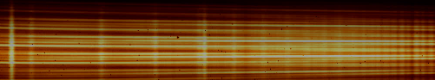
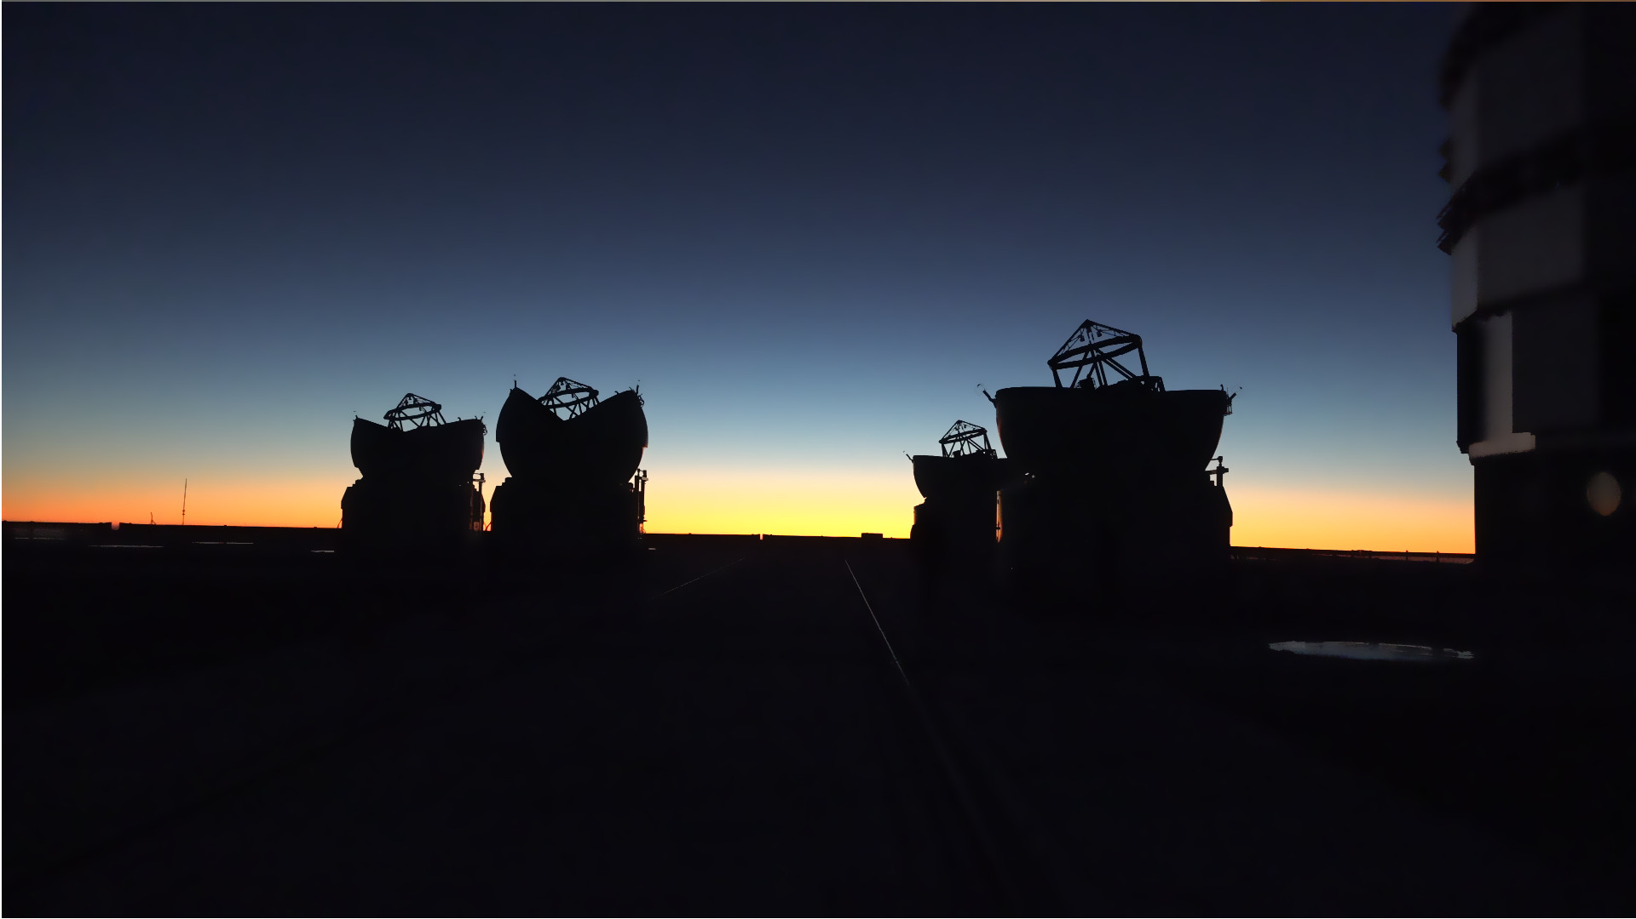
Probing dust and gas around hot stars with optical interferometry
Anthony Meilland
Laboratoire Lagrange - Université Côte d’Azur - CNRS

Slide 2
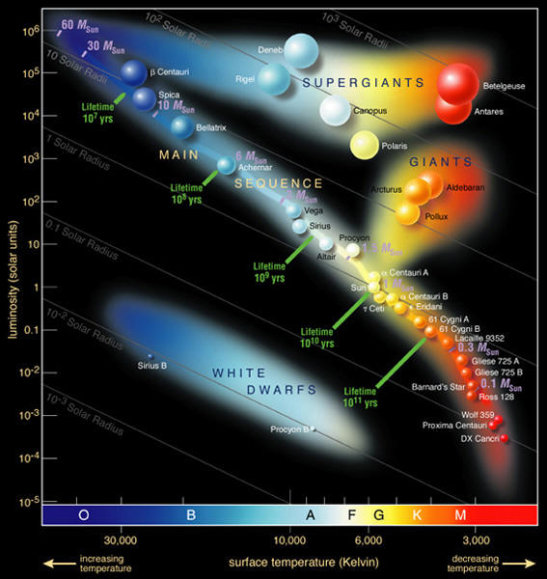
Hot Stars
OB main sequence stars (>3Mo)
  Intermediate to massive stars
OB(A) supergiant stars (>8 Mo)
  Massive evolved stars

Slide 3
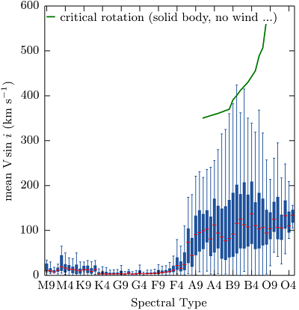
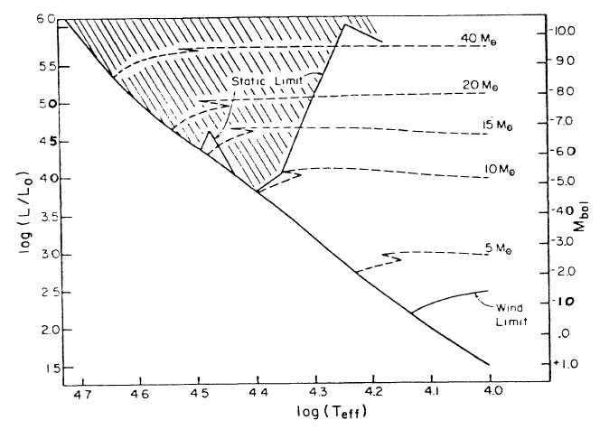
OB stars are affected by
and/or
fast-rotation
radiative wind
Initate wind
Fast Rotation
B1V
Sustain wind
B6V
No wind
© Yves Frémat
Abbott 1979

Slide 4
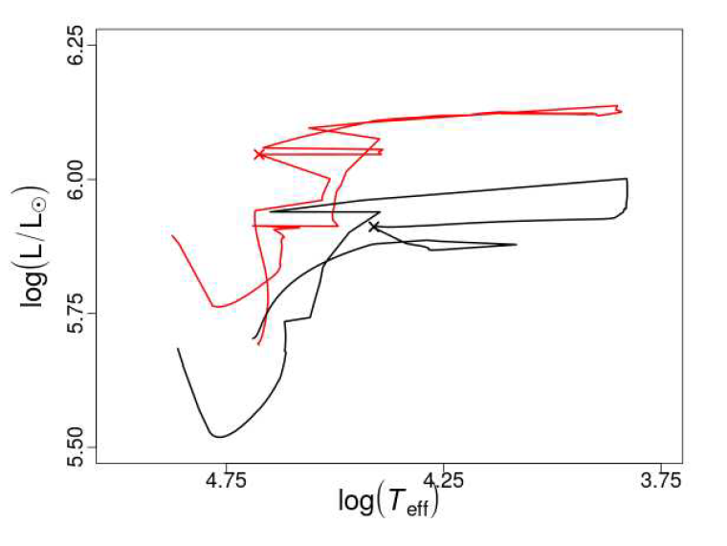
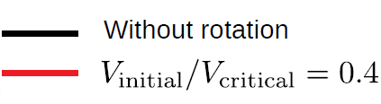
Rotation and radiative wind affect evolution
Geneva evolution model

Slide 5
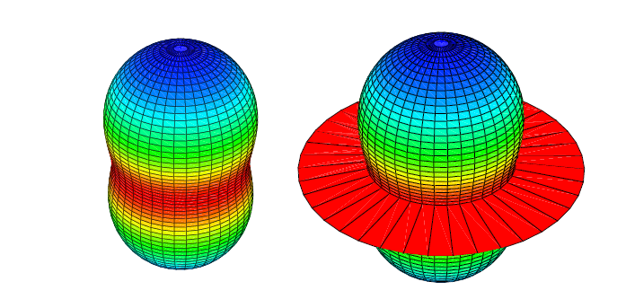
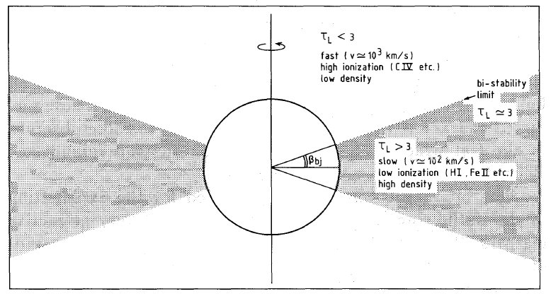
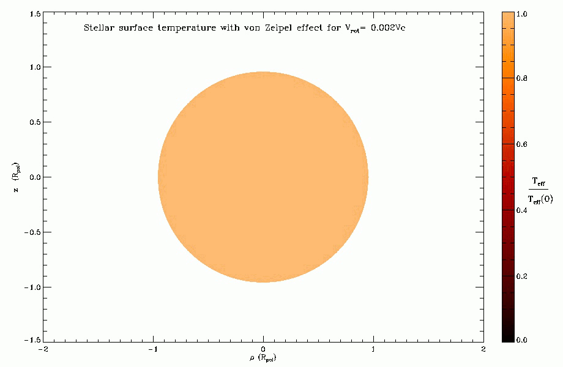
Rotation can affect mass-loss
Teff= 30000K
Teff= 25000K
HDUST radiative model
Of classical Be star
120 Mo
10₆ Lo
Iso Mass-loss distribution
Maeder & Desjacques 2000
Bi-stable model from Lamers 1991
Rotation can be responsible for mass-loss
Rotation can break the symmetry
of a radiative wind

Slide 6
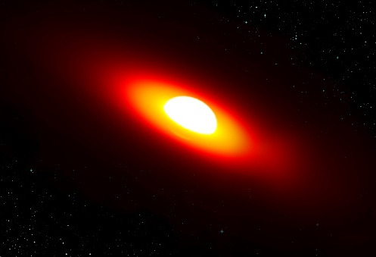
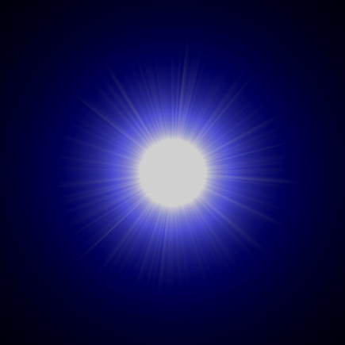
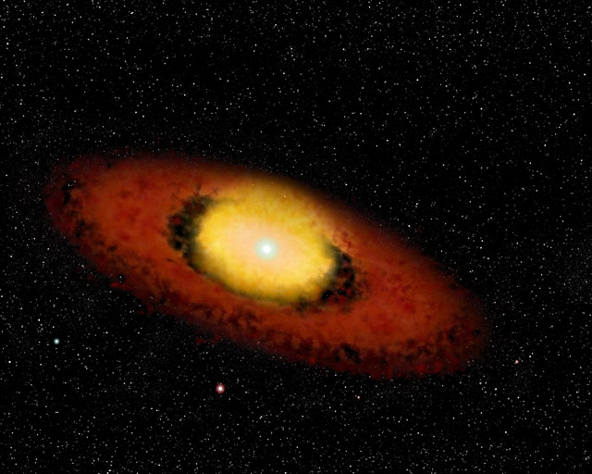
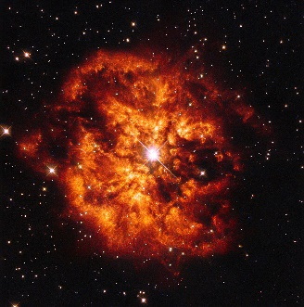
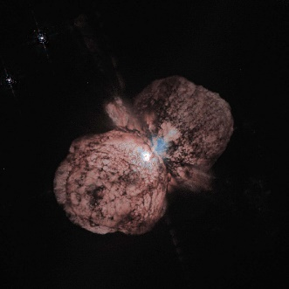
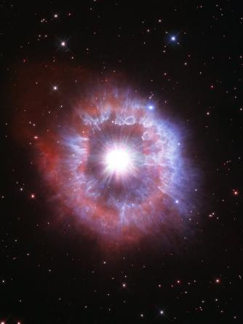
Formation of complex environments
Classical Be stars
‘’normal’’
Radiative winds
B[e] phenomenon
Dusty disk and hot gas
LBV and Wolf-Rayet stars

Slide 7
High angular resolution needed for OB stars
Classical Be stars
Object type | Near(est) Member | Distance | Angular size (mas)
Be stars | Achernar | 44 pc | 1.5 mas
B[e] star | FS CMa | 280 pc | 0.2 mas
Hot supergiant | Rigel | 265 pc | 2.5 mas
Wolft-Rayet | γ² Vel | 260 pc | 0.2 mas
LBV | η Car | 2300 pc | 1 mas?
‘’normal’’
Radiative winds
B[e] phenomenon
Dusty disk and hot gas
Resolution of the order of a few mas needed
Too small for current telescopes
(even for most object even of the ELT)
LBV and Wolf-Rayet stars

Slide 8
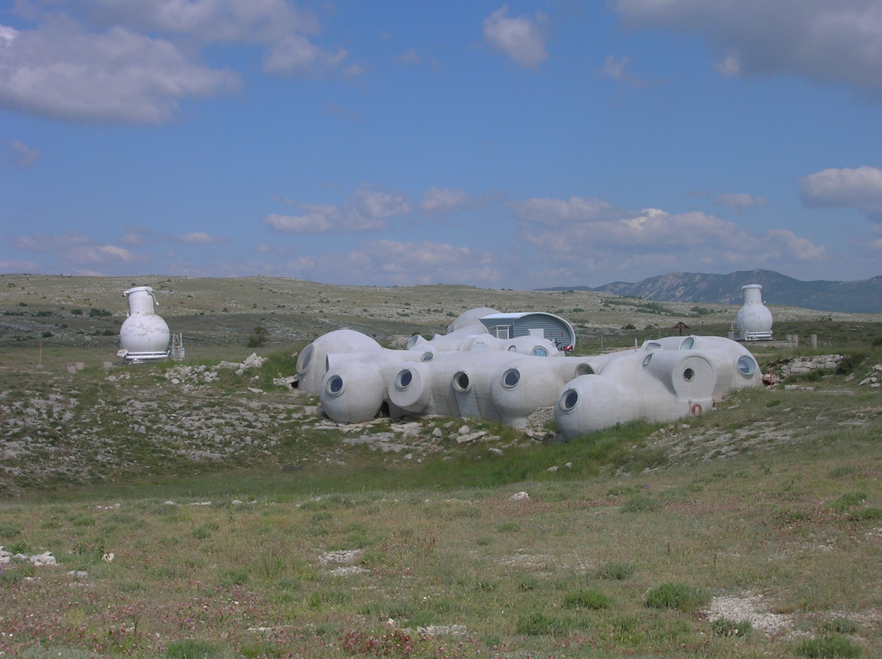
Interferometry
Diameter
Baseline
The « old » GI2T at the Observatoire de la Côte d’Azur near Nice
2) Long baseline interferometry 101

Slide 9
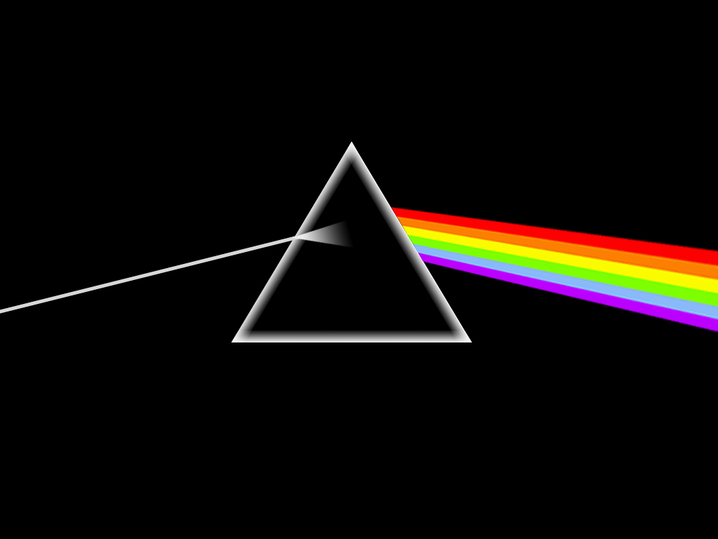
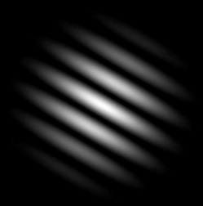
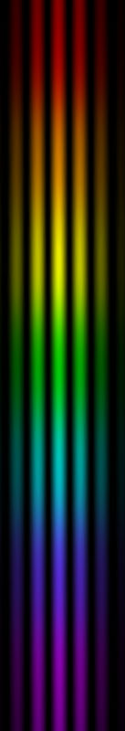
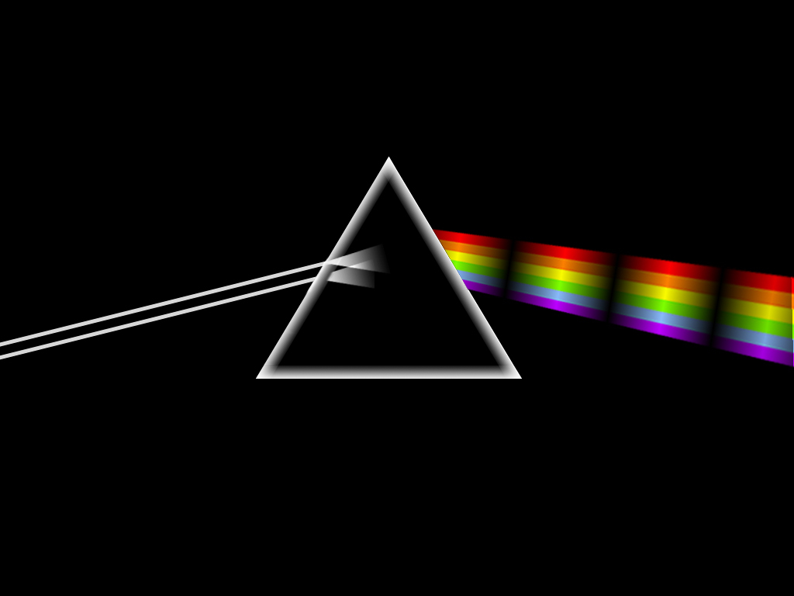
Spectro-interferometry
Spectroscopy
Interferometry
Flux as the function of wavelength
Geometry of objects
Spectro-interferometry
Geometry of objects as a function of the wavelength
d) Spectro-interferometry
1) Long baseline interferometry 101

Slide 10
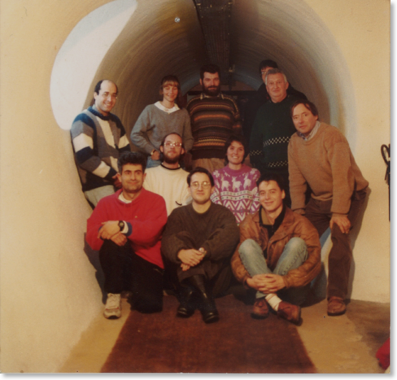
Spectro-interferometry
A. Labeyrie and the GI2T team in 1994
GI2T Calern, France

Slide 11
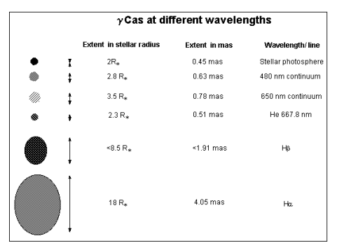
First studies of the geometry and kinematics
Of the environment around a classical Be star
γ Cas
Mourard+ 1989, Stee+ 1995, 1998, Berio+ 1999
Hα
VEGA (5ème étoile plus brillante du ciel)
+
ζ Tau Vakili+ 1998

Slide 12
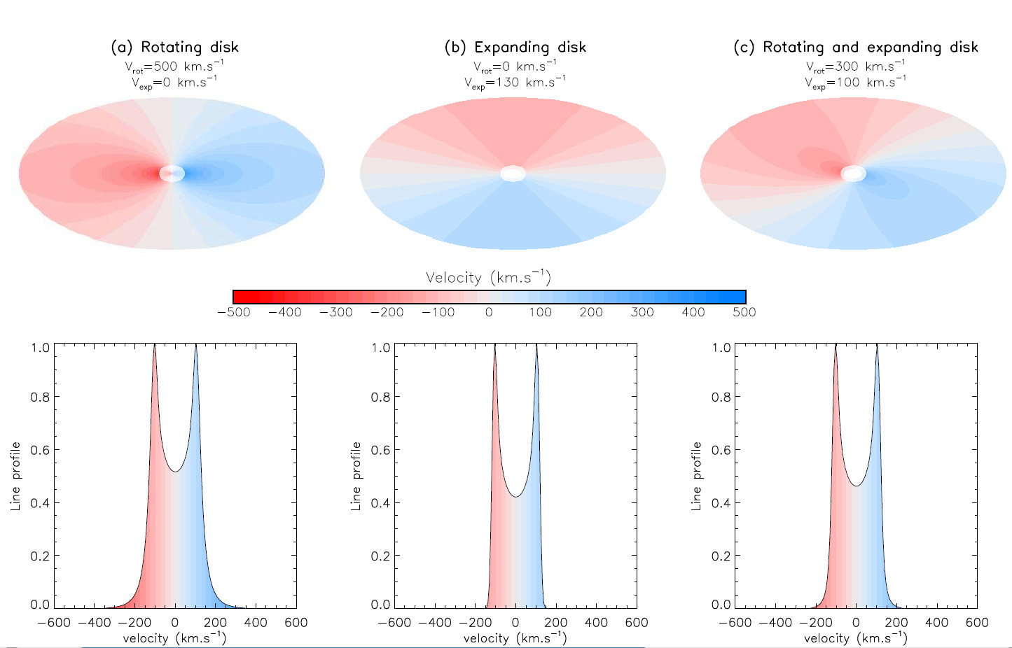
Kinematics without angular resolution

Slide 13
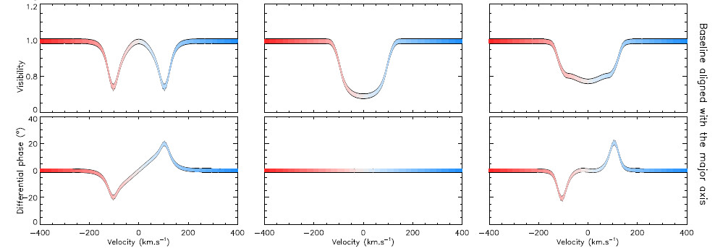
Kinematics with angular resolution

Slide 14
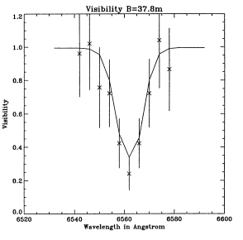
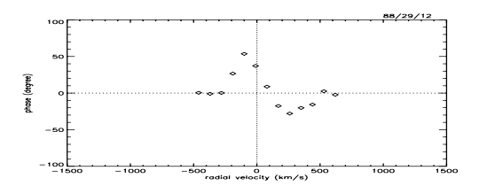
First studies of the geometry and kinematics
Of the environment around a classical Be star
γ Cas
Mourard+ 1989, Stee+ 1995, 1998, Berio+ 1999
Hα
VEGA (5ème étoile plus brillante du ciel)
Favors rotation over expansion in the disk

Slide 15
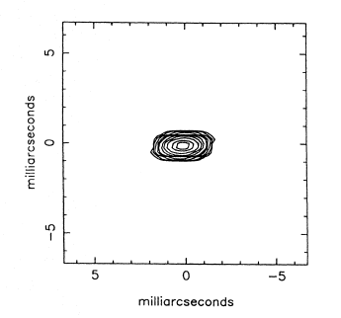
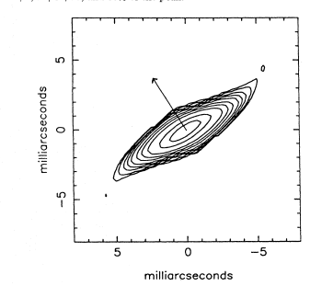
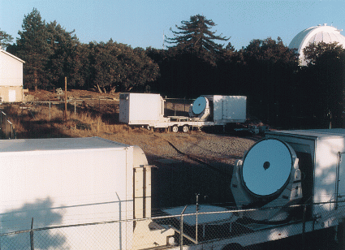
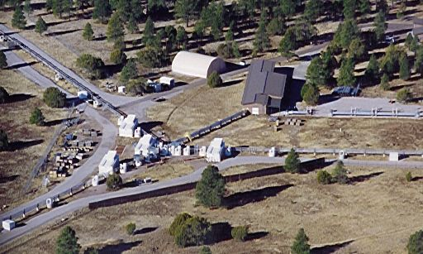
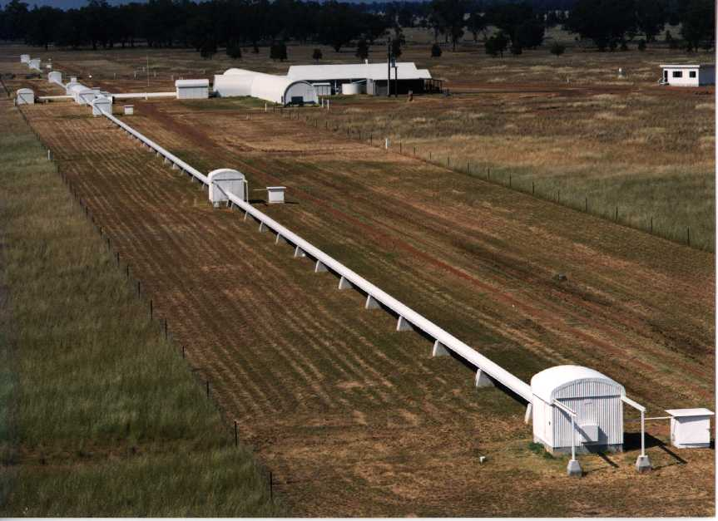
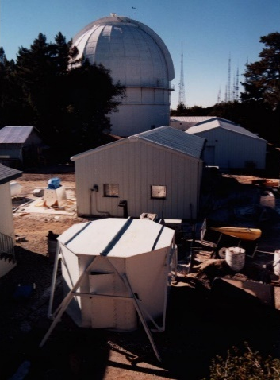
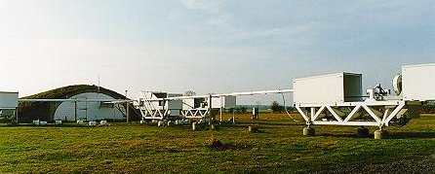
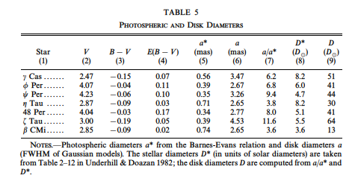
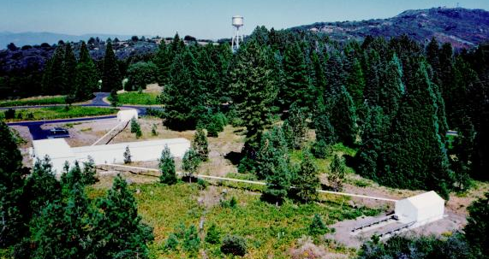
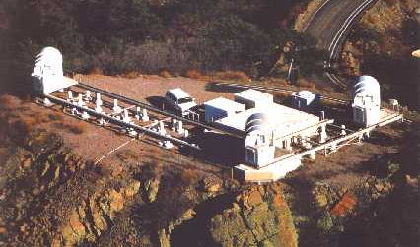
Quirrenbach+ 1994
ζ Tau
Continum
Hα
SUSI, Australia (1991)
NPOI, Arizona, USA (1994)
ISI , California, USA (1988)
Quirrenbach+ 1997
COAST, Cambridge, UK (1988)
PTI, California, USA (1996)
IOTA, Arizona, USA (1993)
Mark III, California, USA (1985)

Slide 16
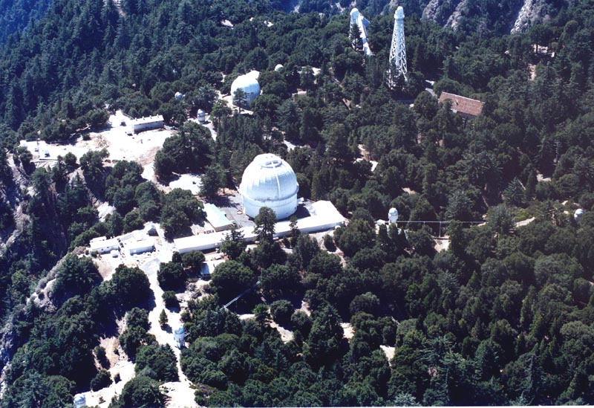
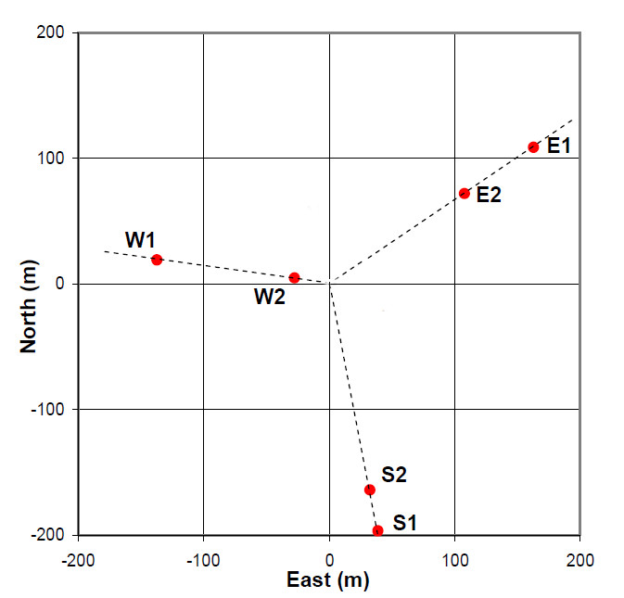
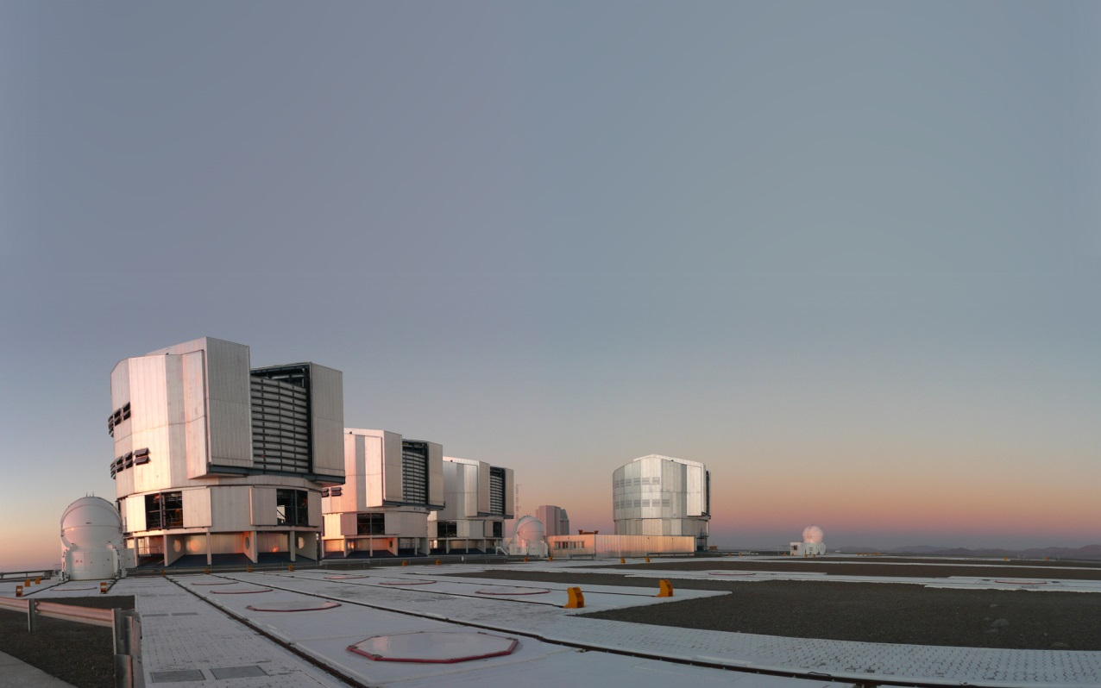
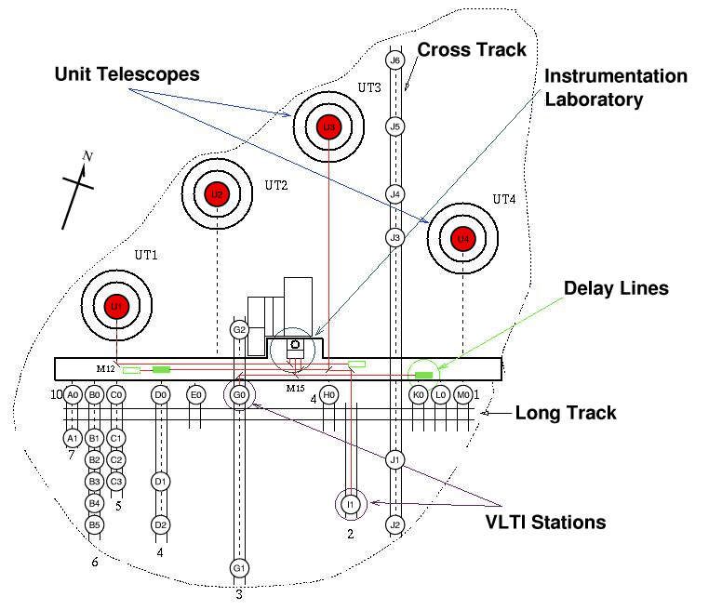
CHARA : California
B_{max}= 330m
6 Tels (1m)
0.5 – 2.4 µm
combiners
1st generation
2nd generation
CLIMB (H)
MIRC (H)
VEGA (V,R)
PAVO (V,R)
SPICA (R)
MIRCX (H)
MYSTIC (K)
VLTI : Chile
4 UTs (8m) + 4 ATs (1.8m)
1.5 – 13.5 µm
combiners
1st generation
2nd generation
VINCI (K)
MIDI (N)
AMBER (H,K)
PIONIER (H)
GRAVITY (K)
MATISSE (L,M,N)
B_{max}= 130m

Slide 17
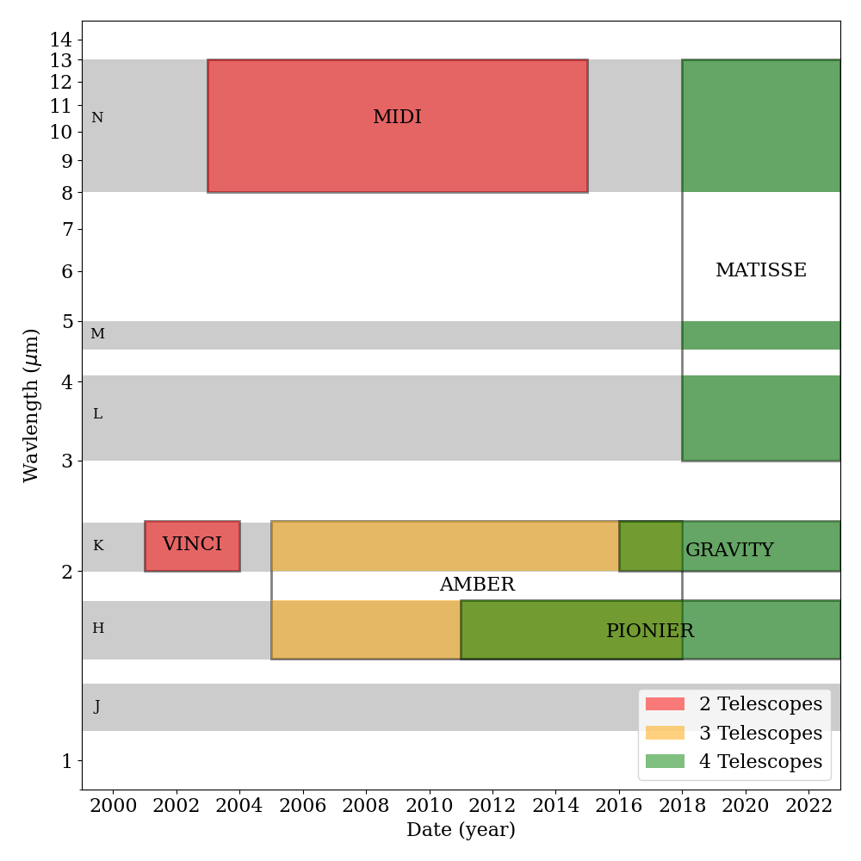
Instruments at the VLTI
Evolution of the instruments:
Number of telescopes combined
Fringe-tracking capability
Accuracy (DIT, calibration)
Sensitivity (detector, sampling)

Slide 18


Our Journey around Hot stars
B[e] stars
Classical Be stars
η Car
Hot supergiants

Slide 19
Some questions about the classical Be stars
Rotational rate of Be stars
how close to critical rotation the Be stars are?
Does it depend on the Teff or Lum?
Velocity law in the disk
Are the disk dominated by rotation or expansion?
What is the rotation law in the disk ?
Disk/environment structure
How thin is the equatorial disk?
Is the disk stratified?
Can we determine the density law?
What about polar wind? Disk wind?
What about the stability of the disk
Artist view of a classical Be star
based on semi-physical model DISCO

Slide 20
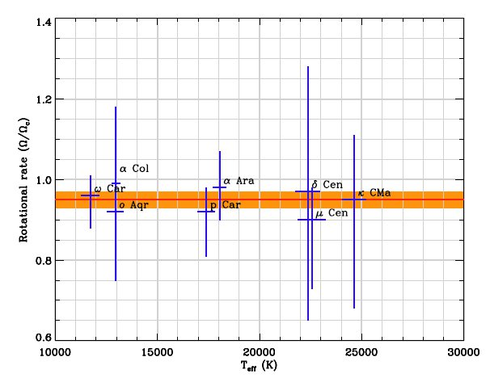
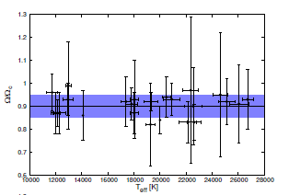
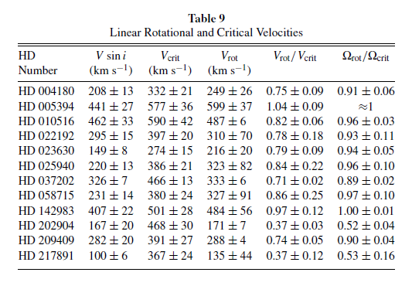
Rotational rate of Be stars
Differential interferometry in Brγ VLTI/AMBER)
VLTI/AMBER spectro-interferometry in Brγ
CHARA/CLIMB K-band continuum data
Meilland+ 2012 (8 stars )
Cochetti+ 2019 (26 stars )
Touhami+ 2013 (12 stars )
Ω/Ω_{c} = 0.95 ± 0.02
Ω/Ω_{c} = 0.86 ± 0.04
Ω/Ω_{c} = 0.95 ± 0.04
Very close to critical rotation ⬄ rotation is the main driver or mass-ejection
no dependence on the effective temperature ⬄ no major effect from radiative pressure

Slide 21
Some questions about the classical Be stars
Rotational rate of Be stars
how close to critical rotation the Be stars are?
Does it depends on the Teff or Lum?
Velocity law in the disk
Are the disk dominated by rotation or expansion?
What is the rotation law in the disk ?
Disk/environment structure
How thin is the equatorial disk?
Is the disk stratified?
Can we determine the density law?
What about polar wind? Disk wind?
What about the stability of the disk
Artist view of a classical Be star
based on semi-physical model DISCO

Slide 22
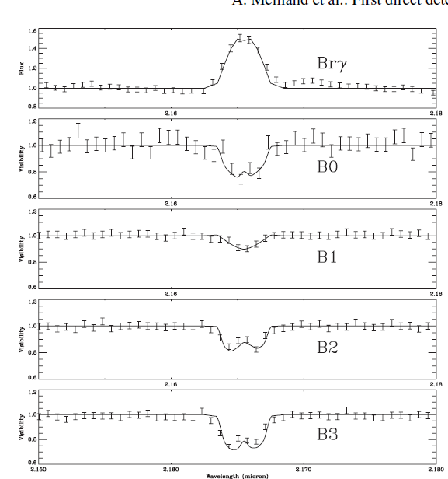
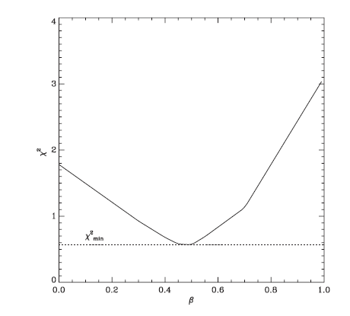
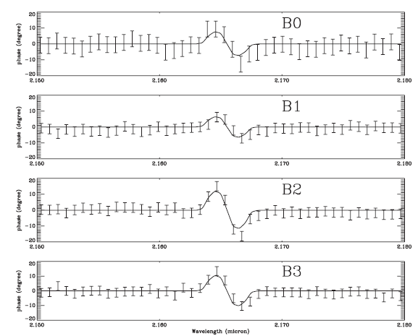
Velocity law in the disk
FLUX
α Ara Observed with VLTI/AMBER
PHASE
VISIBILITY
Rotational law exponent β = -0.48 ± 0.1
Compatible with Keplerian rotation (-0.5)
Expansion is not detectable < 10km/s
Meilland+ 2007

Slide 23
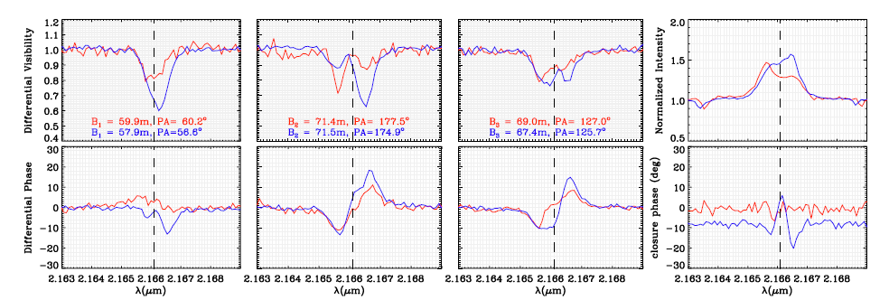
Velocity law in the disk: expansion
change of size of δ Sco 2010 and 2012 A seen by VLTI/AMBER
Flux
Diff. Visbilities
Closure phase
Diff. Phases
Vexp = 0.20 ±0.11 km/s.
Compatible with model-dependent values determined from spectroscopy
Meilland+ 2013

Slide 24
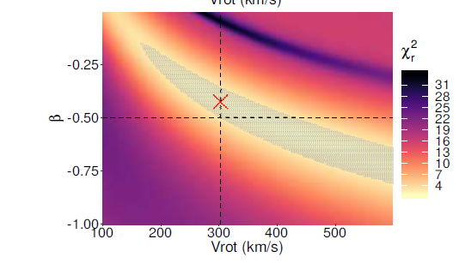
Velocity law in the disk: Rotation law
VLTI/AMBER observation of O Aqr
Fitted with rotating disk model
Strong-correlation
And degeneracy in the models
Between
β and Vrot
(+ inclination angle)
de Almeida+ 2020

Slide 25

Velocity law in the disk: Rotation law
Multi-lines spectro-interferometric observation of β Cmi
Brγ (VLTI/AMBER) + Hα (CHARA/VEGA) + Brα (VLTI/MATISSE)
Need of a line coming for a narrower region!
He 667.8nm would be perfect ⬄ CHARA/SPICA
Klement & Meilland (in preparation)

Slide 26
Some questions about the classical Be stars
Rotational rate of Be stars
how close to critical rotation the Be stars are?
Does it depends on the Teff or Lum?
Velocity law in the disk
Are the disk dominated by rotation or expansion?
What is the rotation law in the disk ?
Disk/environment structure
How thin is the equatorial disk?
Is the disk stratified?
Can we determine the density law?
What about polar wind? Disk wind?
What about the stability of the disk
Artist view of a classical Be star
based on semi-physical model DISCO

Slide 27


Disk global structure : Viscous Decretion Disk
Hydrodynamics similar to accretion disk of YSO
Shakura & Sunyaev 1973
But with an opposite mass-flow
Parametrization of the VDD
Scale height for isothermal disk
m governs the state of disks
m = 3.5 stable disk
m < 3.5 dissipating disk
m > 3.5 growing disk
Porter and Rivinius 2003

Slide 28





Disk global structure
BEDISK + BERAY
Sigut & Jones 2007
Sigut 2011
2D-axisymmetric disk geometry
NLTE-RT
Realistic metallicity
BEDISK
Temperature in the disk
HDUST
Carciofi & Bjorkamn 2006
3D arbitrary gemoetry
NLTE-RT solved with Monte Carlo
Hydrogen only (+ dust)
Temperature in the disk
Successfully tested on spectroscopic, photometric as well as interferometric data: e.g. Tycner+ 2008, Carciofi+ 2009, Sigut+ 2015

Slide 29


Beyond the global structure: limits on the current models?
Multi-lines spectro-interferometric modelling of O Aqr: Brγ (VLTI/AMBER) + Hα (CHARA/VEGA)
Modelling with HDUST model
Global disk structure similar in both lines
Same stellar parameters
Same surface density: Σ₀ = 0.12 g.cm/2
Same exponent of the density law: m = 3.0
But Inclination angle determined from Hα is 15° smaller
Thicker disk in this line?
⬄
Non-isothermal effect or Need of heavier elements?
Importance of multi-bands & multi-lines observations
Need of improved accuracy & efficiency (better uv-plan)

Slide 30





Multi-bands spectro-interferometric view on Be stars
MATISSE
AMBER
Contiunum emission from
0.6 to 13 µm
+
Many emission lines
+
SED
+
Spectroscopy
VEGA
NPOI
Spectro
β CMI Klement & Meilland (in preparation)

Slide 31



Spectro-interferometric imaging of Be stars
The Be star ϕ Persei seen by CHARA Mourard+ 2015
Reconstructed images from the VEGA data
Nearly edge-on Keplerian disk model
Reconstructed images from the model
uv-plan coverage
Observation with CHARA/VEGA in H

Slide 32

Separating spectra using spectro-interferometry
The binary Be star ϕ Persei seen by CHARA Mourard+ 2015
Full spectrum
Star
Disk
outside
Similar to integral-field spectroscopy but with a 10 times higher spatial resolution!

Slide 33

Separating spectra using spectro-interferometry
The binary Be star ϕ Persei seen by CHARA Mourard+ 2015
Full spectrum
Star
Disk
outside
SPICA will offer better accuracy ⬄ more constraints on the Be star photophere

Slide 34
Question on B[e] stars
Geometry of the three main features:
  Dust
  Permitted lines: mainly Hydrogen
  Forbidden lines: ionized Fe, O …
Velocity law in the environment
  Excretion-disk vs bi-stable wind model
Binarity of B[e] stars
Rotational rate of B[e] stars (vsini + inclination)
Homogeneity of the phenomenon

Slide 35



B[e]: Where is the Dust?
CPD -57° 2874
CPD -52° 9243
HD50138
Borges Fernandes+ 2011
Domiciano de Souza+ 2007, 2011
Cidale+ 2012
Other papers …
GG Car (Domiciano de Souza 2015)
Hen 3-1191 (Lachaume+ 2007)
l Pup (meilland+ 2010,Millour 2011+)
Dust in a elongated structure
In the equatorial plan
Excretion-disk vs bi-stable wind
⬄
Velocity field dominated by rotation or expansion
8 with VLTI/MIDI
10 with VLTI/AMBER
2 with CHARA/VEGA
2 with IOTA/IONIC
1 with VLTI/PIONIER
1 with PTI

Slide 36





B[e]: Disk or equatorial wind
Radiative transfert modelling with MC3D (Wolf 2003)
Equatorial wind
Keplerian disk
VLTI/MIDI observation of l Pup
Need of better uv-plan coverage + closure phase + improved accuracy ⬄ We need 2nd generation insturment MATISSE

Slide 37


B[e]: Disk or equatorial wind
l Pup
Spectro-imaging from VLITI/AMBER observation in Brγ
K-band continuum image
Velocity field image in Brγ
Central object
(Gas + Star)
Brγ
Dusty disk inner Rim
3 nights of observation (108 baselines)
Reconstruction with Modified MIRA software
No expansion (<10km.s⁻¹)
Keplerian rotation
Millour+ 2011

Slide 38




MATISSE observations of B[e] stars
L-band image (3.4-3.8 um)
uv coverage
unclB[e] star FS CMa
N-band image (8.6-9.0 um)
Inner-Rim of the dust 6x12 mas ⬄ compatible with PIONIER image
Modelling with 3D-Monte-Carlo Radiative transfer code Polaris
Constraints on the disk density profile
Separation of gaz and dust emission and constraints on the gaseous disk density
Hofmann+ 2021

Slide 39



MATISSE observations of B[e] stars
Work of my phD student
Margaux Abello

Slide 40



Few objects beyond Be stars and B[e] stars
Probing the wind of hot supergiants Deneb & Rigel with CHARA/VEGA and VLTI/AMBER
Consistent Mass-loss derived
using 1D RT code CMFGEN.
But inhomogeneities
in the wind detected
Olivier Chesneau
(1972-2014)
New programmes on hot wind with CHARA/SPICA & VLTI/GRAVITY
Chesneau+ 2010, 2014

Slide 41


Few objects beyond Be stars and B[e] stars
LBV+O star system Eta Car
Direct view of the shock cone
at the periastron passage !
MATISSE iso-velocity images across the Brα feature at 4.05 µm
Weigelt+ 2021

Slide 42
Conclusions

Slide 43


Oscillations in the disk
ζ Tau observed with VLTI/AMBER
Diff. Phase
Visibility
Modeled with the HDUST code
with density distribution including
one arm oscillation model from Okazaki
Carciofi+ 2009

Slide 44


Binarity of OB stars
Affect mass-loss and reorganization of matter
WR 104 (Keck)
Tuthill+ 2008
η Car (HST)

Slide 45


Detection of polar wind?
α Ara
18500K
Achernar
20000K
Polar
Intermediate
equatorial
Kervella & Domiciano de Souza 2006
Meilland+ 2007
modelling disk + polar wind
with SIMECA code
Kanaan+ 2008 modelling polar wind with SIMECA code
Both detections rely on very few measurements
Possible biases introduced by data calibration

