Slide 1
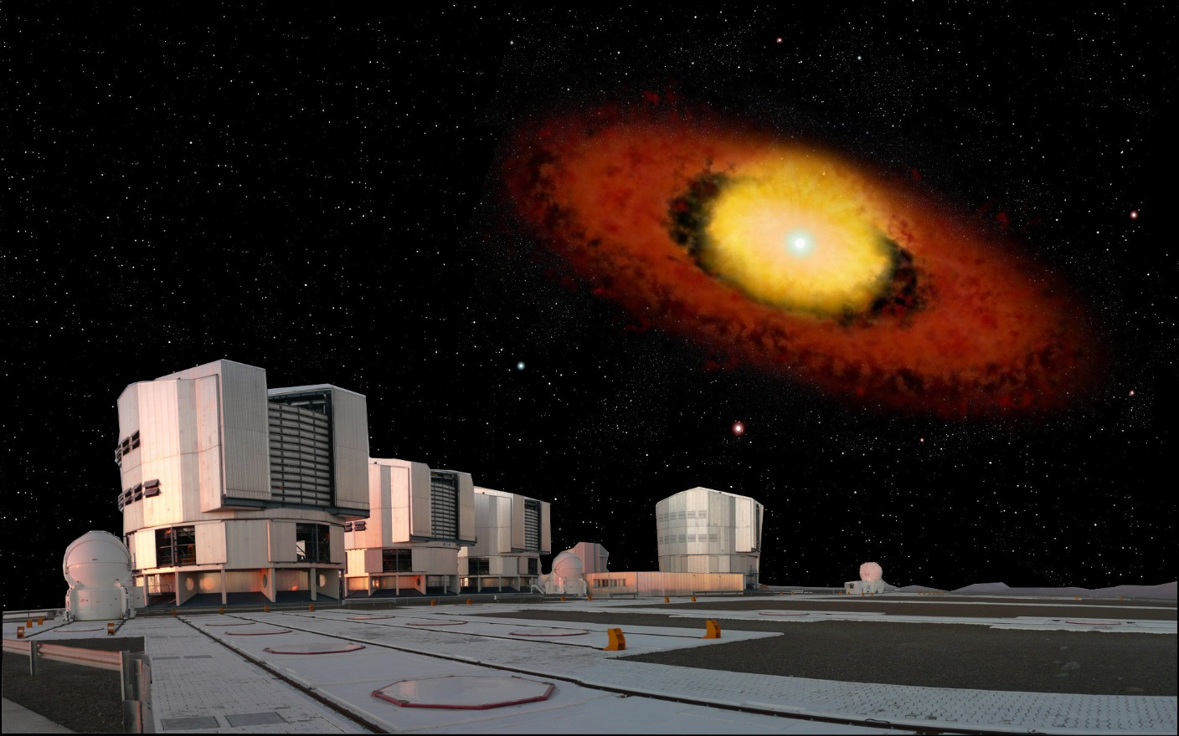




Probing gas and dust around B[e] stars at the highest angular resolution:
A decade of interferometric studies
Anthony Meilland

Slide 2
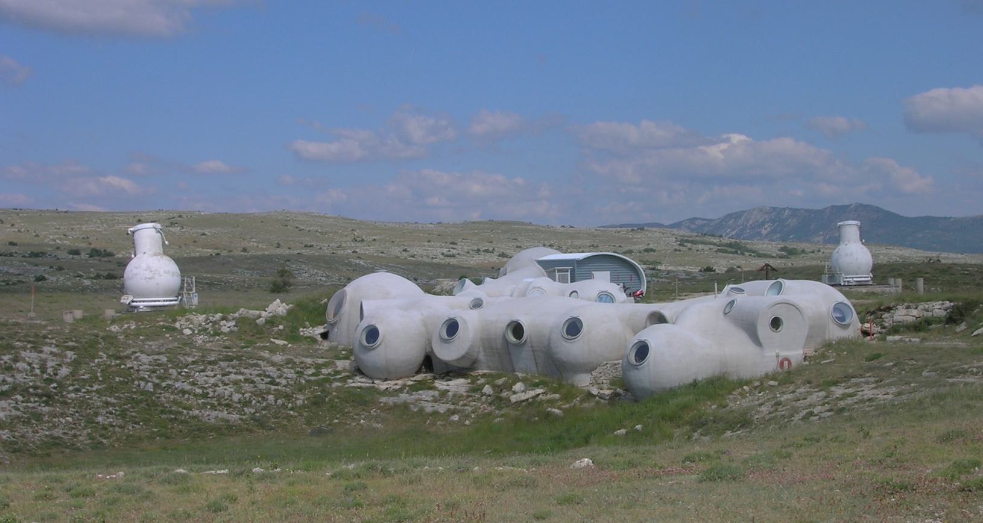
Long baseline interferometry 101
Diameter
Baseline
Angular resolution :
Telescope => 1.22 D/λ
Interferometer => 1.22 B/ λ
The « old » GI2T at Observatoire de la Côte d’Azur, France
1) Long baseline interferometry 101

Slide 3
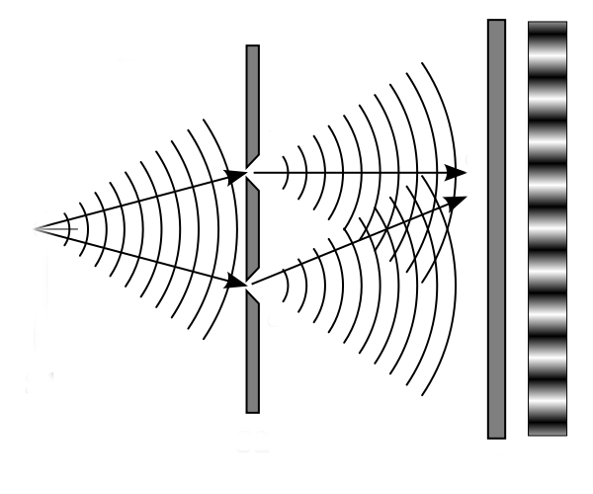
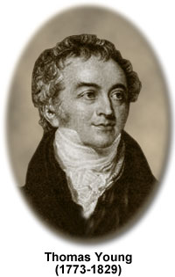
Thomas Young’s slit experiment (1801)
a) Let there be fringes
1) Long baseline interferometry 101

Slide 4
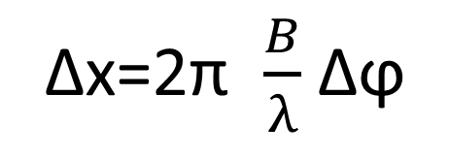
Thomas Young’s slit experiment (1801)
Moving the source
Δx
Fringes phase change
Δϕ
Δx=2π $\frac{B}{λ}$ Δϕ
a) Let there be fringes
1) Long baseline interferometry 101

Slide 5
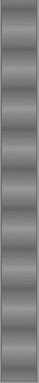
Thomas Young’s slit experiment (1801)
Increasing the source size
+
+
+
…
=
θ
B
Loss of
fringe contrast!
The fringes even disappear for θ=1.22 λ/B !
a) Let there be fringes
1) Long baseline interferometry 101

Slide 6
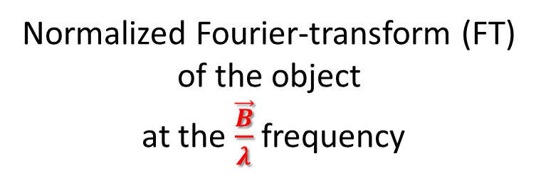
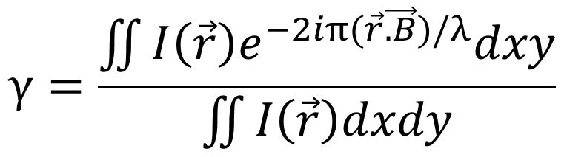
Van Citter & Zernike theorem
$$γ=\frac{\iint{I\left(\vec{r}\right)e^{−2iπ(\vec{r}\vec{.B})/λ}dxy}}{\iint{I\left(\vec{r}\right)dxdy}}$$
Complex visibility
=
γ=Ve^{iϕ}
Normalized Fourier-transform (FT)
of the object
at the $\frac{\vec{B}}{λ}$frequency
Fringe contrast
Fringe phase
b) Living in the Fourier space
1) Long baseline interferometry 101

Slide 7
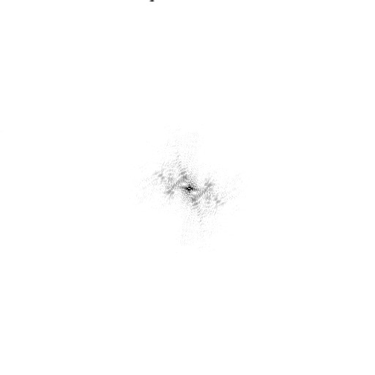
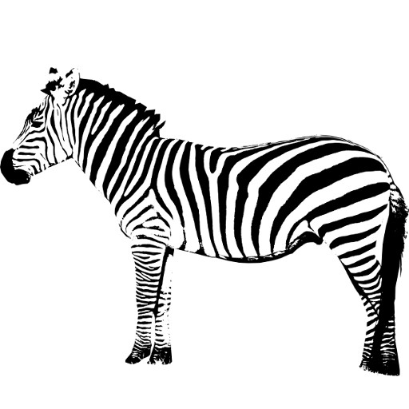
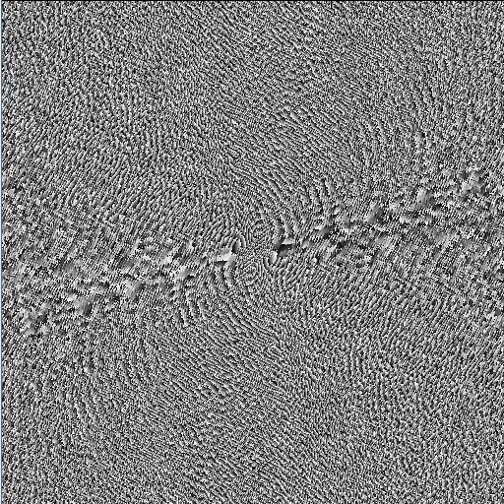
Sampling the object FT ⬄Filling the (u,v) plan
Modulus
Phase
Inverse Fourier transform
FT⁻¹
What is that?
Oh it’s a Zebra!
Need a lot of measurements
with baselines of different orientations and lengths
b) Living in the Fourier space
1) Long baseline interferometry 101

Slide 8
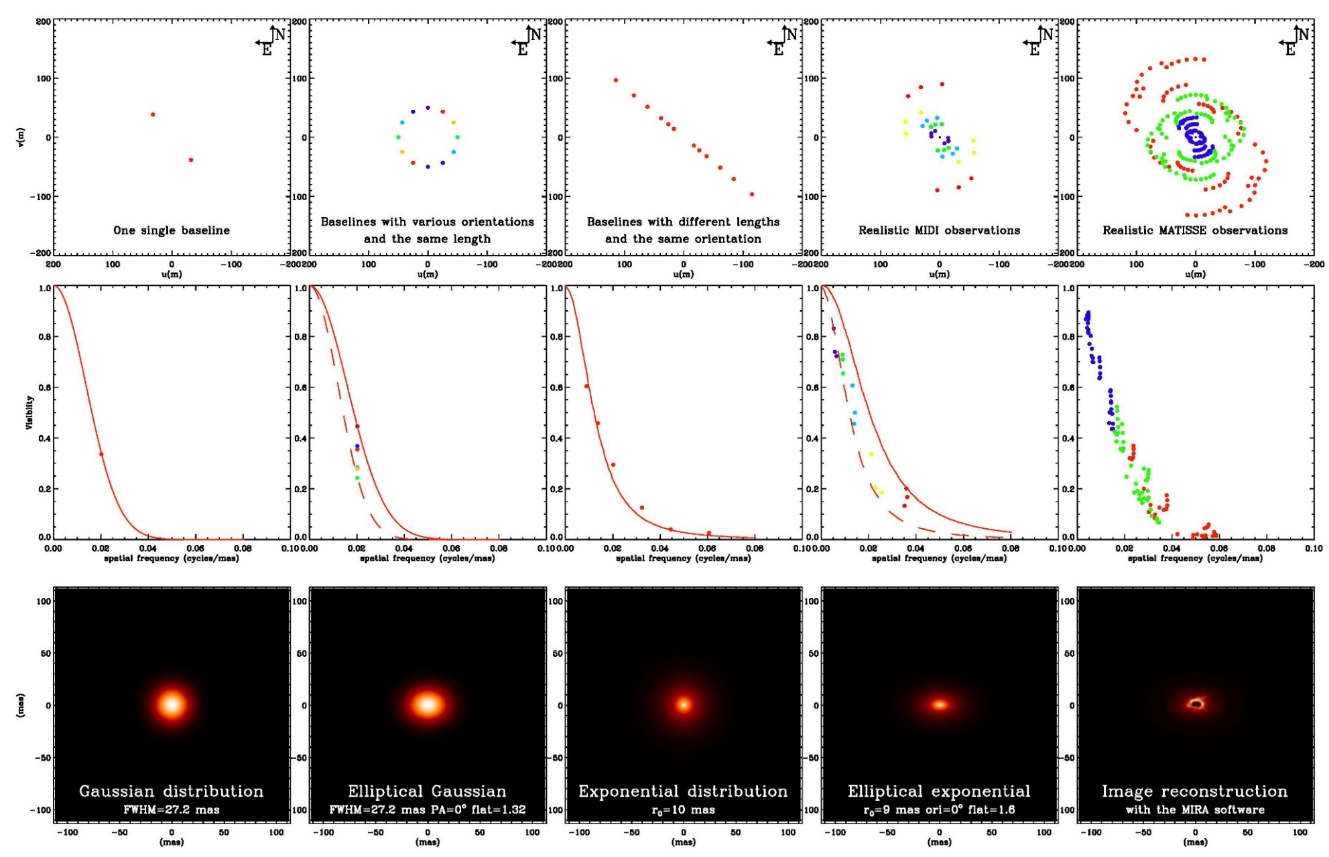
In the real life we always have a sparse (u,v) plan coverage
(u,v) plan
Visibility
Model
Equivalent size
Flattening
Radial profile
``Complex’’ model
Image reconstruction
b) Living in the Fourier space
1) Long baseline interferometry 101

Slide 9
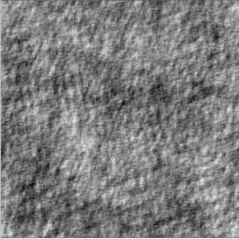


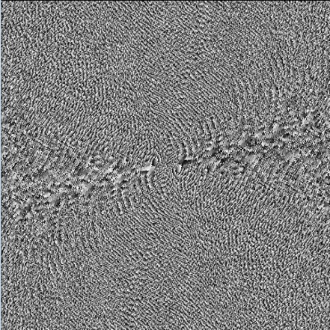
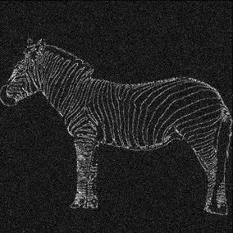
The phase contains most of the information!
Modulus
FT⁻¹
Random map
FT
Phase
FT⁻¹
b) Living in the Fourier space
1) Long baseline interferometry 101

Slide 10
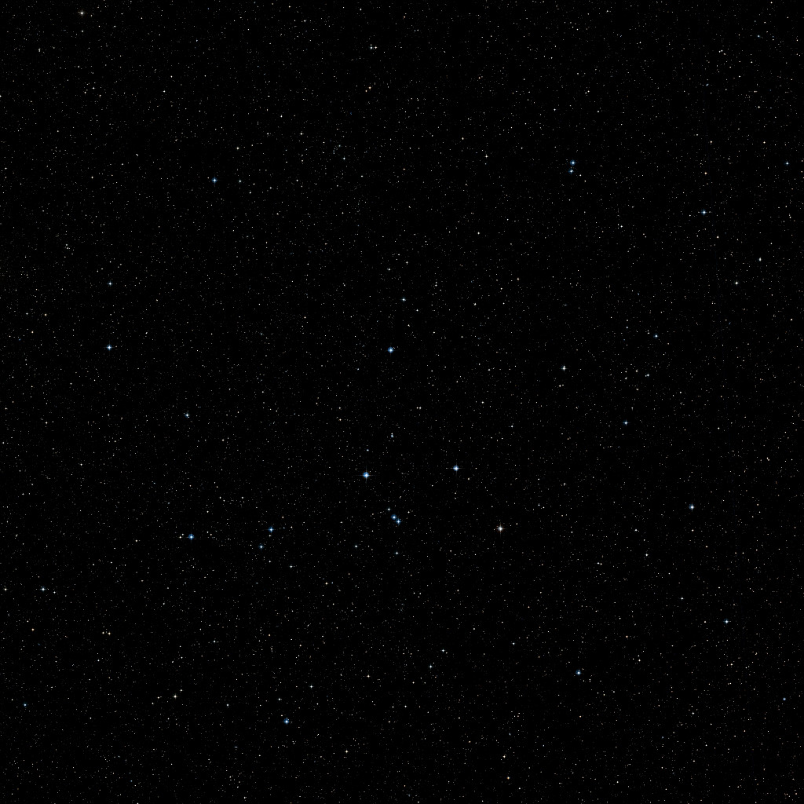

Idealistic situation
Optical Path Difference
Delay Line
c) I want my phase back!
1) Long baseline interferometry 101

Slide 11
Unfortunately, Earth has an atmosphere!
Atmospheric phase δϕ₁(t)
φ₁₂=ϕ₁₂ +δϕ₂- δϕ₁
Atmospheric phase : δϕ₂(t)
c) I want my phase back!
1) Long baseline interferometry 101

Slide 12
The closure phase is our only hope (up to now)
1
ϕ_{ij} = « True » phase for the ij baseline
δϕ_{i} = Atmospheric « random » phase on telescope i
φ_{ij} = Measured phase for the ij baseline
φ₃₁=ϕ₃₁ +δϕ₁- δϕ₃
φ₁₂=ϕ₁₂ +δϕ₂- δϕ₁
3
2
φ₂₃=ϕ₂₃ +δϕ₃- δϕ₂
Closure phase
CP = φ₁₂ + φ₂₃ + φ₃₁ = ϕ₁₂ + ϕ₂₃ + ϕ₃₁
Non zero (% π) Closure phase ⬄ Assymetry of the object
c) I want my phase back!
1) Long baseline interferometry 101

Slide 13
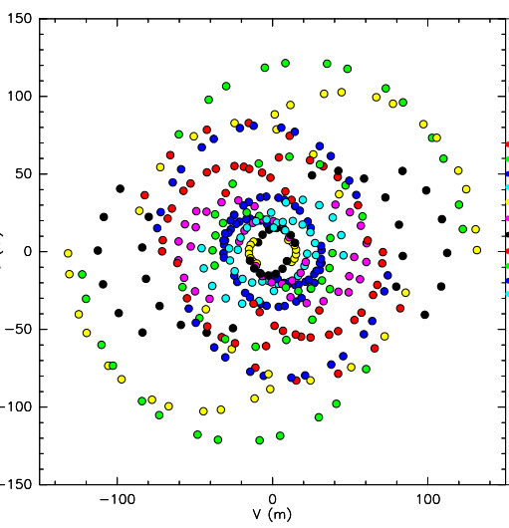

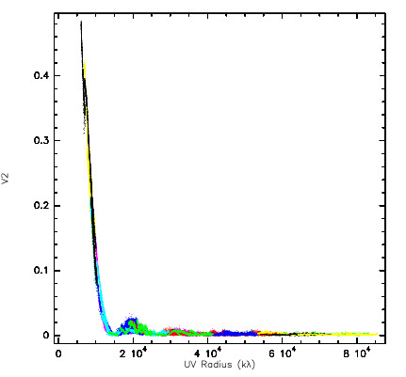
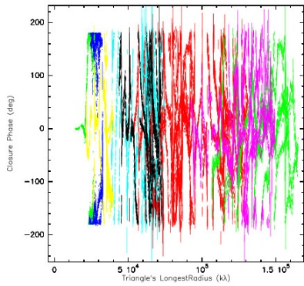
Image reconstruction
N_{x}N_{y} pixels 32x32=1024
Free parameters
Additional priors
  Positivity
  Normalization
Model fitting
but
more free parameters than data
4n of observations
with the VLTI/AMBER
Regularizations methods
  Smoothness
  Compactness
  “Simplicity”
  …
Add even stronger constraints depending on the object
All flux inside a surface (for stellar surface)
Remove unresolved object (for circumstellar disk)
N_{v²}= 102
N_{CP}= 34
= 136 Measurements
d) We want images!
1) Long baseline interferometry 101

Slide 14
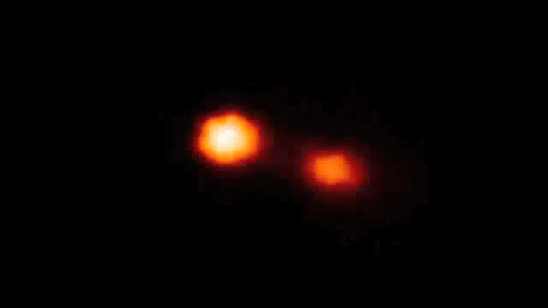
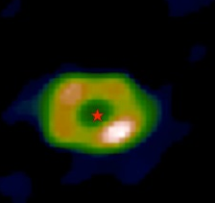

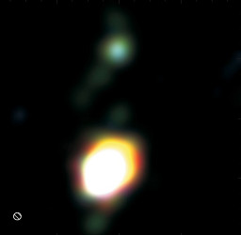
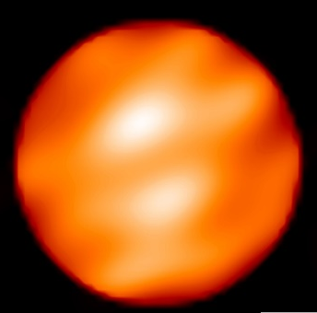
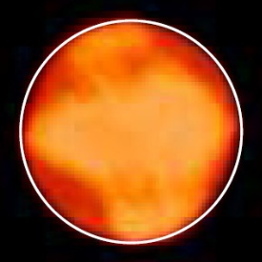



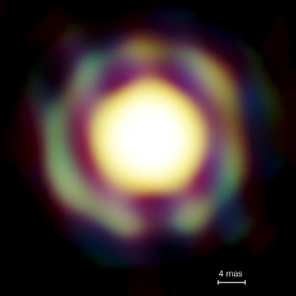
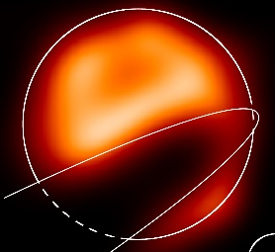

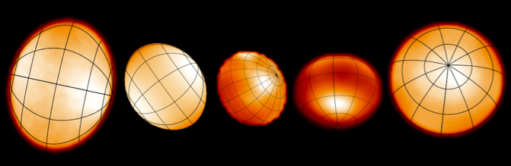

A few images from optical interferometers
Binaries (Interacting, symbiotics, B[e]…)
Dust disks Inner rims
Giants and Supergiants
Kluska+ 2014
Zhao+ 2008
Kraus+ 2012
Benisty+ 2011
Blind+ 2014
Baron+ 2014
Millour+ 2009
Haubois+ 2009
Mira stars
ε Aur
very massive YSO disks
Fast rotators
Kraus+ 2010
Monnier+ 2007, Zhao+ 2009, Che+ 2011
Le Bouquin+ 2009
Kloppenborg+ 2009
d) We want images!
1) Long baseline interferometry 101

Slide 15
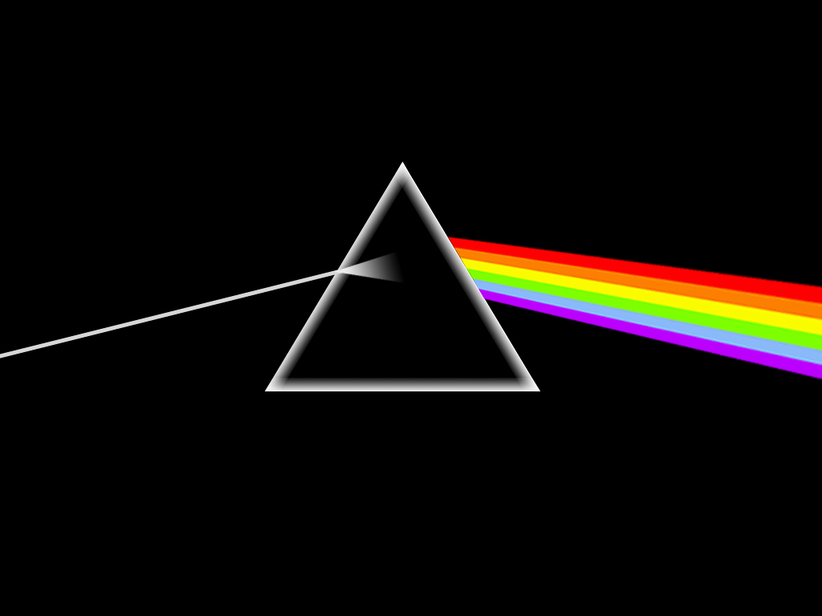
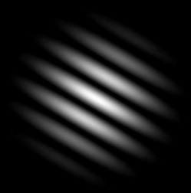
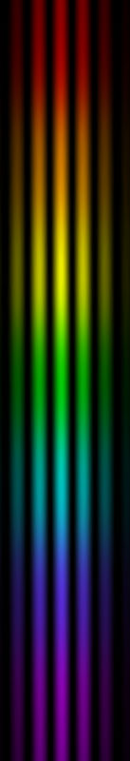
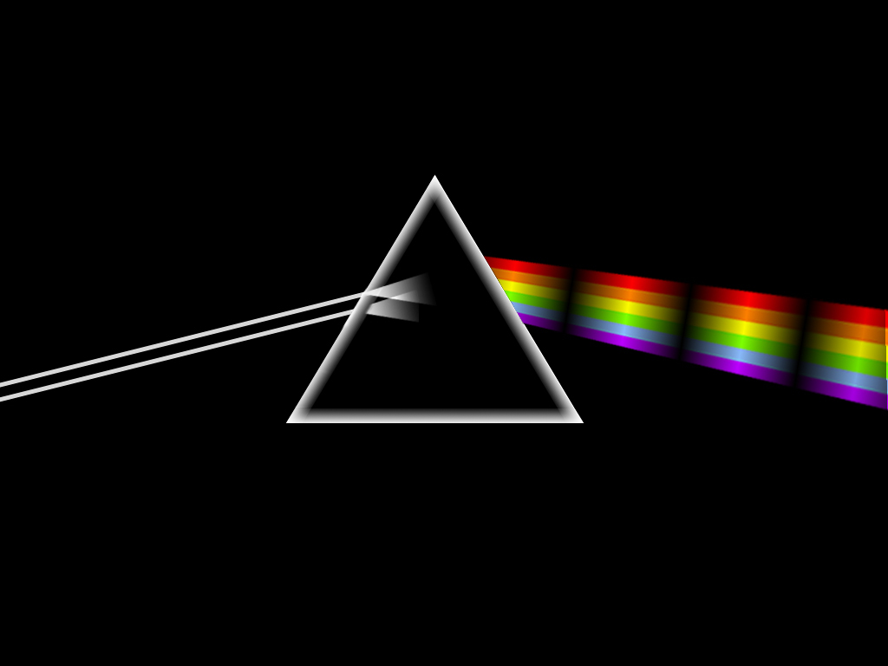
Spectro-interferometry
Spectroscopy
Interferometry
Flux as the function of wavelength
Geometry of objects
Spectro-interferometry
Geometry of objects as a function of the wavelength
e) Any color you like
1) Long baseline interferometry 101

Slide 16
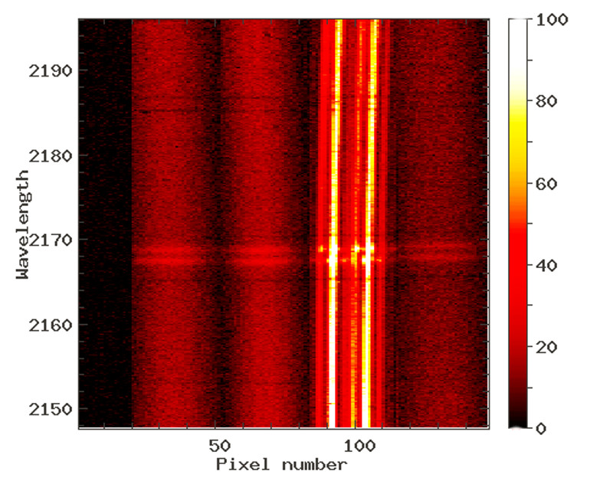
Quantities extracted from spectro-interferometry
Absolute quantities => need of a calibrator
Calibrated visibility V(λ)
Size of object as function of λ
Closure phase φ(λ) (if 3 telescopes or more)
Asymmetry of object as function of λ
Spectrum F(λ)
Differential quantities => no calibrator needed
Differential phase : ϕ(λ)
Variation of photocenter position as a function of λ
Differential visibility : v(λ)
Variation of extension as a function of λ
VLTI/AMBER fringes on the Be star O Aqr around Brγ line
e) Any color you like
1) Long baseline interferometry 101

Slide 17
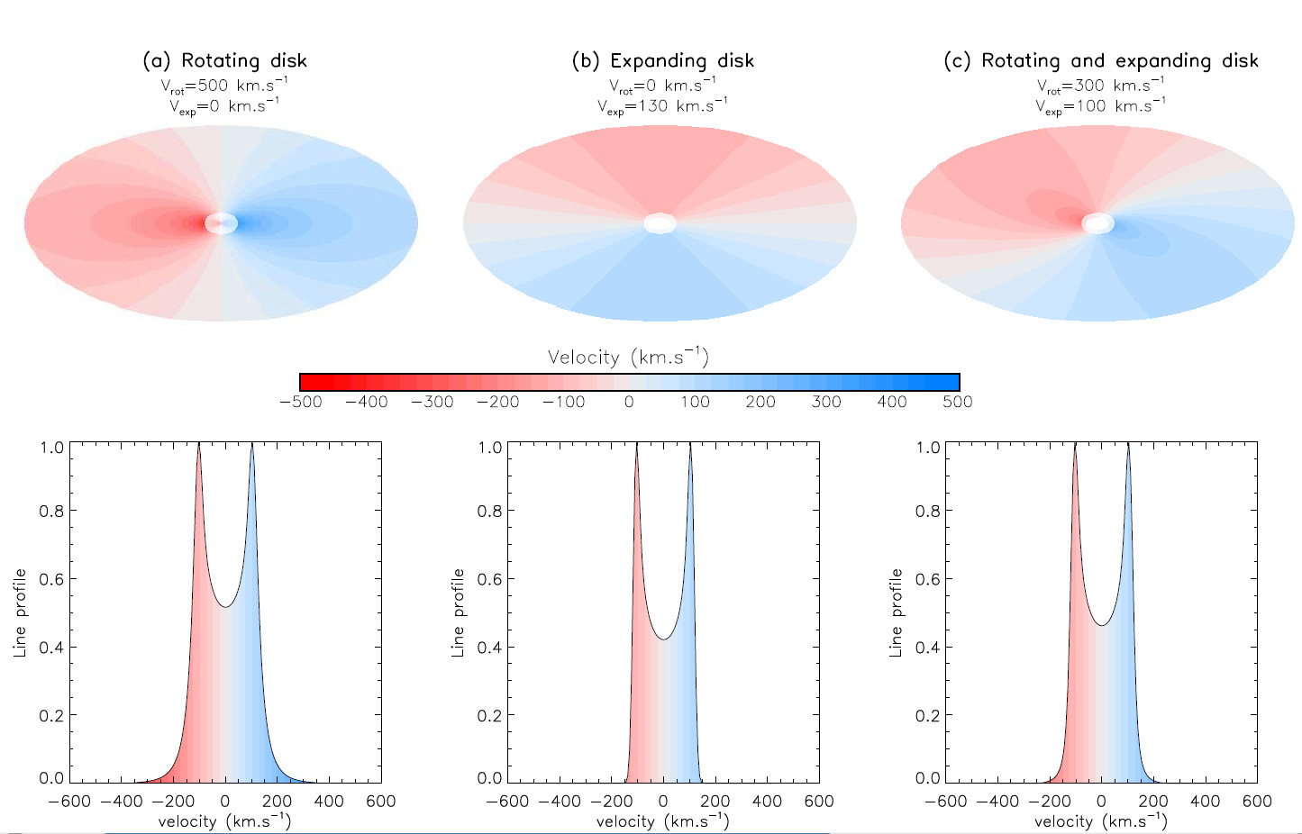
Kinematics with or without angular resolution
e) Any color you like
1) Long baseline interferometry 101

Slide 18
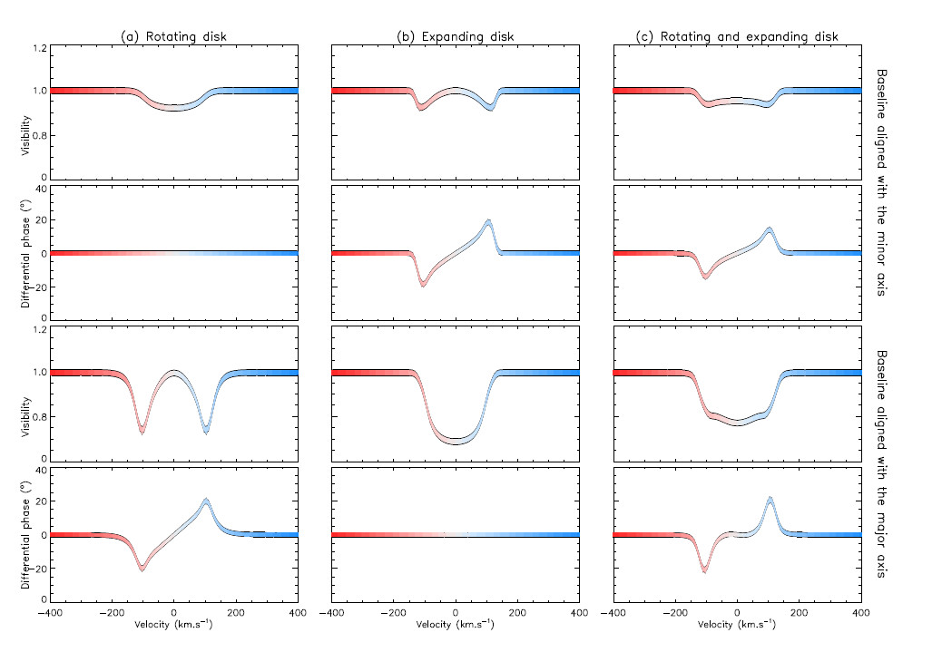
Kinematics with or without angular resolution
e) Any color you like
1) Long baseline interferometry 101

Slide 19
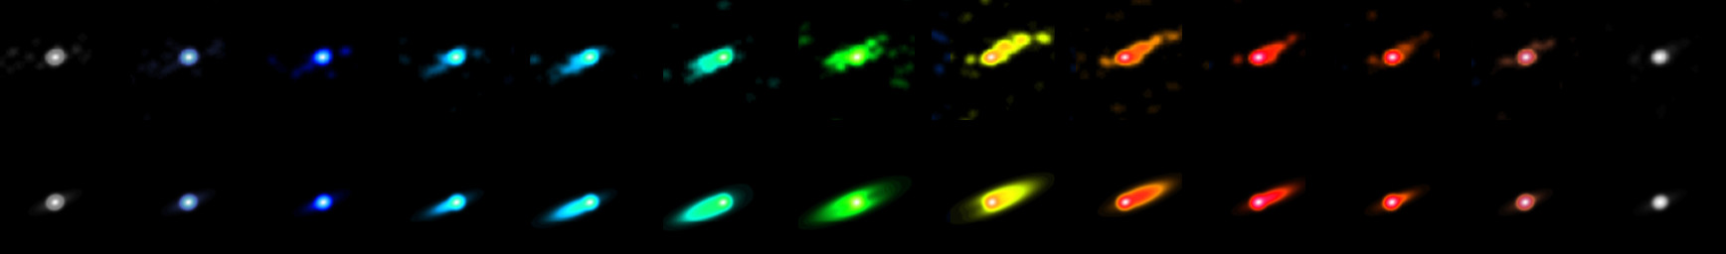
Spectro-interferometric imaging
The binary Be star ϕ Persei seen by CHARA/VEGA (Hα) Mourard+ 2015 (submitted)
Reconstructed images from the VEGA data
Nearly edge-on Keplerian disk model
Spectro-imaging of the classical Be star Phi Disk in Hα (Mourard+ 2015)
e) Any color you like
1) Long baseline interferometry 101

