Slide 1
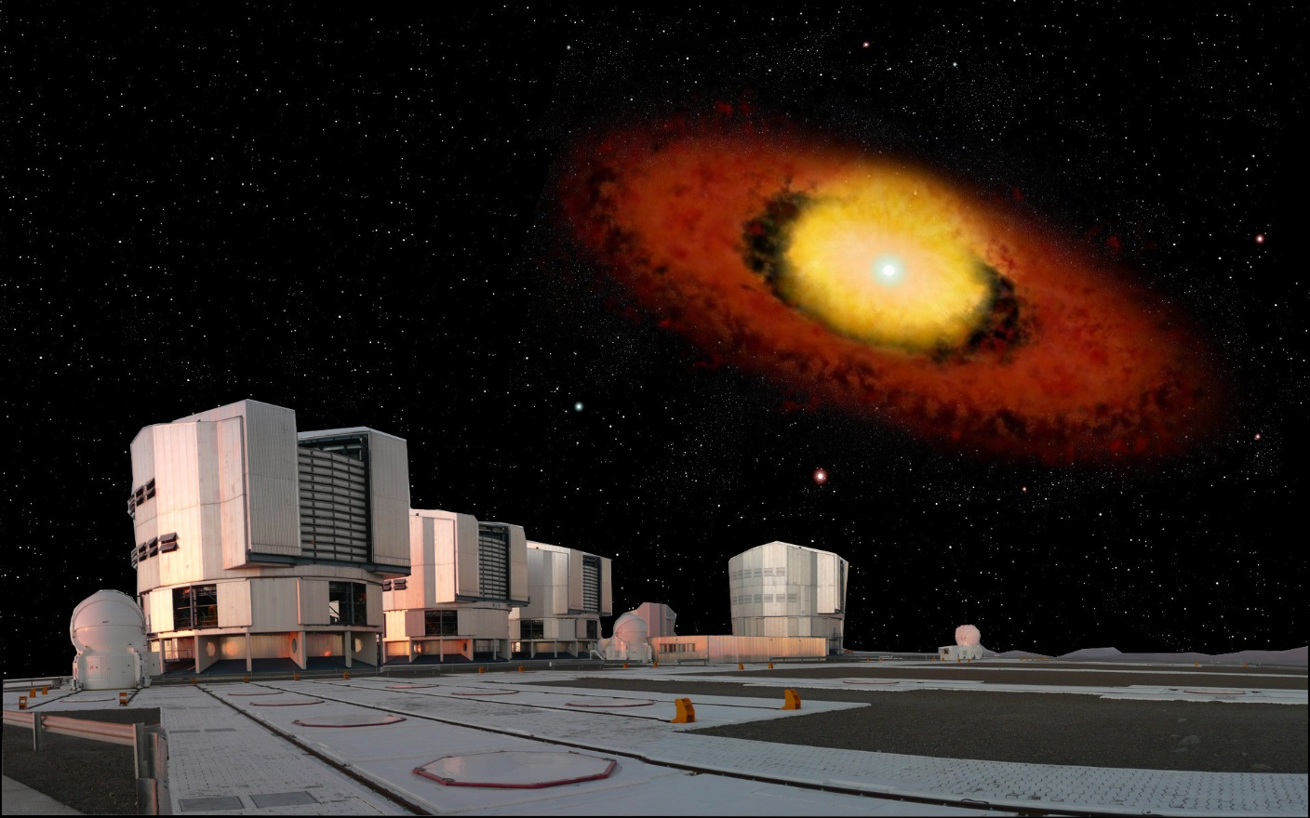
A Spectro-interferometric journey around massive stars
Anthony Meilland

Slide 2
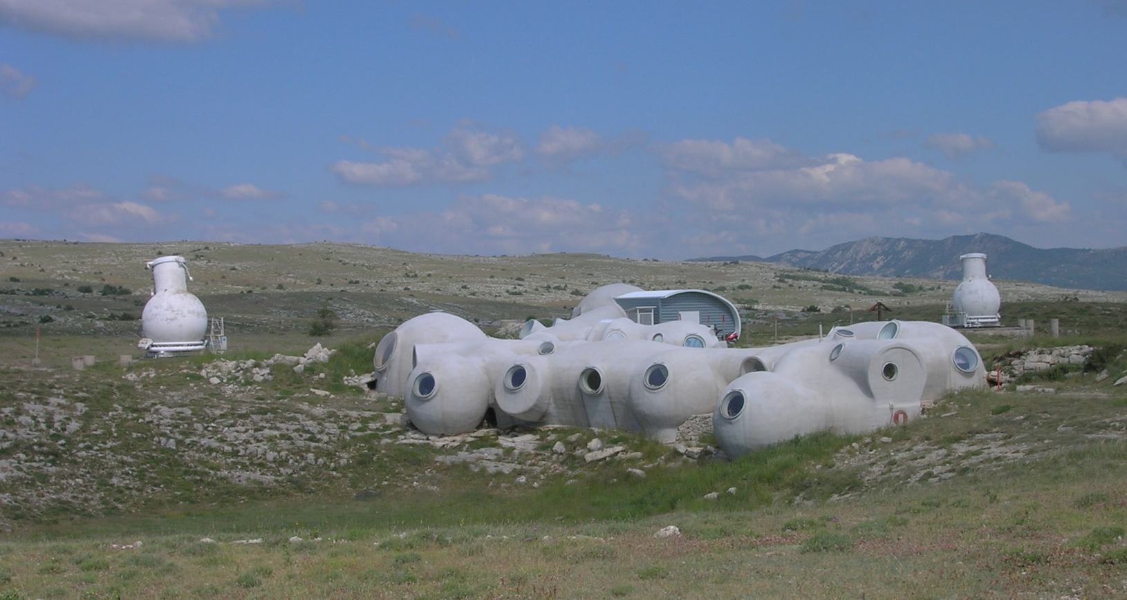
Long baseline interferometry 101
Diameter
Baseline
The « old » GI2T at the Observatoire de la Côte d’Azur near Nice
1) Long baseline interferometry 101

Slide 3
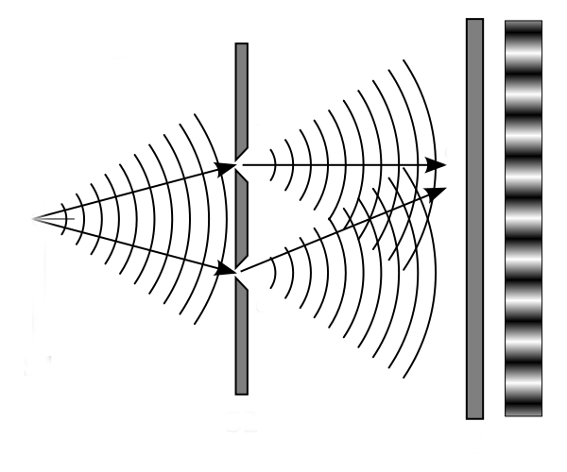
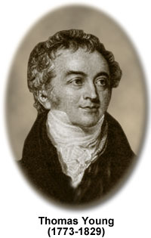
Thomas Young’s slits experiment (1801)
The Detector is the Screen
The Telescopes are the Slits
The Star is the Source
a) Let there be fringes
1) Long baseline interferometry 101

Slide 4
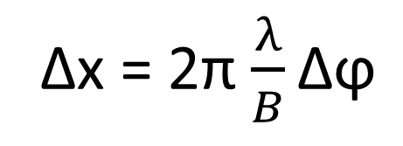
Thomas Young’s slits experiment (1801)
Fringe Phase = Position
Δx
Fringes position change
But not their envelope
Δϕ
Δx = 2π $\frac{λ}{B}\text{Δϕ}$
a) Let there be fringes
1) Long baseline interferometry 101

Slide 5
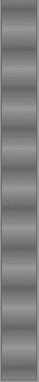
Thomas Young’s slits experiment (1801)
Fringe contrast = Size
+
+
+
…
=
θ
B
You lose
fringe contrast!
The object is fully resolved for θ = 1.22 λ/B !
a) Let there be fringes
1) Long baseline interferometry 101

Slide 6
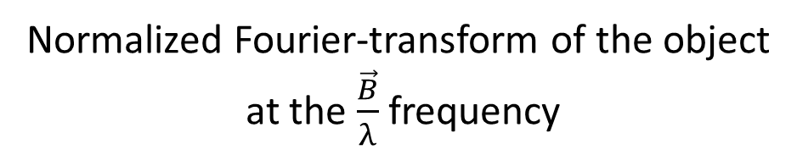
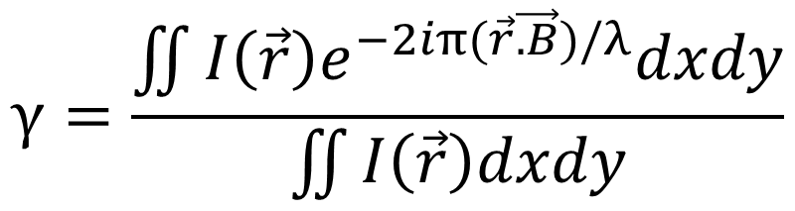
Van Citter & Zernike theorem
Welcome to the Fourier space!
$$γ=\frac{\iint{I\left(\vec{r}\right)e^{−2iπ(\vec{r}\vec{.B})/λ}dxdy}}{\iint{I\left(\vec{r}\right)dxdy}}$$
Complex visibility
=
γ = V e^{iϕ}
Normalized Fourier-transform of the object
at the $\frac{\vec{B}}{λ}$frequency
Fringe contrast
Fringe phase
b) Living in the Fourier space
1) Long baseline interferometry 101

Slide 7

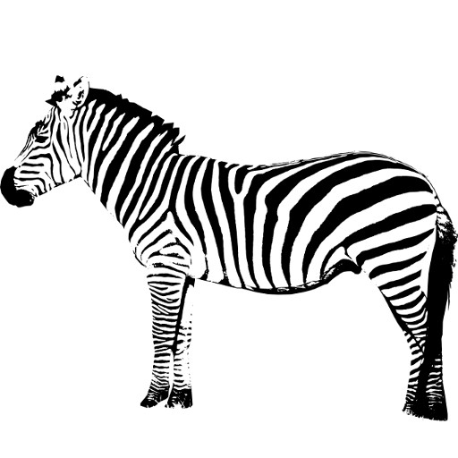
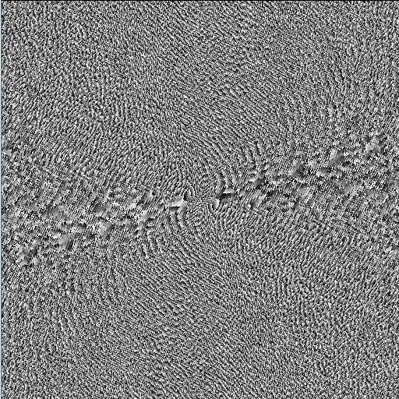
Sampling the object FT ⬄Filling the (u,v) plan
Modulus
Phase
Inverse Fourier transform
FT⁻¹
What is that?
Oh it’s a Zebra!
Need a lot of measurements
with baselines of different orientation and length
b) Living in the Fourier space
1) Long baseline interferometry 101

Slide 8
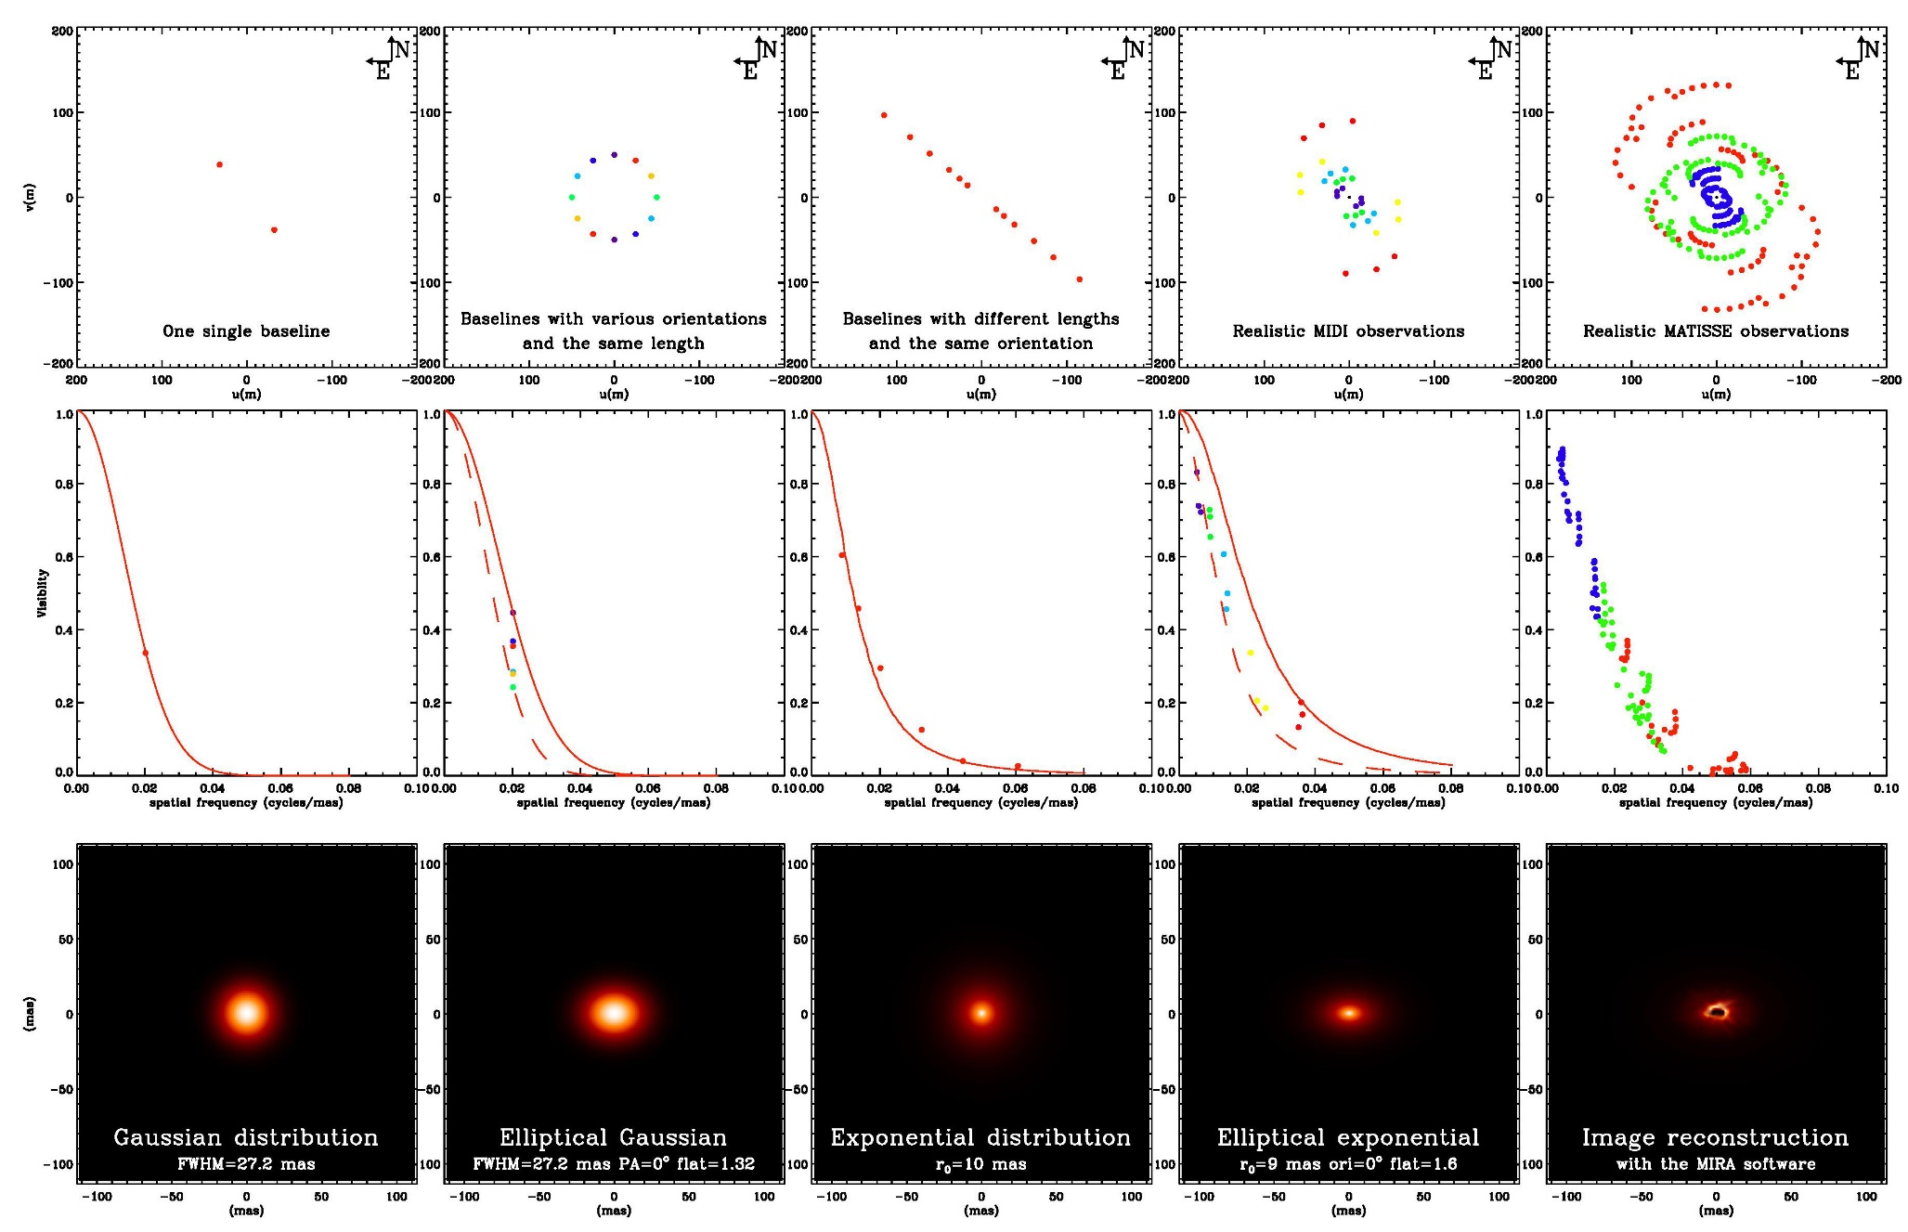
The real life ⬄ always sparse (u,v) plan coverage
(u,v) plan
Increasing the model complexity
Visibility
Model
b) Living in the Fourier space
1) Long baseline interferometry 101

Slide 9
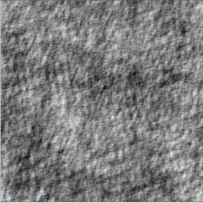


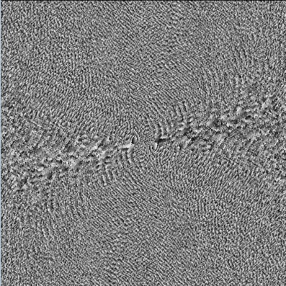
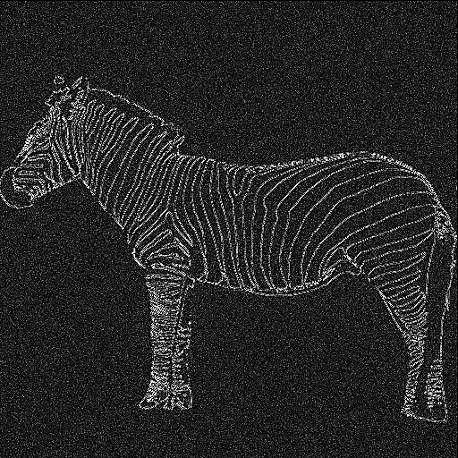
The phase contains most of the information!
Random Phase
Modulus
FT⁻¹
Random map
FT
Phase
Random Modulus
FT⁻¹
b) Living in the Fourier space
1) Long baseline interferometry 101

Slide 10
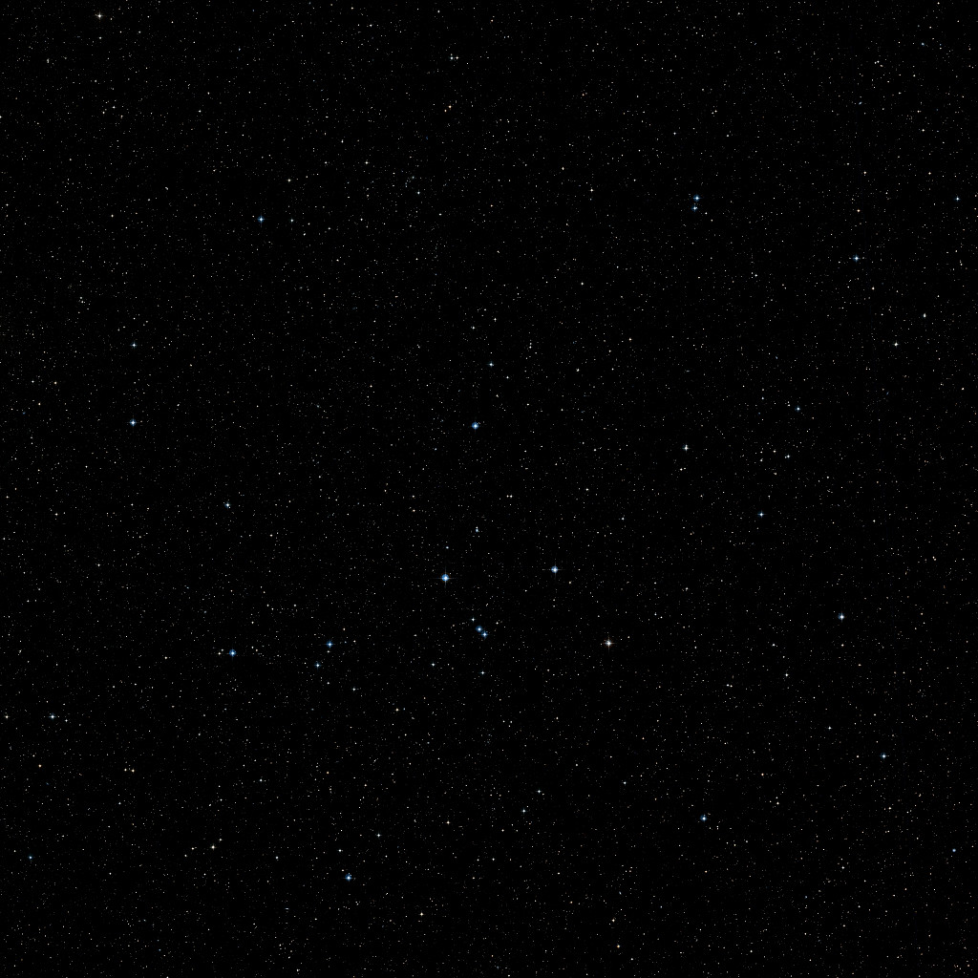

Unfortunately, Earth has an atmosphere!
φ₁₂= ϕ₁₂ +δϕ₂ - δϕ₁
ϕ_{ij} = « True » phase for the ij baseline
δϕ_{i} = Atmospheric « random » phase on telescope i
φ_{ij} = Measured phase for the ij baseline
Random phase δϕ₁(t)
Random phase : δϕ₂(t)
b) Living in the Fourier space
1) Long baseline interferometry 101

Slide 11
“Help me Obiwan Kenobi. You’re my only hope!”
Closure Phase
1
ϕ_{ij} = « True » phase for the ij baseline
δϕ_{i} = Atmospheric « random » phase on telescope i
φ_{ij} = Measured phase for the ij baseline
φ₃₁=ϕ₃₁ +δϕ₁- δϕ₃
φ₁₂=ϕ₁₂ +δϕ₂- δϕ₁
3
2
φ₂₃=ϕ₂₃ +δϕ₃- δϕ₂
Closure phase
CP = φ₁₂ + φ₂₃ + φ₃₁ = ϕ₁₂ + ϕ₂₃ + ϕ₃₁
b) Living in the Fourier space
1) Long baseline interferometry 101

Slide 12
“Help me Obiwan Kenobi. You’re my only hope!”
Closure Phase
1
Telescopes | Baselines | CP | Ind. CP | Info on phase
3 | 3 | 1 | 1 | 33%
4 | 6 | 4 | 3 | 50%
5 | 10 | 10 | 6 | 60%
6 | 15 | 20 | 10 | 67%
7 | 21 | 35 | 15 | 71%
21 | 210 | 1330 | 190 | 90%
2
3
1
4
2
3
Information on phase from closure phase = N-2/N
b) Living in the Fourier space
1) Long baseline interferometry 101

Slide 13
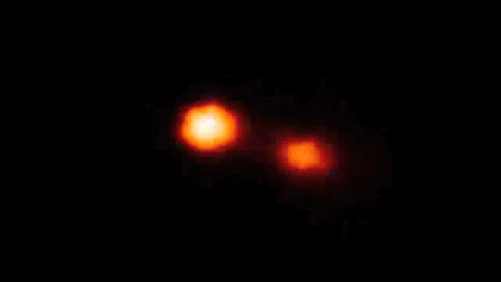
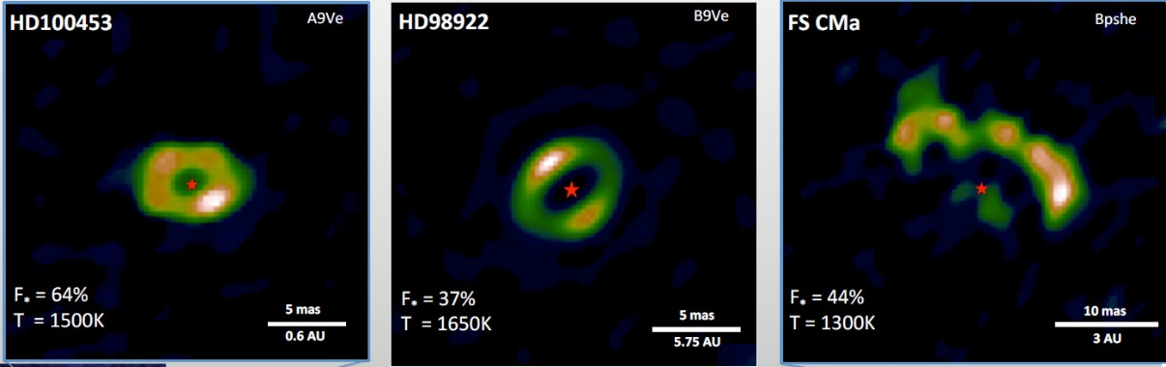

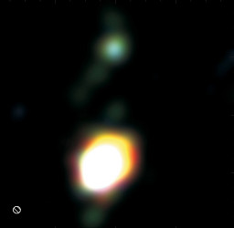
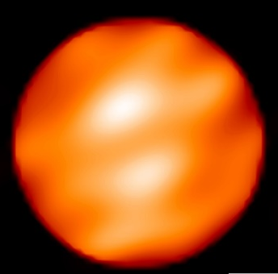
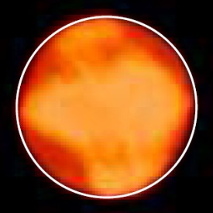


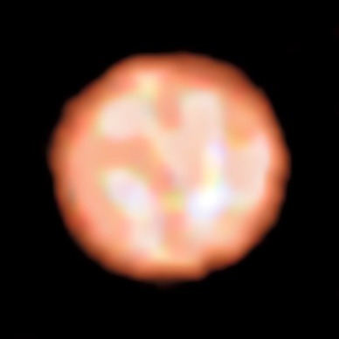

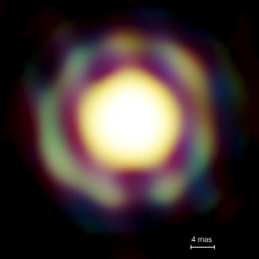
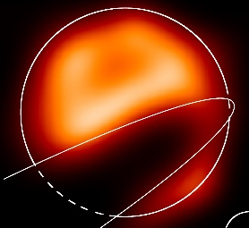


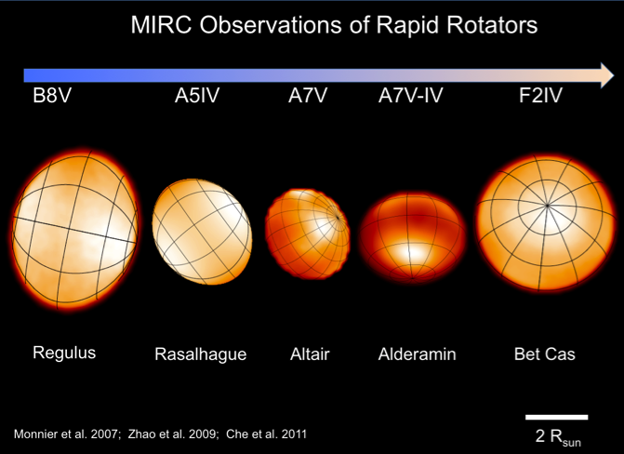
A few images from optical interferometers
Binaries (Interacting, symbiotics, B[e]…)
Dust disks Inner rims of YSO
Giants and Supergiants
Kluska+ 2014
Zhao+ 2008
Kraus+ 2012
Benisty+ 2011
Blind+ 2014
Baron+ 2014
Haubois+ 2009
Millour+ 2009
Paladini+ 2018
Mira stars
The Eclipse of ε Aur
very massive YSO disks
Fast rotators
Kraus+ 2010
Le Bouquin+ 2009
Monnier+ 2007, Zhao+ 2009, Che+ 2011
Kloppenborg+ 2009
c) We want images!
1) Long baseline interferometry 101

Slide 14
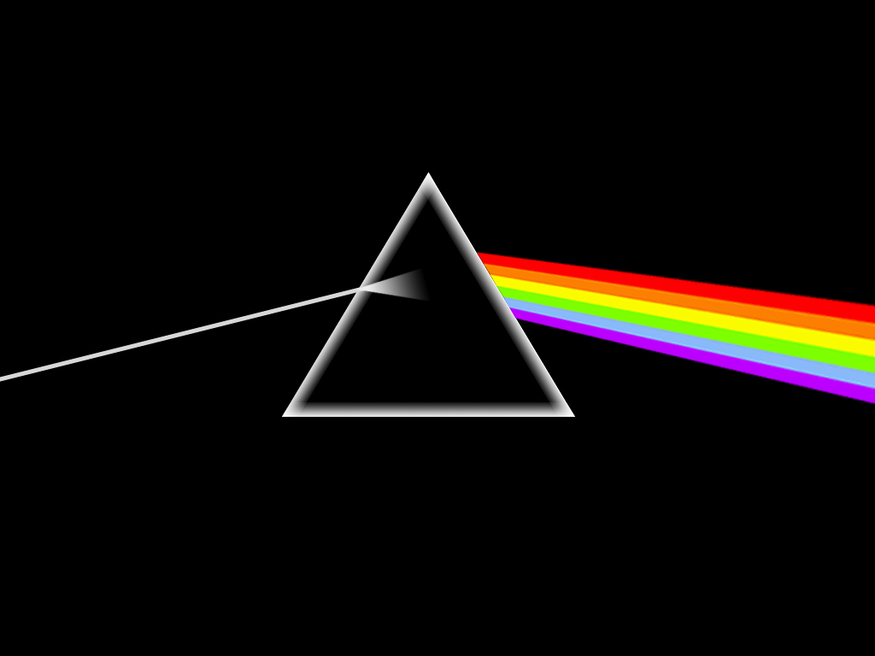

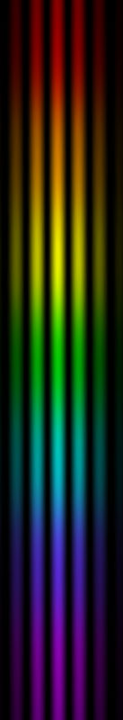
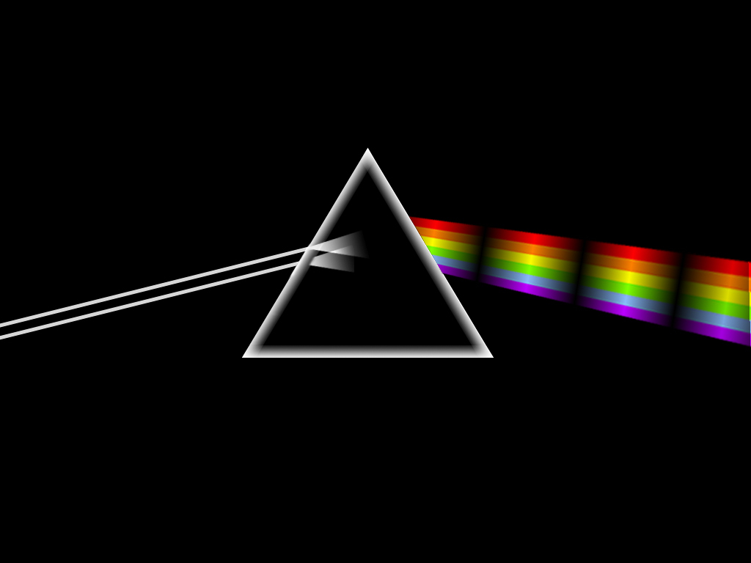
Spectro-interferometry
Spectroscopy
Interferometry
Flux as the function of wavelength
Geometry of objects
Spectro-interferometry
Geometry of objects as a function of the wavelength
d) Spectro-interferometry
1) Long baseline interferometry 101

Slide 15
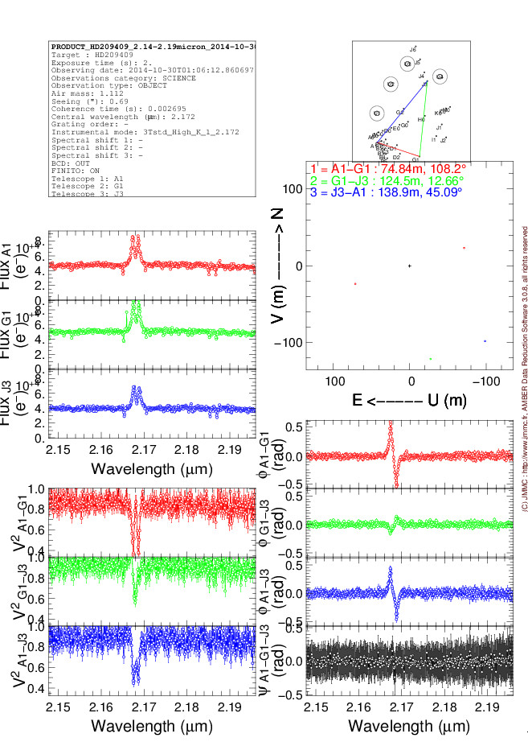
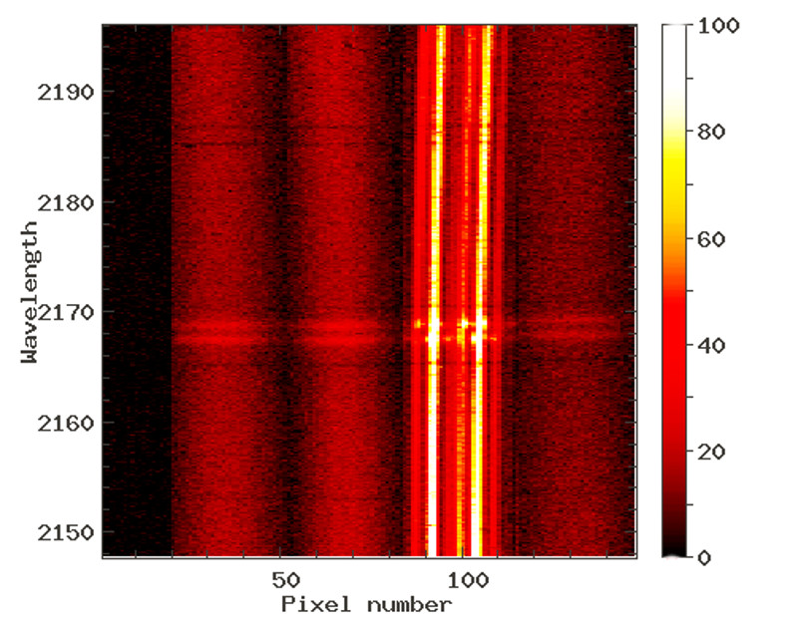
Quantities extracted from spectro-interferometry
Visibility V(λ)
Size of object as function of λ
+
Closure phase φ(λ)
Symmetry of object as function of λ
+
Spectrum F(λ)
+
Differential phase : ϕ(λ) (real phase – cst)
Position as a function of λ
VLTI/AMBER 3Tels fringes on a Be star around Brγ
d) Spectro-interferometry
1) Long baseline interferometry 101

Slide 16
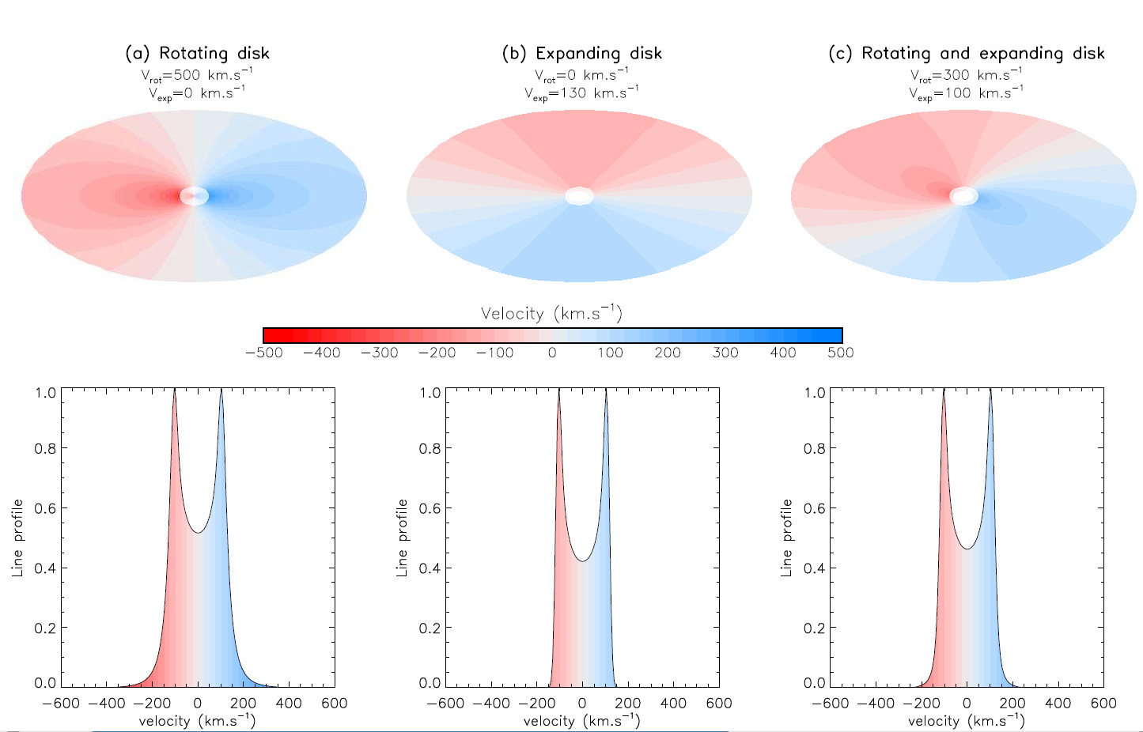
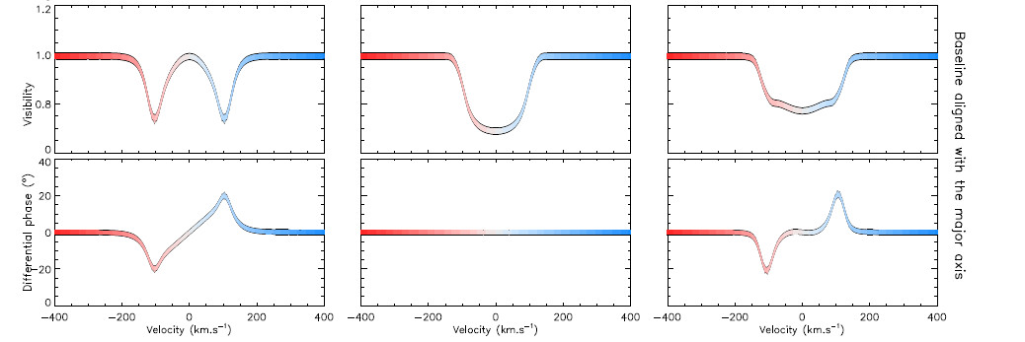
Kinematics with or without angular resolution
d) Spectro-interferometry
1) Long baseline interferometry 101

Slide 17
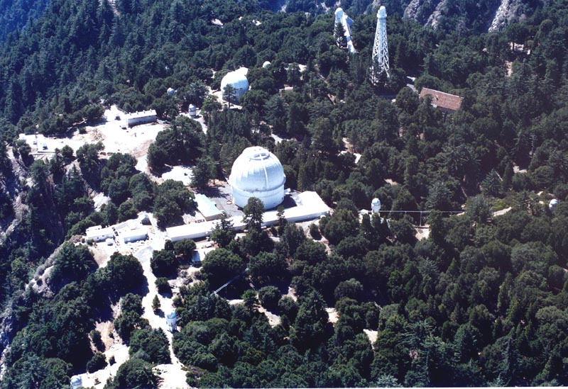
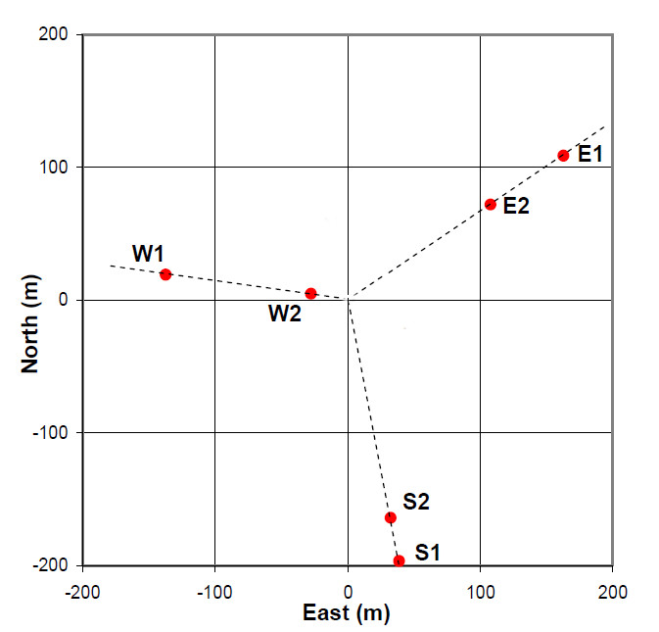
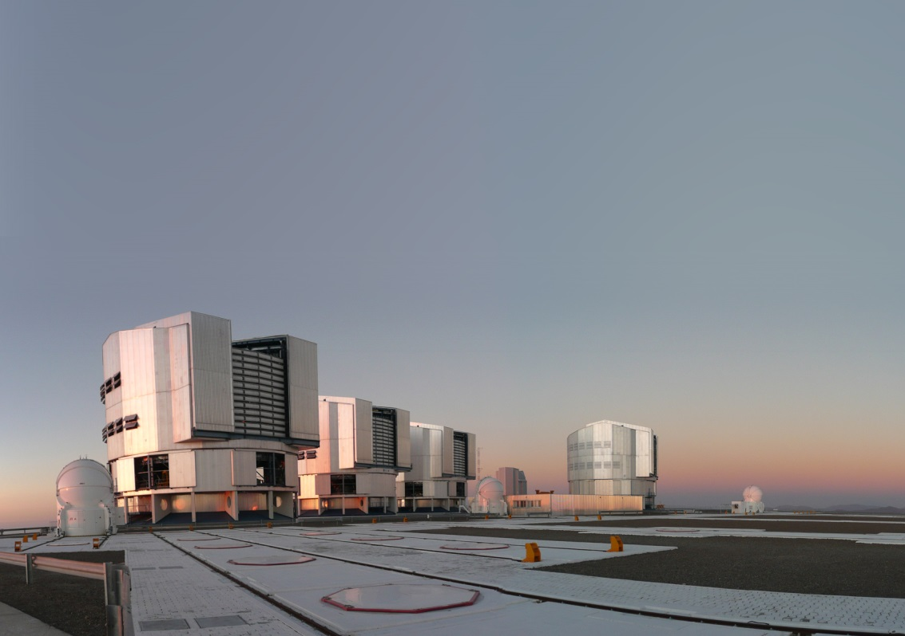
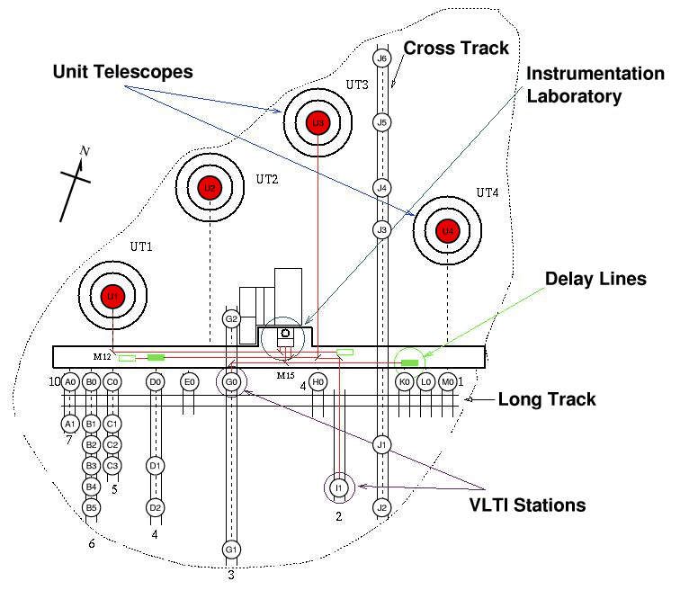
CHARA : California
B_{max}= 330m
6 Telescopes (1m)
VEGA : BVR 4Tels R=15000
PAVO : BVR 3Tels R=30
MIRC: H 6Tels R=30
…
VLTI : Chile
4 UTs (8m) + 4 ATs (1.8m)
MIDI : N 2Tels R=300
AMBER : HK 3Tels R=12000
PIONIER : H 4Tels R=30
GRAVITY : K 4Tels R=4000
MATISSE : LMN 4T R=4000
B_{max}= 130m
e) The current generation of arrays and instruments
1) Long baseline interferometry 101

Slide 18
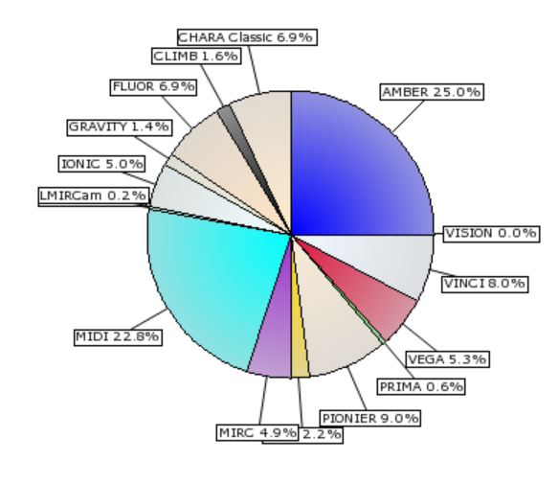
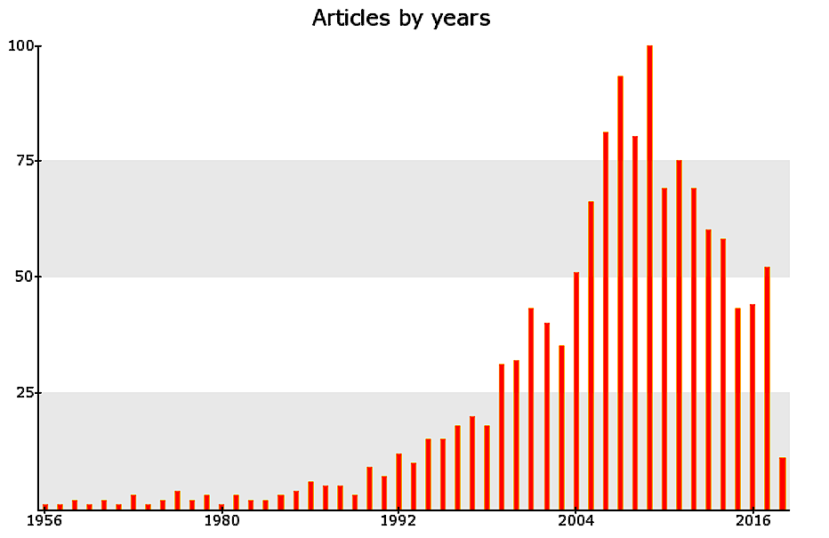
AMBER & MIDI were the most productive interferometric instruments
Share of articles by instrument
Number of articles by year
AMBER
MIDI
Share of articles by facility :
VLTI 67% - CHARA 21 % - Other 12%
e) The current generation of arrays and instruments
1) Long baseline interferometry 101

Slide 19
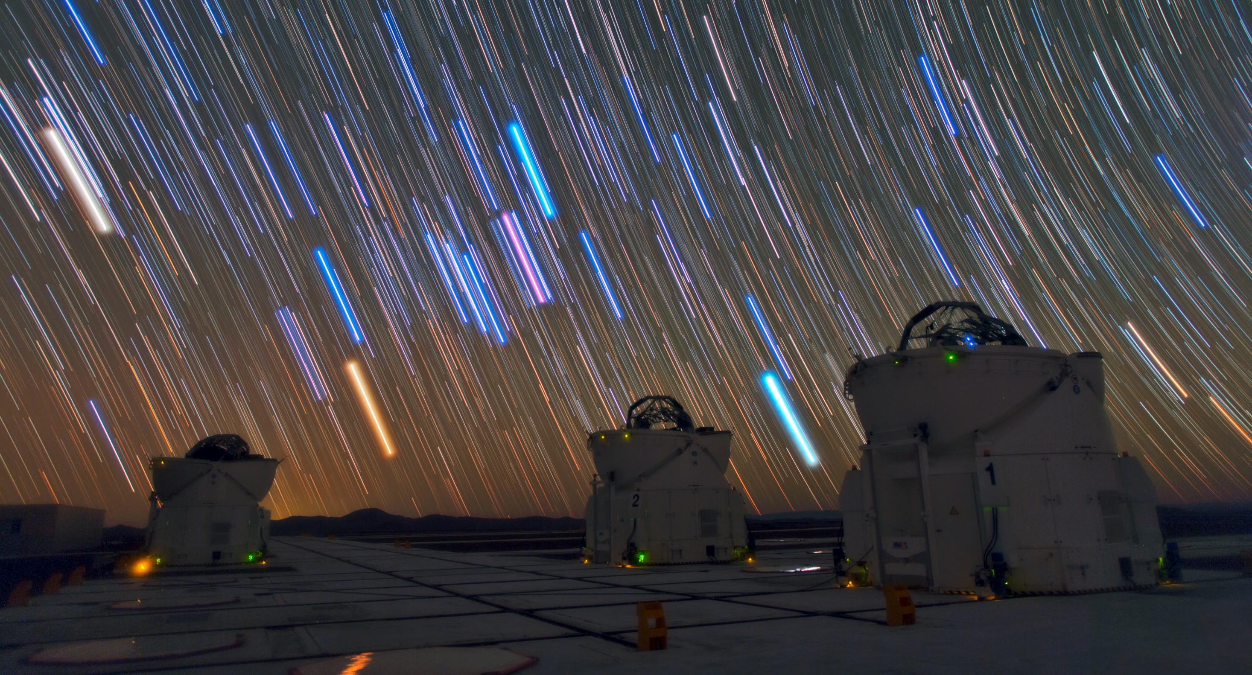
Now that you are in the Fourier space…
…Let’s start our interferometric journey!
VLTI auxiliary telescopes
2) An interferometric journey around Massive stars

Slide 20
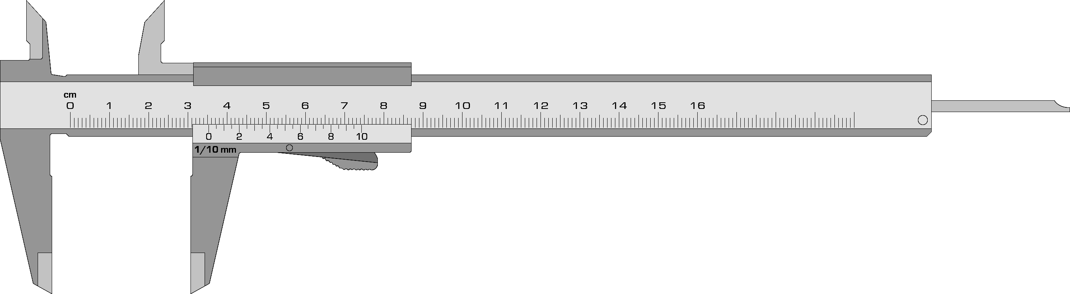
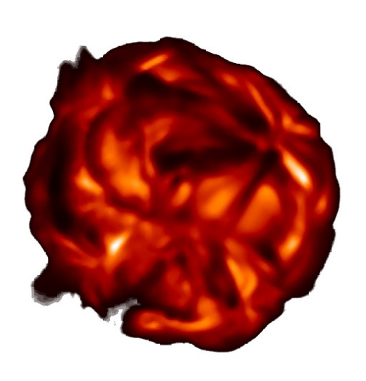
From diameter measurements to stellar imaging
a) From diameters measurements to stellar imaging
2) An interferometric journey around Massive stars

Slide 21
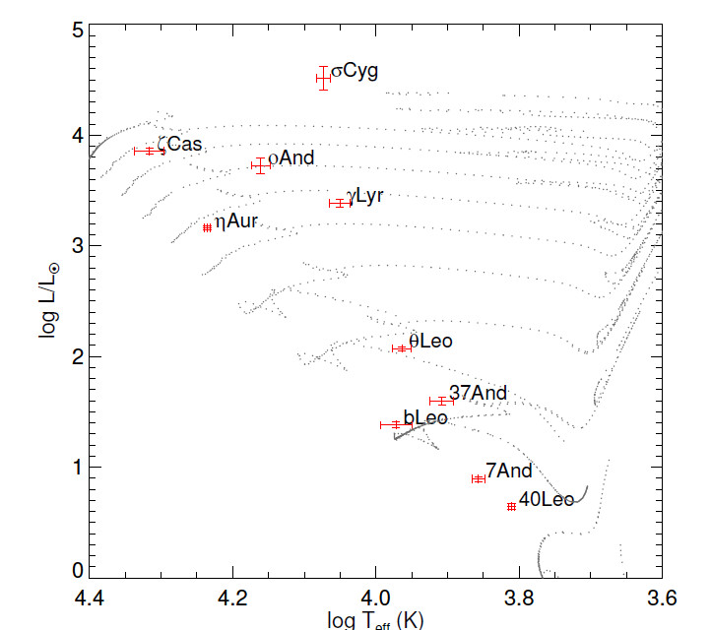
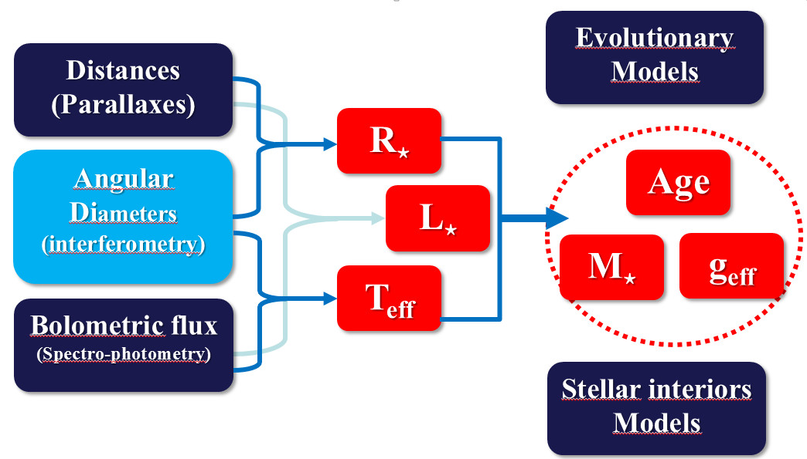
Why do we need accurate diameters?
Mainly for fundamental parameters of stars
CHARA/PAVO
10 early type stars
Maestro+ 2013
η Car
Other reasons includes fundamental parameters of planets and calibration of some distance estimators
a) From diameters measurements to stellar imaging
2) An interferometric journey around Massive stars

Slide 22


Imaging stellar surface of Supergiants
IOTA/IONIC3 H-Band
Reconstructed image
CO5BOLD Freytag+ 2012
CHARA/MIRC H-band images
of two Supergiant stars
Baron+ 2014
θ = 44.28 ± 0.15 mas
η Car
Haubois+ 2009
2) An interferometric journey around Massive stars
a) From diameters measurements to stellar imaging
c) From diameters measurements to stellar imaging

Slide 23
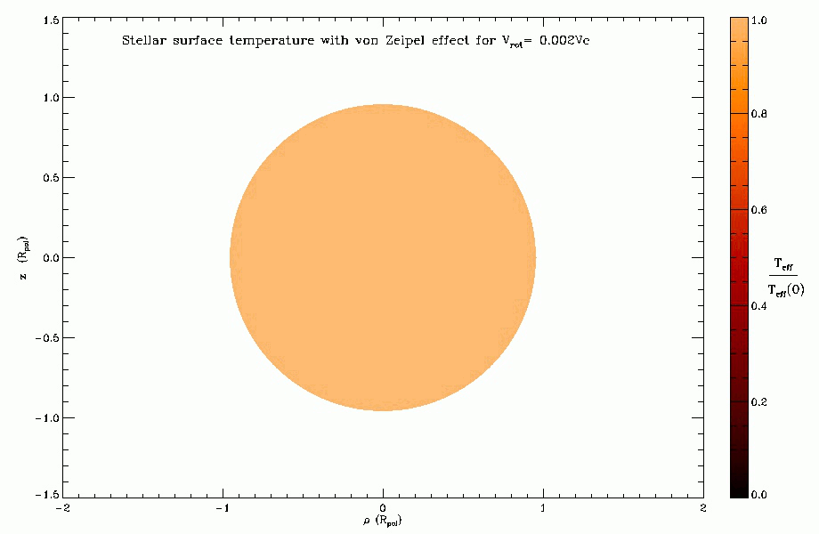
Stellar surfaces of fast-rotators
Constraints on the Gravity darkening
Teff α geff ^{β}
(von Zeipel ⬄ β = 0.25 )
β ~ 0.22 ( and depends on Teff)
Compatible with stellar interior model
for fast-rotators ESTER
(Espinoza Lara+ 2011)
CHARA/
CHARA/
η Car
2) An interferometric journey around Massive stars
a) From diameters measurements to stellar imaging

Slide 24
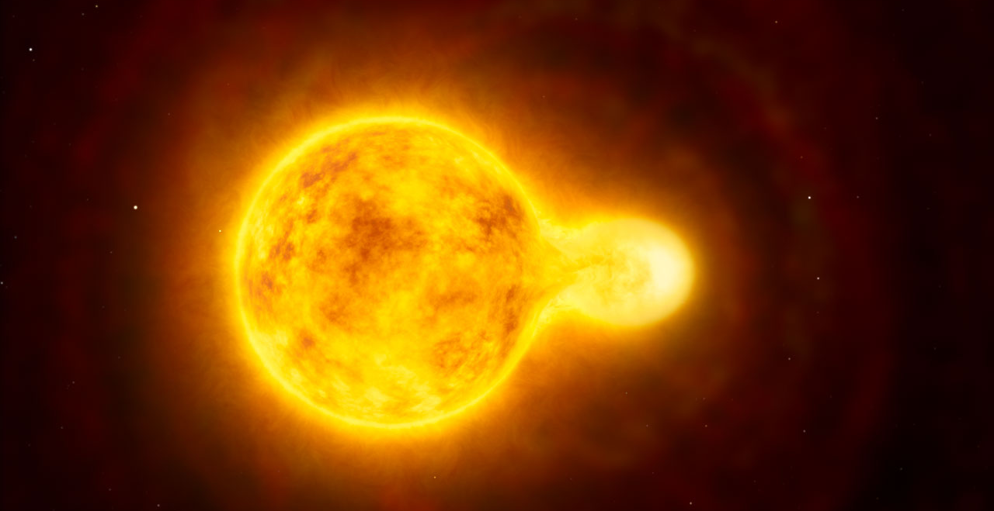
About the binarity of massive stars
HR5171A : Olivier Chesneau’s Peanut star
b) About the binarity of massive stars
2) An interferometric journey around Massive stars

Slide 25
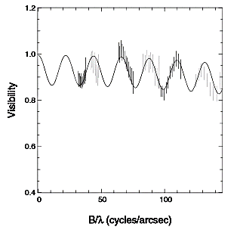
The binarity as seen by interferometers
δ Centauri
Meilland 2008+
VLTI/AMBER
Oscillation period (T)
⬄
Projected separation (s)
Along the baseline
s= 1 / T
Oscillation amplitude (A)
⬄
Flux ratio (f)
f = A / 2
b) About the binarity of massive stars
2) An interferometric journey around Massive stars

Slide 26
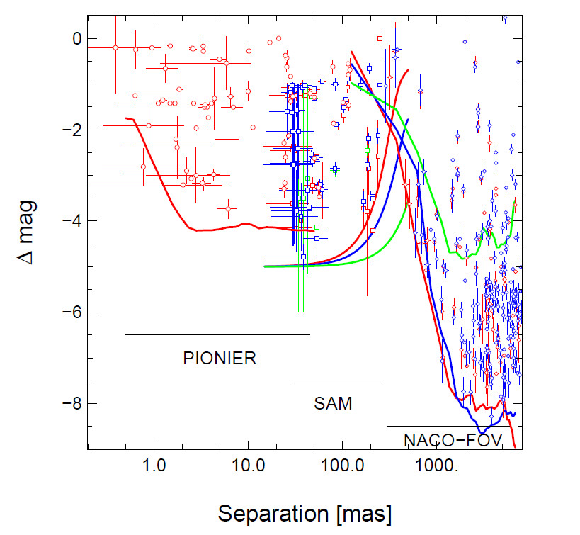
The binary fraction among massive stars
The SMaSH+ program
(Southern Massive Stars at High Angular resolution)
173 O stars observed
105 VLTI/PIONIER
(small separation 1 - 45 mas)
+
162 VLT/NACO
(larger separation 30 mas - 8’’)
High binary fraction : 0.86
Average companion : 1.83±0.32
η Car
Massive stars were formed nearly exclusively in multiple systems
Le Bouquin+ 2014
b) About the binarity of massive stars
2) An interferometric journey around Massive stars

Slide 27
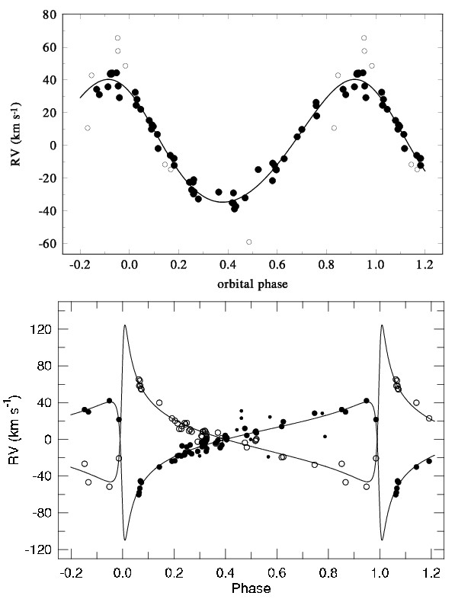
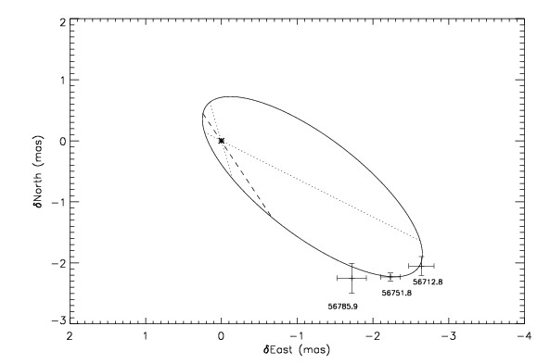
The triple-O stellar system HD 150136 seen by the VLTI/PIONIER
Radial velocity measurments
Interferometric Orbit
3D-orbit
Masses
of the components
η Car
Sana+ 2013 & Nasseri+ 2014
8% accuracy on the masses
b) About the binarity of massive stars
2) An interferometric journey around Massive stars

Slide 28
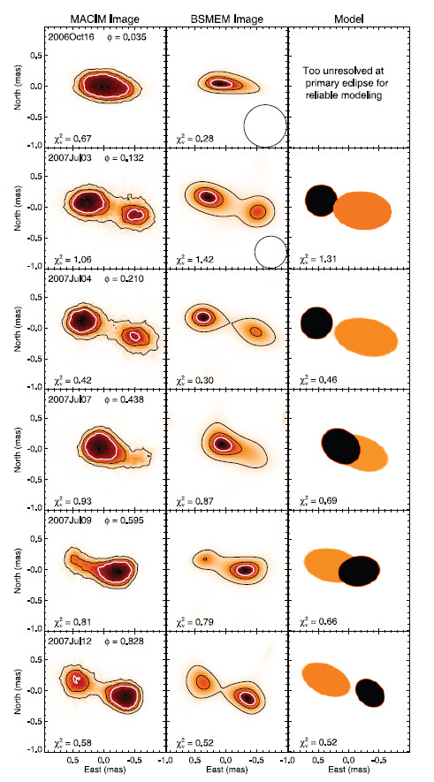
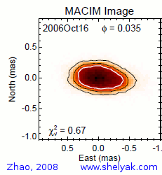
β Lyrae : A semi-detached binary as seen by CHARA/MIRC
Images at 6 epochs
Zhao+ 2008
b) About the binarity of massive stars
2) An interferometric journey around Massive stars

Slide 29

The circumstellar environments of massive stars…
…only a few examples of what can be done and what has been done
Artist view of the A[e] supergiant HD 62623
b) The circumstellar environments of massive stars
2) An interferometric journey around Massive stars

Slide 30

Longer wavelengths probe colder material…
… so further away from the star
Visible interferometry
Dullemond & Monnier (2010)
c) The circumstellar environments of massive stars
2) An interferometric journey around Massive stars

Slide 31



Dust in the mid-IR : the A[e] supergiant HD62623
From Meilland+ 2010
From the VLTI/MIDI point of view
UV plan
Visibility
Infrared Excess
SED
c) The circumstellar environments of massive stars
2) An interferometric journey around Massive stars
b) The circumstellar environments of massive stars

Slide 32


Dust in the mid-IR : the A[e] supergiant HD62623
From Meilland+ 2010
Simple wavelength-depend geometric model
What can be determined:
Extension => 15 to 25 mas
Flatenning => lower limit on i=> 40°
Orientation => Ʇ to the Polarization
c) The circumstellar environments of massive stars
2) An interferometric journey around Massive stars
b) B[e] in the mid-Infrared

Slide 33



Dust in the mid-IR : the A[e] supergiant HD62623
From Meilland+ 2010
Radiative transfert modelling with MC3D (dust only)
Keplerian disk
Only marginally better fit
Equatorial wind
c) The circumstellar environments of massive stars
2) An interferometric journey around Massive stars
b) B[e] in the mid-Infrared

Slide 34


Dust in the mid-IR : the A[e] supergiant HD62623
From Meilland+ 2010
Radiative transfert modelling with MC3D (dust) + SIMECA (gas)
E
We Add
4 10⁻⁷Mo
Of gas
N
c) The circumstellar environments of massive stars
2) An interferometric journey around Massive stars
b) B[e] in the mid-Infrared

Slide 35

Dust in the near-IR ⬄ Inner rim of the disk
Survey on Herbig Ae/Be stars
near-IR extension
Correlation between
NIR extension and Luminosity
Radius/Luminosity
Dust sublimation
temperature
Heating processes
below the inner rim
Chemistry of dust
Physical properties
of the gaz
Monnier+ 2005, Millan-Gabet+ 2006, Dullemond & Monnier 2010
c) The circumstellar environments of massive stars
2) An interferometric journey around Massive stars

Slide 36




Dust in the near-IR
Kluska+ 2014
VLTI/PIONIER
From model fitting…
Monnier+ 2006
IOTA/IONIC3
Renard+ 2010
VLTI/AMBER
Benisty+ 2011
VLTI/AMBER
…to Imaging
c) The circumstellar environments of massive stars
2) An interferometric journey around Massive stars

Slide 37


What about the gas : Herbig stars in Br_{γ}
Kraus+ (2008)
5 Herbig stars observed with VLTI/AMBER
c) The circumstellar environments of massive stars
2) An interferometric journey around Massive stars

Slide 38



What about the gas : Herbig stars in Br_{γ}
Intermediate Size Emission
Compact Emission
Large Emission
Kraus+ (2008)
c) The circumstellar environments of massive stars
2) An interferometric journey around Massive stars

Slide 39




What about the kinematics : classical Be stars
V₁₂
dφ₁₂
V₂₃
dφ₂₃
A LOT of AMBER DATA !!!
V₁₃
dφ₁₃
8 Be stars observed with the
VLTI/AMBER
Closure phase
Spectrum
c) The circumstellar environments of massive stars
2) An interferometric journey around Massive stars

Slide 40


What about the kinematics : classical Be stars
Keplerian disks with no expansion (v_{exp}<10km/s )
Nearly critical rotators
V/V_{c} = 0.82 ± 0.08
Ω/Ω_{c} = 0.95 ± 0.02
8 Be stars observed with the
VLTI/AMBER
c) The circumstellar environments of massive stars
2) An interferometric journey around Massive stars

Slide 41






What about the kinematics : other objects
Hot supergiant’s wind
Cool supergiant’s extended atmosphere
Herbig Ae/Be stars
Chesneau+ 2010
Ohnaka+ 2013
Novas
Supergiant B[e] stars
Malbet+ 2007, Tatulli+2007, Weigelt+ 2011, Perrault 2010+, Benisty 2013+
Chesneau+ 2011
Ellerbroek+ 2015, wheelwright+ 2012, Millour+ 2012
c) The circumstellar environments of massive stars
2) An interferometric journey around Massive stars

Slide 42


Spectro-interferometric imaging
The A[e] supergiant HD62623 from VLTI/AMBER HR observations (Millour+ 2011)
η Car
Image in the 2.1µm continuum
Narrow-band images through the Brγ emission line
(with continuum substracted)
c) The circumstellar environments of massive stars
2) An interferometric journey around Massive stars

Slide 43
Spectro-interferometric imaging
The A[e] supergiant HD62623 from VLTI/AMBER HR observations (Millour+ 2011)
η Car
Reconstructed projected velocity field
Narrow-band images through the Brγ emission line
(with continuum substracted)
c) The circumstellar environments of massive stars
2) An interferometric journey around Massive stars

Slide 44



Spectro-interferometric imaging
The binary Be star ϕ Persei seen by CHARA/VEGA (Mourard+ 2015)
Reconstructed images from the VEGA data
CHARA/VEGA Hα Image
1 mas
Keplerian disk model
Observation with CHARA/VEGA in the Hα emission line wit h a nice (u,v) plan coverage
η Car
c) The circumstellar environments of massive stars
2) An interferometric journey around Massive stars

Slide 45


Toward integral-field spectroscopy …
…at sub-mas spatial resolution!
The binary Be star ϕ Persei seen by CHARA/VEGA (Mourard+ 2015)
Full spectrum
Star
Disk
outside
η Car
c) The circumstellar environments of massive stars
2) An interferometric journey around Massive stars

