Slide 1
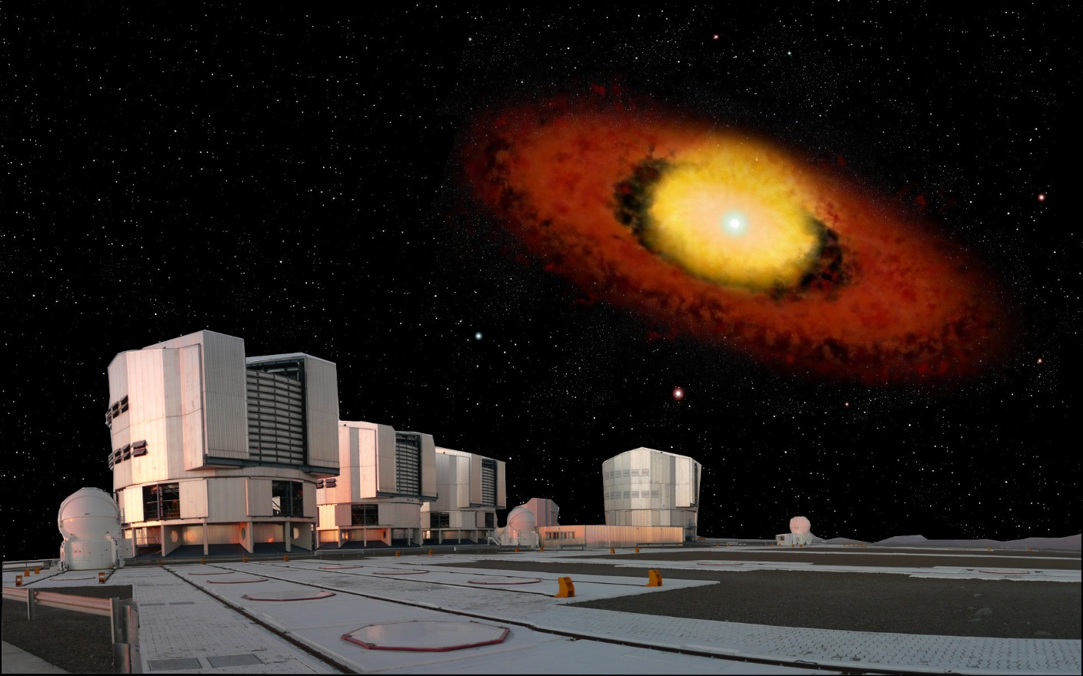




An interferometric journey around massive stars
optical and Infrared
Anthony Meilland

Slide 2
Summary
Long baseline Interferometry 101
2) Our journey around massive stars
  About the binarity of massive stars
  The circumstellar environments of massive stars
  From diameters measurements to stellar surface imaging
3) The next generation of instruments
Summary

Slide 3
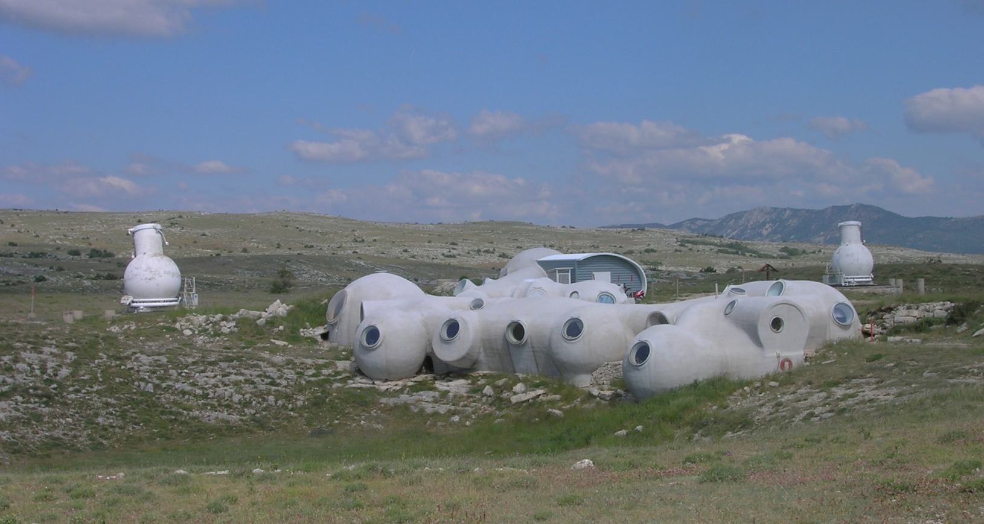
Long baseline interferometry 101
Diameter
Baseline
The « old » GI2T at Observatoire de la Côte d’Azur, France
1) Long baseline interferometry 101

Slide 4
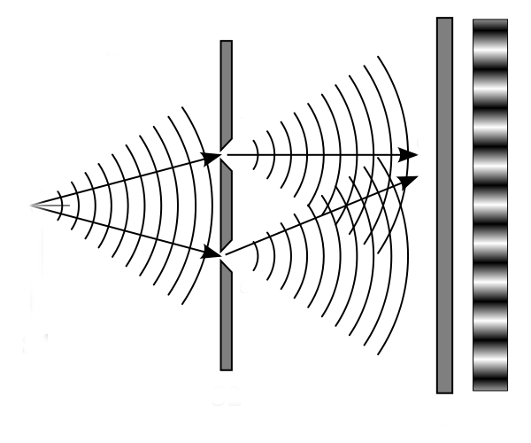
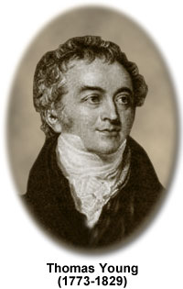
Thomas Young’s slit experiment (1801)
a) Once upon a time
1) Long baseline interferometry 101

Slide 5
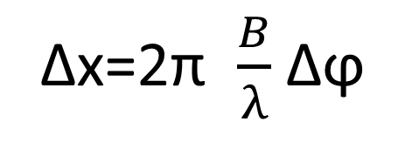
Thomas Young’s slit experiment (1801)
Moving the source
Δx
Fringes position change
But not their envelope
Δϕ
Δx=2π $\frac{B}{λ}$ Δϕ
a) Once upon a time
1) Long baseline interferometry 101

Slide 6
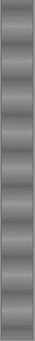
Thomas Young’s slit experiment (1801)
Increasing the source extension
+
+
+
…
=
θ
B
You lose
fringe contrast!
The fringes even disappear for θ=1.22 λ/B !
a) Once upon a time
1) Long baseline interferometry 101

Slide 7
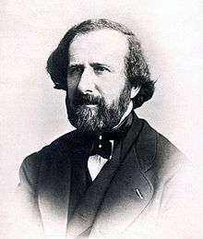
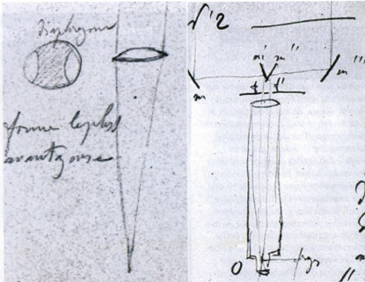
The founding fathers of stellar interferometry
Hippolyte Fizeau
Bonneau 2014
1851
Idea of using Young experiment
to measure stellar diameters
a single telescope
And a mask with two holes
External mirrors
on top of a telescope
a) Once upon a time
1) Long baseline interferometry 101

Slide 8
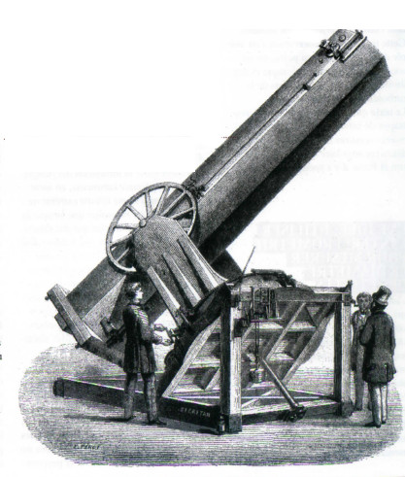
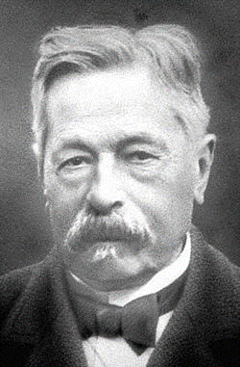
The founding fathers of stellar interferometry
Édouard Stephan
No loss of contrast!
θ < 150 mas
1874
Experiment on sky in Marseille
80 cm Telescope built by Léon Foucault
a) Once upon a time
1) Long baseline interferometry 101

Slide 9
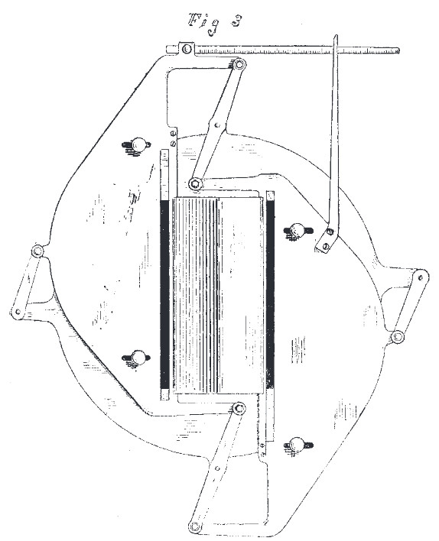
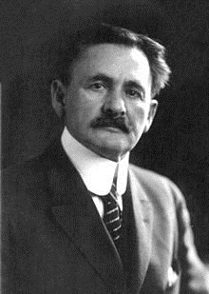
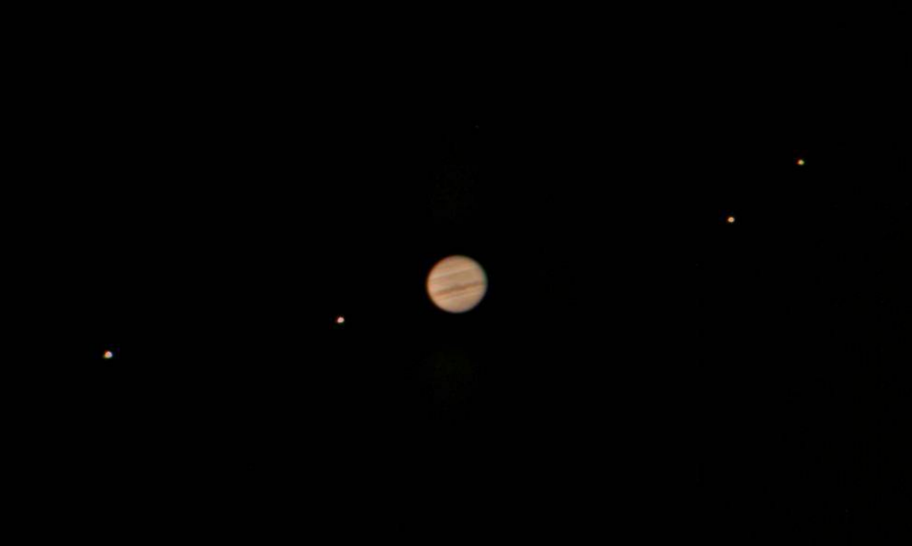
The founding fathers of stellar interferometry
Albert A. Michelson
Jupiter satellites angular diameters
1.31’’
0.94’’
1.02’’
1.37’’
Device very similar to that described by Fizeau
Two movable slits on a single-dish telescope
Lick Observatory (1891)
a) Once upon a time
1) Long baseline interferometry 101

Slide 10
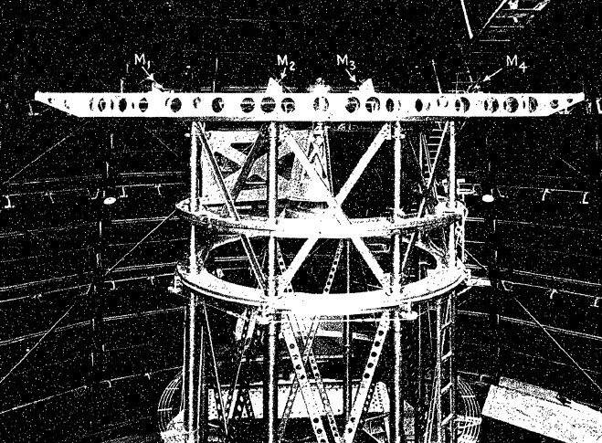
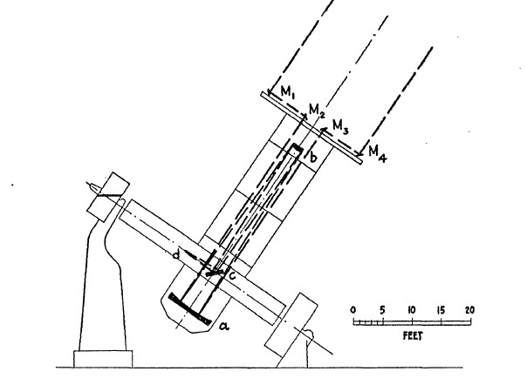
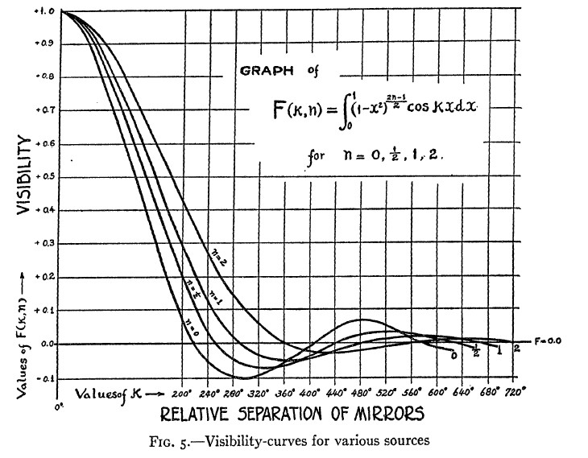
The founding fathers of stellar interferometry
Albert A. Michelson
20 Foot beam
First measurement of the diameter of a star
Betelgeuse ⬄ θ = 47 mas
Michelson & Pease 1921
a) Once upon a time
1) Long baseline interferometry 101

Slide 11
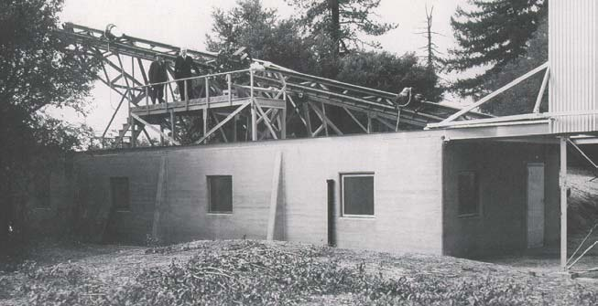
The founding fathers of stellar interferometry
Pease tried to build a larger interferometer at Mount Wilson in the twenties
But there was to many mechanical and optical problems…
a) Once upon a time
1) Long baseline interferometry 101

Slide 12
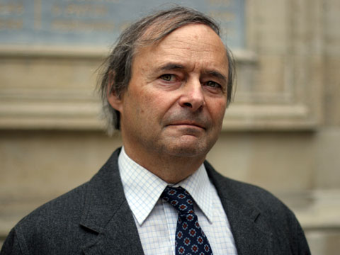
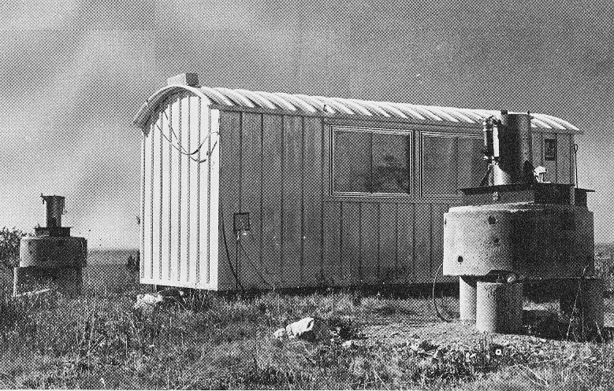
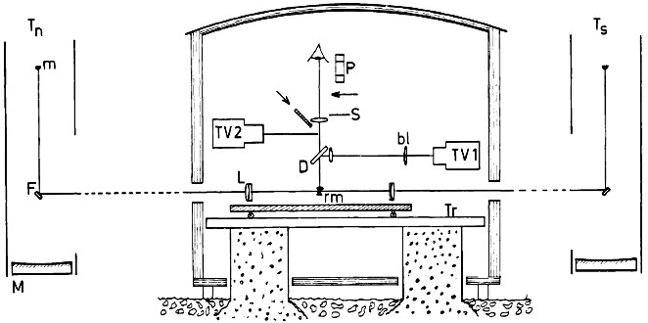
The «rediscovery» of optical interferometry
Antoine Labeyrie
1972
I2T
Calern Observatory
First optical-interferometer with two telescopes
a) Once upon a time
1) Long baseline interferometry 101

Slide 13
What about Fourier?
…
≈ Sum of sinusoids?
+
B
+
+
b) Living in the Fourier space
1) Long baseline interferometry 101

Slide 14

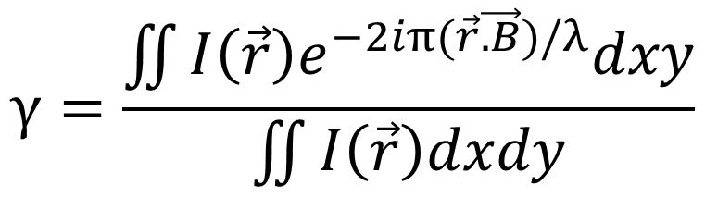
Van Citter & Zernike theorem
$$γ=\frac{\iint{I\left(\vec{r}\right)e^{−2iπ(\vec{r}\vec{.B})/λ}dxy}}{\iint{I\left(\vec{r}\right)dxdy}}$$
Complex visibility
=
γ=Ve^{iϕ}
Normalized Fourier-transform of the object
at the $\frac{\vec{B}}{λ}$frequency
Fringe contrast
Fringe phase
b) Living in the Fourier space
1) Long baseline interferometry 101

Slide 15

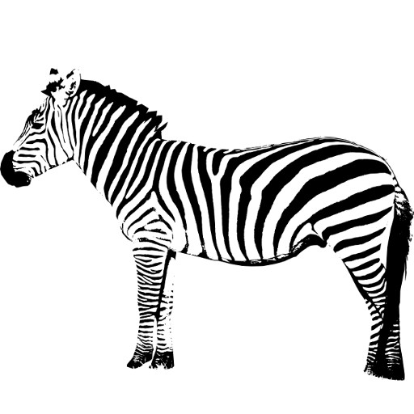
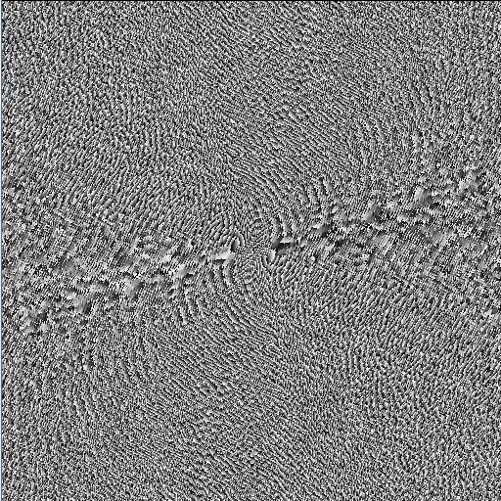
Sampling the object FT ⬄Filling the (u,v) plan
Modulus
Phase
Inverse Fourier transform
FT⁻¹
What is that?
Oh it’s a Zebra!
Need a lot of measurements
with baselines of different orientations and lengths
b) Living in the Fourier space
1) Long baseline interferometry 101

Slide 16
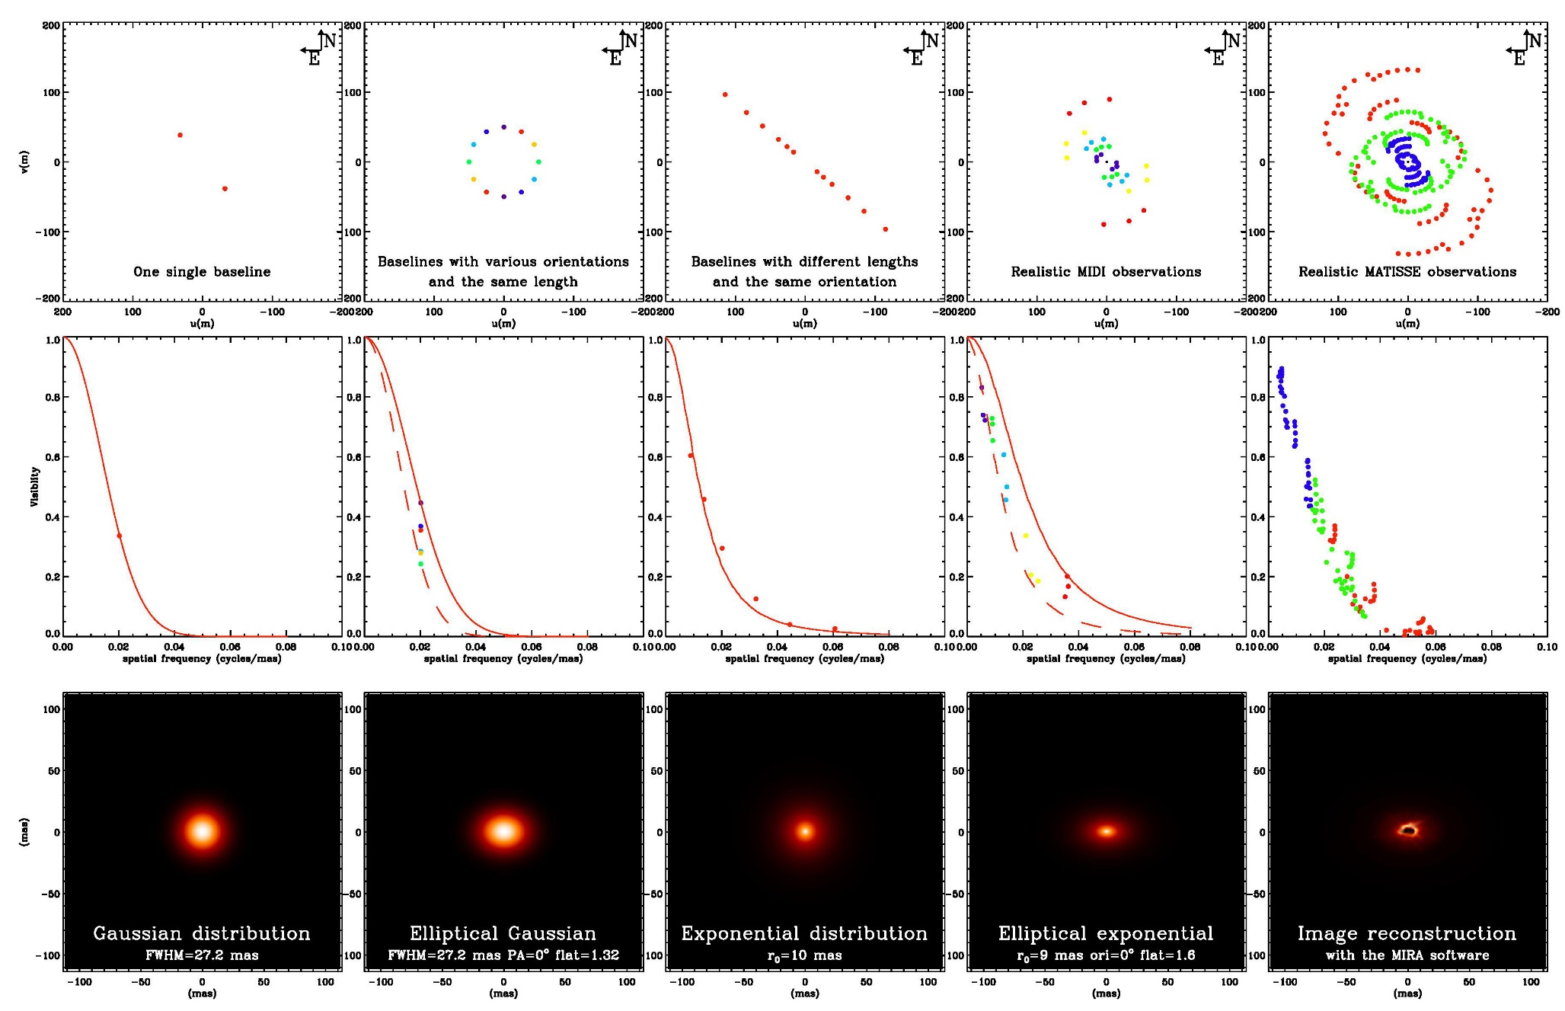
In the real life ⬄ always sparse (u,v) plan coverage
(u,v) plan
Visibility
Model
b) Living in the Fourier space
1) Long baseline interferometry 101

Slide 17
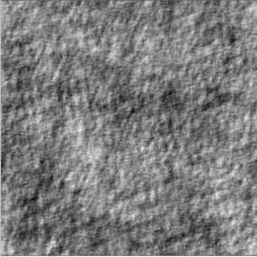


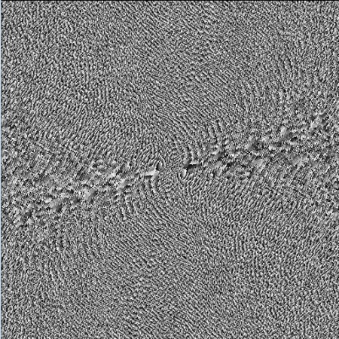
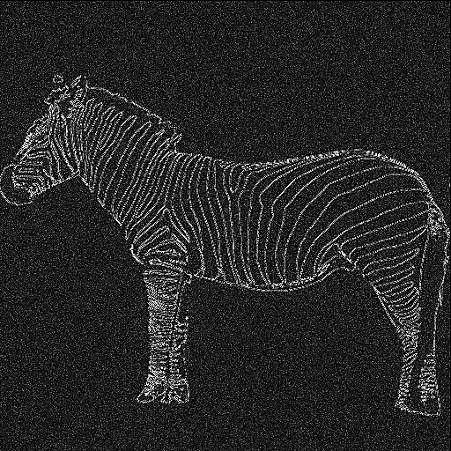
The phase contains most of the information!
Modulus
FT⁻¹
Random map
FT
Phase
FT⁻¹
b) Living in the Fourier space
1) Long baseline interferometry 101

Slide 18
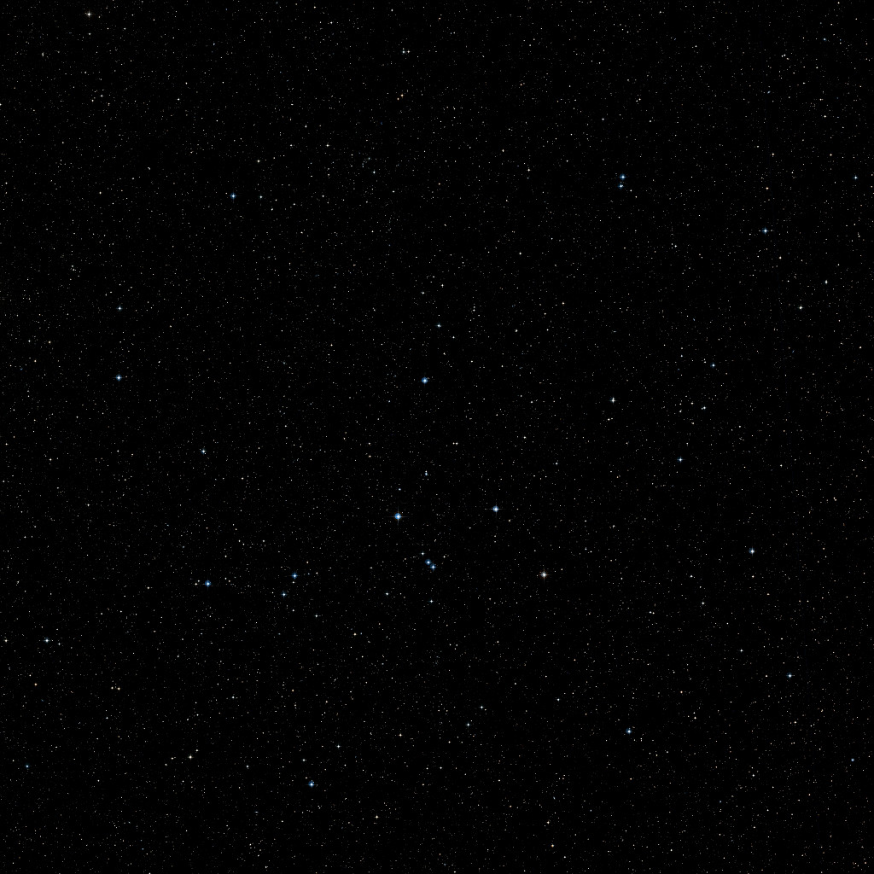

Idealistic situation
Optical Path Difference
Delay Line
b) Living in the Fourier space
1) Long baseline interferometry 101

Slide 19
Unfortunately, Earth has an atmosphere!
Atmospheric phase ϕ₁(t)
Atmospheric phase : ϕ₂(t)
b) Living in the Fourier space
1) Long baseline interferometry 101

Slide 20
The closure phase is our only hope (up to now)
1
ϕ_{ij} = « True » phase for the ij baseline
δϕ_{i} = Atmospheric « random » phase on telescope i
φ_{ij} = Measured phase for the ij baseline
φ₃₁=ϕ₃₁ +δϕ₁- δϕ₃
φ₁₂=ϕ₁₂ +δϕ₂- δϕ₁
3
2
φ₂₃=ϕ₂₃ +δϕ₃- δϕ₂
Closure phase
CP = φ₁₂ + φ₂₃ + φ₃₁ = ϕ₁₂ + ϕ₂₃ + ϕ₃₁
b) Living in the Fourier space
1) Long baseline interferometry 101

Slide 21
The closure phase is our only hope (up to now)
1
Tels | Baselines | CP | Ind. CP | Info in CP
3 | 3 | 1 | 1 | 33%
4 | 6 | 4 | 3 | 50%
5 | 10 | 10 | 6 | 60%
6 | 15 | 20 | 10 | 67%
7 | 21 | 35 | 15 | 71%
21 | 210 | 1330 | 190 | 90%
2
3
1
4
2
3
Information on phase from closure phase = N-2/N
b) Living in the Fourier space
1) Long baseline interferometry 101

Slide 22

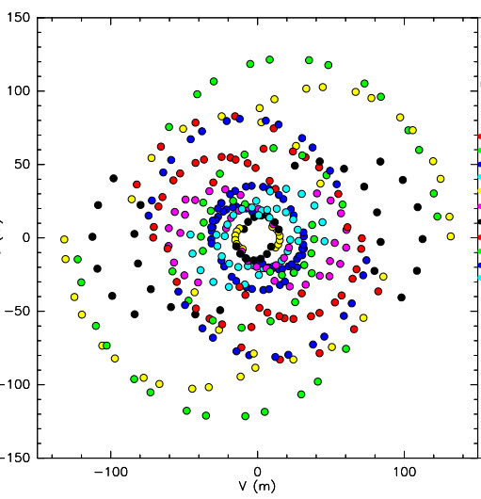
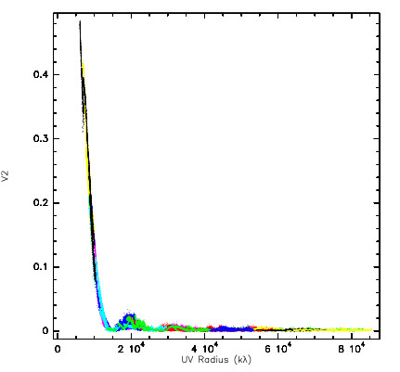
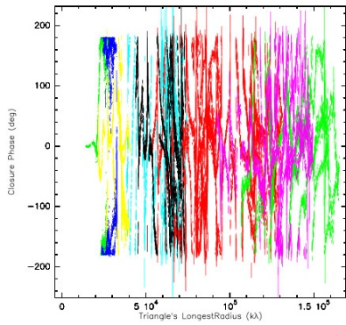
Image reconstruction
N_{x}N_{y} pixels 32x32=1024
Additional priors
  Positivity
  Normalization
Model fitting
Using “Likelihood”
but
N_{v²}+N_{CP} < N_{x}N_{y}
(more free parameters than data)
Regularizations methods
  Smoothness
  Compactness
  “Simplicity”
  …
Add even stronger constraints depending on the object
All flux inside a surface (for stellar surface)
Remove unresolved object (for circumstellar disk)
N_{v²}= 102
N_{CP}= 34
c) We want images!
1) Long baseline interferometry 101

Slide 23
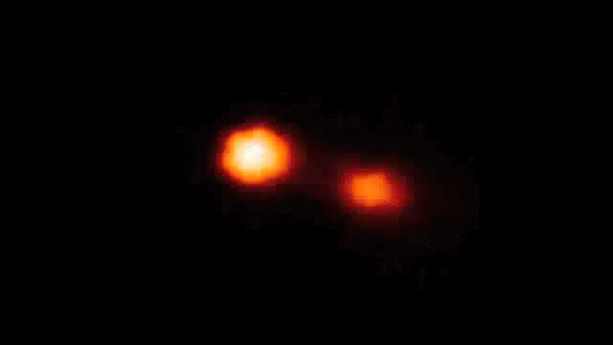
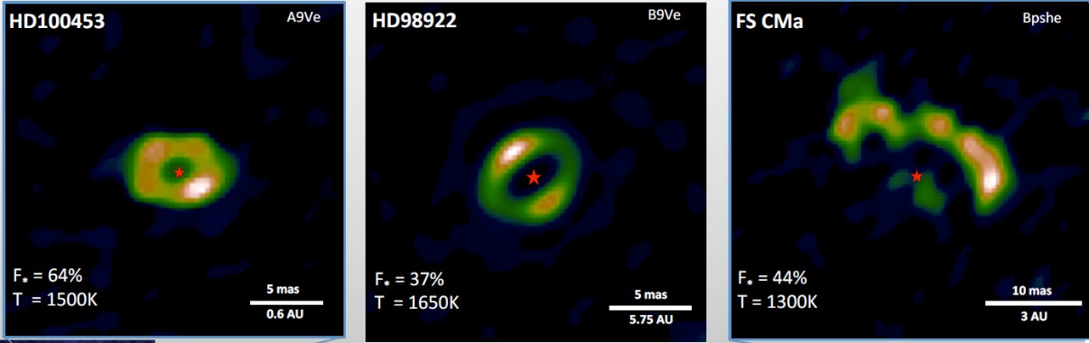

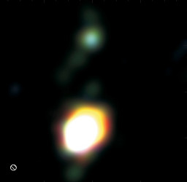
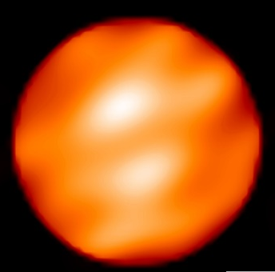
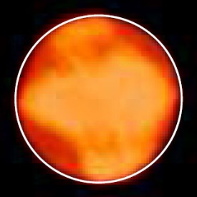



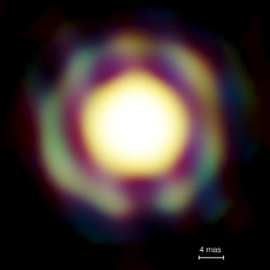
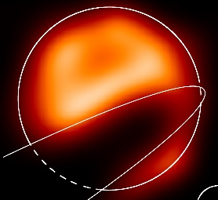

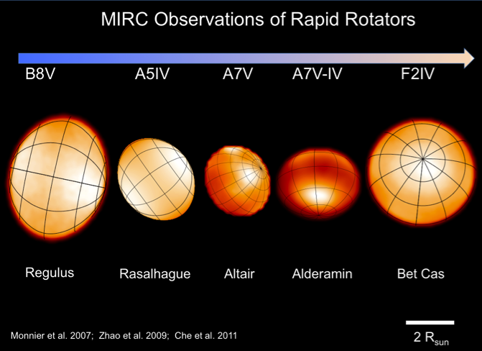

A few images from optical interferometers
Binaries (Interacting, symbiotics, B[e]…)
Dust disks Inner rims
Giants and Supergiants
Kluska+ 2014
Zhao+ 2008
Kraus+ 2012
Benisty+ 2011
Blind+ 2014
Baron+ 2014
Millour+ 2009
Haubois+ 2009
Mira stars
ε Aur
very massive YSO disks
Fast rotators
Kraus+ 2010
Monnier+ 2007, Zhao+ 2009, Che+ 2011
Le Bouquin+ 2009
Kloppenborg+ 2009
c) We want images!
1) Long baseline interferometry 101

Slide 24
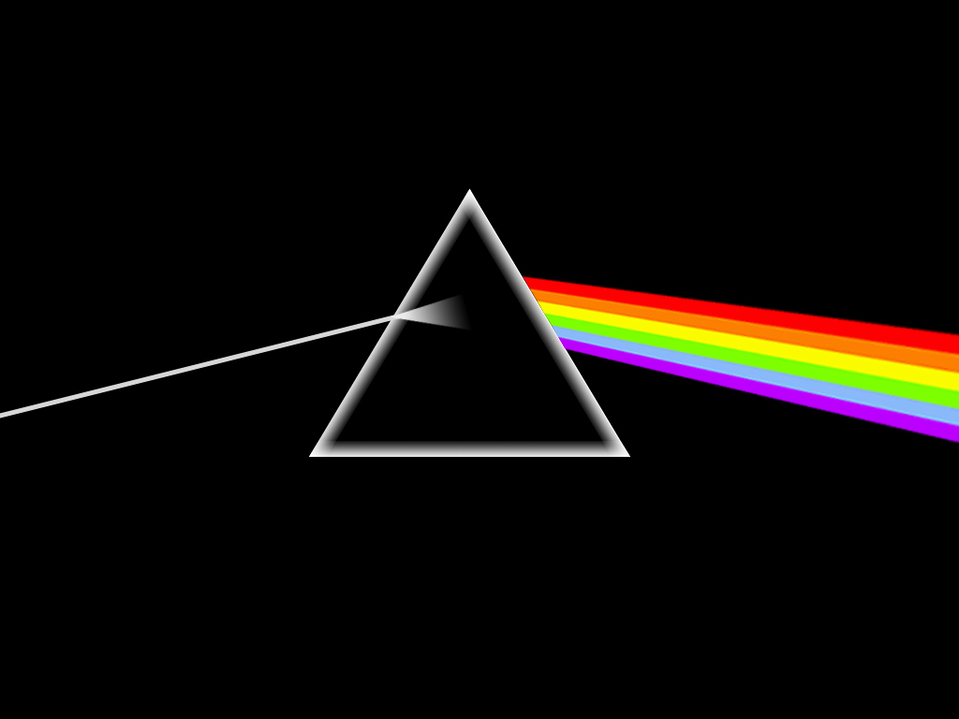

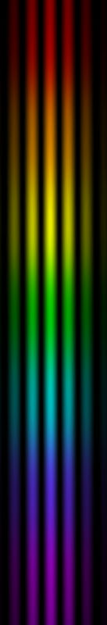
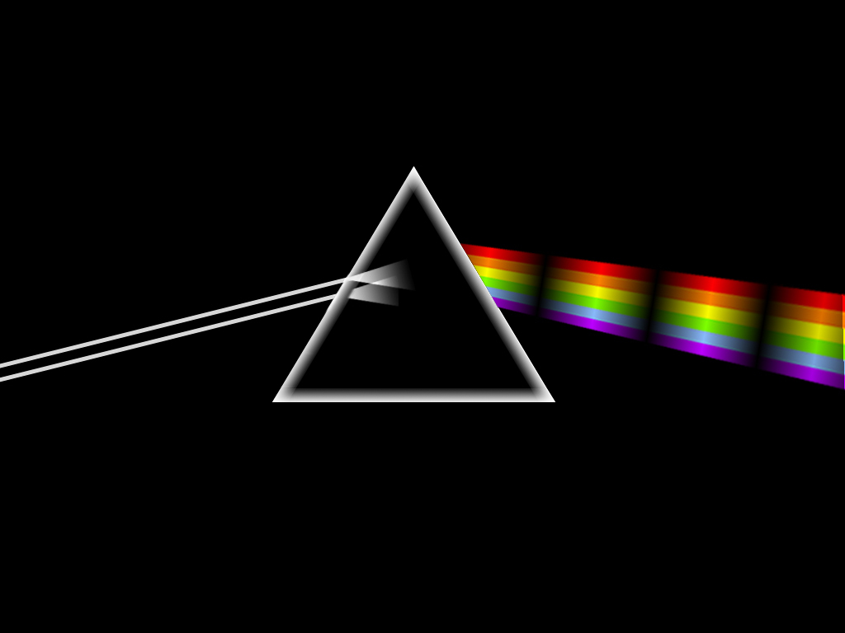
Spectro-interferometry
Spectroscopy
Interferometry
Flux as the function of wavelength
Geometry of objects
Spectro-interferometry
Geometry of objects as a function of the wavelength
d) Spectro-interferometry
1) Long baseline interferometry 101

Slide 25
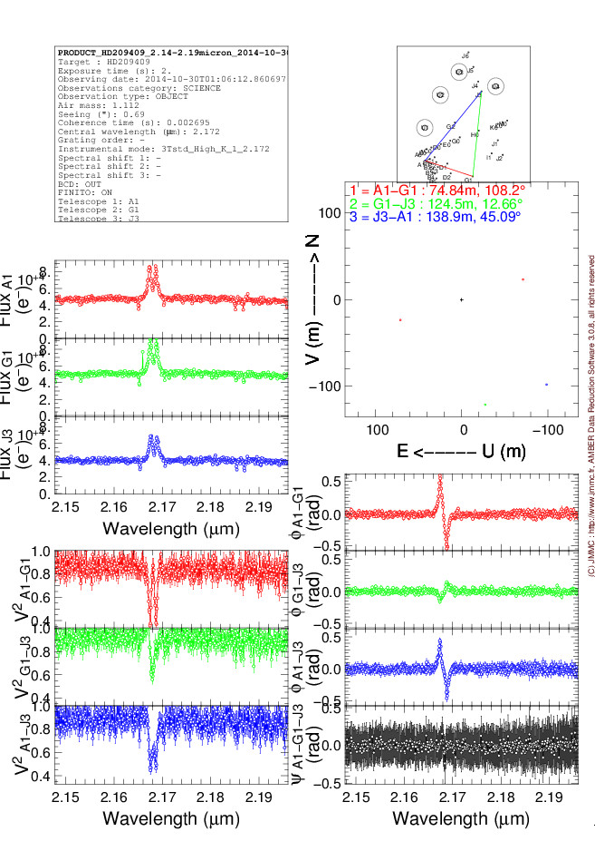
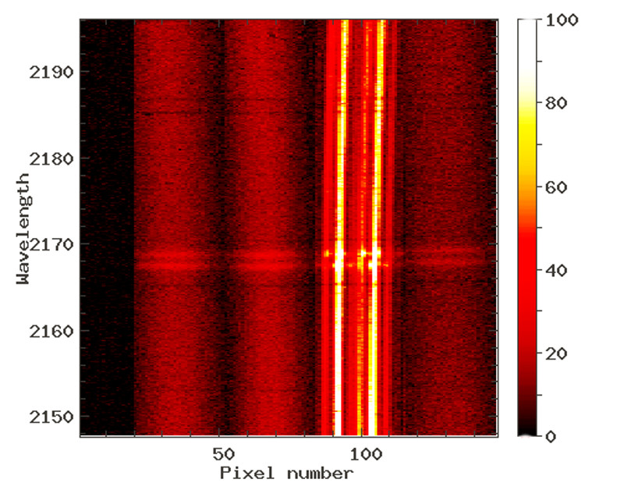
Quantities extracted from spectro-interferometry
Absolute quantities => need of a calibrator
Absolute visibility V(λ)
Size of object as function of λ
Closure phase φ(λ) (if 3 telescopes or more)
Asymmetry of object as function of λ
Spectrum F(λ)
Differential quantities => no calibrator needed
Differential phase : ϕ(λ)
Variation of photocenter position as a function of λ
Differential visibility : v(λ)
Variation of extension as a function of λ
VLTI/AMBER fringes on the Be star O Aqr around Brγ line
d) Spectro-interferometry
1) Long baseline interferometry 101

Slide 26
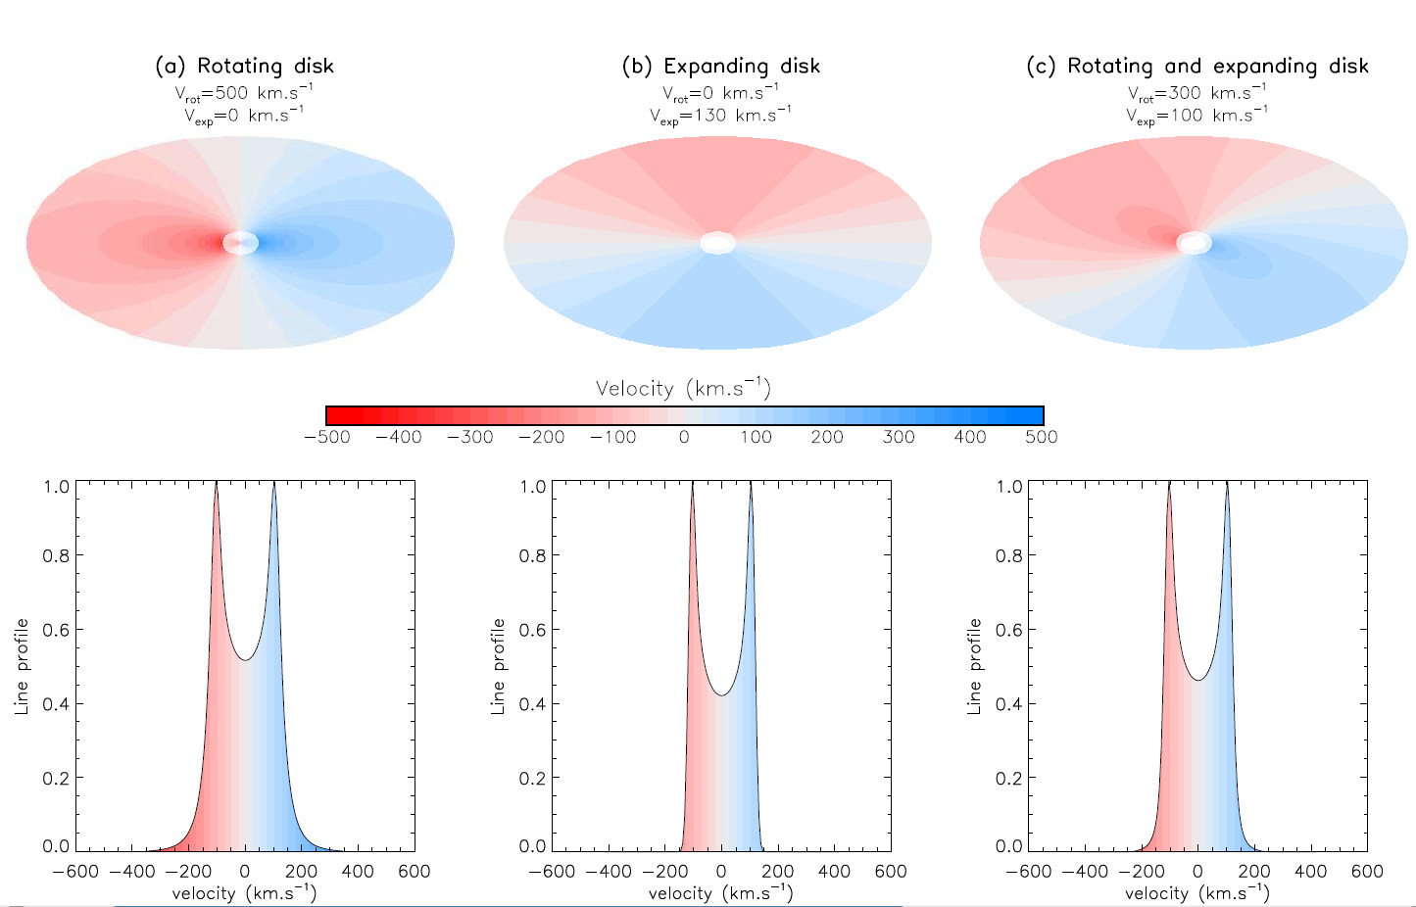
Kinematics with or without angular resolution
d) Spectro-interferometry
1) Long baseline interferometry 101

Slide 27
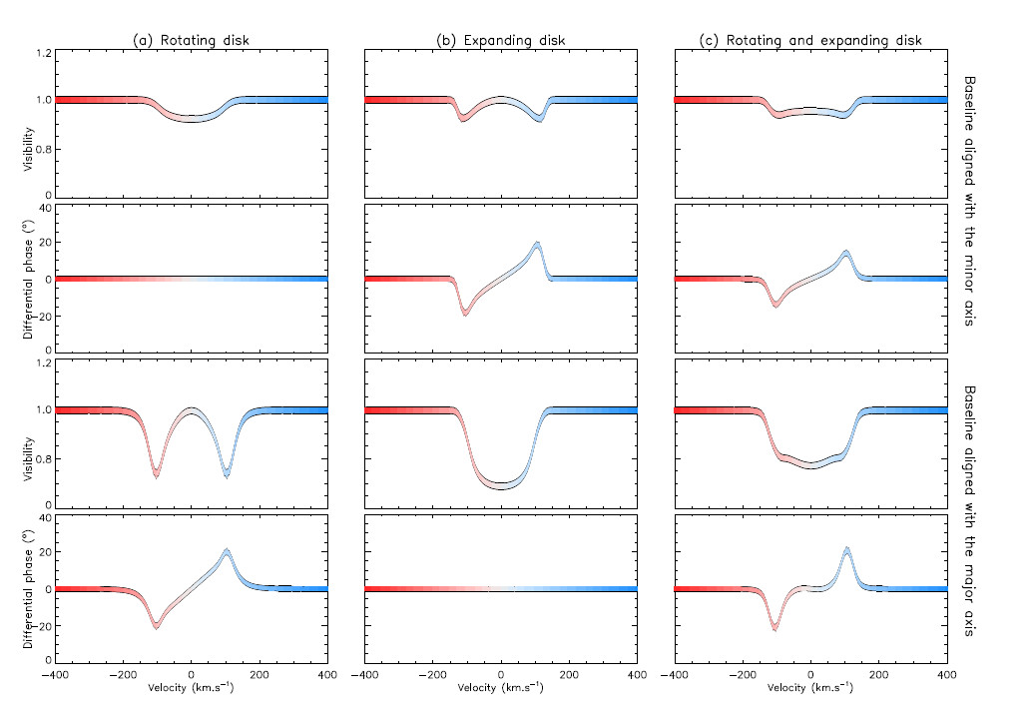
Kinematics with or without angular resolution
d) Spectro-interferometry
1) Long baseline interferometry 101

Slide 28
Kinematics with or without angular resolution
d) Spectro-interferometry
1) Long baseline interferometry 101

Slide 29
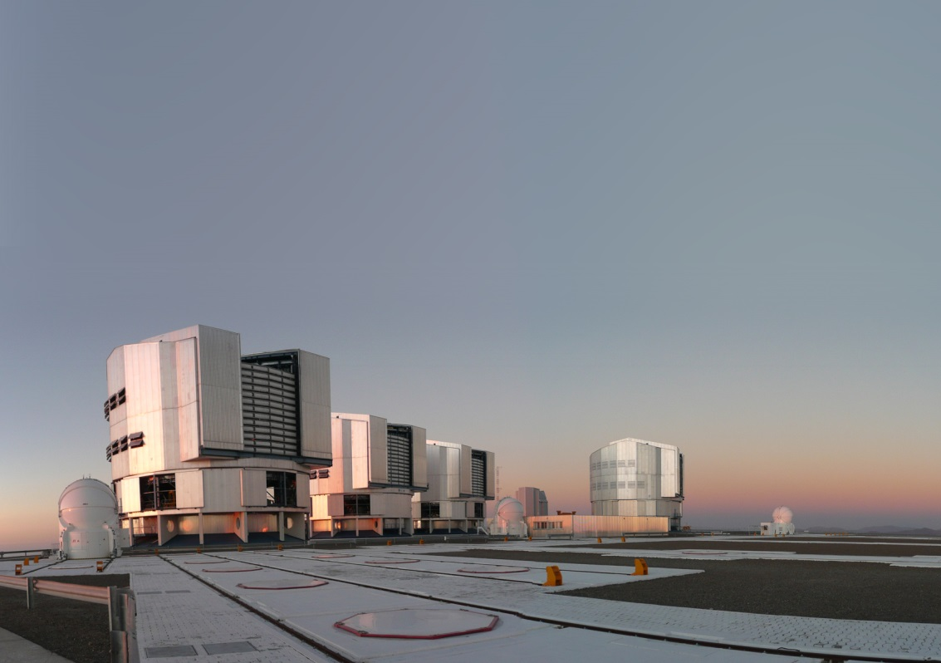
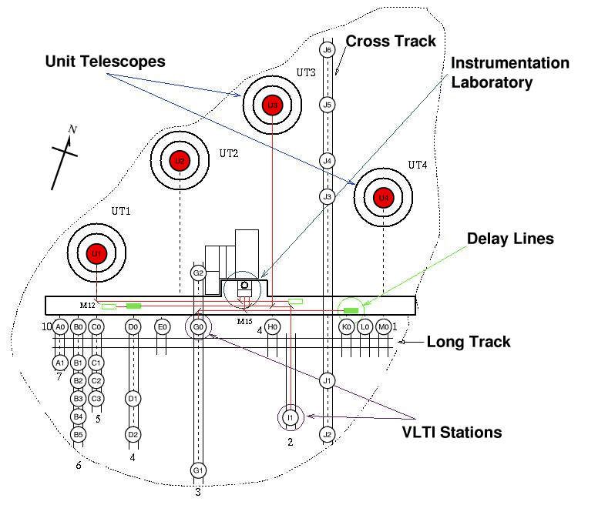
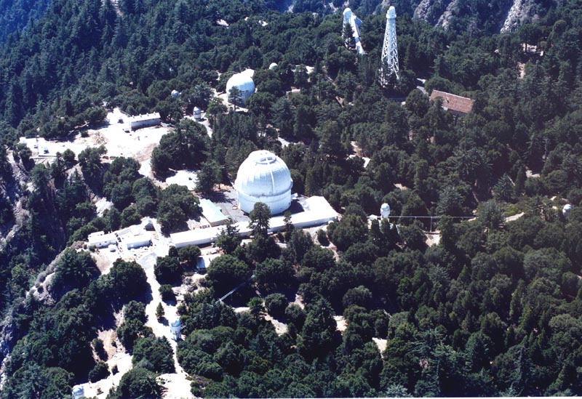
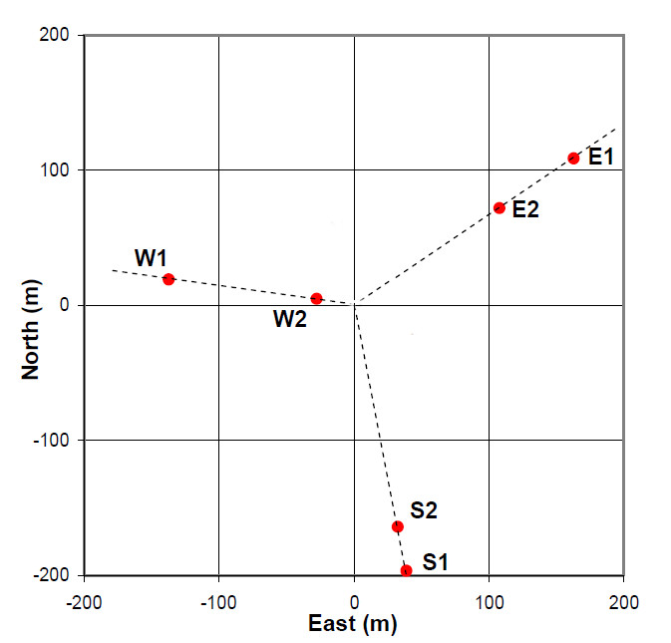
VLTI : Chile
4 UTs (8m) + 4 ATs (1.8m)
AMBER : HK 3T R=12000
MIDI : N 2T R=300
PIONIER : H 4T R=30
GRAVITY : K 4T R=4000
MATISSE : LMN 4T R=4000
6 Telescopes (1m)
VEGA : BVR 4T R=15000
PAVO : BVR 3T R=30
MIRC: H 6T R=30
New instruments in dev.!
CHARA : California
d) The current generation of arrays and instruments
1) Long baseline interferometry 101

Slide 30

Now that you are in the Fourier space…
…Let’s start our interferometric journey!
VLTI auxiliary telescopes
2) An interferometric journey around Massive stars

Slide 31

About the binarity of massive stars
HR5171A : Olivier Chesneau’s Peanut star
a) About the binarity of massive stars
2) An interferometric journey around Massive stars

Slide 32

The binarity as seen by interferometers
δ Centauri (Meilland 2008+)
Oscillation amplitude (A)
⬄
Flux ratio (f)
f=A/2
Oscillation period (T)
⬄
Projected separation (s)
s=1/T
Detection limit due to spatial resolution
and interferometric field of view
0.2 mas < s < 150 mas
Detection limit due to flux ratio
f<100
a) About the binarity of massive stars
2) An interferometric journey around Massive stars

Slide 33


Some binaries as seen by the VLTI/AMBER
λ/Δλ=1500
λ/Δλ=30
The Be star δ Scorpii with λ/Δλ=1500 (Meilland+ 2011)
The B[e] HD87643 (Millour+ 2009)
a) About the binarity of massive stars
2) An interferometric journey around Massive stars

Slide 34

The binary fraction among massive stars
The SMaSH+ program
(Southern Massive Stars at High Angular resolution)
173 O stars observed
105 VLTI/PIONIER
(small separation 1 - 45 mas)
+
162 VLT/NACO
(larger separation 30 mas - 8’’)
High binary fraction : 0.86
Average companion : 1.83±0.32
η Car
Massive stars were formed nearly exclusively in multiple systems
Le Bouquin+ 2014
a) About the binarity of massive stars
2) An interferometric journey around Massive stars

Slide 35


The triple-O stellar system HD 150136 seen by the VLTI/PIONIER
Spectroscopy
Interferometry
3D-orbit
Determination of the stellar masses
η Car
Sana+ 2013 & Nasseri+ 2014
8% accuracy on the masses
a) About the binarity of massive stars
2) An interferometric journey around Massive stars

Slide 36


The binary Be star ϕ Persei seen by CHARA
Circumstellar disk also studied in Hα
(We’ll have a look at it in few minutes!)
Mourard+ 2015 (submitted)
a) About the binarity of massive stars
2) An interferometric journey around Massive stars

Slide 37




A lot of Interferometric orbits of massive binaries
δ Centauri
θ¹ Ori C
WR140
Meilland + (2012)
Kraus+ 2007, 2009
δ Scorpii
Monnier+ (2011)
Meilland + (2011)
a) About the binarity of massive stars
2) An interferometric journey around Massive stars

Slide 38


β Lyrae : A semi-detached binary as seen by CHARA/MIRC
Images at 6 epochs
Zhao+ 2008
a) About the binarity of massive stars
2) An interferometric journey around Massive stars

Slide 39


β Lyrae : A semi-detached binary as seen by CHARA/VEGA
Spectrum
Visibility
Phase
CHARA/VEGA Bonneau+ 2011
β Lyr (+ υ Sgr) Observations in Hα
η Car
Hα Emission larger than the binary separation
And perpendicular to the orbital plan
Jets?
a) About the binarity of massive stars
2) An interferometric journey around Massive stars

Slide 40

HR5171A : a giant peanut?
Chesneau+ 2014
Observations with VLTI/AMBER
+
Photometric data over 50 years
Yellow hypergiant (1300Ro)
Companion detected
+
Probably in common envelope phase
Accelaration by the companion
Clues of fast rotation
η Car
a) About the binarity of massive stars
2) An interferometric journey around Massive stars

Slide 41

The circumstellar environments of massive stars…
…only a few examples of what can be done and what was done
Artist view of the A[e] supergiant HD 62623
b) The circumstellar environments of massive stars
2) An interferometric journey around Massive stars

Slide 42

Choosing the right wavelength
Visible interferometry
Dullemond & Monnier (2010)
b) The circumstellar environments of massive stars
2) An interferometric journey around Massive stars

Slide 43

Dust in the near-IR ⬄ Inner rim of the disk
MWC300
Survey on Herbig Ae/Be stars
near-IR extension
Correlation between
NIR extension and Luminosity
Radius/Luminosity
⬄
Informations on heating processes
below the inner rim
(Optically thin gas)
HD45677
HD327083
HD50138
V921 Sco
HD62623
B[e] stars
HD85567
Monnier+ 2005, Millan-Gabet+ 2006, Dullemond & Monnier 2010
b) The circumstellar environments of massive stars
2) An interferometric journey around Massive stars

Slide 44
Dust in the near-IR ⬄ Inner rim of the disk
Kishimoto+ 2011
Monnier+ 2005, Millan-Gabet+ 2006, Dullemond & Monnier 2010
The Radius/Luminosity relation works also for AGNs
b) The circumstellar environments of massive stars
2) An interferometric journey around Massive stars

Slide 45




Dust in the near-IR
Kluska+ 2014
VLTI/PIONIER
From model fitting…
Same object
Monnier+ 2006
IOTA/IONIC3
Renard+ 2010
VLTI/AMBER
Benisty+ 2011
VLTI/AMBER
…to Imaging
b) The circumstellar environments of massive stars
2) An interferometric journey around Massive stars

Slide 46



Dust in the mid-IR : the A[e] supergiant HD62623
From the VLTI/MIDI point of view
Meilland+ 2010
b) The circumstellar environments of massive stars
2) An interferometric journey around Massive stars
b) The circumstellar environments of massive stars

Slide 47


Dust in the mid-IR : the A[e] supergiant HD62623
From the VLTI/MIDI point of view
8µm
10µm
13µm
Modeling with a radiative transfer code : MC3D (Wolf 2003)
Contraints on inclination angle, density structure, temperature, chemistry…
Compact structure unresolved
Inner gaseous environment?
too slow to influence mass-ejection
too fast for a supergiant star
Rotation :
⬄ spin-up by a putative companion
Meilland+ 2010
b) The circumstellar environments of massive stars
2) An interferometric journey around Massive stars
b) The circumstellar environments of massive stars

Slide 48

Dust in the mid-IR : the A[e] supergiant HD62623
From the VLTI/MIDI point of view
8µm
10µm
13µm
Modeling with a radiative transfer code : MC3D (Wolf 2003)
Contraints on inclination angle, density structure, temperature, chemistry…
Inner gaseous environment
Modeled with the SIMECA code
(Stee 1995)
too slow to influence mass-ejection
too fast for a supergiant star
Rotation :
⬄ spin-up by a putative companion
Meilland+ 2010
b) The circumstellar environments of massive stars
2) An interferometric journey around Massive stars
b) The circumstellar environments of massive stars

Slide 49




What about the gas : Wind of AB stars
Example : Deneb (B8Ia) & Rigel (A2Ia)
Chesneau+ 2010
Model with The CMFGEN code
Constraints on mass-loss
Strong Asymmetry detected for Deneb
η Car
CHARA/VEGA observation
High-resolution (R=30000) on Hα
b) The circumstellar environments of massive stars
2) An interferometric journey around Massive stars

Slide 50


What about the gas : Herbig stars
Kraus+ (2008)
5 Herbig stars observed with VLTI/AMBER
b) The circumstellar environments of massive stars
2) An interferometric journey around Massive stars

Slide 51



What about the gas : Herbig stars
Large Emission
Disk wind?
Compact Emission
Inner disk or magnetospheric accretion?
Intermediate
Stellar wind?
Kraus+ (2008)
b) The circumstellar environments of massive stars
2) An interferometric journey around Massive stars

Slide 52



Example of multi-band interferometry
The classical Be α Ara as seen by the VTI instruments AMBER and MIDI
2.1µm
8µm
12µm
Disk size
constant between
2.1 and 12µm
Disk truncated by a companion (Chesneau+ 2005)
Meilland+ 2009
Isothermal disk (Sigut & Jones 2009)
b) The circumstellar environments of massive stars
2) An interferometric journey around Massive stars

Slide 53






Classical Be stars and interferometry
Author | Star | Instrument
Tycner+ 2004 | ζ Tau | NPOI
Tycner+ 2006 | γ Cas & ϕ Per | NPOI
Kervella+ 2006 | Achernar | VLTI/VINCI
Gies+ 2007 | 4 Stars | CHARA/CLASSIC
Meilland+ 2007 | α Ara | VLTI/AMBER
Meilland+ 2007 | κ CMa | VLTI/AMBER
Meilland+ 2008 | δ Cen | VLTI/AMBER
Kanaan+ 2008 | Achernar | VLTI/VINCI
Tycner+ 2008 | χ Oph | NPOI
Kervella+ 2009 | Achernar | VLTI/MIDI
Stelf+ 2009 | ζ Tau | VLTI/AMBER
Caricofi+ 2009 | ζ Tau | VLTI/AMBER
Meilland+ 2009 | 7 Stars | VLTI/MIDI
Tycner+ 2011 | δ Sco | NPOI
Meilland+ 2011 | δ Sco | VLTI/AMBER+ CHARA/VEGA
Meilland+ 2012 | 8 Stars | VLTI/AMBER
Delaa+ 2011 | 48 Per & ψ Per | CHARA/VEGA
Stee+ 2012 | γ Cas | CHARA/VEGA
Meilland+ 2013 | δ Sco | VLTI/AMBER
Touhami+ 2013 | 24 Stars | CHARA/CLIMB
Radiative transfer modelling
SIMECA
BEDISK
HDUST
Disk kinematics
Keplerian rotation
Binarity
Statistics
Size, flattening…
Density structure
Polar Winds?
Stellar rotation
Near to critical
b) The circumstellar environments of massive stars
2) An interferometric journey around Massive stars

Slide 54





What about kinematics : classical Be stars
8 Be stars observed with the
VLTI/AMBER
b) The circumstellar environments of massive stars
2) An interferometric journey around Massive stars

Slide 55


What about the kinematics : classical Be stars
8 Be stars observed with the
VLTI/AMBER
Keplerian disks with no expansion (v_{exp}<10km/s )
b) The circumstellar environments of massive stars
2) An interferometric journey around Massive stars

Slide 56


What about the kinematics: classical Be stars
Nearly critical rotators
V/V_{c} = 0.82 ± 0.08
Ω/Ω_{c} = 0.95 ± 0.02
8 Be stars observed with the
VLTI/AMBER
b) The circumstellar environments of massive stars
2) An interferometric journey around Massive stars

Slide 57





What about the kinematics : other objects
Herbig Ae/Be stars
Hot supergiant’s wind
Novas
Chesneau+ 2010
B[e] stars
T Pyx
Chesneau+ 2011
Malbet+ 2007, Tatulli+2007, Weigelt+ 2011, Perrault 2010+, Benisty 2013+
Ellerbroek+ 2015, wheelwright+ 2012, Millour+ 2012
b) The circumstellar environments of massive stars
2) An interferometric journey around Massive stars

Slide 58


Spectro-interferometric imaging
The A[e] supergiant HD62623 from VLTI/AMBER HR observations (Millour+ 2011)
η Car
b) The circumstellar environments of massive stars
2) An interferometric journey around Massive stars

Slide 59


Spectro-interferometric imaging
The A[e] supergiant HD62623 from VLTI/AMBER HR observations (Millour+ 2011)
η Car
Image in the 2.1µm continuum
Narrow-band images through the Brγ emission line
b) The circumstellar environments of massive stars
2) An interferometric journey around Massive stars

Slide 60
Spectro-interferometric imaging
The A[e] supergiant HD62623 from VLTI/AMBER HR observations (Millour+ 2011)
η Car
Reconstructed projected velocity field
Keplerian rotation disk
b) The circumstellar environments of massive stars
2) An interferometric journey around Massive stars

Slide 61



Spectro-interferometric imaging
The binary Be star ϕ Persei seen by CHARA Mourard+ 2015
CHARA/VEGA Hα Image
Reconstructed images from the VEGA data
Nearly edge-on Keplerian disk model
1 mas
Reconstructed images from the model
Observation with CHARA/VEGA in the Hα emission line wit h a nice (u,v) plan coverage
η Car
b) The circumstellar environments of massive stars
2) An interferometric journey around Massive stars

Slide 62

Separating spectra using spectro-interferometry
The binary Be star ϕ Persei seen by CHARA Mourard+ 2015
Full spectrum
Star
Disk
outside
η Car
Similar to integral-field spectroscopy but with a 10 times higher spatial resolution!
b) The circumstellar environments of massive stars
2) An interferometric journey around Massive stars

Slide 63


From diameter measurements to stellar imaging
η Car
A red supergiant model (CO5BOLD)
c) From diameters measurements to stellar imaging
2) An interferometric journey around Massive stars

Slide 64

A bit of history…
20 Foot beam
First measurement of the diameter of a star
Betelgeuse ⬄ θ = 47 mas
IOTA/IONIC3 H-Band
Reconstructed image
θ = 44.28 ± 0.15 mas
Michelson & Pease 1921
Haubois+ 2009
c) From diameters measurements to stellar imaging
2) An interferometric journey around Massive stars

Slide 65


Why do we need accurate diameters?
1) For fundamental parameters of stars
CHARA/PAVO
10 early type stars
Maestro+ 2013
η Car
c) From diameters measurements to stellar imaging
2) An interferometric journey around Massive stars

Slide 66


Why do we need accurate diameters?
2) Surface brightness relation ⬄ Distance estimators in the Universe
CHARA/PAVO
Maestro+ 2013
CHARA/VEGA
Challouf+ 2014
η Car
c) From diameters measurements to stellar imaging
2) An interferometric journey around Massive stars

Slide 67


Imaging stellar surface of Betelgeuse and beyond…
IOTA/IONIC3 H-Band
Reconstructed image
CO5BOLD Freytag+ 2012
CHARA/MIRC H-band images
of two Supergiant stars
Baron+ 2014
θ = 44.28 ± 0.15 mas
η Car
Haubois+ 2009
2) An interferometric journey around Massive stars
c) From diameters measurements to stellar imaging
c) From diameters measurements to stellar imaging

Slide 68

Stellar surfaces of fast-rotators
CHARA/
Achernar
VLTI/VINCI
Domiciano+ 2003
B2Vne star close to critical rotation
From 2 telescopes and 100m baselines…
η Car
…to 6 telescopes and 300m baselines
c) From diameters measurements to stellar imaging
2) An interferometric journey around Massive stars

Slide 69

Stellar surfaces of fast-rotators
Constraints on the Gravity darkening
Teff α geff ^{β}
(von Zeipel ⬄ β = 0.25 )
β ~ 0.22 ( and depends on Teff)
Compatible with stellar interior model
for fast-rotators ESTER
(Espinoza Lara+ 2011)
CHARA/
CHARA/
η Car
2) An interferometric journey around Massive stars
c) From diameters measurements to stellar imaging

Slide 70

Stellar surfaces of fast-rotators
Equator faster than pole
Rigid rotation
Pole faster than Equator
α = 0.5
β_{app} = 0.22
α = 0.0
β_{app} = 0.25
α = -1,5
β_{app} = 0.30
But apparent β might be affected by latitudinal differential rotation
Delaa+ 2013
2) An interferometric journey around Massive stars
c) From diameters measurements to stellar imaging

Slide 71


Stellar rotation and spectro-interferometry
Equator faster than pole
Rigid rotation
Pole faster than Equator
Images through a photospheric line
Hadjara 2014+ & Delaa+ 2013
λ=587.55nm
2) An interferometric journey around Massive stars
c) From diameters measurements to stellar imaging

Slide 72



of interferometric instruments
3) Interferometry : The next generation

Slide 73



The next generation at VLTI
PIONIER
2011
GRAVITY
2015
Still in commissioning
MATISSE
2017
All 4-telescopes combiners ( 6 V² + 3 iCP)
H band
No Spectral resolution
mH<8
K band
Up to R = 4000
mK<10 (7 for ATs)
DIT up to 1min!
L,M, & N bands
Up to R = 4000
F_{12µm} > 1 Jy
Possible extension to J band
and spectral resolution
Potential « I-Shooter » mode with the 3 instruments
operating simultaneously ( 1.6- 13.5 µm)
+ possible Visible (R and I bands)
instrument for 3rd generation (after 2022)
3) Interferometry : The next generation

Slide 74

The next generation at CHARA
Installation of adaptive optics on the telescopes
B
V
R
H
K
VEGA (4T)
PAVO (2T)
SPICA (6T) VRI
MIRC (6T)
MIRCx (6T) J? H
CLIMB(3T)
FLUOR (2T)
Also « I-shooter » mode
0.6 – 2.5 µm
With a gain in limiting magnitude
MYSTIC (6T) K
New generation of detectors
+
Fringe tracker
3) Interferometry : The next generation

Slide 75


MROI : a new interferometric facility?
Magdalena Ridge (New Mex.)
9 Movable 1.4m telescopes
28 Stations
Baselines from 8 to 340m
Lack 100M$
But US Air Force is interested
3) Interferometry : The next generation

