Slide 1

Our science with
MATISSE
A. Meilland, B. Lopez, R. Petrov, W. Jaffe, F. Millour, A. Matter, K. Meisenheimer
and the MATISSE consortium

Slide 2
Our science with MATISSE
  Long-baseline interferometry 101 in 5min
  Description of consortium Programmes
  My personnal sciences cases : hot stars environments

Slide 3
Our science with MATISSE
  Long-baseline interferometry 101 in 5min
  Description of consortium Programmes
  My personnal sciences cases : hot stars environments

Slide 4


Our science with MATISSE
  Van Citter & Zernike theorem : Welcome to the Fourier space!
$$γ=\frac{\iint{I\left(\vec{r}\right)e^{−2iπ(\vec{r}\vec{.B})/λ}dxdy}}{\iint{I\left(\vec{r}\right)dxdy}}$$
Complex visibility
=
γ = V e^{iϕ}
Normalized Fourier-transform of the object
at the $\frac{\vec{B}}{λ}$frequency
Fringe contrast
Fringe phase

Slide 5

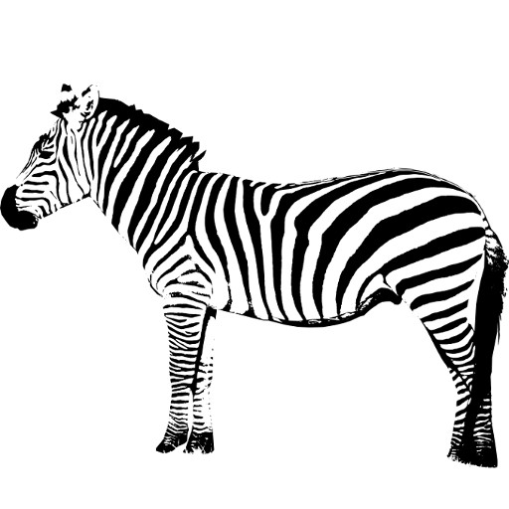
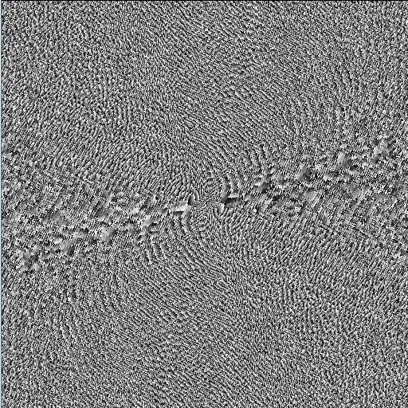
Our science with MATISSE
  Sampling the object FT ⬄Filling the (u,v) plan ⬄ having a lot of baselines
Modulus
Phase
Inverse Fourier transform
FT⁻¹
What is that?
Oh it’s a Zebra!

Slide 6
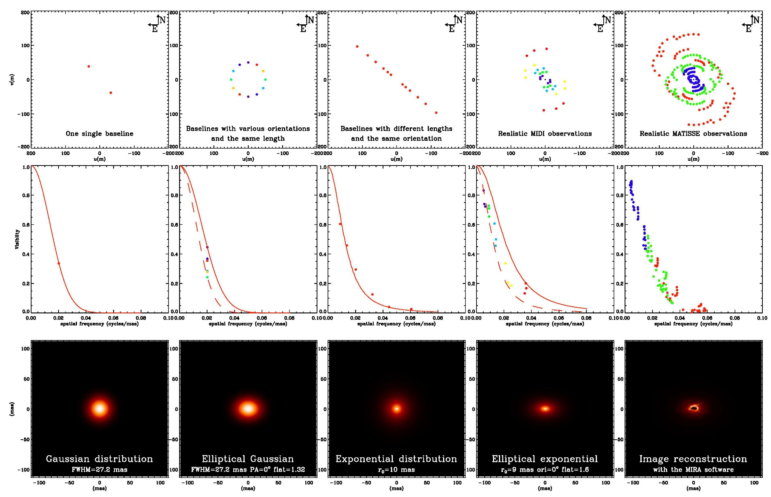
Our science with MATISSE
  Life is hard ⬄ We always get a sparse (u,v) plan coverage
(u,v) plan
Increasing nbs of uv-pts ⬄ increasing model complexity
Visibility
Model

Slide 7
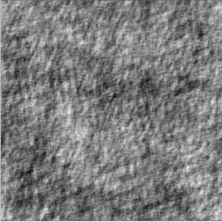


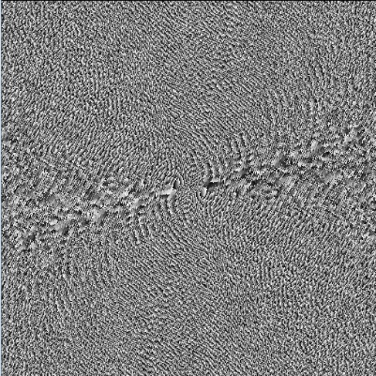
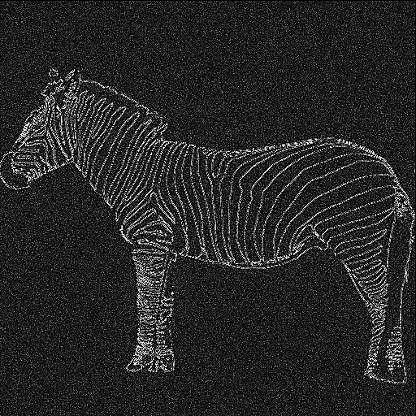
Our science with MATISSE
  Life is even harder ⬄ The phase contains most of the information!
Random Phase
Modulus
FT⁻¹
Random map
FT
Phase
Random Modulus
FT⁻¹

Slide 8
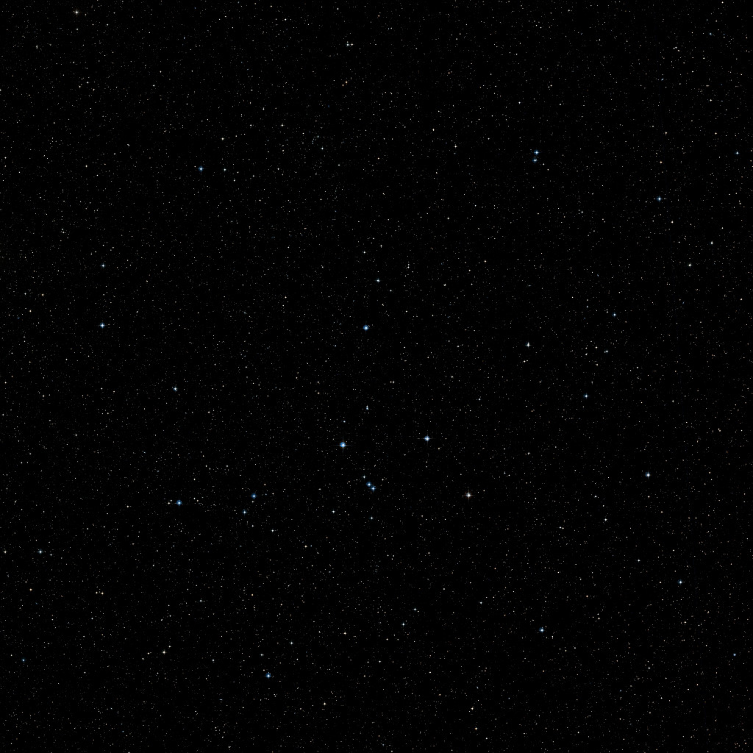

Our science with MATISSE
  Unfortunately, Earth has an atmosphere!
φ₁₂= ϕ₁₂ +δϕ₂ - δϕ₁
ϕ_{ij} = « True » phase for the ij baseline
δϕ_{i} = Atmospheric « random » phase on telescope i
φ_{ij} = Measured phase for the ij baseline
Random phase δϕ₁(t)
Random phase : δϕ₂(t)

Slide 9
Our science with MATISSE
  Closure phase is your best friend
1
ϕ_{ij} = « True » phase for the ij baseline
δϕ_{i} = Atmospheric « random » phase on telescope i
φ_{ij} = Measured phase for the ij baseline
φ₃₁=ϕ₃₁ +δϕ₁- δϕ₃
φ₁₂=ϕ₁₂ +δϕ₂- δϕ₁
3
2
φ₂₃=ϕ₂₃ +δϕ₃- δϕ₂
Closure phase
CP = φ₁₂ + φ₂₃ + φ₃₁ = ϕ₁₂ + ϕ₂₃ + ϕ₃₁

Slide 10
Our science with MATISSE
  Closure phase is your best friend
1
Telescopes | Baselines | CP | Ind. CP | Info on phase
3 | 3 | 1 | 1 | 33%
4 | 6 | 4 | 3 | 50%
5 | 10 | 10 | 6 | 60%
6 | 15 | 20 | 10 | 67%
7 | 21 | 35 | 15 | 71%
21 | 210 | 1330 | 190 | 90%
2
3
1
4
2
3
Information on phase from closure phase = N-2/N

Slide 11
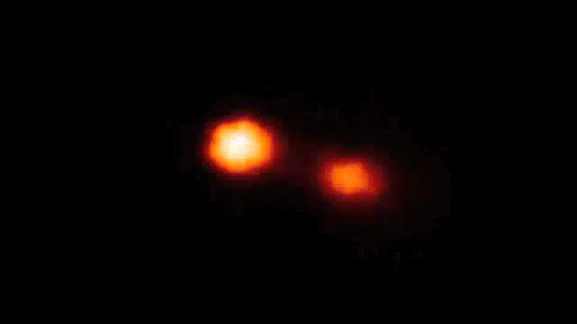
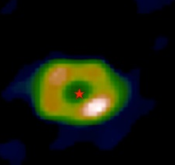

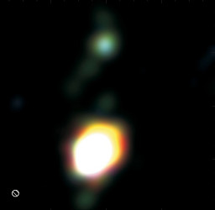
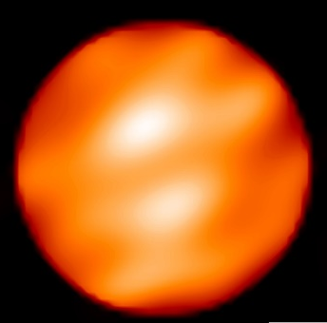
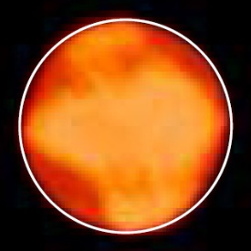


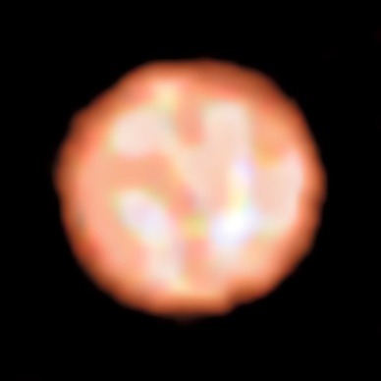

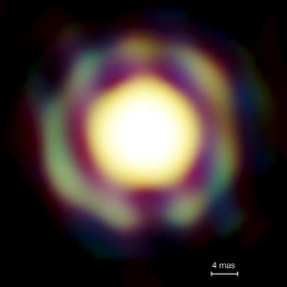
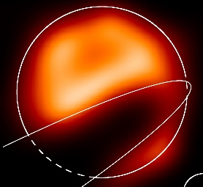


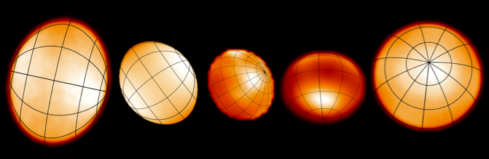
Our science with MATISSE
  A few Images with interferometry
Binaries (Interacting, symbiotics, B[e]…)
Dust disks Inner rims of YSO
Giants and Supergiants
Kluska+ 2014
Zhao+ 2008
Kraus+ 2012
Benisty+ 2011
All in H or K band!!
Blind+ 2014
Baron+ 2014
Haubois+ 2009
Millour+ 2009
Paladini+ 2018
Mira stars
The Eclipse of ε Aur
very massive YSO disks
Fast rotators
Kraus+ 2010
Le Bouquin+ 2009
Monnier+ 2007, Zhao+ 2009, Che+ 2011
Kloppenborg+ 2009

Slide 12
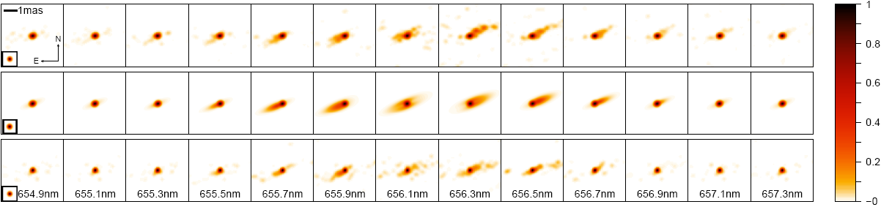
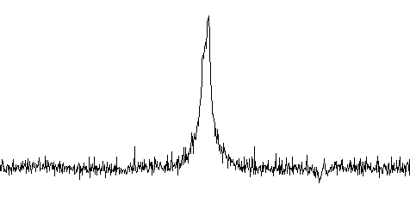
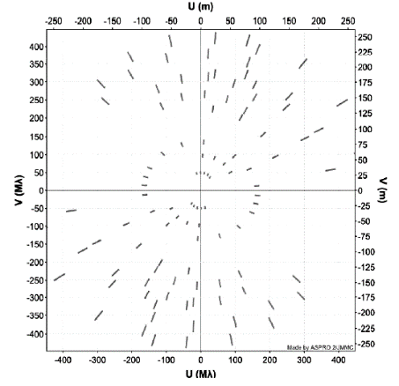
Our science with MATISSE
  Spectro-interferometric imaging
The binary Be star ϕ Persei seen by CHARA/VEGA (Mourard+ 2015)
Reconstructed images from the VEGA data
CHARA/VEGA Hα Image
1 mas
Keplerian disk model
Observation with CHARA/VEGA in the Hα emission line wit h a nice (u,v) plan coverage

Slide 13
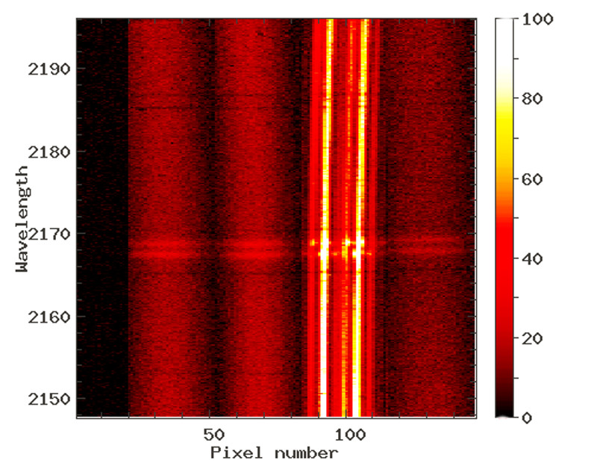
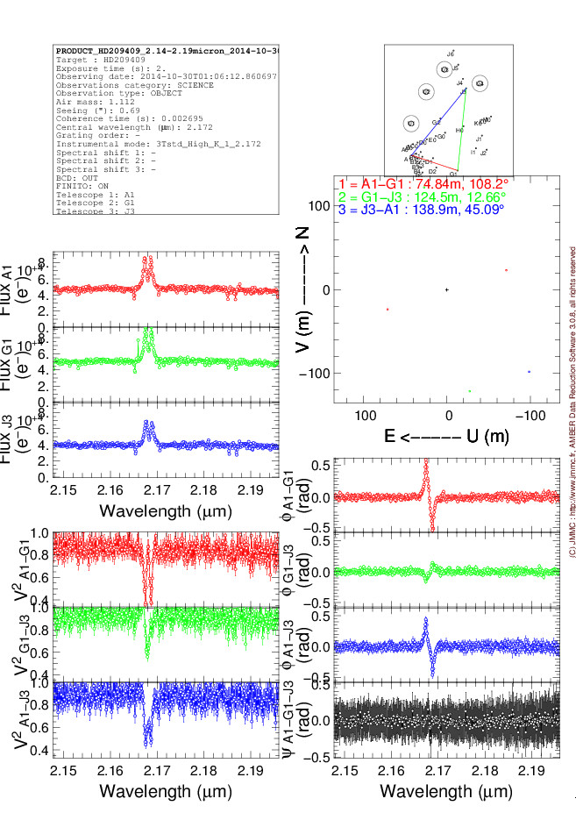
Our science with MATISSE
  Spectro-interferometry
Spectro-interferometric data
Visibility V(λ)
+
Closure phase φ(λ)
+
Spectrum F(λ)
+
Differential phase : ϕ(λ)
(~real phase – cst)
« Position » as a function of λ
VLTI/AMBER 3Tels fringes on a Be star around Brγ

Slide 14
Our science with MATISSE
  Long-baseline interferometry 101 in 5min
  Description of consortium Programmes
  My personnal sciences cases : hot stars environments

Slide 15
Our science with MATISSE
  MATISSE is MIDI successor…
  MATISSE was originally thought as a 4-telescopes MIDI
  More or less the same sensibility
  Same spectral window : N band (8-13um)
  But 6x gain is efficiency for visibility measurements
  And imaging capability thanks to closure phase
  Then L&M bands were added (2.9-5um) in the concept :
  Allow to study warmer material (dust & gas)
  Higher resolution modes up to 4000 : chemistry & kinematics
  Easier fringe search and coherencing (L band usually more sensitive)
  … with a bit of AMBER

Slide 16
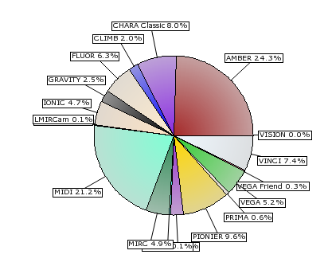
Our science with MATISSE
  MATISSE is MIDI successor…
AMBER and MIDI deserve their retirement
 | nTel | Band | Spectral Res. | Available
MIDI | 2 | N | 20-230 | 2003-2015
AMBER | 3 | HK | 30-12000 | 2005-2018
PIONIER | 4 | H | 5-30 | 2012
GRAVITY | 4 | K | 22-4000 | 2016
MATISSE | 4 | LMN | 30-4000 | 2019
Interferometric papers by instrument
(source : JMMC bibDb)
  … with a bit of AMBER

Slide 17
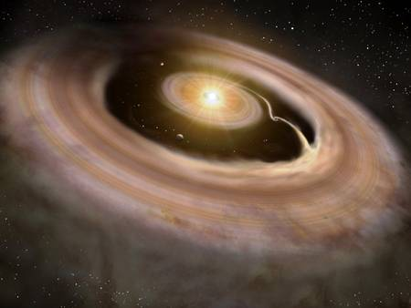
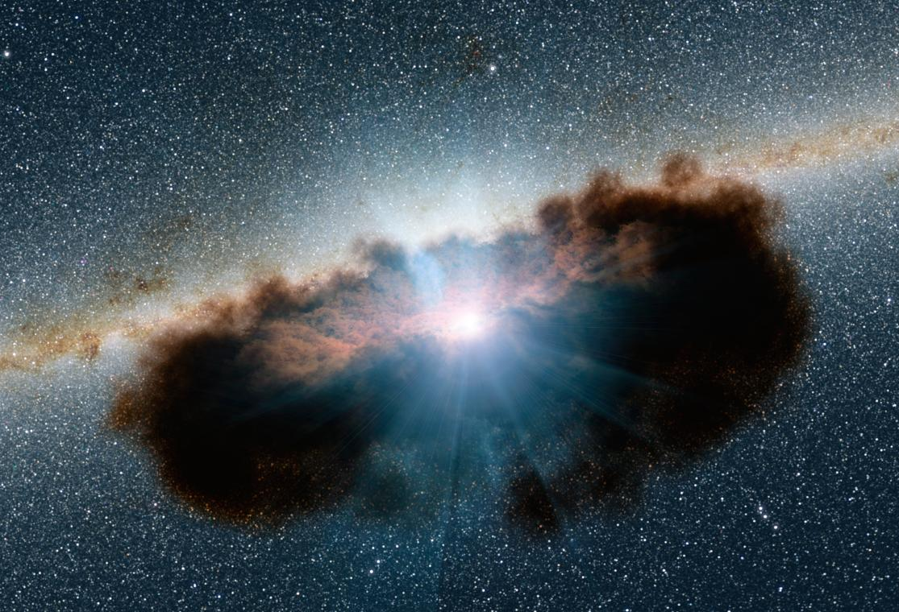
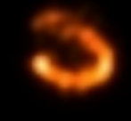
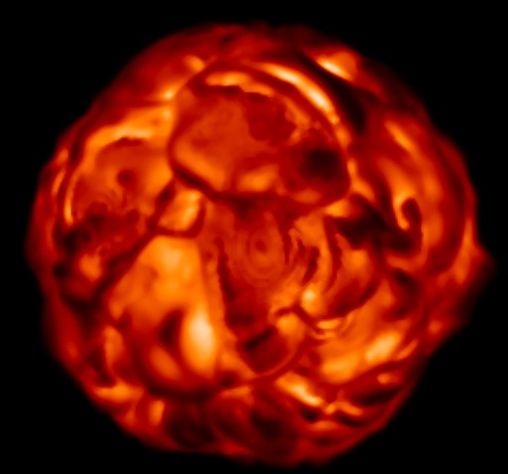
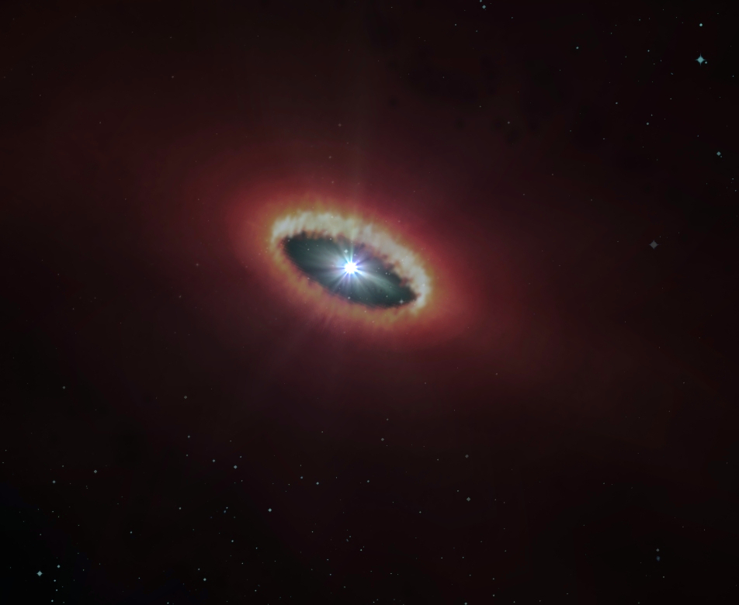
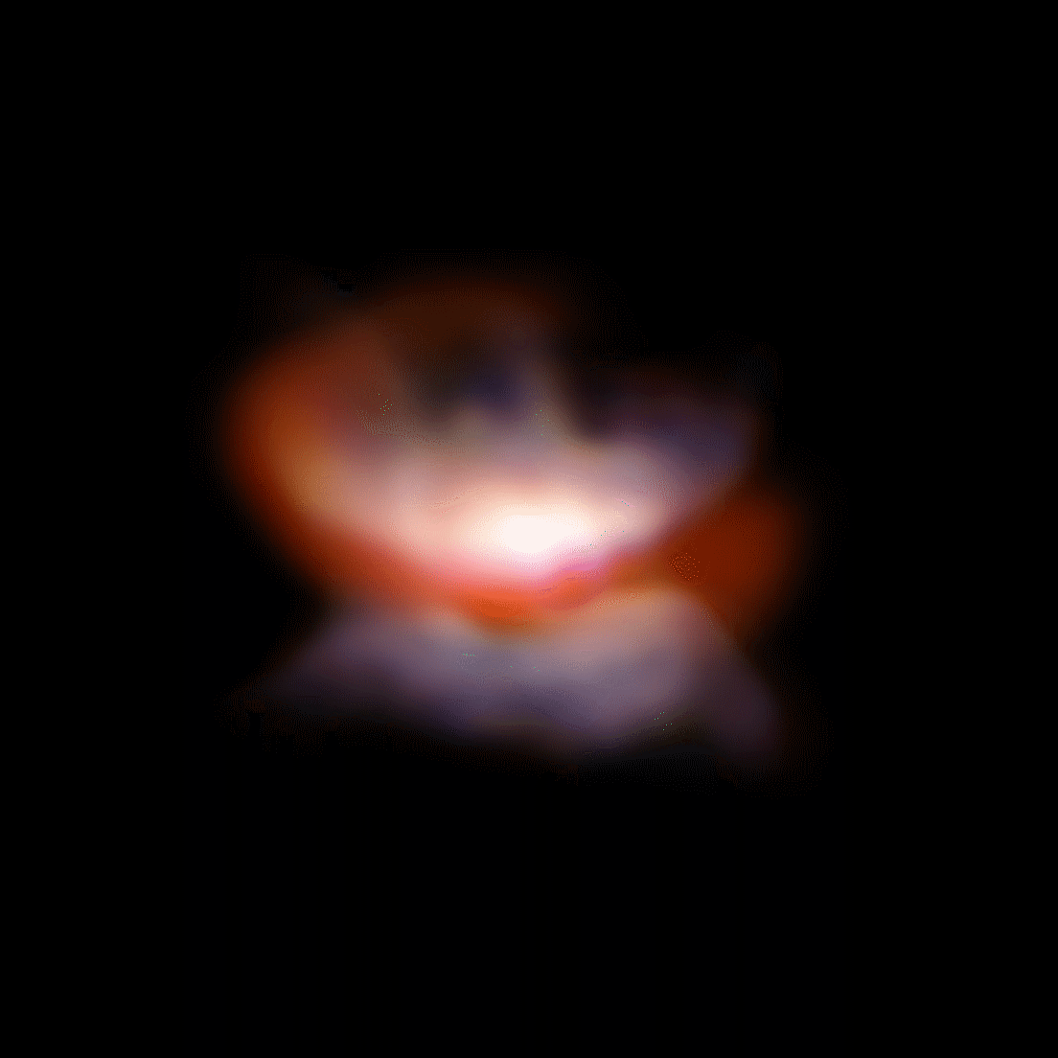
Our science with MATISSE
  Main science programmes from the consortium
Protoplanetary disk
AGN
Evolved stars

Slide 18
Our science with MATISSE
  Consortium protoplanetary disks GTO programmes
Study temperature and density profile in the disk (in conitnuum L,M, and N bands)
Detect gaps and other structures in the disk
Locate chemical elements in the disk such as water, ice, CO,…

Slide 19
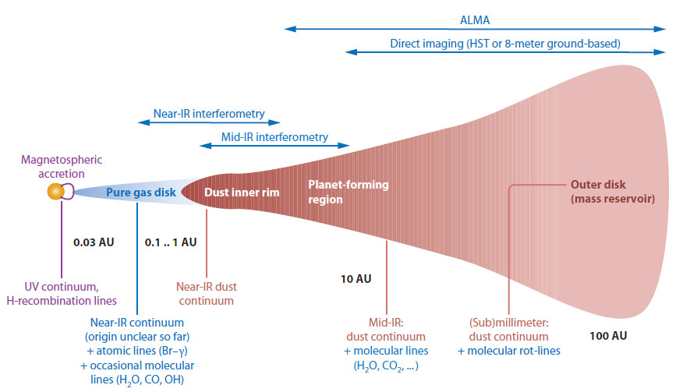
Our science with MATISSE
  Consortium protoplanetary disks GTO programmes
Visible interferometry
Dullemond & Monnier (2010)
Larger wavelengths probe colder material so further from the star ⬄ With MATISSE 1000K (3µm) to 200K (13µm)

Slide 20
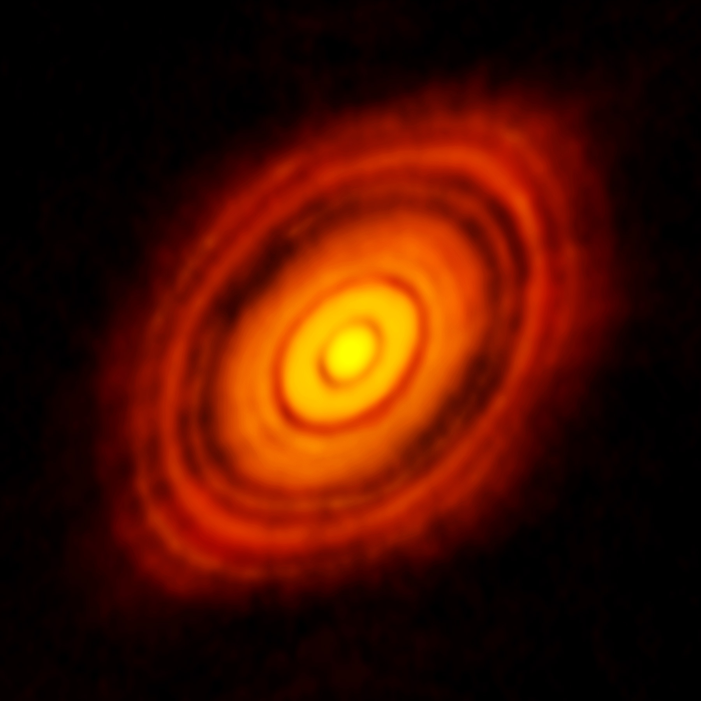
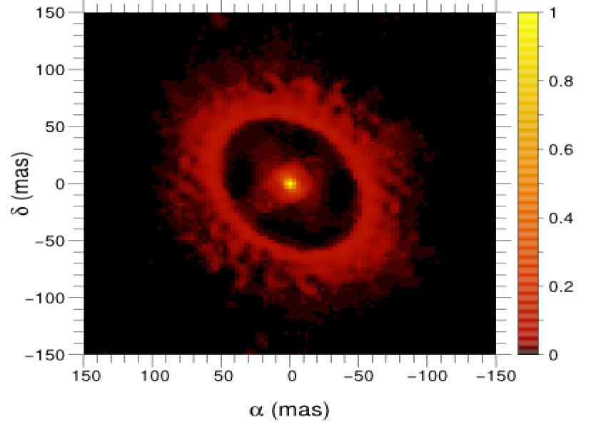
Our science with MATISSE
  Consortium protoplanetary disks GTO programmes
Inner part of outer disk
Inner disk
(down to sublimation radius)
150AU
Details on the Gap
15AU
Clump?
Simulation of MATISSE image for 3 nights of observation of the disk around HD100546
HL Tau image from ALMA

Slide 21
Our science with MATISSE
  Consortium protoplanetary disks GTO programmes
Nano-diamonds in the protoplanetary disk around HD100456
Size is larger in the band than the continuum

Slide 22
Our science with MATISSE
  Consortium protoplanetary disks GTO programmes
Nano-diamonds in the protoplanetary disk around HD100456
No asymmetry in the disk continuum nor
in the nano-diamonds distribution

Slide 23
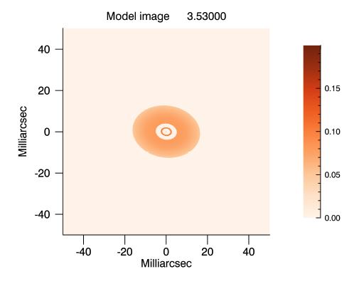
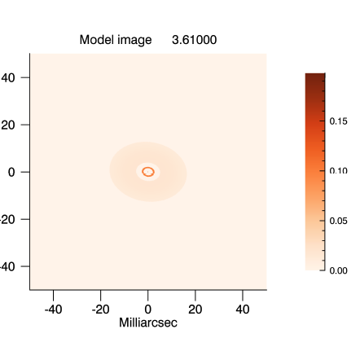
Our science with MATISSE
  Consortium protoplanetary disks GTO programmes
Nano-diamonds in the protoplanetary disk around HD100456
First interpretation :
Continuum coming from the hot inner disk close to sublimation radius
Nano-diamonds located further in an apparently dust free zone ort with a very low dust density

Slide 24
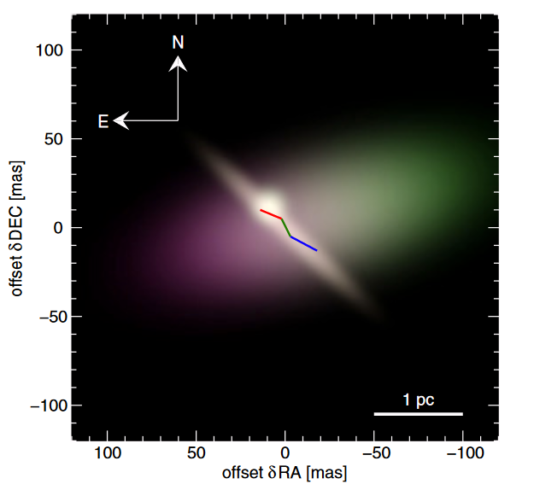
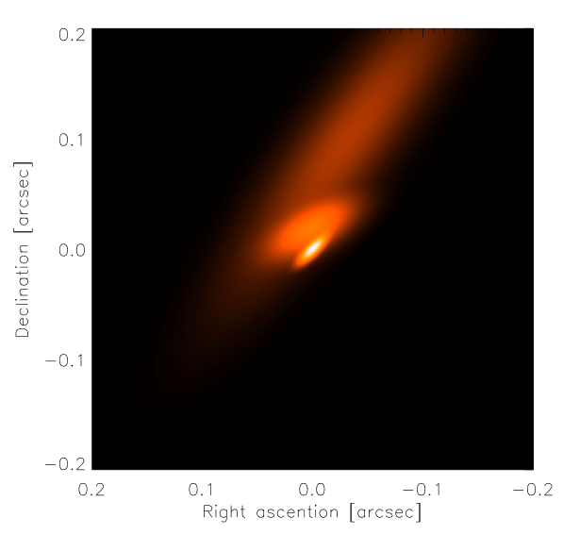
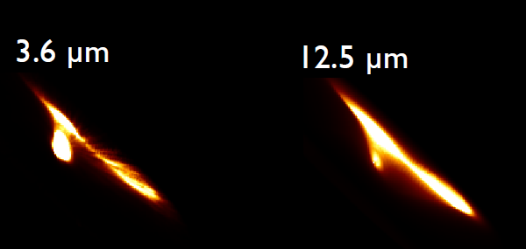
Our science with MATISSE
  Consortium AGNs GTO programs
Imaging the Torus of bright AGNs
Going beyond MIDI thanks to closure phase
Access to hotter dust and gas with L&M bands
CIrcinus
NGC1068
CIrcinus
Tristram+ 2014
Lopez-Gonzaga+ 2014
Radiative model of Circinus

Slide 25
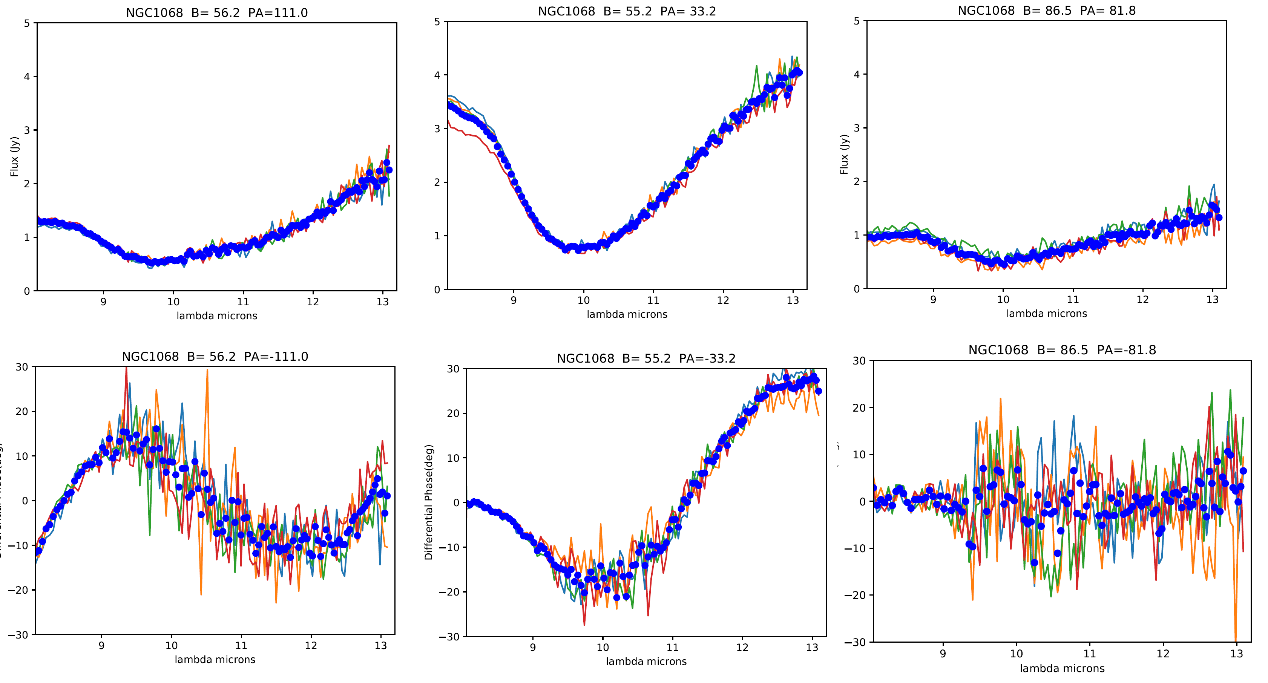
Our science with MATISSE
  Consortium AGNs GTO programs
MATISSE-UT observations of NGC1068

Slide 26
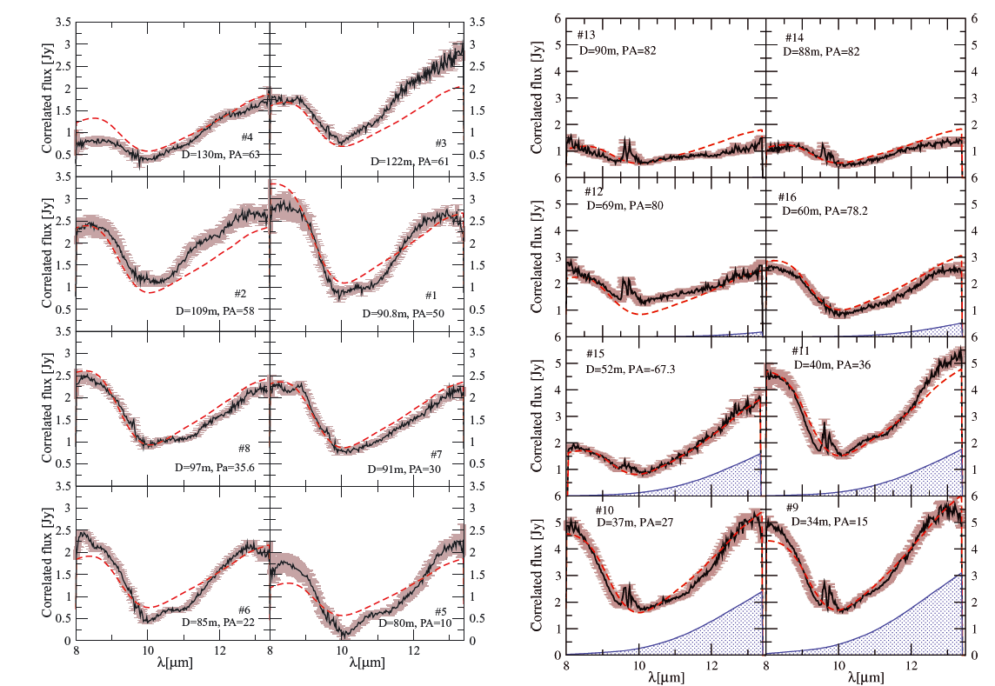
Our science with MATISSE
  Consortium AGNs GTO programs
Comparison with VLTI/DATA from Raban+ 2014

Slide 27
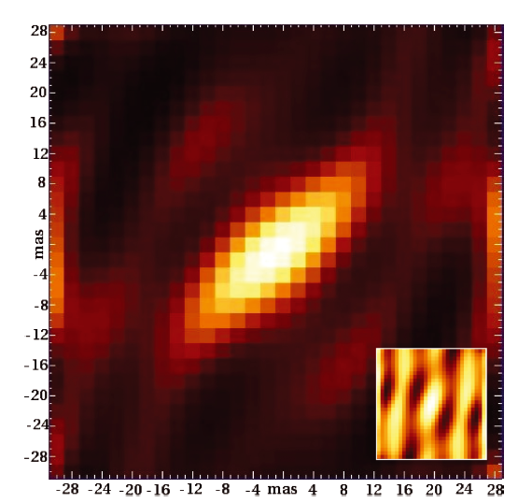
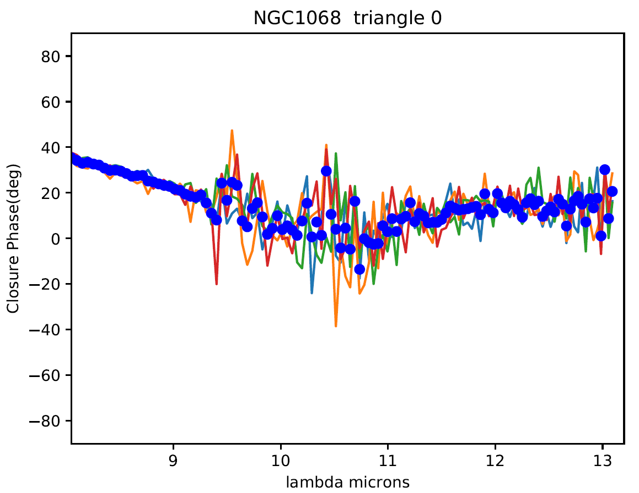
Our science with MATISSE
  Consortium AGNs GTO programs
Raban+ 2014
10° accuracy at 13µm
1° accuracy at 8µm
More accurate model
Image reconstruction?
Non-zero CP means assymetric object

Slide 28
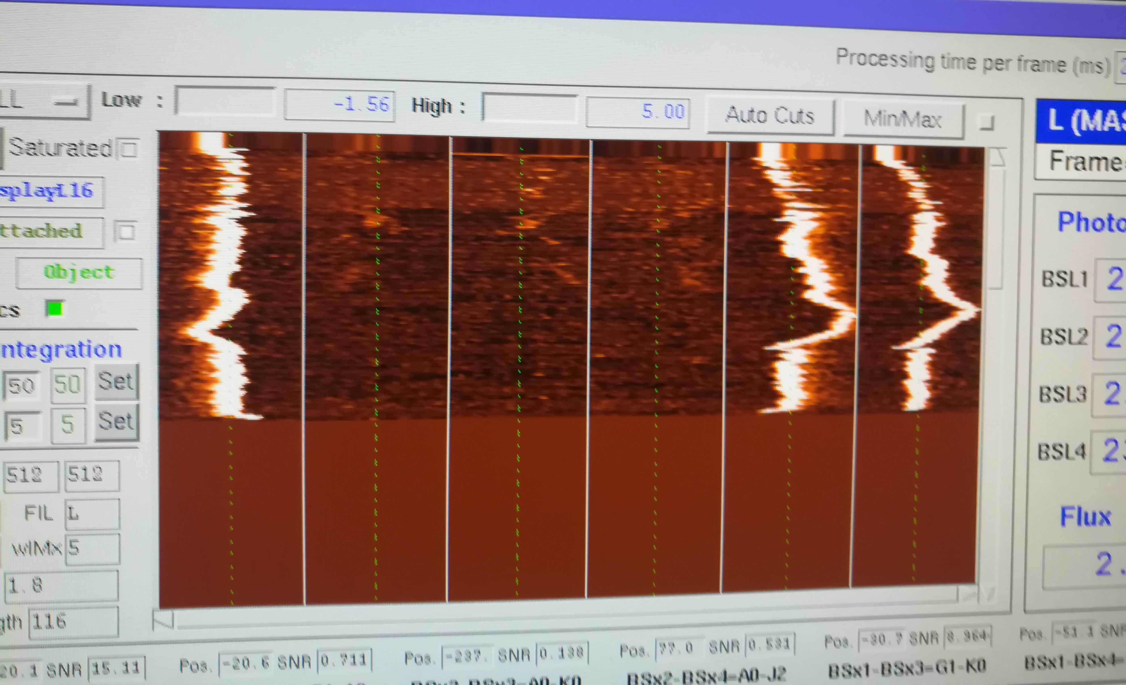
Our science with MATISSE
  Consortium AGNs GTO programs
L band data are
coming soon…
…and even with ATs
J2-K0
48m
A0-G1
90m
A0-K0
128m
A0-J2
129m
G1-K0
90m
G1-J2
58m
MATISSE L band waterfall of the fringes on NGC1068

Slide 29
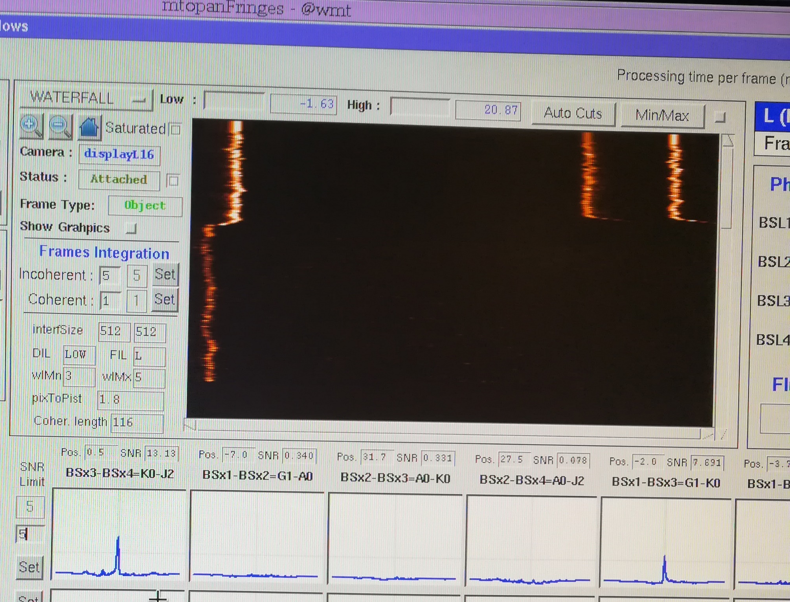
Our science with MATISSE
  Consortium AGNs GTO programs
Coherencing the fringes
on 3Tels at 1Hz

Slide 30
Our science with MATISSE
  Consortium stellar physics programs
Programmes mainly on evolved stars
Stellar surface spectro-imaging:
  Red giants
  Red supergiants
  AGB
Environments of evolved stars including :
  AGB & post-AGB
  Wolf-Rayet
  B[e]
  Cepheids

Slide 31
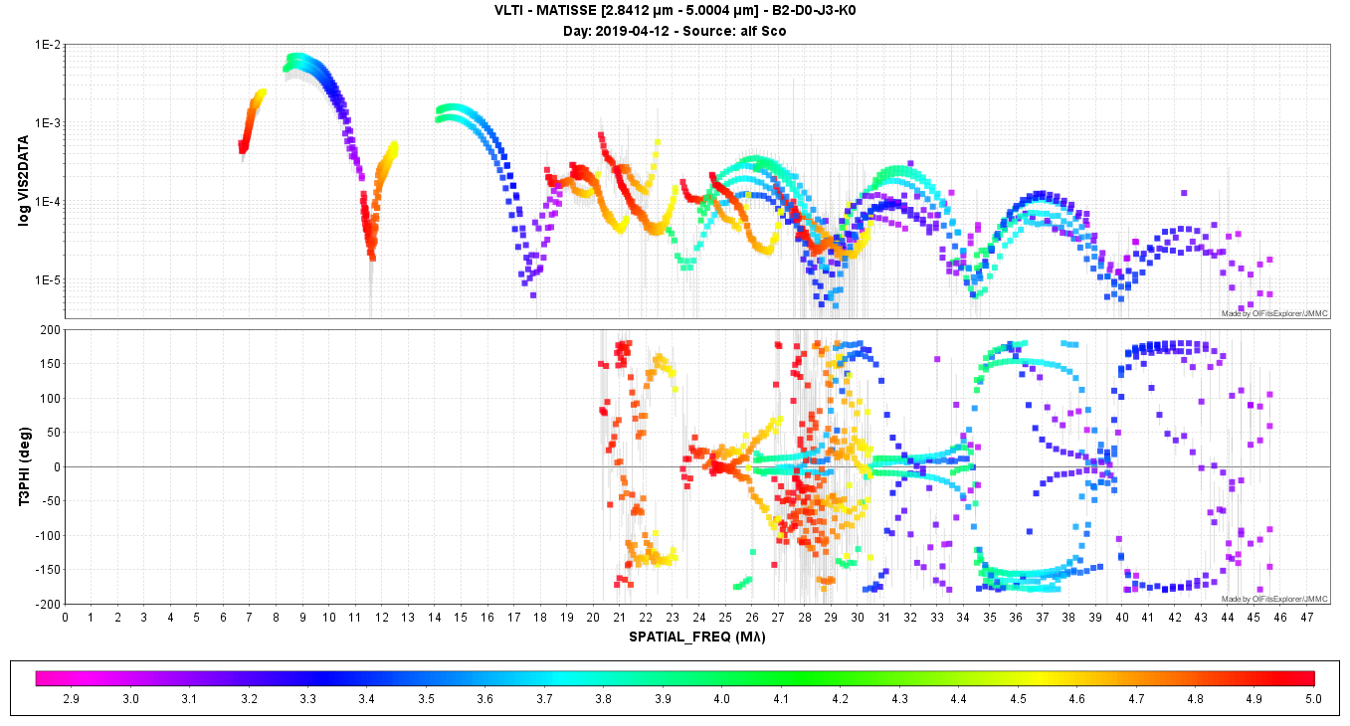
Our science with MATISSE
  Consortium stellar physics programs
Antares 8th visibility lobes measurements down to V² = 10⁻⁵

Slide 32
Our science with MATISSE
  Consortium stellar physics programs
Haubois+ 2009
Paladini+ 2018
Baron+ 2014
Antares 8th visibility lobes measurements down to V²=10⁻⁵

Slide 33
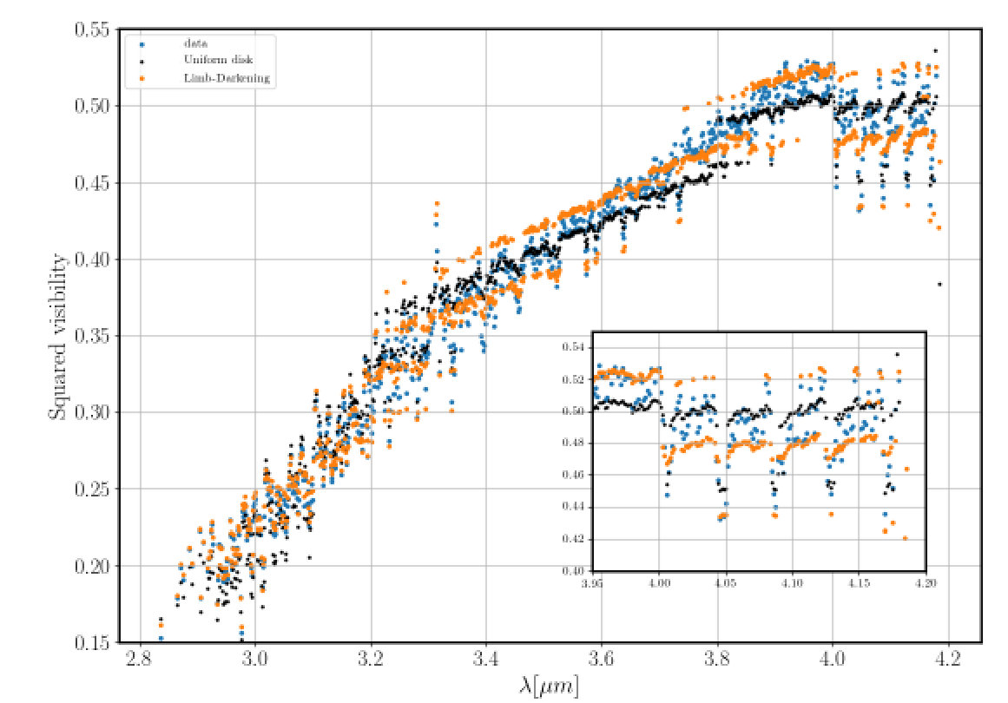
Our science with MATISSE
  Test of image capability of MATISSE (December 2018)
Betelgeuse HIGH-L
Spectro-imaging in CO lines
Study of upper atmosphere
No kinematics (R=1000)
VHIGH is coming soon R~5000
(commissioning in 10 days)

Slide 34
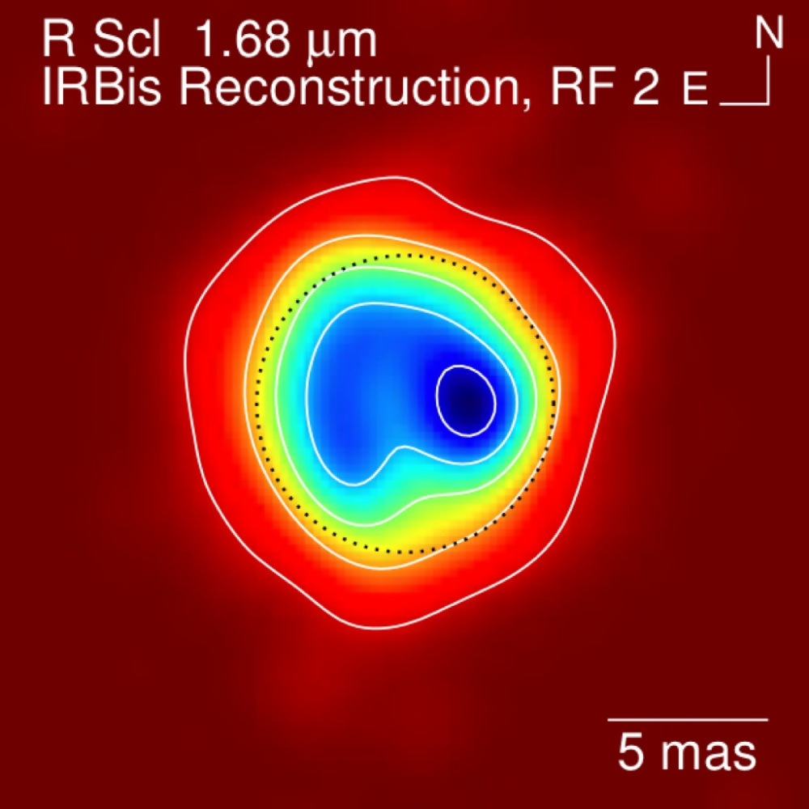
Our science with MATISSE
  Test of image capability of MATISSE (December 2018)
Imaging Commissioning Run
10 nights of observation
All 4 offered AT configurations :
Small : 12-35m
Medium : 40-105m
Astrometric:58-129m
Large : 90-132m
3 main targets (well studied) :
FS CMa : YSO or B[e]? => circumstellar disk
R Scl : AGB
Betelgeuse : to test HR imaging capability
PIONIER image of FS CMa
B[e] or Herbig?
PIONIER image of R Scl
Carbon-rich AGB
Haubois+ 2009
Betelgeuse

Slide 35
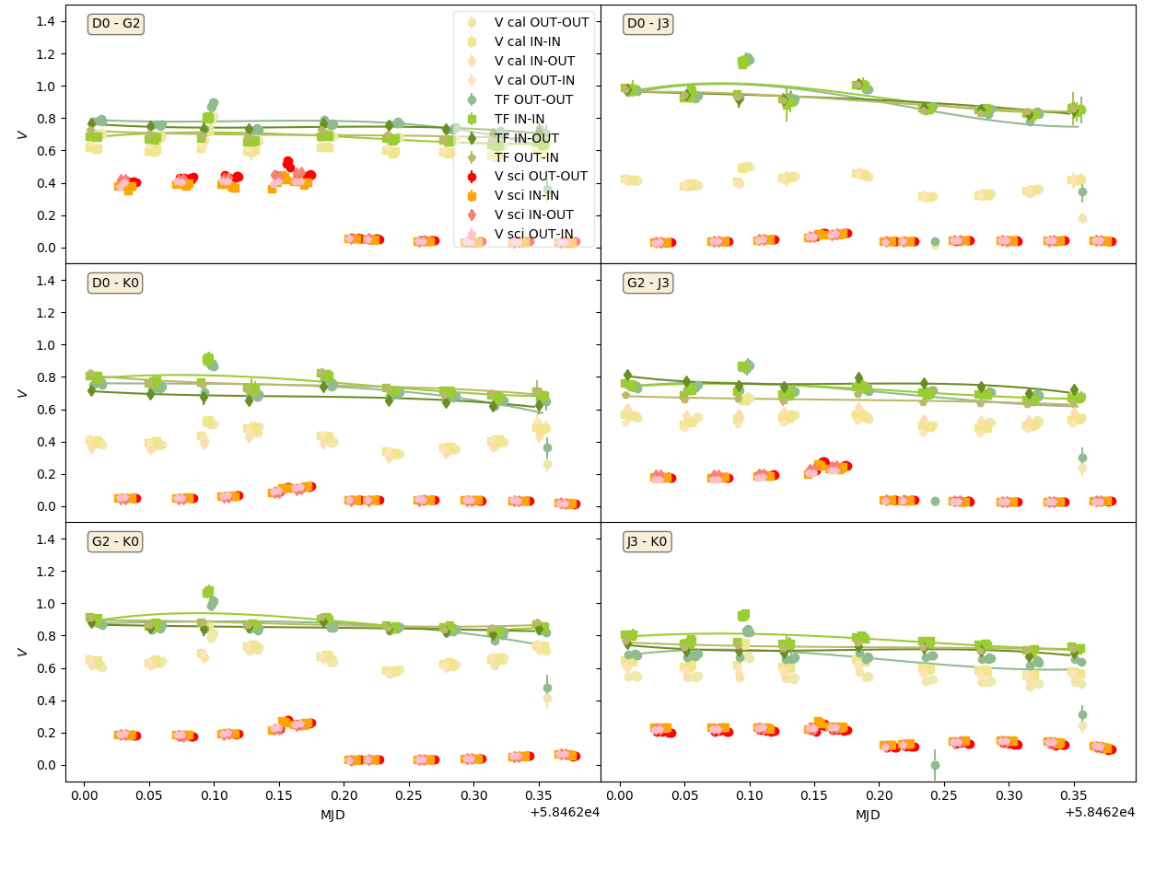
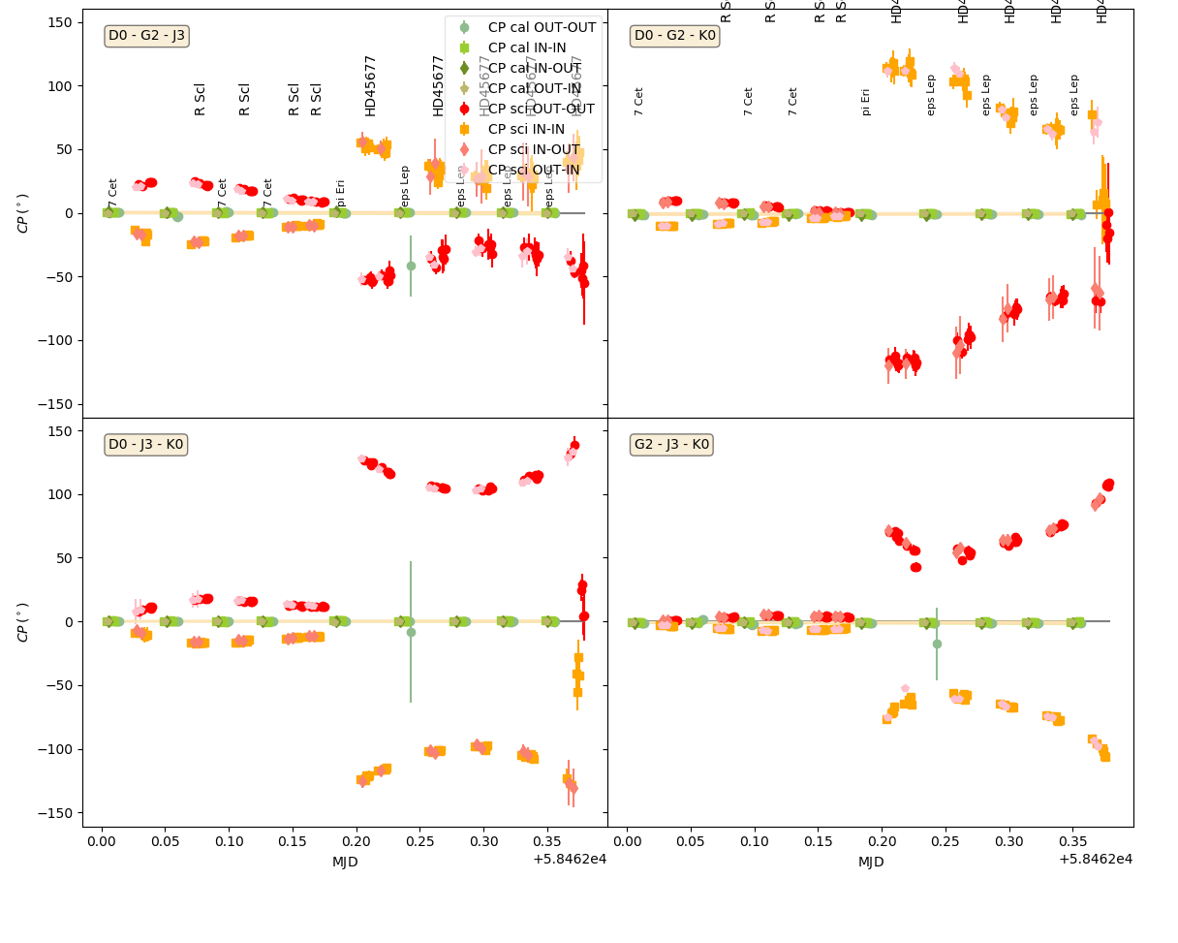
Our science with MATISSE
  Test of image capability of MATISSE (December 2018)
R Scl
FS CMa
R Scl
FS CMa
L-Band Transfer function in visibility
L-Band Transfer function in Closure Phase

Slide 36
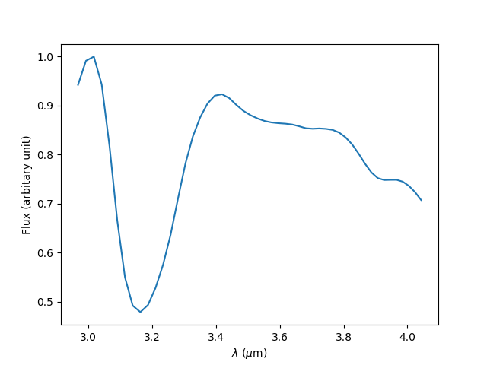
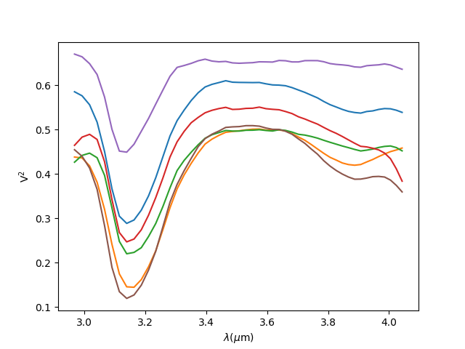
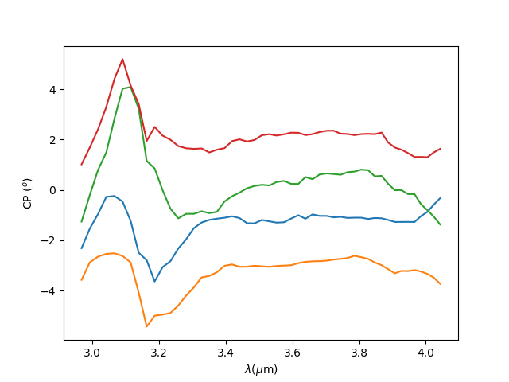
Our science with MATISSE
  Test of image capability of MATISSE (December 2018)
One R Scl dataset (1 Flux + 6 Visibilities + 4 CP)
Strong visibility and CP effects in the 3.1µm band of Acethylene ( C₂H₂ )

Slide 37

Our science with MATISSE
  Test of image capability of MATISSE (December 2018)
PIONIER H-band
MATISSE L-band spectrally-resolved images

Slide 38

Our science with MATISSE
  Test of image capability of MATISSE (December 2018)
FS CMa N-Band Visibility as function of spatial frequency
2n MATISSE
1n MIDI

Slide 39


Our science with MATISSE
  Test of image capability of MATISSE (December 2018)
MATISSE L-band image
PIONIER image
MATISSE N-band image

Slide 40

Our science with MATISSE
  Test of image capability of MATISSE (December 2018)
Multi-band inteferometry is a powerful
tool to probe circumstellar material

Slide 41

  Test of image capability of MATISSE (December 2018)
Let’s dream of a «I-shooter» mode for VLTI
It could include the J band and even R and I

Slide 42
Our science with MATISSE
  Test of image capability of MATISSE (December 2018)
Multi-band inteferometry is a powerful
tool to probe circumstellar material
Let’s dream of a «I-shooter» mode for VLTI
It could include the J band and even R and I
First step will be GRA+MAT
which would deliver data from 2 to 13µm

Slide 43
Our science with MATISSE
  Long-baseline interferometry 101 in 5min
  Description of consortium Programmes
  My personnal sciences cases : hot stars environments

Slide 44



Our science with MATISSE
  Circumstellar environment of hot stars in the mid-infrared
Artist view of CPD -57° 2874
from MIDI + AMBER observation
Rigel wind in Brγ
from CMFGEN model
« Betoy » model of a Be star
B[e] stars
Linked to rotation or binarity?
Strongly anisotropic geometry
diluted & dense gas + dust
Hot supergiants wind
Radiatively driven
Assymmetry, clumping?
Classical Be stars
Fastest rotators
Gaseous disk
Better knowledge of CE => better understanding of stellar evolution

Slide 45


Our science with MATISSE
  Mid-infrared view of classical Be stars
MIDI observation show almost unresolved CE in N band.
Mid-infrared puts constraints on outer disk density law
Linked with disk dissipation and truncature by putative companions
Can we do better with MATISSE?
What about in L&M bands?
Meilland+ 2009

Slide 46

Our science with MATISSE
  Mid-infrared view of classical Be stars
Brα
Pfund lines (+ Humphreys)
GRA4MAT spectrum obtaine on K CMa

Slide 47




Our science with MATISSE
  Mid-infrared view of classical Be stars
λ = 4.047µm
Size
v=-300km/s
Orientation
λ = 4.056µm
v=+300km/s
Inclination
Angle
MCMC–fit on disk geometry and kinematics from Brα using a toy-model
Radiative transfer will add information on the density and temperature distribution

Slide 48

Our science with MATISSE
  Of gas and dust around B[e] stars
HD62623 observation from MIDI and MATISSE
4h MATISSE
1n MIDI

Slide 49



Our science with MATISSE
  Of gas and dust around B[e] stars
HD62623 : Radiative transfert modelling of MIDI data with MC3D
Keplerian disk
Equatorial wind
From Meilland+ 2010

Slide 50


Our science with MATISSE
  Of gas and dust around B[e] stars
N
L
M
My first service mode dataset from MATISSE : MWC300

Slide 51

Our science with MATISSE
  Of gas and dust around B[e] stars
My first service mode dataset from MATISSE : MWC300

Slide 52

Our science with MATISSE
  Of gas and dust around B[e] stars
Comparison with MIDI data from Boley+ 2014 : similar noise level up to 11µm
MIDI noise significantly lower beyond this limit
⬄
Data-processing or instrumental (bad prism transmission)

Slide 53



Our science with MATISSE
  Of gas and dust around B[e] stars
Differential phase
Visibility
Closure phase

Slide 54

Our science with MATISSE
  Wind of hot stars
Brα
????
Pfund lines
MATISSE L&M band spectrum of the blue supergiant Rigel (GRA4MAT DIT=10s)

Slide 55

Our science with MATISSE
  Wind of hot stars
Accurate diameter
Measurement 2.7mas
Visibility (top) and closure phase (bottom) from GRA4MAT observation of Rigel

Slide 56

Our science with MATISSE
  Wind of hot stars
CMFGEN model
Constraints on Mass-loss
+
Clumping or Asymmetry
Wind of Rigel in the Brα line

Slide 57
Our science with MATISSE
  Conclusion
  It’s great and we are happy.

