Slide 1
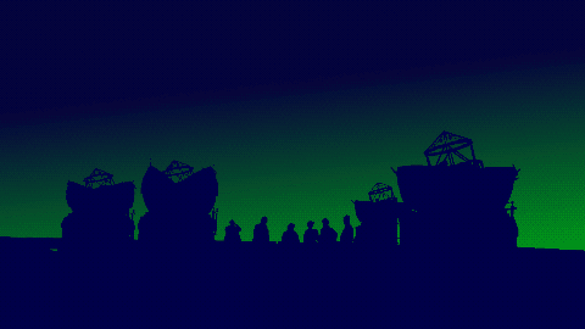

Slide 2
The 10th VLTI School of Interferometry
15 years of VLTI Schools
June 2021 100% Online MATISSE and interferometry for planetology
July 2018 Lisbon (Portugal) 2nd generation instruments at VLTI
Sept. 2015 Cologne (Germany) Optical interferometry from theory to observations
Sept. 2013 Barcelonnette (France) High spatial resolution for stellar astrophysics
April 2010 Porquerolles (France) High spatial resolution in Astronomy
June 2008 Keszthely (Hungary) Astrometry and Imaging with the VLTI
Sept. 2007 Torun (Poland) AGN at the highest angular resolution
June 2007 Porto (Portugal) Circumstellar disks and planets at very high resolution
June 2006 Goutelas (France) Observation and data reduction with the VLTI
Feb. 2002 Les Houches (France) Observing with the VLTI
First light of VLTI in March, 17 2001

Slide 3
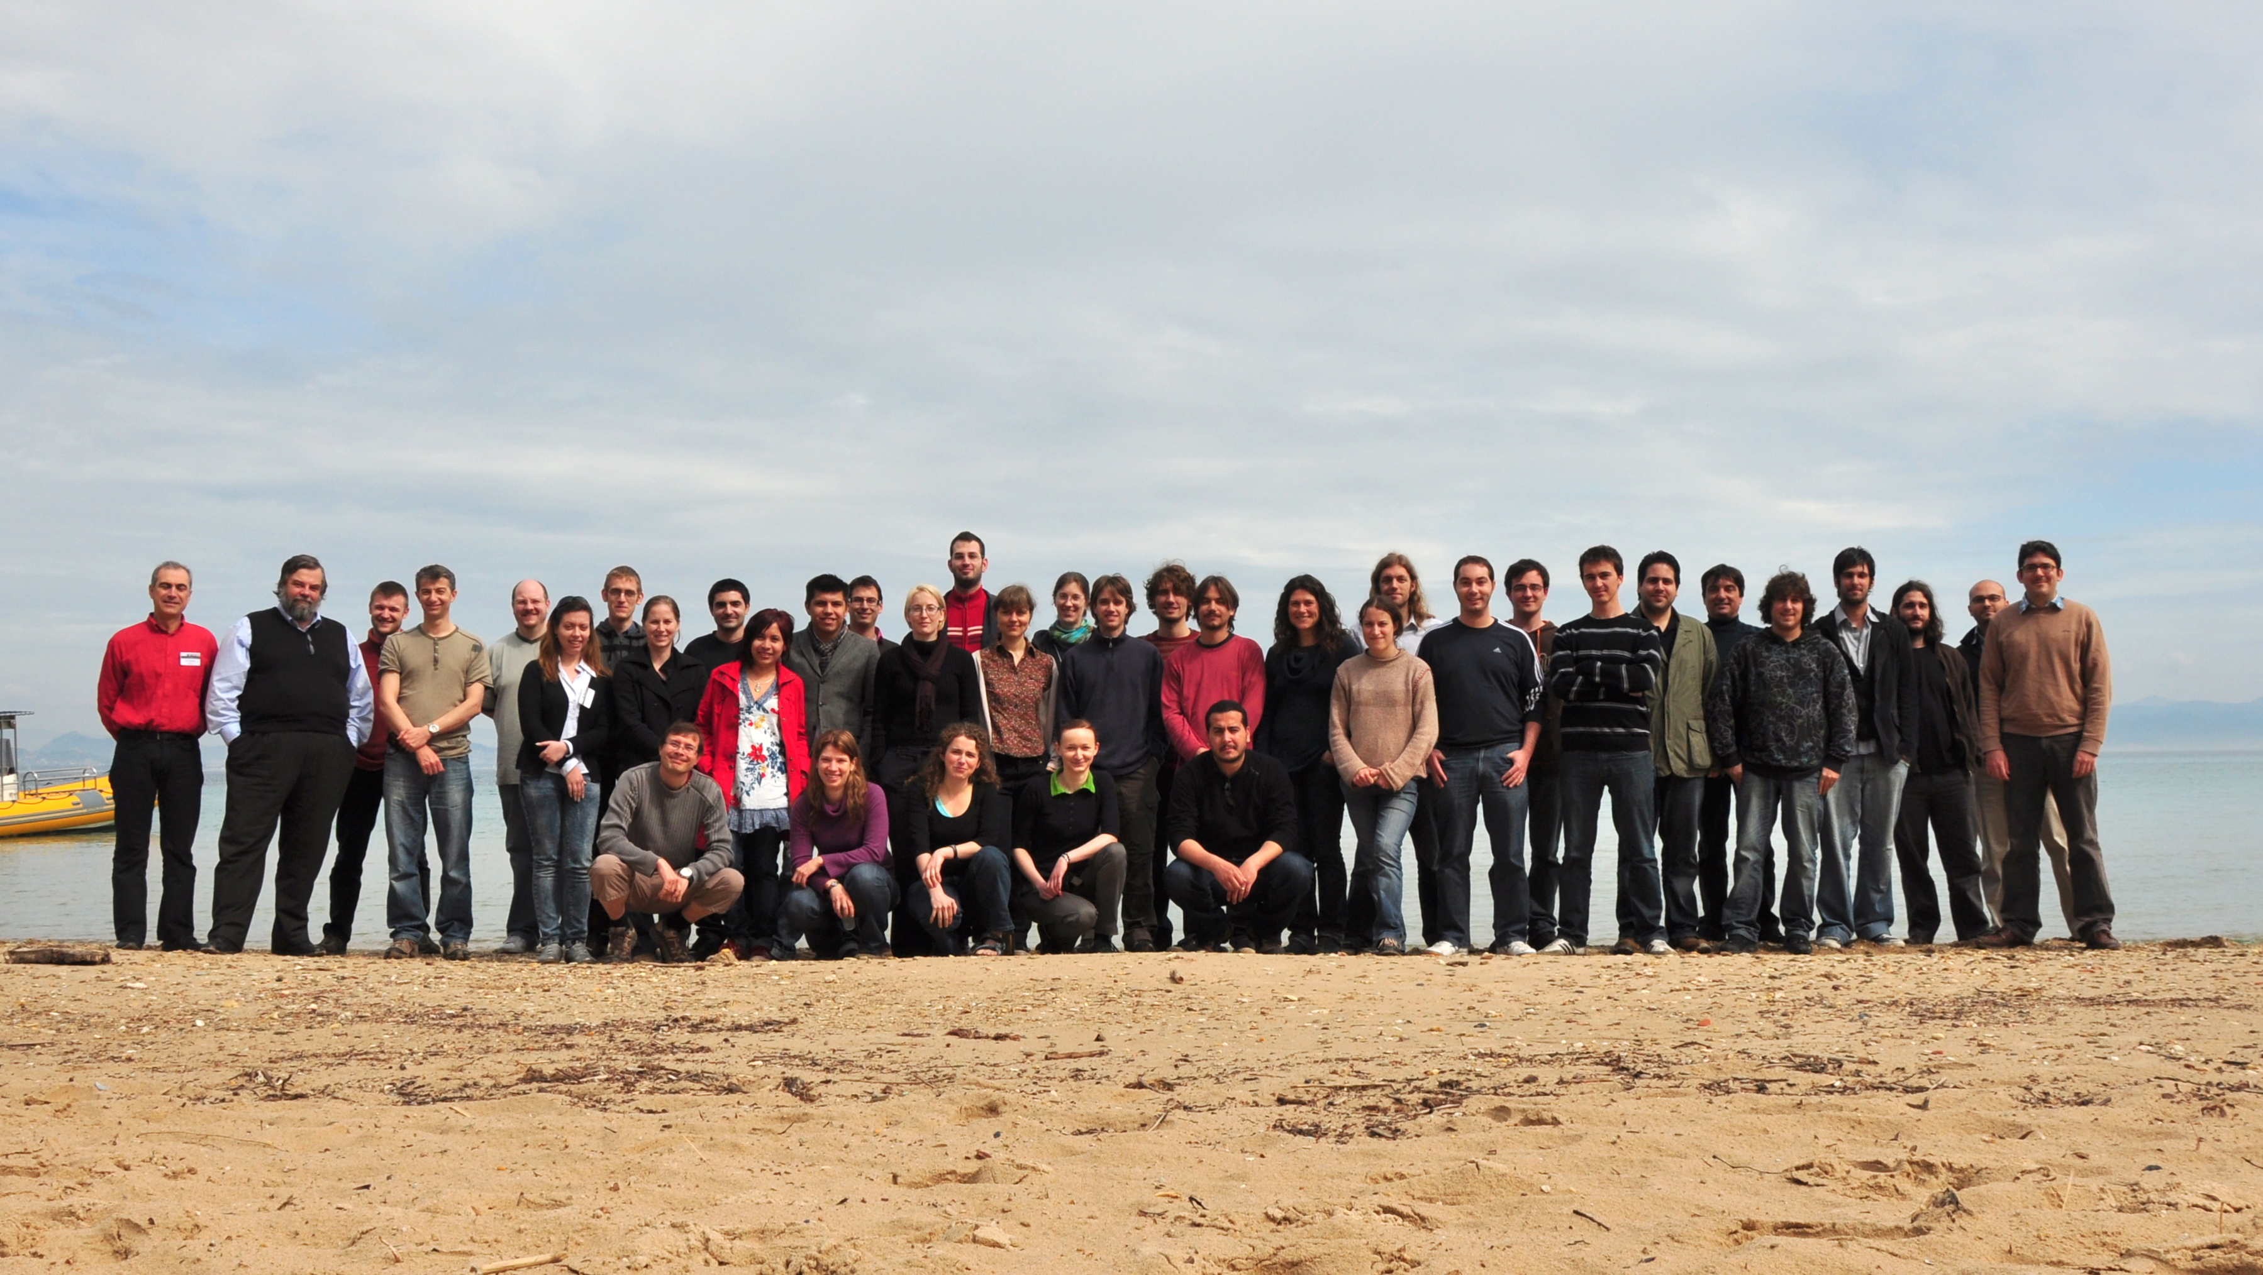
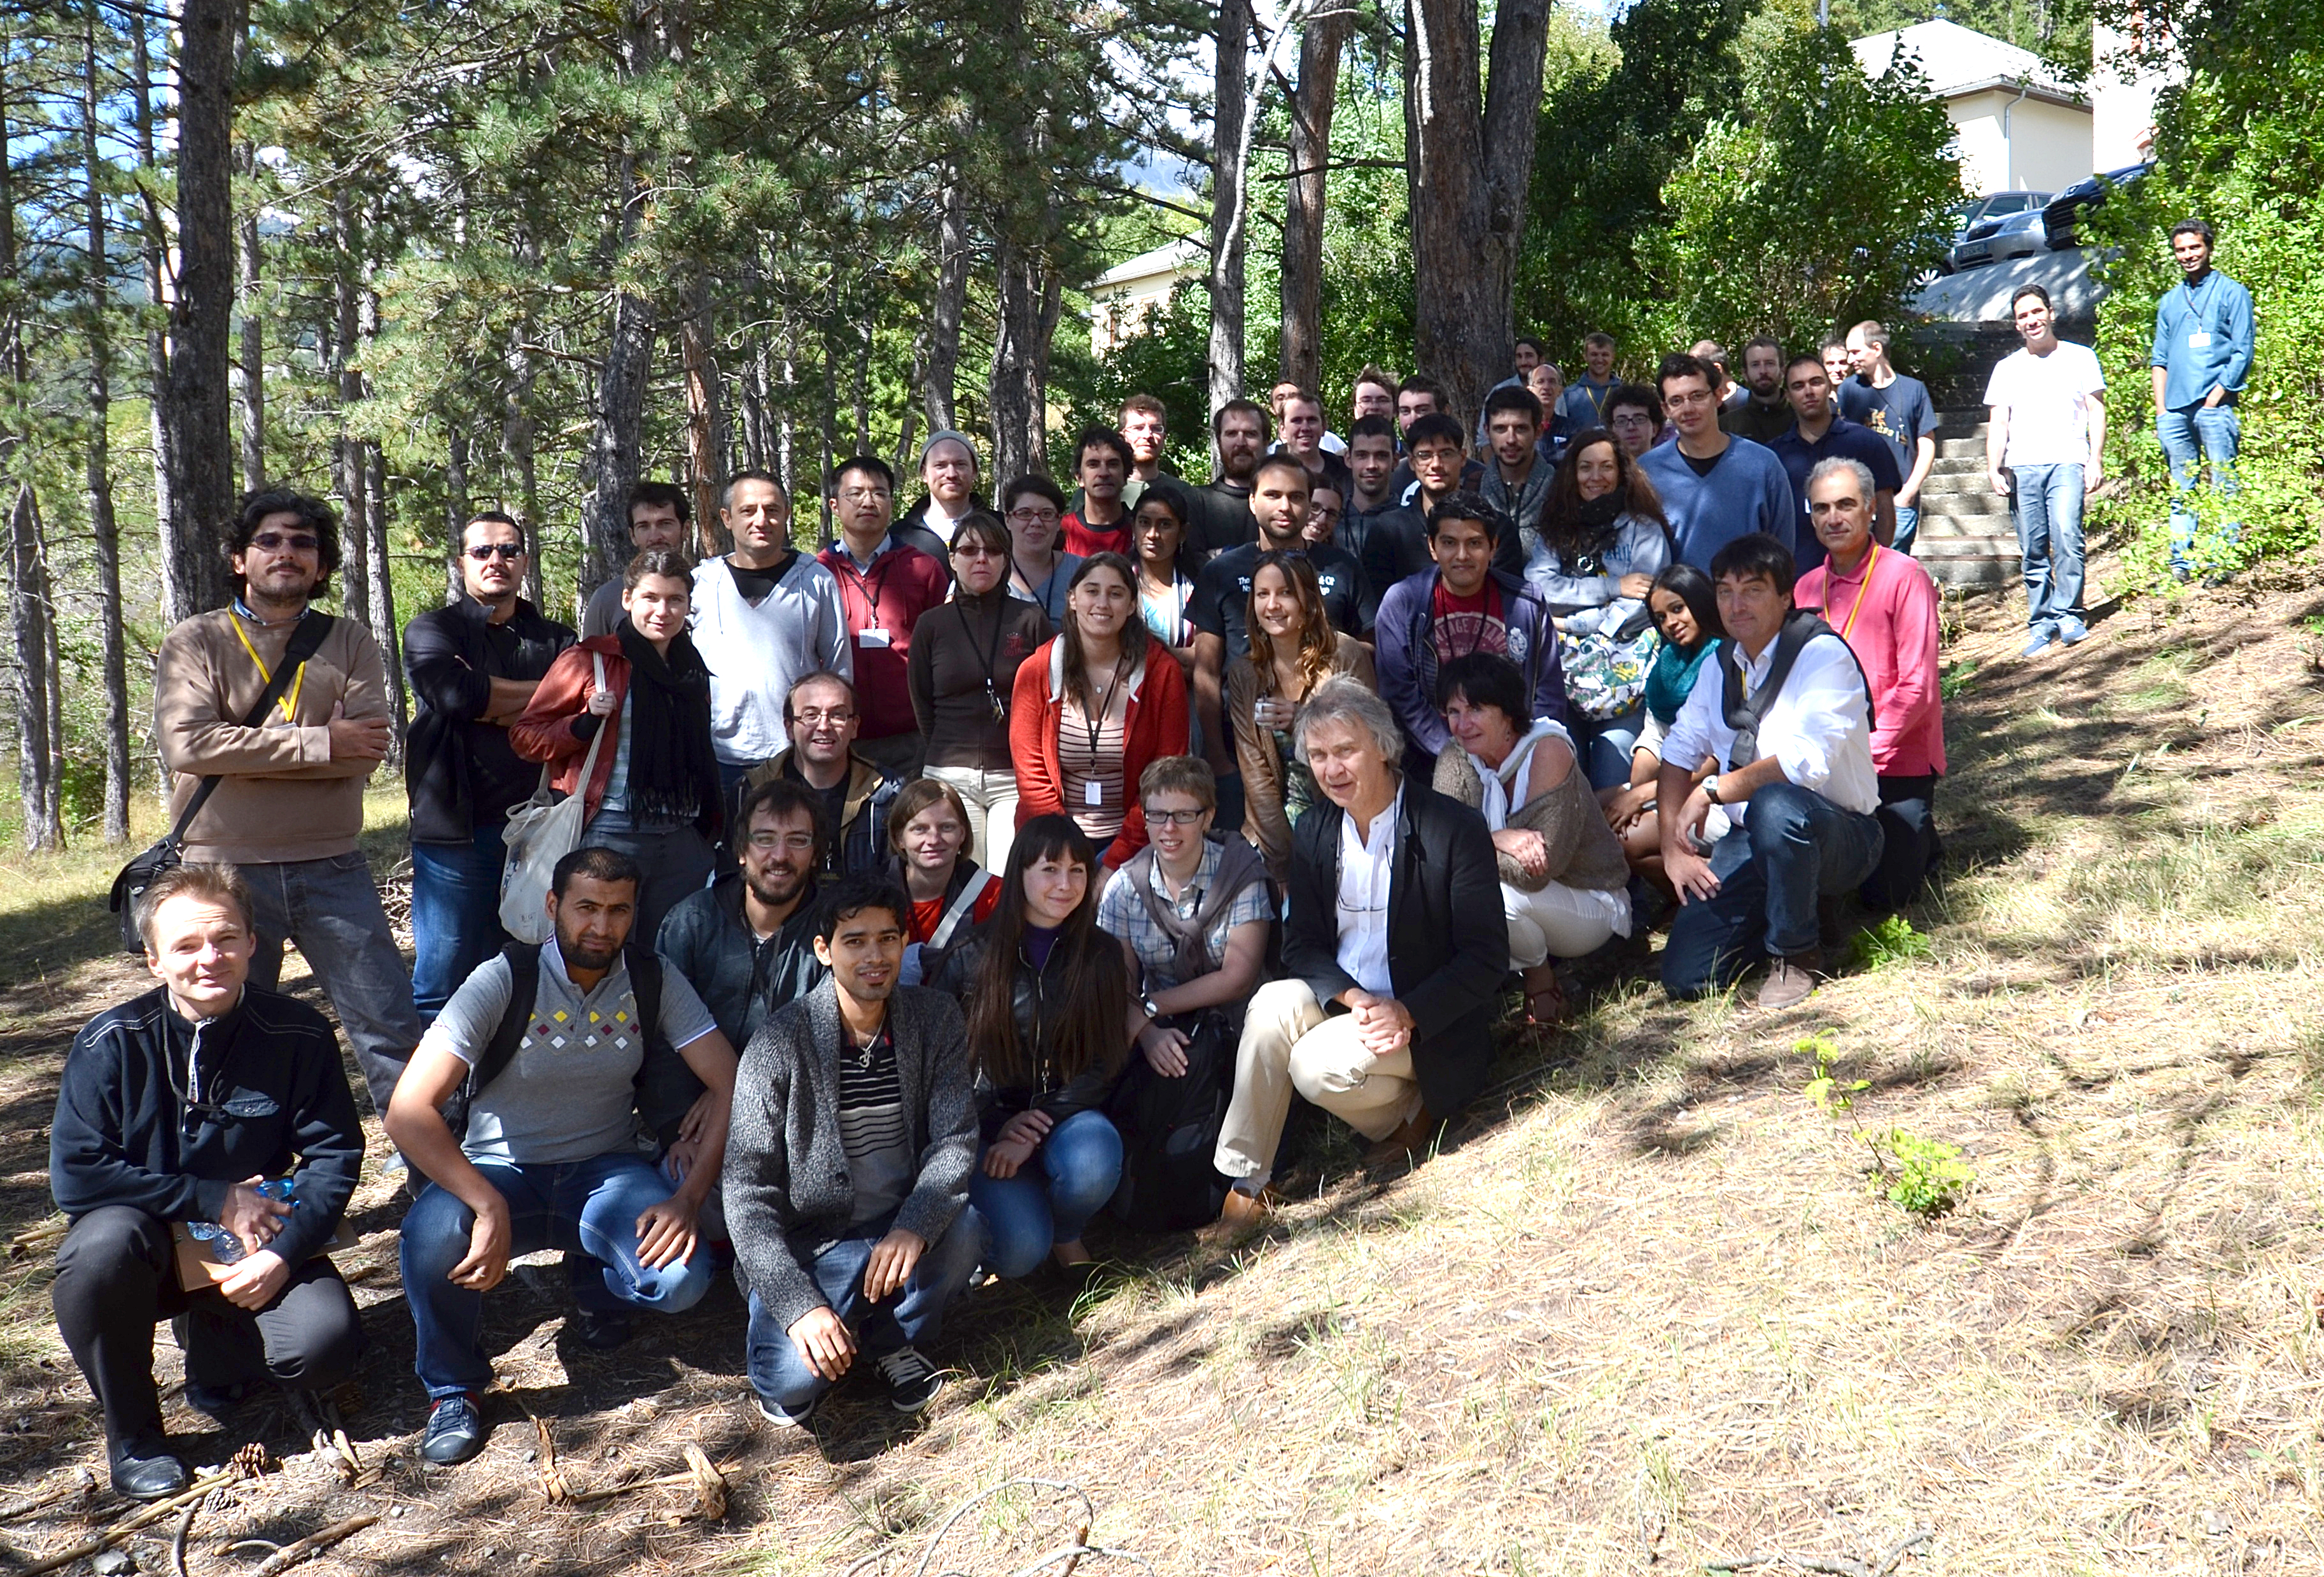
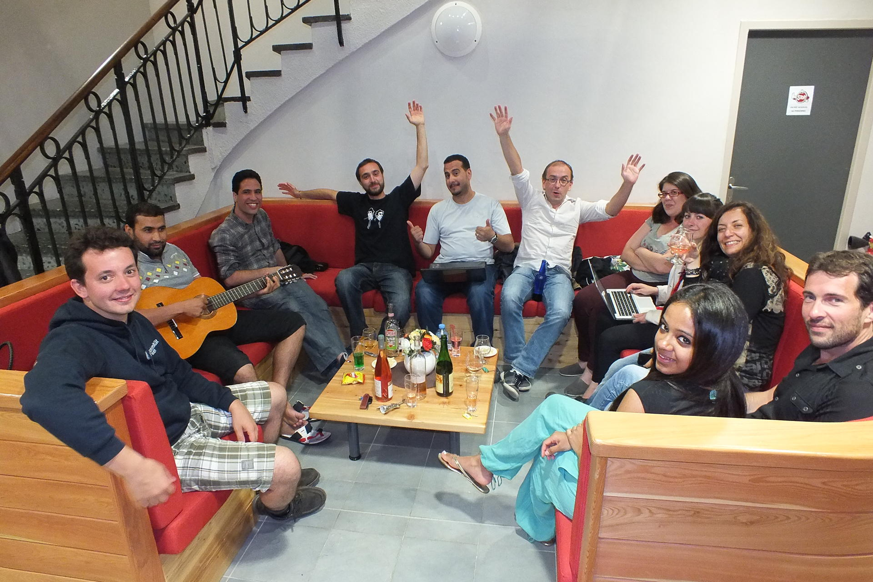
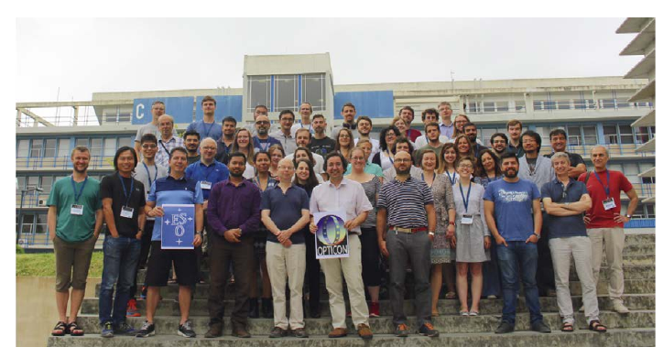
The 10th VLTI School of Interferometry
A Long history of VLTI Schools
Barcelonnette 2013
Porquerolles 2010
Barcelonnette 2010
Lisbon 2018

Slide 4
The 10th VLTI School of Interferometry
About 40 students per school
≈ 400 Students trained in 15 years
The 2021 is the largest VLTI school
20 Teachers
60 Registered Students
30 Registration for Lectures only
I hope it will be a success

Slide 5
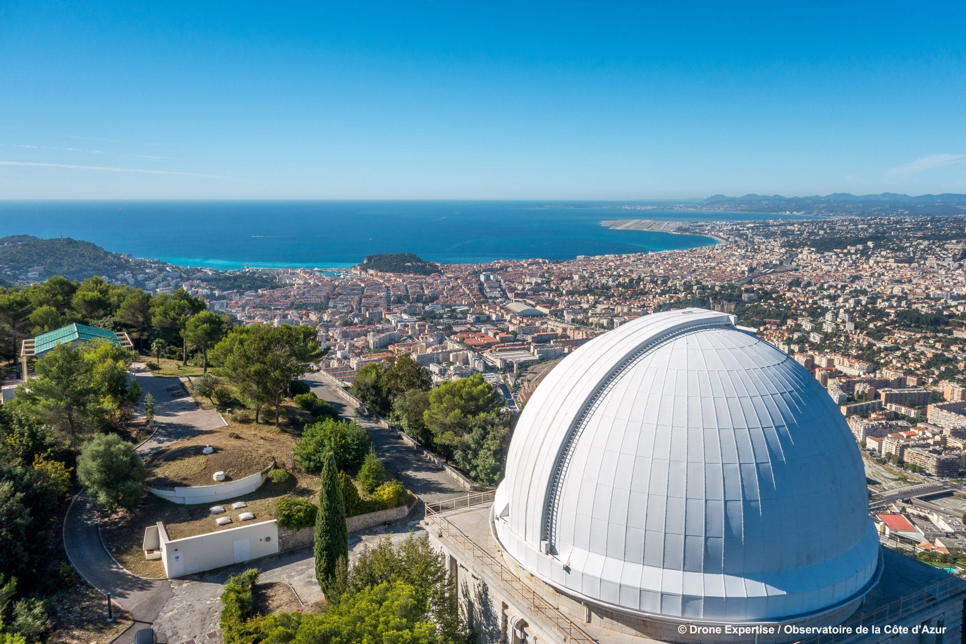
The 10th VLTI School of Interferometry

Slide 6
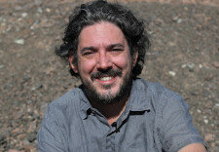
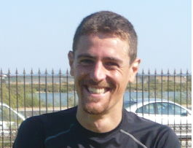
The 10th VLTI School of Interferometry
My co-organizers
Florentin Millour
Alexis Matter

Slide 7
The 10th VLTI School of Interferometry
Scientific Organizing Committee (SOC)
Myriam Benisty (IPAG)
Roy van Boekel (MPIA)
Laurent Bourges (OSUG)
David Buscher (University of Cambridge)
Mercedes Filho (University of Porto)
Ágnes Kóspál (Konkoly Observatory)
Roxanne Ligi (INAF)
Alexis Matter (OCA)
John McKean (ASTRON)
Anthony Meilland (OCA)
Florentin Millour (OCA)
Claudia Paladini (ESO)
Isabelle Tallon-Bosc (CRAL)
Local Organizing Committee (LOC)
Laurent Bourges (OSUG)
Pierre Cruzalebes (OCA)
A. Domiciano de Souza (OCA)
Camille Maccotta (OCA)
Alexis Matter (OCA)
Anthony Meilland (OCA)
Florentin Millour (OCA)
Fabien Patru (OCA)
Sophie Rousset (OCA)
Alain Spang (OCA)

Slide 8
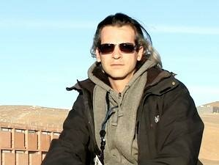
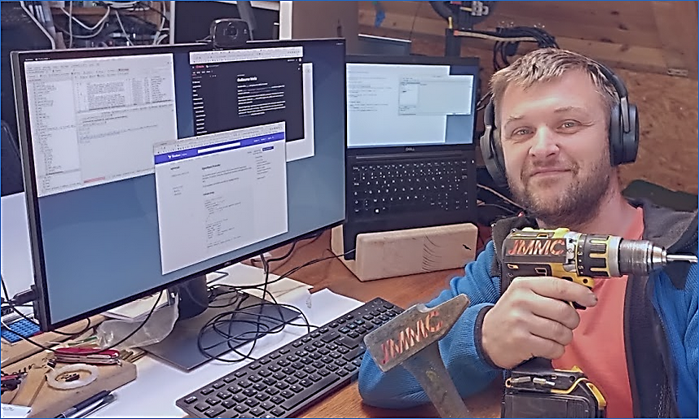
The 10th VLTI School of Interferometry
Many thanks to the Jean-Marie Mariotti Center (JMMC)
The French center of expertise on interferometry
Providing interferometric tools for the community
Helping in the organization from practice sessions
Setting the technical means for this 100% online schools
The JMMC technical Gurus
Laurent Bourges (top)
Guillaume Mella (bottom)

Slide 9
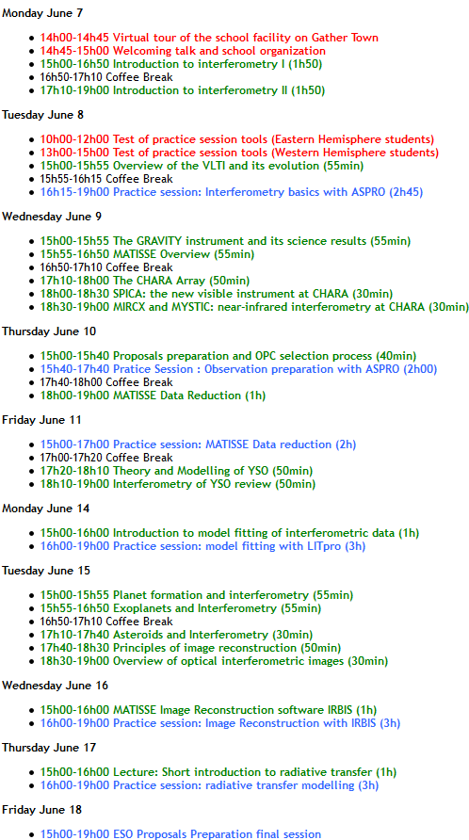
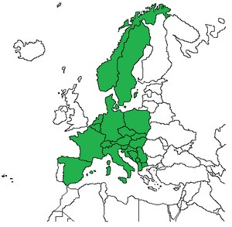
The 10th VLTI School of Interferometry
Schedule available on the website & Nuclino
Time are in Central European Summer Time (CEST)

Slide 10
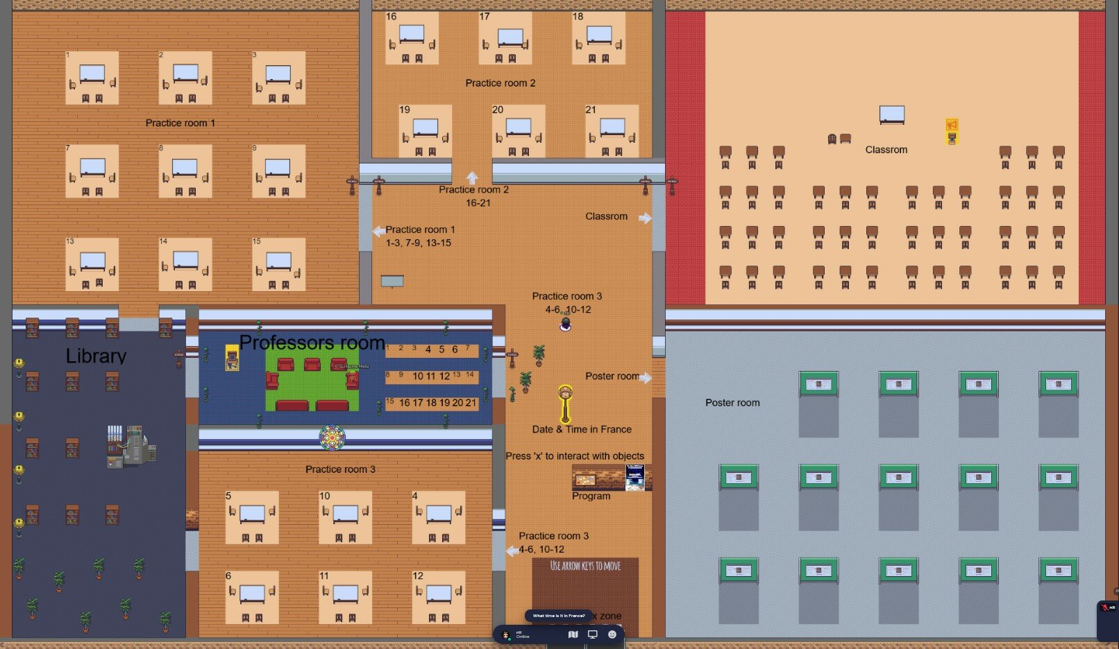
The 10th VLTI School of Interferometry
Our Gather Town School

Slide 11
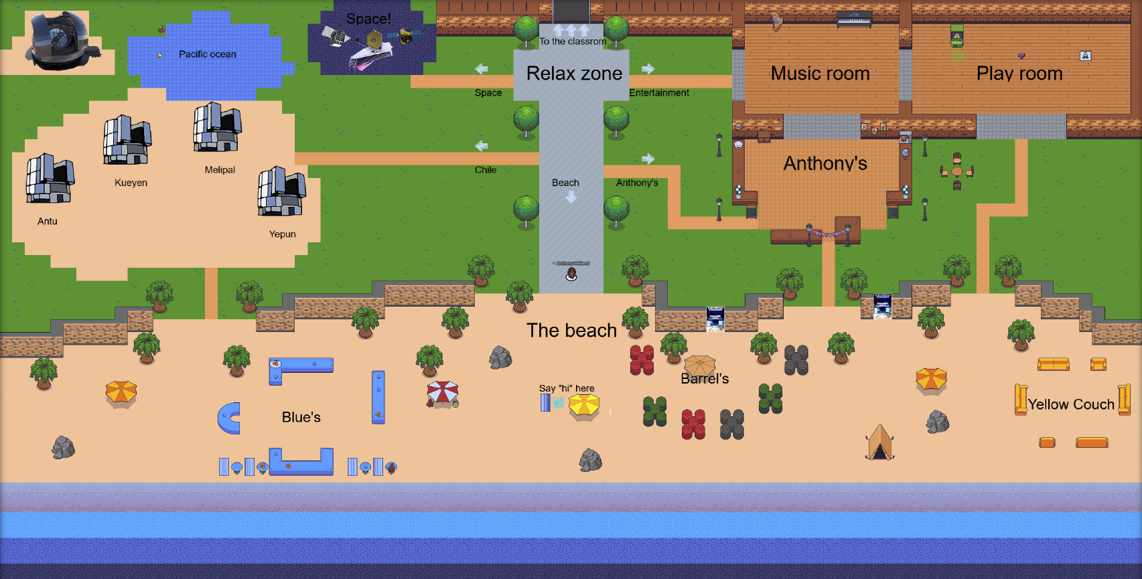
The 10th VLTI School of Interferometry
The Gather Town Relax Zone
Many Private rooms to gather in small groups
to work, talk and socialize

Slide 12
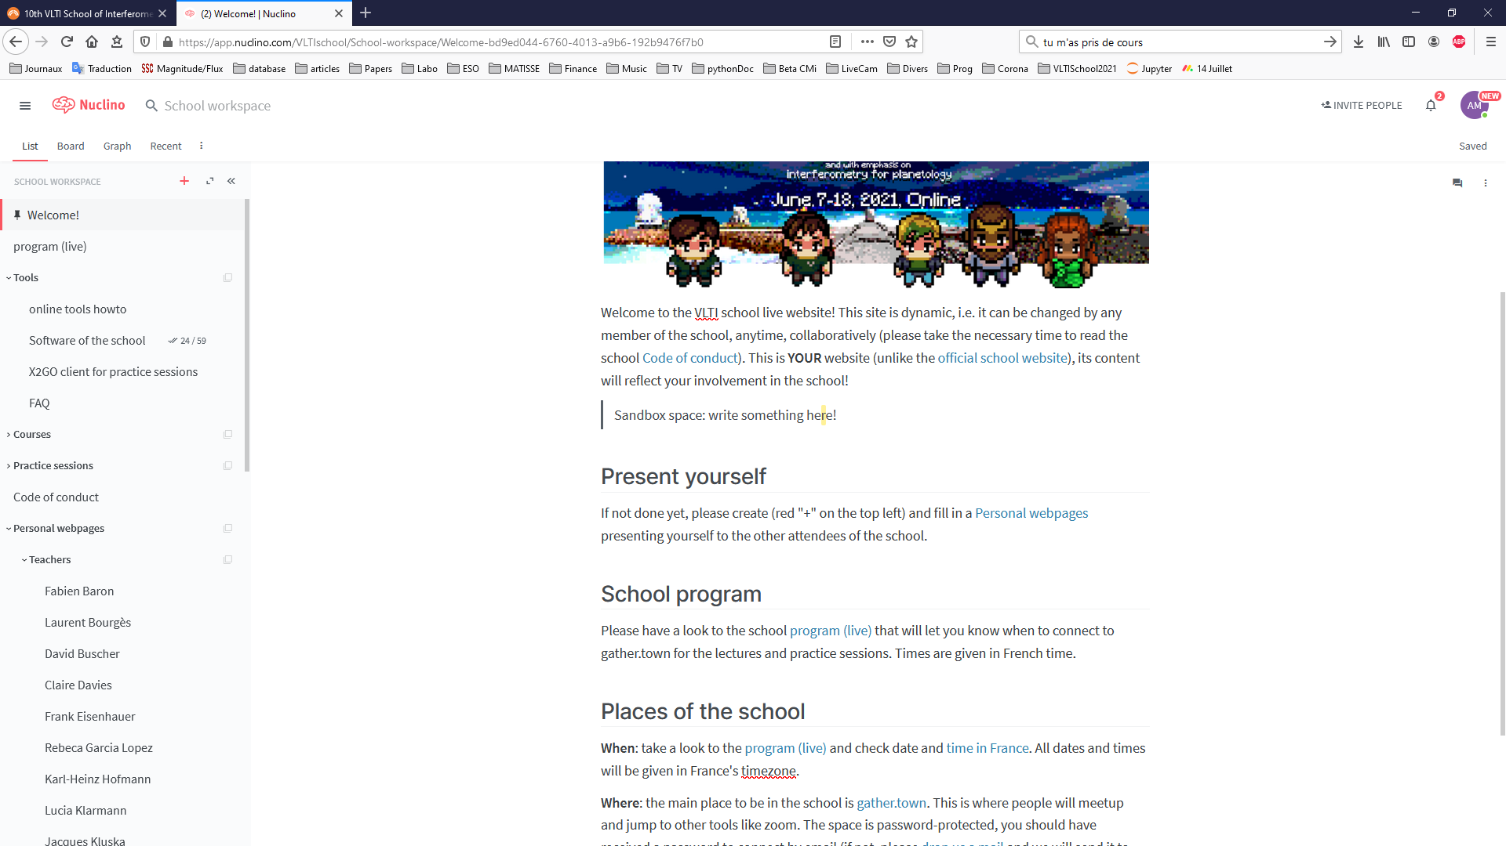
The 10th VLTI School of Interferometry
Nuclino : the place to find informations on the school

Slide 13
The 10th VLTI School of Interferometry
6 Practice sessions
Tuesday 8 16:15-19:00 Interferometry basics with ASPRO
Thursday 10 15:40-17:40 Observation preparation with ASPRO
Friday 11 15:00-17:00 MATISSE Data Reduction
Monday 14 16:00-19:00 Model Fitting with LITpro
Wednesday 16 16:00-19:00 Image Reconstruction with IRBIS
Thursday 17 16:00-19:00 Radiative transfer modelling

Slide 14
The 10th VLTI School of Interferometry
Practice sessions : 21 Virtual machines for 60 students
vlti-001@vs2021-01.jmmc.fr
…
vlti-021@vs2021-21.jmmc.fr
Organize yourself in groups of 3
Registered on the Nuclino
Before the first session tomorrow!

Slide 15
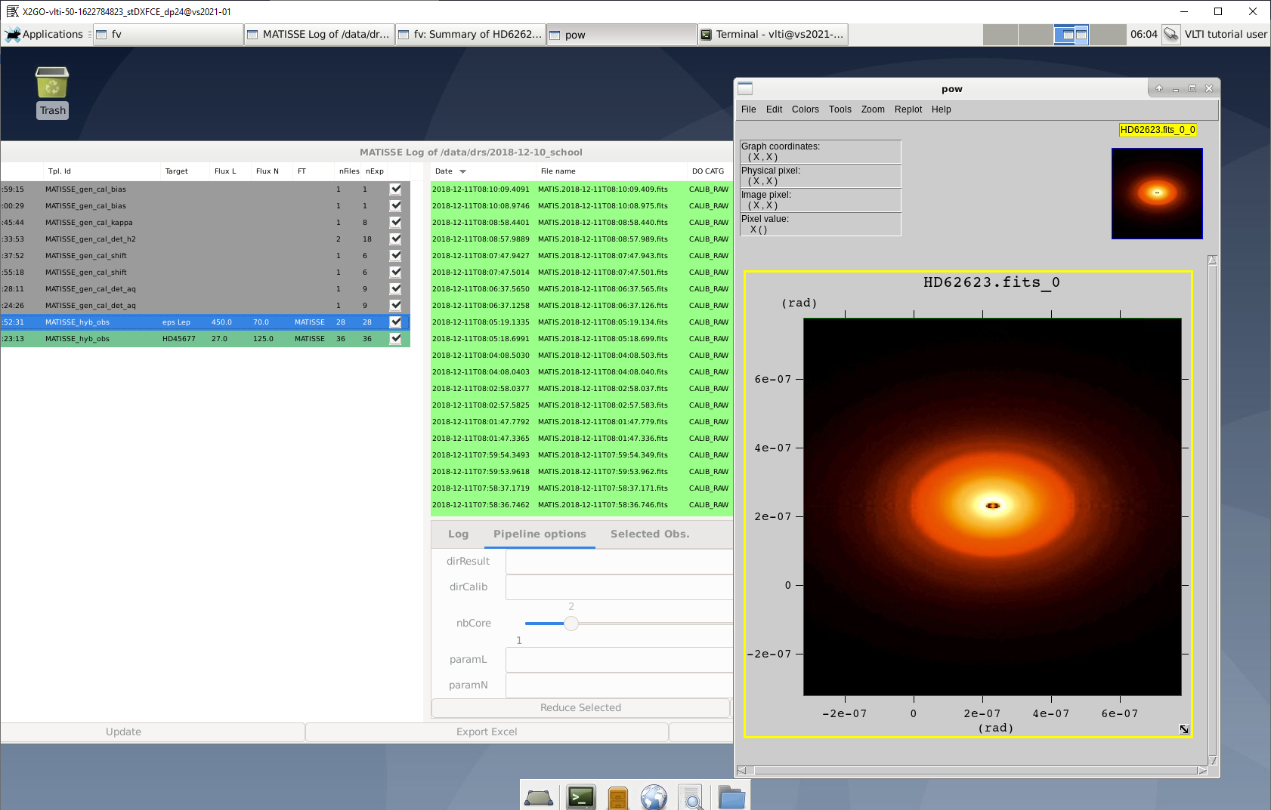
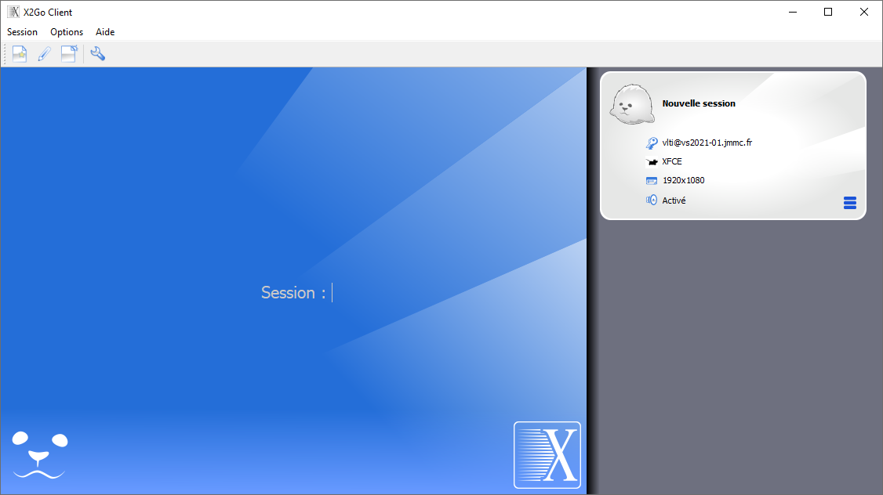
The 10th VLTI School of Interferometry
Practice sessions : Access to Virtual machines through X2Go
Install and test it before the first Practice session tomorrow 16:15 CET

Slide 16
The 10th VLTI School of Interferometry
Practice sessions : Test of X2Go tomorrow before the school

Slide 17
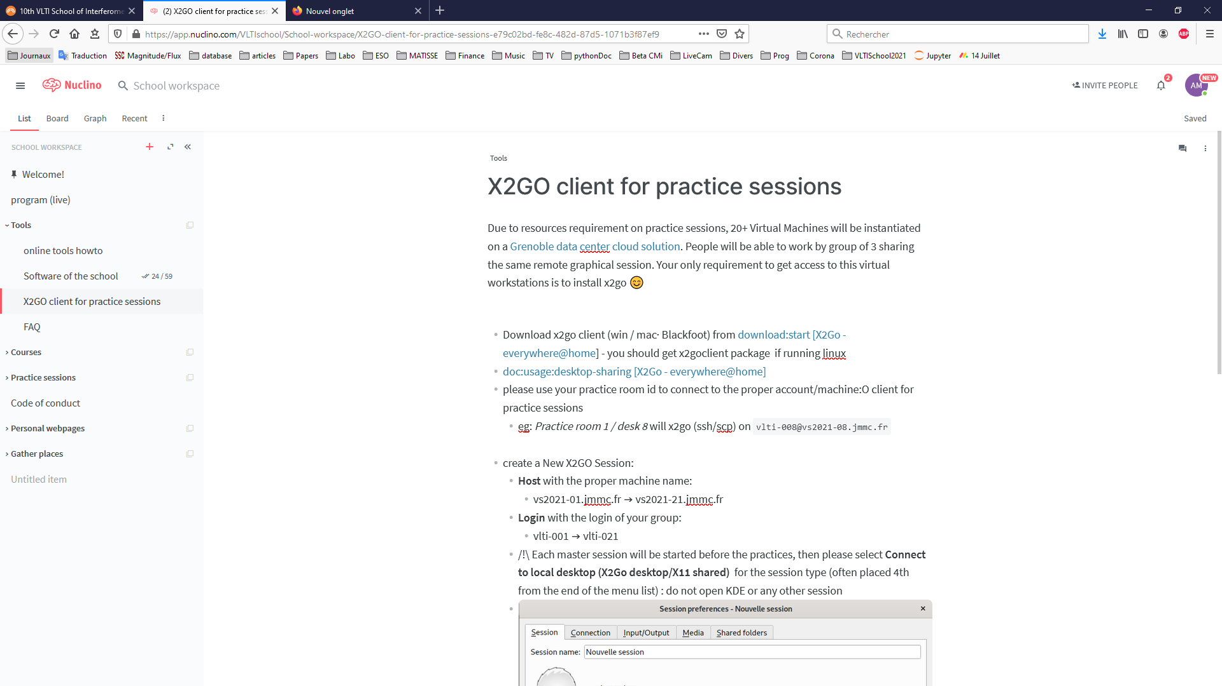
The 10th VLTI School of Interferometry
Practice sessions : Test of X2Go tomorrow before the school
Everything is Explained on the Nuclino webpage

Slide 18
The 10th VLTI School of Interferometry
Practice sessions : 3 Rooms and 21 ``spaces’’ on Gather Town
Professors room

Slide 19
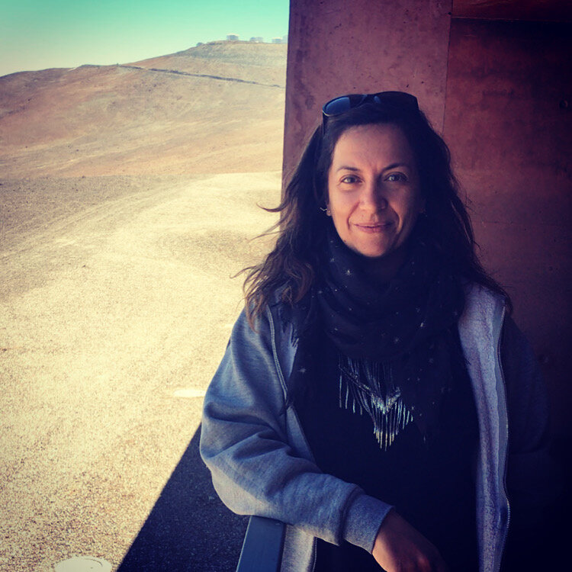
The 10th VLTI School of Interferometry
Proposal Preparation
Claudia’s Talk
Students working
in Groups
Don’t hesitate
to ask questions
to teachers
and organizers
Claudia Paladini
ESO Astronomer
MATISSE Instrument Scientist at Paranal
Groups projects
Evaluation

Slide 20
The 10th VLTI School of Interferometry
Now it is time to start the School
with David Busher
Introduction to Interferometry

