Slide 1
A modular modelling software
for optical interferometry
Meilland

Slide 2
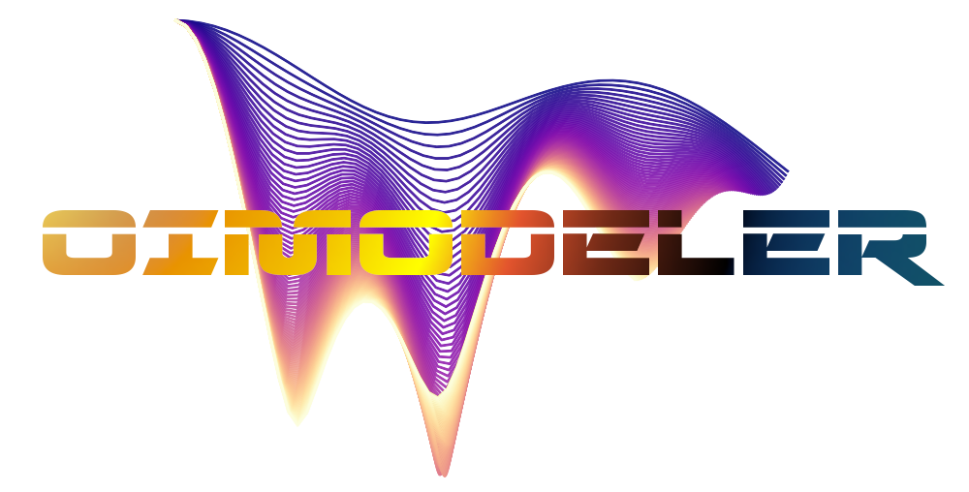
The project was mainly driven by my own frustration …
I was not happy with the available tools
LITPro (models too simple, no chromaticity, limited fitters, not scriptable)
Florentin’s Fitomatic (great but written in Yorick)
My personal badly written tools ( too specific and not easily reusable )
Students building of these bad tools (even mixing python and IDL)
I couldn’t model efficiently my huge amount of data from AMBER & VEGA
… and my fear that it will even get worst
MATISSE & SPICA will produce more data

Slide 3
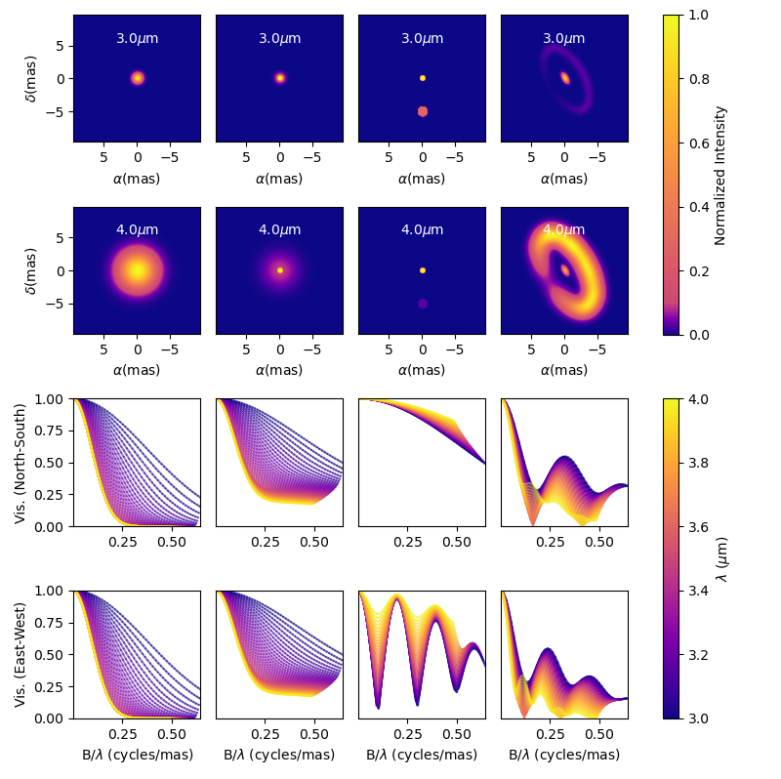
I started to really think about during
the 1st confinement in 2020
And developed a prototype
during the 2nd confinement
Oimodel.py
A modular & Fourier-based
chromatic modelling tool
with a emcee (MCMC) fitter

Slide 4
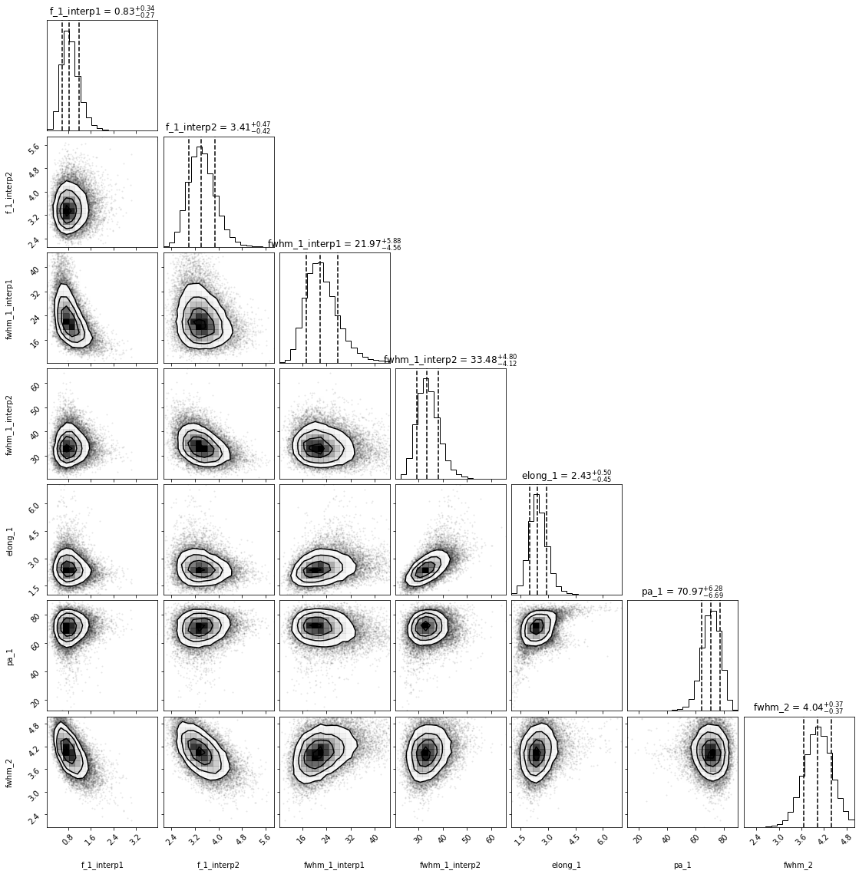
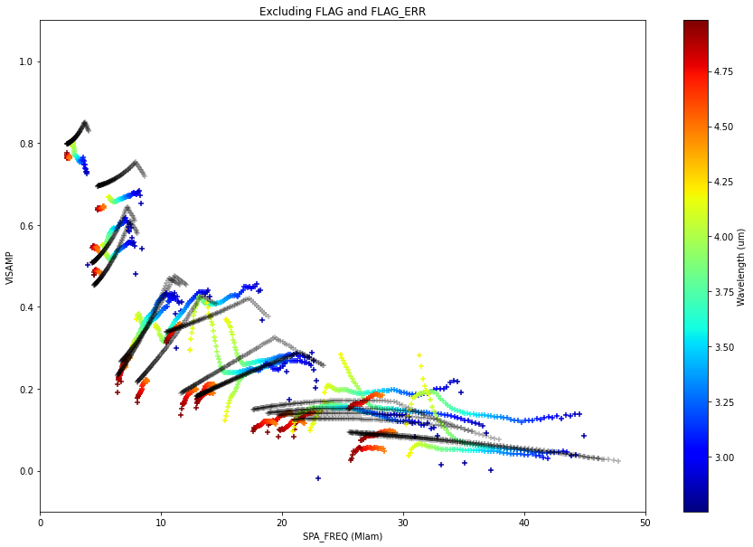
2021 : Model-fitting on MATISSE B[e] data with Oimodel.py
(by my master student Dorian Demars)
f_1_interp1
f_1_interp2
fwhm_1_interp1
fwhm_1_interp2
elong_1
pa_1
fwhm_2

Slide 5
MATISSE modelling group 2021
July 2021

Slide 6
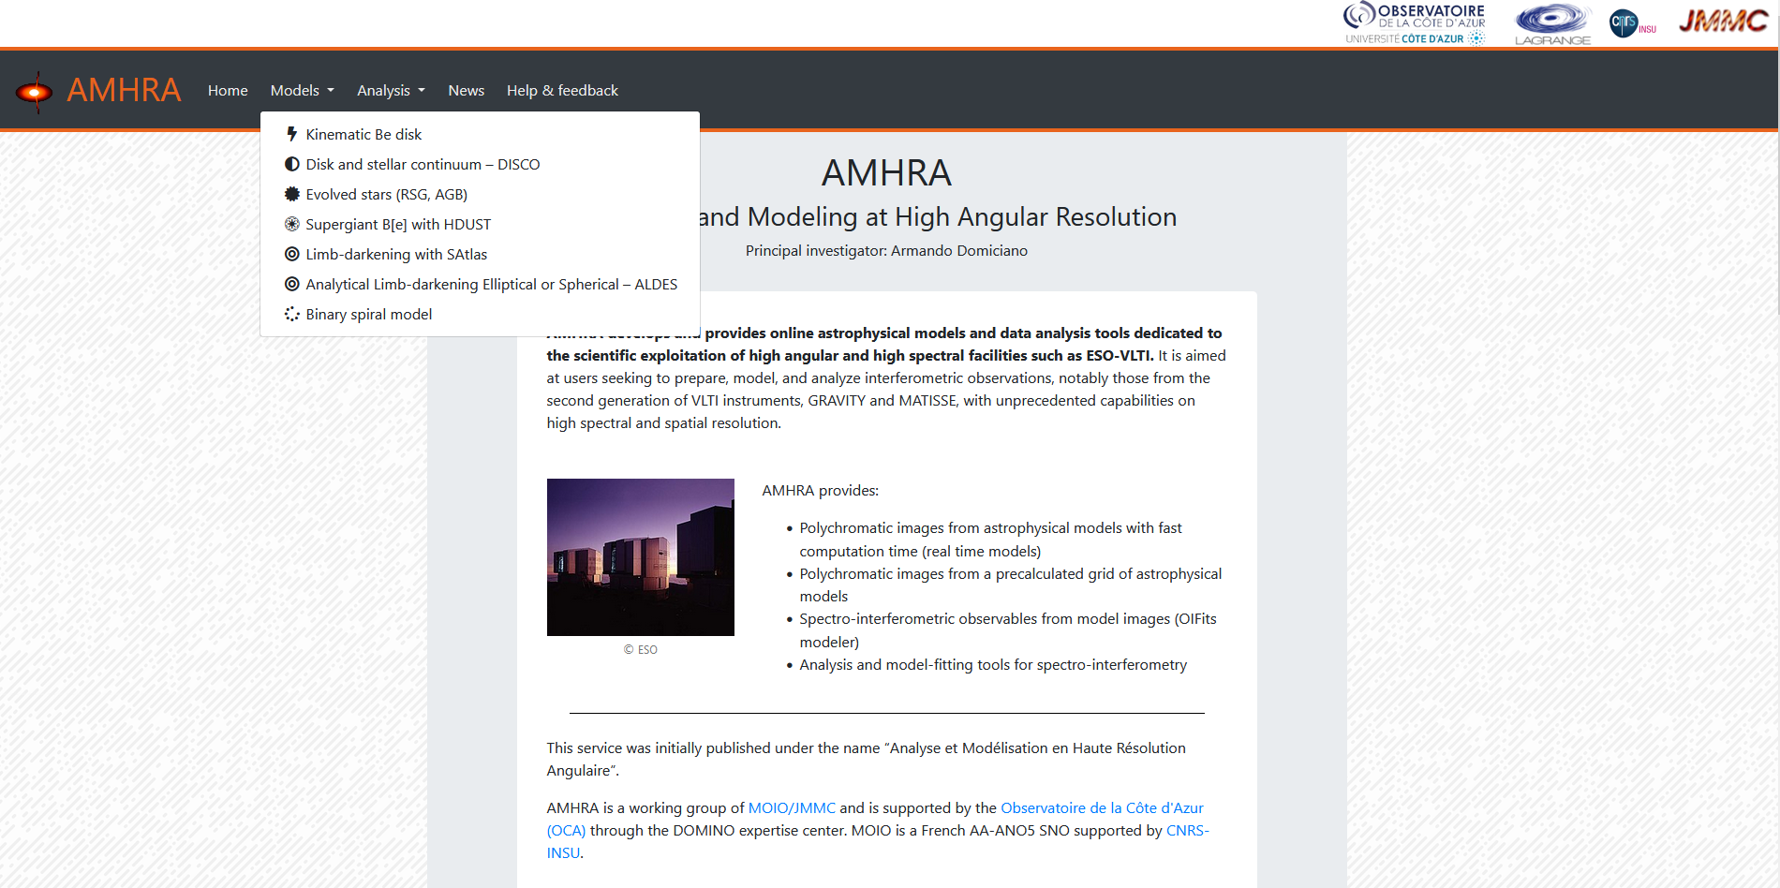
Meanwhile in the context of the new JMMC/AMHRA service
https://amhra.oca.eu
Coordinated by Armando Domiciano de Souza

Slide 7
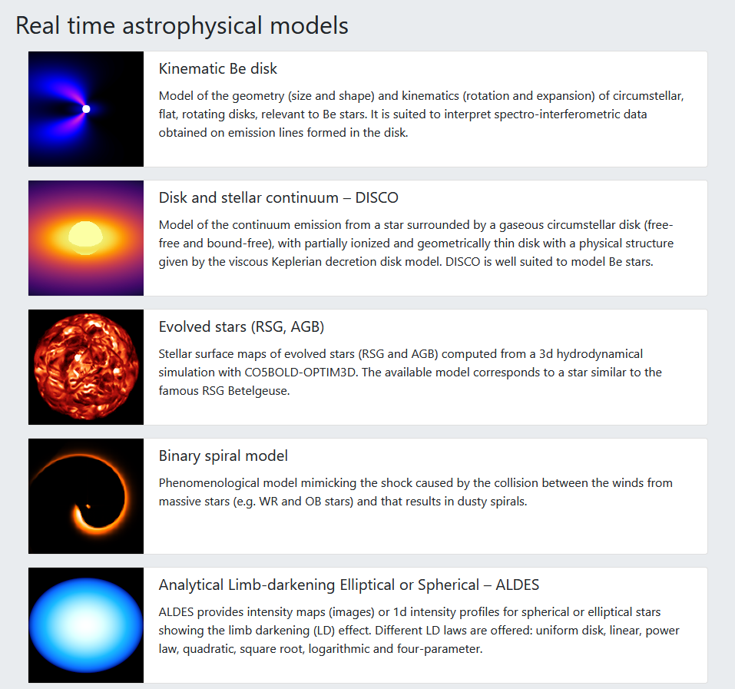
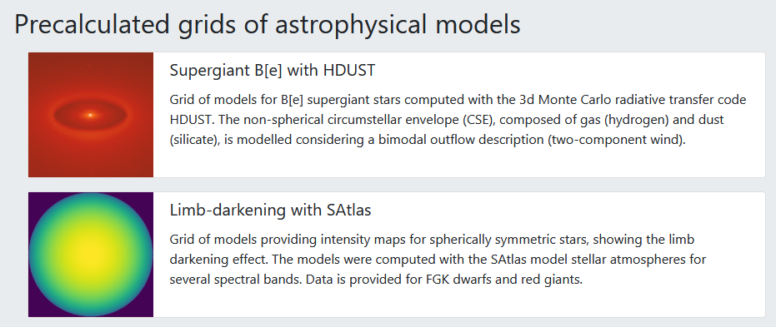
Meanwhile in the context of the new JMMC/AMHRA service
Need of tools to compute
interferometric observables
from chromatic image-cubes
In fits format

Slide 8
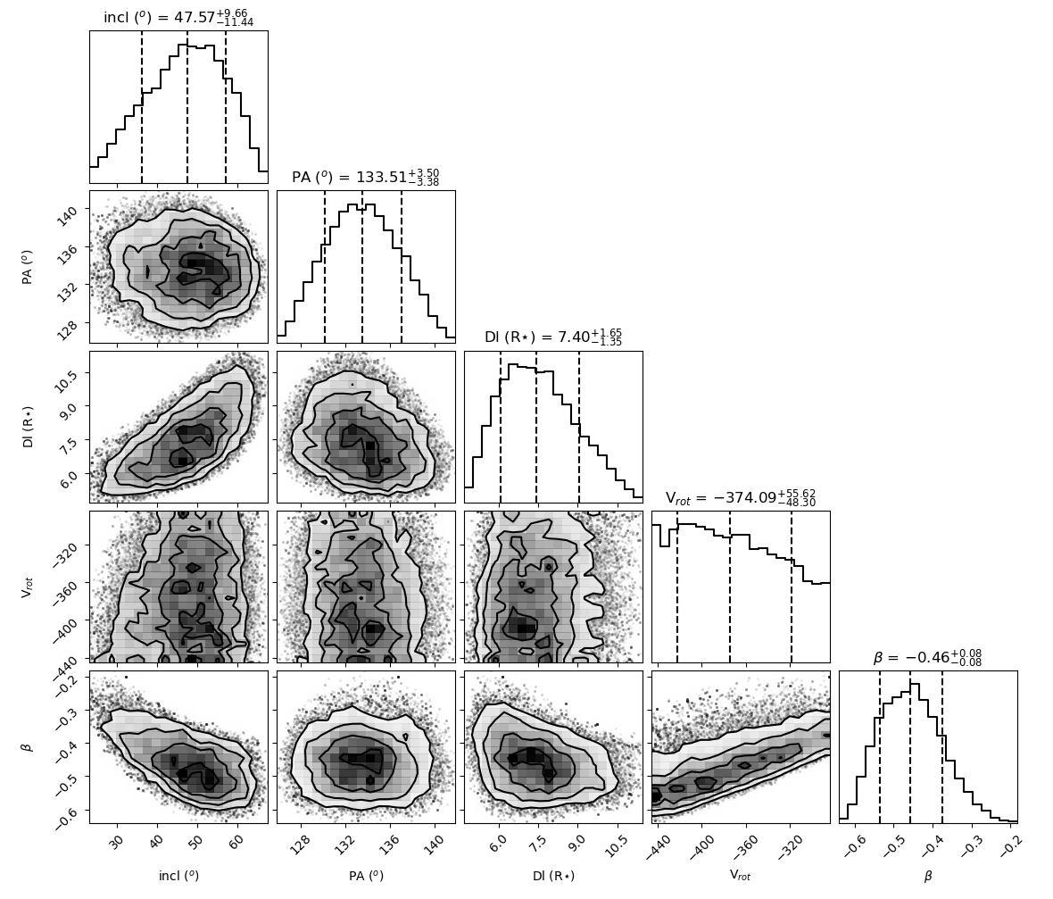
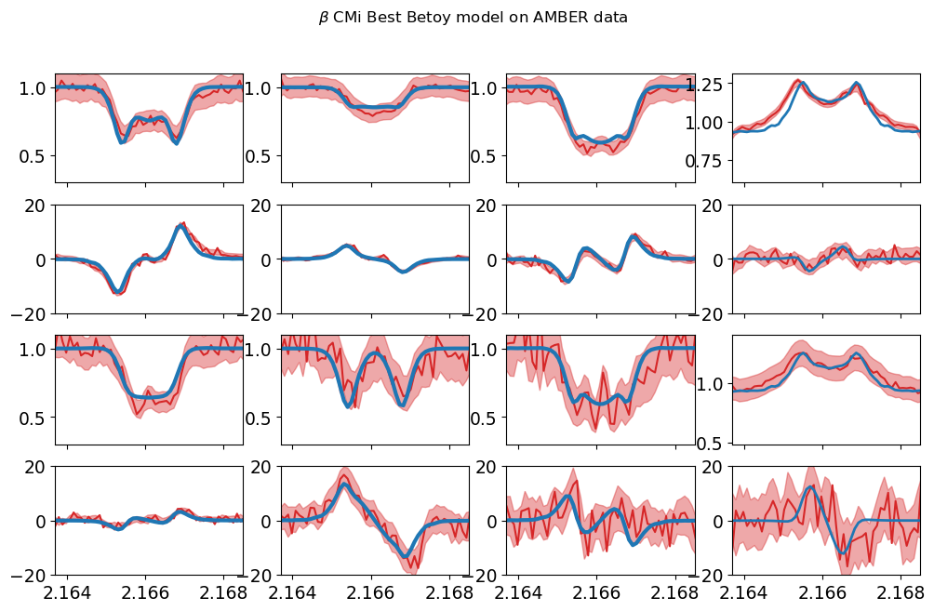
Cubetools.py
OIFITS + Image-Cube FITS
=
Simulated Data + χ²

Slide 9
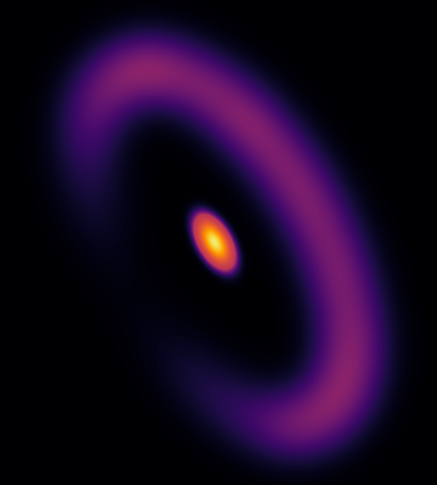
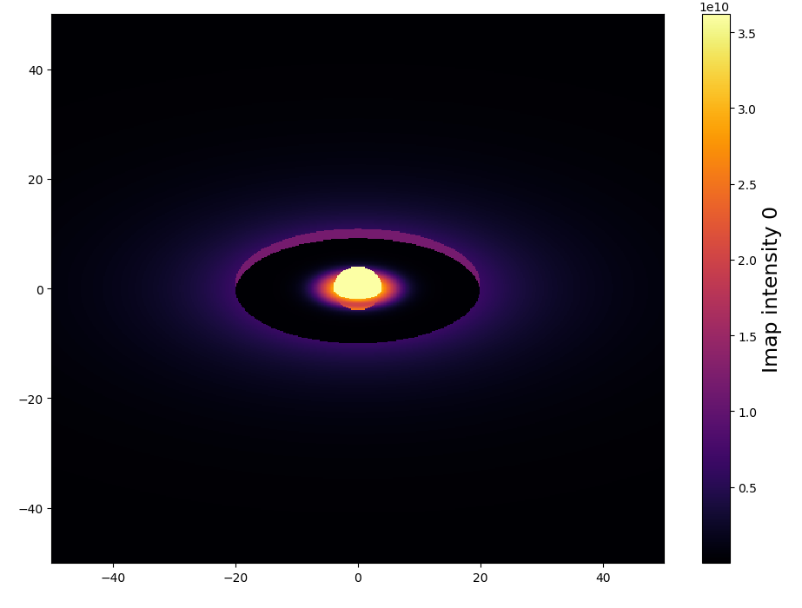
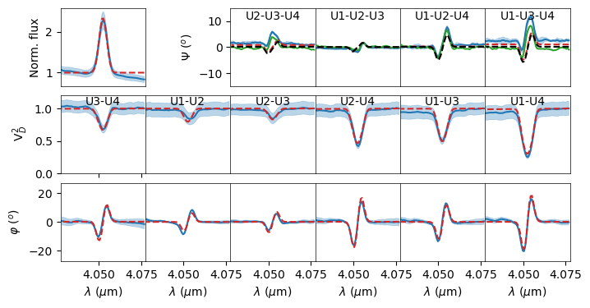
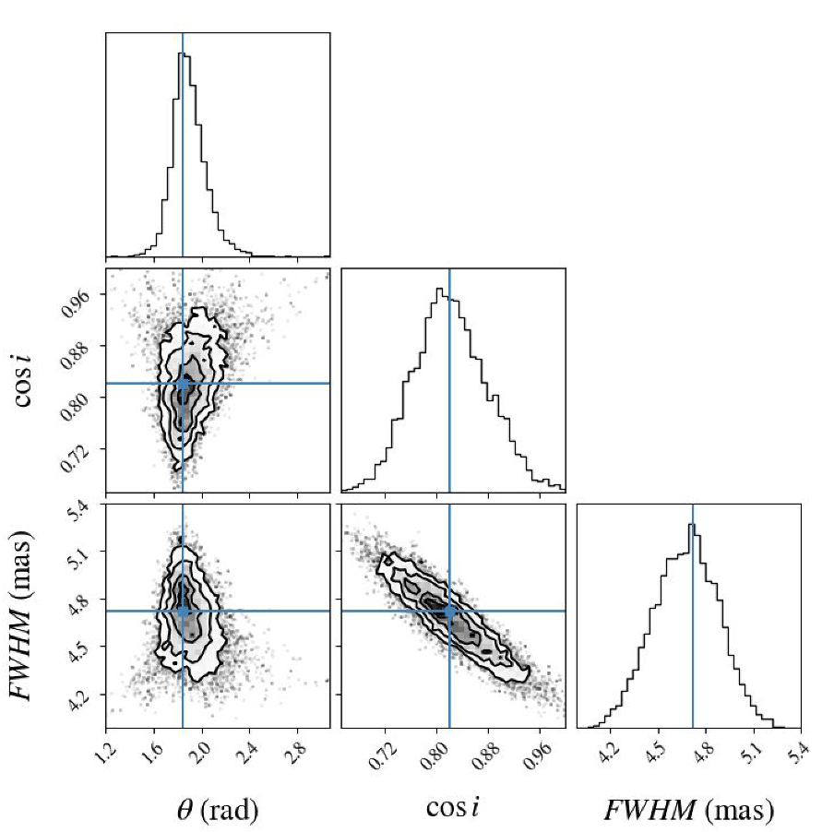
MATISSE modelling group 2021
Analytical model
Python3
Modularity and flexibility
Analytical models in Fourier-plan
Analytical & numerical models in Image-plan
Use outputs from radiative transfer and explore grids of models
Build more complex geometries by mixing components
Chromaticity and time dependence
Of the components parameters
Chromatic components (such as temperature gradient, binary)
Kinematics through line models
Ability to use interferometric data from all instruments (oifits)
Produce high-quality publishable outputs
Nice plots
Robust estimation of parameters with uncertainties and correlations
Export simulated data and images to standard format (oifits and fits images)
Expandability
Easily create new component for models (inheritance, wrapping functions)
But also other features: type of data, filters, fitters, plots
Well documented (and with a test suite, examples, tutorials)
Open source & easily available (Github)
Semi-physical
RT-models
Or grid
DISCO+
Kinematic
HDUST
Betoy

Slide 10
Defining the code structure
Inheritance of the oimComponent class
Image components defined by
analytical functions in direct plan
OIm...
OIm...
OIm...
OIm...
Wrappers from image codes
(RT, semi-physical, complex-toy models)
OIm...
oimComponentImage
OImComponentFitsImage
Image or cube from fits file
oimComponentImageGrid
Grid of image models
oimComponent
OImComponentRadialProfile
1D-components defined by
analytical function in direct space
OIm...
OIm...
OIm...
oimComponentFourier
OIm...
Wrappers from radial
profile codes
OIm...
oimPt
OIm...
oimBckG
Radial profile from fits file
oimUD
OImComponentRadialProfileFits
oimEllipse
oimGauss
oim...
oimComponentIRadialProfileGrid
Grid of radial Profiles
Components defined
analytically in Fourier plan

Slide 11
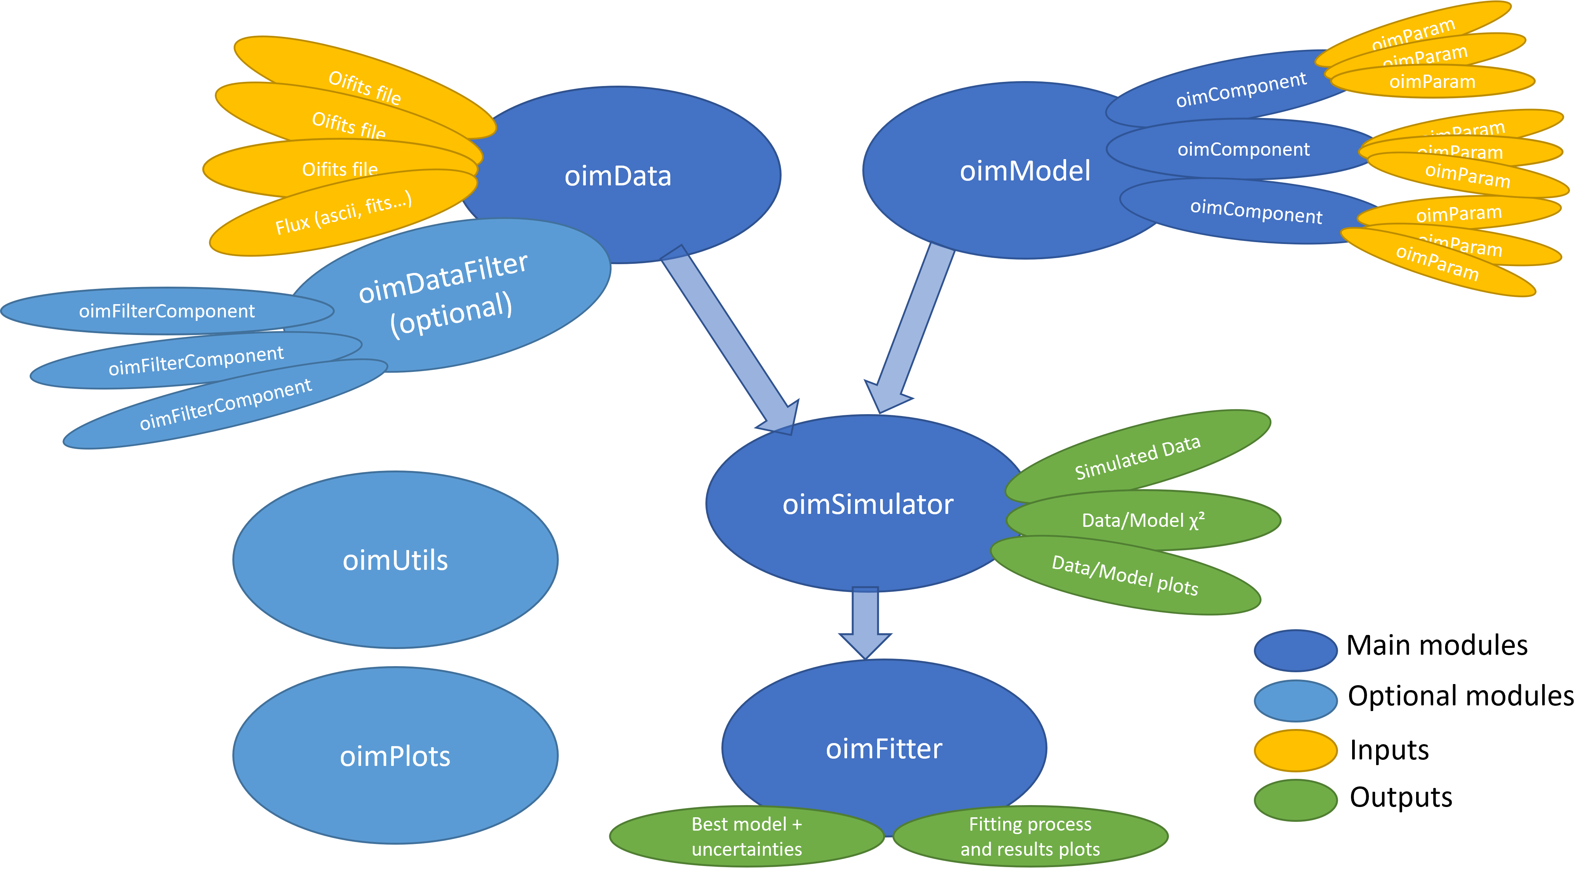
Defining the code structure

Slide 12
Coding started in 2022
January
Model skeleton : oimParam, oimComponents, oimModel

Slide 13
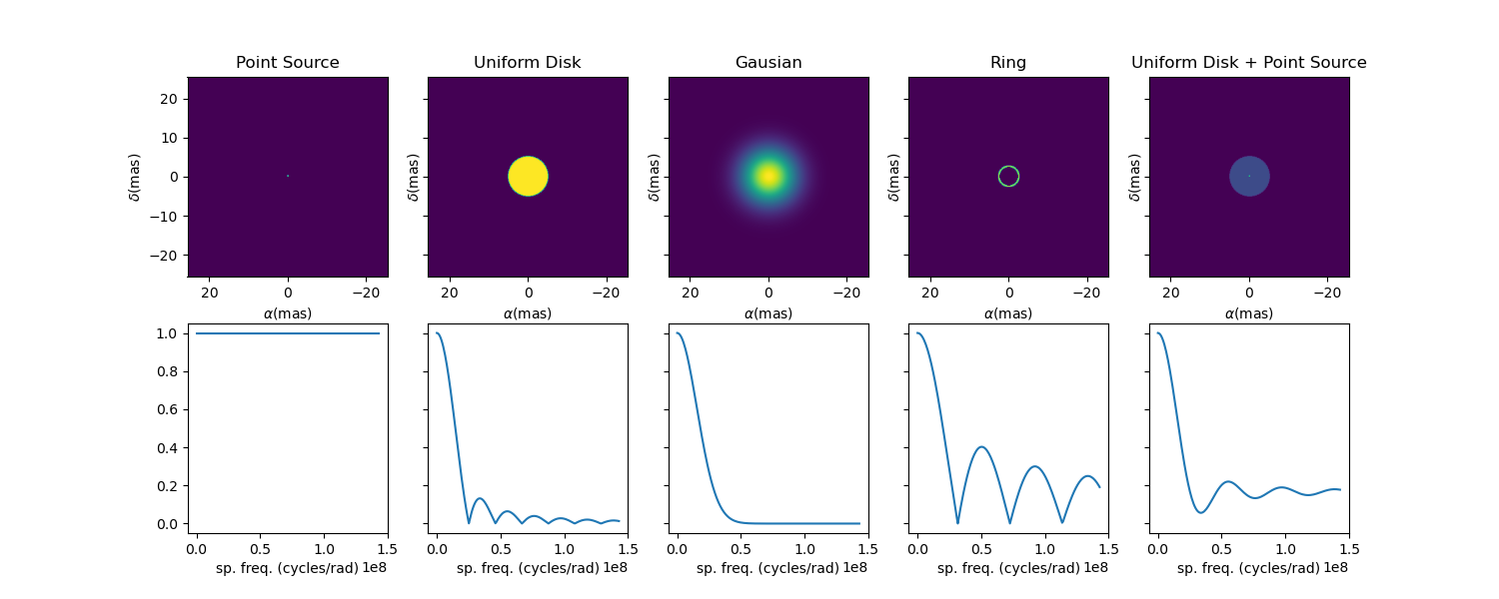
Coding started in 2022
January
Model skeleton : oimParam, oimComponents, oimModel
March-May
Implementation of Fourier-based components
with chromatic parameters (using linear interpolation)
Link between parameters

Slide 14
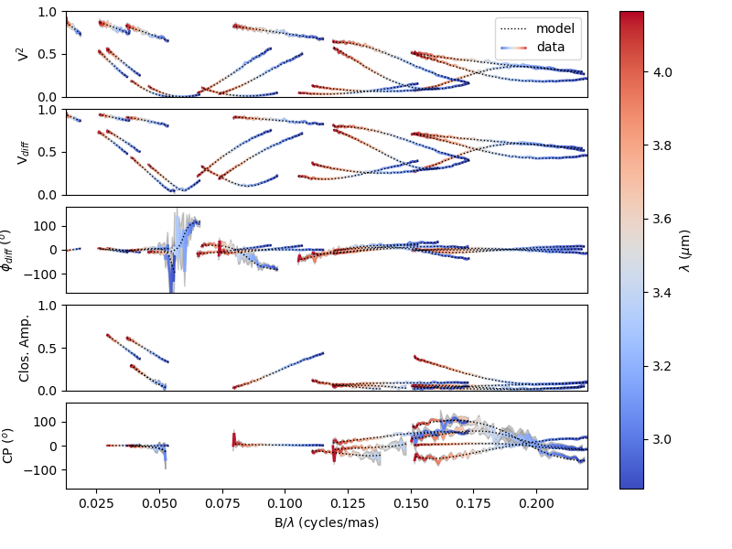
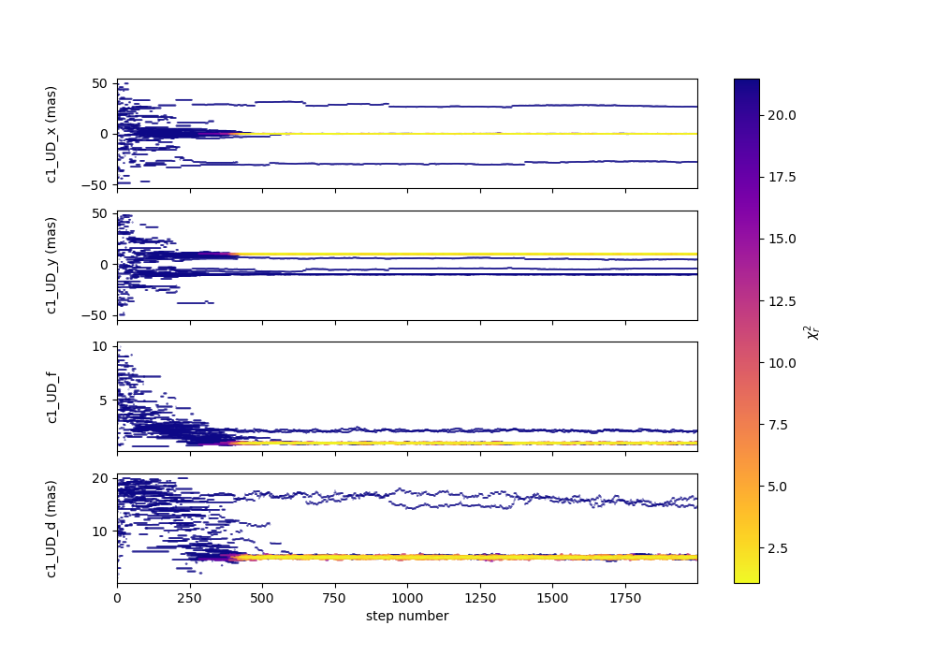
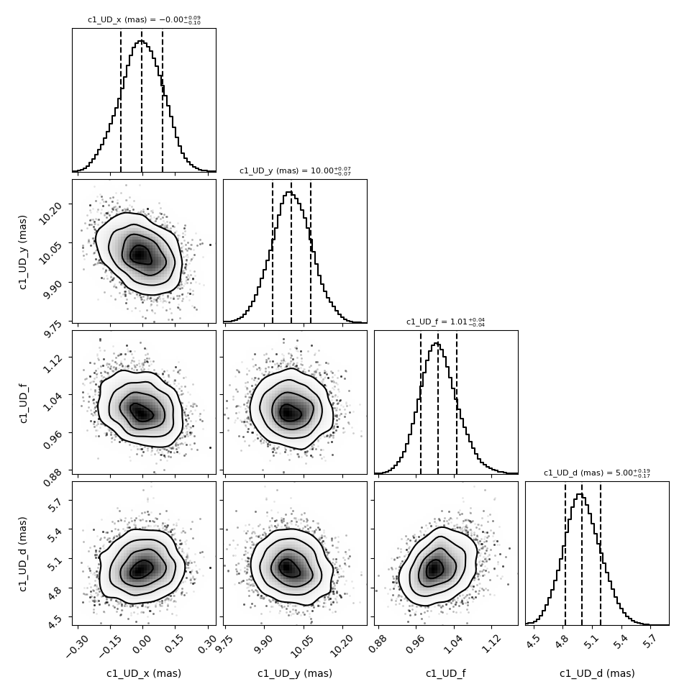
Coding started in 2022
January
Model skeleton : oimParam, oimComponents, oimModel
March-May
Implementation of Fourier-based components
with chromatic parameters (using linear interpolation)
link between parameters
June-August:
oimSimulator class (optimize data, data simulation, chi2)
oimFitter class and first emcee Fitter

Slide 15
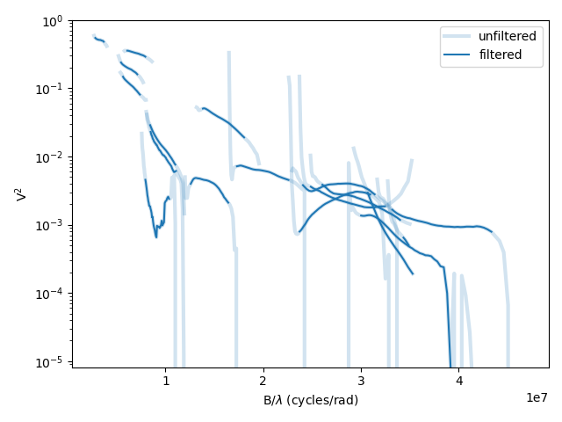
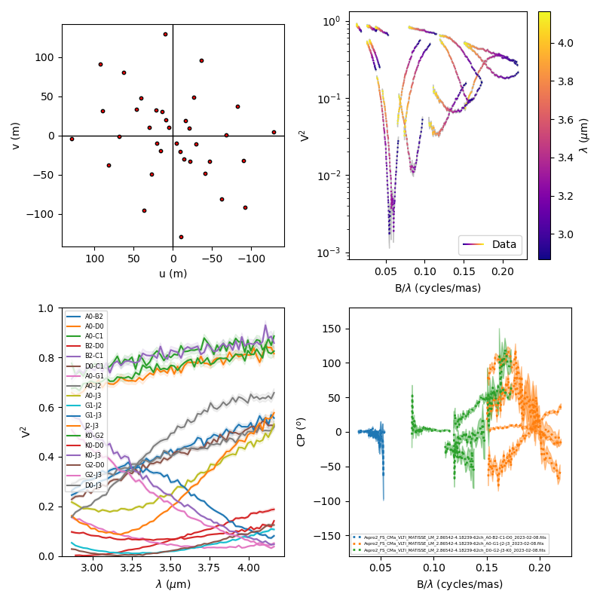
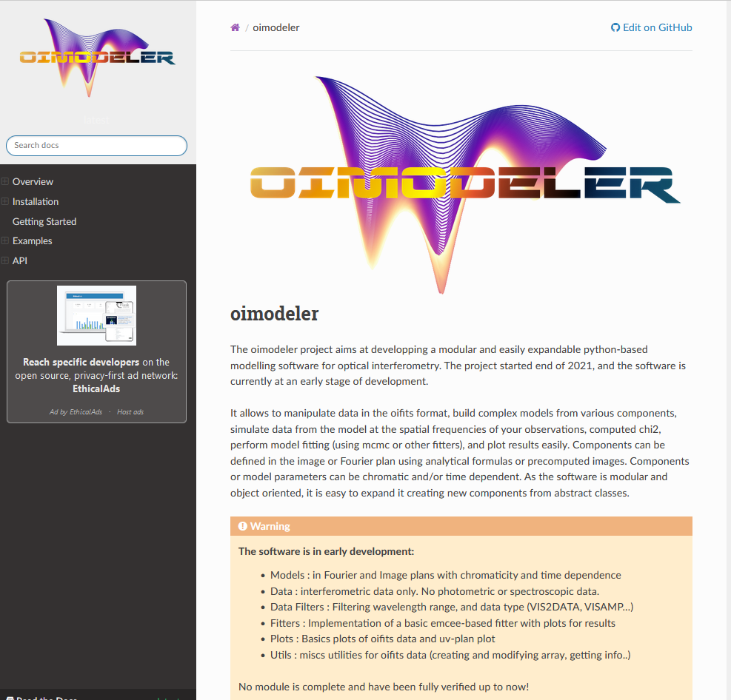
II. The OIMODELer project
Coding started in 2022
January
Model skeleton : oimParam, oimComponents, oimModel
March-May
Implementation of Fourier-based components
with chromatic parameters (using linear interpolation)
Link between parameters
June-August:
oimSimulator class (optimized data, data simulation, chi2)
oimFitter class and first emcee Fitter
September:
data filtering & plots
documentation (on readthedoc)

Slide 16
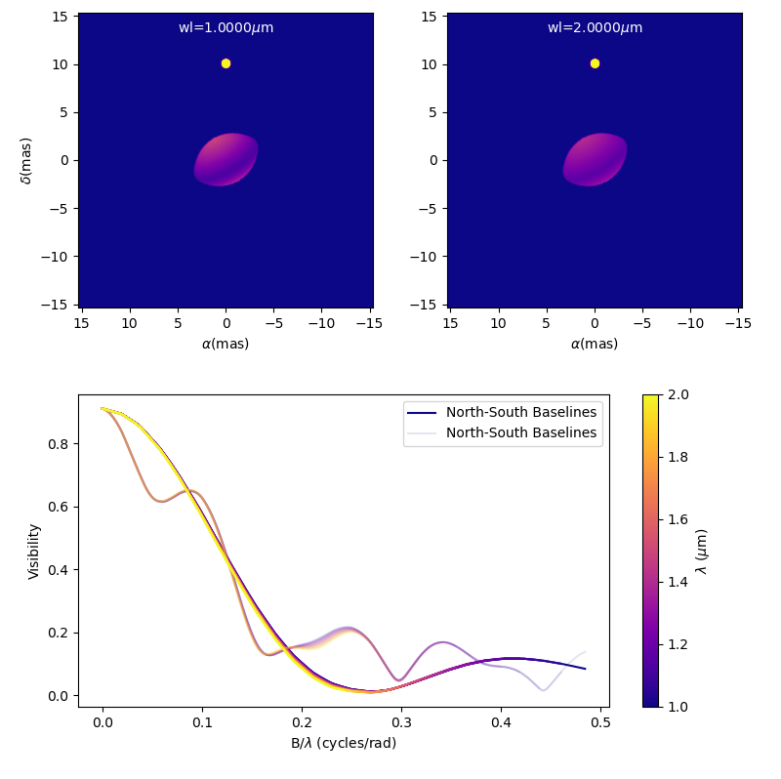
Coding started in 2022
January
Model skeleton : oimParam, oimComponents, oimModel
March-May
Implementation of Fourier-based components
with chromatic parameters (using linear interpolation)
Link between parameters
June-August:
oimSimulator class (optimized data, data simulation, chi2)
oimFitter class and first emcee Fitter
September:
data filtering & plots
documentation (on readthedoc)
October :
image-plan components (FFT, sampling…)

Slide 17
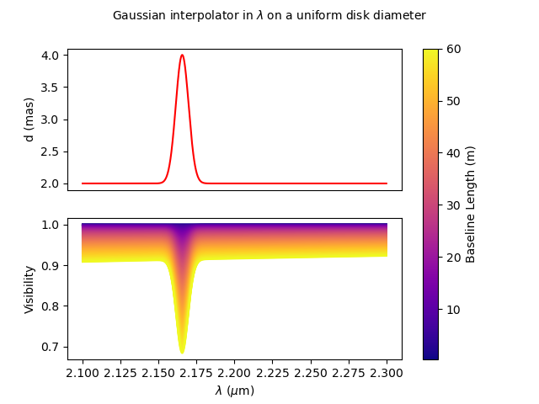
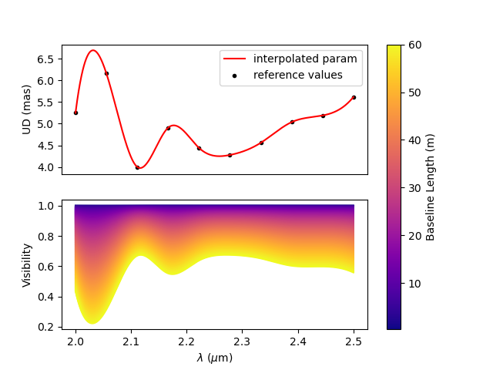
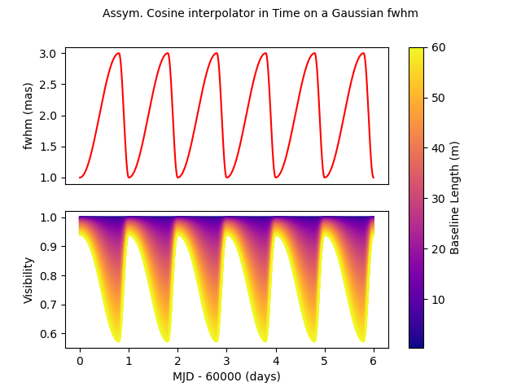
Coding started in 2022
January
Model skeleton : oimParam, oimComponents, oimModel
March-May
Implementation of Fourier-based components
with chromatic parameters (using linear interpolation)
Link between parameters
June-August:
oimSimulator class (optimized data, data simulation, chi2)
oimFitter class and first emcee Fitter
September:
data filtering & plots
documentation (on readthedoc)
October :
image-plan components (FFT, sampling…)
parameter interpolators (time and chromaticity)

Slide 18
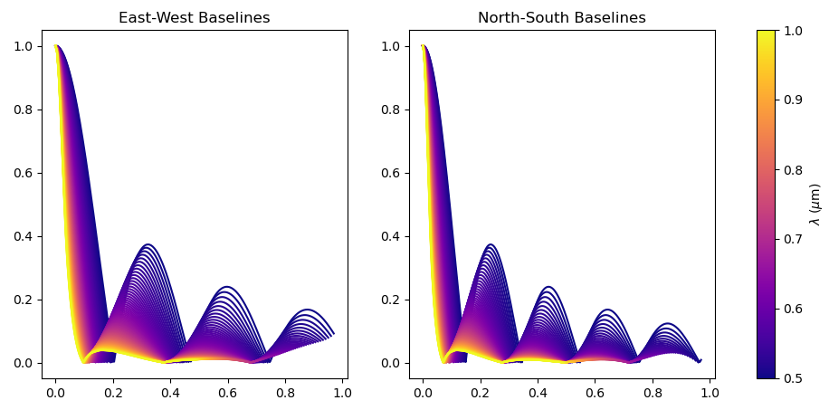
Coding started in 2022
January
Model skeleton : oimParam, oimComponents, oimModel
March-May
Implementation of Fourier-based components
with chromatic parameters (using linear interpolation)
Link between parameters
June-August:
oimSimulator class (optimized data, data simulation, chi2)
oimFitter class and first emcee Fitter
September:
data filtering & plots
documentation (on readthedoc)
October :
image-plan components (FFT, sampling…)
parameter interpolators (time and chromaticity)
November
radial profile components

Slide 19
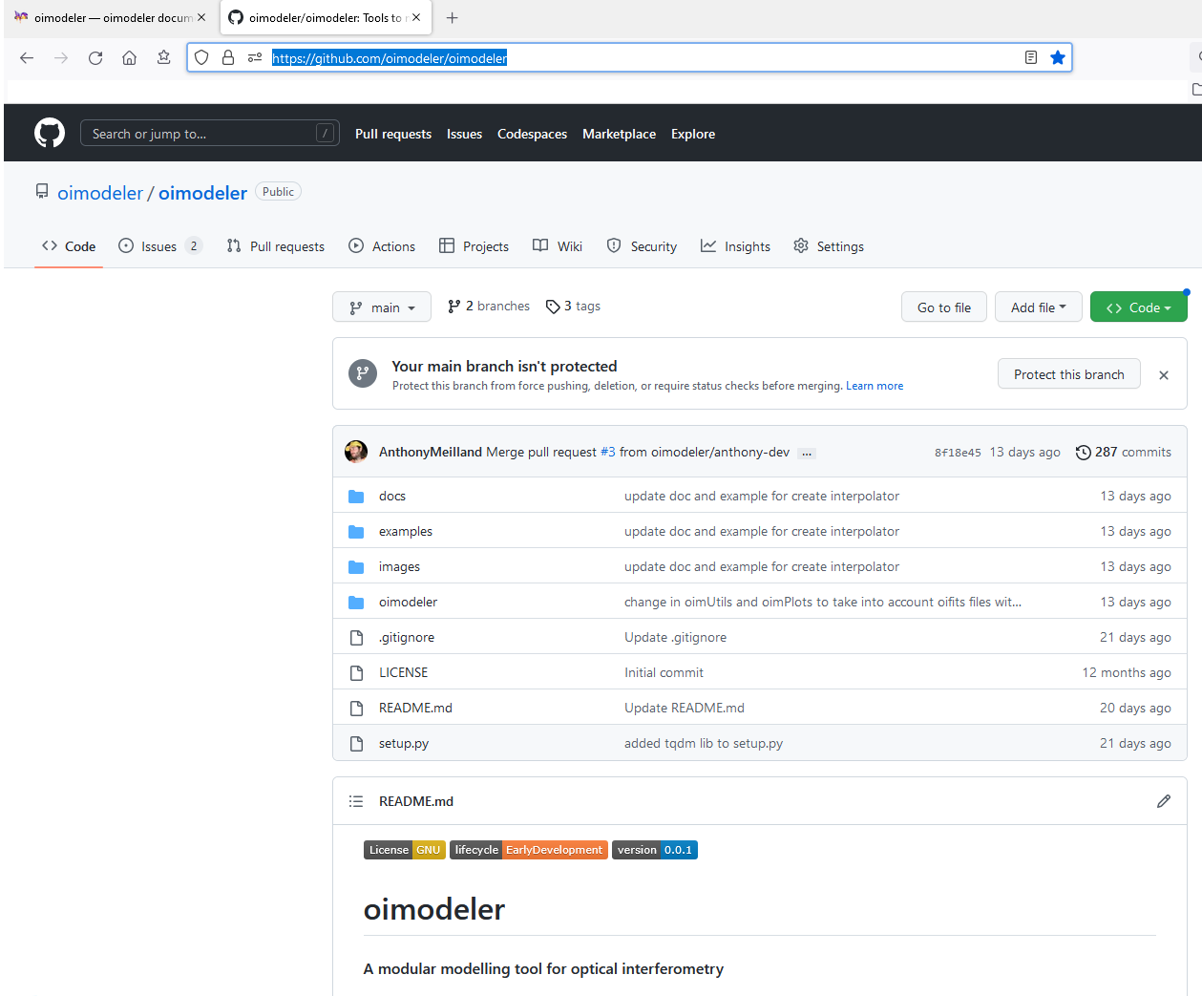
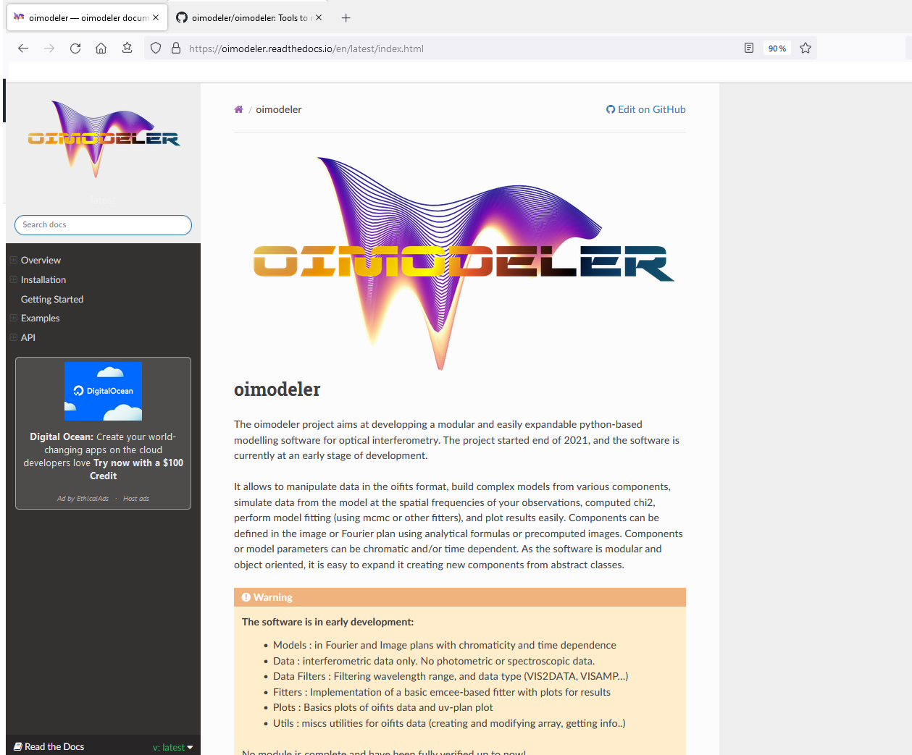
Oimodeler on the web
Code available on github
https://github.com/oimodeler
Documentation available on readthedocs
https://oimodeler.readthedocs.io
Needs of a mailing list for updates, news features, bugs?

Slide 20
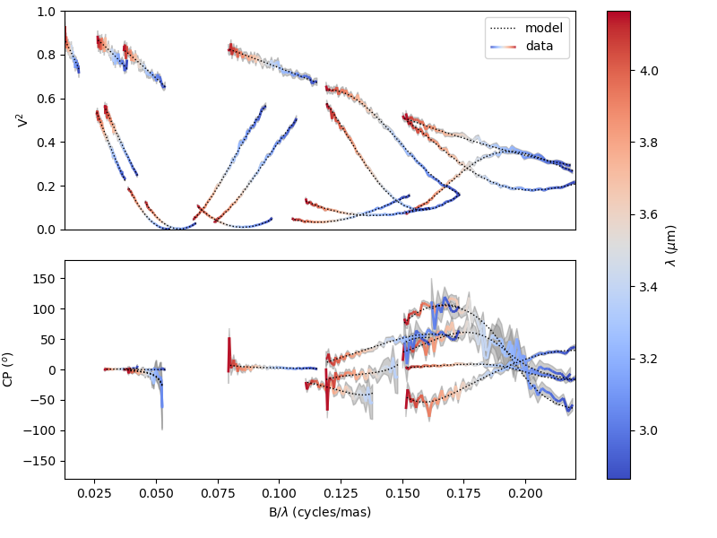
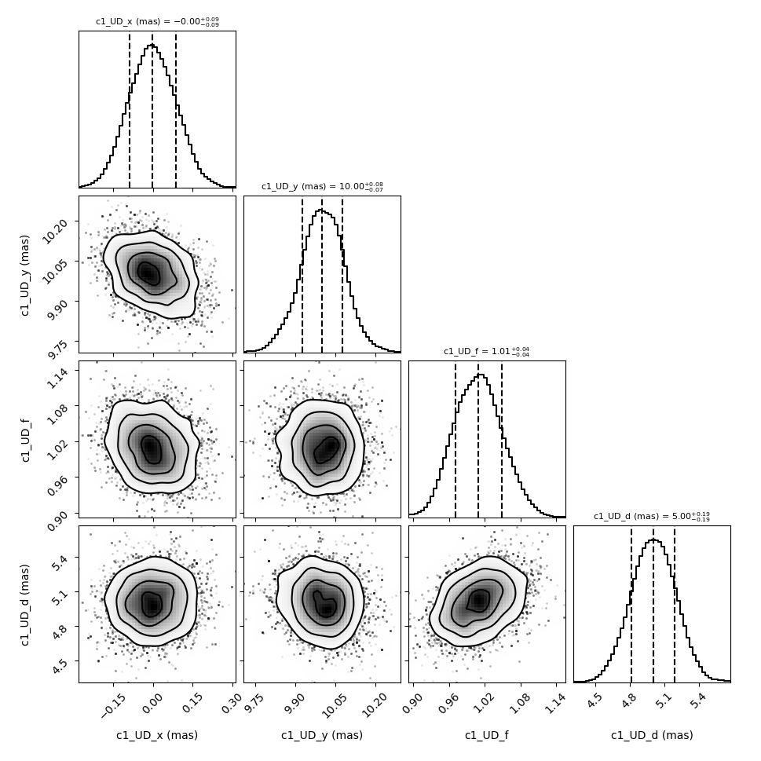
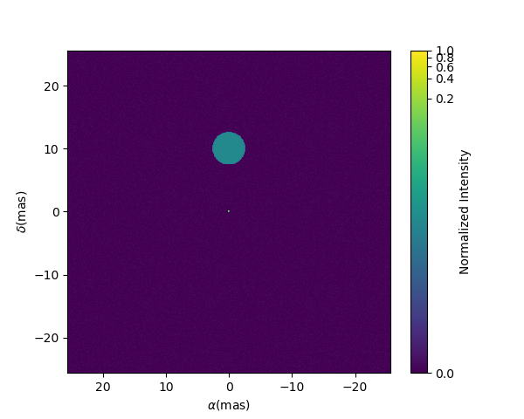
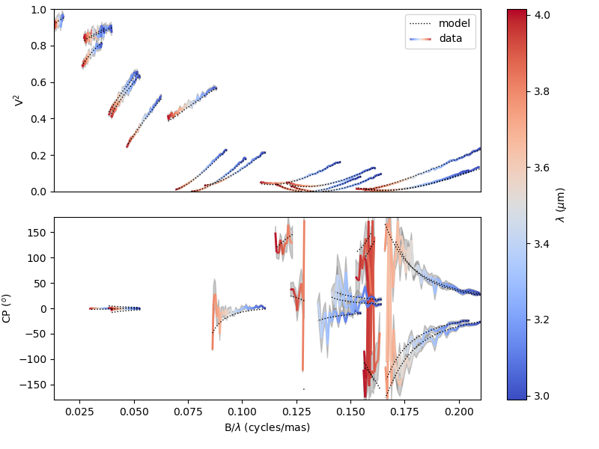
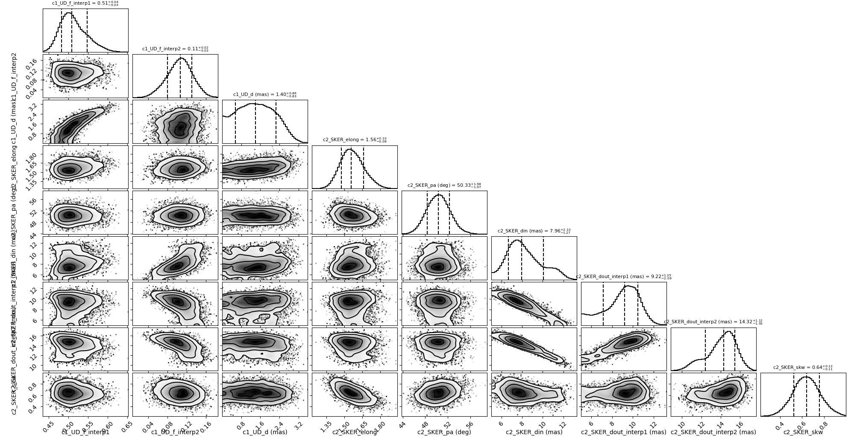
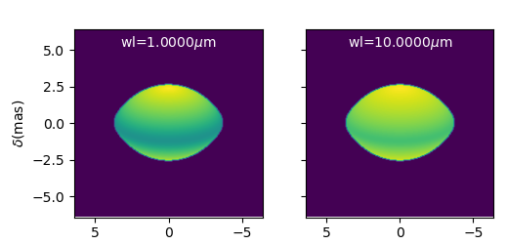
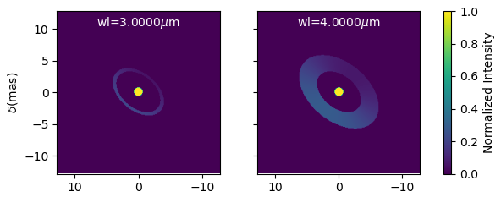
A Few examples
Model-fitting (on simulated data)
Creating new components
Achromatic
binary
Chromatic
Skewed disk
+ star

Slide 21
How did I produce simulated data for comparison?
ASPRO
oimodeler
Analytical model
Analytical model
Same model
Data Simulator
with errors
Fitter
OIFITS

Slide 22
How did I produce simulated data for comparison?
ASPRO
oimodeler
User model
(image-cube fits)
Complex model
(chromatic or Image)
Image-Cube (fits)
Data Simulator
with errors
Fitter
OIFITS

Slide 23
Example of simple model-fitting
Import oimodeler
import oimodeler as oim
ud = oim.oimUD(d=3,f=0.5,x=5,y=-5)
pt = oim.oimPt(f=1)
model = oim.oimModel(ud,pt)
ud.params['d'].set(min=0.01,max=20)
ud.params['x'].set(min=-50,max=50,free=True)
ud.params['y'].set(min=-50,max=50,free=True)
ud.params['f'].set(min=0.,max=10.)
pt.params['f']=oim.oimParamNorm(ud.params['f’])
fit = oim.oimFitterEmcee(files,model,nwalkers=20)
fit.prepare(init="random")
fit.run(nsteps=2000, progress=True)
median,err_l,err_u,err=fit.getResults(discard=1000)
fit.walkersPlot()
fit.cornerPlot()
fit.simulator.plot(["VIS2DATA","T3PHI"])
model.showModel(512,0.1)
Create a binary model
Set the parameters space
Normalizing flux to 1 (remove one free parameter)
Create, prepare and run the MCMC fitter
Get the results and plots
Make nice plots

Slide 24
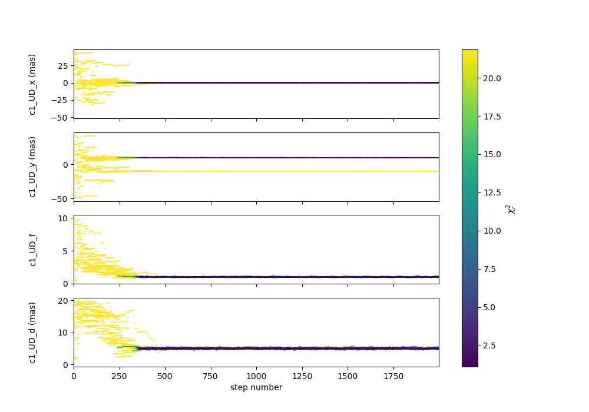
Example of simple model-fitting
import oimodeler as oim
ud = oim.oimUD(d=3,f=0.5,x=5,y=-5)
pt = oim.oimPt(f=1)
model = oim.oimModel(ud,pt)
ud.params['d'].set(min=0.01,max=20)
ud.params['x'].set(min=-50,max=50,free=True)
ud.params['y'].set(min=-50,max=50,free=True)
ud.params['f'].set(min=0.,max=10.)
pt.params['f']=oim.oimParamNorm(ud.params['f’])
fit = oim.oimFitterEmcee(files,model,nwalkers=20)
fit.prepare(init="random")
fit.run(nsteps=2000, progress=True)
median,err_l,err_u,err=fit.getResults(discard=1000)
fit.walkersPlot()
fit.cornerPlot()
fit.simulator.plot(["VIS2DATA","T3PHI"])
model.showModel(512,0.1)

Slide 25
Example of simple model-fitting
import oimodeler as oim
ud = oim.oimUD(d=3,f=0.5,x=5,y=-5)
pt = oim.oimPt(f=1)
model = oim.oimModel(ud,pt)
ud.params['d'].set(min=0.01,max=20)
ud.params['x'].set(min=-50,max=50,free=True)
ud.params['y'].set(min=-50,max=50,free=True)
ud.params['f'].set(min=0.,max=10.)
pt.params['f']=oim.oimParamNorm(ud.params['f’])
fit = oim.oimFitterEmcee(files,model,nwalkers=20)
fit.prepare(init="random")
fit.run(nsteps=2000, progress=True)
median,err_l,err_u,err=fit.getResults(discard=1000)
fit.walkersPlot()
fit.cornerPlot()
fit.simulator.plot(["VIS2DATA","T3PHI"])
model.showModel(512,0.1)

Slide 26
Example of simple model-fitting
import oimodeler as oim
ud = oim.oimUD(d=3,f=0.5,x=5,y=-5)
pt = oim.oimPt(f=1)
model = oim.oimModel(ud,pt)
ud.params['d'].set(min=0.01,max=20)
ud.params['x'].set(min=-50,max=50,free=True)
ud.params['y'].set(min=-50,max=50,free=True)
ud.params['f'].set(min=0.,max=10.)
pt.params['f']=oim.oimParamNorm(ud.params['f’])
fit = oim.oimFitterEmcee(files,model,nwalkers=20)
fit.prepare(init="random")
fit.run(nsteps=2000, progress=True)
median,err_l,err_u,err=fit.getResults(discard=1000)
fit.walkersPlot()
fit.cornerPlot()
fit.simulator.plot(["VIS2DATA","T3PHI"])
model.showModel(512,0.1)

Slide 27
Example of simple model-fitting
import oimodeler as oim
ud = oim.oimUD(d=3,f=0.5,x=5,y=-5)
pt = oim.oimPt(f=1)
model = oim.oimModel(ud,pt)
ud.params['d'].set(min=0.01,max=20)
ud.params['x'].set(min=-50,max=50,free=True)
ud.params['y'].set(min=-50,max=50,free=True)
ud.params['f'].set(min=0.,max=10.)
pt.params['f']=oim.oimParamNorm(ud.params['f’])
fit = oim.oimFitterEmcee(files,model,nwalkers=20)
fit.prepare(init="random")
fit.run(nsteps=2000, progress=True)
median,err_l,err_u,err=fit.getResults(discard=1000)
fit.walkersPlot()
fit.cornerPlot()
fit.simulator.plot(["VIS2DATA","T3PHI"])
model.showModel(512,0.1)

Slide 28
Chromatic model-fitting
import oimodeler as oim
star=oim.oimUD(d=1,f=oim.oimInterp("wl",wl=[3e-6,4e-6],values=[0.5,0.1]))
disk=oim.oimESKRing(din=8,dout=oim.oimInterp("wl",wl=[3e-6,4e-6],values=[9,14]),elong=1.5,skw=0.8,pa=50)
disk.params["skwPa"]=oim.oimParamLinker(disk.params["pa"],"add",90)
disk.params['f']=oim.oimParamNorm(star.params['f'])
model=oim.oimModel(star,disk)
params=model.getFreeParameters()
params['c1_UD_f_interp1'].set(min=0.0,max=1)
params['c1_UD_f_interp2'].set(min=0.0,max=1)
params['c1_UD_d'].set(min=0,max=5,free=True)
params['c2_SKER_pa'].set(min=0.,max=180)
params['c2_SKER_elong'].set(min=1,max=3)
params['c2_SKER_din'].set(min=5,max=20.)
params['c2_SKER_skw'].set(min=0,max=1.)
params['c2_SKER_dout_interp1'].set(min=5.,max=30.)
params['c2_SKER_dout_interp2'].set(min=5.,max=30.)
fit=oim.oimFitterEmcee(files,model,nwalkers=30)
fit.prepare(init="random")
fit.run(nsteps=2000,progress=True)
figWalkers,axeWalkers=fit.walkersPlot()
figCorner,axeCorner=fit.cornerPlot(discard=1000)
median,err_l,err_u,err=fit.getResults(mode='median',discard=1000)
figSim,axSim=fit.simulator.plot(["VIS2DATA","T3PHI"])
figImg,axImg,im=model.showModel(256,0.1,wl=[wl[0],wl[-1]])

Slide 29
Chromatic model-fitting
import oimodeler as oim
star=oim.oimUD(d=1,f=oim.oimInterp("wl",wl=[3e-6,4e-6],values=[0.5,0.1]))
disk=oim.oimESKRing(din=8,dout=oim.oimInterp("wl",wl=[3e-6,4e-6],values=[9,14]),elong=1.5,skw=0.8,pa=50)
disk.params["skwPa"]=oim.oimParamLinker(disk.params["pa"],"add",90)
disk.params['f']=oim.oimParamNorm(star.params['f'])
model=oim.oimModel(star,disk)
params=model.getFreeParameters()
params['c1_UD_f_interp1'].set(min=0.0,max=1)
params['c1_UD_f_interp2'].set(min=0.0,max=1)
params['c1_UD_d'].set(min=0,max=5,free=True)
params['c2_SKER_pa'].set(min=0.,max=180)
params['c2_SKER_elong'].set(min=1,max=3)
params['c2_SKER_din'].set(min=5,max=20.)
params['c2_SKER_skw'].set(min=0,max=1.)
params['c2_SKER_dout_interp1'].set(min=5.,max=30.)
params['c2_SKER_dout_interp2'].set(min=5.,max=30.)
fit=oim.oimFitterEmcee(files,model,nwalkers=30)
fit.prepare(init="random")
fit.run(nsteps=2000,progress=True)
figWalkers,axeWalkers=fit.walkersPlot()
figCorner,axeCorner=fit.cornerPlot(discard=1000)
median,err_l,err_u,err=fit.getResults(mode='median',discard=1000)
figSim,axSim=fit.simulator.plot(["VIS2DATA","T3PHI"])
figImg,axImg,im=model.showModel(256,0.1,wl=[wl[0],wl[-1]])

Slide 30
Chromatic model-fitting
import oimodeler as oim
star=oim.oimUD(d=1,f=oim.oimInterp("wl",wl=[3e-6,4e-6],values=[0.5,0.1]))
disk=oim.oimESKRing(din=8,dout=oim.oimInterp("wl",wl=[3e-6,4e-6],values=[9,14]),elong=1.5,skw=0.8,pa=50)
disk.params["skwPa"]=oim.oimParamLinker(disk.params["pa"],"add",90)
disk.params['f']=oim.oimParamNorm(star.params['f'])
model=oim.oimModel(star,disk)
params=model.getFreeParameters()
params['c1_UD_f_interp1'].set(min=0.0,max=1)
params['c1_UD_f_interp2'].set(min=0.0,max=1)
params['c1_UD_d'].set(min=0,max=5,free=True)
params['c2_SKER_pa'].set(min=0.,max=180)
params['c2_SKER_elong'].set(min=1,max=3)
params['c2_SKER_din'].set(min=5,max=20.)
params['c2_SKER_skw'].set(min=0,max=1.)
params['c2_SKER_dout_interp1'].set(min=5.,max=30.)
params['c2_SKER_dout_interp2'].set(min=5.,max=30.)
fit=oim.oimFitterEmcee(files,model,nwalkers=30)
fit.prepare(init="random")
fit.run(nsteps=2000,progress=True)
figWalkers,axeWalkers=fit.walkersPlot()
figCorner,axeCorner=fit.cornerPlot(discard=1000)
median,err_l,err_u,err=fit.getResults(mode='median',discard=1000)
figSim,axSim=fit.simulator.plot(["VIS2DATA","T3PHI"])
figImg,axImg,im=model.showModel(256,0.1,wl=[wl[0],wl[-1]])
Chromatic parameter interpolators
Linear interpolation between two reference
wavelengths at 3 and 4 microns
Parameter linker to set the position angle of disc and skewness at 90°
Flux normalization to 1 (remove one parameter)
Flux of UD & dout of skewed disk replaced by to parameters (at 3 and 4 microns)

Slide 31
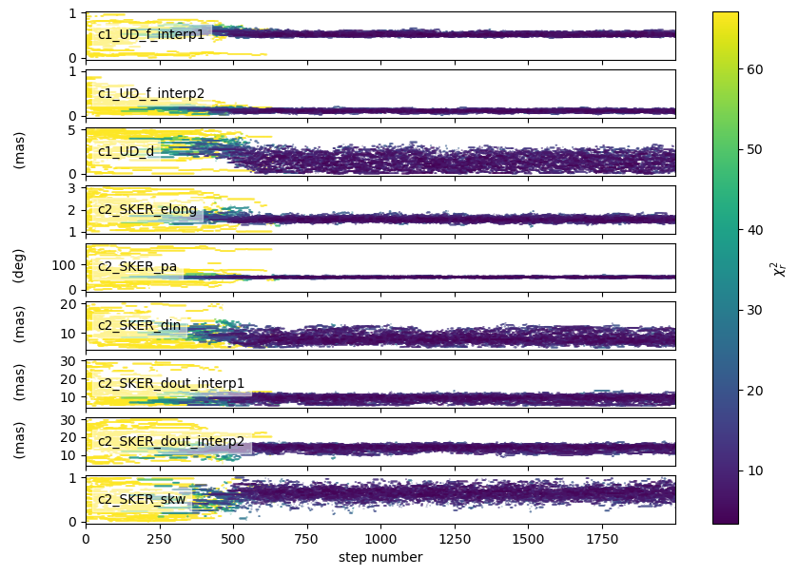
Chromatic model-fitting
import oimodeler as oim
star=oim.oimUD(d=1,f=oim.oimInterp("wl",wl=[3e-6,4e-6],values=[0.5,0.1]))
disk=oim.oimESKRing(din=8,dout=oim.oimInterp("wl",wl=[3e-6,4e-6],values=[9,14]),elong=1.5,skw=0.8,pa=50)
disk.params["skwPa"]=oim.oimParamLinker(disk.params["pa"],"add",90)
disk.params['f']=oim.oimParamNorm(star.params['f'])
model=oim.oimModel(star,disk)
params=model.getFreeParameters()
params['c1_UD_f_interp1'].set(min=0.0,max=1)
params['c1_UD_f_interp2'].set(min=0.0,max=1)
params['c1_UD_d'].set(min=0,max=5,free=True)
params['c2_SKER_pa'].set(min=0.,max=180)
params['c2_SKER_elong'].set(min=1,max=3)
params['c2_SKER_din'].set(min=5,max=20.)
params['c2_SKER_skw'].set(min=0,max=1.)
params['c2_SKER_dout_interp1'].set(min=5.,max=30.)
params['c2_SKER_dout_interp2'].set(min=5.,max=30.)
fit=oim.oimFitterEmcee(files,model,nwalkers=30)
fit.prepare(init="random")
fit.run(nsteps=2000,progress=True)
figWalkers,axeWalkers=fit.walkersPlot()
figCorner,axeCorner=fit.cornerPlot(discard=1000)
median,err_l,err_u,err=fit.getResults(mode='median',discard=1000)
figSim,axSim=fit.simulator.plot(["VIS2DATA","T3PHI"])
figImg,axImg,im=model.showModel(256,0.1,wl=[wl[0],wl[-1]])

Slide 32
Chromatic model-fitting
import oimodeler as oim
star=oim.oimUD(d=1,f=oim.oimInterp("wl",wl=[3e-6,4e-6],values=[0.5,0.1]))
disk=oim.oimESKRing(din=8,dout=oim.oimInterp("wl",wl=[3e-6,4e-6],values=[9,14]),elong=1.5,skw=0.8,pa=50)
disk.params["skwPa"]=oim.oimParamLinker(disk.params["pa"],"add",90)
disk.params['f']=oim.oimParamNorm(star.params['f'])
model=oim.oimModel(star,disk)
params=model.getFreeParameters()
params['c1_UD_f_interp1'].set(min=0.0,max=1)
params['c1_UD_f_interp2'].set(min=0.0,max=1)
params['c1_UD_d'].set(min=0,max=5,free=True)
params['c2_SKER_pa'].set(min=0.,max=180)
params['c2_SKER_elong'].set(min=1,max=3)
params['c2_SKER_din'].set(min=5,max=20.)
params['c2_SKER_skw'].set(min=0,max=1.)
params['c2_SKER_dout_interp1'].set(min=5.,max=30.)
params['c2_SKER_dout_interp2'].set(min=5.,max=30.)
fit=oim.oimFitterEmcee(files,model,nwalkers=30)
fit.prepare(init="random")
fit.run(nsteps=2000,progress=True)
figWalkers,axeWalkers=fit.walkersPlot()
figCorner,axeCorner=fit.cornerPlot(discard=1000)
median,err_l,err_u,err=fit.getResults(mode='median',discard=1000)
figSim,axSim=fit.simulator.plot(["VIS2DATA","T3PHI"])
figImg,axImg,im=model.showModel(256,0.1,wl=[wl[0],wl[-1]])

Slide 33
Chromatic model-fitting
import oimodeler as oim
star=oim.oimUD(d=1,f=oim.oimInterp("wl",wl=[3e-6,4e-6],values=[0.5,0.1]))
disk=oim.oimESKRing(din=8,dout=oim.oimInterp("wl",wl=[3e-6,4e-6],values=[9,14]),elong=1.5,skw=0.8,pa=50)
disk.params["skwPa"]=oim.oimParamLinker(disk.params["pa"],"add",90)
disk.params['f']=oim.oimParamNorm(star.params['f'])
model=oim.oimModel(star,disk)
params=model.getFreeParameters()
params['c1_UD_f_interp1'].set(min=0.0,max=1)
params['c1_UD_f_interp2'].set(min=0.0,max=1)
params['c1_UD_d'].set(min=0,max=5,free=True)
params['c2_SKER_pa'].set(min=0.,max=180)
params['c2_SKER_elong'].set(min=1,max=3)
params['c2_SKER_din'].set(min=5,max=20.)
params['c2_SKER_skw'].set(min=0,max=1.)
params['c2_SKER_dout_interp1'].set(min=5.,max=30.)
params['c2_SKER_dout_interp2'].set(min=5.,max=30.)
fit=oim.oimFitterEmcee(files,model,nwalkers=30)
fit.prepare(init="random")
fit.run(nsteps=2000,progress=True)
figWalkers,axeWalkers=fit.walkersPlot()
figCorner,axeCorner=fit.cornerPlot(discard=1000)
median,err_l,err_u,err=fit.getResults(mode='median',discard=1000)
figSim,axSim=fit.simulator.plot(["VIS2DATA","T3PHI"])
figImg,axImg,im=model.showModel(256,0.1,wl=[wl[0],wl[-1]])

Slide 34
Creating new Fourier components
class oimBox(oim.oimComponentFourier):
name="2D Box"
shortname = "BOX“
def __init__(self,**kwargs):
super().__init__(**kwargs)
self.params["dx"]=oim.oimParam(name="dx", value=1,description="Size in x",unit=u.mas)
self.params["dy"]=oim.oimParam(name="dy", value=1,description="Size in y",unit=u.mas)
self._eval(**kwargs)
def _visFunction(self,ucoord,vcoord,rho,wl,t):
x=self.params["dx"](wl,t)*self.params["dx"].unit.to(u.rad)*ucoord
y=self.params["dy"](wl,t)*self.params["dy"].unit.to(u.rad)*vcoord
return np.sinc(x)*np.sinc(y)
def _imageFunction(self,xx,yy,wl,t):
return ((np.abs(xx)<=self.params["dx"](wl,t)/2) &
(np.abs(yy)<=self.params["dy"](wl,t)/2)).astype(float)
Initialization function
Call parent __init__
Define parameters (oimParam)
Call eval function
visibility function
formula as function of u and v or ρ (and optionally λ and t)
Image function
formula as function of x and y (and optionally λ and t)

Slide 35
Creating new Fourier components
class oimBox(oim.oimComponentFourier):
name="2D Box"
shortname = "BOX“
def __init__(self,**kwargs):
super().__init__(**kwargs)
self.params["dx"]=oim.oimParam(name="dx", value=1,description="Size in x",unit=u.mas)
self.params["dy"]=oim.oimParam(name="dy", value=1,description="Size in y",unit=u.mas)
self._eval(**kwargs)
def _visFunction(self,ucoord,vcoord,rho,wl,t):
x=self.params["dx"](wl,t)*self.params["dx"].unit.to(u.rad)*ucoord
y=self.params["dy"](wl,t)*self.params["dy"].unit.to(u.rad)*vcoord
return np.sinc(x)*np.sinc(y)
def _imageFunction(self,xx,yy,wl,t):
return ((np.abs(xx)<=self.params["dx"](wl,t)/2) &
(np.abs(yy)<=self.params["dy"](wl,t)/2)).astype(float)
b1=oimBox(dx=40,dy=10)
m1=oim.oimModel(b1)
m1.showModel(512,0.2,axe=ax[0],colorbar=False)
vis=np.abs(m.getComplexCoherentFlux(spfx,spfy)

Slide 36
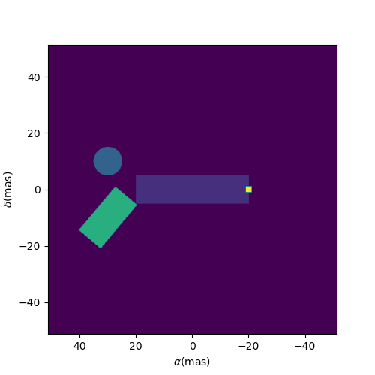
Creating new Fourier components
class oimBox(oim.oimComponentFourier):
name="2D Box"
shortname = "BOX“
def __init__(self,**kwargs):
super().__init__(**kwargs)
self.params["dx"]=oim.oimParam(name="dx", value=1,description="Size in x",unit=u.mas)
self.params["dy"]=oim.oimParam(name="dy", value=1,description="Size in y",unit=u.mas)
self._eval(**kwargs)
def _visFunction(self,ucoord,vcoord,rho,wl,t):
x=self.params["dx"](wl,t)*self.params["dx"].unit.to(u.rad)*ucoord
y=self.params["dy"](wl,t)*self.params["dy"].unit.to(u.rad)*vcoord
return np.sinc(x)*np.sinc(y)
def _imageFunction(self,xx,yy,wl,t):
return ((np.abs(xx)<=self.params["dx"](wl,t)/2) &
(np.abs(yy)<=self.params["dy"](wl,t)/2)).astype(float)
b1=oimBox(dx=40,dy=10)
b2=oimBox(dx=2,dy=2,x=-20,y=0,f=0.5)
b3=oimBox(dx=10,dy=20,x=30,y=-10,pa=-40,f=10)
c=oim.oimUD(d=10,x=30,y=10)
m2=oim.oimModel(b1,b2,b3,c)

Slide 37
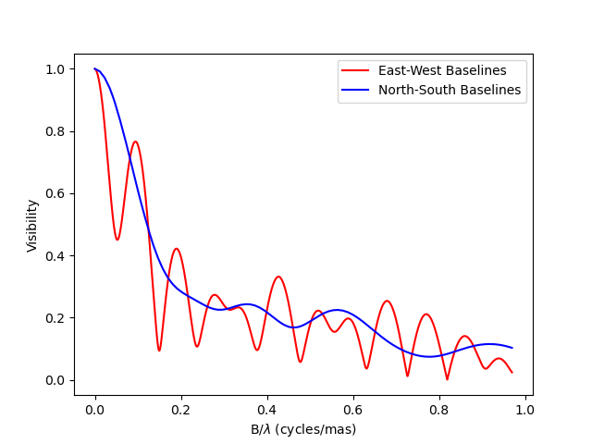
Creating new Image components with an analytical formula
class oimSpiral(oim.oimComponentImage):
name="Spiral component"
shorname="Sp"
elliptic=True
def __init__(self,**kwargs):
super(). __init__(**kwargs)
self.params["fwhm"]=oim.oimParam(**oim._standardParameters["fwhm"])
self.params["P"]=oim.oimParam(name="P", value=1,description="Period in mas",unit=units.mas)
self.params["width"]=oim.oimParam(name="width",
value=0.01,description="Width as filling factor",unit=units.one)
self._pixSize=0.05*units.mas.to(units.rad)
self._t = np.array([0]) # constant value <=> static model
self._wl = np.array([0]) # constant value <=> achromatic model
self._eval(**kwargs)
def _imageFunction(self,xx,yy,wl,t):
r=np.sqrt(xx**2+yy**2)
phi=np.arctan2(yy,xx)
p=self.params["P"](wl,t)
sig=self.params["fwhm"](wl,t)/2.35
w=self.params["width"](wl,t)
im=1 + np.cos(-phi-2*np.pi*np.log(r/p+1))
im=(im<2*w)*np.exp(-r**2/(2*sig**2))
return im

Slide 38
Creating new Radial Profile components (analytical)
class oimExpRing(oim.oimComponentRadialProfile):
name="A ring with a descreasing exponential profil"
shortname = "ExpR"
elliptic=True
def __init__(self,**kwargs):
super().__init__(**kwargs)
self.params["d"]=oim.oimParam(**(oim._standardParameters["d"]))
self.params["fwhm"]=oim.oimParam(**(oim._standardParameters["fwhm"]))
self._dim=256
self._t = np.array([0])
self._wl = np.array([0.5e-6,1e-6])
self._r = np.arange(0, self._dim)*0.05 #in mas
self._eval(**kwargs)
def _radialProfileFunction(self,r,wl,t):
r0=self.params["d"](wl,t)/2
fwhm=self.params["fwhm"](wl,t)
return np.nan_to_num((r>r0)*np.exp(-0.692*np.divide(r-r0,fwhm)),nan=0)

Slide 39
Creating new Image components (external code)
class oimFastRotator(oim.oimComponentImage):
name="Fast Rotator"
shortname="FRot"
def __init__(self,**kwargs):
super(). __init__(**kwargs)
self.params["incl"]=oim.oimParam(name="incl",value=0,description="Inclination angle",unit=units.deg)
self.params["rot"]=oim.oimParam(name="rot",value=0,description="Rotation Rate",unit=units.one)
self.params["Tpole"]=oim.oimParam(name="Tpole",value=20000,description="Polar Temperature",unit=units.K)
self.params["dpole"]=oim.oimParam(name="dplot",value=1,description="Polar diameter",unit=units.mas)
self.params["beta"]=oim.oimParam(name="beta", value=0.25,description="Gravity Darkening Exponent",unit=units.one)
self._t = np.array([0])
self._wl = np.linspace(0.5e-6,15e-6,num=10)
self._eval(**kwargs)
def _internalImage(self):
dim=self.params["dim"].value
incl=self.params["incl"].value
rot=self.params["rot"].value
Tpole=self.params["Tpole"].value
dpole=self.params["dpole"].value
beta=self.params["beta"].value
im=fastRotator(dim,1.5,incl,rot,Tpole,self._wl,beta=beta)
im=np.tile(np.moveaxis(im,-1,0)[None,:,:,:],(1,1,1,1))
self._pixSize=1.5*dpole/dim*units.mas.to(units.rad)
return im

Slide 40
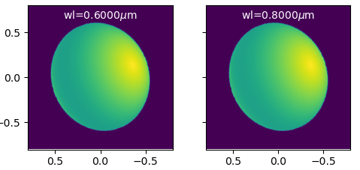
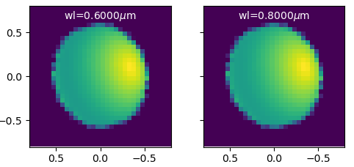
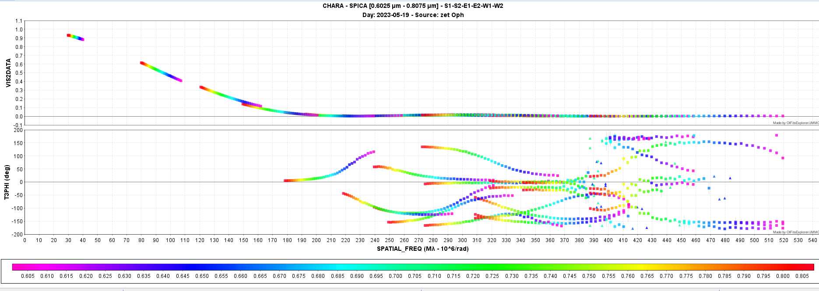
Model-fitting with a image-plan model
DIM=256
ASPRO
oimodeler
User model
(image-cube fits)
Complex model
(chromatic or Image)
Image-Cube (fits)
DIM = 32
Data Simulator
with errors
Fitter
OIFITS
2000 steps
20 walkers
40000 models
13min
(20ms/model)
One 6T obs with SPICA

Slide 41
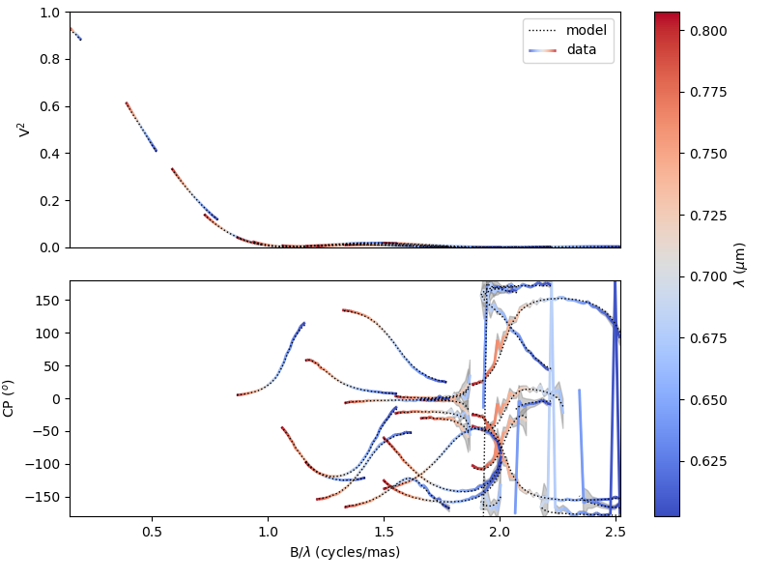
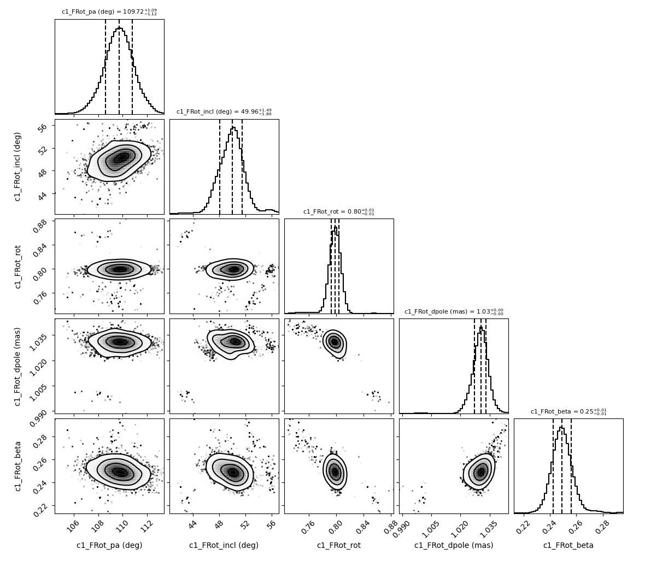
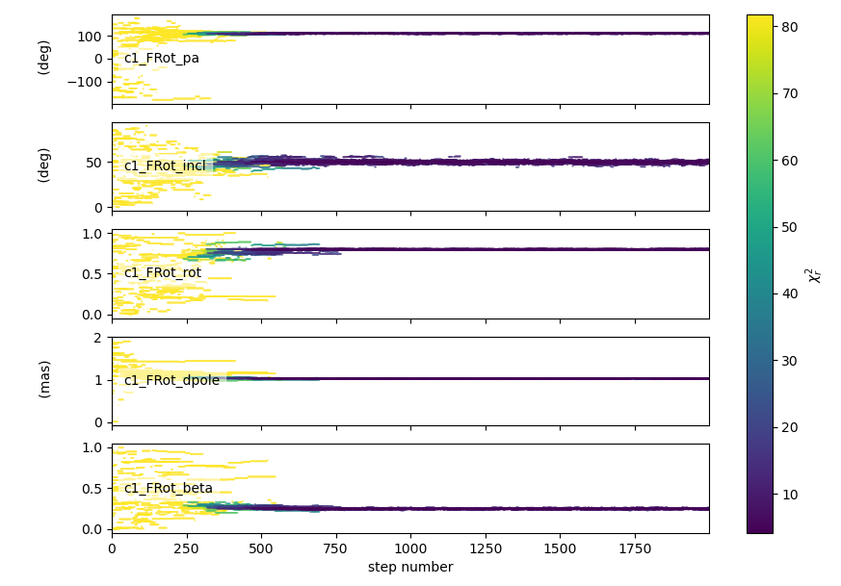
Model-fitting with a image-plan model

Slide 42
Implement missing basic features:
Create components from fits files and grid
Saving (data, models, fitter)
Flux normalization (from 1 or ad-hoc to Jy)
Photometric and spectroscopic data
Documentation and code cleaning
Add a few advanced features
models (rot. disk, DISCO+, AMHRA, grids?)
fitters (chromatic, lmfit, chain)
filters (wl shift, smoothing, binning…)
Start building a test suite
Tests for all models and features
Simulated data (chromatic + time-dependent)
Real data from all known instruments
Start working on optimization
Parallelization
FFT & Hankel algorithms
Data optimization
TODO list until the end of the year
HELP WANTED!

