Slide 1

Massive Stars Study in InterFerometry
(Jan 2022 – Dec 2025)
End of the project
AAPG 2021 – CE31

Slide 2


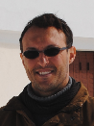

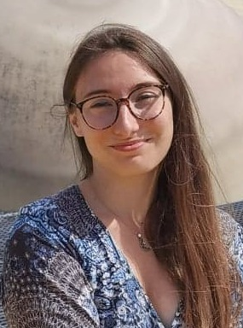




MASSIF project presentation
Topics: Stellar Physics – Massive stars - Optical long baseline interferometry
Funding instrument: PRC
Consortium
Laboratoire Lagrange (UMR7293 Nice)
A. Meilland (PI), A. Domiciano de Souza, F. Millour, J. Perdigon (postdoc 2023-2025), M. Abello (PhD 2022-2026)
Master Interns: Adlan Sadou (2023), M. Houlebreque (2024&2025), K. Sivkova (2025), J. Calderon Gomez (2025)
IRAP (UMR5277 Toulouse)
M. Rieutord, J. Mombarg (postdoc 2022-2024)
Master Interns: C. Mabileau (2023), B. Jourdin (2023), E. Brossier Sécher (2024)
LESIA (UMR8109, Paris-Meudon)
D. Reese, L. Manchon (postdoc 2023 – 2025)
Master Interns: Rupam J. (2024)
J. Perdigon
A. Meilland
A. Domiciano
de Souza
F. Millour
M. Abello
M. Rieutord
J. Mombarg
D. Reese
L. Manchon

Slide 3
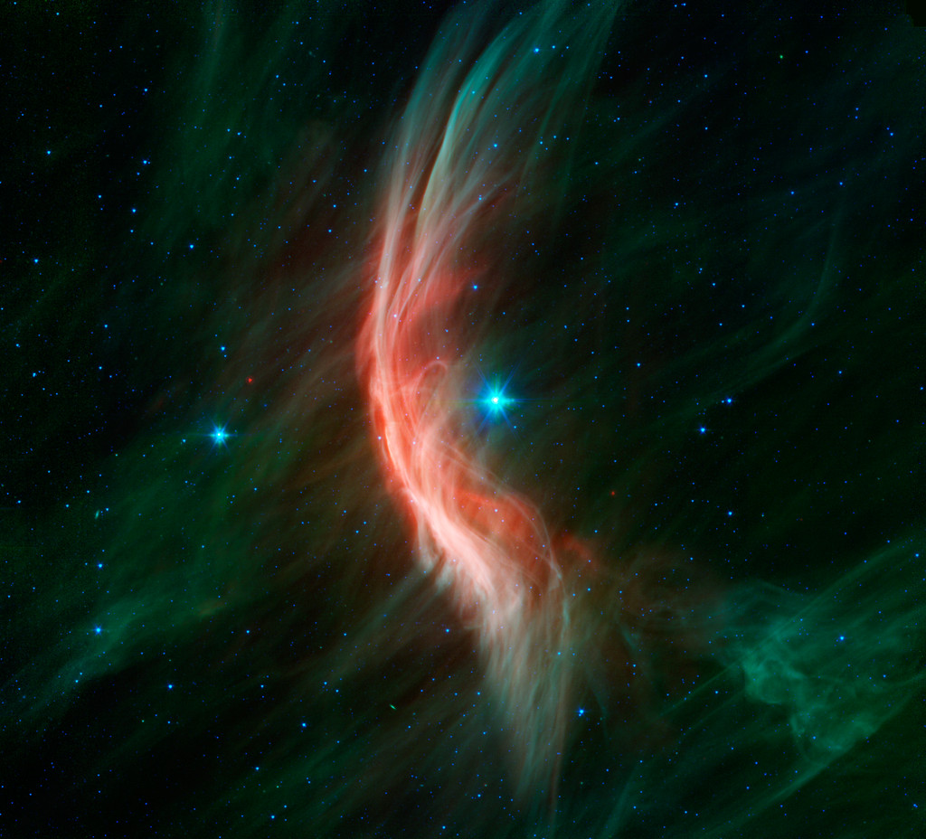
Objectives
Importance of Massive Stars
Strong mass loss during their lifetime
Injection of kinetic and radiative energy
Production of heavy elements (> Oxygen)
Progenitors of:
  supernovae
  neutron stars
  stellar black holes
in the primordial Universe
  Lack of heavy elements
  First generation of stars were massive
Shock wave between the radiative wind of the
massive star Zeta Oph and the interstellar medium

Slide 4
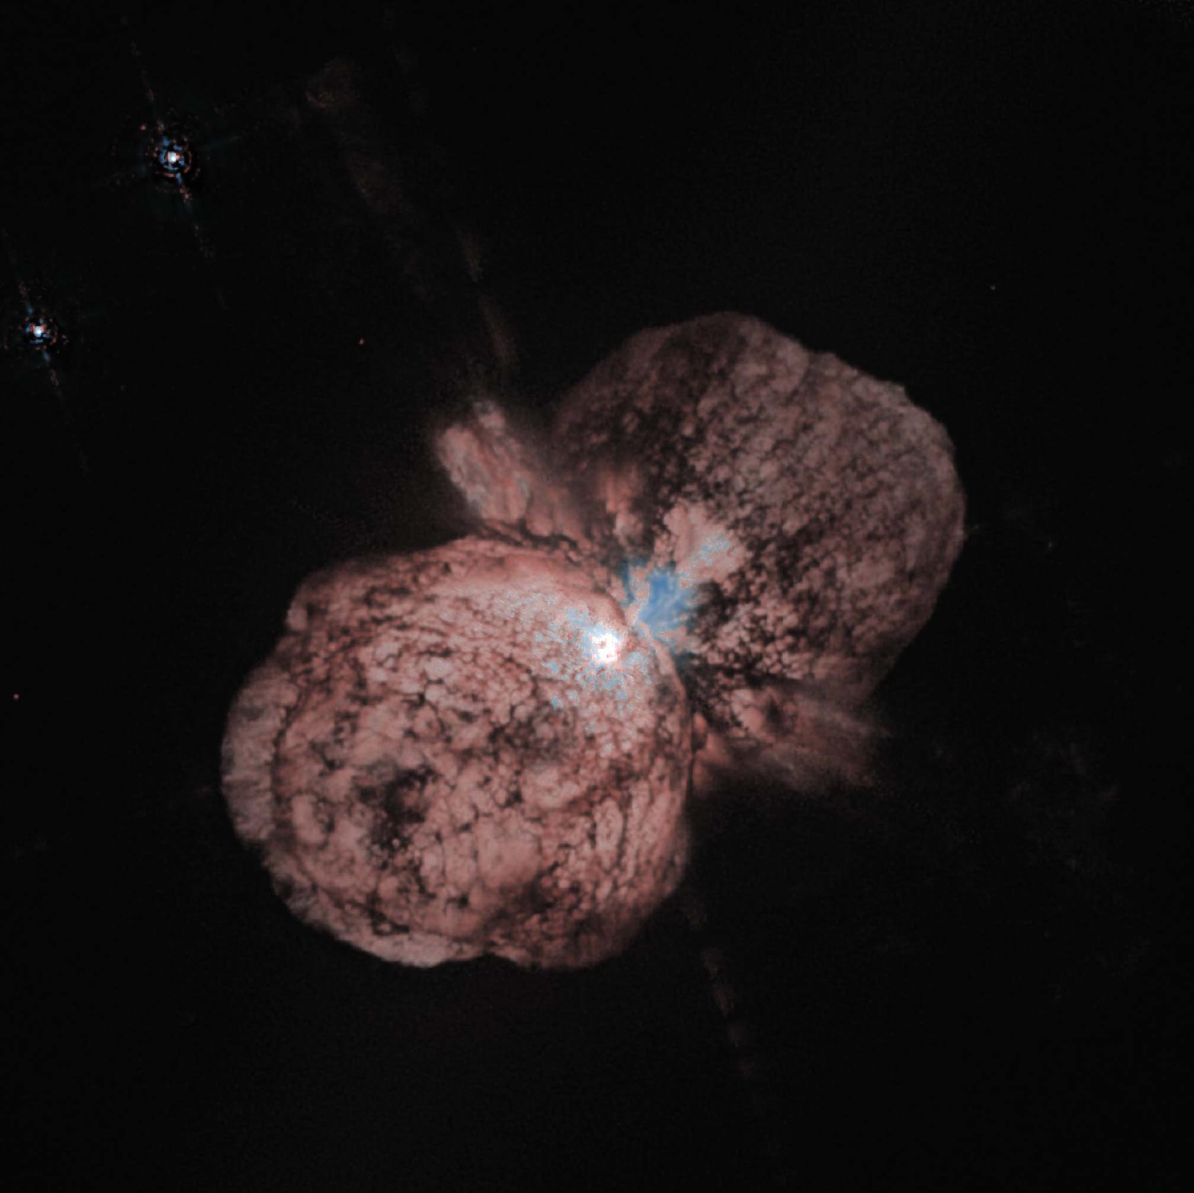
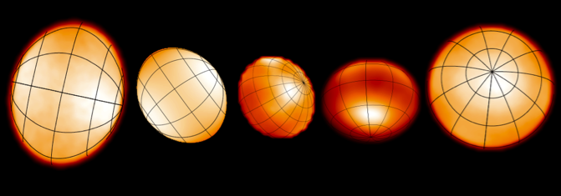
Objectives
Some challenges related to massive stars
Characterizing mass loss at the different
evolutionary stages of massive stars
+
Influence of rotation and binarity on massive stars
⇳
breaking of spherical symmetry of mass loss
Modification of internal structure
Impact on stellar evolution
Homunculus Nebula around the
hypermassive star Eta Carinae
Fast-rotators imaged by the CHARA interferometer
Need of advanced models of stars and circumstellar environments (CE)
and observations at high-spatial and spectral resolution

Slide 5
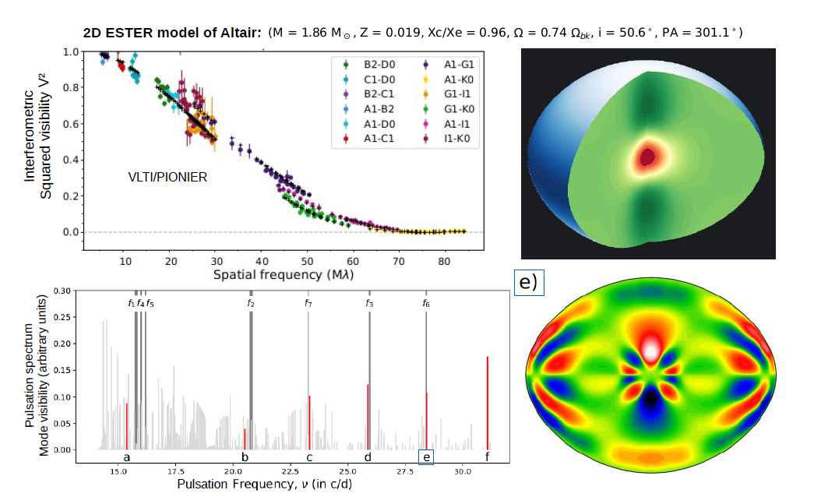
Previous Work
A. Domiciano
de Souza
M. Rieutord
D. Reese

Slide 6
The MASSIF Work Packages
J. Mombarg
J. Perdigon
M. Rieutord
M. Abello
D. Reese
F. Millour
A. Domiciano
de Souza
A. Meilland
L. Manchon

Slide 7
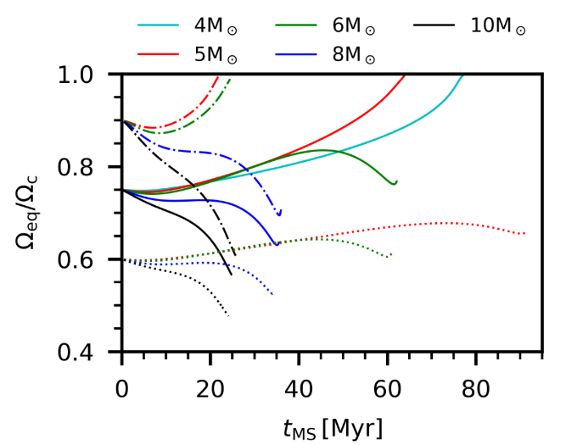
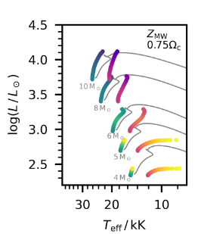
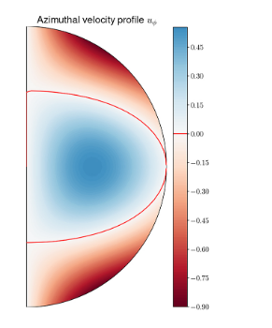
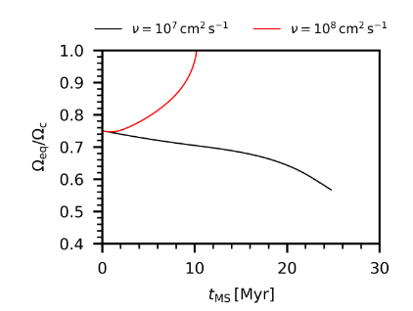

Major results from WP1: Stellar Interiors (ESTER)
From ESTER Static model to ESTER with temporal evolution
The first self-consistent 2D stellar evolution models of rotating stars
New evolutionary tracks of intermediate to massive stars with rotation
Only intermediate mass stars reach critical rotation
But depends on efficiency of angular momentum transport in the radiative zone
Evolution of rotational rate
Interior model (velocity)
also depends on viscosity
For a 10 ${\text{M}}_{⊙}$star
HR-diagram

Slide 8
Major results from WP1: Stellar Interiors (ESTER)
From ESTER Static model to ESTER with temporal evolution
The first self-consistent 2D stellar evolution models of rotating stars
New evolutionary tracks of intermediate to massive stars with rotation
Only intermediate mass stars reach critical rotation
But depends on efficiency of angular momentum transport in the radiative zone
6 refereed papers published in A&A
Spectroscopic detection of Altair's non-radial pulsations (Rieutord+ 2023)
Photometric determination of rotation axis inclination, rotation rate, and mass of rapidly rotating intermediate-mass stars pulsations (Lazzarotto+ 2023)
The first two-dimensional stellar structure and evolution models of rotating stars. Calibration to β Cephei pulsator HD192575 (Mombarg+ 2024)
A two-dimensional perspective of the rotational evolution of rapidly rotating intermediate-mass stars: Implications for the formation of single Be stars (Mombarg + 2024)
An improved asteroseismic age of the rapid rotator Altair from TESS data (Rieutord+ 2024)
Angular momentum relaxation in models of rotating early-type stars (Rieutord+ 2025)
Deliverables
Improved version of the ESTER code including the latest updates on mass and angular momentum losses
grids of ESTER interiors models (12000 models available but the evolution of ESTER )
ESTER-PHOENIX atmosphere models computed for typical main sequence O&B stars
✔
/
✔

Slide 9
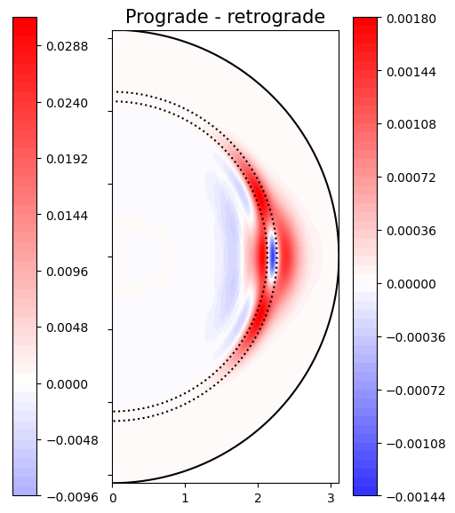
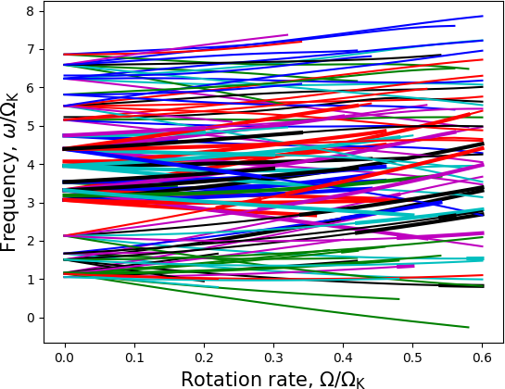
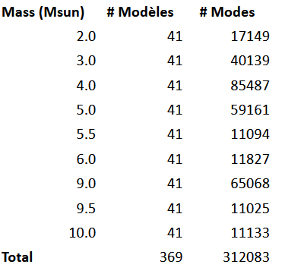


Major results from WP2: Asteroseismology of Massive stars
Asteroseismology of fast-rotating stars using TOP and ESTER (and CESAM2K) models
Non-adiabatic oscillations of ESTER models
Excitation and damping regions in a 9${\text{M}}_{⊙}$ star rotating at 40% of the critical velocity
Oscillation modes frequencies
in 9 ${\text{M}}_{⊙}$ ESTER models.
ESTER-TOP models

Slide 10
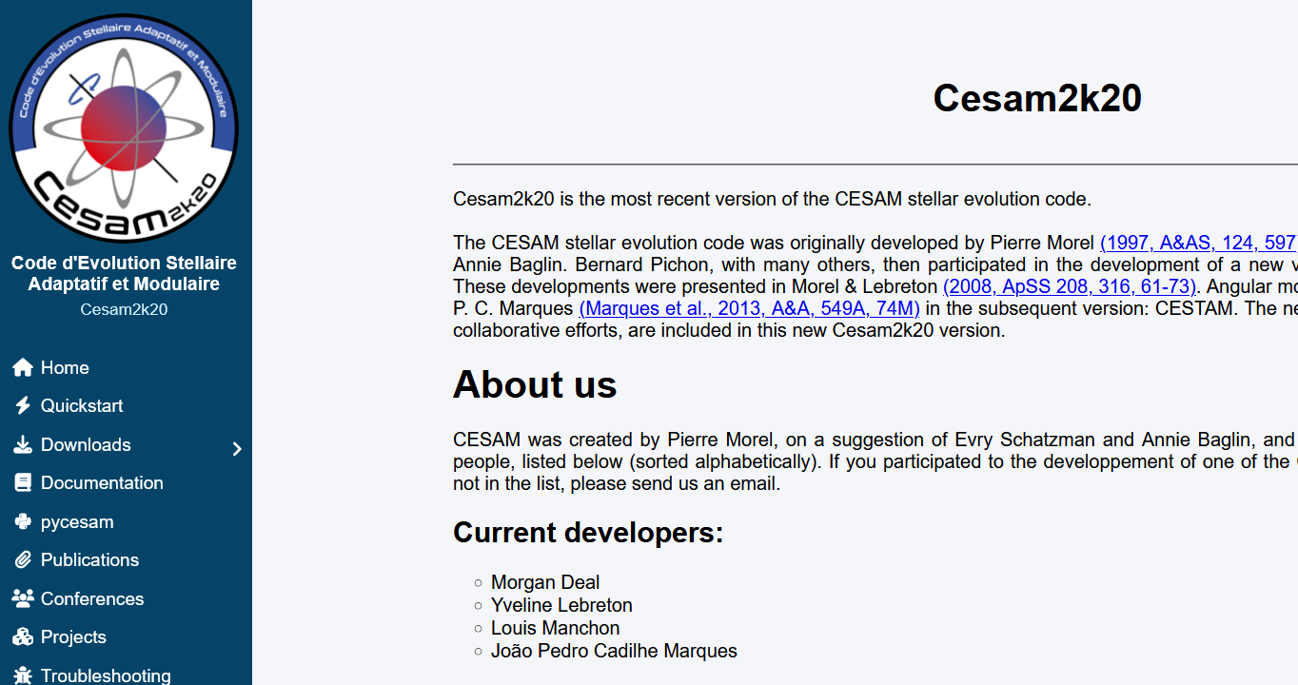
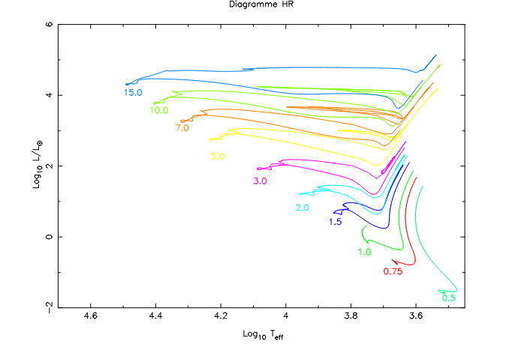
Major results from WP2: Asteroseismology of Massive stars
Asteroseismology of fast-rotating stars using TOP and ESTER (and CESAM2K) models
Non-adiabatic oscillations of ESTER models
Finalization of CESAM2k20 (CESAM with rotation into account, including centrifugal deformation)
L. Manchon
Evolutionary tracks for mass ranging from 0.5 ${\text{M}}_{⊙}$ to 15 ${\text{M}}_{⊙}$
Asteroseismic grid of models for PLATO stars

Slide 11
Major results from WP2: Asteroseismology of Massive stars
Asteroseismology of fast-rotating stars using TOP and ESTER (and CESAM2K) models
Non-adiabatic oscillations of ESTER models
Finalization of CESAM2k20 (CESAM with rotation into account, including centrifugal deformation)
Rotation-profile inversions in rapidly rotating stellar models (not-conclusive)
Variations of line profiles in rapidly rotating stars
3 papers:
Entropy calibrated stellar modeling (Manchon+ A&A 2024)
Cesam2k20: A code for a new generation of stellar evolution models. I. Description of the code (Manchon+ A&A 2023)
2D modelling of pulsating stars with rapid rotation (Reese+ Frontiers in Astronomy and Space Sciences, 2022)
Deliverables:
Public release of the TOP code (January 2026)
Seismic observables for the grid of ESTER rotating stellar models
Seismic grid for PLATO using CESAM2K
✔
✔
✔

Slide 12
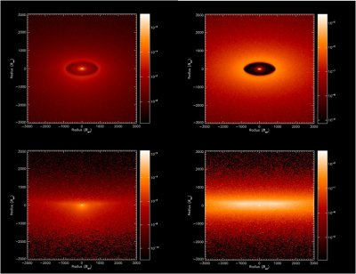
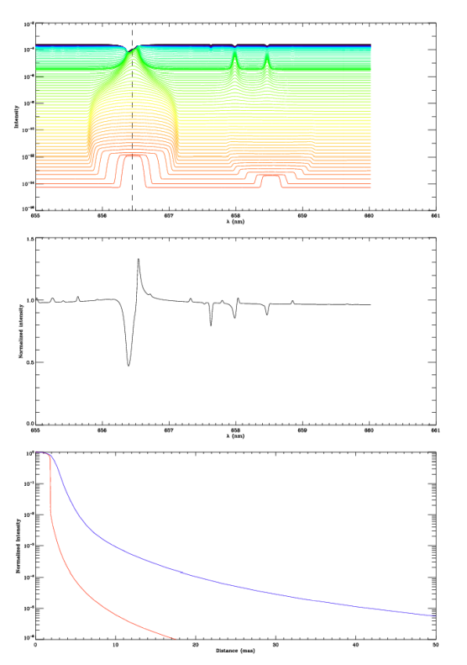
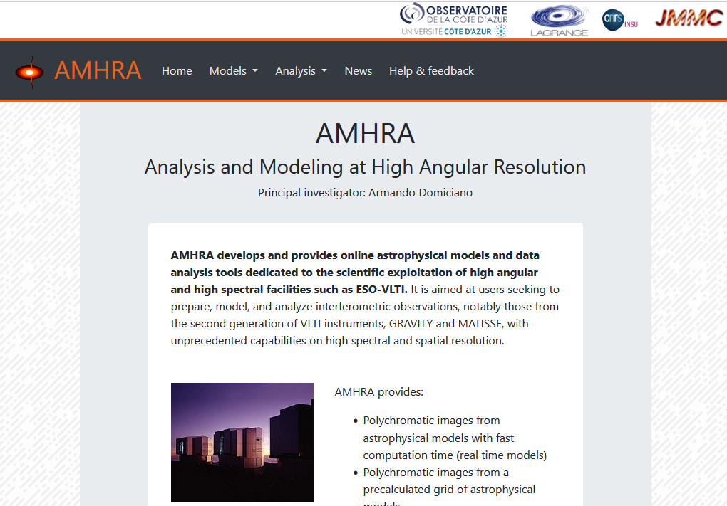
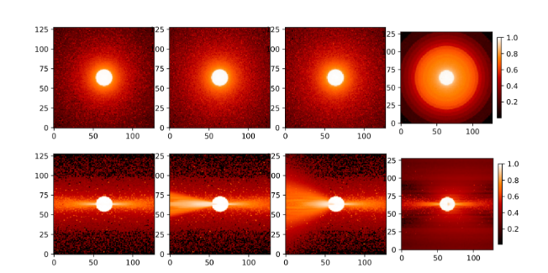
Major results from WP3: Polychromatic image synthesis for interferometry
WP31: Grids of polychromatic images for different types of massive stars and environment (radiative-transfer)
HDUST grids of models of Be & B[e] stars computed in Nice in relation (with A. Carciofi group in Brazil)
CMFGEN grid of models of OB stars radiative winds computed in Nice (with E. Saldanha de Almeida)
→ Grids will be available through the AMHRA service
B[e] stars HUDST models (gas & dust)
hot stars winds CMFGEN
polychromatic
radial intensity profiles
B stars HUDST models (gas only)

Slide 13
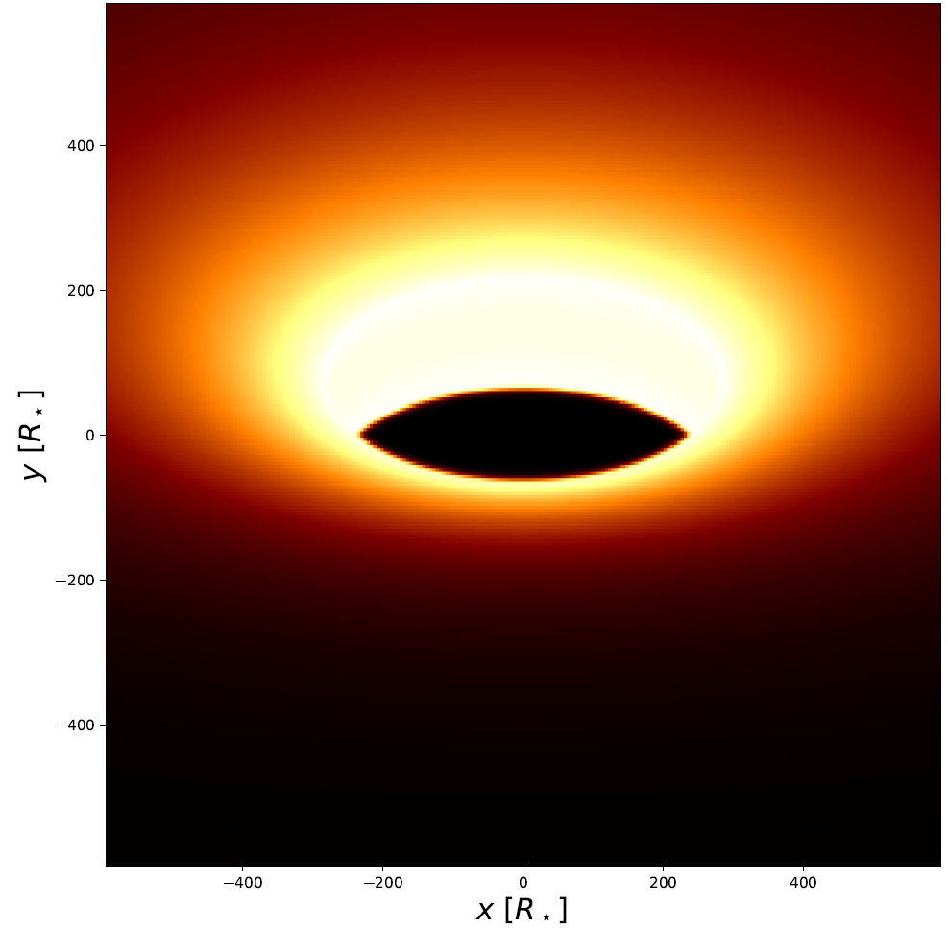
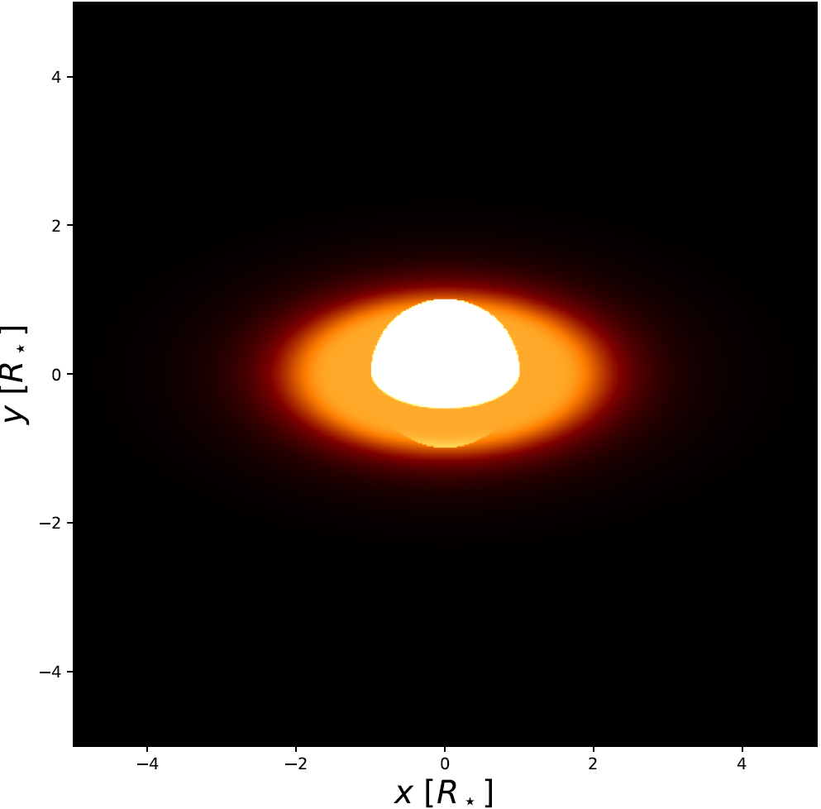
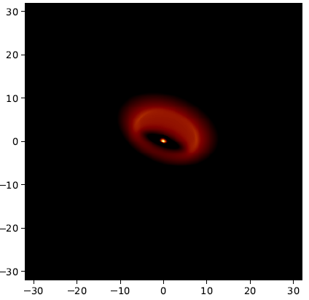
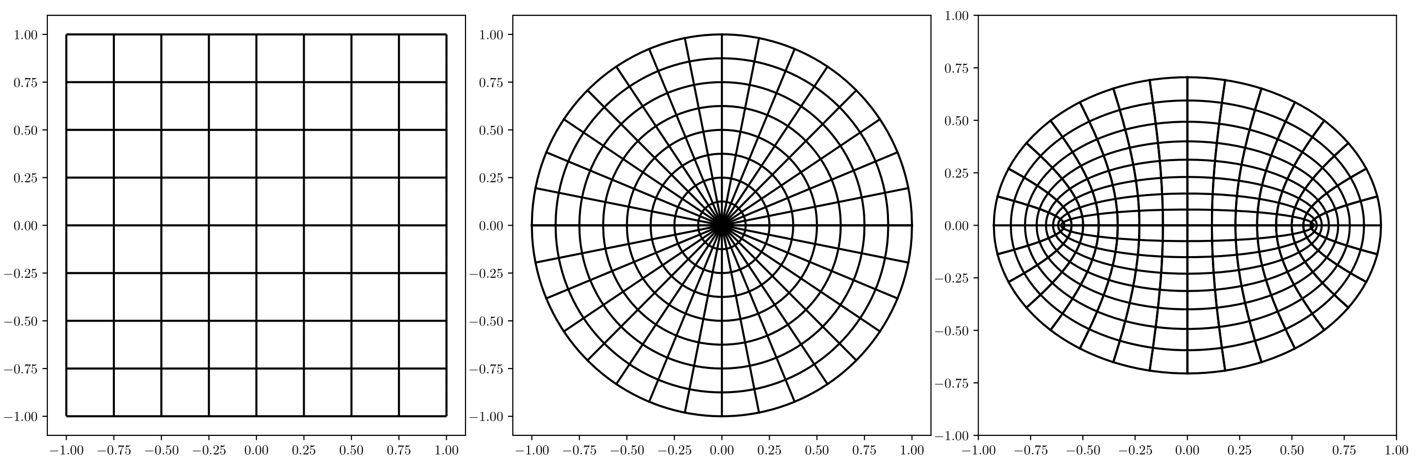
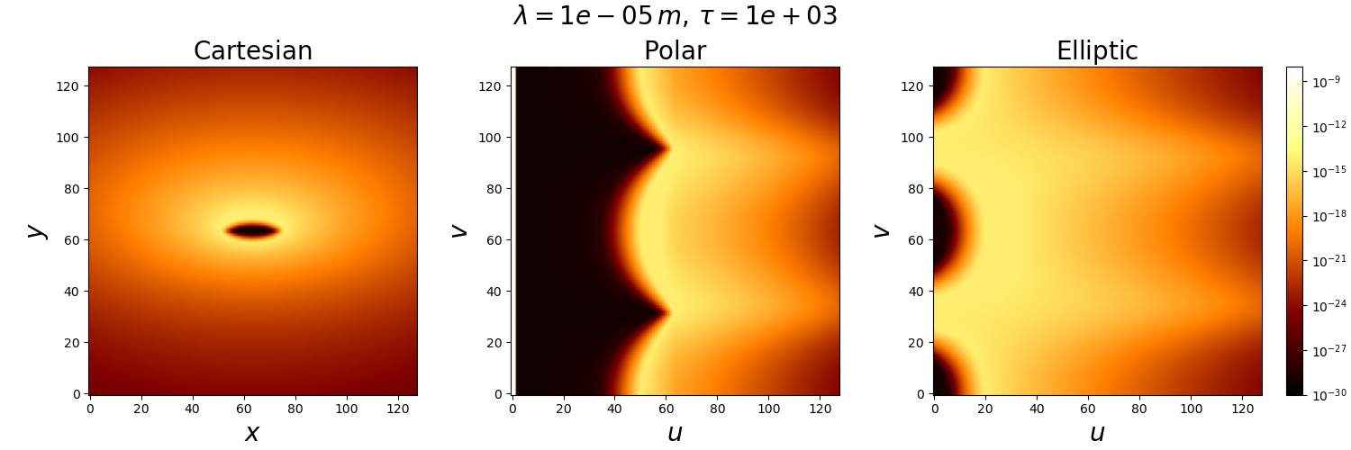
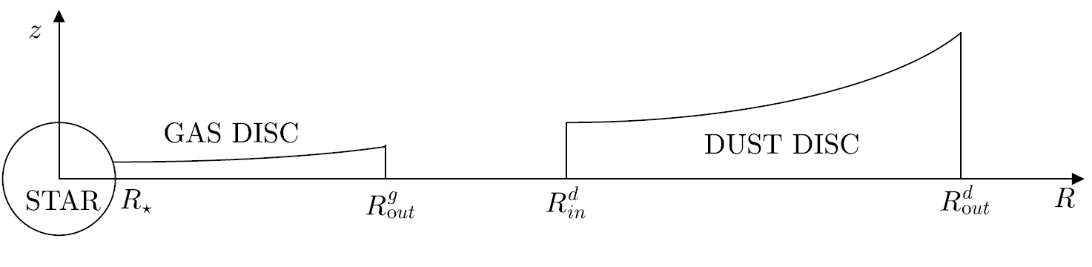
Major results from WP3: Polychromatic image synthesis for interferometry
WP31: Grids of polychromatic images for different types of massive stars and environment (radiative-transfer)
HDUST grids of models of Be & B[e] stars computed in Nice in relation (with A. Carciofi group in Brazil)
CMFGEN grid of models of OB stars radiative winds computed in Nice (with E. Saldanha de Almeida)
→ Grids will be available through the AMHRA service
Development of an innovative fast (1-10s) radiative-transfer ray-tracer code for dusty/gaseous CE: RTSPyCE
Dust
Star + Gas
Dust + Gas + Star
+
=
Jeremy
Perdigon
Non-cartesian grids ⬄ more suited to model
inteferometric measurements at different scales

Slide 14
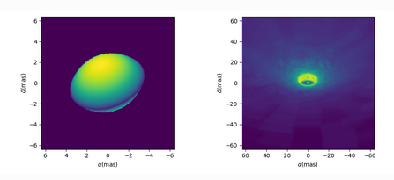
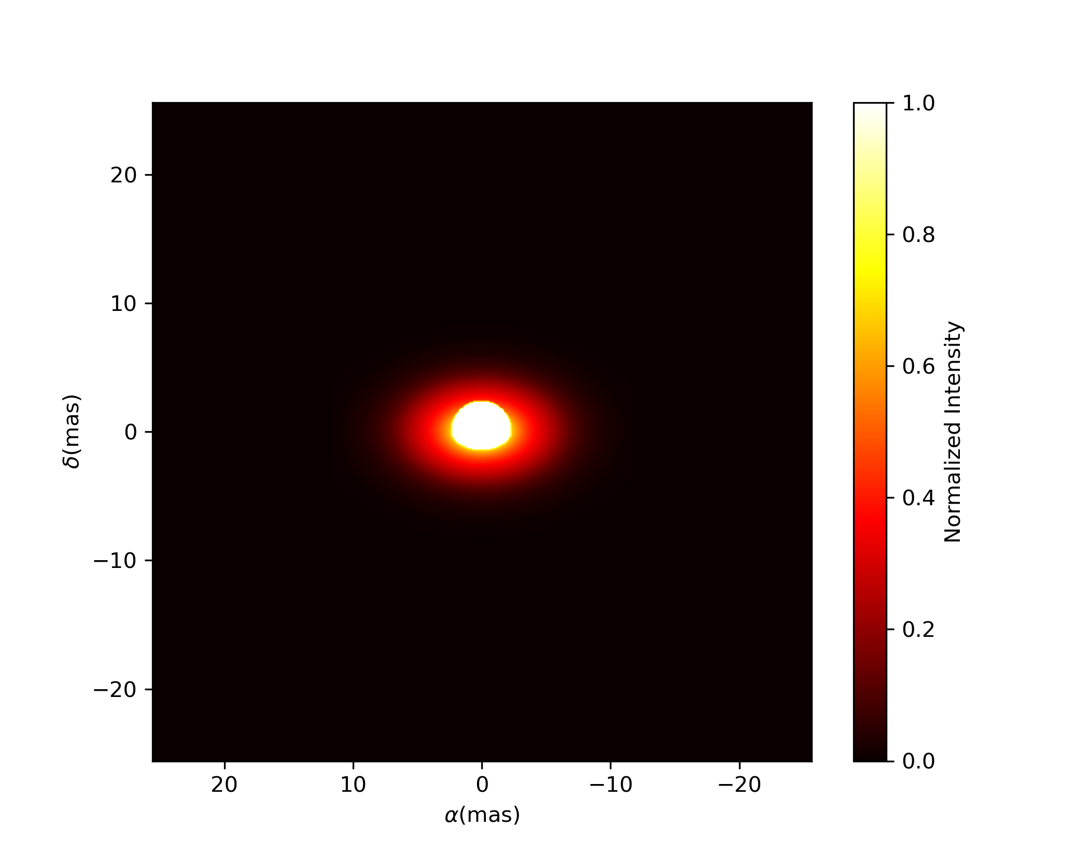
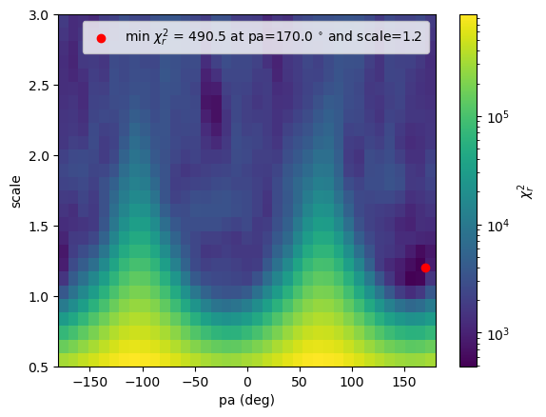
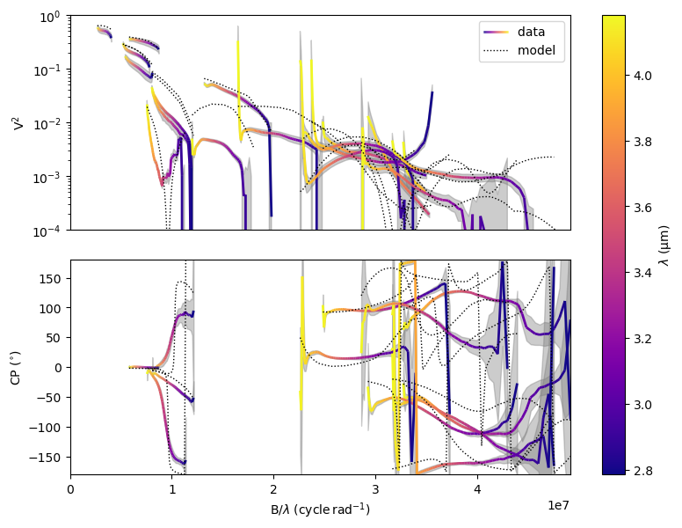
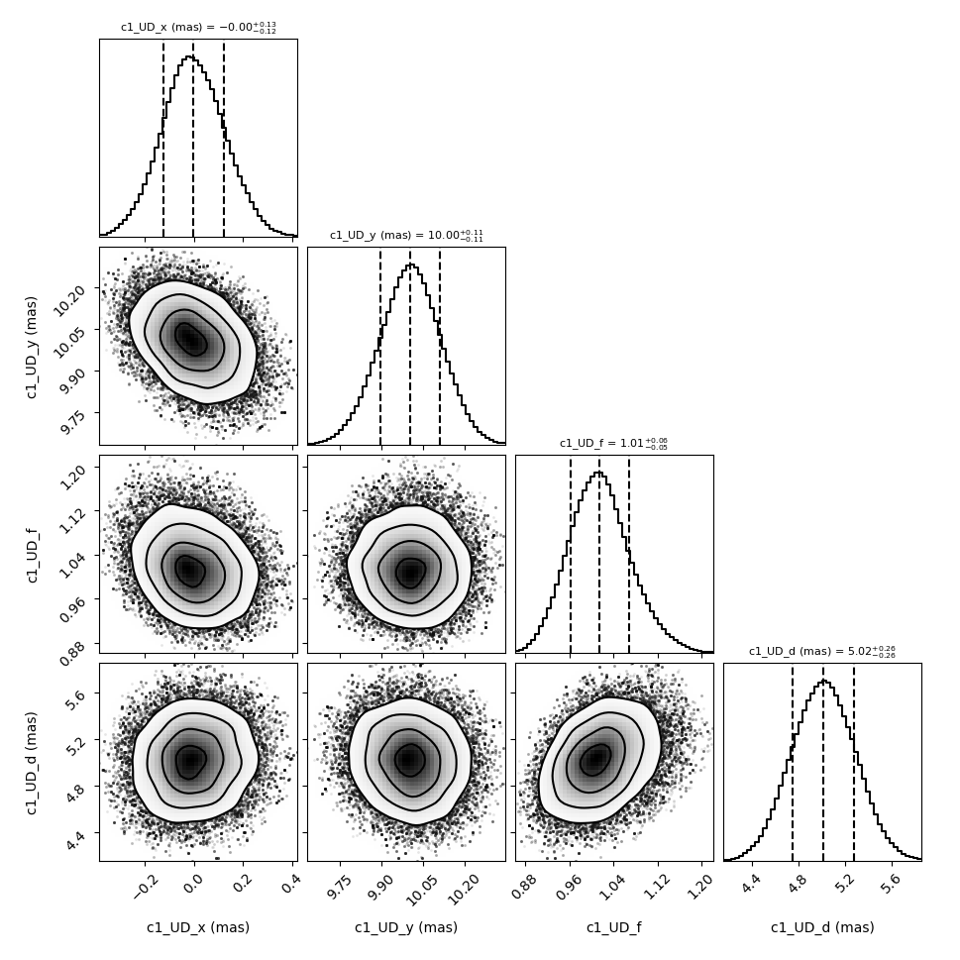
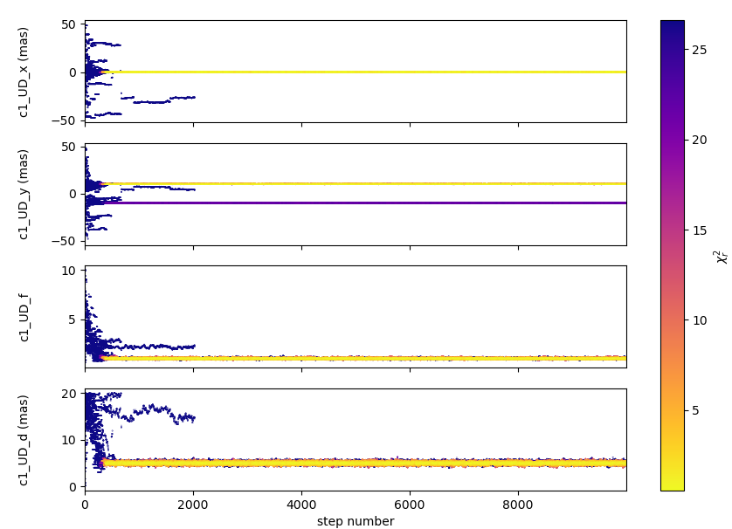
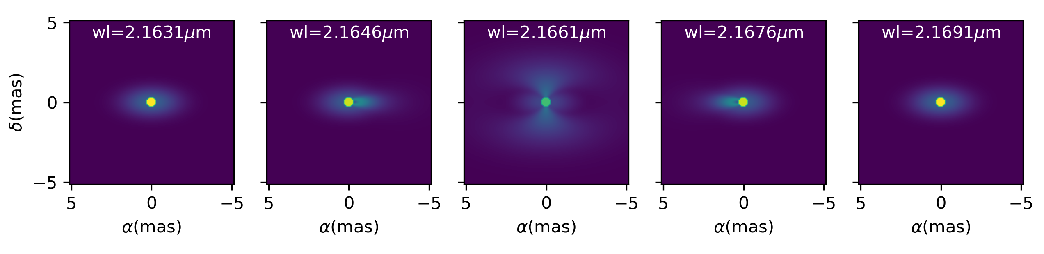
Major results from WP3: Polychromatic image synthesis for interferometry
WP31: Grids of polychromatic images for different types of massive stars and environment (radiative-transfer)
HDUST grids of models of Be & B[e] stars computed in Nice in relation (with A. Carciofi group in Brazil)
CMFGEN grid of models of OB stars radiative winds computed in Nice (with E. Saldanha de Almeida)
→ Grids will be available through the AMHRA service
Development of an innovative fast (1-10s) radiative-transfer ray-tracer code for dusty/gaseous CE: RTSPyCE
2) WP32: Tools for spectro-interferometric analysis (image reconstruction and model fitting)
Development of the oimodeler model-fitting suite for spectro-interferometry
Fast Rotators
HDUST
DISCO
Rotating disk of Be star through emission line
Many types of models
Fully compatible with OIFITS2
+ spectroscopy + photometry
Model fitting algorithms
(MCMC, gradient descent, grid search

Slide 15
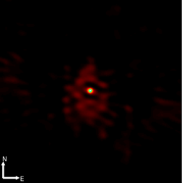
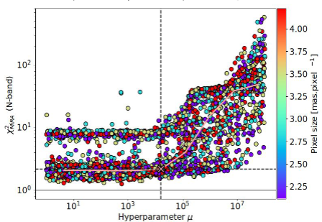
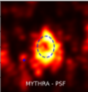

Major results from WP3: Polychromatic image synthesis for interferometry
WP31: Grids of polychromatic images for different types of massive stars and environment (radiative-transfer)
HDUST grids of models of Be & B[e] stars computed in Nice in relation (with A. Carciofi group in Brazil)
CMFGEN grid of models of OB stars radiative winds computed in Nice (with E. Saldanha de Almeida)
→ Grids will be available through the AMHRA service
Development of an innovative fast (1-10s) radiative-transfer ray-tracer code for dusty/gaseous CE: RTSPyCE
2) WP32: Tools for spectro-interferometric analysis (image reconstruction and model fitting)
Development of the oimodeler model-fitting suite for spectro-interferometry
Participation to the development of the PYRA/MYTHRA packages for statistical image reconstruction (PI: J. Devron)
MYTHRA statistical analysis
J Devron
PYRA generates
thousands of images
With MIRA software
Average image
and confidence map
Exploration of hyperparameter(s),
regularisation, FOV, pixel size…

Slide 16
Major results from WP3: Polychromatic image synthesis for interferometry
WP31: Grids of polychromatic images for different types of massive stars and environment (radiative-transfer)
HDUST grids of models of Be & B[e] stars computed in Nice in relation (with A. Carciofi group in Brazil)
CMFGEN grid of models of OB stars radiative winds computed in Nice (with E. Saldanha de Almeida)
→ Grids will be available through the AMHRA service
Development of an innovative fast (1-10s) radiative-transfer ray-tracer code for dusty/gaseous CE: RTSPyCE
2) WP32: Tools for spectro-interferometric analysis (image reconstruction and model fitting)
Development of the oimodeler model-fitting suite for spectro-interferometry
Participation to the development of the PYRA/MYTHRA packages for statistical image reconstruction (PI: J. Devron)
3 papers
Oimodeler: a modular modelling software for optical interferometry (Meilland+ SPIE 2024)
Discontinuous Galerkin finite element method for the continuum radiative transfer problem inside axis-symmetric circumstellar envelope (Perdigon+ A&A, 2024)
The circumstellar environment of FS CMa: Modelling spectroscopic, VLTI-PIONIER and -MATISSE data with ray-tracing (Perdigon+, A&A submitted, 2025)
Deliverables
Grid of RT-polychromatic (visible-to-mid-infrared) models of Be stars, B[e] stars, OB winds
RTSPyCE fast RT-code optimized for fast spectro-inteferometric analysis of hot CE (Be, B[e], YSO, AGNs…)
Oimodeler code for polychromatic spectro-interferometric modelling
PYRA/MYTHRA suite for statistical and automatized image reconstruction
/
✔
✔
✔

Slide 17
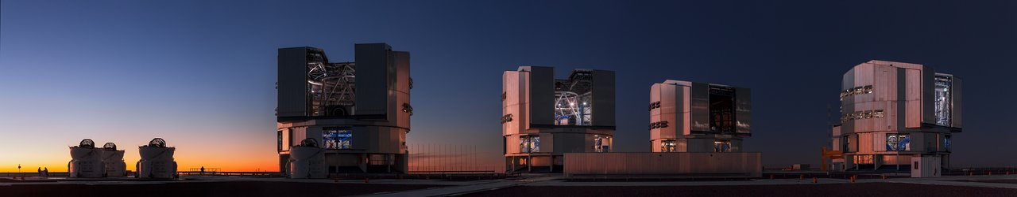
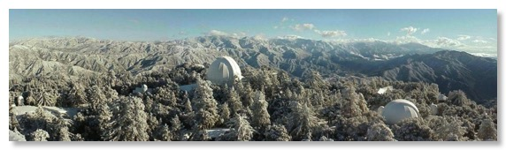
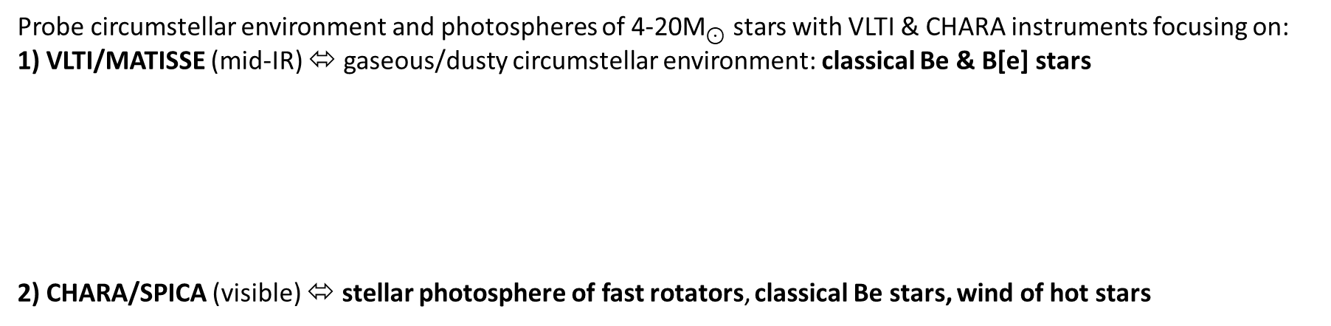
Major results from WP4: Interferometric Surveys
Probe circumstellar environment and photospheres of 4-20${\text{M}}_{⊙}$ stars with VLTI & CHARA instruments focusing on:
1) VLTI/MATISSE (mid-IR) ⬄ gaseous/dusty circumstellar environment: classical Be & B[e] stars
2) CHARA/SPICA (visible) ⬄ stellar photosphere of fast rotators, classical Be stars, wind of hot stars

Slide 18
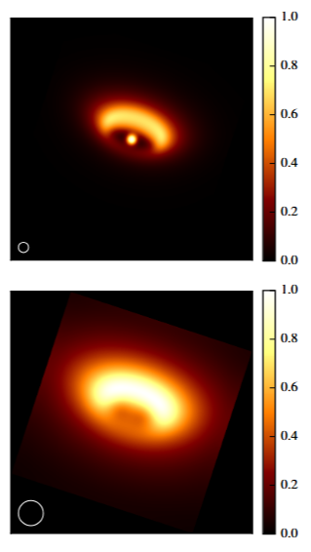
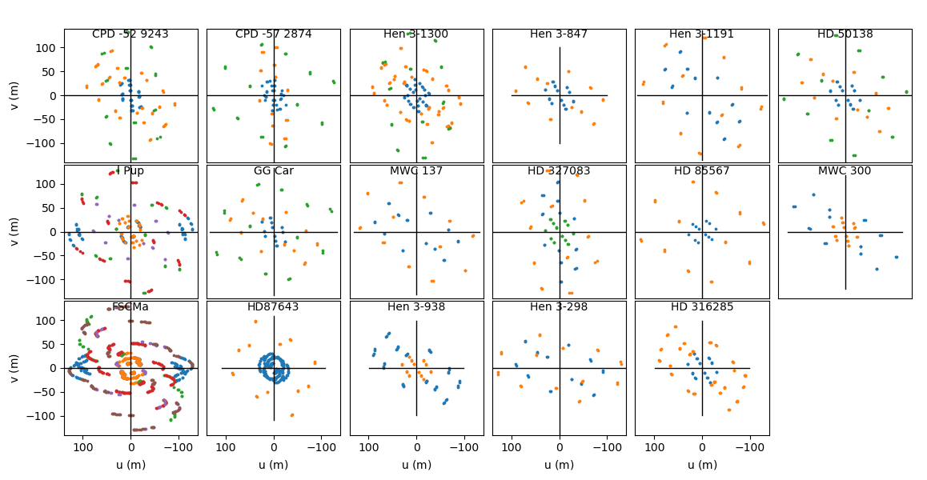
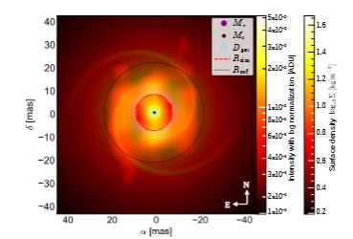
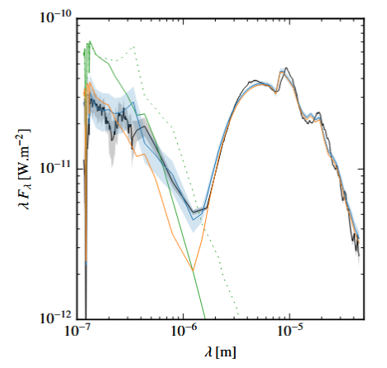
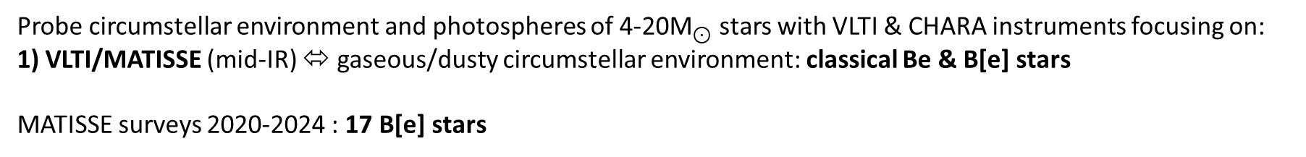
Major results from WP4: Interferometric Surveys
Probe circumstellar environment and photospheres of 4-20${\text{M}}_{⊙}$ stars with VLTI & CHARA instruments focusing on:
1) VLTI/MATISSE (mid-IR) ⬄ gaseous/dusty circumstellar environment: classical Be & B[e] stars
MATISSE surveys 2020-2024 : 17 B[e] stars
Spatial frequencies plan coverage
of 17 observed targets
Spectral Energy Distribution
3µm
10µm
M. Abello
Other papers in preparation
MWC300
Hen 3-1300
Statistical analysis
Jeremy
Perdigon
Multi-band infrared imaging reveals dusty spiral arcs
around the binary B[e] star 3 Puppis
Abello, A&A 2025, in press
(data analysed with oimodeler + PYRA/MYTHRA)
The circumstellar environment of FS CMa: Modelling
spectroscopic, VLTI-PIONIER and -MATISSE data with ray-tracing
Perdigon, A&A 2025, in preparation
(using RTSPyCE)

Slide 19
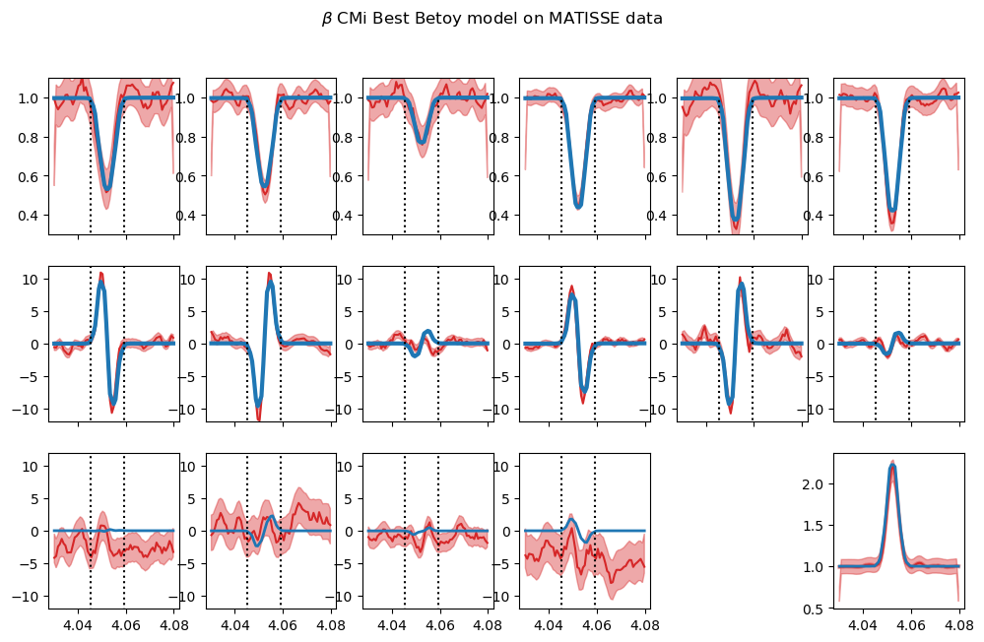
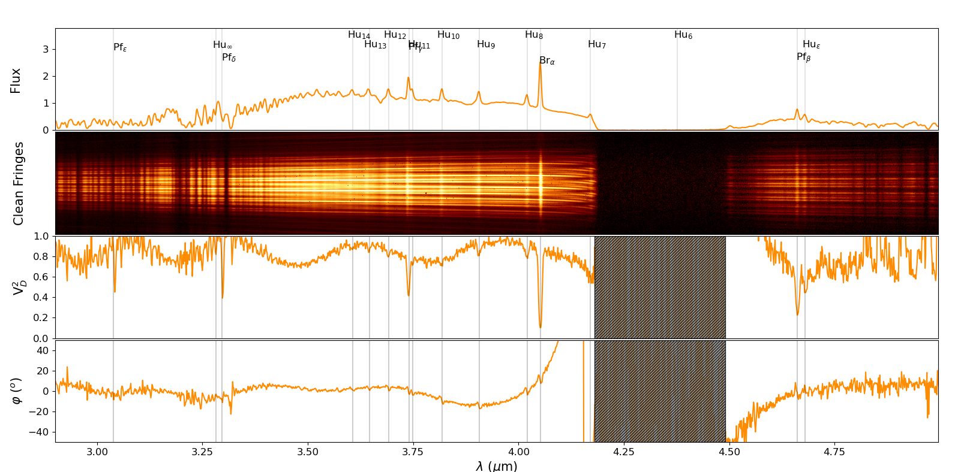
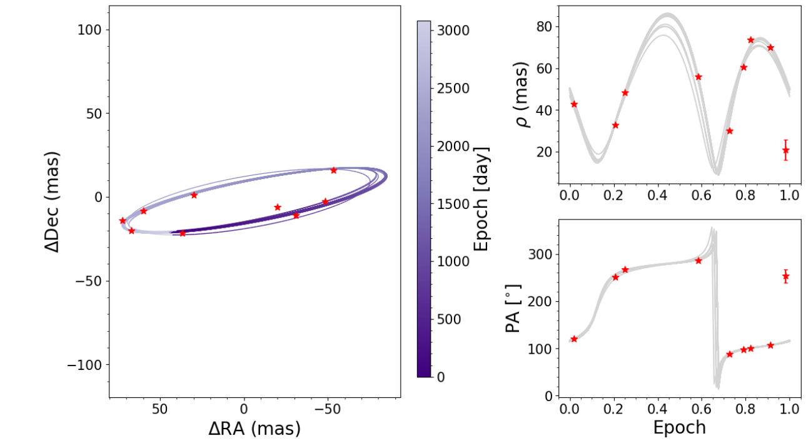
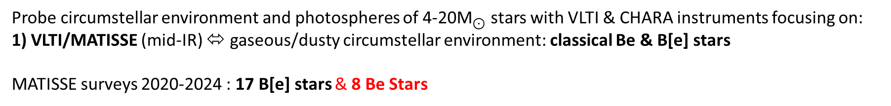
Major results from WP4: Interferometric Surveys
Probe circumstellar environment and photospheres of 4-20${\text{M}}_{⊙}$ stars with VLTI & CHARA instruments focusing on:
1) VLTI/MATISSE (mid-IR) ⬄ gaseous/dusty circumstellar environment: classical Be & B[e] stars
MATISSE surveys 2020-2024 : 17 B[e] stars & 8 Be Stars
β CMi
multi-lines & multi-bands
R-K-L-bands + Hα + Brα + Brγ
Klement+ (in preparation)
δ Cen
Star, Disk and Orbit
from spectro-interferometry
Houlbreque+ (in preparation)
First observaton of a Be star with MATISSE in Gra4Mat mode
Lopez+ (2024), Woilez+ (A&A 2024)

Slide 20
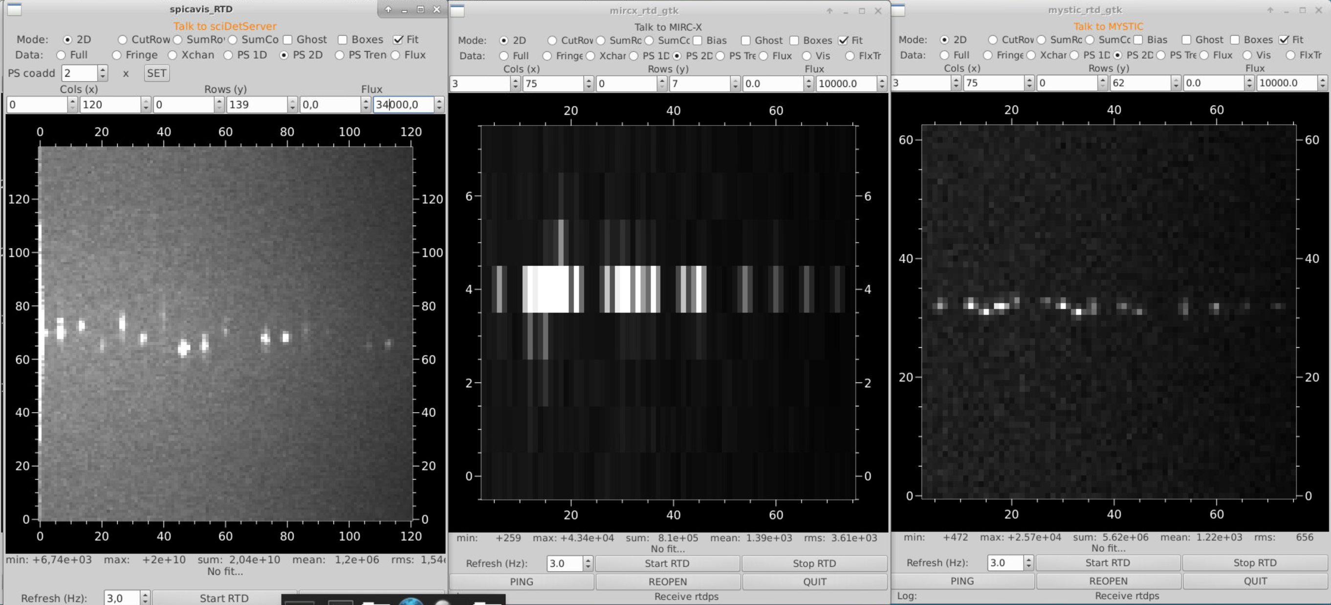
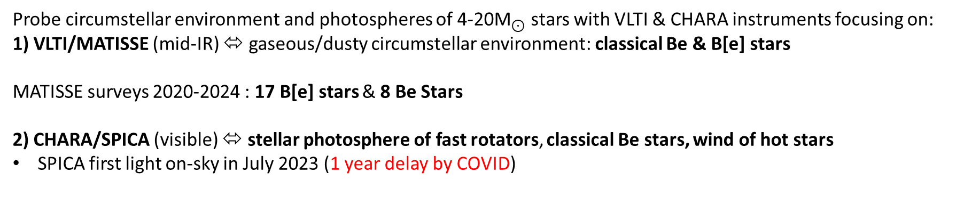
Major results from WP4: Interferometric Surveys
Probe circumstellar environment and photospheres of 4-20${\text{M}}_{⊙}$ stars with VLTI & CHARA instruments focusing on:
1) VLTI/MATISSE (mid-IR) ⬄ gaseous/dusty circumstellar environment: classical Be & B[e] stars
MATISSE surveys 2020-2024 : 17 B[e] stars & 8 Be Stars
2) CHARA/SPICA (visible) ⬄ stellar photosphere of fast rotators, classical Be stars, wind of hot stars
SPICA first light on-sky in July 2023 (1 year delay by COVID)
SPICA (R-band)
MIRCX (H-band)
MYSTIC (K-band)
Simultaneous
Observation
From 0.65 to 2.4 µm
Power-Spectrum on the 3 instruments showing 15 fringe-peaks (6 telescopes)

Slide 21
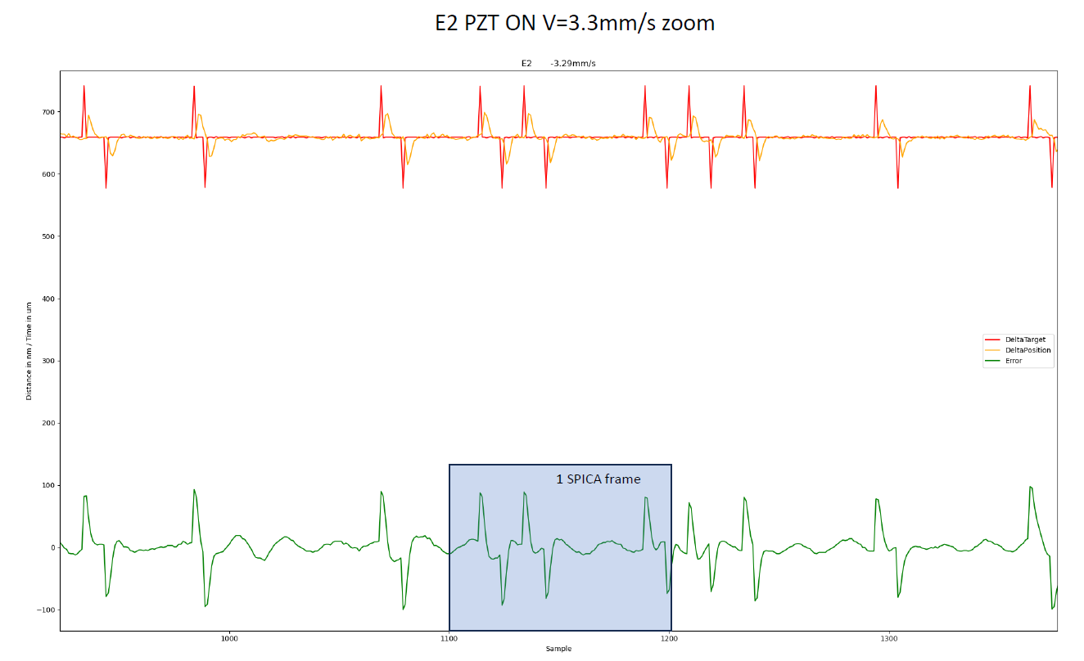

Major results from WP4: Interferometric Surveys
Probe circumstellar environment and photospheres of 4-20${\text{M}}_{⊙}$ stars with VLTI & CHARA instruments focusing on:
1) VLTI/MATISSE (mid-IR) ⬄ gaseous/dusty circumstellar environment: classical Be & B[e] stars
MATISSE surveys 2020-2024 : 17 B[e] stars & 8 Be Stars
2) CHARA/SPICA (visible) ⬄ stellar photosphere of fast rotators, classical Be stars, wind of hot stars
SPICA first light on-sky in July 2023 (1 year delay by COVID)
Detection of CHARA infrastructure issues: AO, visible-IR alignement, Delay-lines jumps
→ SPICA data quality still far from optimal for science observation in 2025
Jumps detected in the metrology
of CHARA delay lines (2024)

Slide 22







Major results from WP4: Interferometric Surveys
Probe circumstellar environment and photospheres of 4-20${\text{M}}_{⊙}$ stars with VLTI & CHARA instruments focusing on:
1) VLTI/MATISSE (mid-IR) ⬄ gaseous/dusty circumstellar environment: classical Be & B[e] stars
MATISSE surveys 2020-2024 : 17 B[e] stars & 8 Be Stars
2) CHARA/SPICA (visible) ⬄ stellar photosphere of fast rotators, classical Be stars, wind of hot stars
SPICA first light on-sky in July 2023 (1 year delay by COVID)
Detection of CHARA infrastructure issues: AO, visible-IR alignement, Delay-lines jumps
→ Strategy of survey changed with observations focusing on H-and-K-bands
First data on Fast-rotators acquired in 2024-2025 (18 objects, 5 well resolved)
Companions detected on some objects!
Constraints depending on object angular size

Slide 23

Major results from WP4: Interferometric Surveys
Probe circumstellar environment and photospheres of 4-20${\text{M}}_{⊙}$ stars with VLTI & CHARA instruments focusing on:
1) VLTI/MATISSE (mid-IR) ⬄ gaseous/dusty circumstellar environment: classical Be & B[e] stars
MATISSE surveys 2020-2024 : 17 B[e] stars & 8 Be Stars
2) CHARA/SPICA (visible) ⬄ stellar photosphere of fast rotators, classical Be stars, wind of hot stars
SPICA first light on-sky in July 2023 (1 year delay by COVID)
CHARA infrastructure issues: AO, Alignement, Delay-lines “jumps”
→ Strategy of survey changed with observations focusing on H-and-K-bands
First data on Fast-rotators acquired in 2024-2025 (18 objects, 5 well resolved)
2 published papers:
Multi-band infrared imaging reveals dusty spiral arcs around the binary B[e] star 3 Puppis (Abello+ A&A, 2025)
The circumstellar environment of FS CMa: Modelling spectroscopic, VLTI-PIONIER and -MATISSE data with ray-tracing (Perdigon, A&A, 2025)
Deliverables:
reduced interferometric data on the JMMC OiDB database (automatically done for SPICA)
200 stellar parameters and mass-loss (delayed due to SPICA problems)
Detailed view of photosphere & CE of 25 primary targets (2 published, 5 to 10 next year)
✔
X
/

Slide 24
Outputs from ANR MASSIF & Perspective
1) Software (new and upgrades)
Stellar interiors & pulsations:
  ESTER: http://ester-project.github.io/ester/
  CESAM2k: https://www.ias.u-psud.fr/cesam2k20/
  TOP: To be released in 2026
Radiative Transfer:
  RTSPyCE: https://gitlab.oca.eu/jperdigon/rtspyce
Interferometric data analysis:
  oimdodeler: https://github.com/oimodeler/oimodeler/
  PYRA/MYTHRA: https://github.com/jdrevon/
Interferometric data reduction:
  MATISSE tools: https://gitlab.oca.eu/MATISSE/tools
2) Grid of Models
Stellar interiors & pulsations:
  ESTER: 12000 models to be released in 2026
  ESTER-PHOENIX: https://cdsarc.cds.unistra.fr/viz-bin/cat/J/A+A/676/A50
  ESTER-TOP: To be released in 2026
  CESAM2k- seismic-PLATO: https://ui.adsabs.harvard.edu/abs/2023plat.confE..14M/
Radiative Transfer:
  HDUST B[e] stars: on-going: To be published on AMHRA website
  HDUST Be Stars: https://amhra.oca.eu/AMHRA/
  CMFGEN OB-wind:
✔
/
✔
✔
/
/
✔
✔
/
✔
/
✔
✔
✔
4) Publications
15 in A&A (refereed)
3 Papers at SPIE 2024 conference
Several other papers in conferences
5) Training of young researchers
3 postdocs
1 PhD (defence in 2026)
8 Master interns (5 now in PhD)
3) Interferometric Surveys
VLTI/MATISSE (Be & B[e] stars CE)
  Observations completed (25 stars)
  Analysis on-going (2/25)
CHARA/SPICA (Fast-rotators, OB-wind, Be stars)
  Observations were delayed
  Strategy changed focusing on H-and-K-bands
  Work on solving problems and improving data-quality in R
  18 fast-rotators observed in 2025
✔
/
Perspectives
ERC-synergy 4D-STAR to continue development of ESTER
New methods to infer pulsation modes calibrated on ESTER-TOP and AIMS codes
Study of massive stars in LMC & SMC (GRAVITY+)
Fringe tracking on SPICA to enhance performance (similar to GRAVITY-FT)
Interferometry in Echelle mode for very high-spectral resolution with SPINER
Interferometric tools developed in MASSIF used for other objects (YSO, AGNs…)
/

Slide 25
Additional material

Slide 26
Objectives and expected results
Coupling
stellar interiors models
of massive stars
including rotation, pulsations, and mass loss
with
radiative transfer models
of their photospheres and circumstellar environments
and
Comparing
with spectro-interferometric observations,
as well as asteroseismic data
M. Rieutord
D. Reese
A. Domiciano
de Souza
F. Millour
A. Meilland
1ère image VLTI/MATISSE
Fast-rotators imaged by the CHARA interferometer

Slide 27

The MASSIF Sample

Slide 28


Major results from WP2: Asteroseismology of Massive stars
Asteroseismology of fast-rotating stars using TOP and ESTER (and CESAM2K) models
Non-adiabatic oscillations of ESTER models
Finalization of CESAM2k20 (CESAM with rotation into account, including centrifugal deformation)
Rotation-profile inversions in rapidly rotating stellar models
Mixed results — recovering the rotation profile is difficult, even when chaotic modes are included in the inversion

Slide 29


Beyond WP4: instrumentation for interferometry
ANR MASSIF team in Nice participation in instrumental development at VLTI:
MATISSE commisionning and GTO observations (Evolved star, AGNs, YSOs)
Gra4MAT: (2020-2023): using Gravity Fringe-tracker on MATISSE
GRAVITY+ (2022-ongoing): new AO, laser guide stars, wide double field observation
Participation to SPICA commisionning
Test and caracterisation of new fringe-tracker
Stastisitcal analysis of commissioning data
SPINER: SPectro-Interferometry with Echelle grating at high Resolution
Simulation of data and design for prototype for CHARA (2020-2023)
Test-bench in Nice (2024-2025)
SNR on SPICA data
All 2024 obserations
SPINER simulated fringes

Slide 30
Major results from WP4: Interferometric Surveys
Probe circumstellar environment and photospheres of 4-20${\text{M}}_{⊙}$ stars with VLTI & CHARA instruments focusing on:
1) VLTI/MATISSE (mid-IR) ⬄ gaseous/dusty circumstellar environment: classical Be & B[e] stars
MATISSE surveys 2020-2024 : 17 B[e] stars
More B[e] than was previously observed
With the 1st generation instruments at VLTI
Much more spatial frequencies probed
More details on the environments

